Slide 1
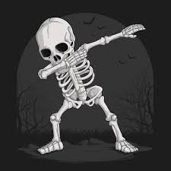
WEEK 2 VOCAB
Flexion-bending movement around a joint in an arm or leg that lessens the angle between bones at the joint.
Extension-joint movement that increases the angle between two bones, usually resulting in straightening.

Slide 2

WEEK 2 VOCAB
Flexion-bending movement around a joint in an arm or leg that lessens the angle between bones at the joint.
Extension-joint movement that increases the angle between two bones, usually resulting in straightening.
Abduction-movement in anatomy that involves moving a limb or appendage away from the body's midline
Adduction-movement that pulls a body part or structure towards the midline of the body or a limb

Slide 3
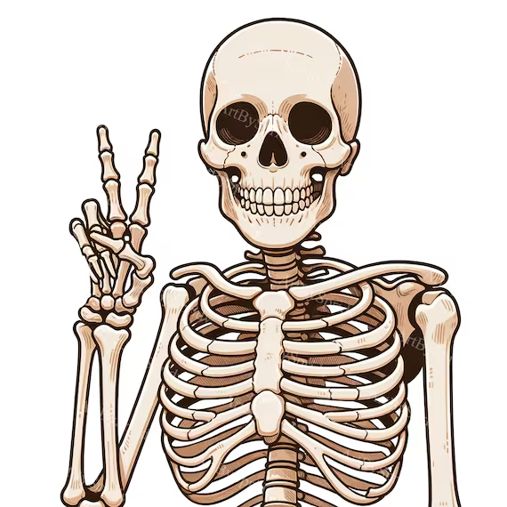
WEEK 2 VOCAB
Flexion-bending movement around a joint in an arm or leg that lessens the angle between bones at the joint.
Extension-joint movement that increases the angle between two bones, usually resulting in straightening.
Abduction-movement in anatomy that involves moving a limb or appendage away from the body's midline
Adduction-movement that pulls a body part or structure towards the midline of the body or a limb
Supination-rotational movement of the forearm or foot that results in the palm or sole facing up.
Pronation-rotational movement of an anatomical part towards the midline.

Slide 4

WEEK 2 VOCAB QUIZ
FLEXION
EXTENSION
SUPINATION
PRONATION
ABDUCTION
ADDUCTION

