Slide 1
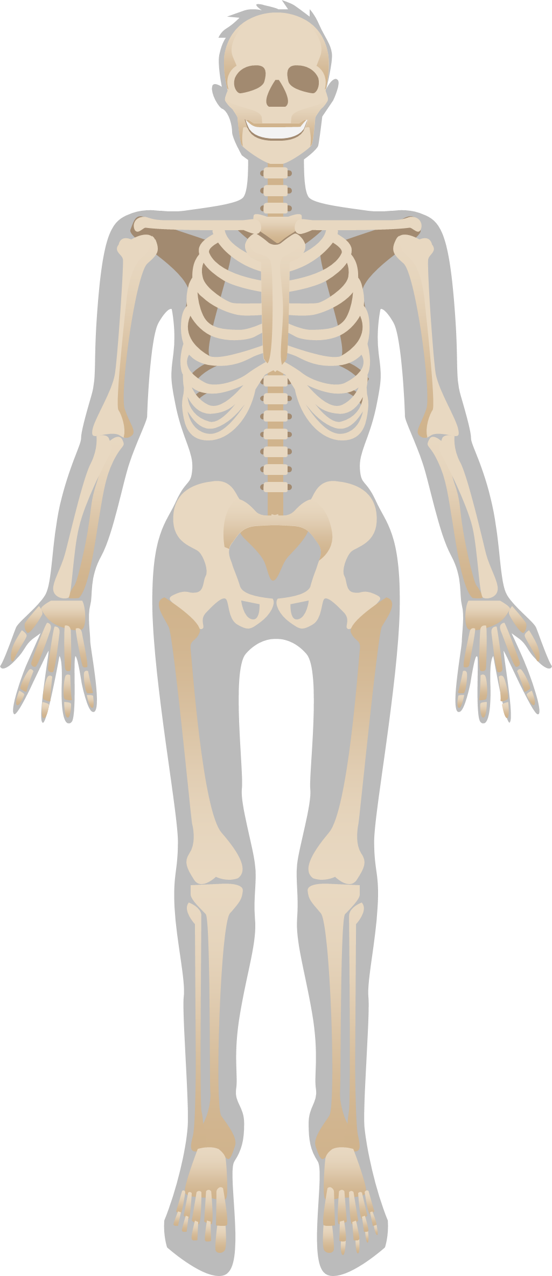
Week 1 Vocab
Synovial Joint-A type of joint that joints bones that move against each other(hip, knee, shoulder, etc)
Articulating Bones- points where two or more bones in the body meet to allow movement and stability

Slide 2
Week 1 Vocab
Synovial Joint-A type of joint that joints bones that move against each other(hip, knee, shoulder, etc)
Articulating Bones- points where two or more bones in the body meet to allow movement and stability
Ball and Socket Joint- joint in which a ball moves within a socket so as to allow rotary motion in every direction within certain limit
Hinge Joint- type of synovial joint that exists in the body and serves to allow motion primarily in one plane.

Slide 3
WEEK 1 VOCAB
Synovial Joint-A type of joint that joints bones that move against each other(hip, knee, shoulder, etc)
Articulating Bones- points where two or more bones in the body meet to allow movement and stability
Ball and Socket Joint- joint in which a ball moves within a socket so as to allow rotary motion in every direction within certain limit
Hinge Joint- type of synovial joint that exists in the body and serves to allow motion primarily in one plane.
Condyloid Joint- type of synovial joint that allows for angular movement along two axes
Pivot Joint- joints that permit rotatory movement of bones, around a single axis.

