Slide 1

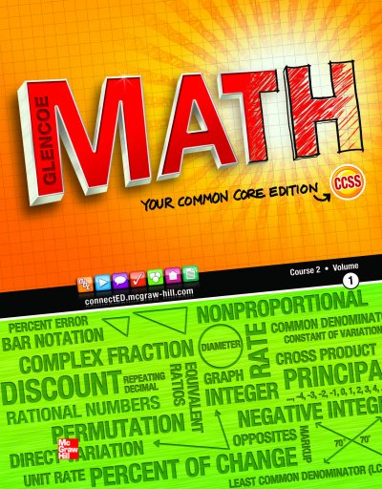
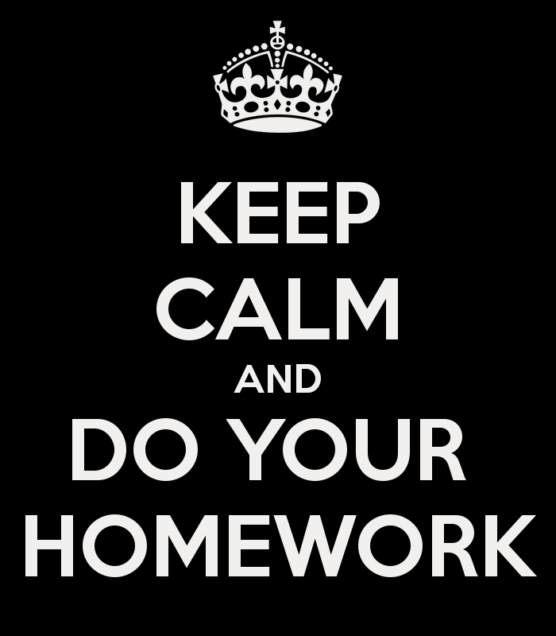
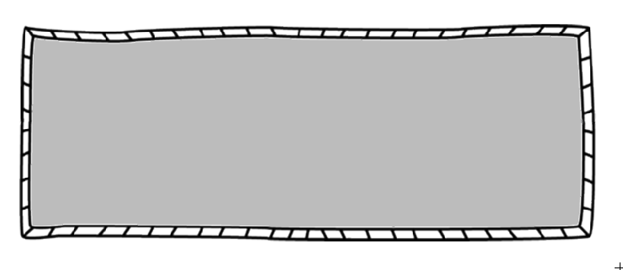
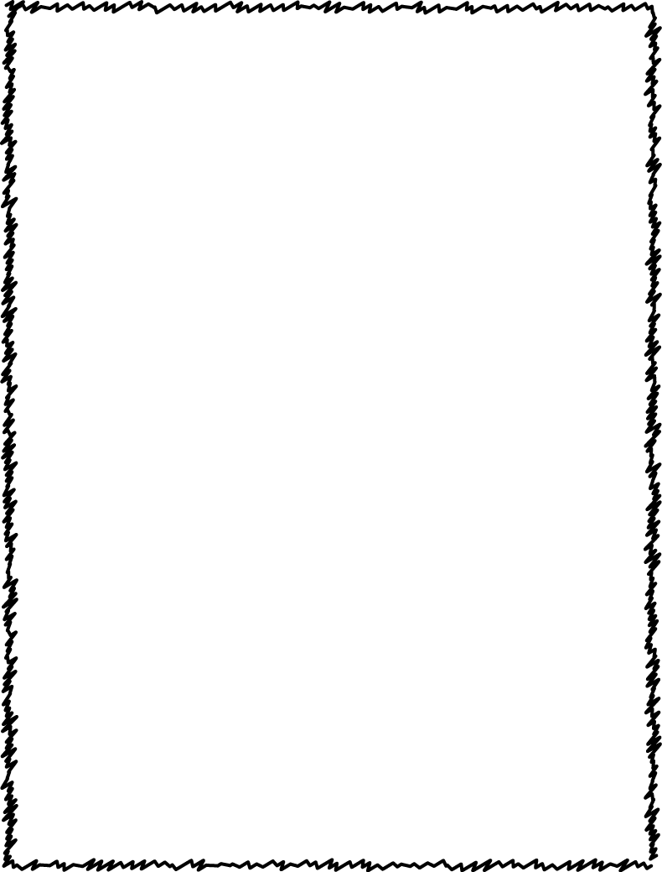


Homework Policy
Supply List
Homework will be assigned regularly
Check planner and/or teacher website each evening for homework assignments.
Late homework will NOT be accepted unless absent.
Use notes to help refresh previously learned skills.
These items are needed for a successful, prepared school year:
2 - one subject spiral bound notebook
2 - 3 pronged folders
Pencils
Crayons/colored pencils
Glue Sticks
Hand Held Pencil Sharpener
Plug in Ear Buds
These items are optional but are greatly appreciated for the class:
Tissues • Lined Paper
Pencils • Disinfectant Wipes
Eraser caps
We will be using the McGraw-Hill FL MATH Textbook. Each student can access it through their Launchpad at classlink.yourcharlotteschools.net
Extra Help
PCMS offers free after-school Math enrichment one day from 7:50-8:50 and two days from 4:10-5:00 (days and room TBA). Please sign up weekly with your math teacher.
Students will be allowed to redo any quiz or test during this time period, but must stay two days (on day 1 to study and day 2 to retest). The higher test score will be used.
6th Grade Math
Mrs. Weissinger, Room E-3
misty.weissinger@yourcharlotteschools.net
Teacher Website:
Please check my teacher website regularly. You can access my lesson plans, see homework assignments, and find links to helpful websites. Use the PCMS school website to access this.
You will receive messages through remind on occasion for the class. Please make sure your cell phone is up-to-date on Focus.
Google Classroom:
Students will be submitting most of their assignments on Google Classroom. Home internet is highly recommended. If you do not have internet, send a note in with your student to inform me.
www.yourcharlotteschools.net/pcm

