Slide 1

Scheduling your Future
Mexico High School
Class of 2025

Slide 2
Identify which diploma type is appropriate for you

Slide 3
Diploma Requirements
Regents
4 Credits English
4 Credits Social Studies
3 Credits Math
3 Credits Science
1 Credit World Lang
1 Credit Fine Arts
½ Credit Health
2 Credits Phys. Ed
3 ½ Credits Electives
22 Units of Credit
Advanced Regents
4 Credits English
4 Credits Social Studies
3 Credits Math
3 Credits Science
3 Credits World Lang
1 Credit Fine Arts
½ Credit Health
2 Credits Phys. Ed
1 ½ Credits Electives
22 Units of Credit

Slide 4
Regents Diploma
5 Regents Exams
Passing score of 65*
English (ELA) – Grade 11
US History – Grade 11
Global Studies/ Geography – Grade 10
Algebra I
Science – 1 Regents Exam:
Earth Science, Biology, Chemistry, Physics
**There are alternative pathways towards graduation, your counselor will let you know if one applies to you

Slide 5
Advanced Regents Diploma
8 Regents Exams
Passing score of 65
English (ELA) – Grade 11
US History – Grade 11
Global Studies/ Geography – Grade 10
Math: Algebra I, Geometry, Algebra II
Science – 2 Regents Exams:
Earth Science, Biology, Chemistry, Physics
World Language – Local exam given in 3rd year

Slide 6
Additional Graduation Requirements
All students must complete 20 hours of community service
  Complete 5 hours each year to stay on track
      Current School Opportunities:
        Birthday Bag (5 hours per bag)
        Cans (1 hour per 3 cans)
        JROTC (for students in class, ask teacher for more information)
Other ways to find out about community service:
  Community Service Bulletin Board
  Mexico HS website
  Ms. Wood
  Announcements

Slide 7
Working toward your goals...
Choose the strongest & most realistic course load you can successfully complete!
Take an advanced or dual enrollment course!
Consider a CTE program at CiTi BOCES for 11th and 12th grade.
Get involved both in & out of school!

Slide 8
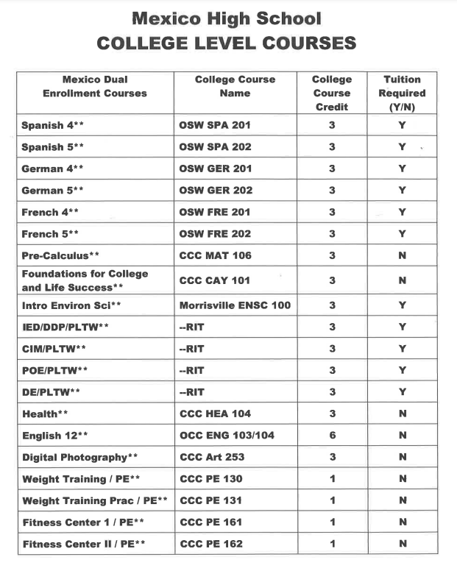
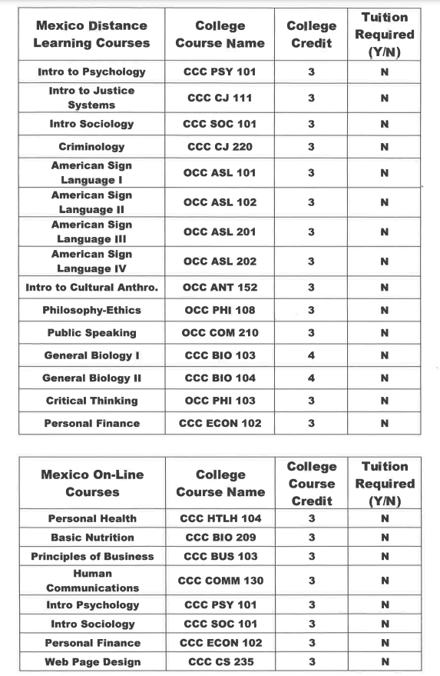
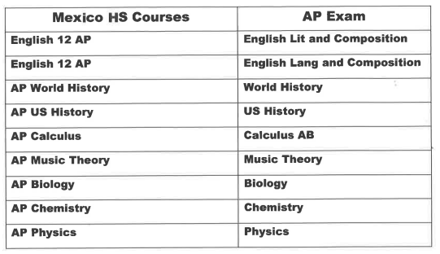
Dual Enrollment Courses
Offered though SUNY Oswego, Cayuga Community College, Rochester Institute of Technology, SUNY Morrisville and Onondaga Community College
Offered during the regular school day
Most Dual Enrollment classes are FREE to Mexico Students
Grades 10-12
** Some College Classes are not offered yearly. Speak with your counselor for more information

Slide 9
CiTi BOCES
16 programs offered at CiTi to 11th and 12th grade students
  Advanced Metal Manufacturing
  Agricultural Studies
  Auto Body Repair
  Auto Technology
  Computer Coding
  Construction Technology
  Cosmetology
  Culinary Arts
  Dental Assisting
  Digital Media Technology
  Early Childhood Education
  Heavy Equipment Repairs & Operation
  Industrial Electrical Technology
  Nursing Assistant
  Public Safety & Justice
  Welding Technology
4 credits per year
Integrated credits based on program
  Science, Math, English 12 and/or PE
2 years required for most certificates
College Credits offered in some programs
Mexico covers tuition costs & provides transportation
Eligibility- good attendance and behavior, must be on track for graduation
12th grade ONLY: New Visions Allied Health & New Visions Specialized Careers

Slide 10
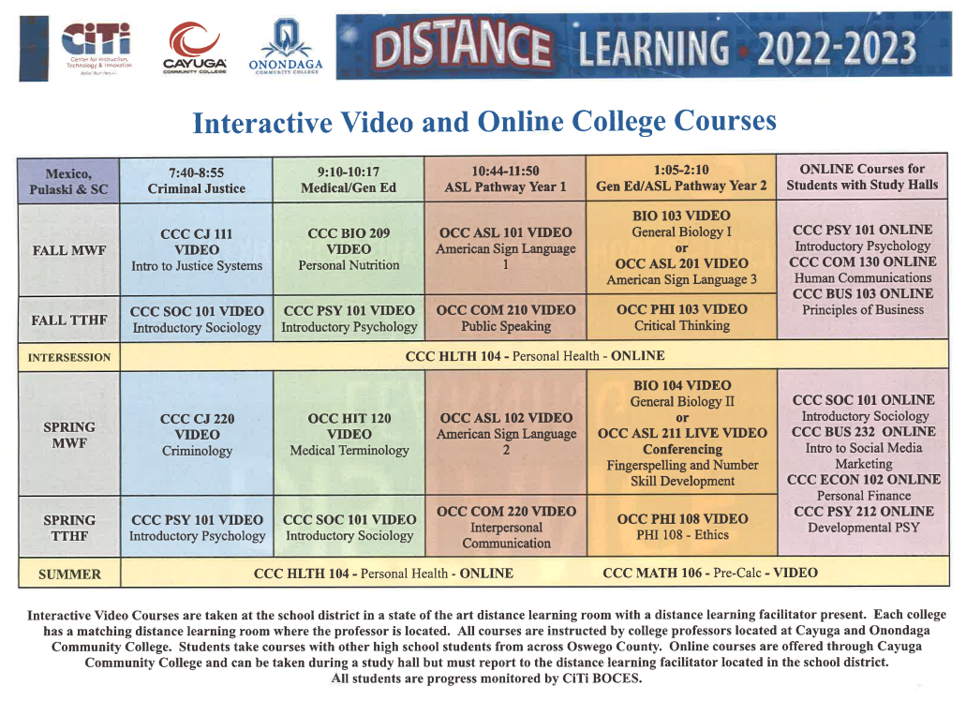
DISTANCE LEARNING

Slide 11
Creating your Schedule
Must have 6.5 credits in your schedule
  Semester classes = .5 credit
  Full year classes = 1 credit
    PE is .5 credit
Course descriptions can be found on our website: High School > Student Services > Course Catalog
Counselors will return during your English class to meet individually with you for planning next years courses.

Slide 12
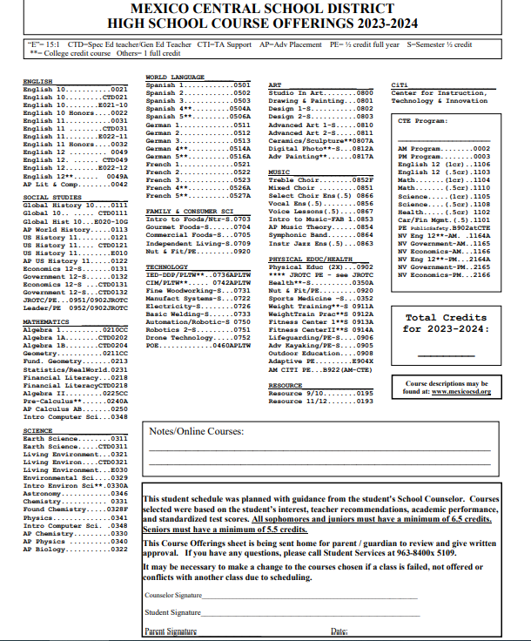
C
O
U
R
S
E
S
E
L
E
C
T
I
O
N
S

Slide 13
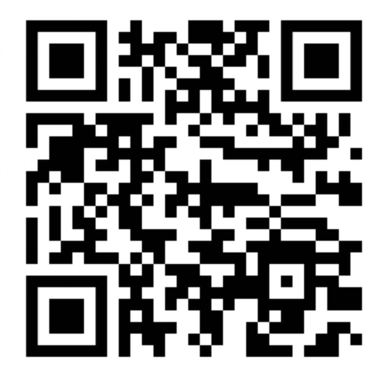
Exit Ticket

