Slide 1
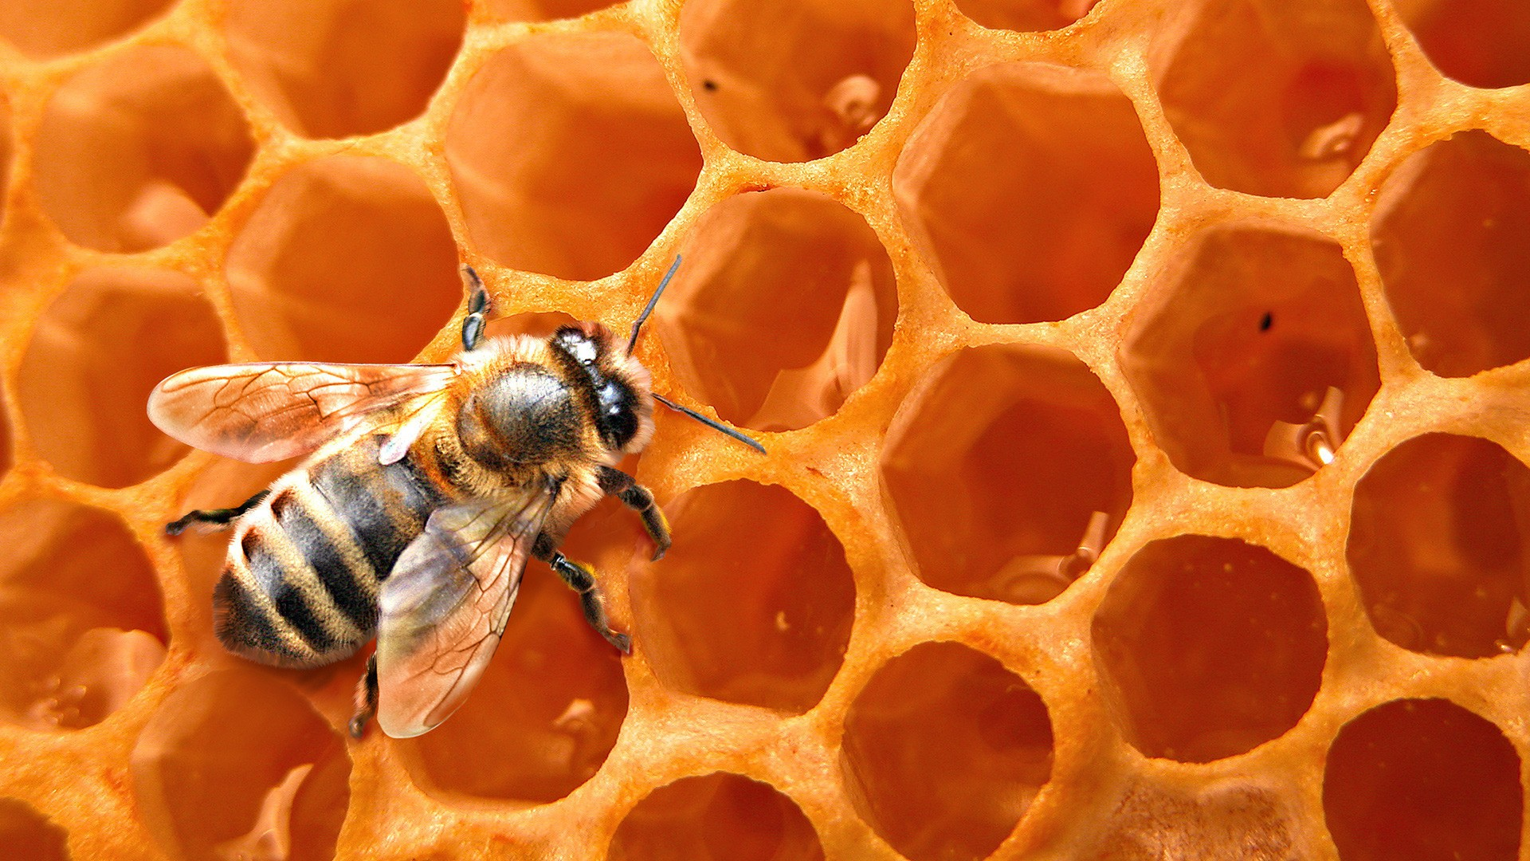
Secret Life of Bees
Blogging Project
Please login to the computer and head to the Durgee Library page

Slide 2
What’s a blog?
A regularly updated website or web page, typically one run by an individual or small group, that is written in an informal or conversational style

Slide 3
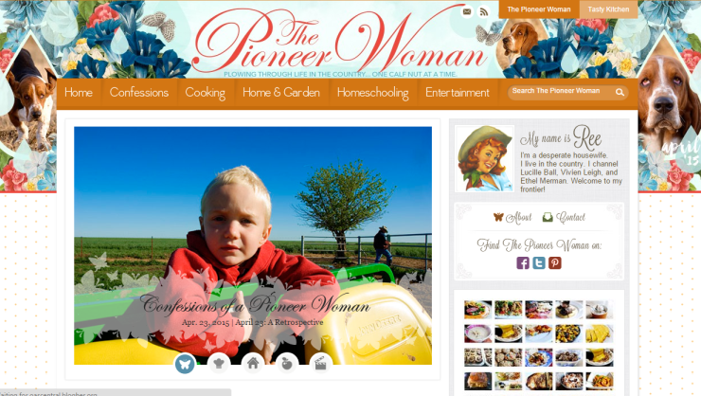
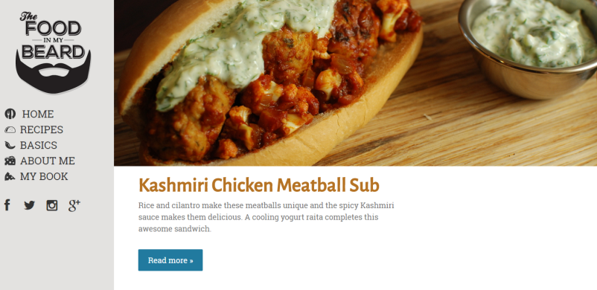
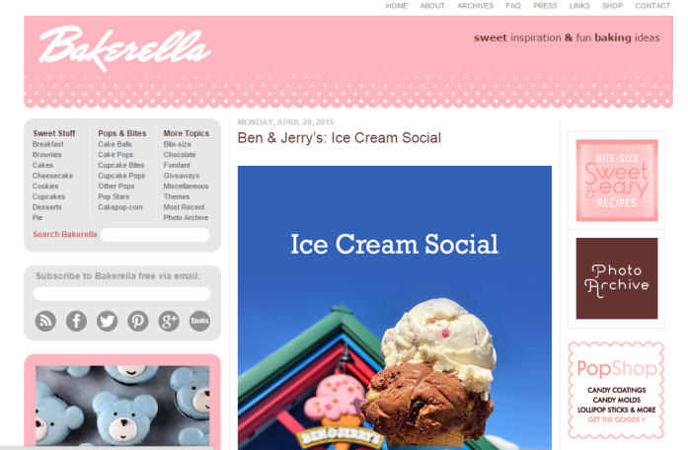
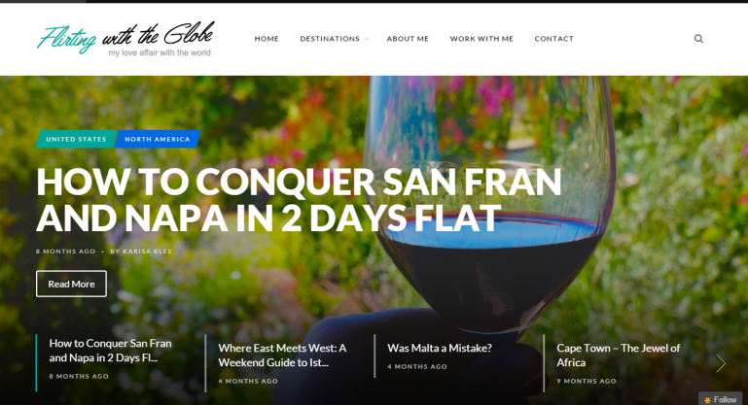
Check Out Some Blogs

Slide 4
3 Qualities of a Great Blog Post

Slide 5
Writing is informal and engaging
Sound conversational, like you’re talking to your friend, but avoid confusing slang and jargon. Lots of opportunities for “creative” and “pretty” writing that’s not academic.
Notes:
People won’t bother reading your post if the title doesn’t catch their eye

Slide 6
Post is visually appealing
Photos help tell a story. “Stock” photos are okay, but personal photos are the best. We’re striving for original, interesting content.
Notes:
People won’t bother reading your post if the title doesn’t catch their eye

Slide 7
Post is the right length
The right length is the number of words needed to adequately tell you story. Sometimes that’s a lot, sometimes that’s a little. It’s an art.
Notes:
People won’t bother reading your post if the title doesn’t catch their eye

Slide 8
Post is proofread, and then proofread again
Bad writing full of mistakes takes a lot of effort to read. You want to sound like a person that’d be enjoyable to hang with. Spelling mistakes, typos, and grammar issues just hurt your case.
Notes:
People won’t bother reading your post if the title doesn’t catch their eye

Slide 9
KidBlog Sign-Up
Period 2: acksv7
Period 5: abmqv2
Notes:
Walk the kids through the sign up
kidblog.org, enter course code, create account
Always look for Mrs. Cartier post first
Writing a new post
Adding media and tags
Commenting

