Slide 1


Note Taking Style #2
Cornell Notes
Walter Pauk
Notes:
Cornell University's reading and study center director
Invented in the 1950s

Slide 2
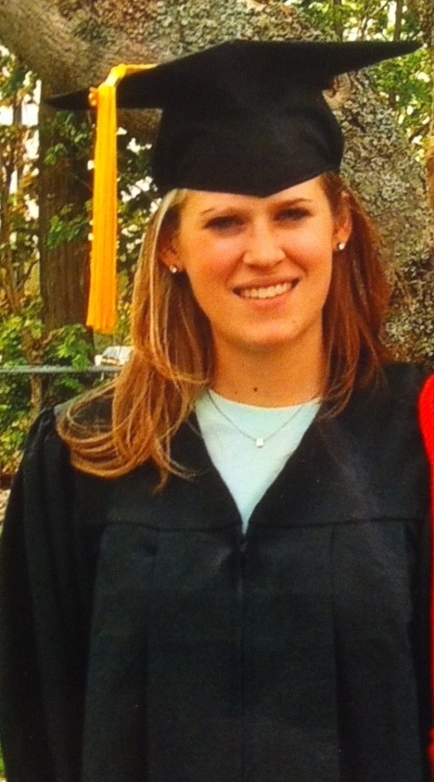

An endorsement.
Graduation made possible by Cornell notes.

Slide 3
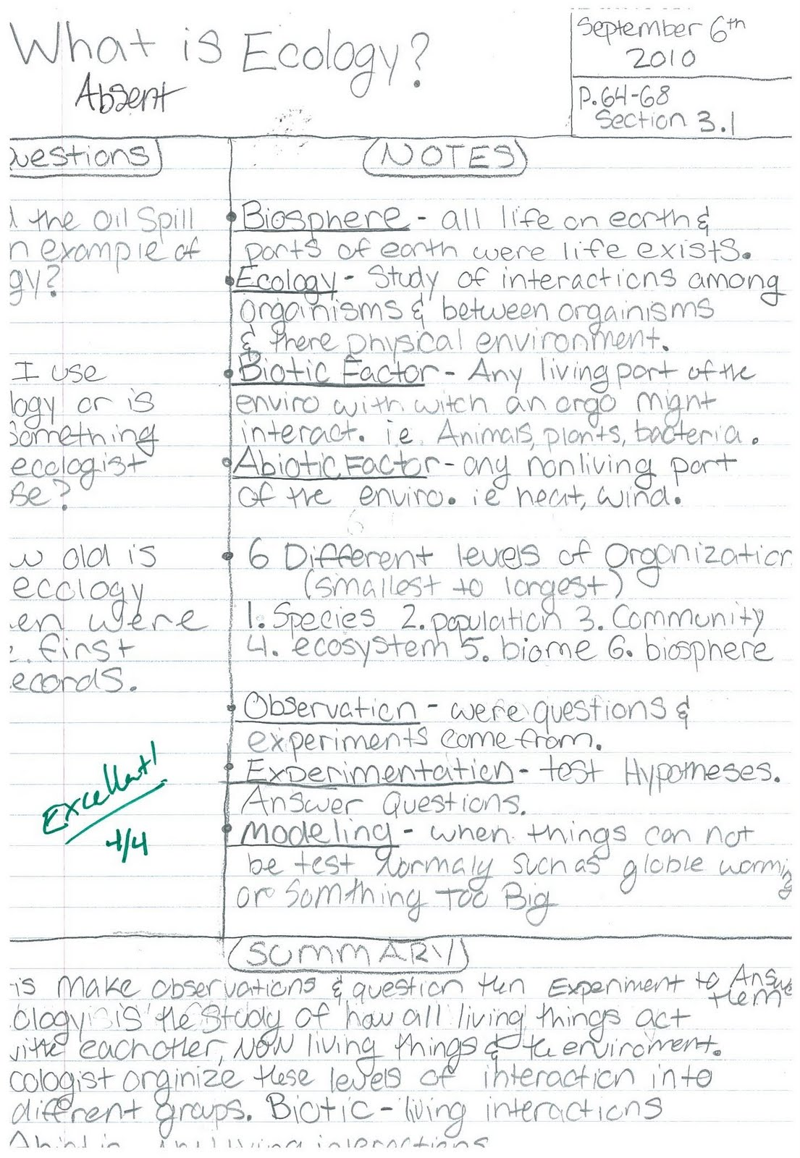
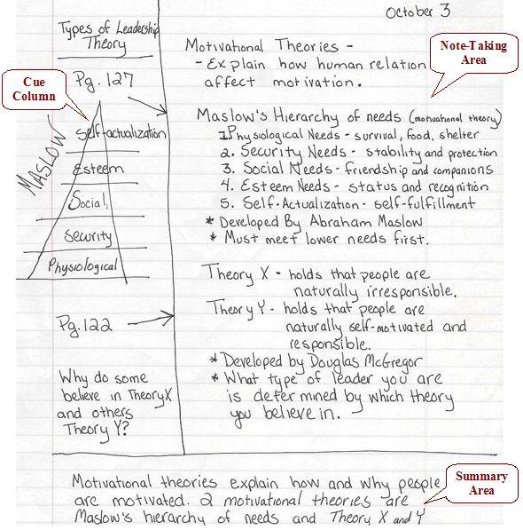
The basics.
1
1
2
2
3
3
Notes:
Cornell Notes Special features
Paper divided into three sections
Note taking area
Cue area
Summary area

Slide 4
* you’er
Higher Level Thinking Words
Categorize – put into different categories
Compare - how it is the same or different
Connect – link things you don’t know with things you do know (like to real life)
Contrast - how it is different
Describe - explain, tell – use who, what, where, when, why and/or how
Diagram – draw a picture that explains how something works
Explain - tell how and why about a subject, tell how it works, describe
Rank – put in a hierarchy
Summarize - re-tell briefly, tell in your own words, and tell like an ESPN clip
Trace - follow event from beginning to end
Cues
Notes
Use cues to review notes and prepare for tests
Words to define
HIGHER LEVEL thinking ?s based on notes
Diagrams
Record textbook and lecture notes here using:
Outline format
  Main ideas → details
Short sentences
Summarization
Paraphrase
Abbreviations
1
2
While reading
When: During class / While reading
When: Within 24 hours
Summary
3-4 sentences that summarize the topic
3
When: Within 24 hrs, but AFTER Notes and Cues
Don’t do at end of every page, just at end of topic
Notes:
Talk about what’s still the same:
Still skim whole article, then go back and take notes paragraph by paragraph
Still identifying words in bold and important keywords and highlighting them

Slide 5
Cues
Notes
Describe Judaism’s founding.
Define: 10 Commandments
Summarize the major beliefs of Judaism
Judaism
Founding
  4,000 yrs ago in Fertile Crescent
  Founded by Abraham
  Jerusalem, Israel
10 Commandments – rules for behavior
  Moses got them from God
  If Jews follow → messiah will reappear
While reading
Summary
Judaism is a monothesitc religion practiced by the Jews. The religion was founded by Abraham. Jews follow behavioral and ethical rules, including the 10 Commandments, recorded in the Torah, as delivered to Moses from God.
Notes:
In notes section:
Asked you to learn concept maps to practice brevity
Should be good at that now
Can be SLIGHTLY more long winded in Cornell notes - not quite complete sentences, and certainly no paragraphs
Still want to see paraphrasing (translating to your own words)
Still looking for main ideas supported sub points
Still looking for abbreviations
Still looking for keywords to be highlighted
In cues section:
Write questions that ask you describe, define, think
In summary section:
Three or four sentences that summarize the entire topic (one day of in-class lecture / 1 reading assignment)

Slide 6
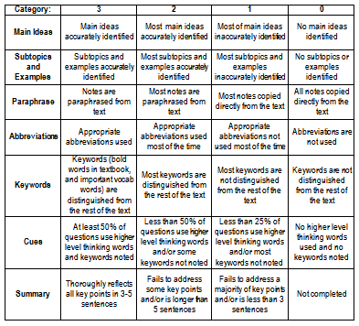

Slide 7

It’s cool. For real.
Notes:
sdfsdf

Slide 8
Higher Level Thinking Questions
Categorize – put into different categories
Compare - how it is the same or different
Connect – link things you don’t know with things you do know (like to real life)
Contrast - how it is different
Describe - explain, tell – use who, what, where, when, why and/or how
Diagram – draw a picture that explains how something works
Explain - tell how and why about a subject, tell how it works, describe
Rank – put in a hierarchy
Summarize - re-tell briefly, tell in your own words, and tell like an ESPN clip
Trace - follow event from beginning to end

Slide 9
Cues
Notes
Questions in the left column, go ahead try to guess what the teacher’s going to ask
Notes go on the right side.
Write what the teacher emphasize
While reading
When: During class / While reading
When: Within 24 hours
Summary
I like my summary like a mini-skirt: short – enough, but still covers all the important stuff
When: Within
24 hours

