Slide 1
Note-Taking
The ins and outs

Slide 2

Note-Taking Agenda
Why Take Notes
Note-Taking Strategies
The Technique: Mapping
Practice
Assignment
Notes:
Unit Overview
3 month unit
Going to practice 3 different styles of note-taking, 1 each month
During that month you’ll have a variety of assignments that allow you to practice the technique
I’m co-teaching this with ___________
I’ll be doing some of the evaluating
Goal – after 3 months you’ll find a style that works for you

Slide 3
Why Take Notes
The ins and outs

Slide 4

Why Take Notes
Helps you mentally process the material you’ve read
Provides a condensed record of what you’ve read
Provides materials to prepare for tests and quizzes

Slide 5
Note-Taking Strategies

Slide 6
Read 1st, Note 2nd
Skim text to get an understanding of scope and content
  Don’t take notes yet!
  Goal is to get the big picture
Chunk it
  Go 1 paragraph at a time, or one section at a time
A waste of time?
  Taking notes too soon means you’ll write too much
  Your notes will be unfocused
  Copying without understanding

Slide 7

Paraphrase & Summarize
Note-taking most valuable when it’s in your own words
  Do not copy directly from the textbook
  Forces your brain to process the material
  Active vs. passive

Slide 8
Writing it Down
Identify main idea
Identify sub points
Provide details and examples
Check for vocabulary

Slide 9
Use abbreviations & symbols
ex. example
esp. especially
= equals
= not/not equals
< less than
> greater than
w/ with
w/o without
ex increase
= decrease
< therefore
--> leading to/results in
b/4 before
b/c because
gov’t government
v. very

Slide 10
The Technique: Mapping
Notes:
Great for visual people
Technique requires you to use both sides of your brain because it’s not linear
Creating a big picture
Using shapes, colors, pictures

Slide 11
Taking Notes
Read a chunk
Identify main idea
Identify sub points
Provide details and examples
Check for vocabulary
Notes:
This is a basic pattern your are going to see over and over and over again

Slide 12
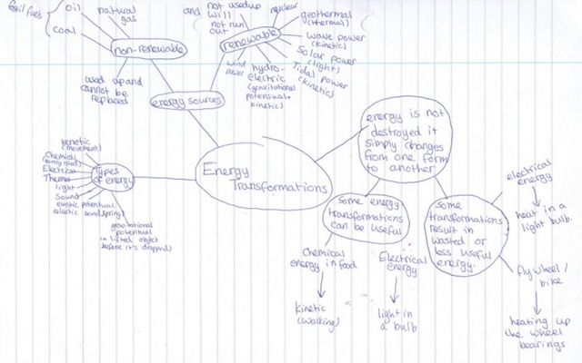
Concept Mapping
Main Idea
Sub Points
Details &
Examples

Slide 13
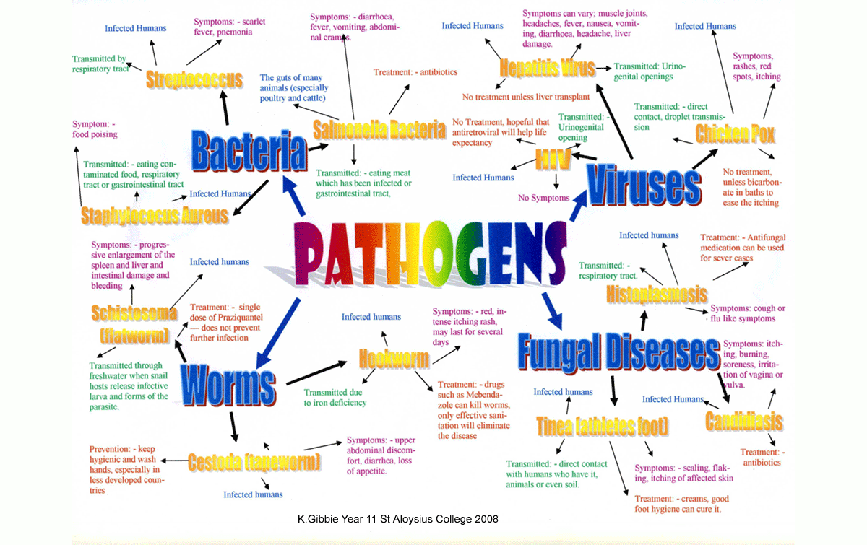
Concept Mapping

Slide 14

Mind Mapping
Notes:
Like concept map, but it incorporates colors and images
* Helps engage additional parts of your brain
Thickness of branch determines the importance of the concept

Slide 15
YOUR TURN!
Read a chunk
Identify main idea
Identify sub points
Provide details and examples
Check for vocabulary
Summarize!
Paraphrase!
Abbreviate!
Notes:
This is a basic pattern your are going to see over and over and over again

Slide 16
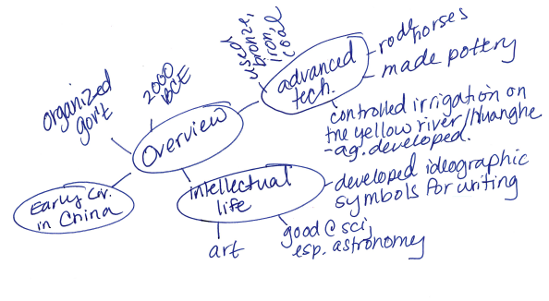
My Version

Slide 17
Assignment
Create a concept map for the section on Early China
Use the rubric to make sure you’re on the right track

Slide 18
