Slide 1
Week 8 Vocab
Pilgrims- Separatists that founded the colony of Plymouth in 1620 to escape religious persecution
Puritans- non-separatists that founded a colony at Massachusetts Bay in 1630

Slide 2
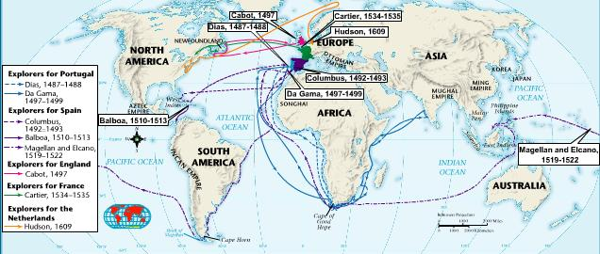

Slide 3
Week 8 Vocab
Montezuma- Aztec leader when Cortez conquered their empire
Atahualpa- Incan leader when Pizarro conquered their empire
Encomienda-grant of land to settlers, including the right to use Native Americans as laborers on it
Jamestown- England’s first permanent settlement in North America
Pilgrims- Separatists that founded the colony of Plymouth in 1620 to escape religious persecution
Puritans- non-separatists that founded a colony at Massachusetts Bay in 1630

Slide 4
Week 8 Vocab Quiz
Encomienda
Puritan
Jamestown
Pilgrim

