Slide 1
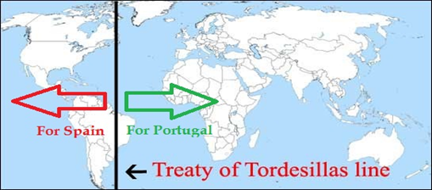
WEEK 7 VOCAB
Colony- a land controlled by another nation
Treaty of Tordesillas- 1494- between Spain and Portugal; lands to west of imaginary line in Atlantic Ocean belong to Spain and lands East belong to Portugal

Slide 2

Week 7 Vocab
Colony- a land controlled by another nation
Treaty of Tordesillas- 1494- between Spain and Portugal; lands to west of imaginary line in Atlantic Ocean belong to Spain and lands East belong to Portugal
Conquistador-Spanish explorers who took part in the conquest of the Americas
Mestizo- A person of mixed Spanish and Native American descent

Slide 3
Week 7 Vocab Quiz
Conquistador
Treaty of Tordesillas
Mestizo
Colony

