Slide 1
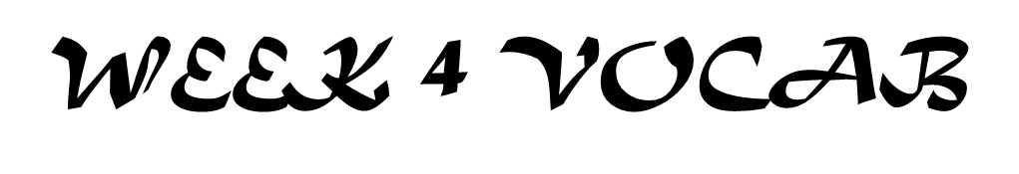
Utopia- described by Thomas More, an ideal society
Northern Renaissance- Revival in Northern Europe, focusing on education and reform of society

Slide 2
Week 4 vocab
Utopia- described by Thomas More, an ideal society
Northern Renaissance- Revival in Northern Europe, focusing on education and reform of society
Shakespeare- famous English Poet and playwright, created many words in English language
Gutenberg- invented moveable printing press, allowed books to be mass produced at a fast rate

Slide 3
Week 4 Vocab Quiz
Shakespeare
Utopia
Gutenberg
Northern Renaissance

