Slide 1



Slide 2


Slide 3
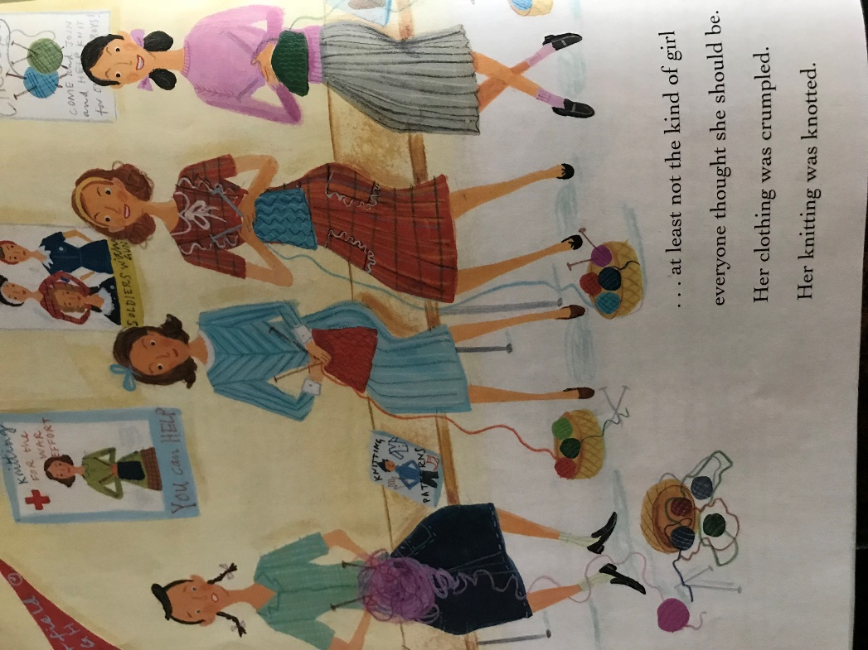

Slide 4


Slide 5


Slide 6
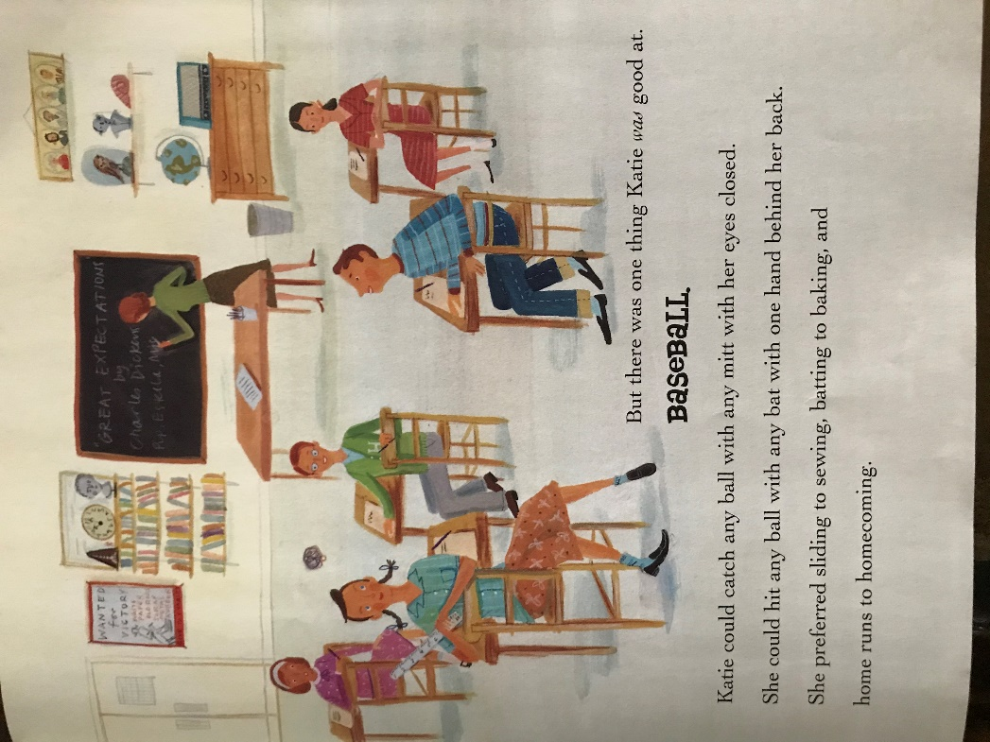

Slide 7


Slide 8


Slide 9
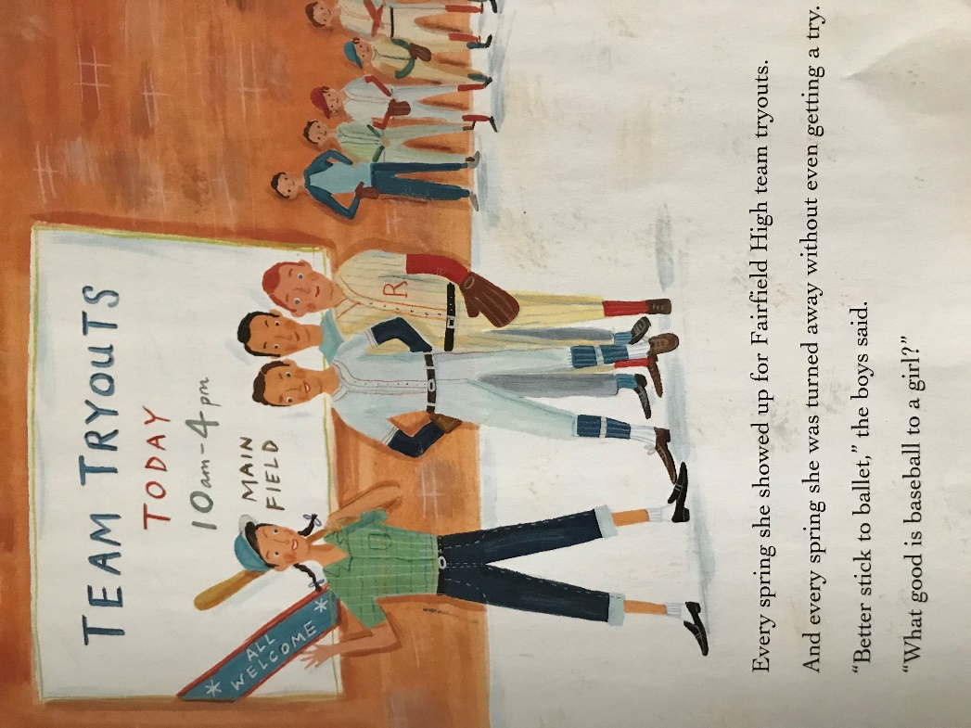

Slide 10
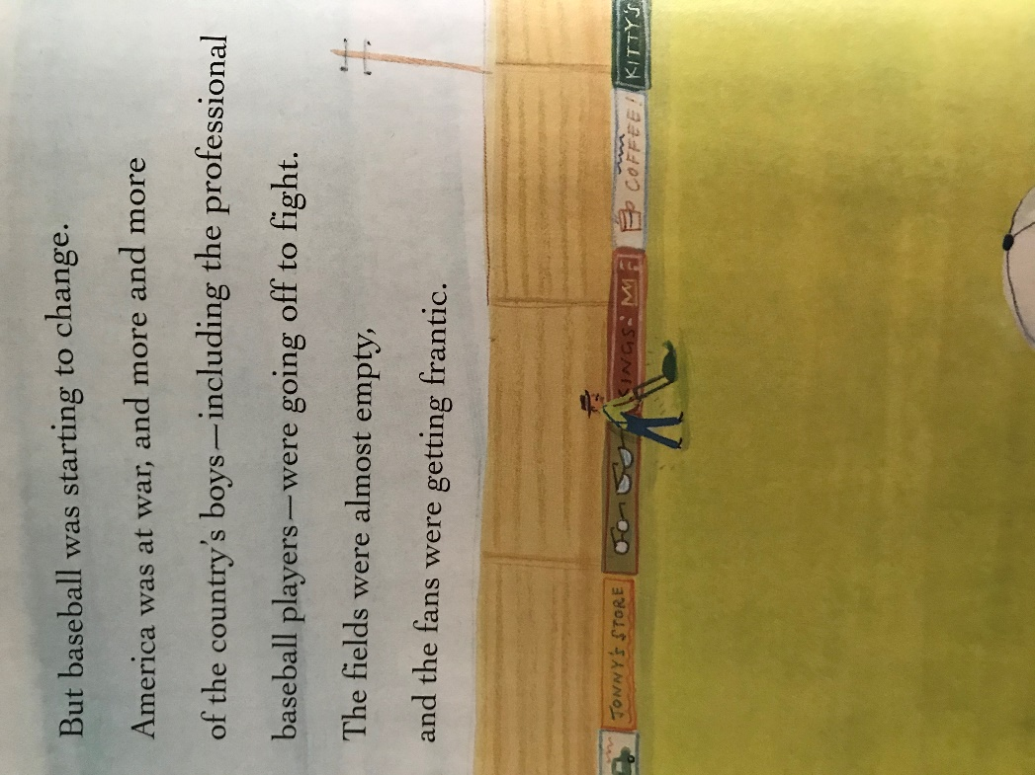

Slide 11
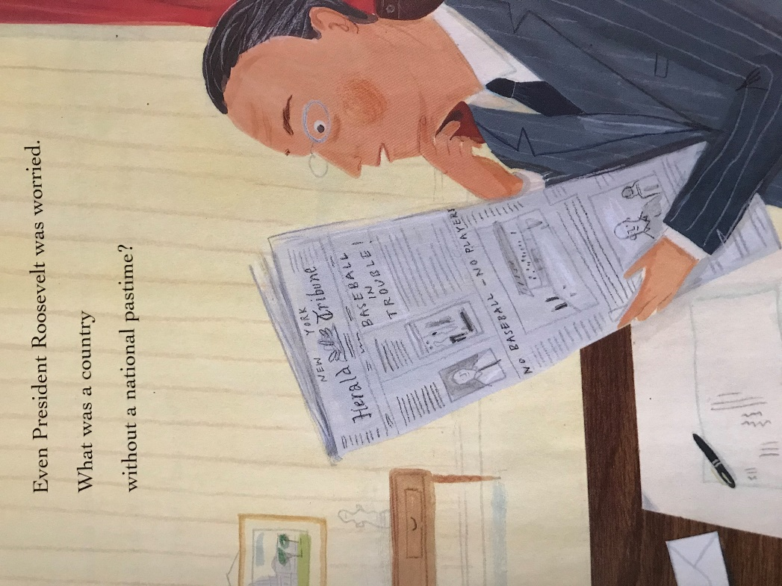

Slide 12
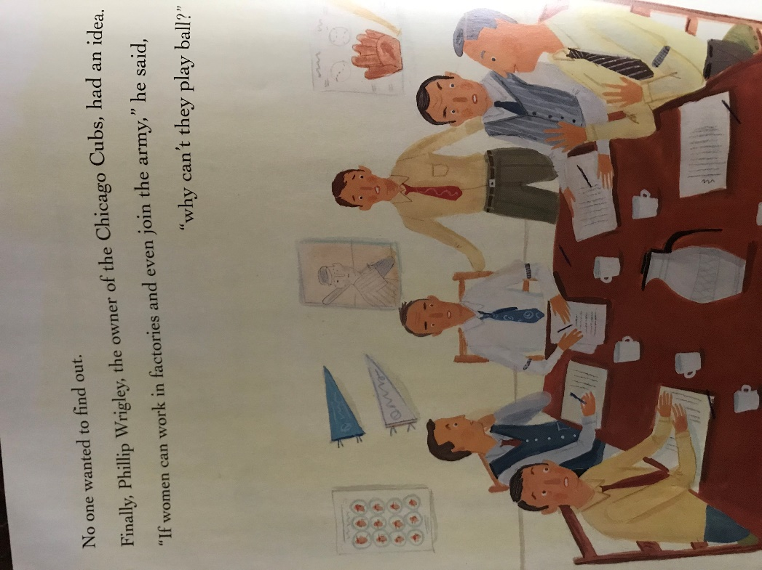

Slide 13
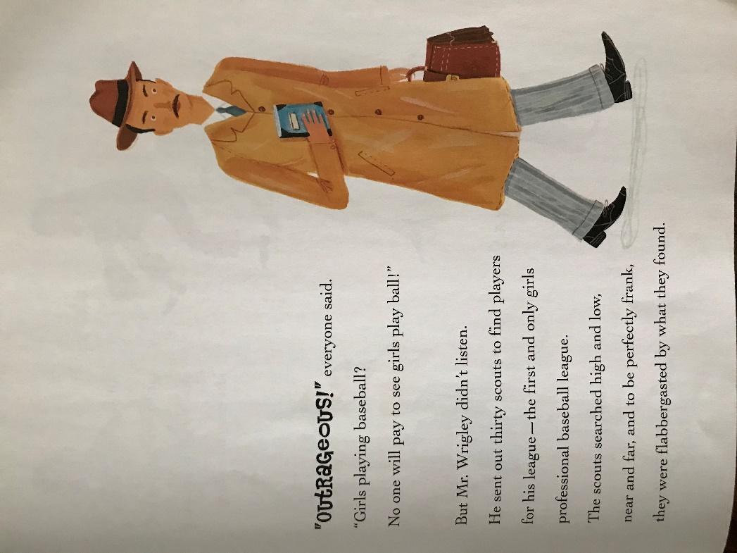

Slide 14
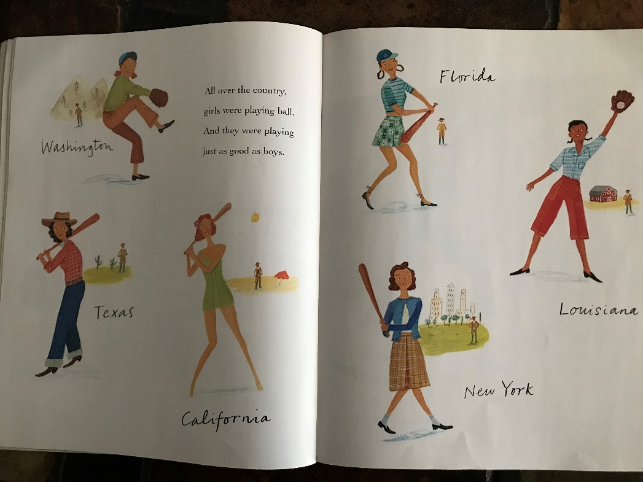

Slide 15


Slide 16


Slide 17
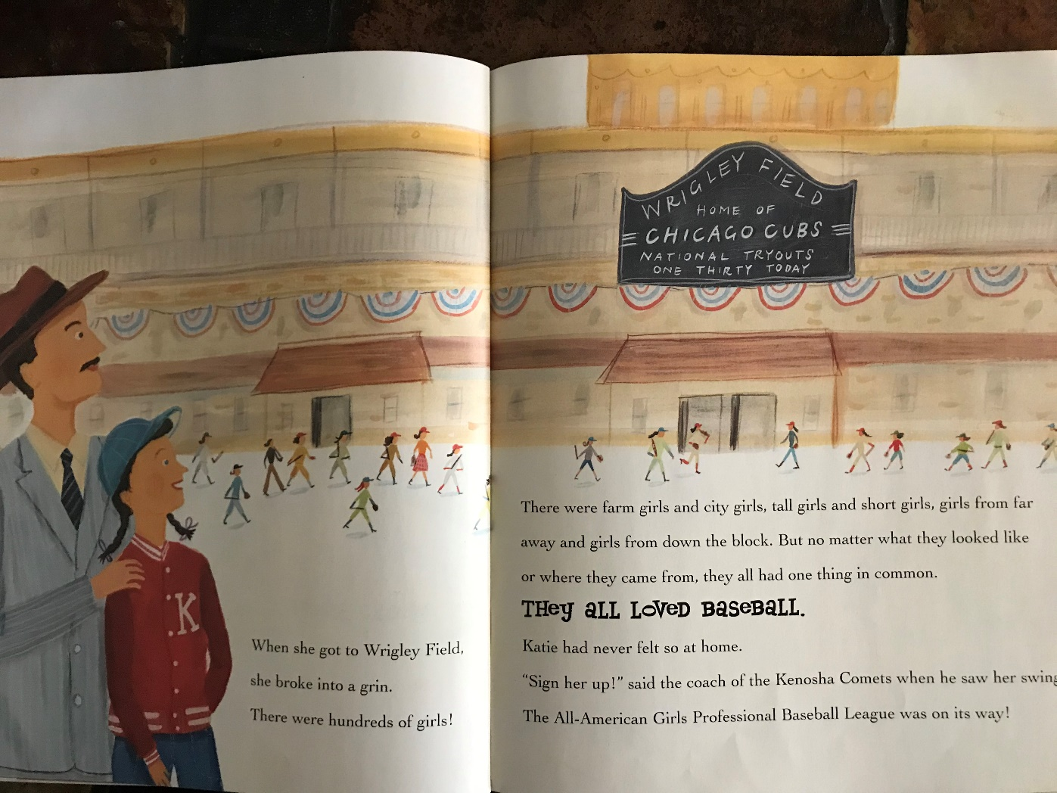

Slide 18
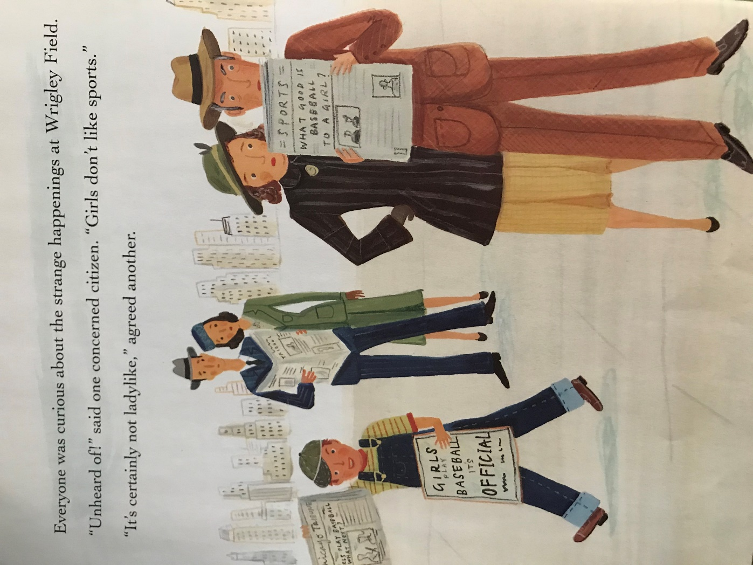

Slide 19
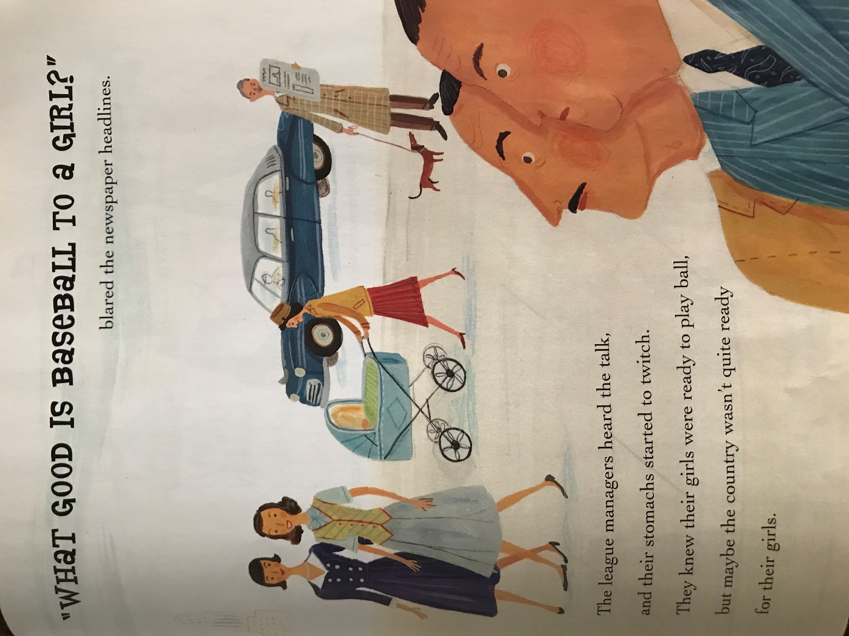

Slide 20
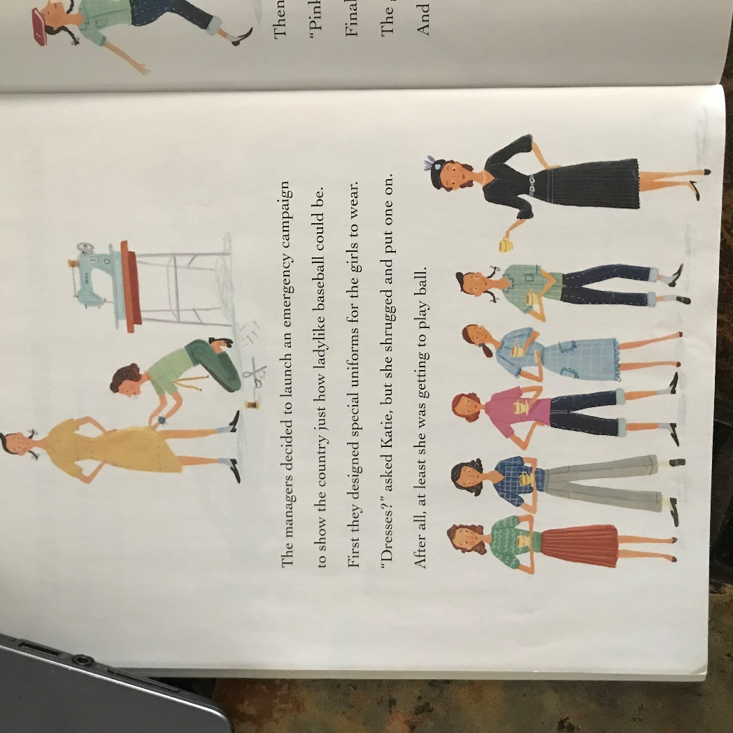

Slide 21


Slide 22


Slide 23
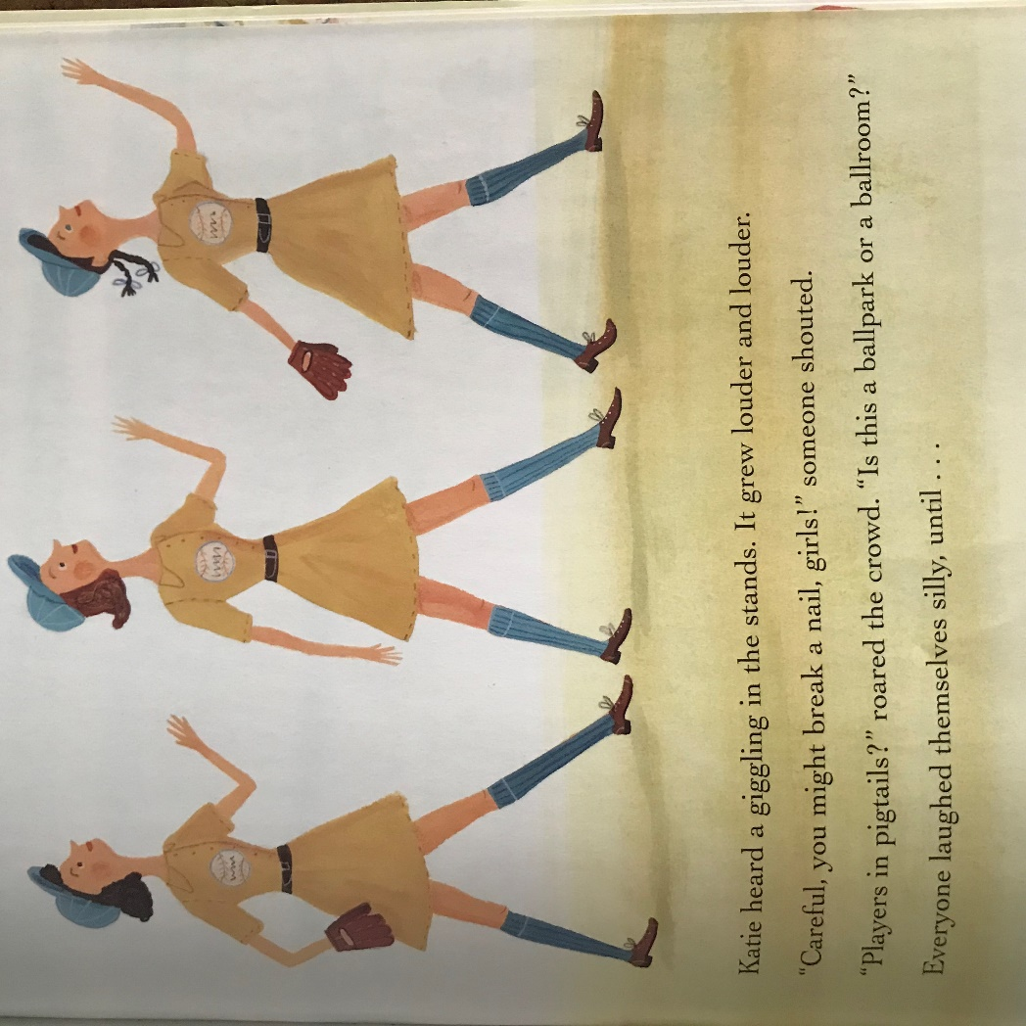

Slide 24
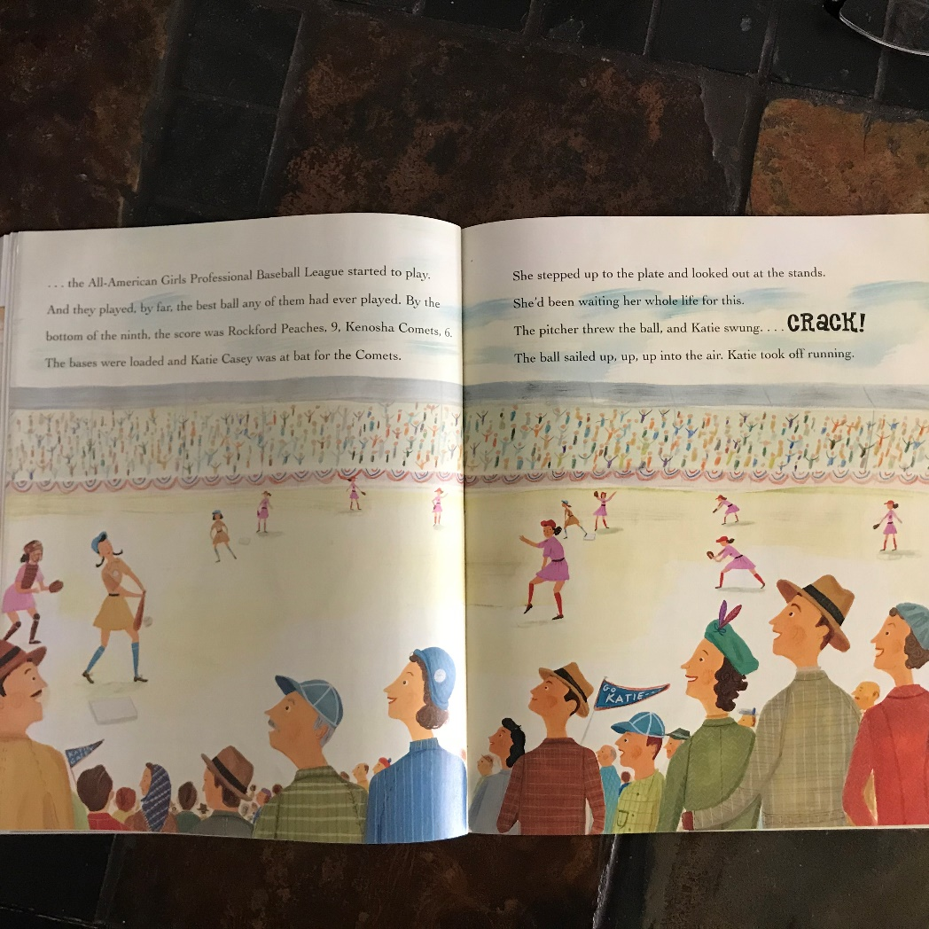

Slide 25
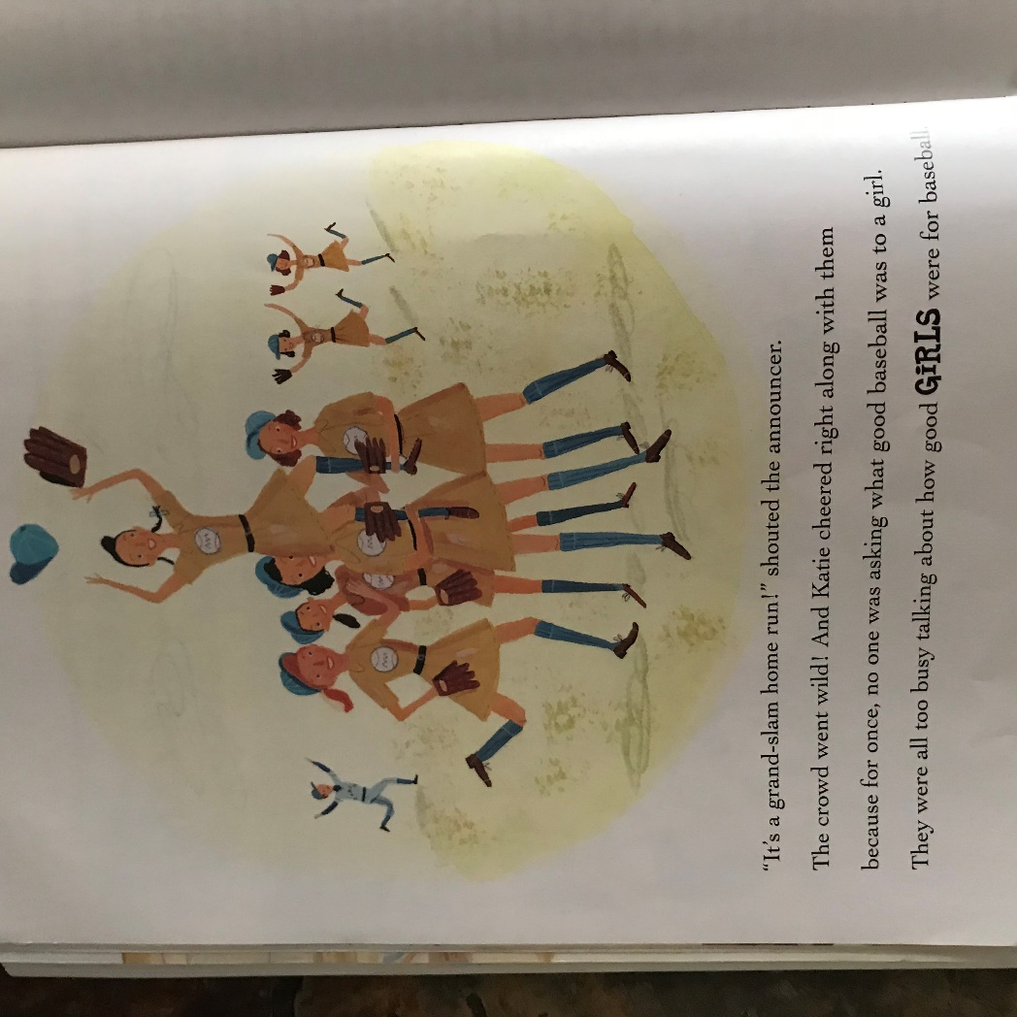

Slide 26
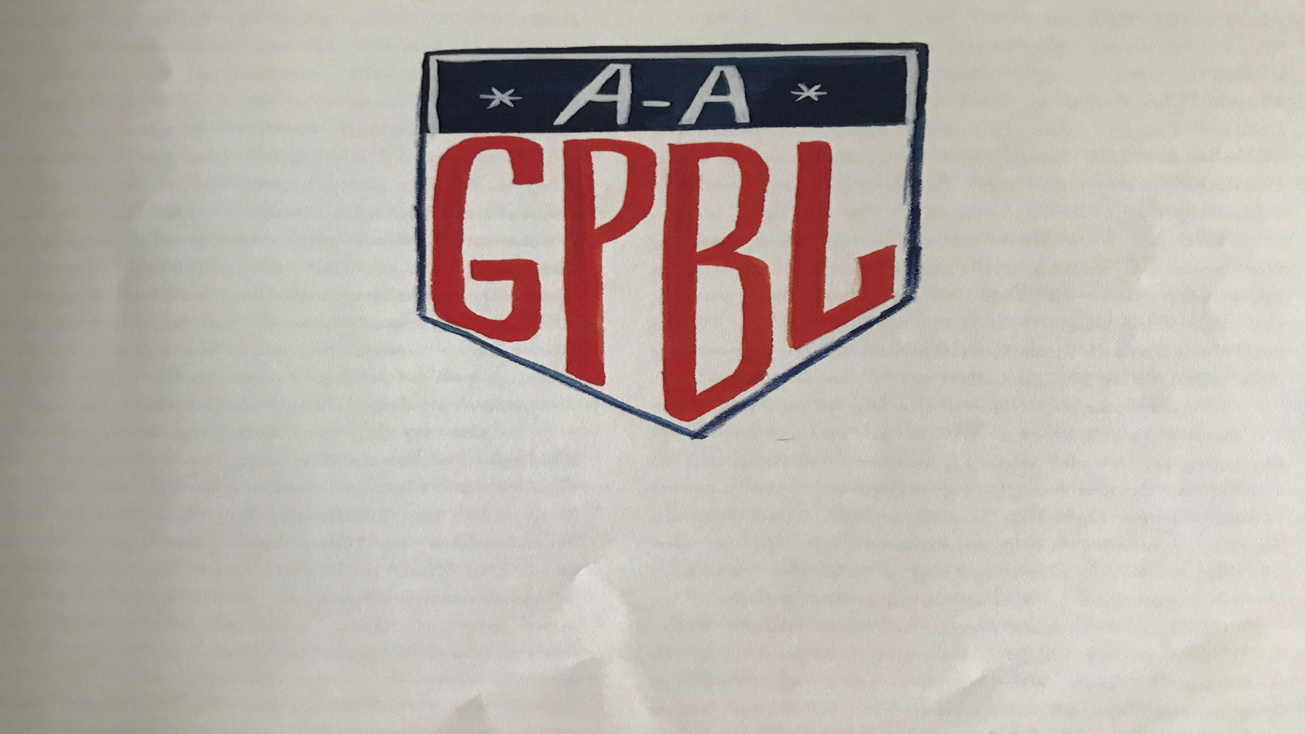
All-American Girls Professional Baseball League
AR Reading Level 3.4
0.5 point
Quiz #70062
If you’d like to know more about the All-American Girls Professional Baseball League, check out these websites!!
en.wikipedia.org/wiki/All-American_Girls_Professional_Baseball_League
aagpbl.org
britannica.com/topic/All-American-Girls-Professional-Baseball-League

