Slide 1


Slide 2
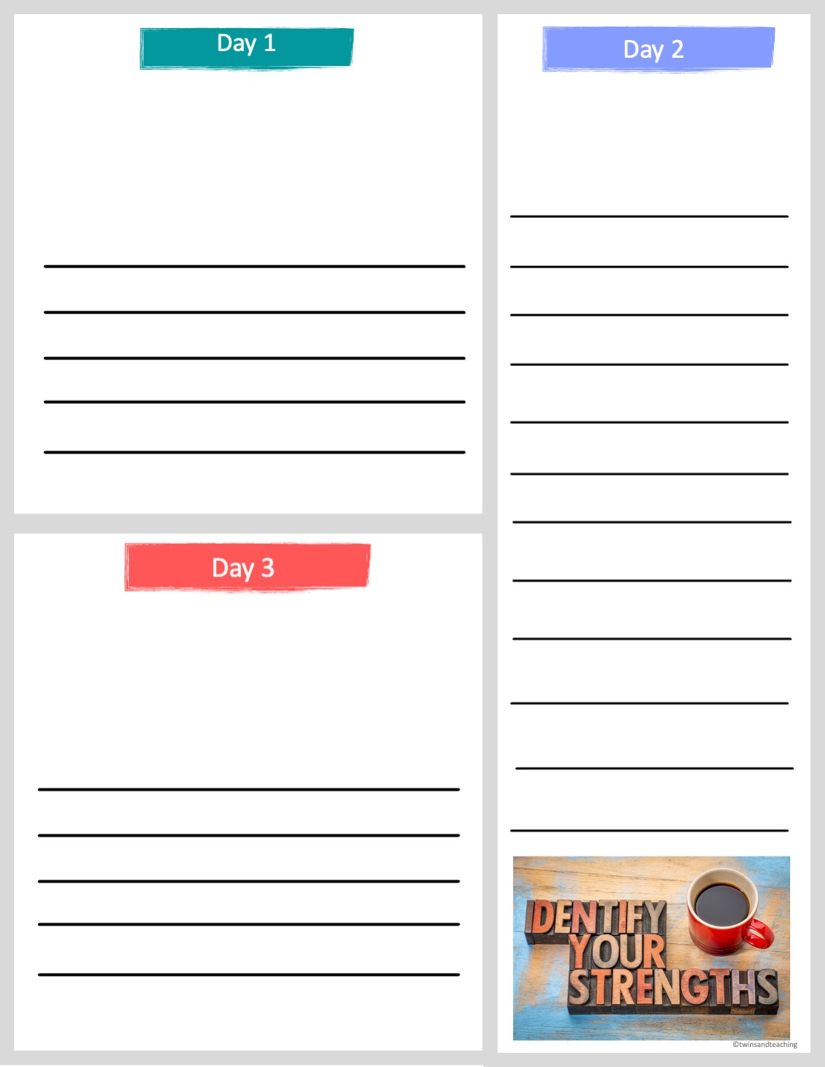
"If opportunity doesn’t knock, build a door."
-Milton Berle
Think about something you are good at. Describe this strength of yours.
What do you think this quote means? What is a door that you can "build" on today?
What is your dream destination? What is one place you would love to live or visit one day? Explain why.

Slide 3
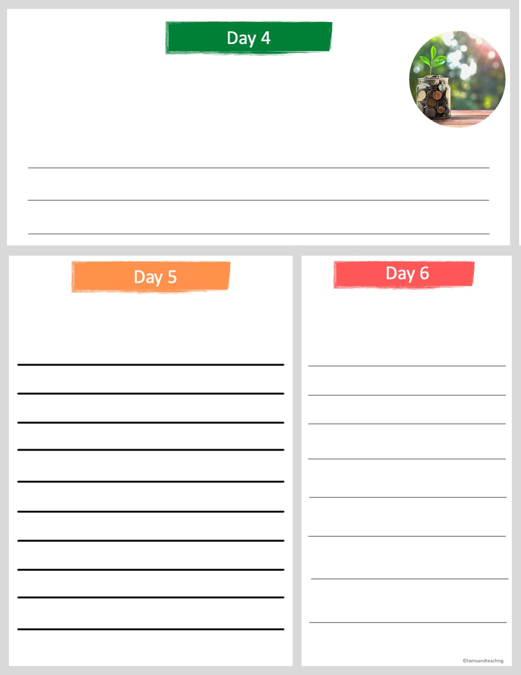
When you think about your future dream job, what would be the least amount of money you would be willing to make a year? Explain your answer.
If you could use one word to describe yourself what would it be? Explain your answer.
What are your favorite things to do? Describe what you like to do in your free time.

Slide 4
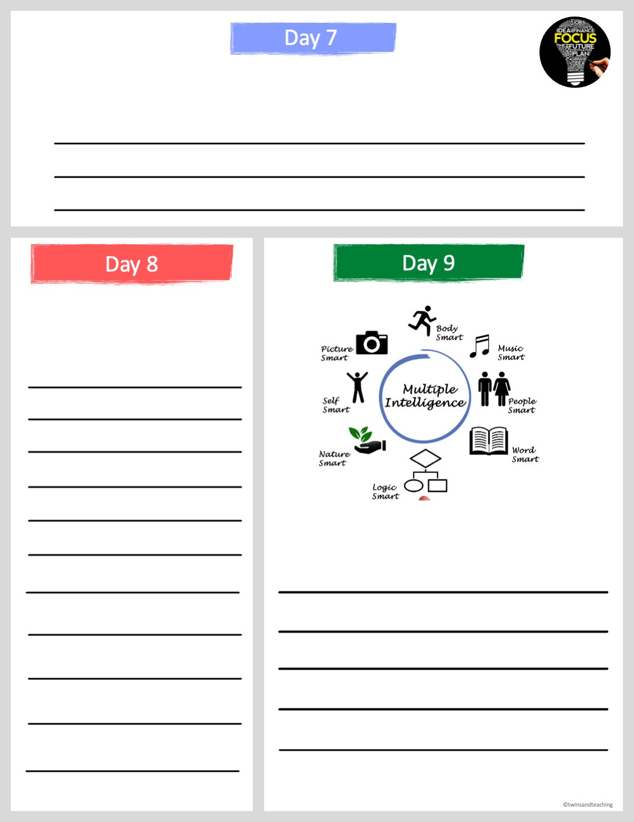
"Focus on being the best you can at what you want to do."
-David Maister
What does this quote mean? What are you focusing on to improve your future?
Would you rather learn from reading and writing or learn from doing? Explain.
After looking at the digram above, choose 2 "intelligences" that describe you. Explain.

Slide 5
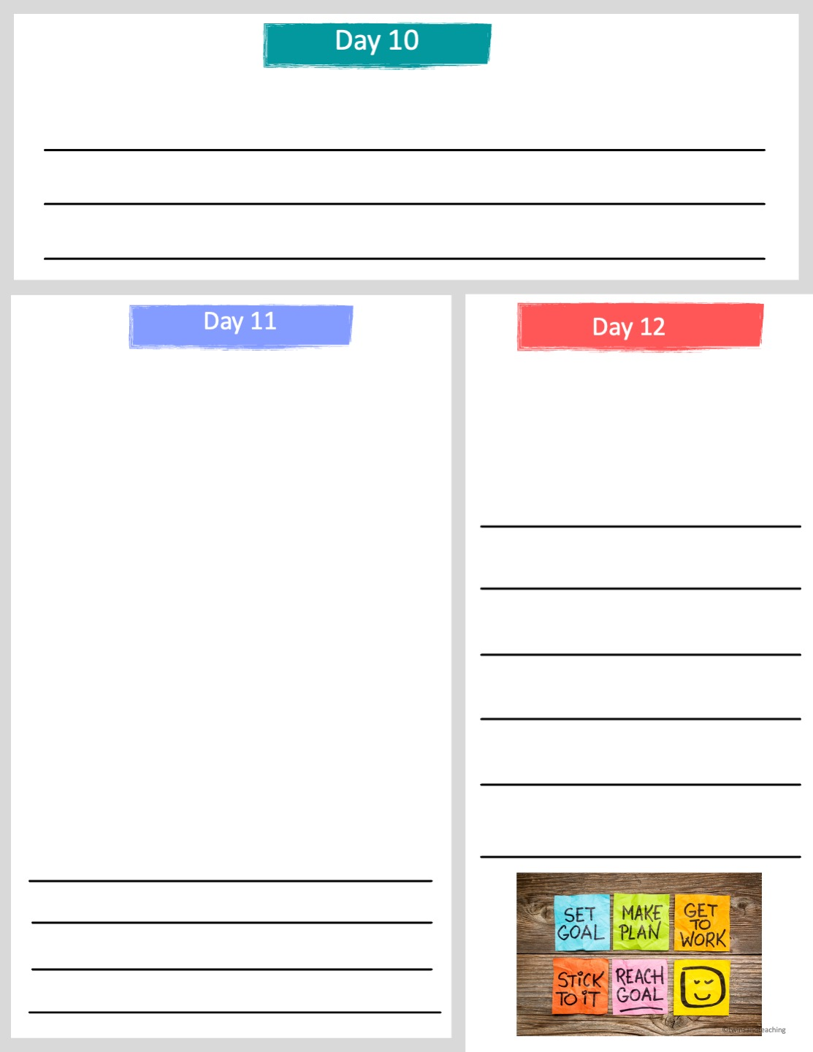
In your own words, list and describe 2 characteristics of a leader.
  Takes on responsibilities
  Energetic
  Leader
  Works hard to get things done
  Friendly
  Works well with others
  Easy to get along with
  Sensitive to the feelings of others
  Helpful
  Mature
  Self-confident
  Flexible
  Honest
  Creative
  Problem-solver
  Thinks things through
  Continues trying when the work gets difficult
  Follows instructions
From the list on the left hand side of the page, underline 2 characteristics that you would like to improve on. Explain the 2 and how you will improve upon that below.
The characteristics above are those that make people successful in school, life and their jobs. Circle 5 of the characteristics above that describe you. Choose one that you circled and explain why it describes you below.

Slide 6
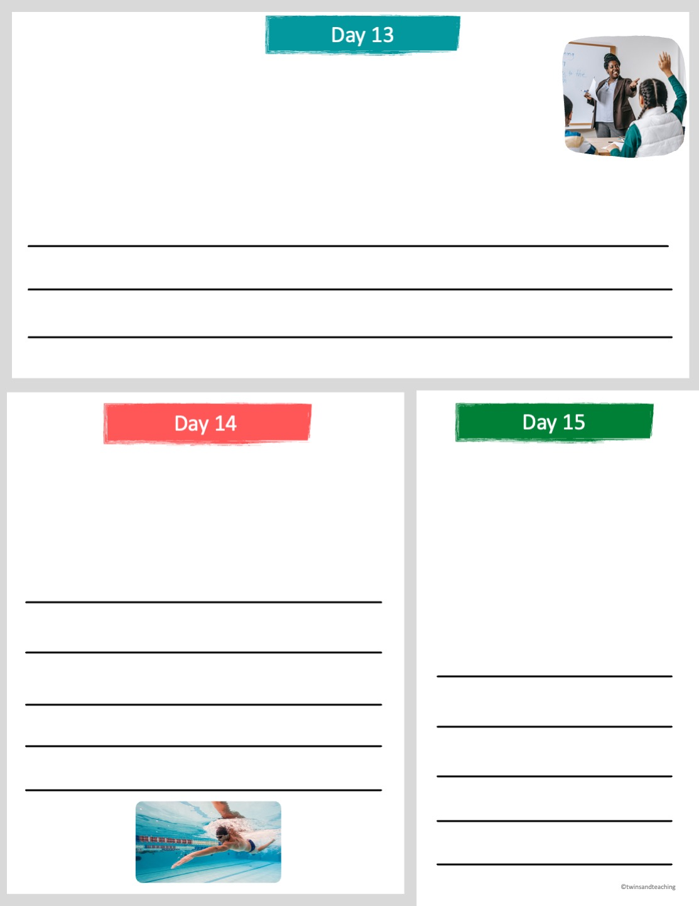
References are people who can talk about your work ethic and experience, work habits, character and skills.
References are people that have been in a work or school environment with you such as a teacher, coach, counselor, mentor, etc. Name 2 people who you could ask to be a reference for you. What is their role and how do they know you?
It is a good idea to be involved in extra-curricular groups or sports outside of school.
Volunteering in your community or school is also a very good attribute. Describe volunteer work you have been involved with. If you have not done volunteer work, list some ways that you can volunteer in the near future.
List all of the extra-curricular clubs, sports, events that you are involved in or have been involved in recently.

Slide 7
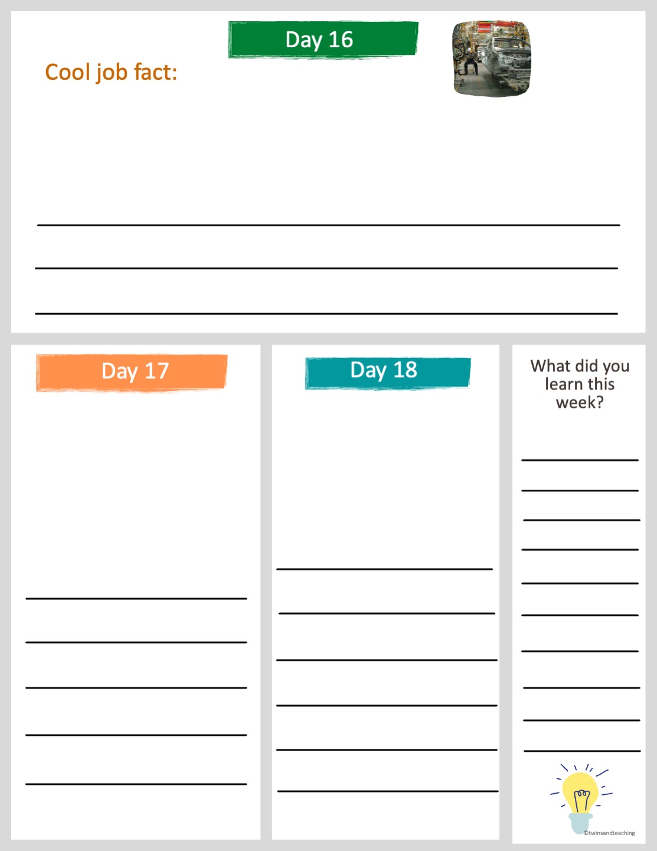
The US automobile industry has suffered very much in the last decade. In recent years roughly 350,000 American auto jobs were lost.
Why do you think the automobile industry has declined?
According to Pew Research, about 16 million Americans are self-employed.
According to Pew Research, American women earn 85 cents on the dollar compared with men.
What does self-employed mean? Is this something that you would be interested in? If so, what would you make, sell or what service would you provide?
Are you surprised by this information? Why or why not? Do you think the gap between pay will get wider or more narrow in the future?

Slide 8
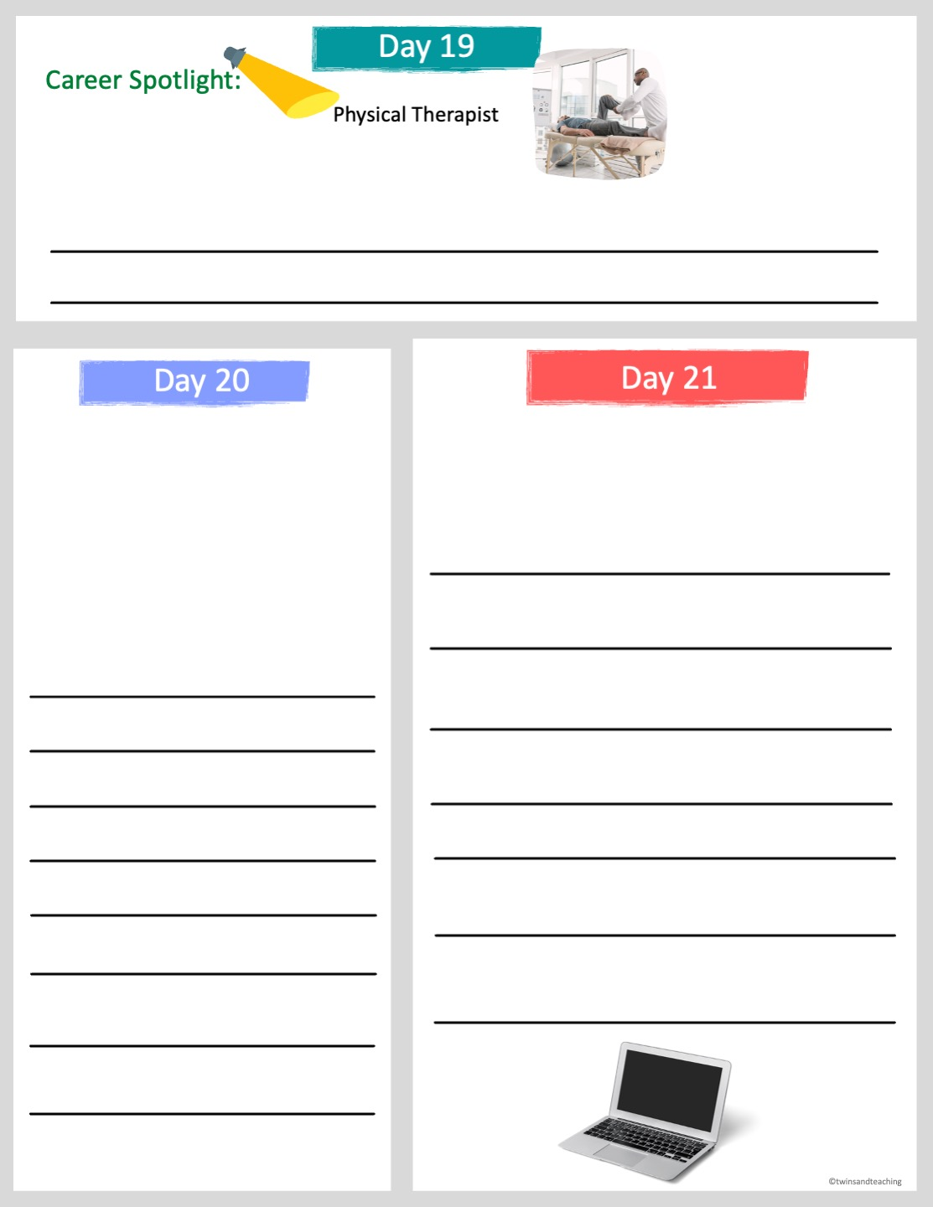
Physical therapists help injured or ill people improve movement and manage pain. They create exercises, stretches and different therapies to help them heal.
Physical therapists median salary is about $80,000. What interests or strengths do you think would make someone want to become a physical therapist?
“By recording your dreams and goals on paper, you set in motion the process of becoming the person you most want to be. Put your future in good hands—your own.” —Mark Victor Hansen
Staying organized in school and in life is an important skill to have. List 3 ways that you can stay organized in your life.
What does this quote mean?
Write down one goal that you have for this school year.

Slide 9
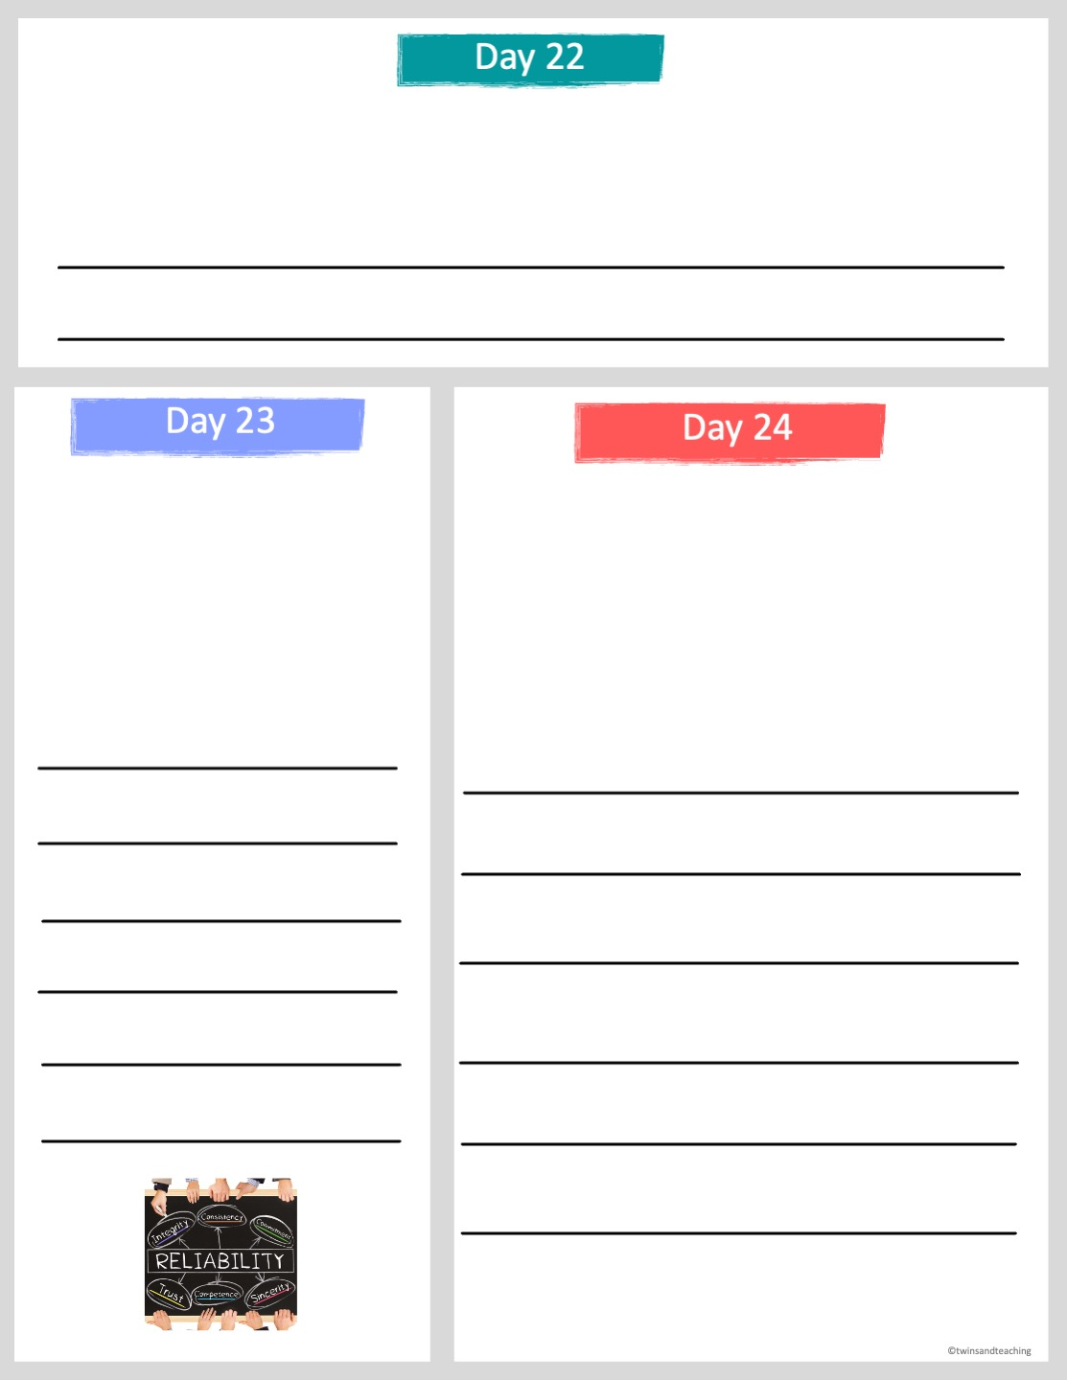
Punctuality is showing up to where you are supposed to be on time.
Explain why it is important to be punctual. Why would that be an important quality a boss would look for?
Reliability is the quality of being trustworthy or of performing consistently well.
Professionalism means communicating effectively and appropriately and always finding a way to be productive.
Why do you think it is important to be reliable in a job? Write a scenario in which someone was not reliable.
Imagine you work in a kitchen and all of your work is finished but everyone around you is still busy. What would be the professional thing to do?

Slide 10
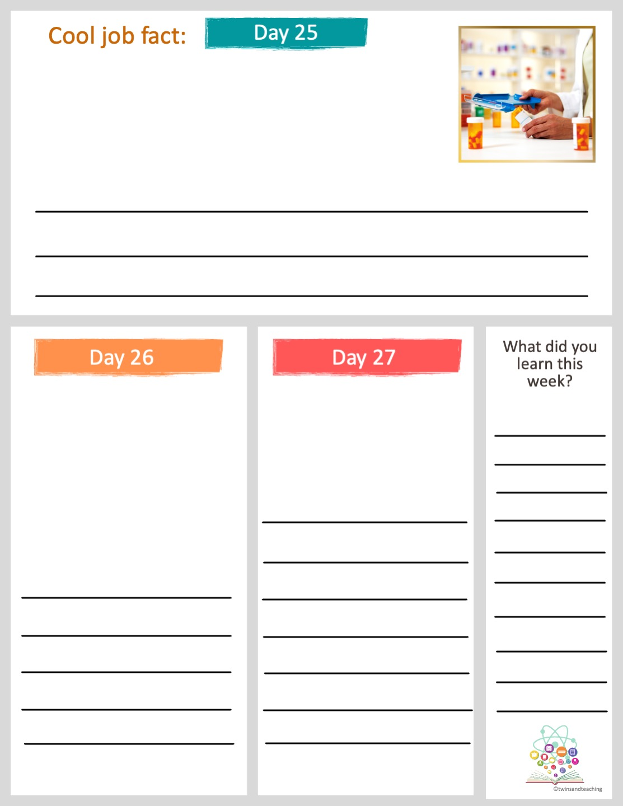
Physicians, pharmacists, nurse practitioners, and physician's assistants are some of the highest paid jobs in the United States.
Why do you think people in these fields are paid so well?
Often doctors have to go to school after high school for 10 years.
What characteristics do you think people that work in the medical field need to have?
Would you be willing to go to school for 10 years after high school? Why or why not?

Slide 11
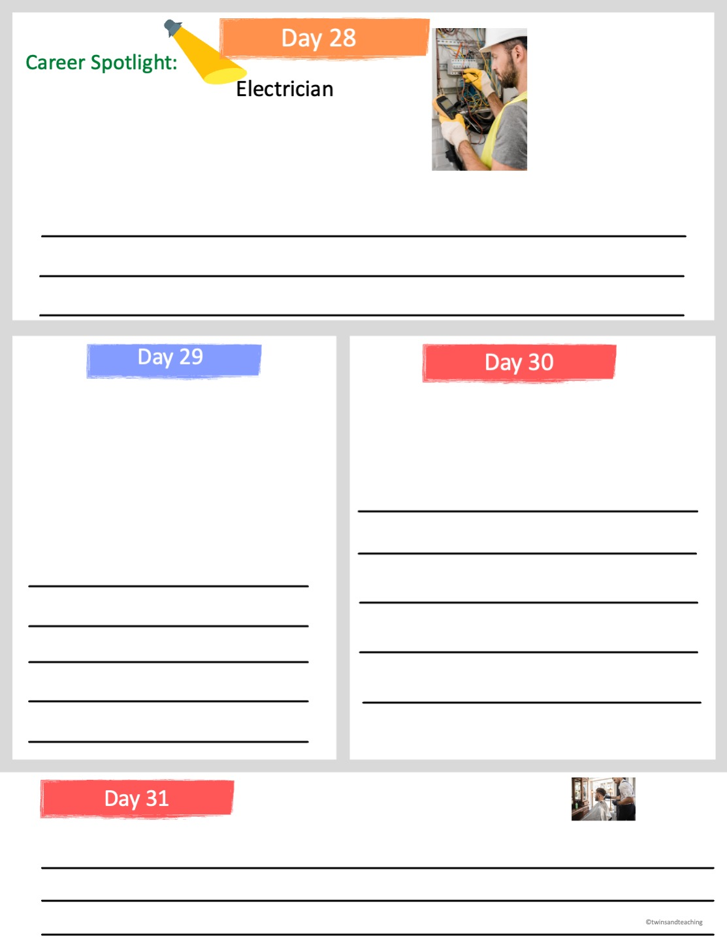
An electrician is a skilled tradesperson. They design, install, maintain, and repair the electrical systems in homes, businesses, and factories.
To become an electrician you need a high school degree and to attend a vocational program or an apprenticeship. The average electrician makes about $60,000 a year.
What qualities do you believe someone who becomes an electrician must have?
Trades such as electrician, carpenter, construction worker, auto mechanic, etc. do not require a traditional college education but usually require a license from a technical school or apprenticeship.
Do any of your family members have a skill or trade? Have they ever taught you anything about their skill? Explain.
What is an apprenticeship? Why might that be a good experience to have before starting a career?
One advantage to learning a trade is that people can open their own business.
Name an advantage to owning your own business. Name a disadvantage to owning a business.

Slide 12
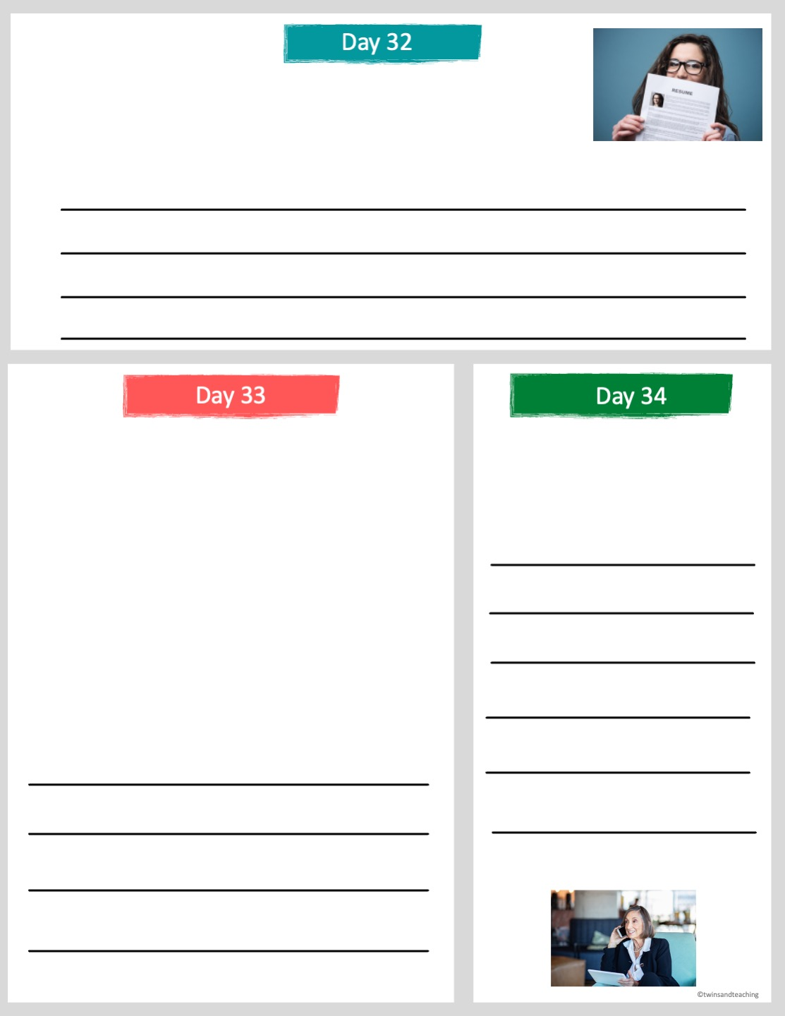
A résumé is a summary of your skills, education and experience that is given to an employer for consideration for a job.
Write your information on the lines below.
skills-
education-
experiences-
A résumé usually follows this order:
  Heading: your name, your address and contact information.
  Objective: a one sentence description of the job you are seeking or your job interests.
  Education: dates and location of school experience.
  Experience: previous employers and dates and roles and responsibilities.
  Activities: any special clubs, sports, or service.
  Summary of Skills: special skills or talents.
  References: After asking permission from each reference, you can include their information.
Why would a potential employer want references included in a resume?
After looking at the categories above, which do you think is most important in a résumé? Explain.

Slide 13
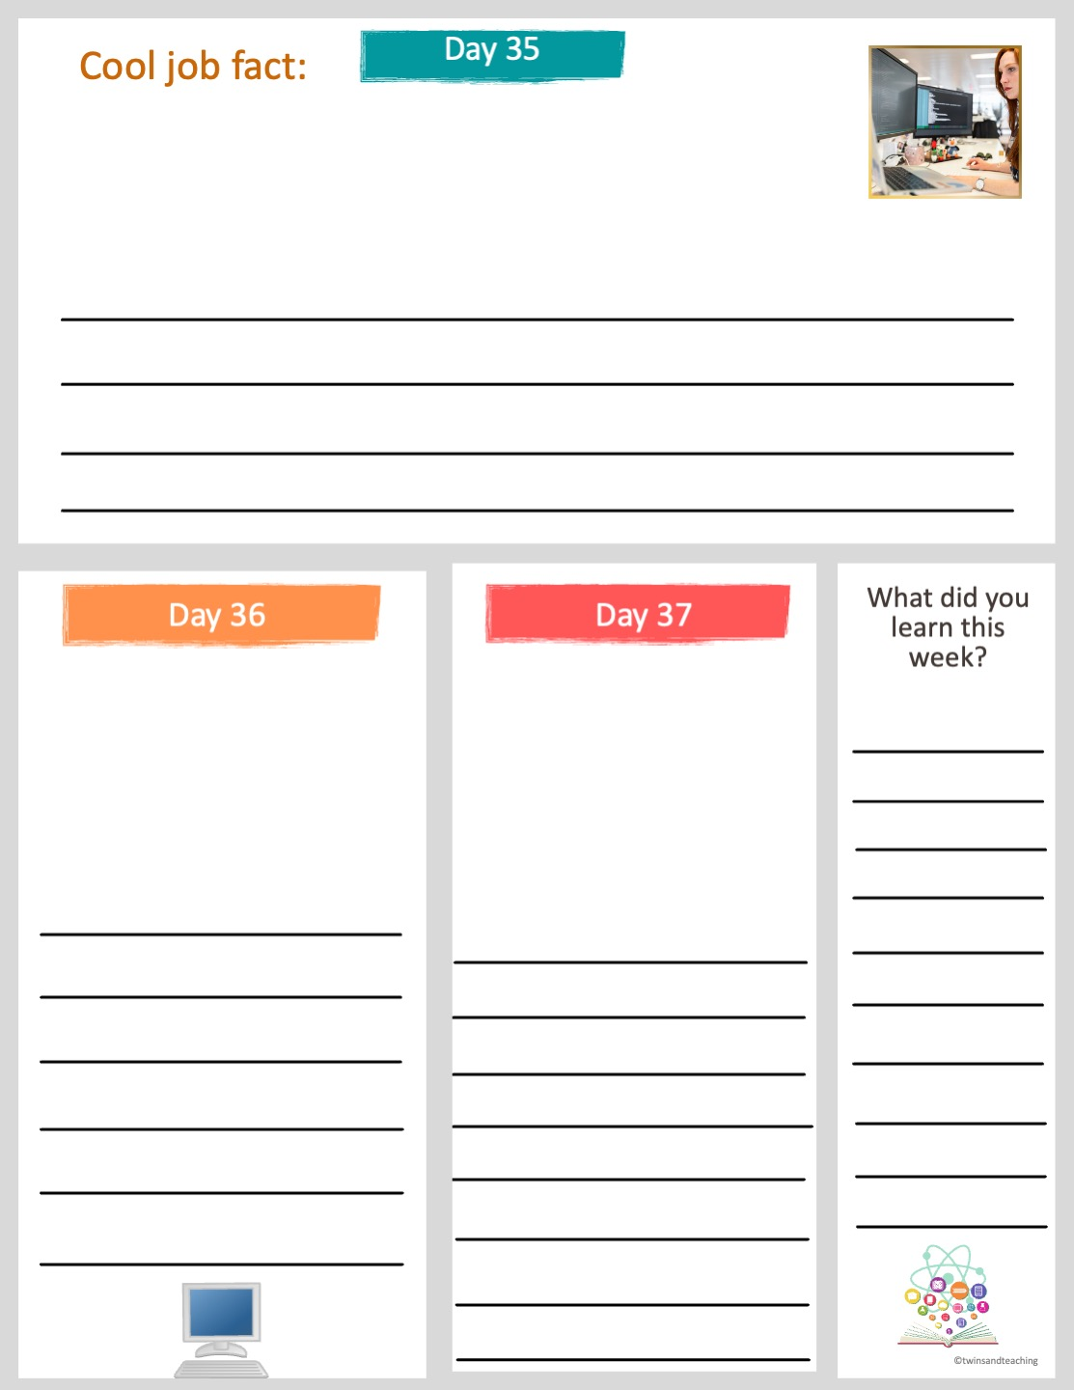
Computer science related job salaries are about twice as much as the average salary in the United States.
More and more people are working in front of a computer screen all day. Do you feel as though this is something you could do? Why or why not?
Computer science related jobs include: software tester, website developer, data scientist, information security analyst, technology support and more.
Computers and the internet did not become widespread until the late 1990s.
What are some characteristics one must have to work in the computer science field in your opinion? Explain why.
How have careers changed with the invention and use of computers and the internet?

Slide 14
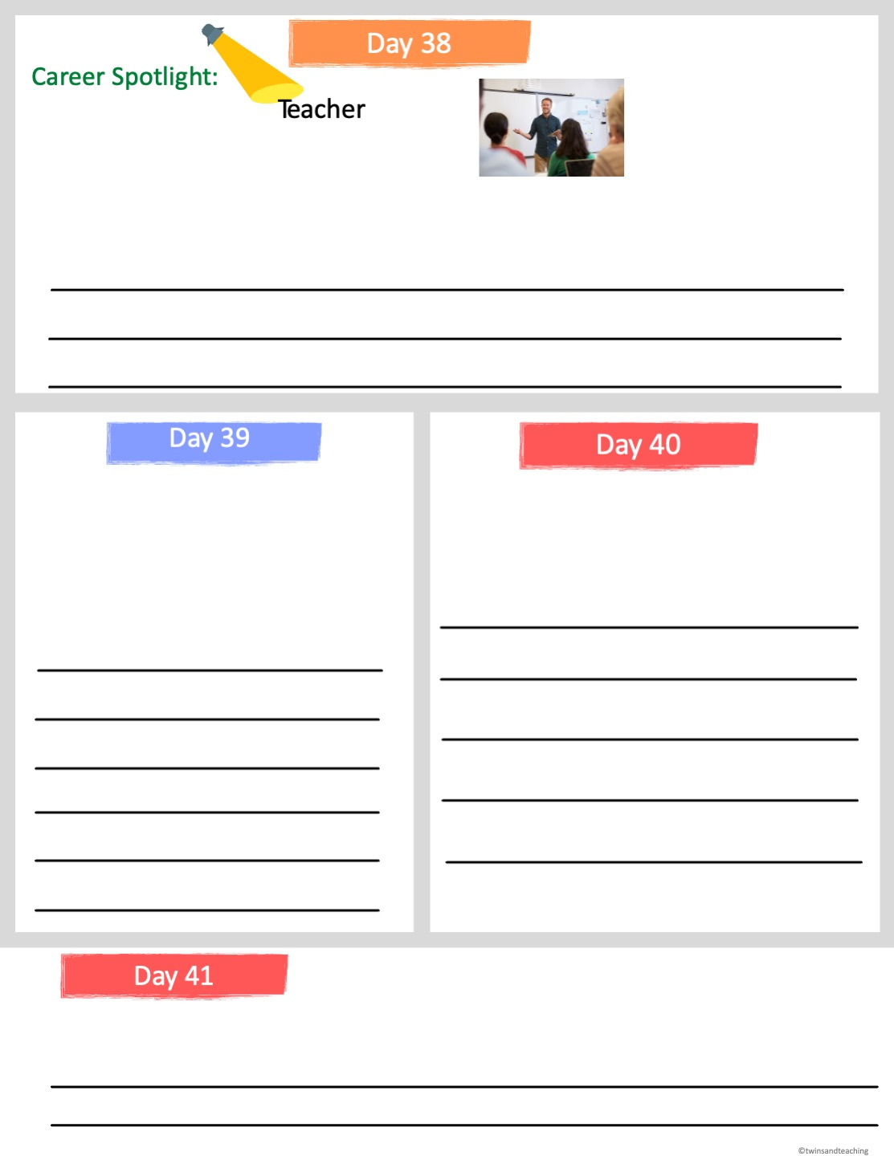
There are many different teaching positions from pre-k to high school teacher. Teachers need at least a Bachelor's degree and in many states they require a Master's degree.
According to the Bureau of Labor Statistics, a teacher's primary job is to “give students the knowledge and tools to succeed both in school and beyond the classroom.”
What qualities do you think a teacher needs to have?
Teachers and other employers require a background check before they are hired.
What careers do you believe would be the most fulfilling? Which careers make the most difference in the lives of others? Is that an important job description for you?
Do you think background checks are important? Do you think they are more important for some jobs more than others? Explain.
On average, teachers earn around $45,000 a year depending on where they live and what they teach.
Do you think having breaks and vacations off would make you want a job that pays less money than others?

Slide 15
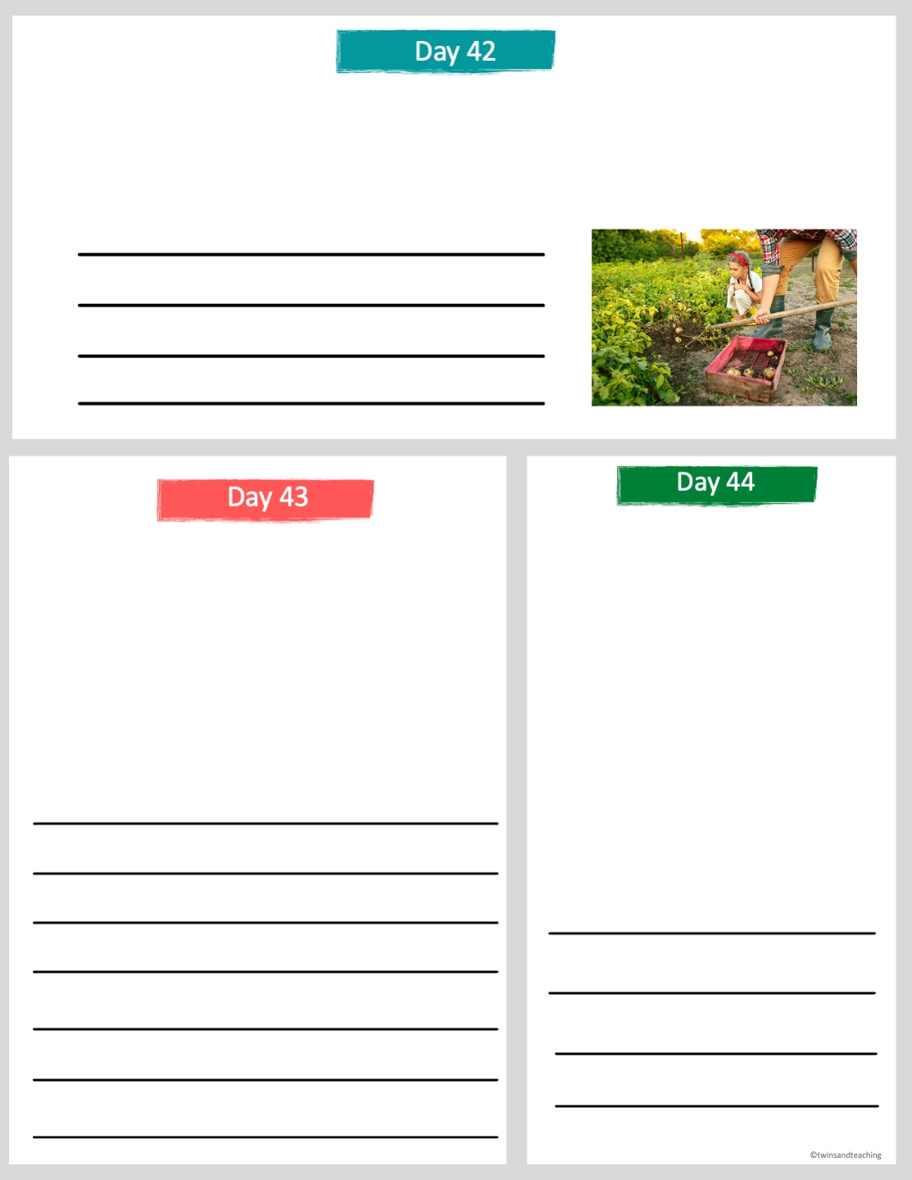
Agricultural Careers includes occupations related to farming, ranching, forestry, and preserving natural resources. Working outdoors may be a part of these careers.
What characteristics and interests do you think that someone who works in the agricultural field would need?
Some signs that you may be interested in an agricultural career would be if you:
  Participating in Earth Day.
  Recycling household goods.
  Taking care of pets or farm animals.
  Growing your own garden.
Some careers in the Agricultural field include:
  Animal Breeder
  Husbandry
  Animal Geneticist
  Animal Nutritionist
  Veterinarian
  Water Conservationist
  Park Manager
  Tree surgeon
Do any of these activities interest you? Explain. What would be an advantage to working in an agricultural career?
Choose one of these occupations that you have never heard of. Look on the internet to find out more information and write a sentence or 2 about the career.

Slide 16
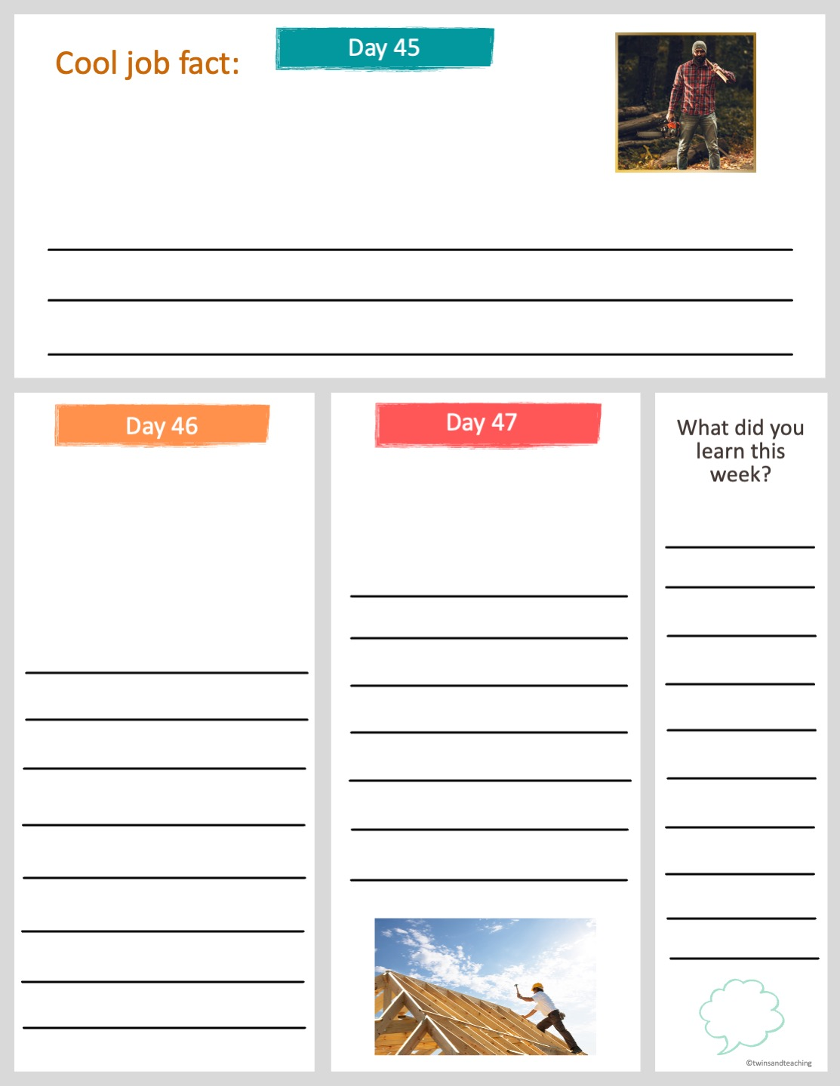
The most dangerous job in the United States is logging. A lumberjack is about 30 times more likely to die on the job than the average worker.
Why do you think logging is a dangerous job? Why do you think some people still decide to do this job?
Other dangerous jobs in the US include fishing and related fishing workers, pilots, roofers, truck drivers, steel worker, construction workers.
The most dangerous jobs are also very important for society.
What would happen if the country did not have any more loggers or roofers?
Would you work in a dangerous job if you are interested in it and it pays well? Explain your answer.

Slide 17
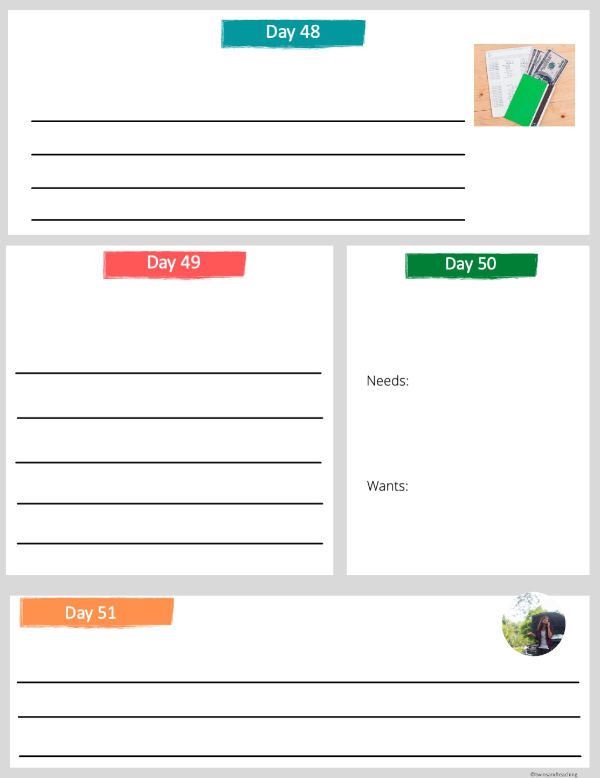
69% of Americans said in 2019 that they had some type of savings account.
Why is it important to have savings? Do you have any money saved?
What kinds of things do people normally save for? What are some things you think you should save for in the next 5 years?
If you had $1,000 in a bank account, list what you would buy with it based on needs and wants:
What happens if you do not have savings and something that is necessary to your life breaks? For instance, your car breaks down. What would you do?

Slide 18
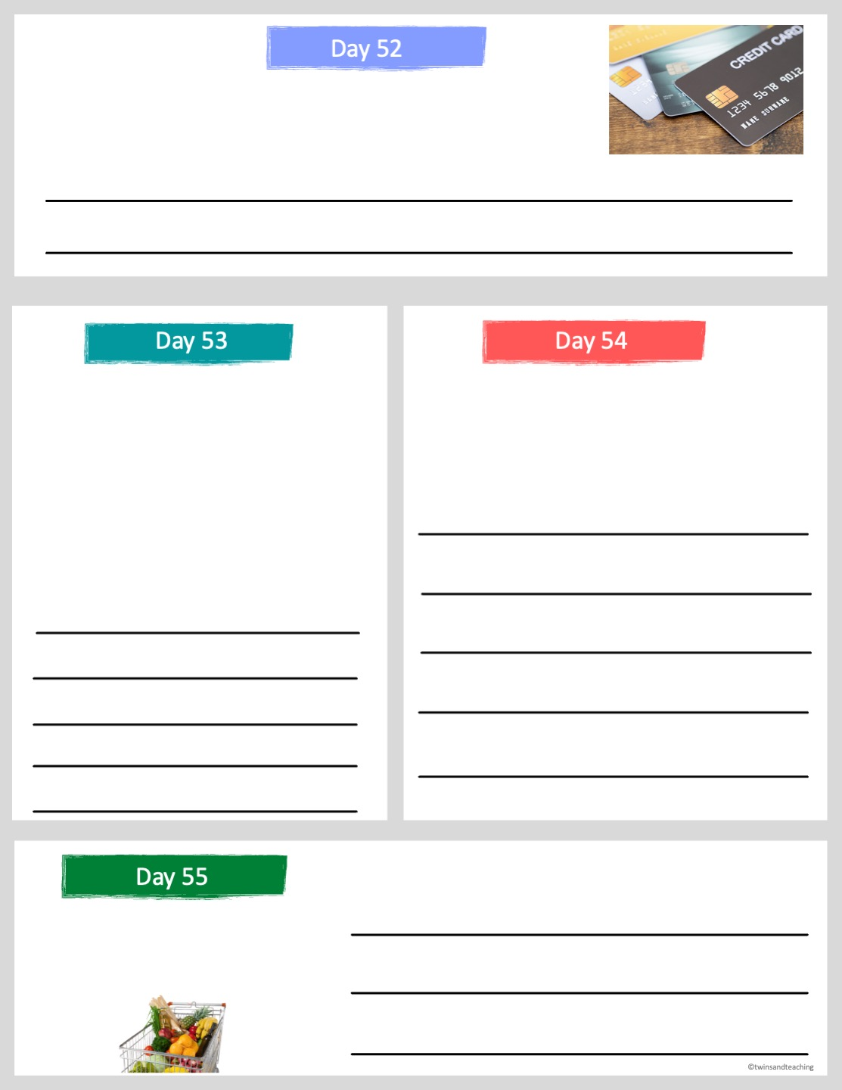
Credit is when you borrow money to pay later. Can you think of a time when someone may need to use credit?
When buyers borrow money with a credit card they have to pay the money back within a time frame and often with interest.
If you pay off your credit card and any borrowed money on time you can build good credit and it can help you financially.
The extra amount you have to pay to the company lending you the money is called interest. Depending on the interest rate, the company will benefit from you borrowing because you are giving them money.
What is an advantage to using credit?
What is a disadvantage to using credit?
Imagine you had to buy healthy food for yourself with $10 for one day. What would you purchase?

Slide 19
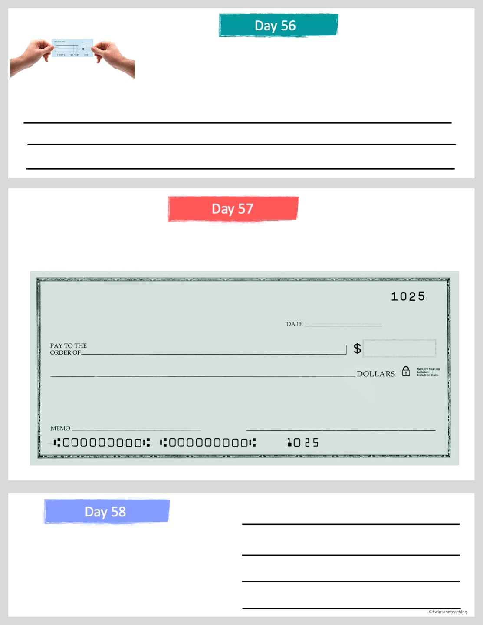
A bank check is a way to pay someone. It does not cost anything and the money comes directly out of your bank account.
Have you ever written a check? What are other ways to pay people?
Complete the blank check below as if you are paying someone for an item you purchased.
There are new apps and websites that allow people to pay each other such as Venmo and PayPal.
Name an advantage to using an app to pay someone and name a possible disadvantage.

Slide 20
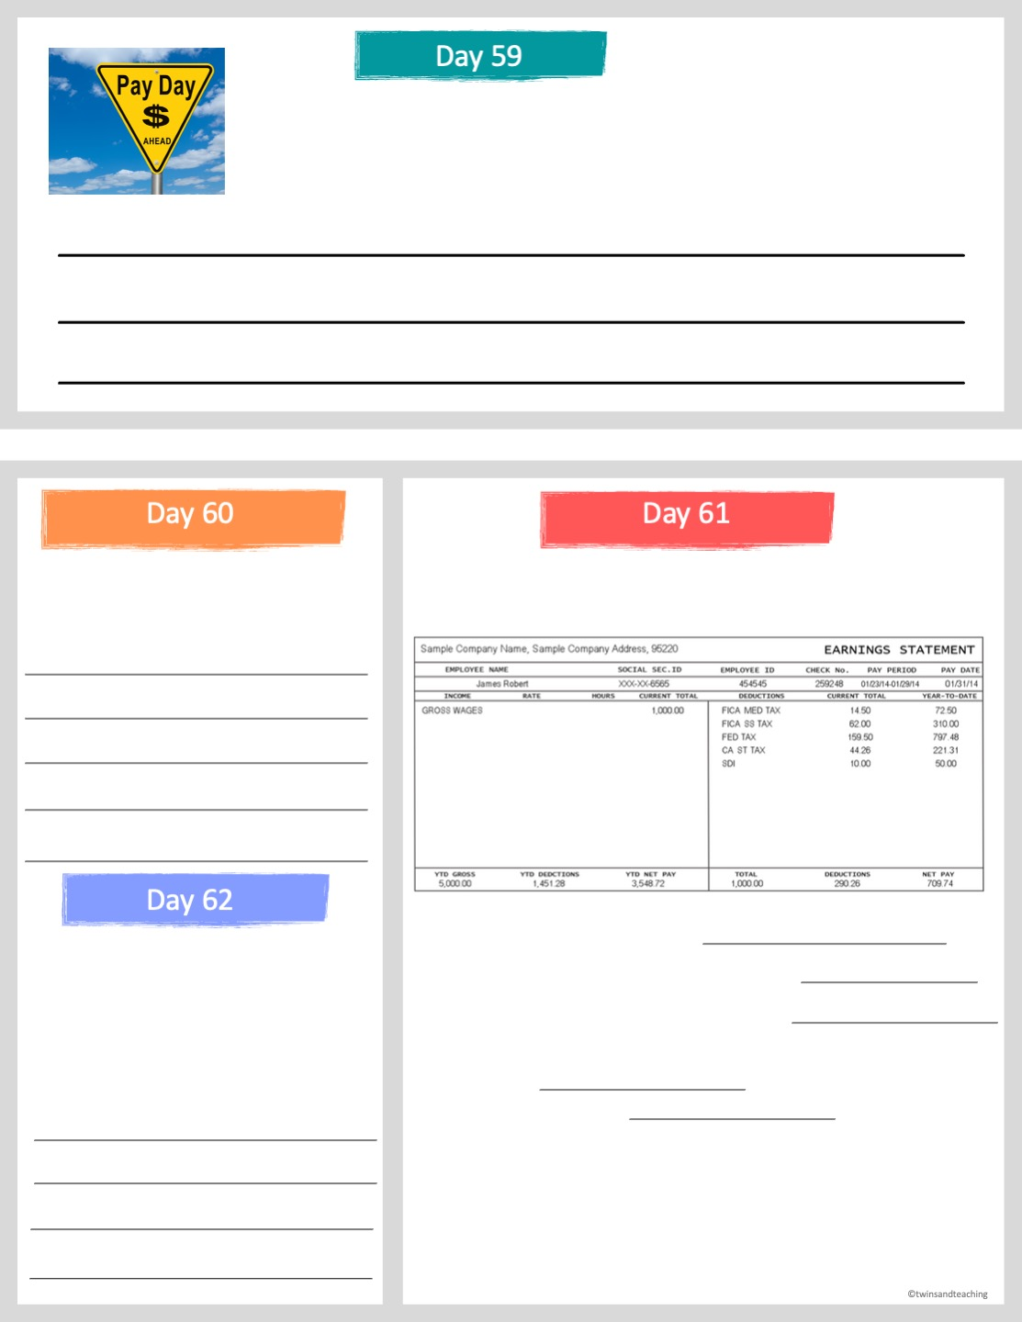
When you get paid from an employer, almost 30% of your pay is probably being deducted.
Where do you think the 30% is going?
Why do you think the federal and state government collect taxes from citizen's wages?
Read the sample paycheck below and answer the questions.
As of 2021, the federal minimum wage is $7.25 per hour. States have their own minimum wage laws that increase that number.
  What are the gross wages?
  How much is deducted for FICA SS tax?
  How much is deducted for federal tax?
  How much is deducted for state tax? (California is the example).
  What is the net pay?
Do you think that $7.25 an hour is a livable wage? What is the minimum wage rate in your state?
Gross wages is the amount the person earned by working. Net pay is how much money they get to keep.

Slide 21
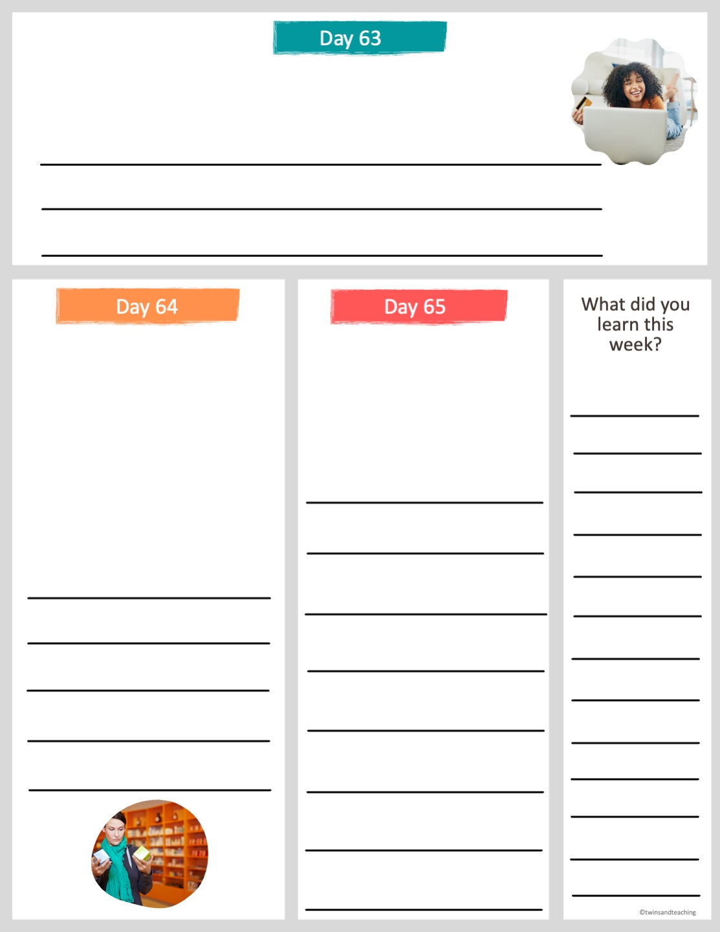
If you are about to make a big purchase what are some things you should do to make sure you are buying the best possible item?
Comparison shopping means that
you “shop around” in person, by
phone or on the Internet, to
compare prices in order to find
the best deal.
What are some items that people buy second hand or used? What are the benefits of this? What are the disadvantages?
When was the last time you or your family comparison shopped? Describe how you found a better deal.

Slide 22
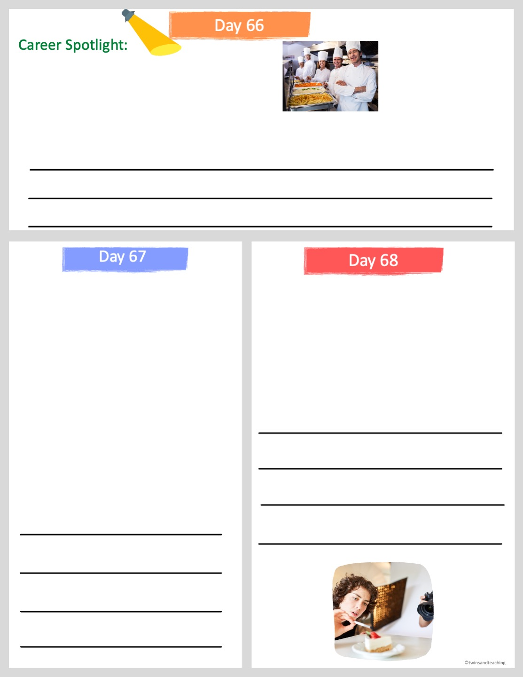
Chefs and head cooks oversee the daily food preparation at restaurants and other places where food is served.
Chef or Head Cook
Most chefs or head cooks either learn through work experience or through training at a vocational school or college. The median pay is about $50,000 a year. Chefs work long hours and the work is often fast paced.
What qualities do you think a chef needs to have? Does this seem like a career that woud interest you? Why or why not?
The food and hospitality employs millions of Americans. Some of the jobs in this field include:
  executive chef
  hotel manager
  cook
  waitress
  pastry chef
  restaurant manager
  bartender
  sous chef
  baker
Food stylist is another career in the food industry. They prepare food for photographs or television.
How is this career different than other food service careers?
If you had to choose one of the jobs above which would it be and why?

Slide 23
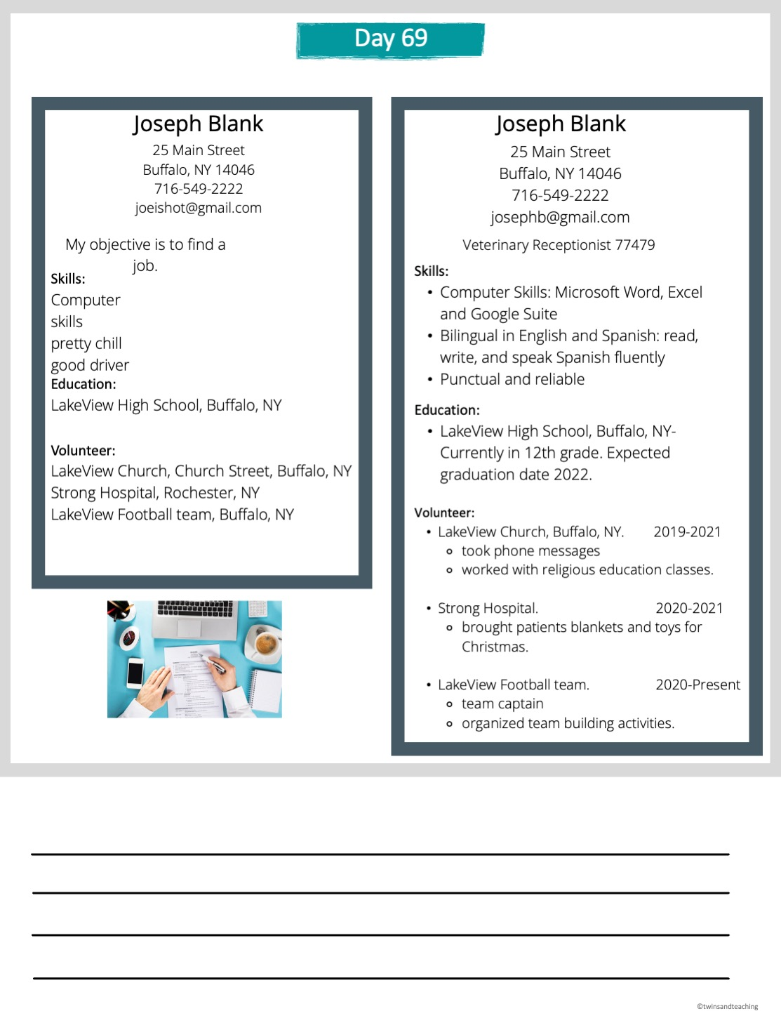
Read the resume samples below and answer the questions.
Find 3 major differences in the resumes above and describe them.

Slide 24
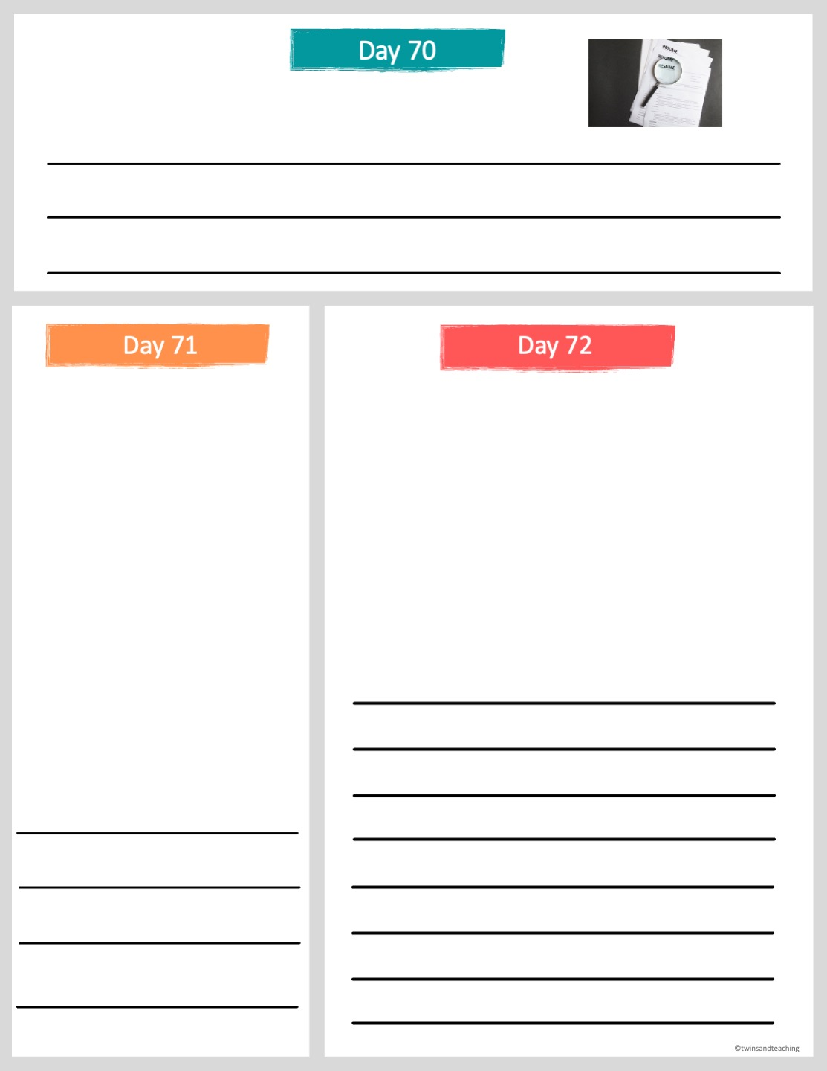
Why do you think including dates in a resume is important?
Read the following scenario and then answer the question.
Read the following scenario and then
answer the question.
Jennie was recently hired to work as a receptionist for an office. One of her duties on the job is to make copies for people in her office. She is hosting a Halloween party and really needs color copies of invitations to hand out to her friends. She is tempted to make the copies at work and put them in her bag.
Caden works in a local restaurant as a cook. He is scheduled to work on Friday night. His friends call him on Thursday and tell him that they have free tickets to his favorite concert on Friday night. He really wants to go to the concert.
What do you think Caden should do in this scenario? Explain your answer.
What do you think Jennie should do in this scenario?

Slide 25
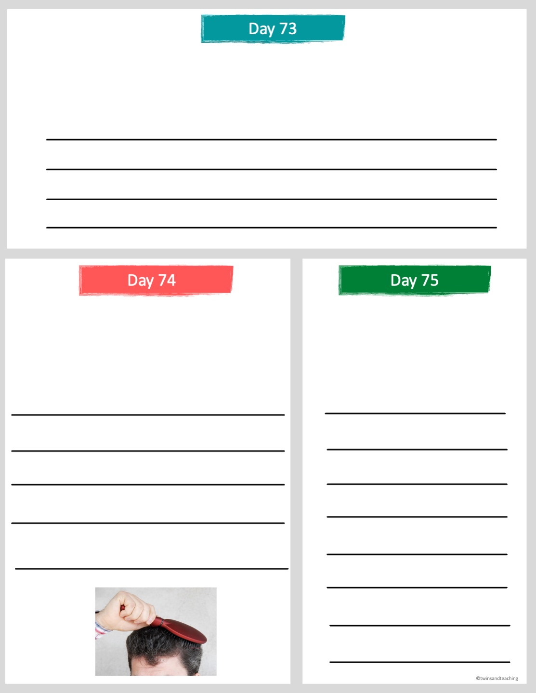
Professionalism in the workplace can be defined as "communicating effectively and appropriately and always finding a way to be productive."
What do you think "communicating effectively" means?
“Dress yourself to define yourself.”
― Debasish Mridha
Do you think you have to spend a lot of money to look professional? What are other important ways to make yourself look professional besides nice clothes?
What do you think this quote means? Do you think first impressions matter? Explain.

Slide 26
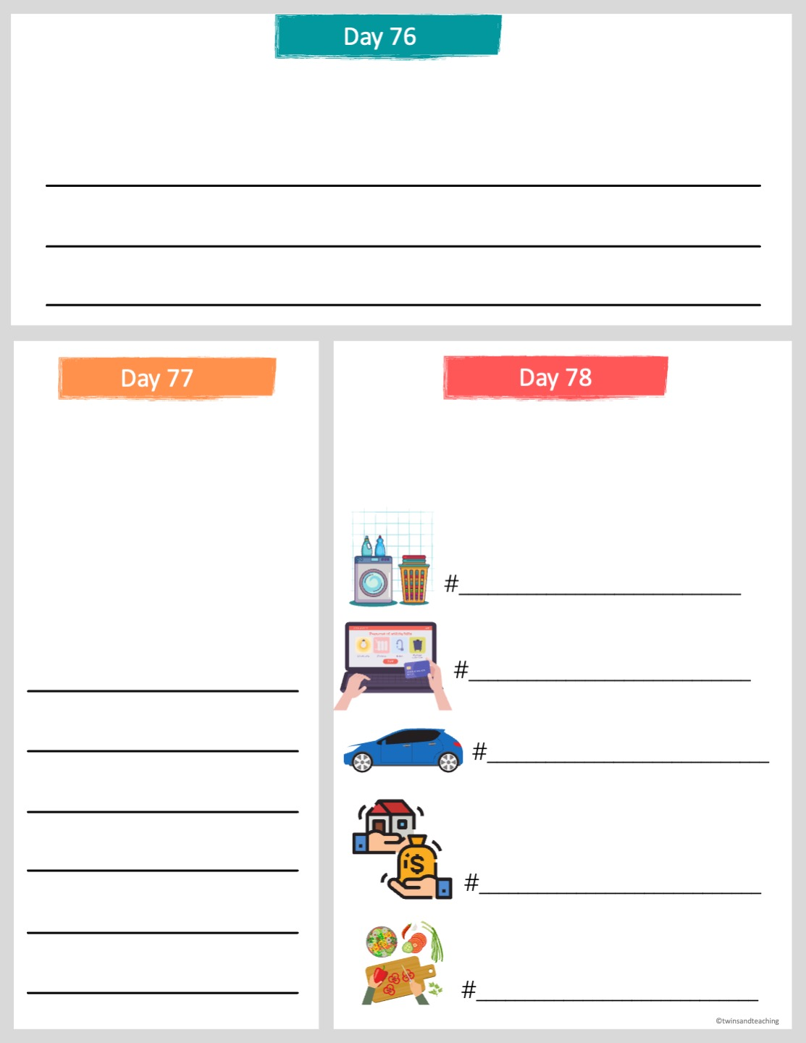
What do you think the term "adulting" means? What are some negative aspects of adulting and what are some positive aspects of adulting?
How prepared do you feel to be an adult? If you had to give yourself a grade on how prepared you feel for the demands and responsibilities of becoming an adult, what grade would you give yourself?
Look at the adulting symbols below and write a hashtag for each one that describes the symbol.

Slide 27
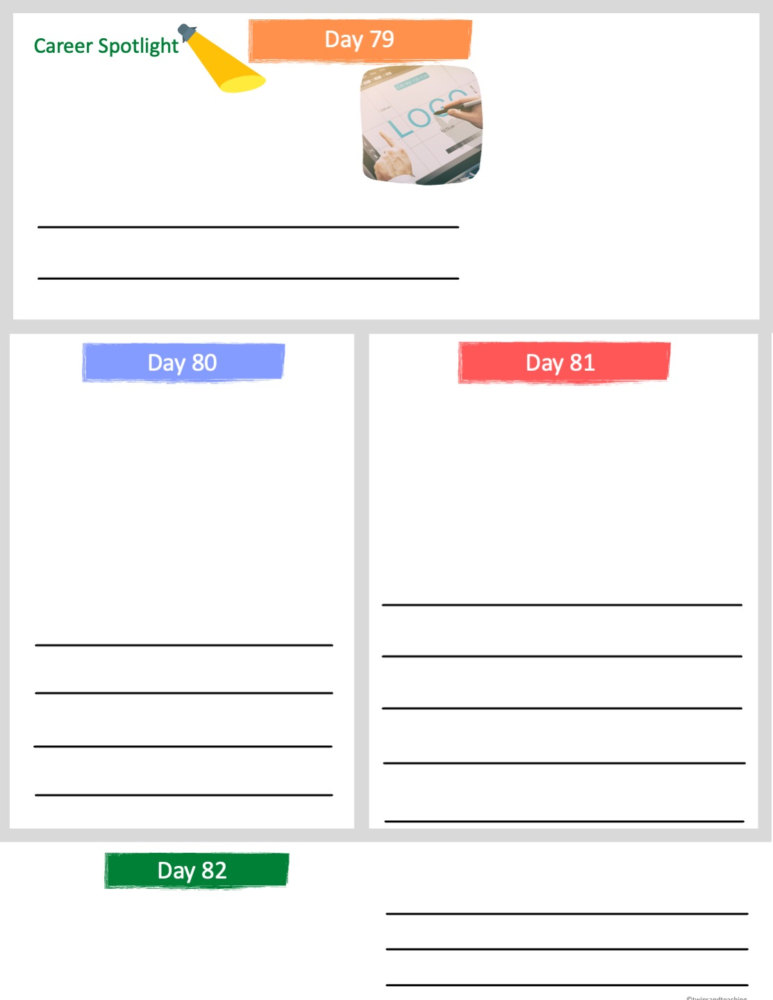
Graphic designers create visual text and imagery either by hand or by using computer software. They communicate ideas that promote a company, inform, or captivate buyers.They create logos, websites, product drawings and more.
Graphic Designer
What characteristics do you think a graphic designer would need to be successful?
Many companies require that a graphic designer has a bachelor's degree.
Graphic designers working for or with print can expect a 22.8% decline, whereas those working with computer systems should increase with about a 25% gain in job growth.
The average pay for a graphic designer is $50,000. The top 10% of them make over $90,000. The bottom 10% make about $30,000.
Why do you think that there will be less of a demand for graphic designers that work with print (paper) in the next 20 years?
Why do you think some people in the same field make a lot more money than others?
How would you feel working overtime or more than 40 hours a week? Explain.
This career can involve a lot of overtime as there are often deadlines that need to be met to finish a project. Self-employed graphic designers will often find themselves meeting and communicating with clients at all hours of the day.

Slide 28
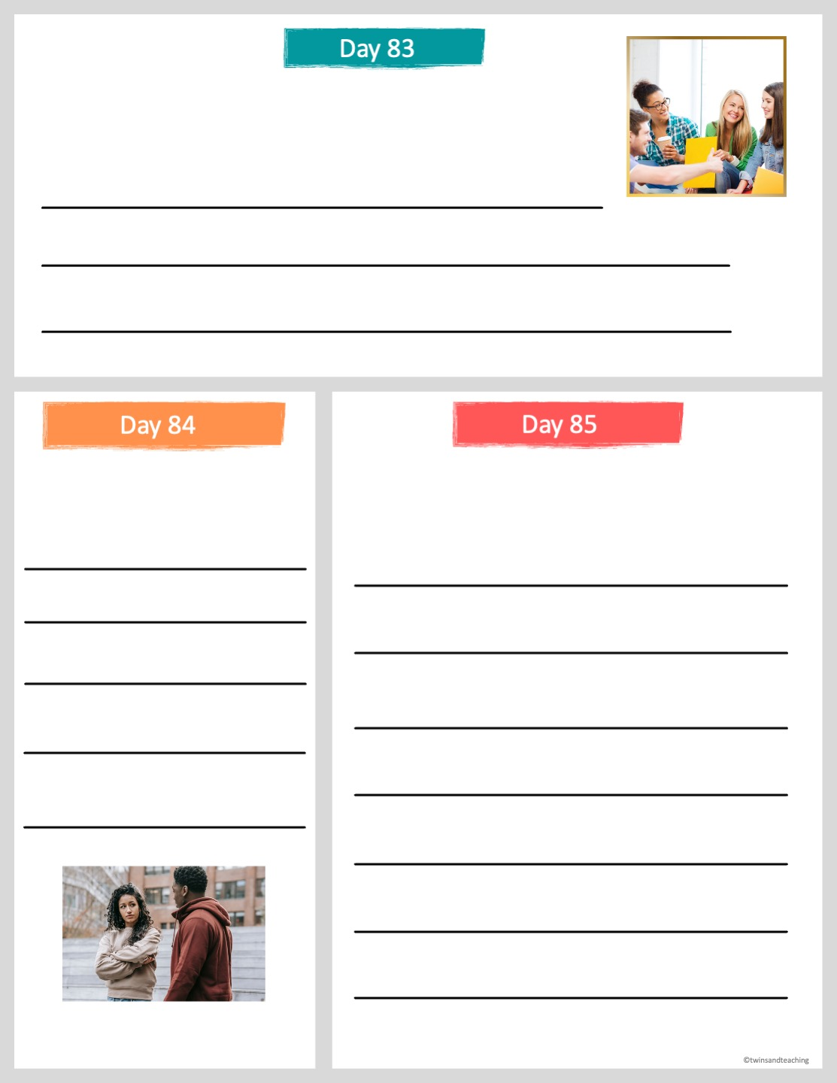
Complete the phrase: communication is...
Do you think it is possible to not communicate? Explain.
How easy is it to communicate effectively? What can go wrong? List ways it can go wrong.

Slide 29
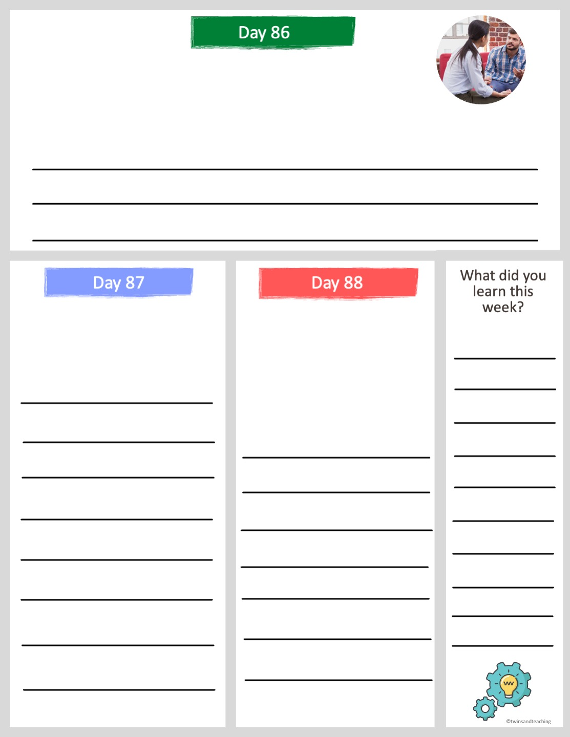
Effective communication includes eye contact, active listening, a clear message and feedback.
What makes someone an active listener? Have you ever spoken to someone and you did not feel as though they were listening to you? Explain.
How would you feel if you were talking with someone and they did not make eye contact with you? Why do you think eye contact is important?
There are 3 types of communication:
  verbal communication
  written communication
  non-verbal communication
What type of communication are you best at? Explain.

Slide 30
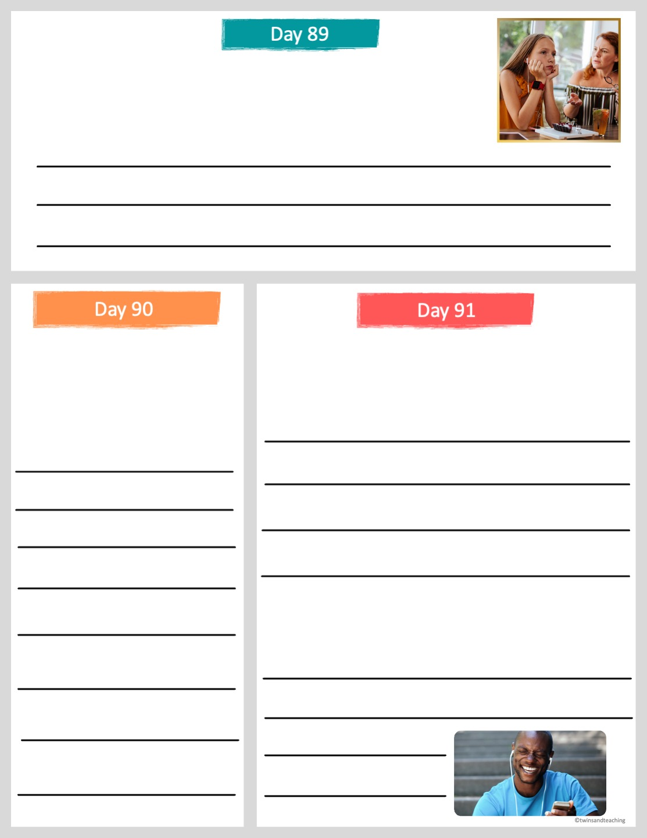
Nonverbal Communication includes body language, gestures, eye contact, posture, dress and symbols.
How effective is nonverbal communication at making a point? Do you think nonverbal communication is important in the workplace? Why or why not?
It is estimated that non-verbal communication is 93% of the messages we receive.
Cell phones have become a major way of communication today. What are some ways you communicate with a cell phone? Is the communication verbal, nonverbal or written?
When do we receive nonverbal communication during a typical day?
Do you think people feel more connected or less connected with cell phones? Explain.

