Slide 1
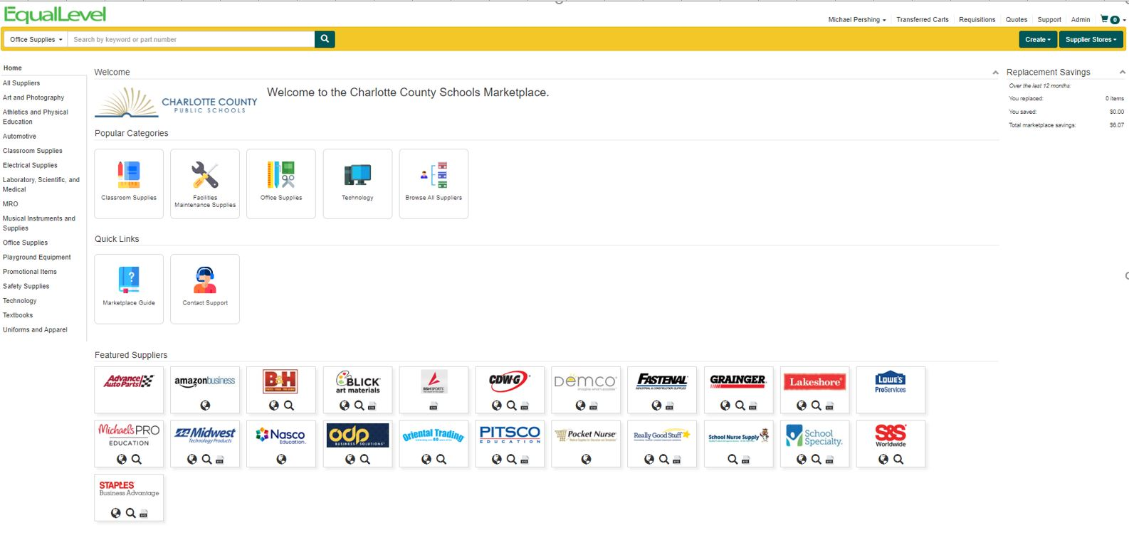
EqualLevel Marketplace

Slide 2
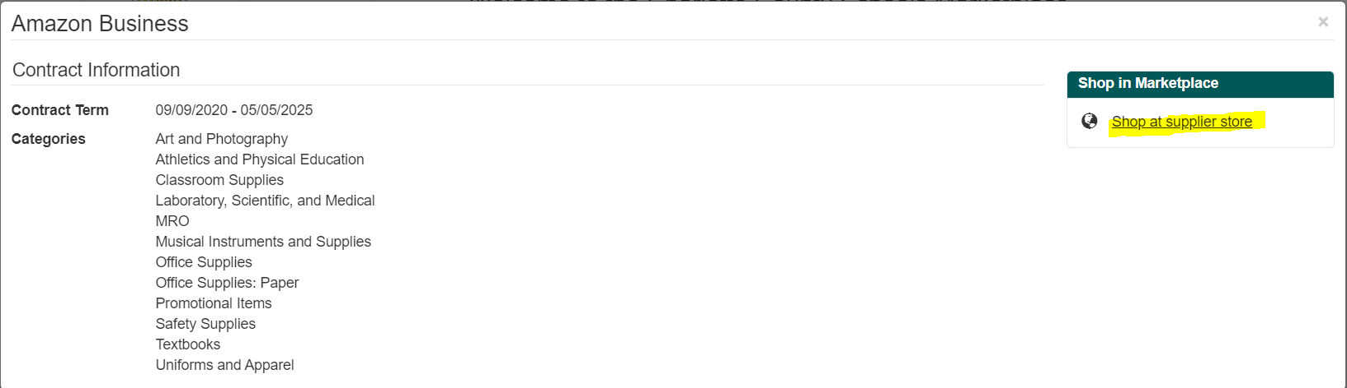
Supplier View

Slide 3
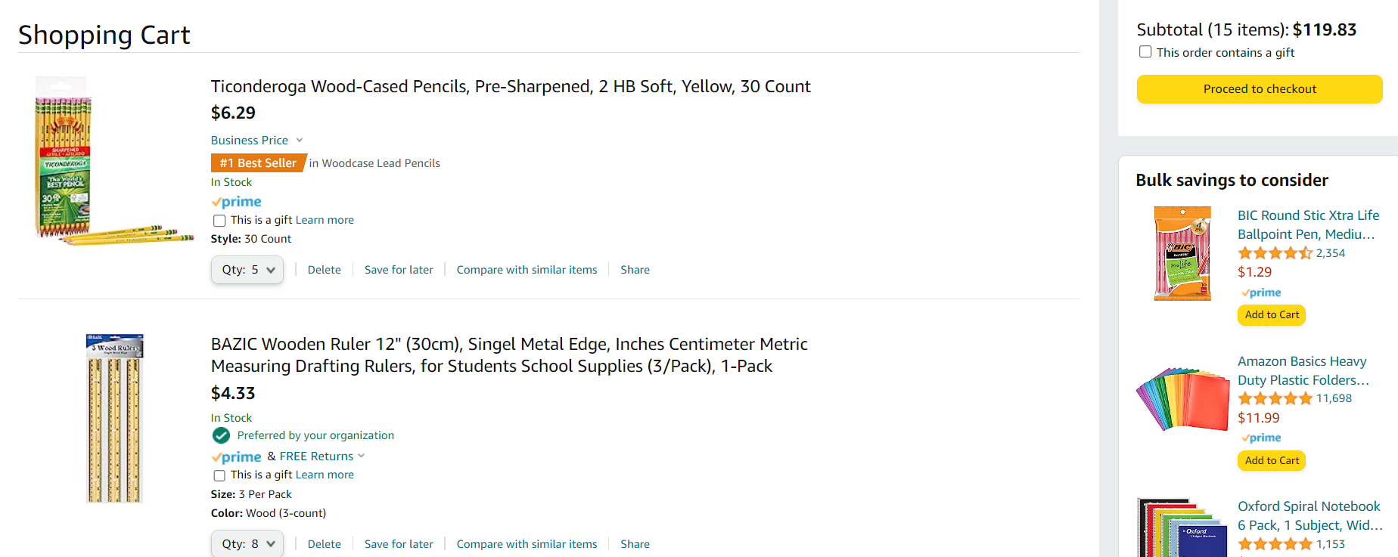
Cart – Proceed to Checkout

Slide 4
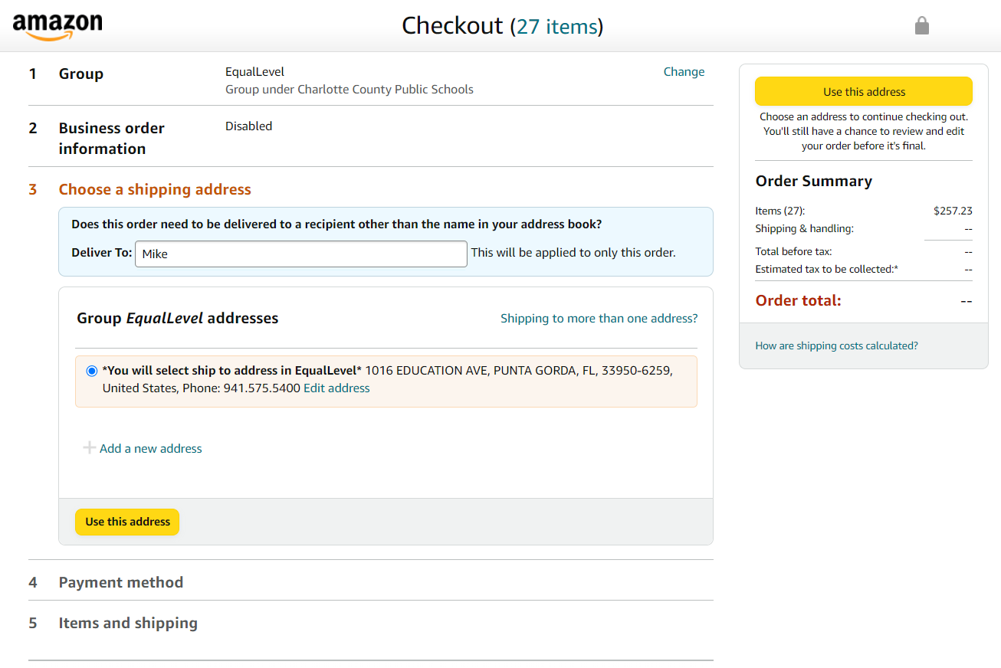

Checkout

Slide 5
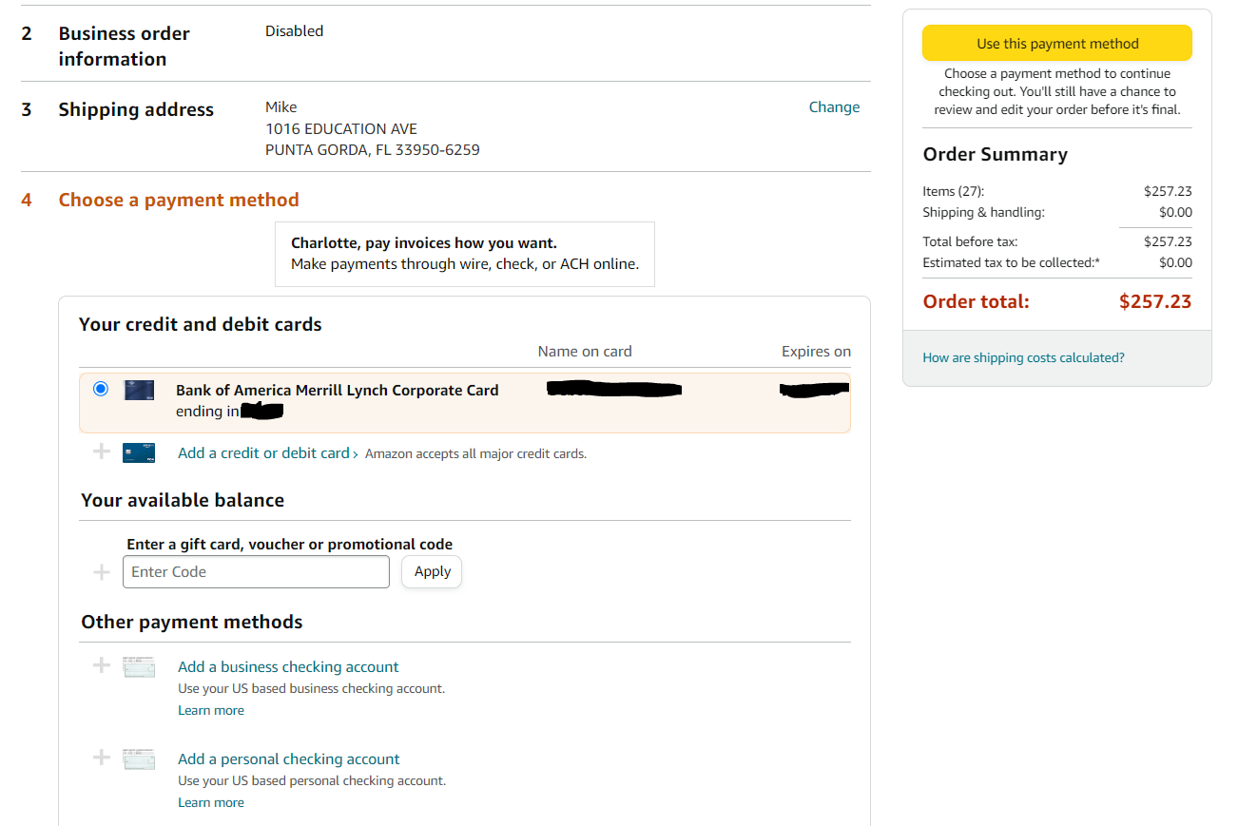
Payment Method

Slide 6
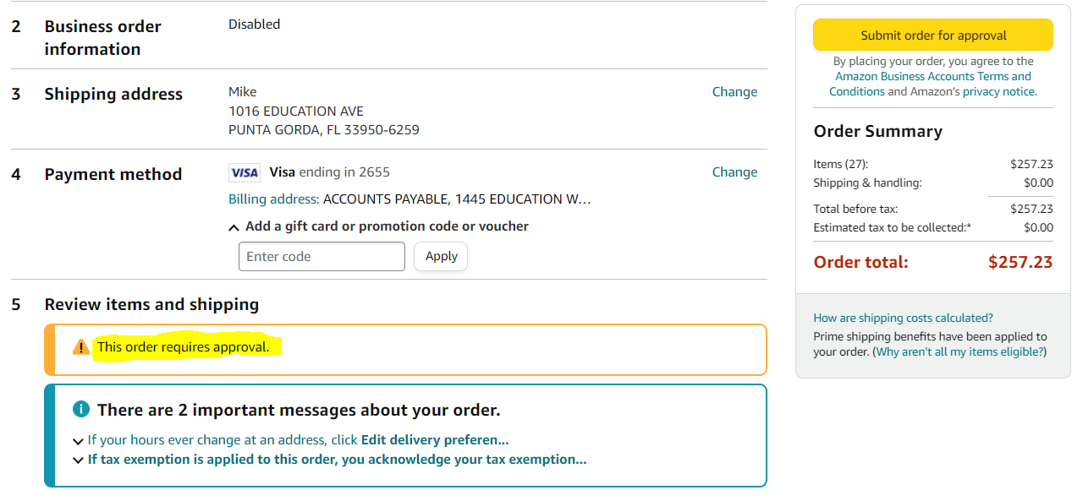
Submit Order for Approval

Slide 7
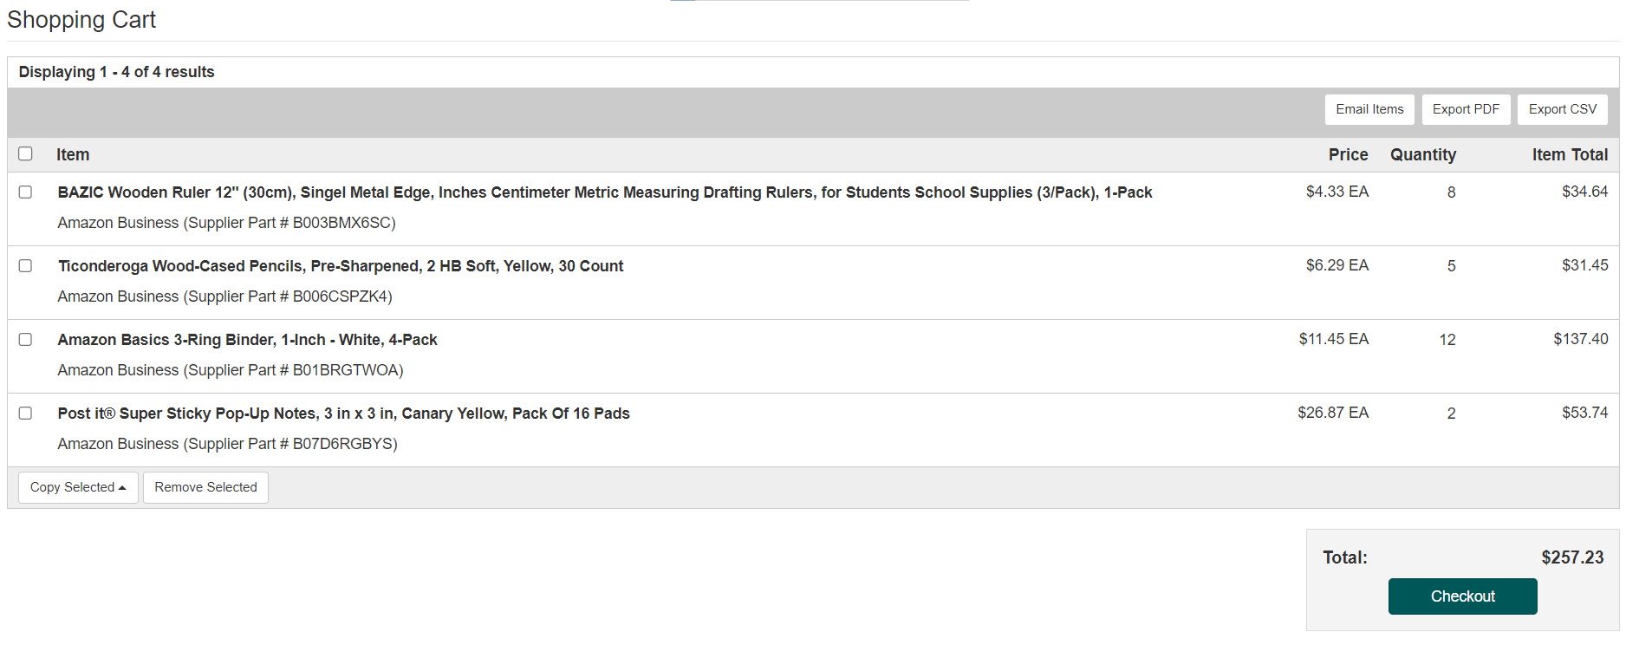
EqualLevel Cart

Slide 8
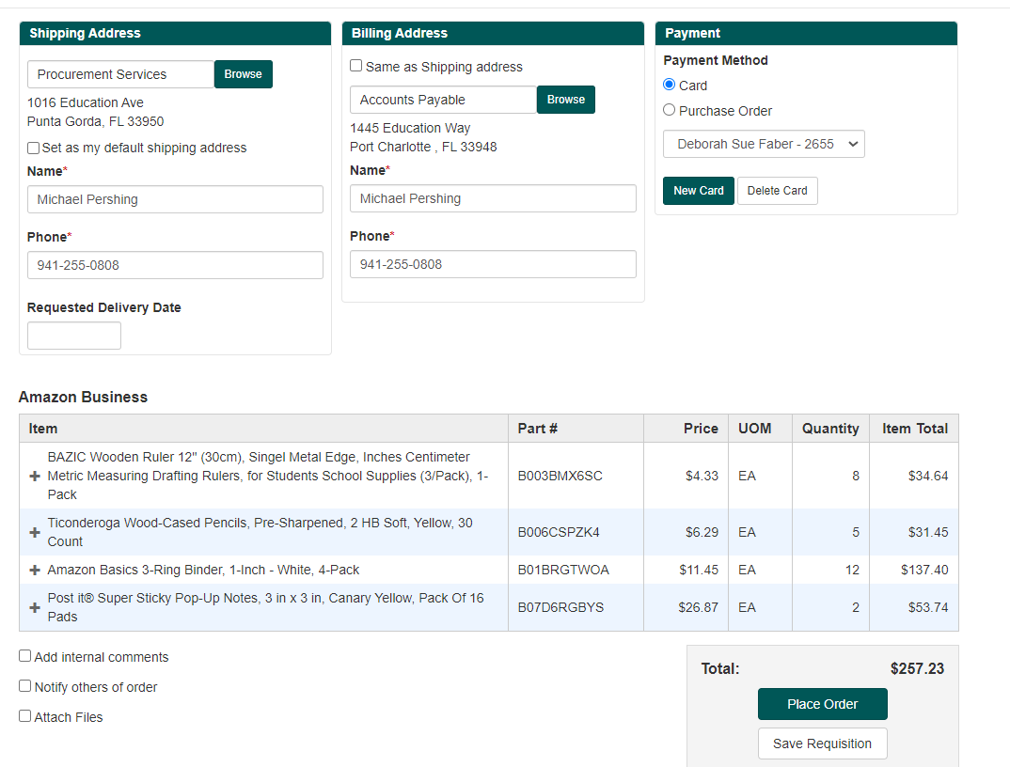
Checkout in EqualLevel

Slide 9
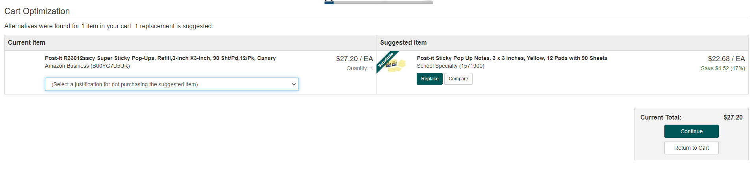
Cart Optimization

Slide 10
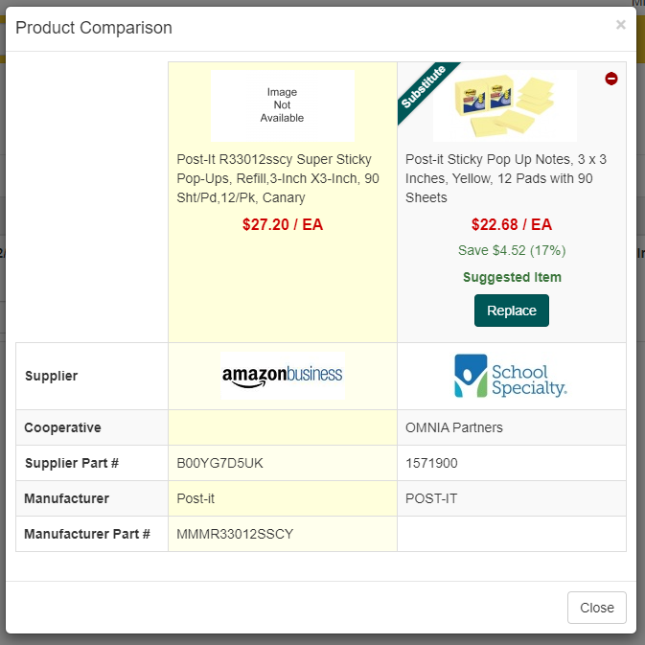
Product Comparison

