Slide 1



Slide 2
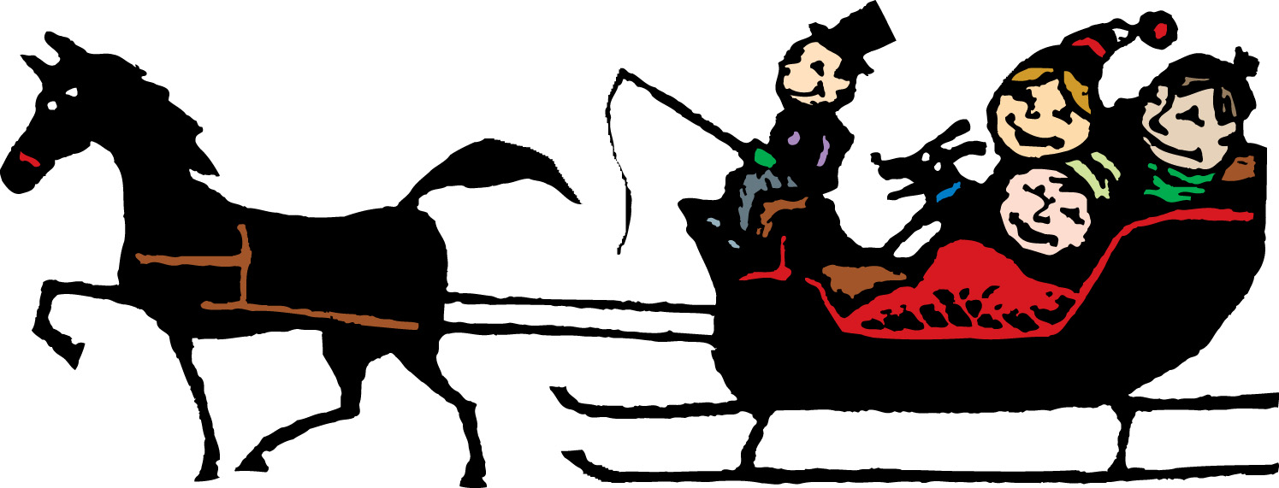
Dashing through the snow
in a one horse open sleigh.

Slide 3
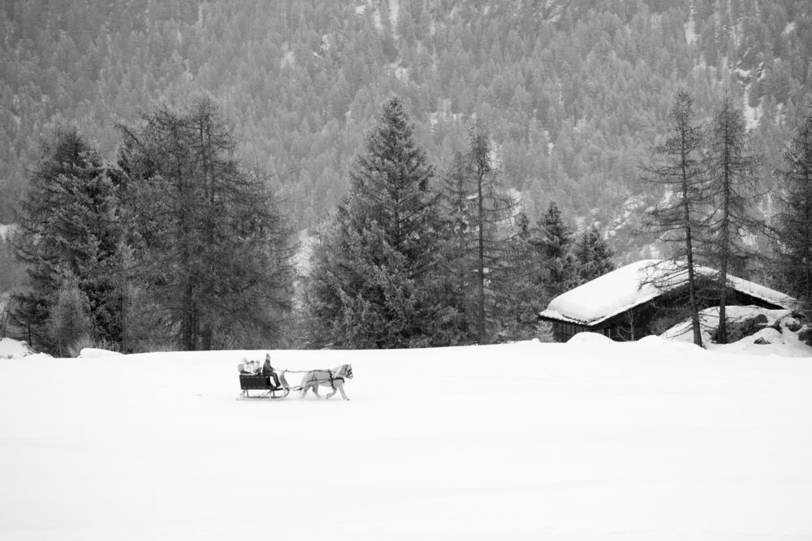
O’er the fields we go,
laughing all the way.

Slide 4
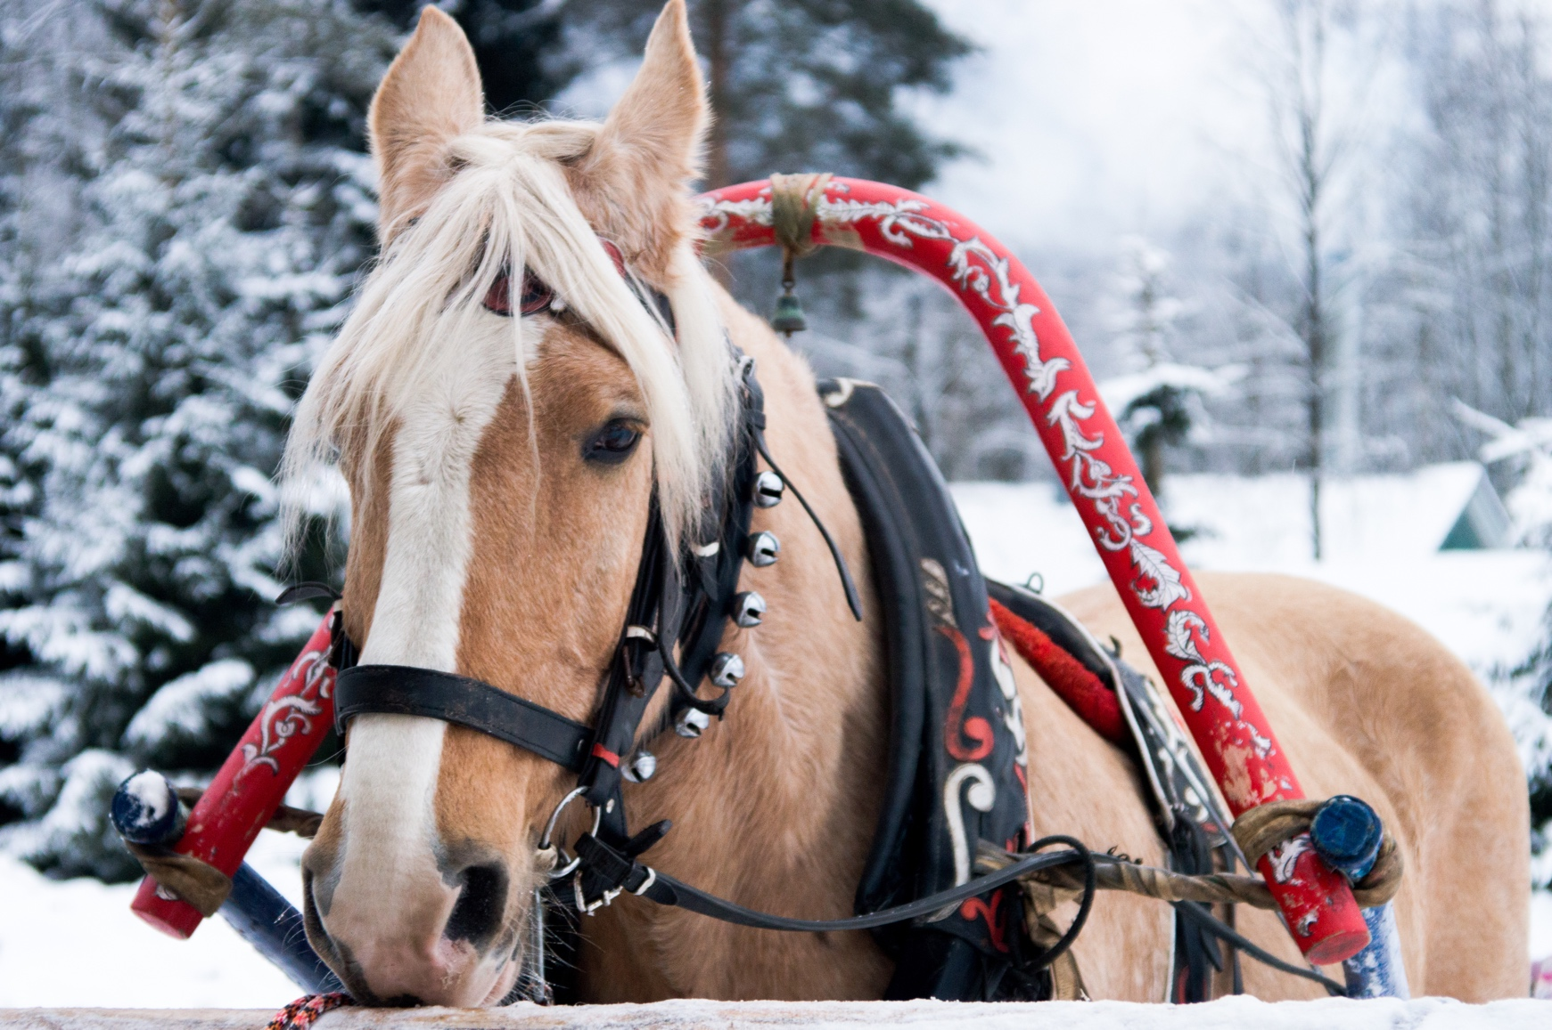
Bells on bobtail ring,
making spirits bright.

Slide 5
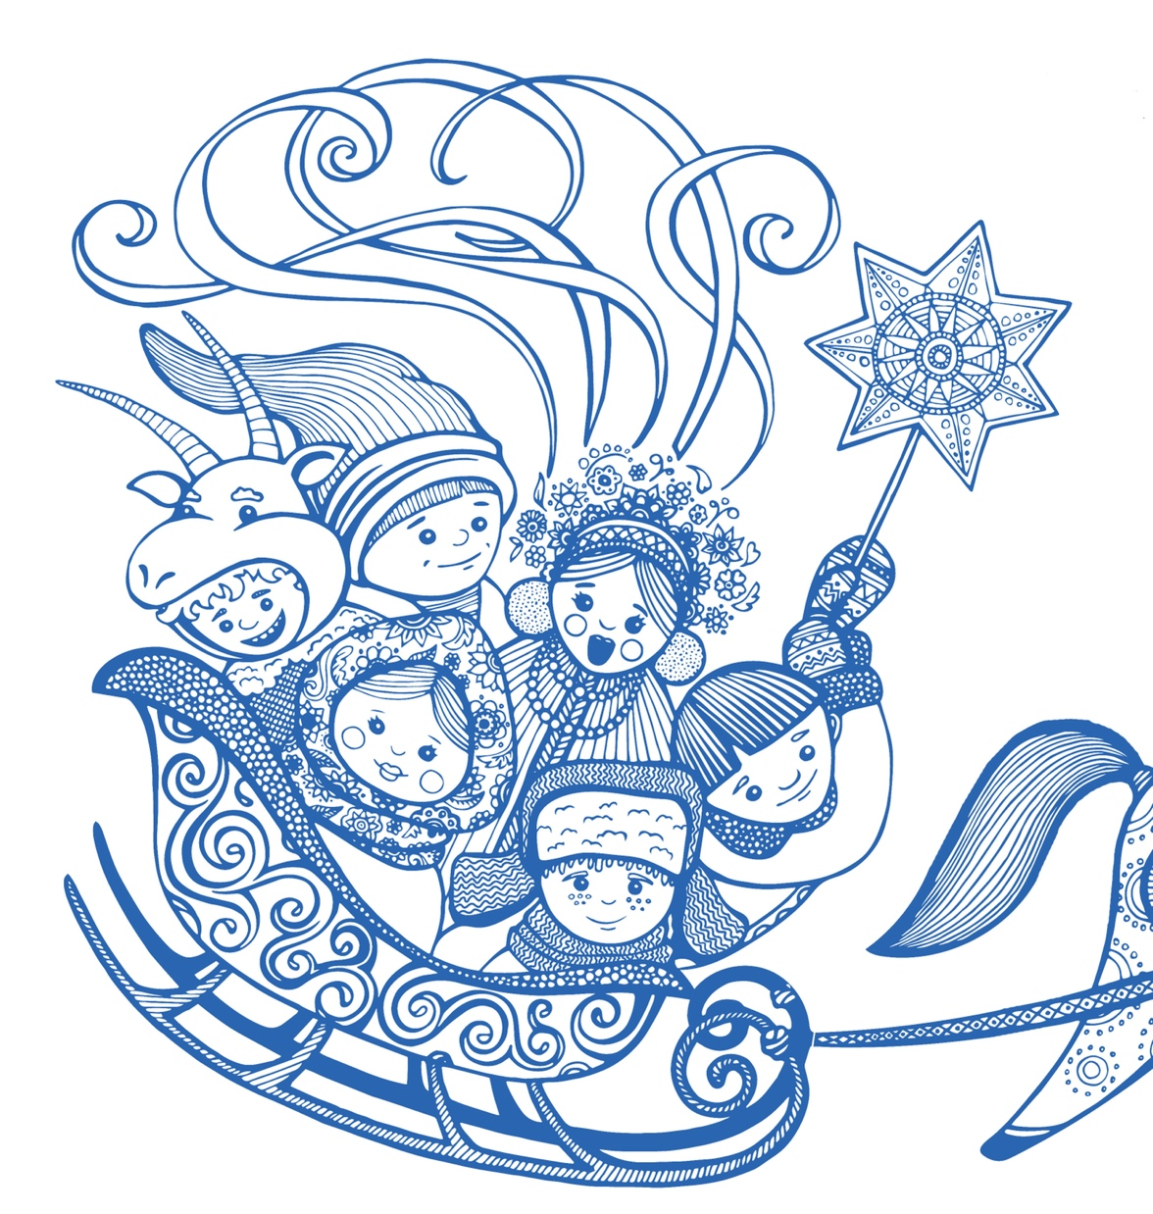
What fun it is to ride and sing
our sleighing song tonight!
Oh!

Slide 6

Jingle bells. Jingle bells.
Jingle all the way!

Slide 7
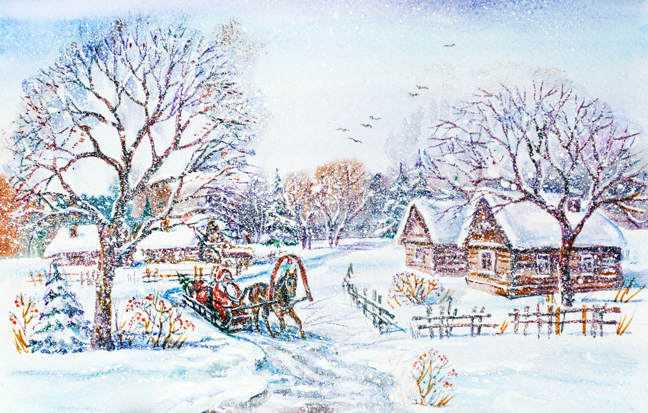
Oh, what fun it is to ride
in a one horse open sleigh!

Slide 8
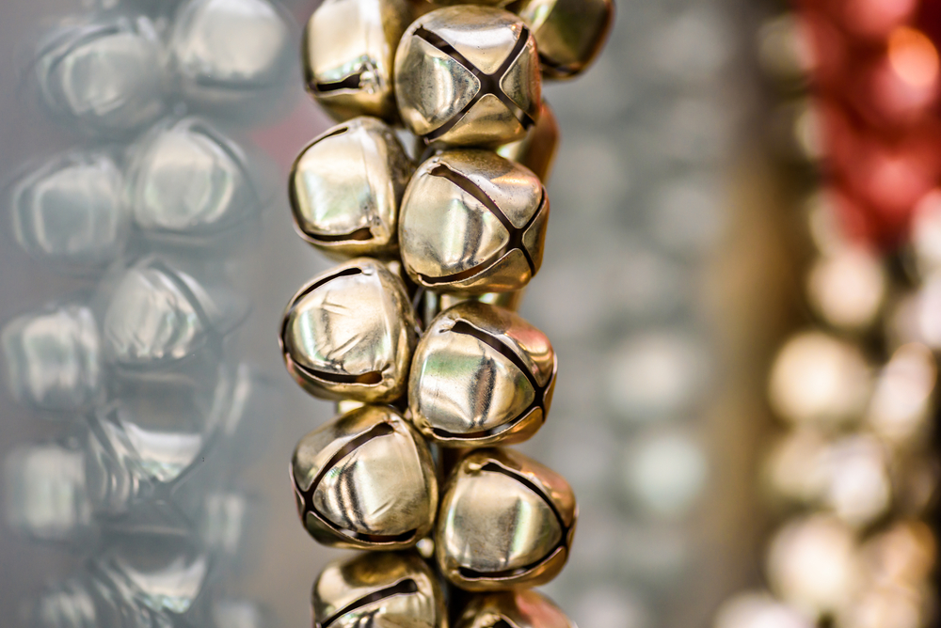
Jingle bells. Jingle bells.
Jingle all the way!

Slide 9
Oh, what fun it is to ride
in a one horse open sleigh!

Slide 10
Dashing through the (snow)
in a one horse open (sleigh).

Slide 11
O’er the fields we (go),
laughing all the (way).

Slide 12
Bells on bobtail (ring),
making spirits (bright).

Slide 13
What fun it is to (ride and sing)
our sleighing song (tonight)!
Oh!

Slide 14
Jingle (bells). Jingle (bells).
Jingle (all the way)!

Slide 15
Oh, what (fun) it is to (ride)
in a (one horse) open (sleigh)!

Slide 16
Jingle (bells). Jingle (bells).
Jingle (all the way)!

Slide 17
Oh, what (fun) it is to (ride)
in a one horse (open) sleigh!

Slide 18
Oh, what fun it is to ride
in a one horse open sleigh!
Jingle all the way!

