Slide 1



Slide 2
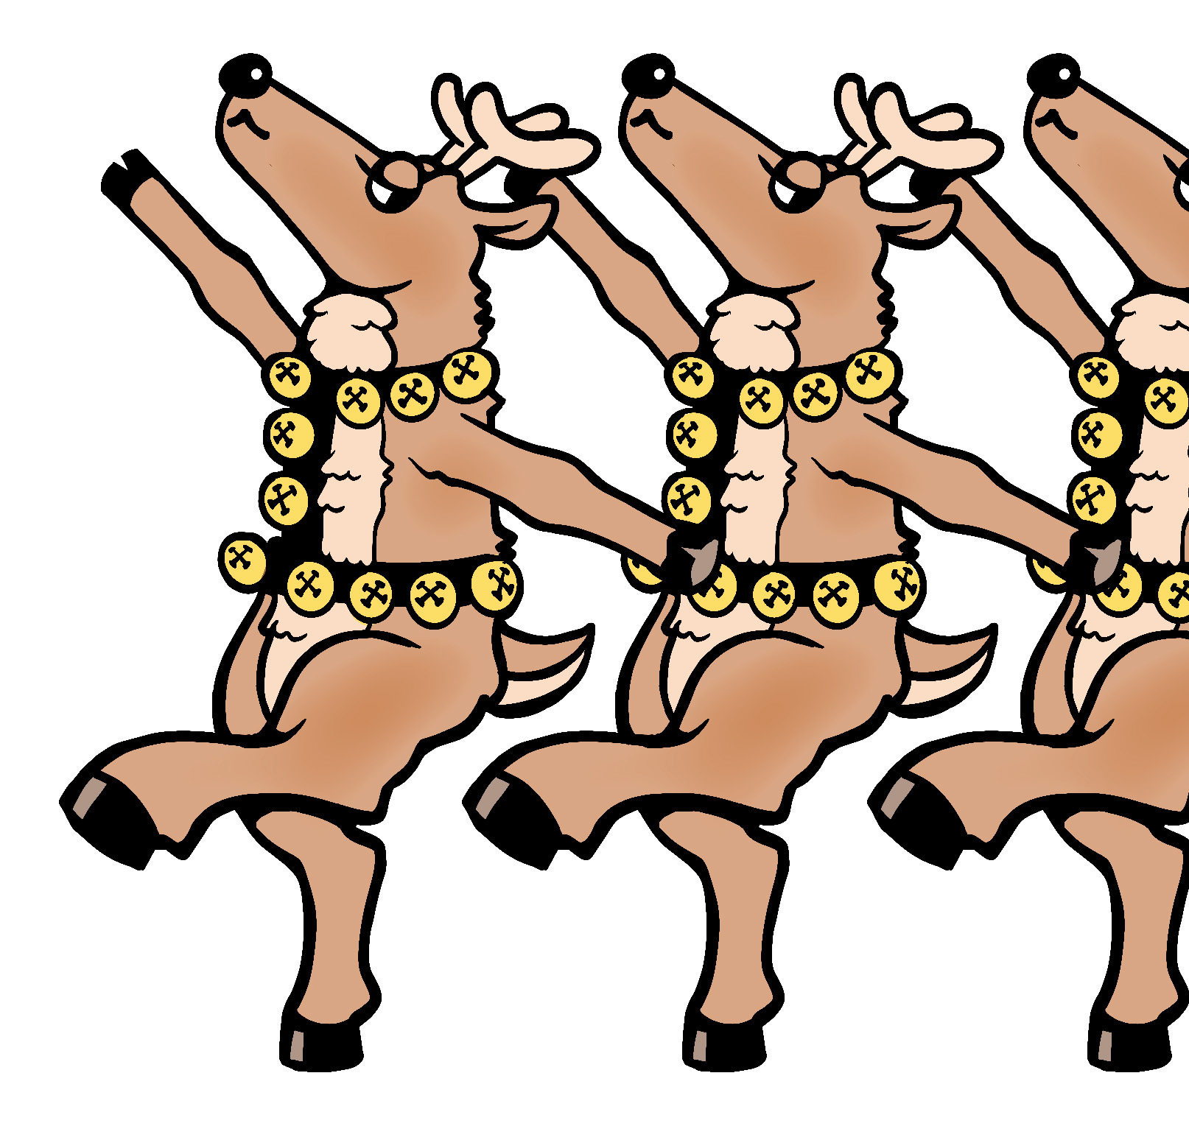
Do you hear the hoofin’
comin’ down the street?
Do you see the antlers
bouncin’ to the beat?

Slide 3
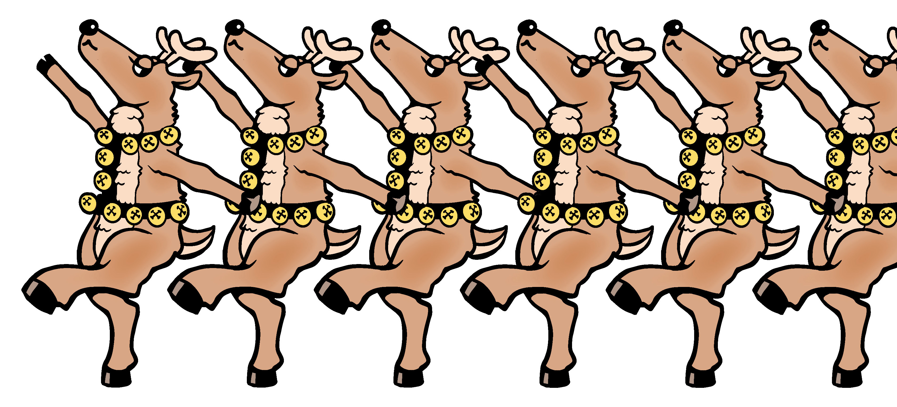
Do you hear the jingles
as they’re passin’ by?
Do you see the reindeer?
Now they’re gonna fly!

Slide 4
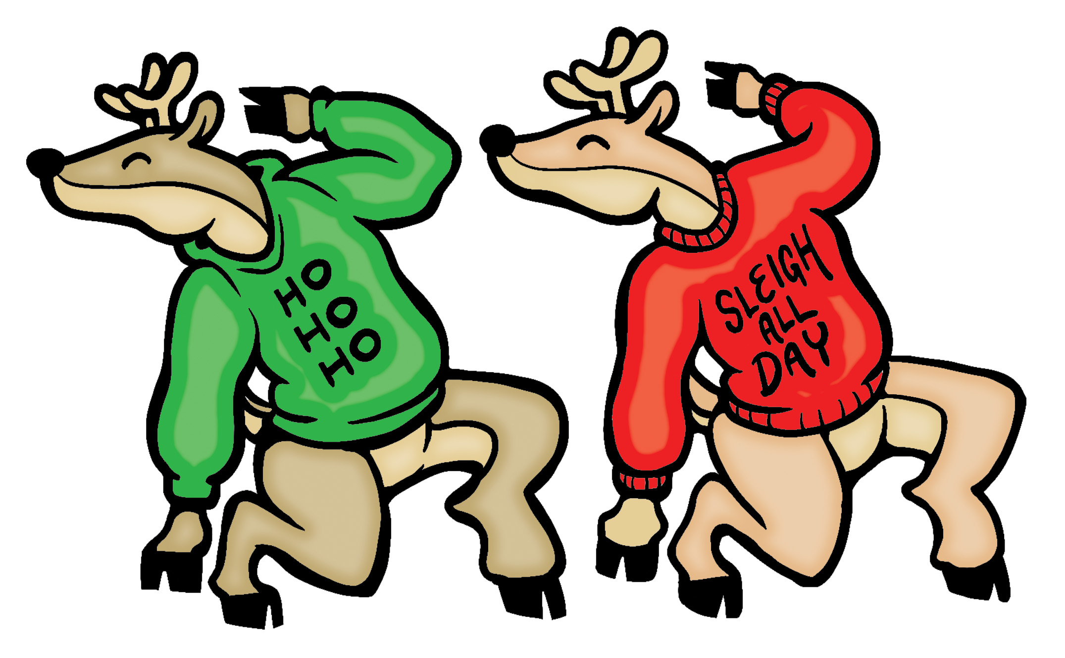
Here comes the reindeer parade,
reindeer parade, reindeer parade.
Here comes the reindeer parade.
Reindeer passin’ by.

Slide 5
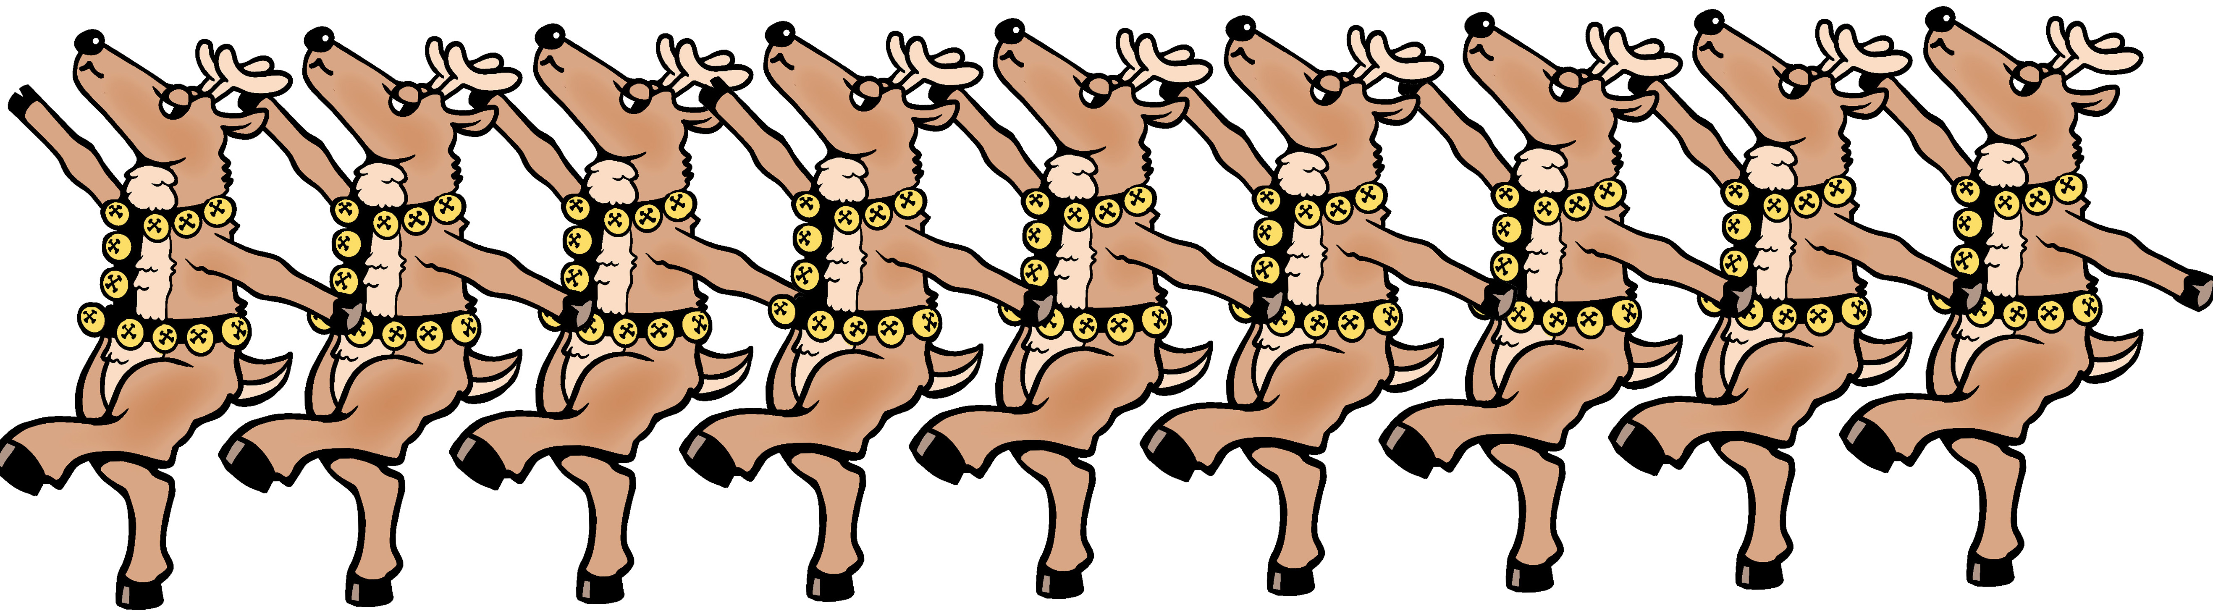
Do you hear the hoofin’
comin’ down the street?
Do you see the antlers
bouncin’ to the beat?

Slide 6
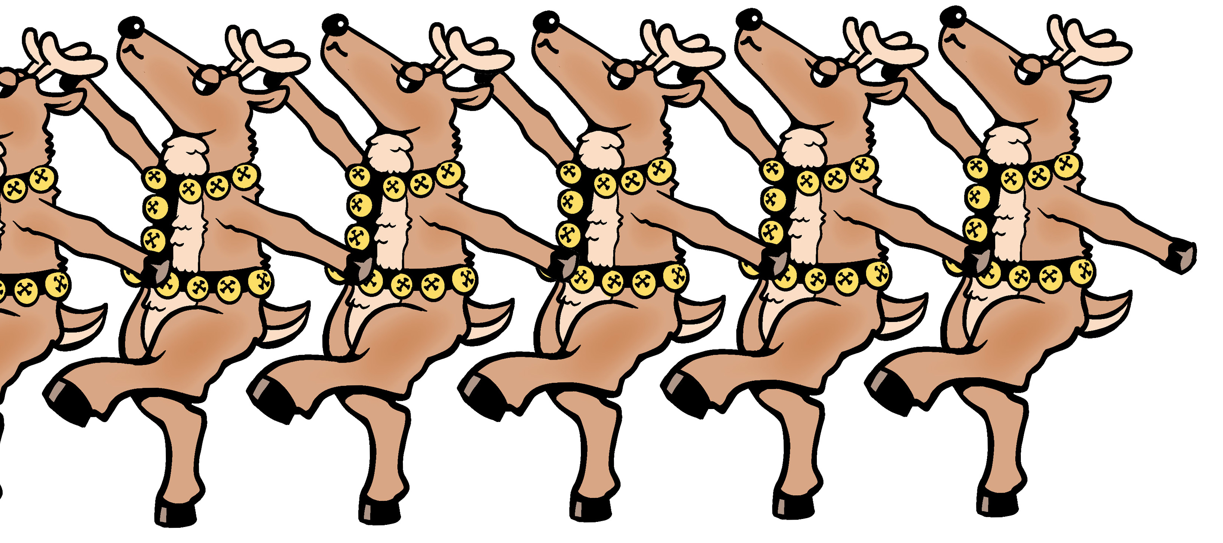
Do you hear the jingles
as they’re passin’ by?
Do you see the reindeer?
Now they’re gonna fly!

Slide 7
Here comes the reindeer parade,
reindeer parade, reindeer parade.
Here comes the reindeer parade.
Reindeer passin’ by.

Slide 8
Here comes the reindeer parade,
reindeer parade, reindeer parade.
Here comes the reindeer parade.
Reindeer passin’ by.

Slide 9
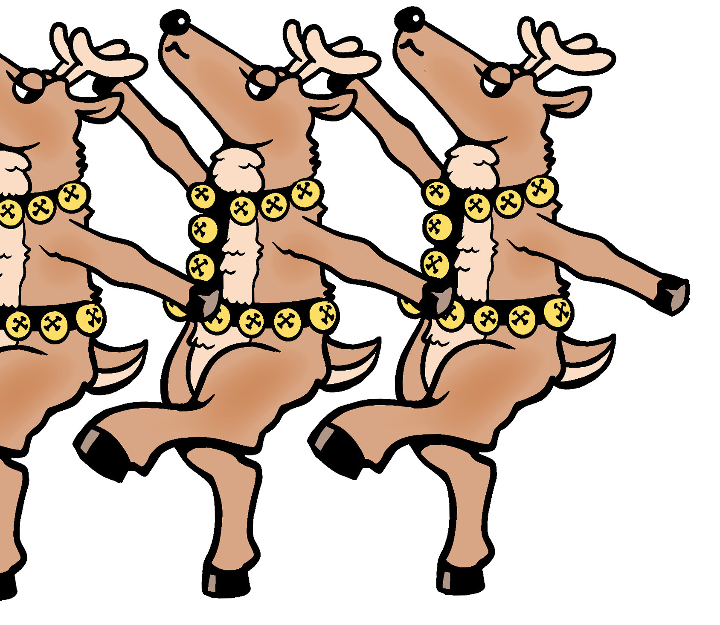
On the street and in the sky.
Oh, reindee--------
passin’ by.
Reindeer passin’ by.

