Slide 1
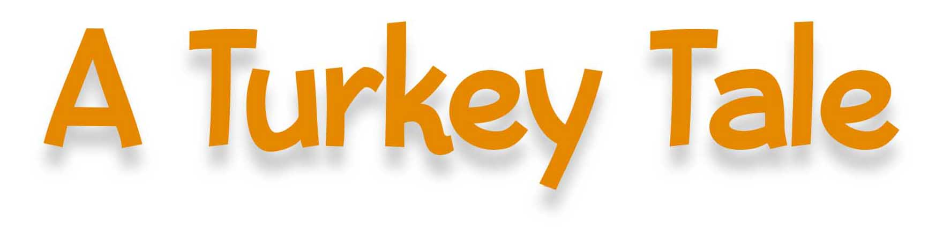


Slide 2
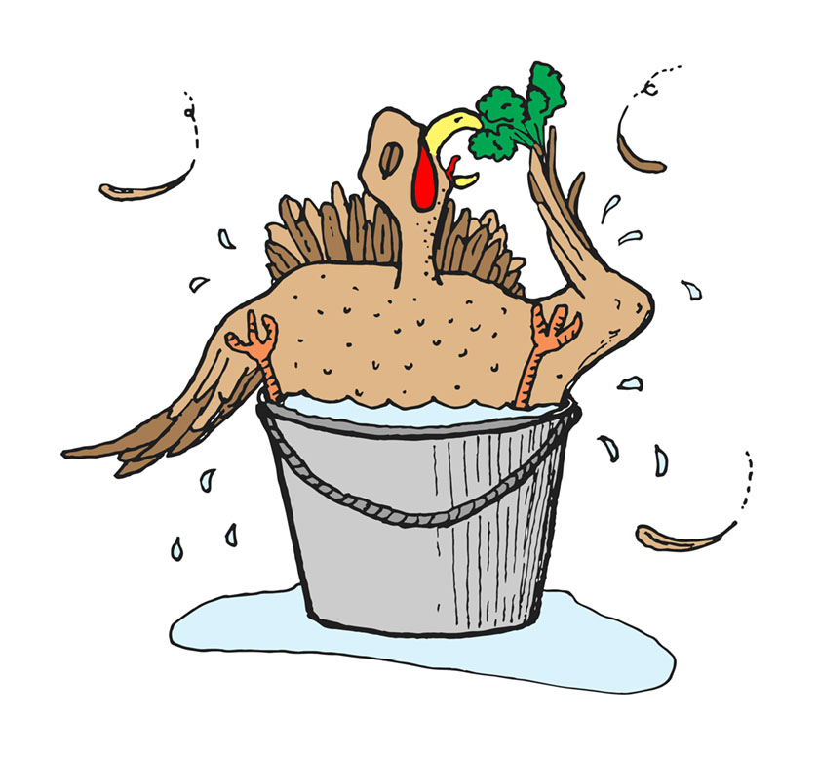
A turkey tripped on his tail.
(solo turkey)
His feathers flew when he fell. (solo turkey)

Slide 3
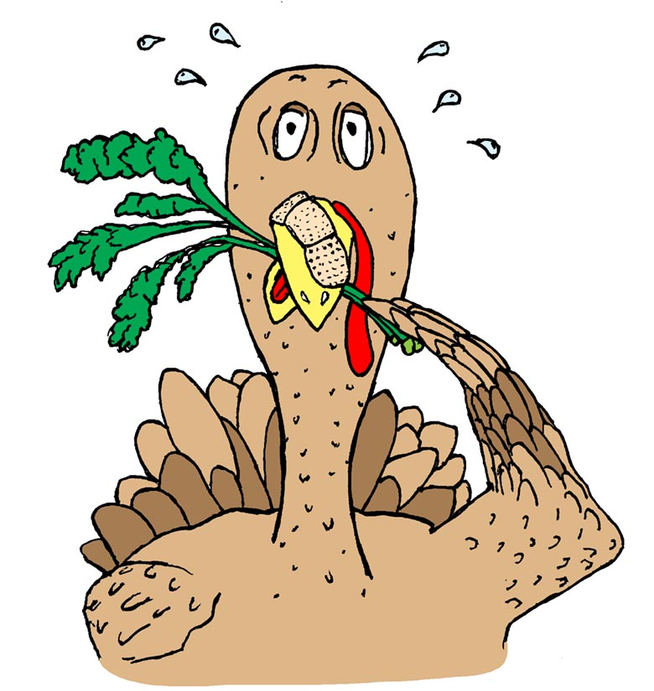
His wattle was muddled,
the turkey befuddled.
(solo turkey)
Oh, what a turkey tale.

Slide 4
The turkey nibbled some kale
(solo turkey)
to try to grow back his tail.
(solo turkey)

Slide 5
He pecked and he poked and
his beak was near broken.
(solo turkey)
Oh, what a turkey tale.

Slide 6
The turkey sat in a pail
(solo turkey)
to try to water his tail.
(solo turkey)

Slide 7
He thought he was better but
only got wetter.
(solo turkey)
Oh, what a turkey tale.

Slide 8
Now here’s the end of our tale.
(solo turkey)
This bird will probably fail.
(solo turkey)

Slide 9
’Cause though he is plucky,
he’s not very lucky.
(solo turkey)
Oh, what a turkey tale.

Slide 10
’Cause though he is plucky,
he’s not very lucky. (solo turkey)
Oh, what a turkey tale!
(solo turkey)

Slide 11
A tale!
(turkeys gobble after, ad lib)

