Slide 1
THE SEVEN HABITS OF
HIGHLY EFFECTIVE TEENS
BY SEAN COVEY
South Sumter Middle School
M&M Time 2017-2018

Slide 2
“It’s not the mountain we conquer, but ourselves.”
Edmund Hillary
(first person to climb Mount Everest)

Slide 3
SEVEN HABITS OF
HIGHLY EFFECTIVE TEENS
HABIT 3: PUT FIRST THINGS FIRST

Slide 4
HABIT 3: PUT FIRST THINGS FIRST
Define you mission and goals in life.
Definition:
  Learning to prioritize and manage your time so that your first things come first, not last. Putting things first also can help you overcome your fears and be strong during hard moments.
Habit 3 can be referred to as the habit of willpower (the strength to say yes to your most important things) and the won’t power (the strength to say no to less important things and to peer pressure).

Slide 5
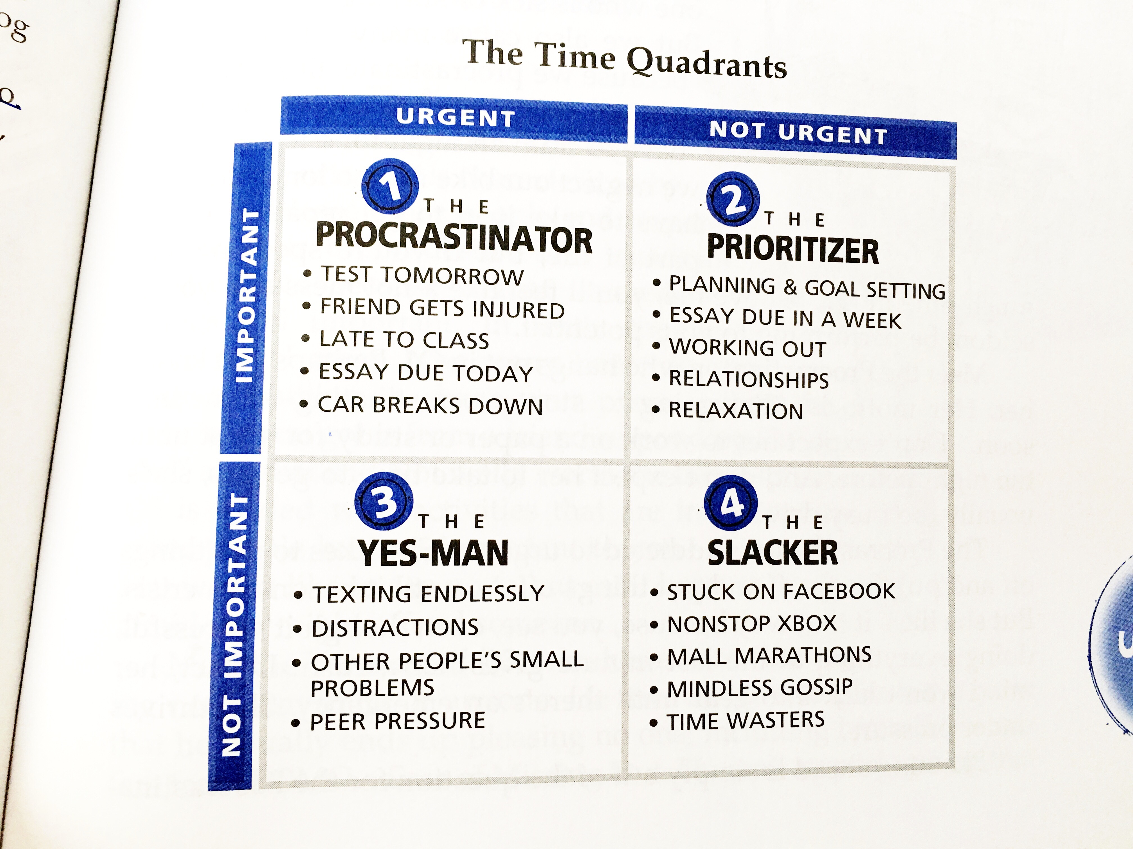
THE TIME QUADRANTS

Slide 6
QUADRANT 1: THE PROCRASTINATOR
  Things are both urgent and important.
  Addicted to the sense of urgency. Likes to put things off until it becomes a crisis.
    How many of you did this with your science fair project??
  Results of too much time in Q1:
    Stress and anxiety
    Feeling burnt out
    Mediocre performance

Slide 7
QUADRANT 2: THE PRIORTIZER
Things that are important but not urgent.
Plan Weekly
  Step 1: Identify “Big Rocks” for the week
    Study for test
    Finish essay in ELA
    Attend basketball game
    Attend family party

Slide 8
QUADRANT 2: THE PRIORITIZER
Step 2: Block Out Time for Your Big Rocks
  Put these on your calendar first and block out those times.
  You can refer to this as “making a reservation”
  The rest of your daily activities (pebbles) will fill in as well and if they don’t, WHO CARES?
Step 3: Schedule everything else
  Here’s where the pebbles go.
  Upcoming events, and activities, vacations, concerts, birthdays.

Slide 9
QUADRANT 3: THE YES-MAN
These things are urgent, but not important.
  This quadrant is deceptive because urgent, immediate things feel important. Truth is, they’re not.
    How often do you check your phone when a text comes through only to find it’s a friend responding “K” or “LOL”
The Yes-Man has a hard time saying no to anything or anyone.
This person tries to please everyone and usually ends up pleasing no one, including himself.
Suffers from FOMO – Fear of Missing Out

Slide 10
QUADRANT 4: THE SLACKER
These activities are neither urgent nor important.
This person loves anything in excess
  Too much TV, napping ,video games.
Results of living in this quadrant:
  Lack of responsibility
  Guilt
  Flakiness
  Missing out on adventures

Slide 11
VIDEO
https://www.youtube.com/watch?v=pG81D2OMpcI

Slide 12
DISCUSSION
What quadrant are you most often in?
What are your big rocks for the upcoming week?
What are you pebbles?
Take out your planners and write block out time for your big rocks.

