Slide 1




Slide 2
School Loop
Teacher Web Sites
The following information will soon appear on each P.E. teachers’ webpage.

Slide 3
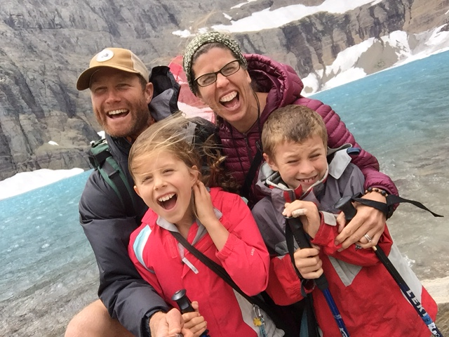
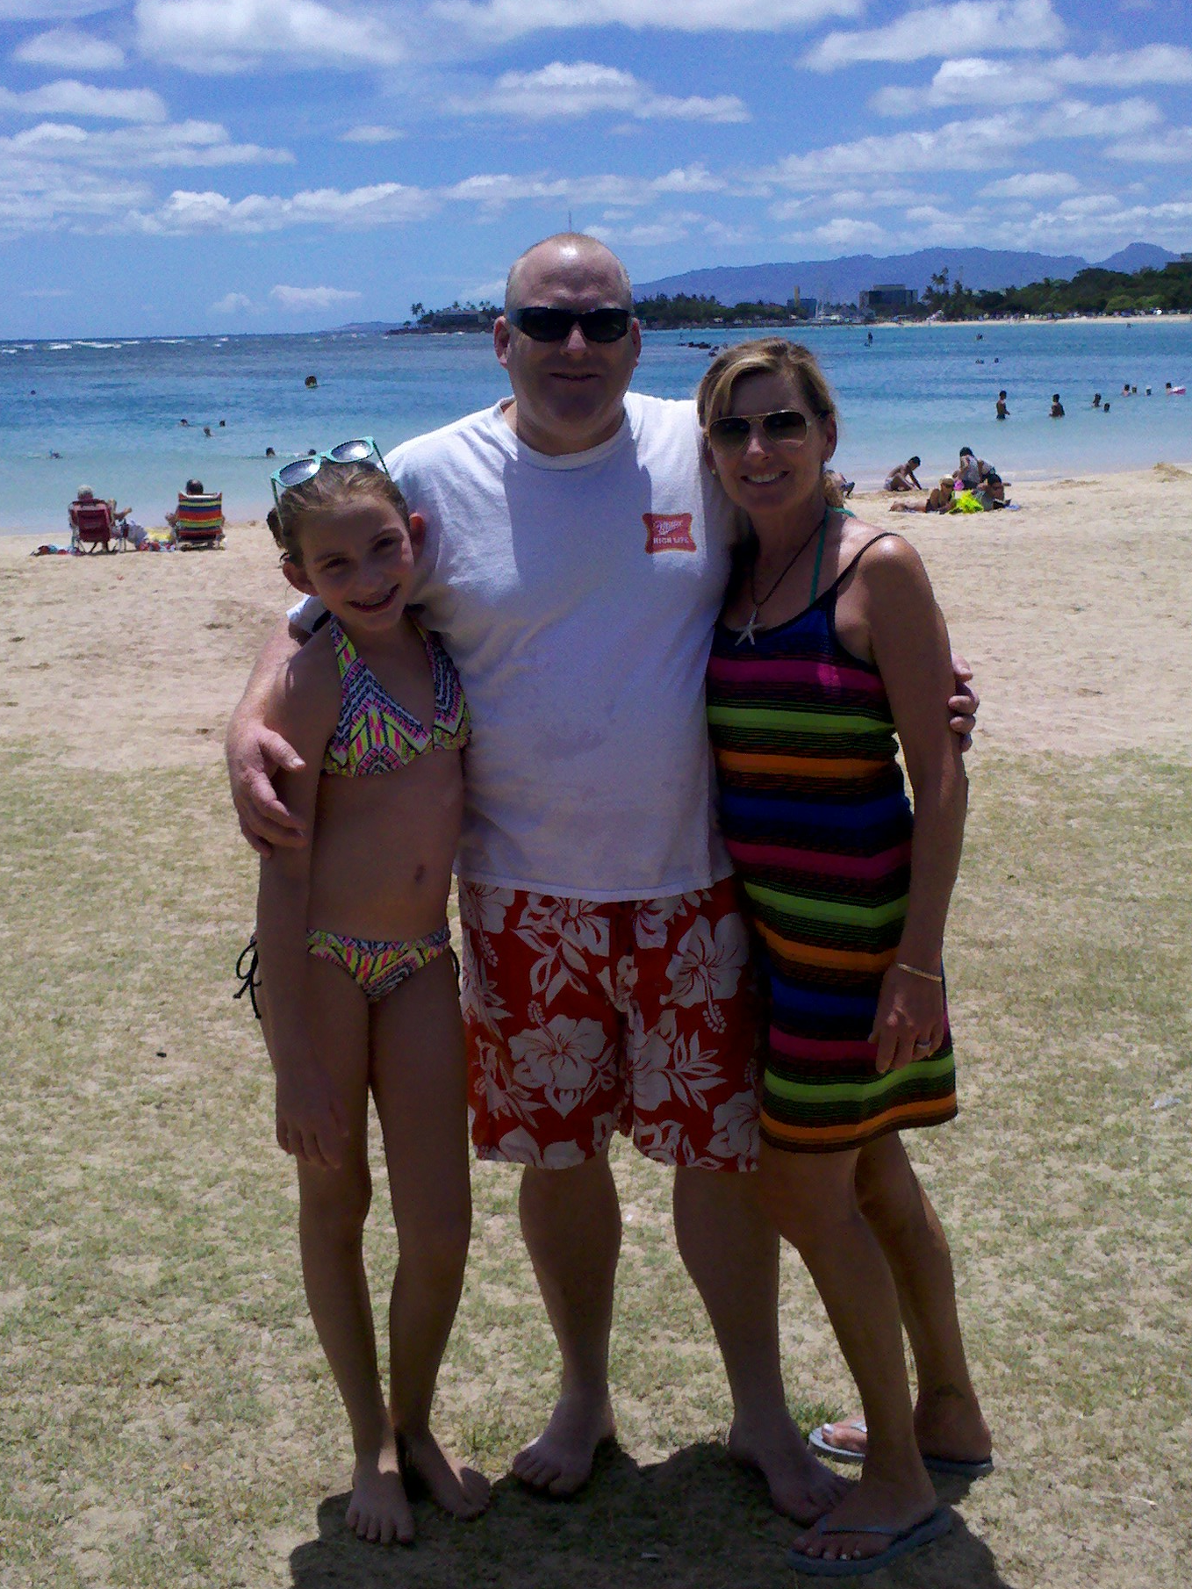
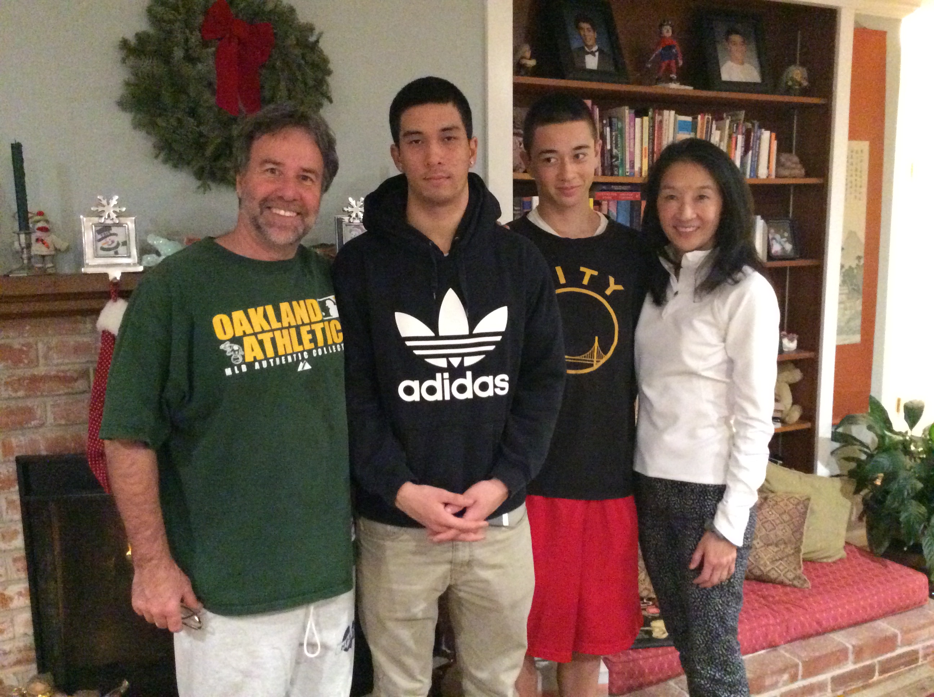
Patrick
Chamberlain 11 years experience
Degree(s): B.A. - Advertising, Texas Tech University
Credential(s): Physical Education, Sonoma State University
--------------------------------------------------------------------------------------
Leilani Siri 14 years experience
Degree(s): B.S. - Exercise, Nutrition, Kinesiology, Hayward State
M.A. – Education, Dominican College
Credential(s): Physical Education & Health, Dominican College
--------------------------------------------------------------------------------------
Borg Klein 16 years experience
Degree(s): B.A. - Psychology & Sociology, Pitzer College
M.A. - Curriculum Design, Dominican University
Credential(s): Multiple Subjects & P.E., Dominican College

Slide 4

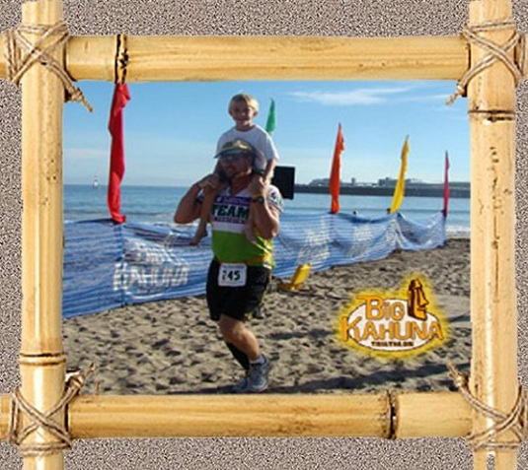
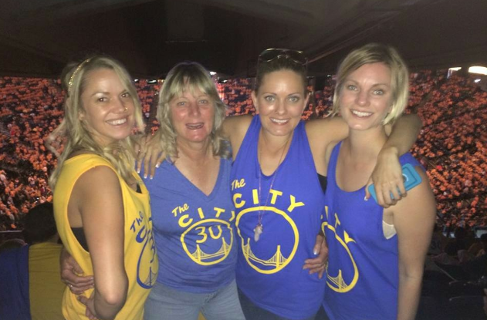
Eugene Lang 24 years
Degree(s): B.A. - Psychology, U.C. Santa Cruz
M.A. - Educational Administration, SF State Univ.
Credential(s): Physical Education & Science, Dominican College
Administrative Services
--------------------------------------------------------------------------------------
Mike Runyeon 24 years experience
B.A. - Organizational Psych, U.C. Santa Barbara
M.A. - Educational Administration, SF State Univ.
Credential(s): Physical Education & History , Dominican College
Administrative Services
--------------------------------------------------------------------------------------
Stephanie
Stenmark 25 years experience
Degree(s): B.S. Physical Education, Cal Poly San Luis Obispo
Credential(s): Physical Education
San Francisco State University
Adaptive Physical Education, Sonoma State Univ.

Slide 5
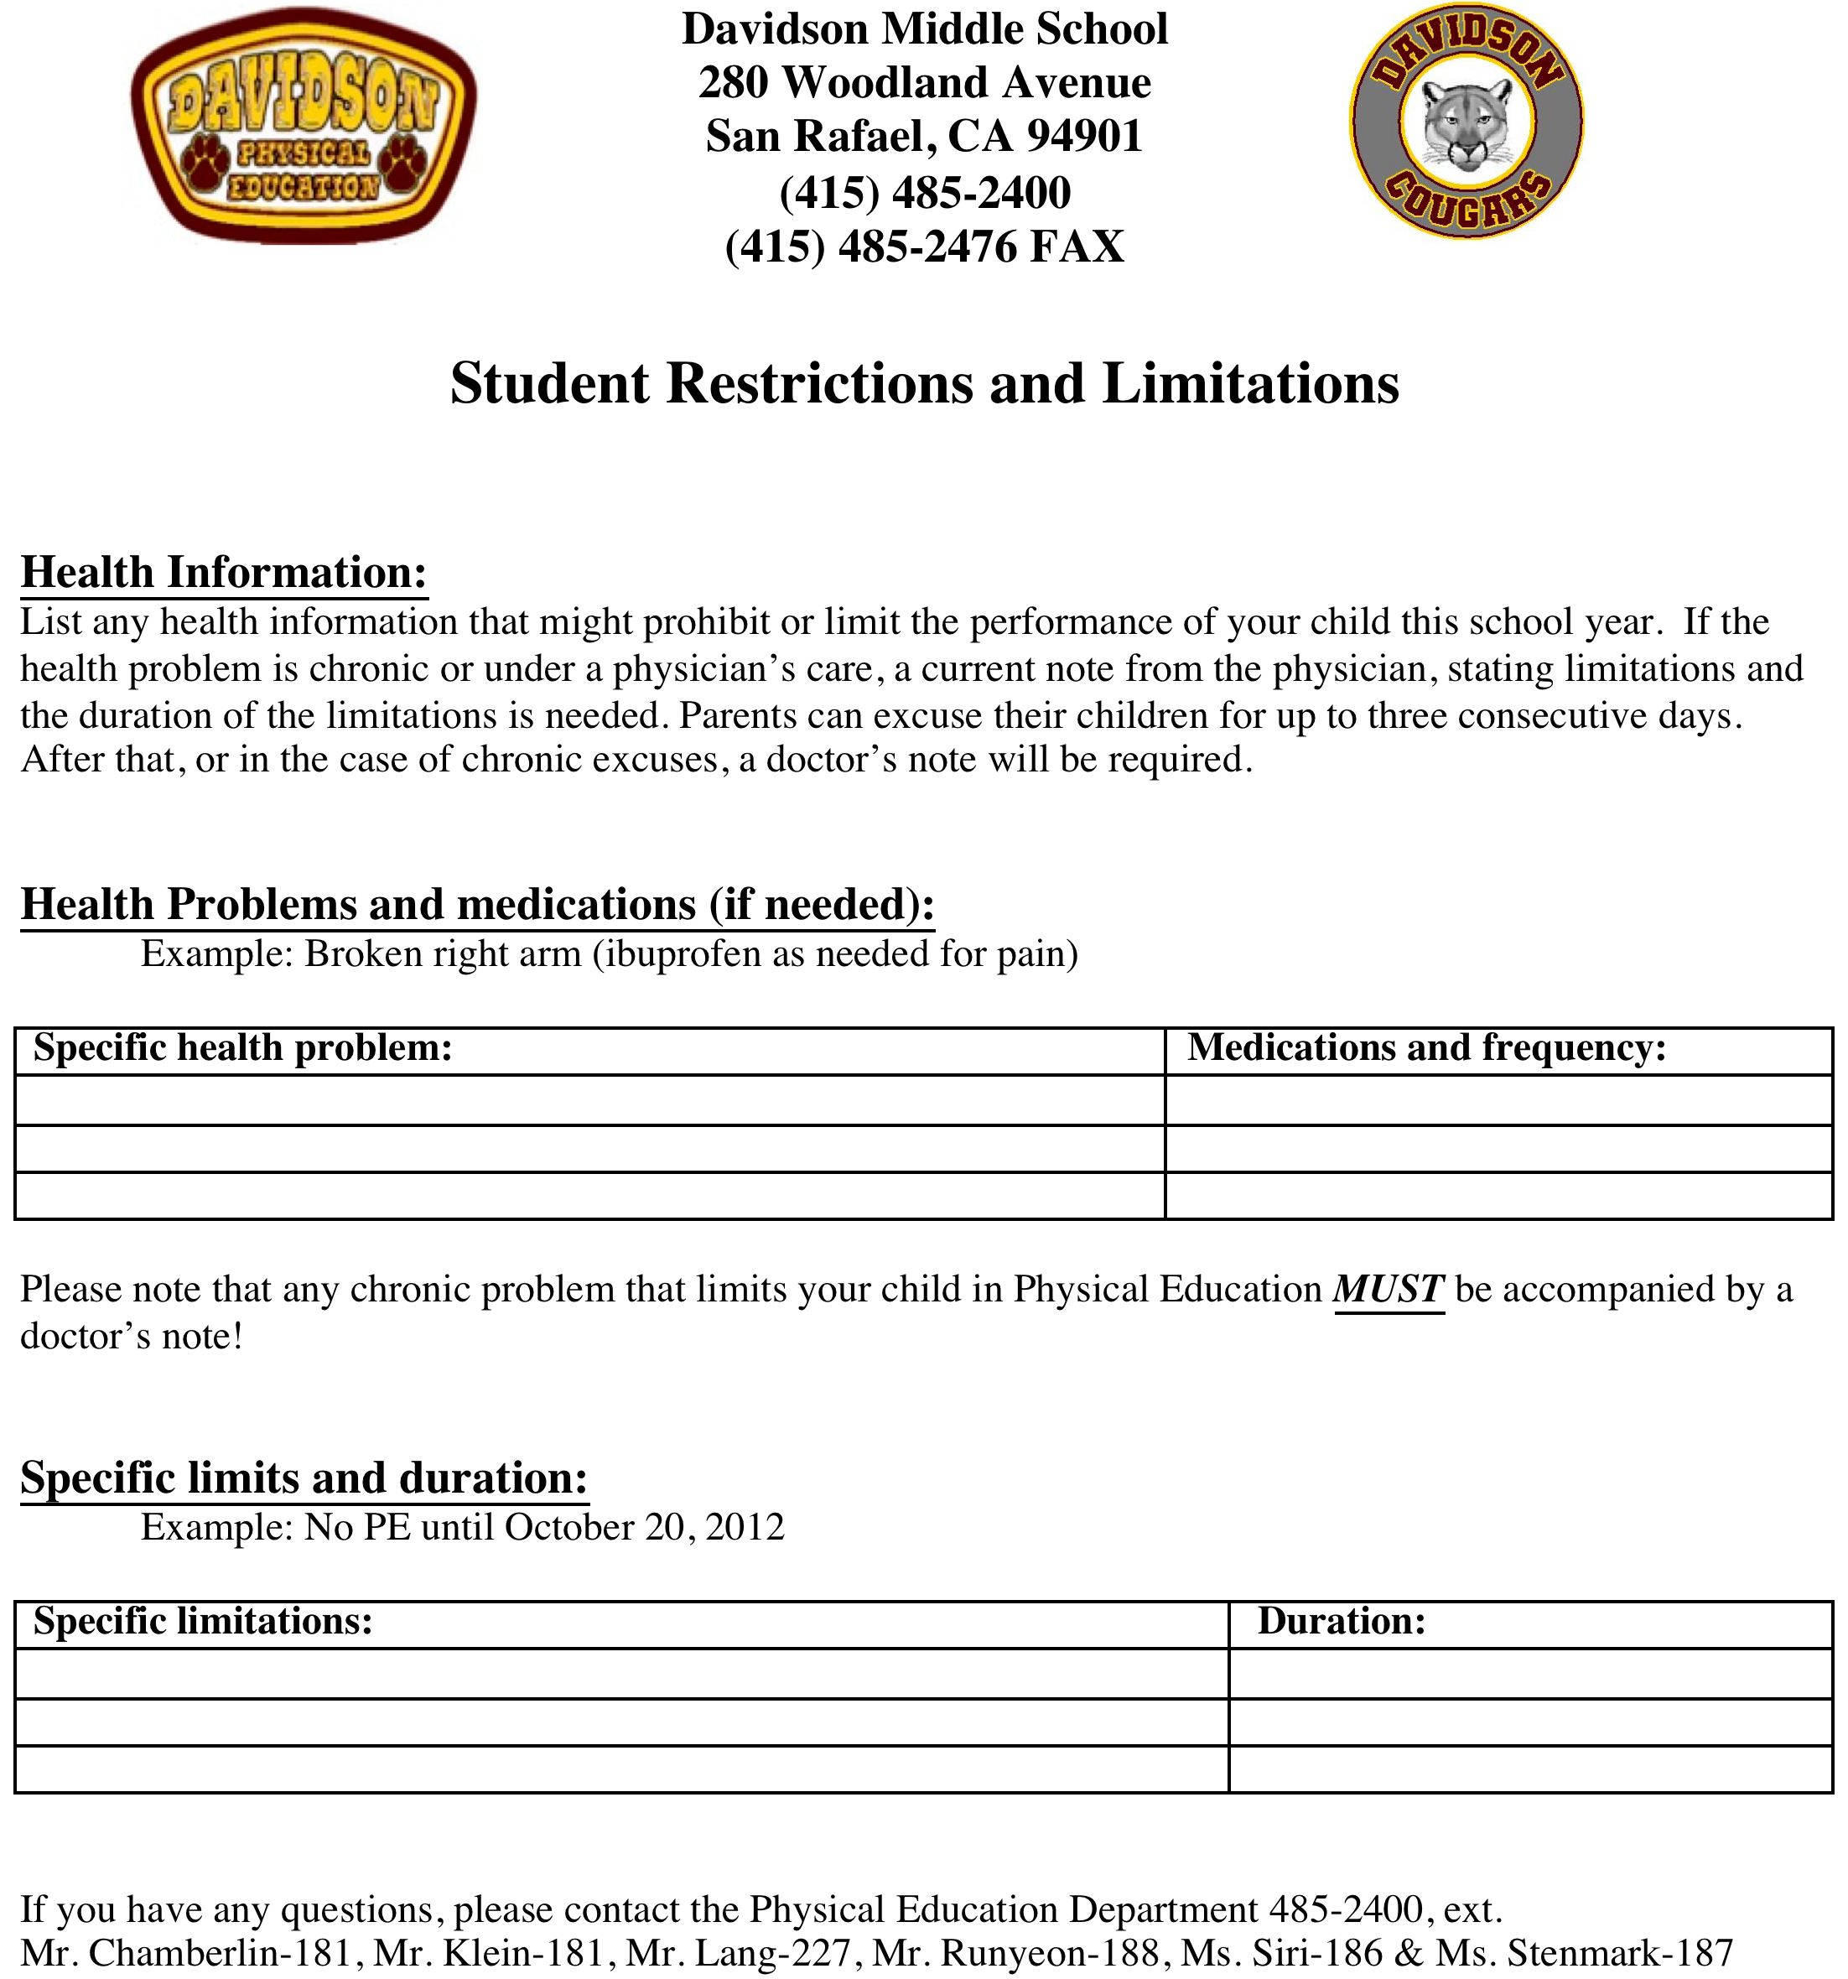
Health
Form

Slide 6
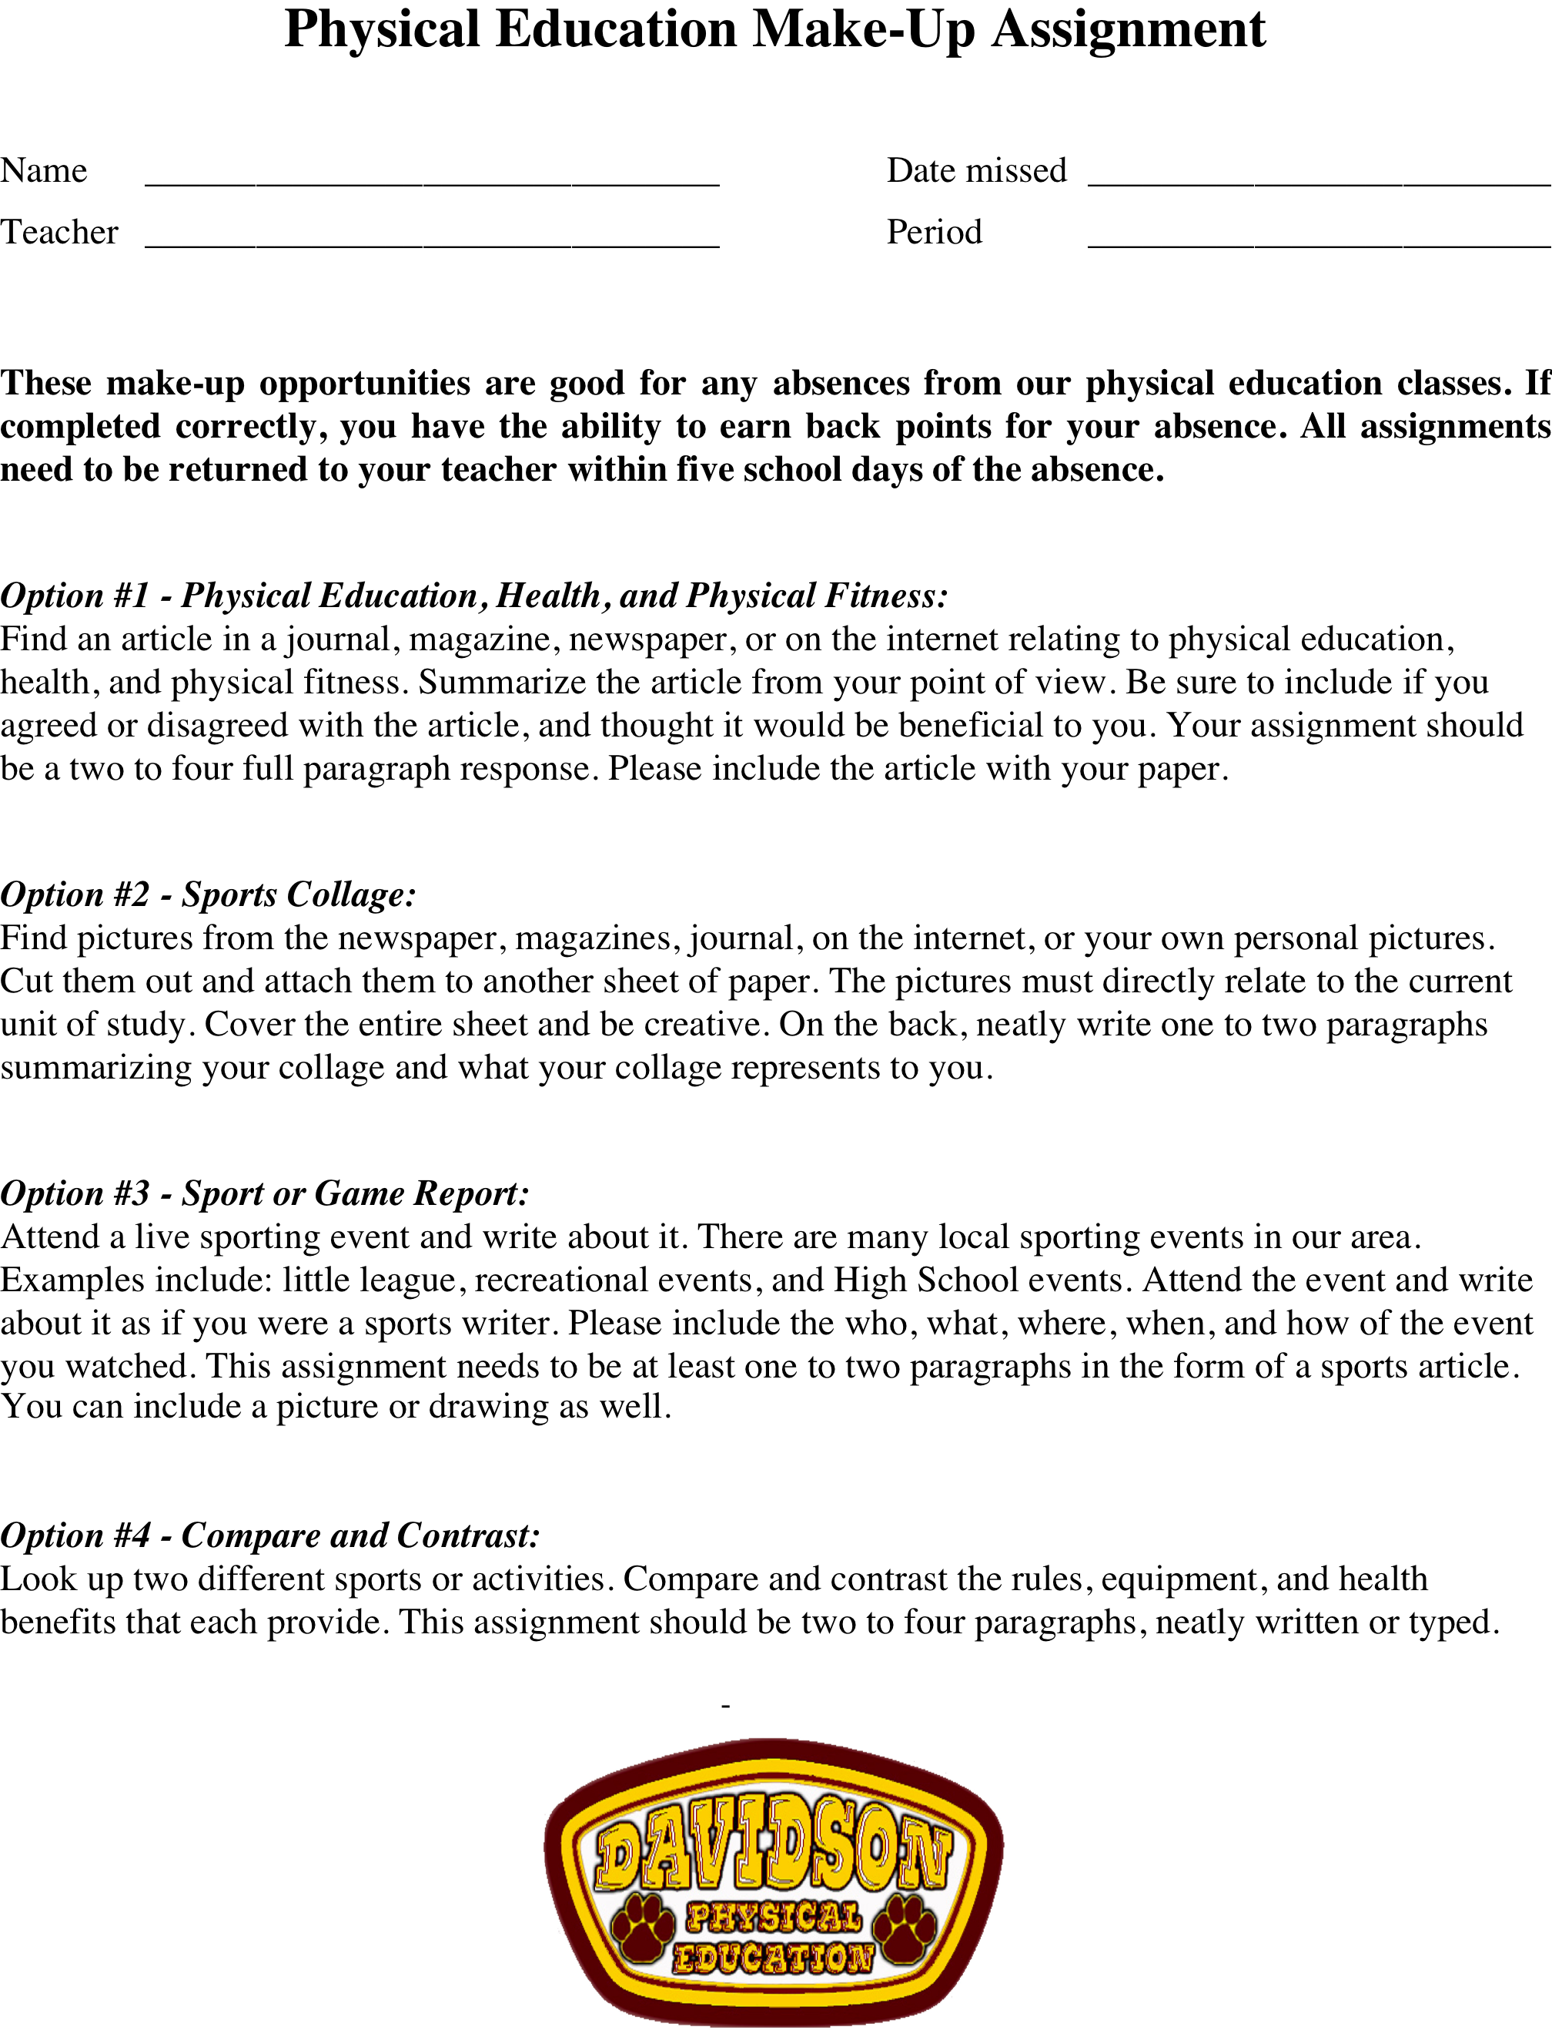

Slide 7
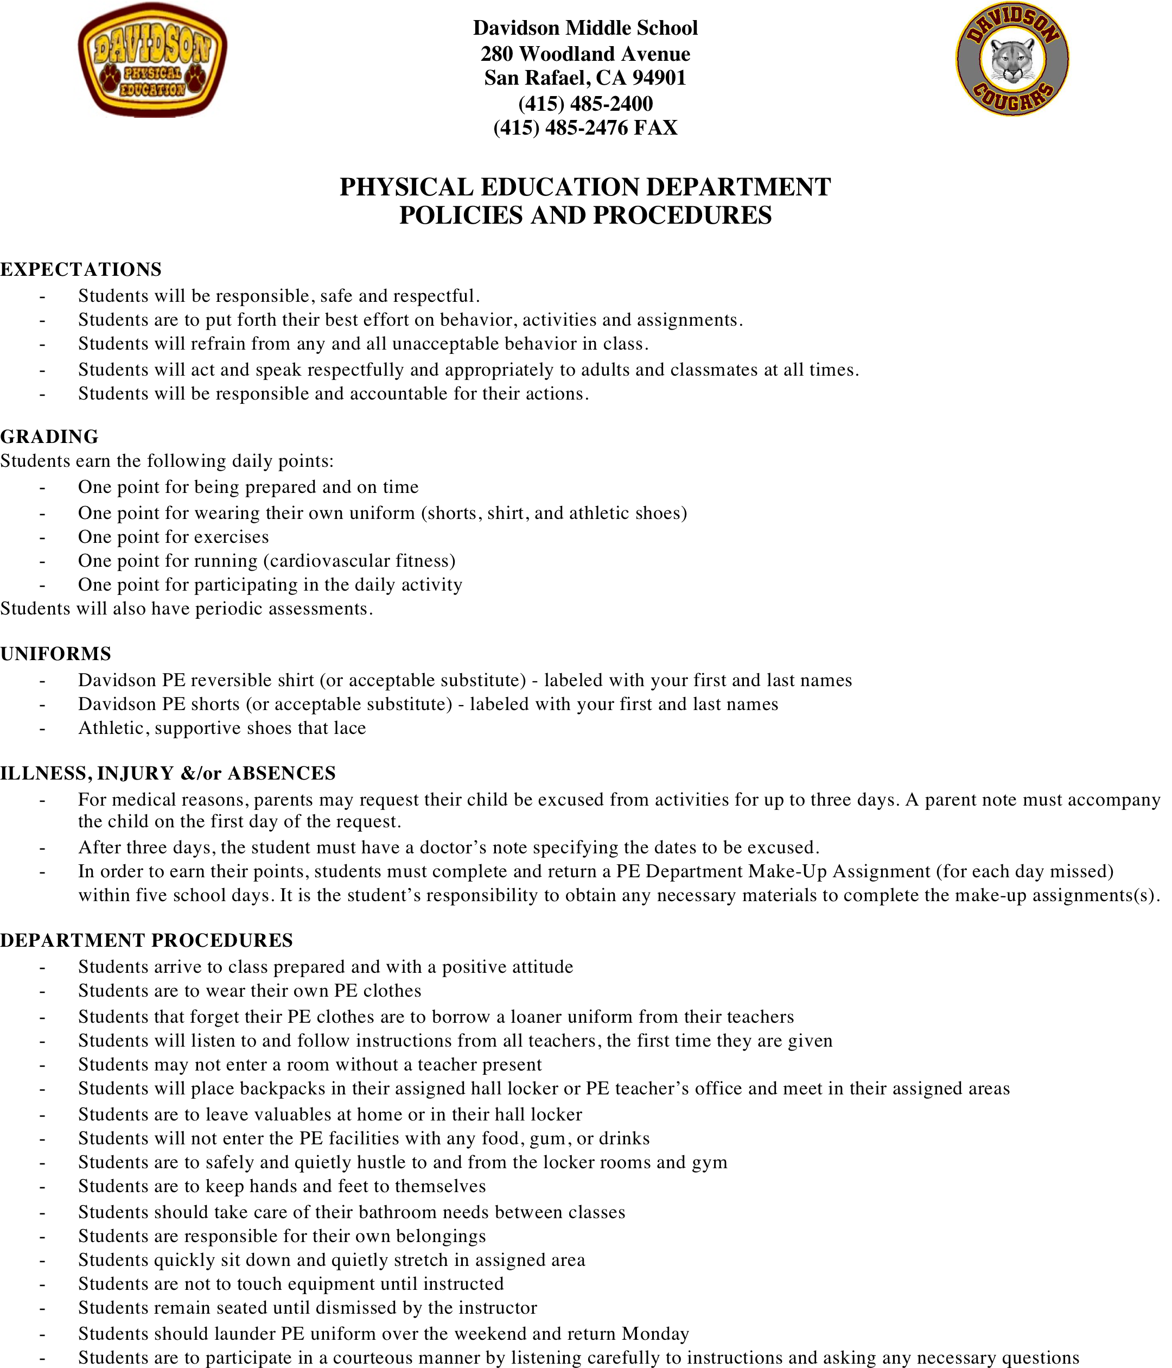
PE
Policies
&
Procedures

Slide 8
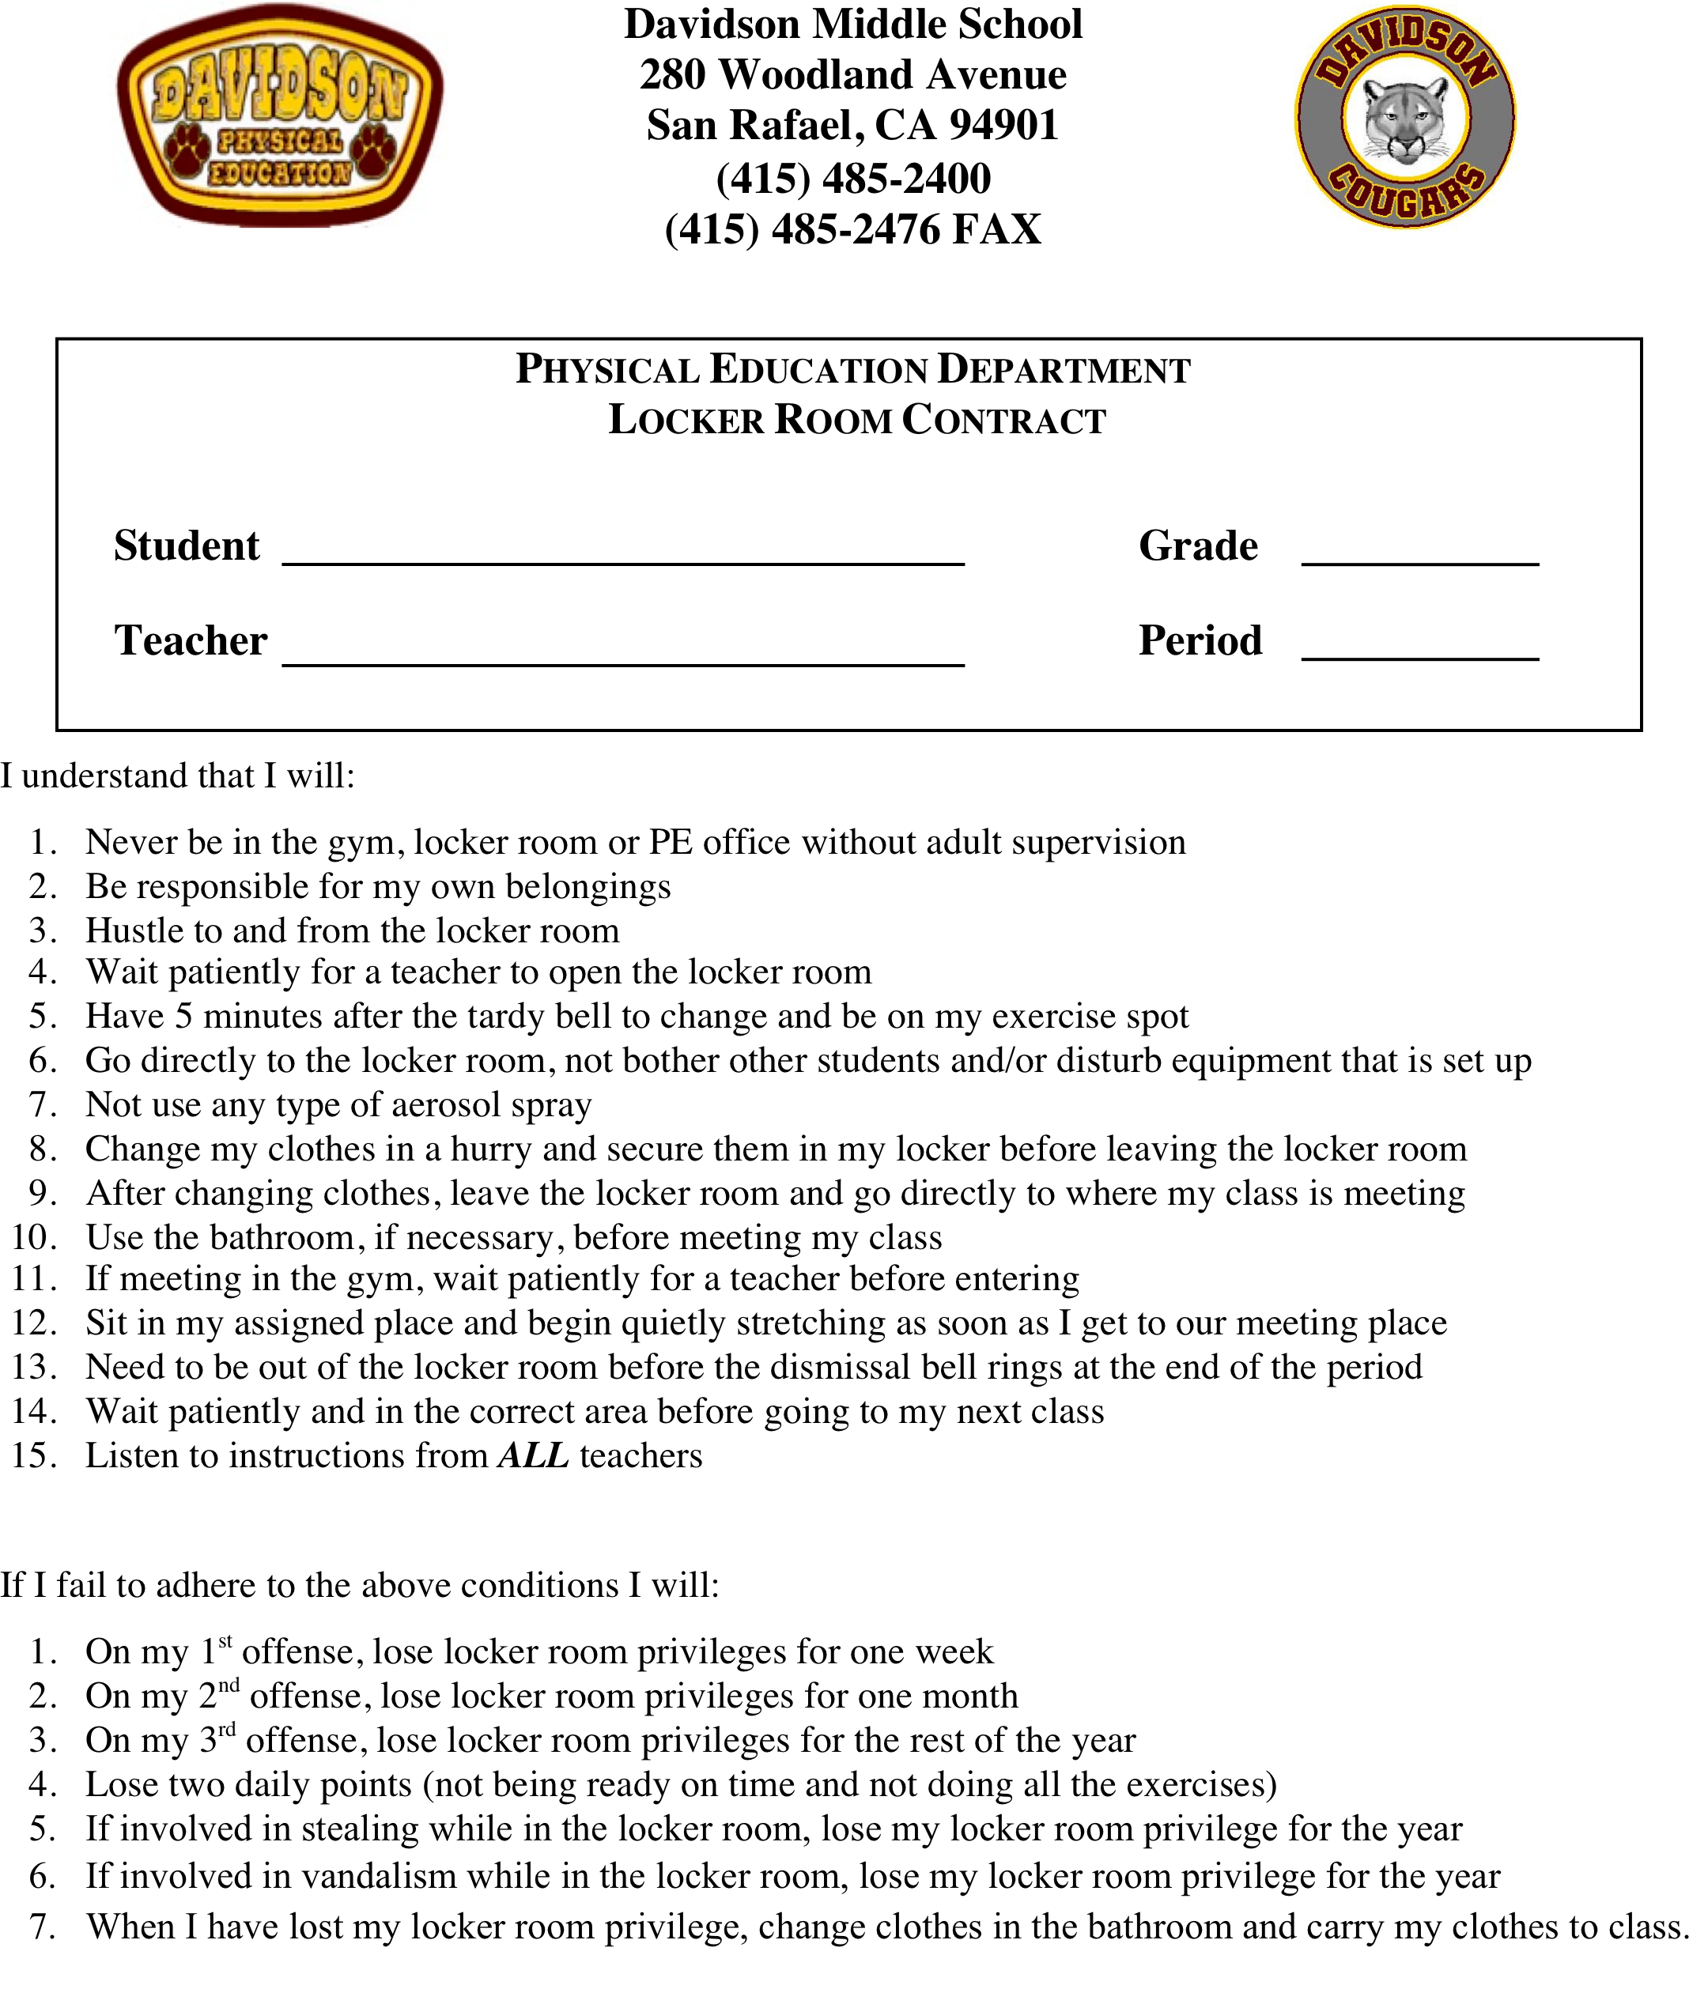
Locker Contract

Slide 9

Lock & Locker
Policy
Students that have a hall locker are not assigned a P.E. locker. Everyone will have one or the other.
The reasons are as follows:
There are not enough locks & lockers for each student to have his/her own
The locker rooms were not designed for the amount of students now enrolled
Students will get in and out of the locker rooms in a more efficient manner
The locker rooms are kept l0cked during class and no students can enter without a teacher being present!

Slide 10


Slide 11
UNITS
Fall Semester
Fitness everyday
Volleyball
Soccer
Football
Ultimate Frisbee
Hockey
Basketball
Team Handball
Speedball
Zumba
Bike Presentation & Clinic
Spring Semester
Fitness everyday
Nutrition
Personal Fitness Plan
Tumbling
Dance
Track & Field
Softball
Lacrosse
Rugby
Racquet Sports
Yoga

Slide 12
Themes & Concepts
Movement Concepts
Assessment – Find and describe a picture of a professional athlete using proper movement concepts
2. Manipulative Skills
Assessment – Describe in writing how to perform one of the Manipulative Concepts
3. Rhythmic Skills
Assessment – Develop and perform a tumbling routine

Slide 13
Themes & Concepts
4. Self-Responsibility
Assessment – Regarding athletics, identify one personal strength and one personal weakness; describe, in writing, how you can help your team be successful.
5. Social Interaction
Assessment – Write a reflective paragraph describing how you are, and could become a better, teammate
6. Group Dynamics
Assessment – Create and teach the class a new game

Slide 14
After School
Sports
Fall
Cross country (boys & girls)
Volleyball (girls only)
Flag football (coed)
Winter
Basketball (boys & girls)
Wrestling (coed)
Spring
Tennis (coed)
Track & Field (boys & girls)

Slide 15

Other Announcements:
1. Supplies – If you so desire, please take an Stickie Note
    Feminine Products
    Kleenex
    Ice Packs
    Dixie cups (for ice)
    Hand sanitizer
    Bandages (Costco size)
    Paper – White & Multi Colored Reams
    Gift Cards:
    iTunes, Target, Staples, Office Depot, Jackson’s Hardware, Rafael Lumber
    2. Washington DC Meeting in October; date TBD
    3. SF Giants vs. Padres – Sept. 11th
    SF Giants vs. A’s – Sept. 25th , see Mr. Klein for more info!

Slide 16
Thank You

