Slide 1
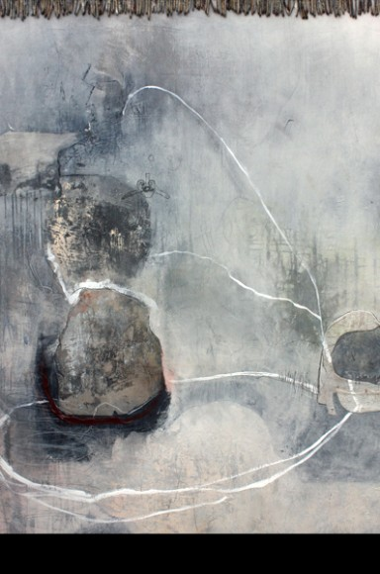
Mark,
Meaning,
Metaphor

Slide 2
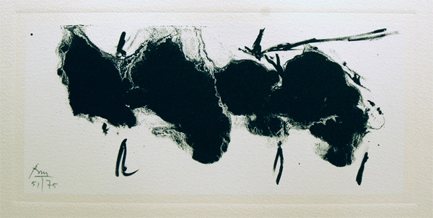
Robert Motherwell

Slide 3
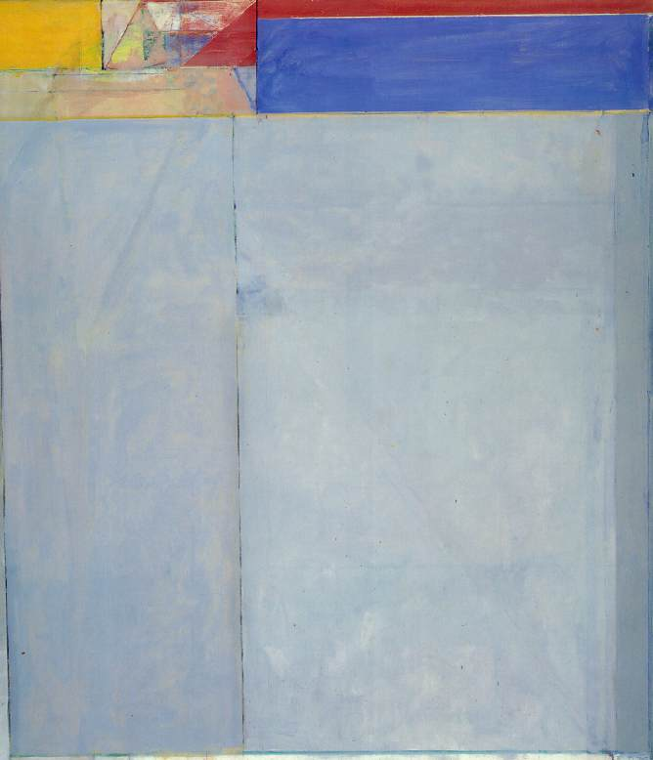
Richard Diebenkorn

Slide 4
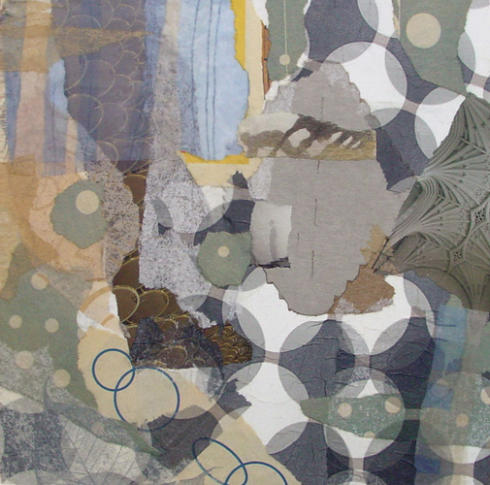
Janice McDonald

Slide 5
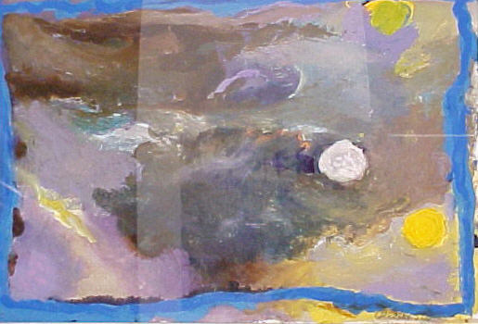
Jules Olitski

Slide 6
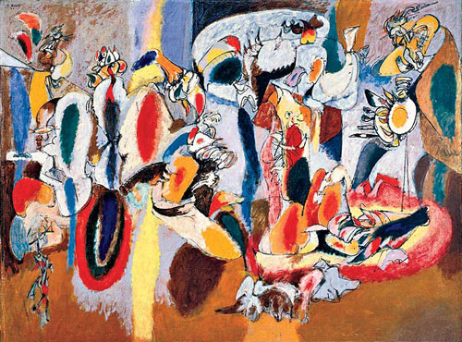
Ashile Gorky

Slide 7
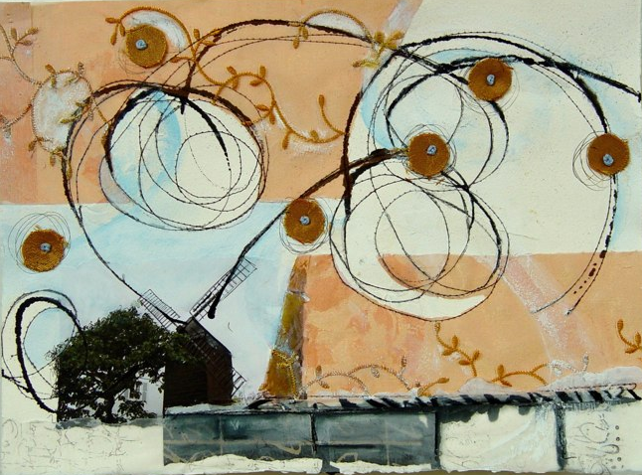
Clare Murray Adams

Slide 8
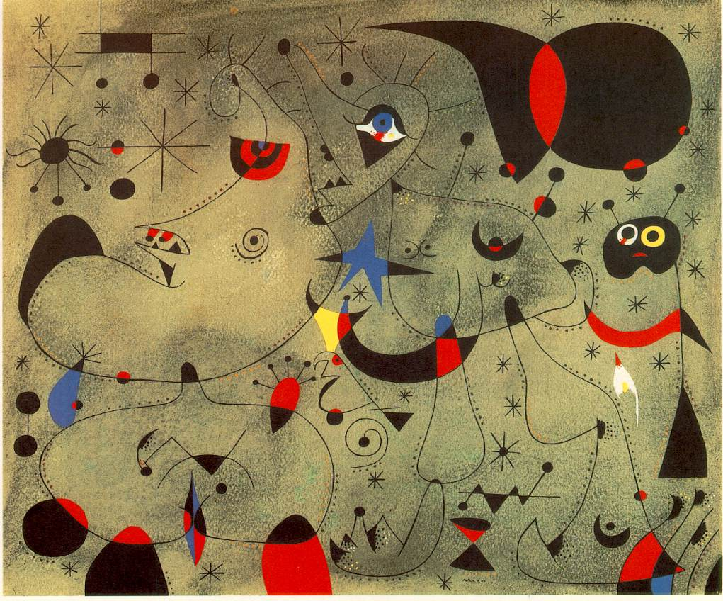
Joan Miro

Slide 9
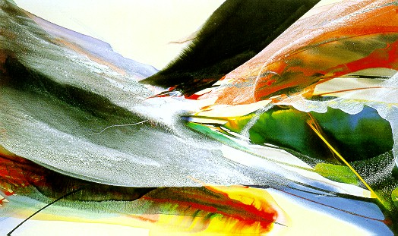
Paul Jenkins

Slide 10
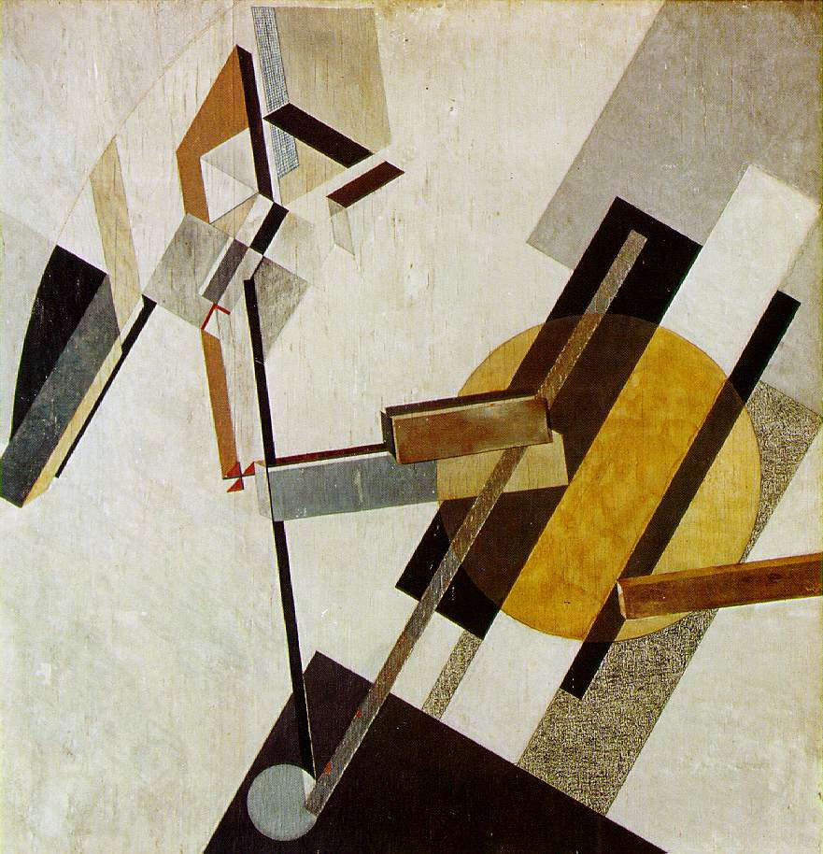
El Lissitsky

Slide 11
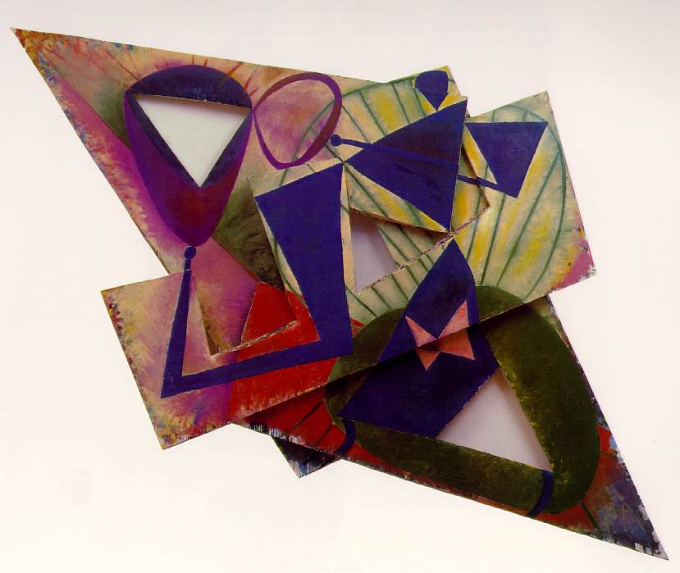
Elizabeth Murray

Slide 12
Eydi Lampasona

Slide 13
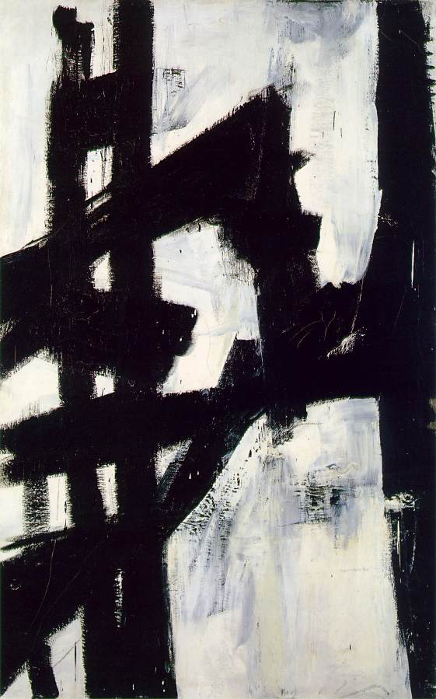
Franz Kline

Slide 14
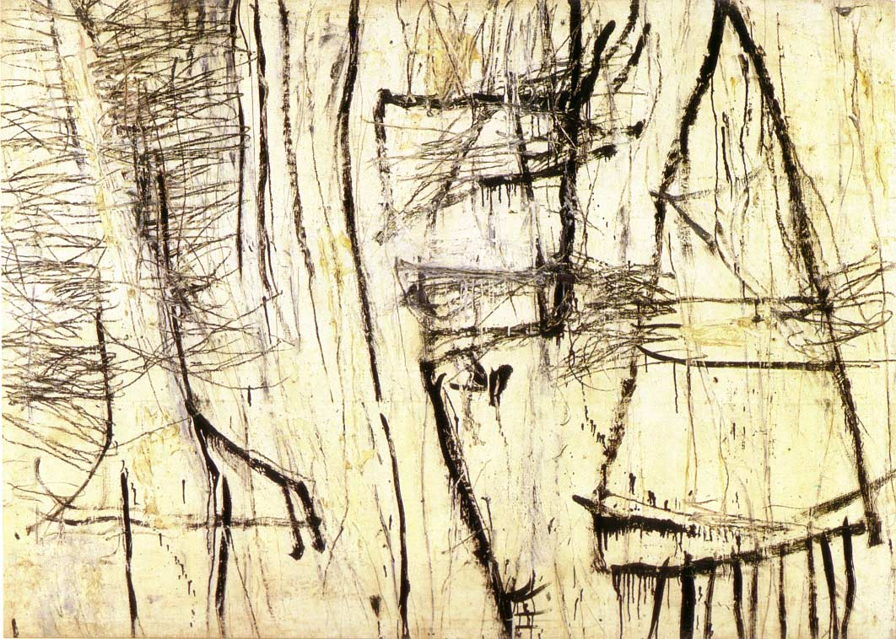
Cy Twombly

Slide 15
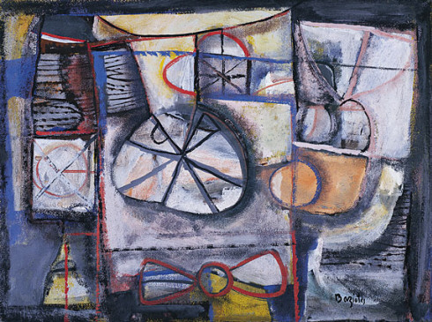
William Baziotes

Slide 16
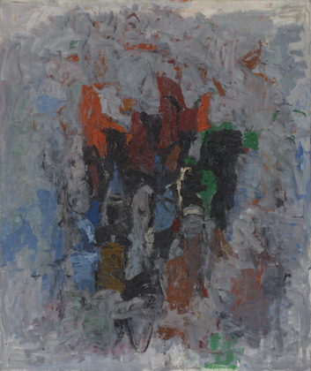
Philip Guston

Slide 17
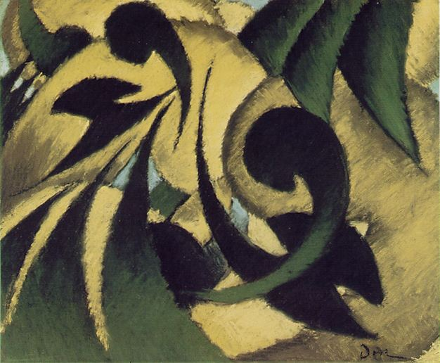
Arthur Dove

Slide 18
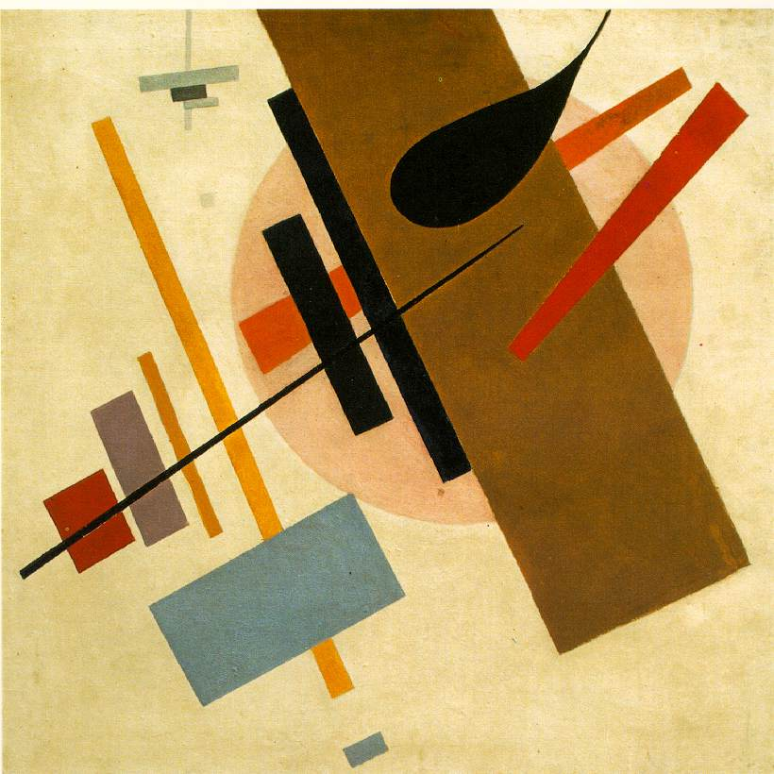
Kasmir Malevich

Slide 19
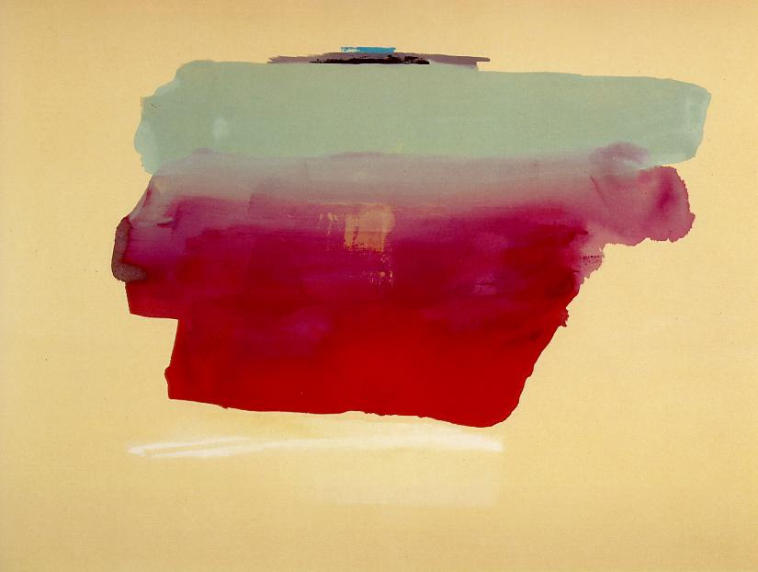
Helen Frankenthaler

Slide 20
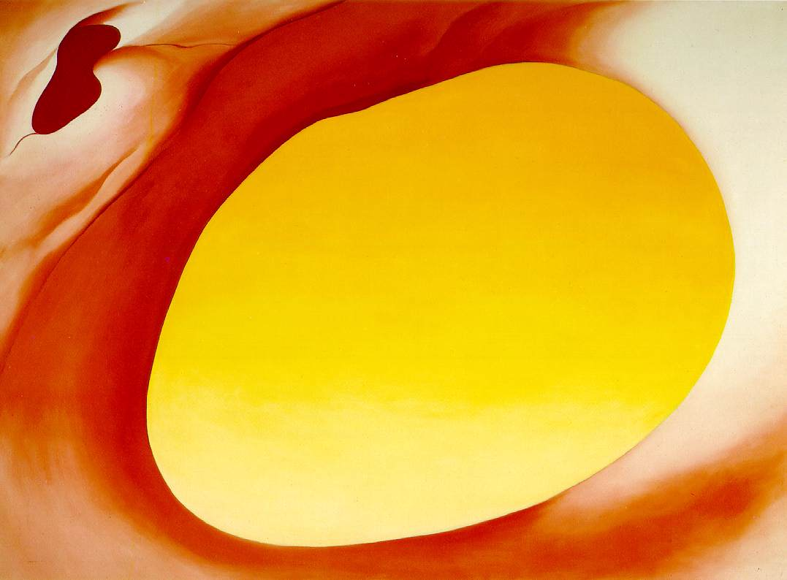
Georgia OKeefe

Slide 21
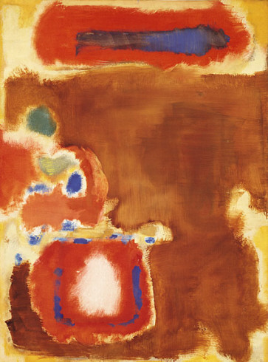
Mark Rothko

Slide 22
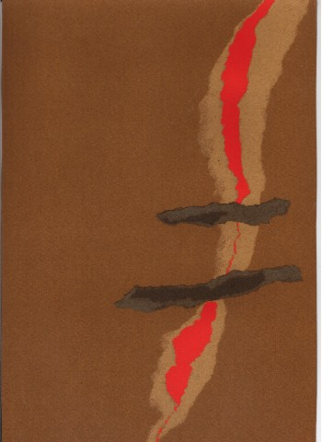
Gianfranco Maletti

Slide 23
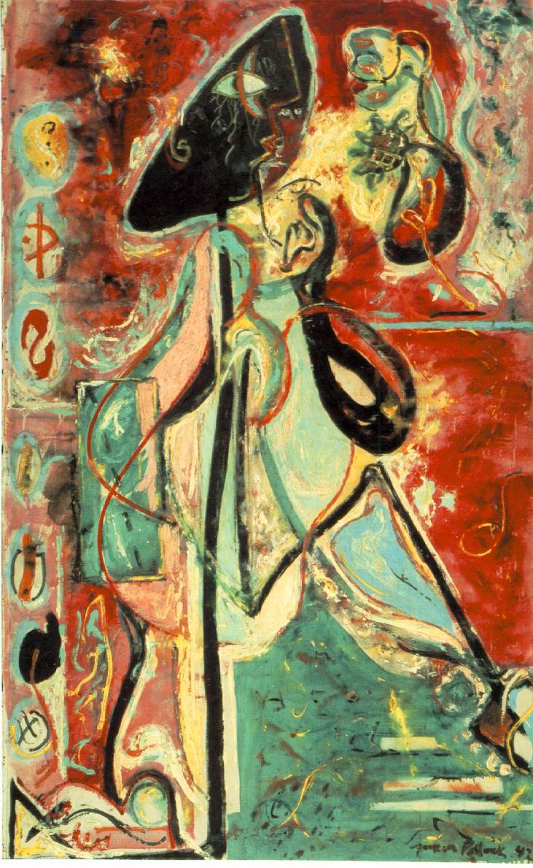
Jackson Pollack

Slide 24
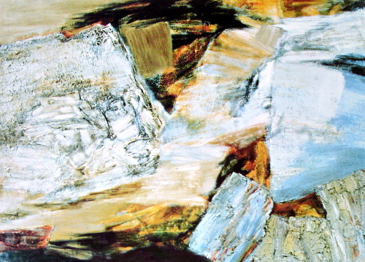
Jane Frank

Slide 25
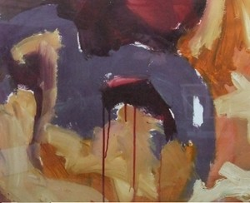
Jess Levine

Slide 26
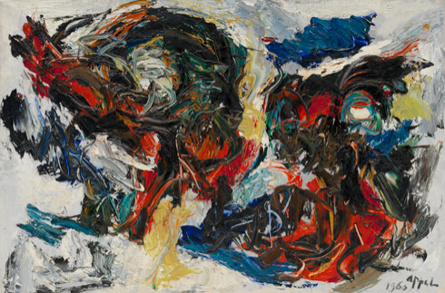
Karel Appel

Slide 27
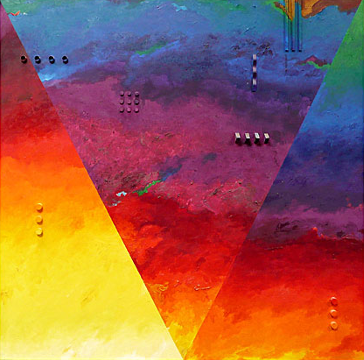
John Kuzich

Slide 28
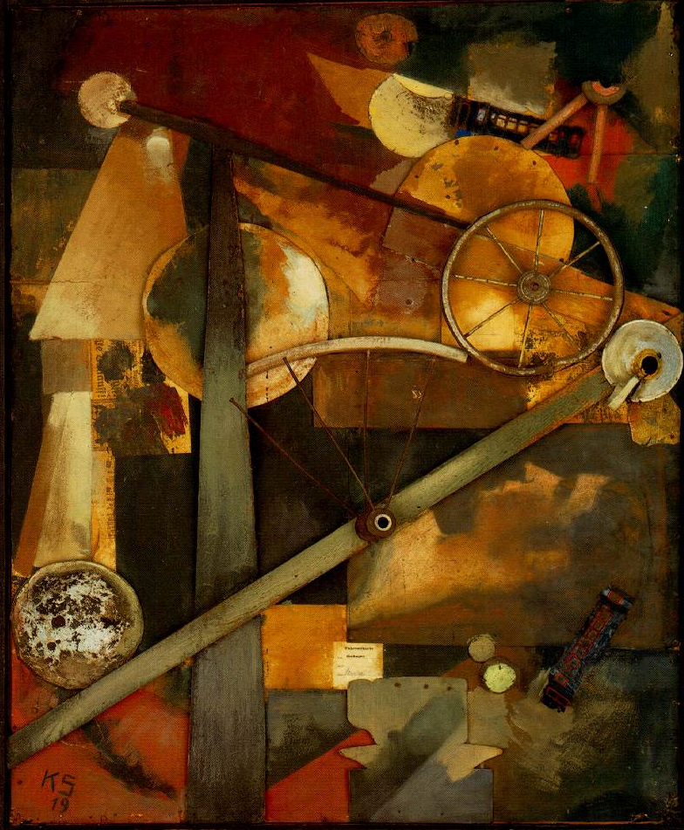
Kurt Schwitters

Slide 29
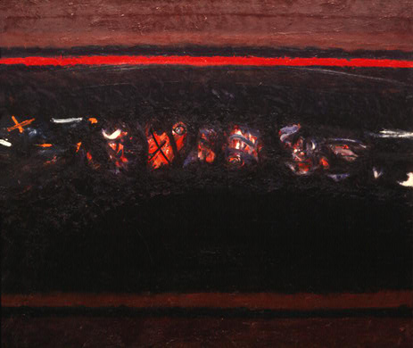
Lawrence Calcagno

Slide 30
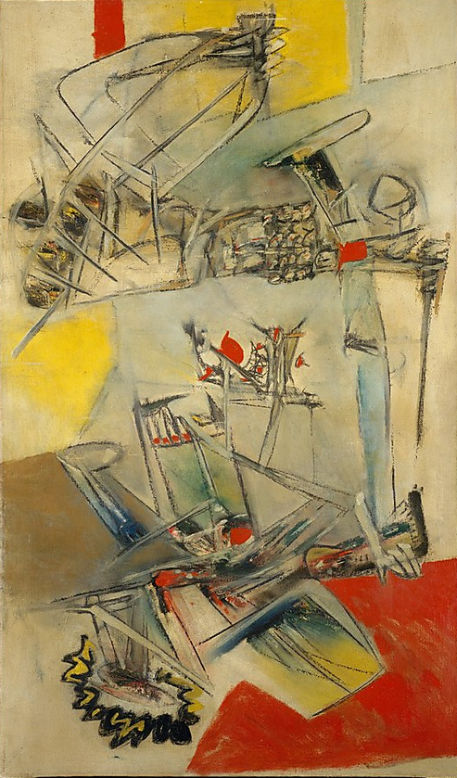
Roberto Matta

Slide 31
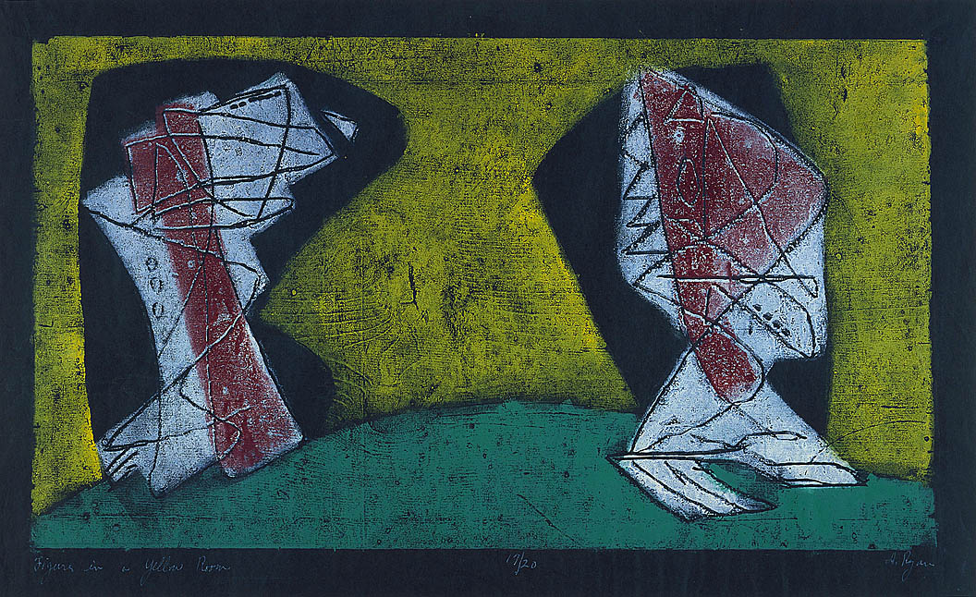
Anne Ryan

Slide 32
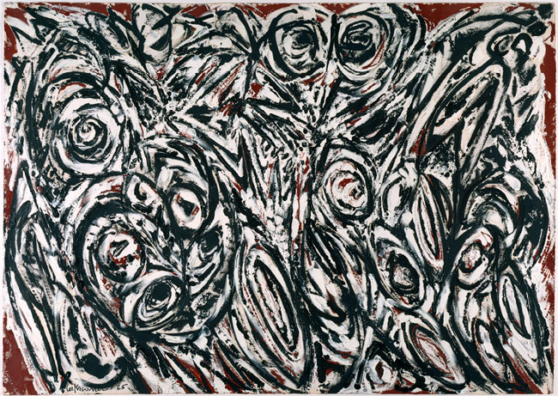
Lee Krasner

Slide 33
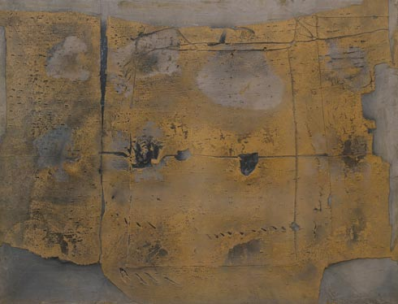
Antoni Tapies

Slide 34
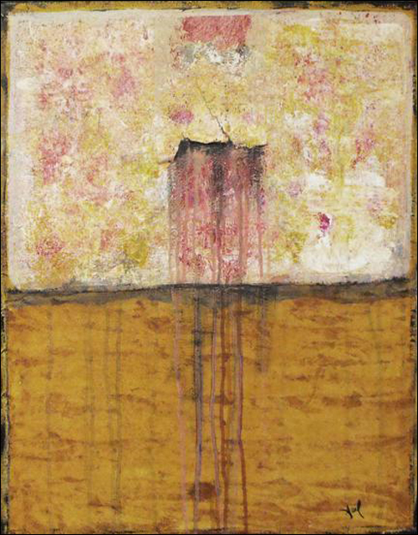
Lisa Carney

Slide 35
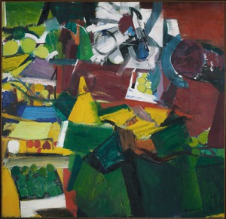
Grace Hartigan

Slide 36
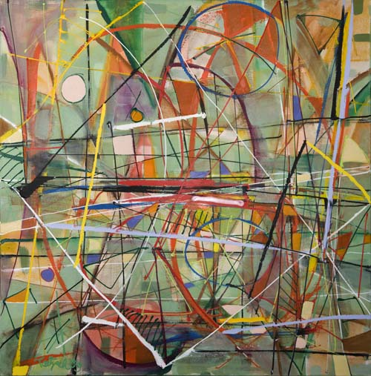
Lynne Taetzsch

Slide 37
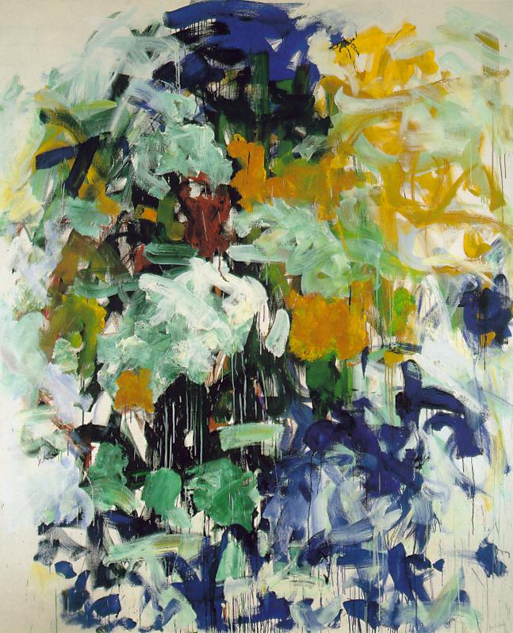
Joan Mitchell

Slide 38
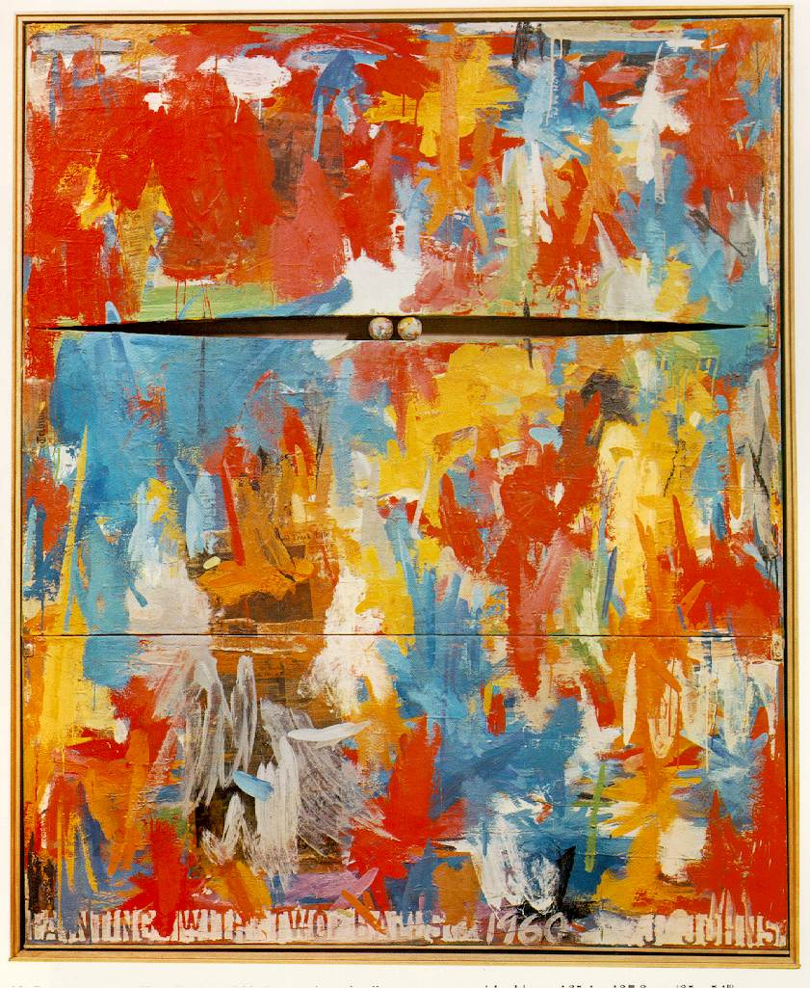
Jasper Johns

Slide 39
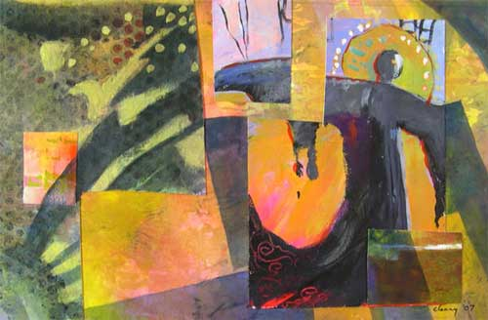
Melody Cleary

Slide 40
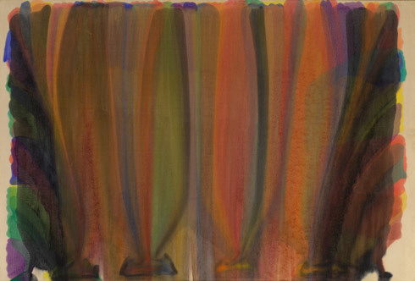
Morris Louis

Slide 41
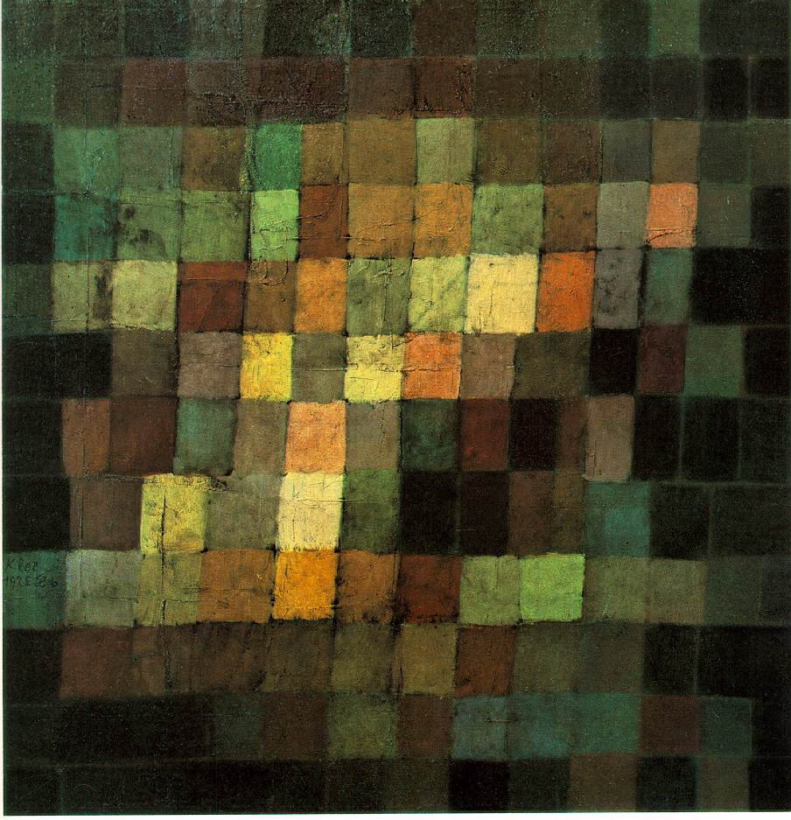
Paul Klee

Slide 42
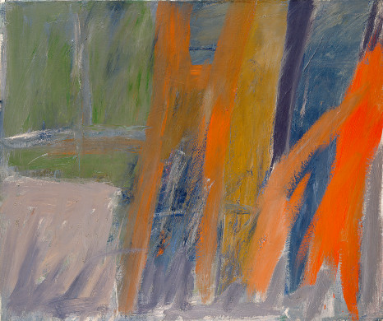
Jack Tworkov

Slide 43
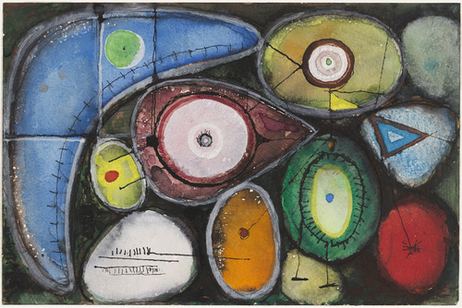
Richard Pousette-Dart

Slide 44
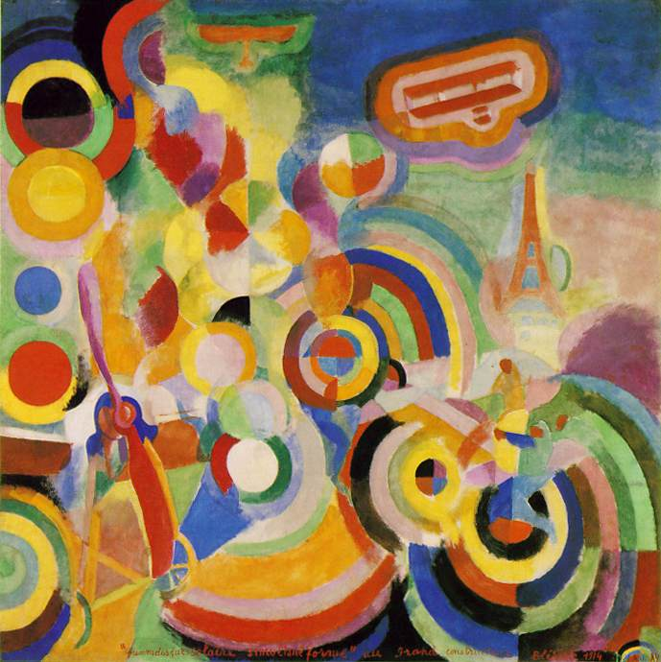
Robert Delaunay

Slide 45
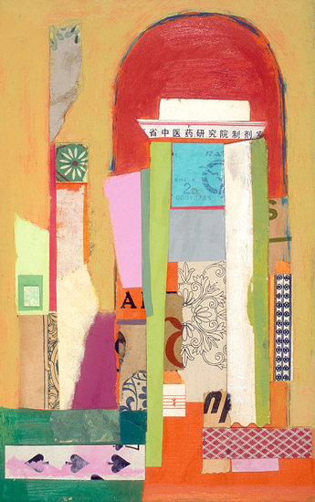
Jaqueline Dee Parker

Slide 46
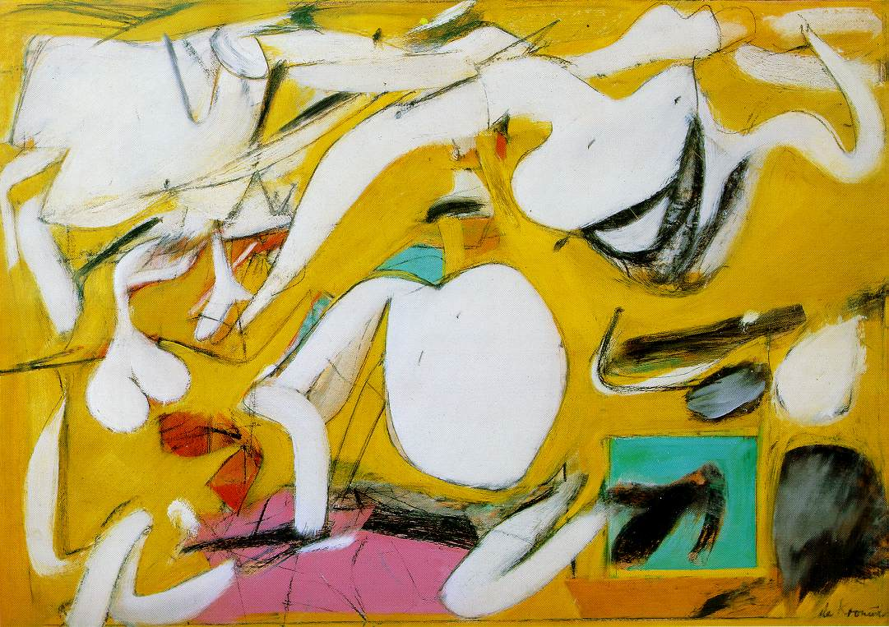
Willem de Kooning

Slide 47
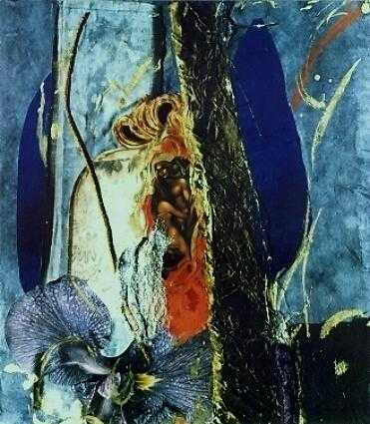
Christel Arnold

Slide 48
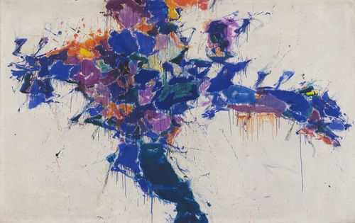
Sam Francis

Slide 49
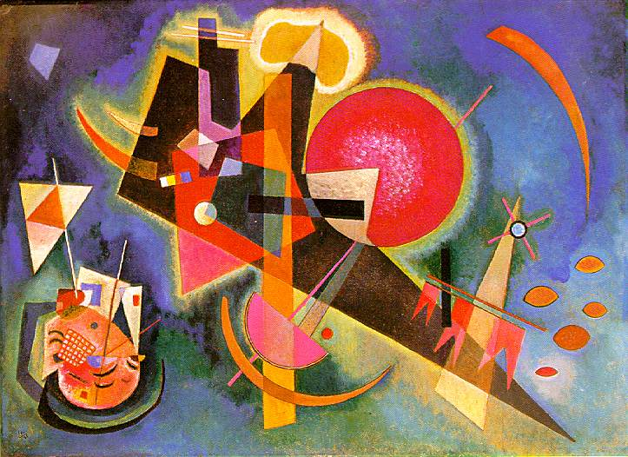
Wassily Kandinsky

