Slide 1
Drawing
Drawing
AP Studio Art
2015

Slide 2
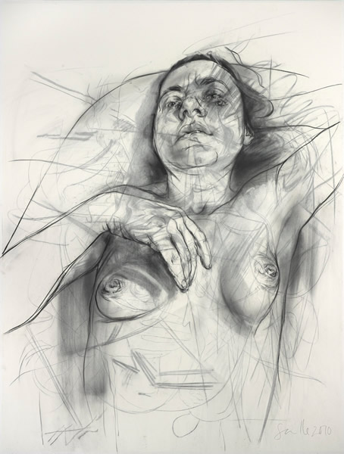
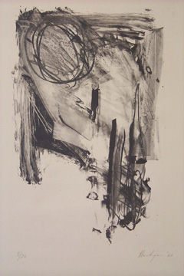
Jenny Saville
Grace Hartigan
Notes:
Welcome to the Drawing Portfolio. So, as we transition from 2D Design we want to continue to keep in mind the principles and elements of design while also looking at how various drawing issues are addressed in the work we will see.
When considering these two drawings by Saville and Hartigan, each approaches the picture plane with differing aesthetics and visions, each using energetic mark-making to create compositions that engage negative space and the edge of the picture plane.

Slide 3
-Section I: Quality (Selected Works)
5 actual drawings 18”x 24” or smaller
-Section II: Concentration (Sustained Investigation) 12 images
-Section III: Breadth (Range of Approaches) 12 images
The AP Studio Art
Drawing Portfolio
is divided into three sections.
Notes:
The AP Studio Art Drawing Portfolio is divided into three sections. Section I- Quality-these are five actual works that best demonstrate the student’s understanding of and engagement with drawing. They must be 18x24 inches or less.
Section II- Concentration-Is a sustained investigation. This body of work should describe an in-depth exploration of a particular drawing concern. This should be 12 images which could include detailed images. There is a writing component to this section that is not scored but should be read to help the reader understand the students’ process. During this reading, there will be more emphasis on documenting process. Section III- Breadth- 12 images that demonstrate a range of approaches.

Slide 4
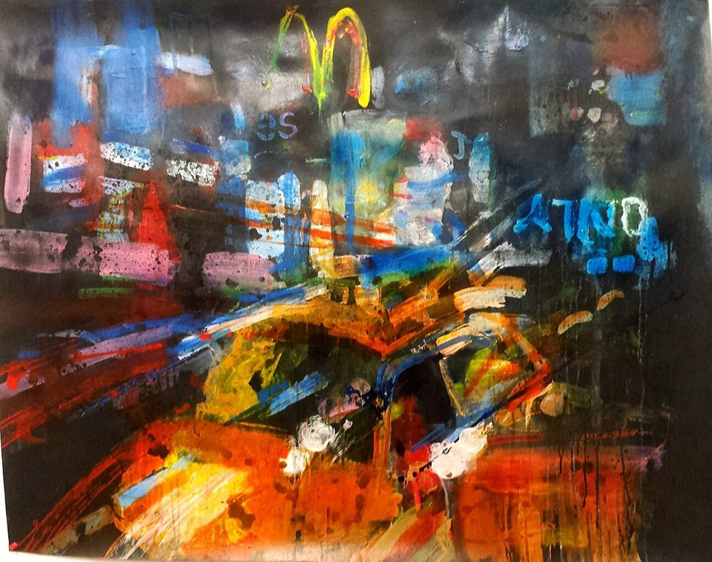
“Art is not what you see, but what you make others see.” Edgar Degas
Al Strachan
Notes:
Al Strachan’s use of loose fluid gestural mark-making and splashes of color depict the dynamic movement and kinetic energy of the city.

Slide 5
The Drawing Portfolio is designed to address a wide range of approaches and media.

Slide 6
DRAWING ISSUES
-Line quality
-Light and shade
-Rendering of form
-Composition
-Surface manipulation
-Illusion of depth
-Mark making can be addressed through…

Slide 7
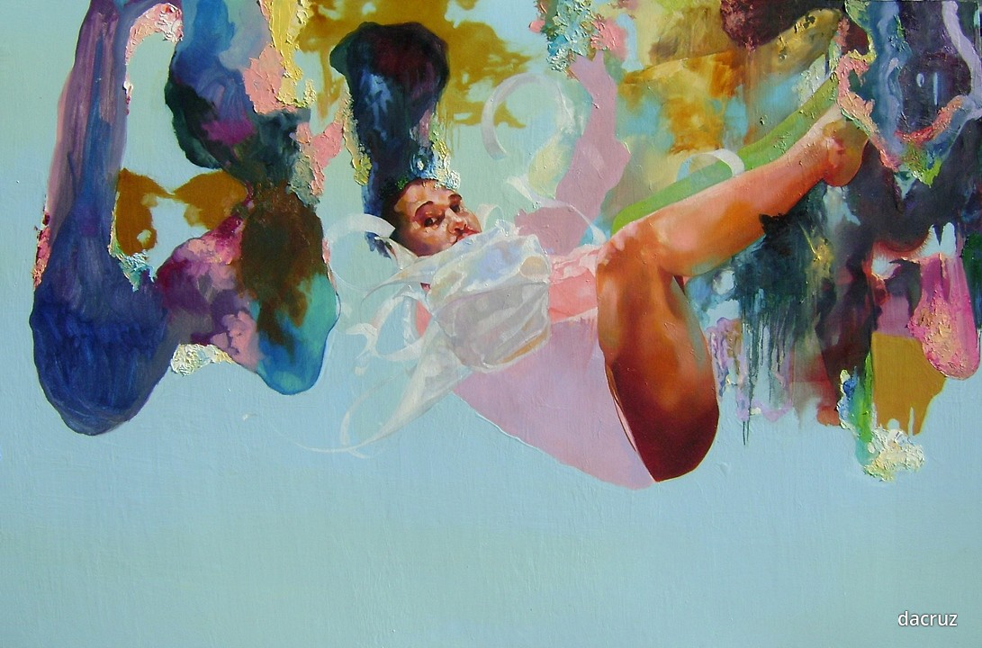
… a variety of means,
-Drawing
-Painting
-Printmaking
-Mixed Media
-Collage
-etc.
David Antonio Cruz, Candyboyit’sonlycastleburning, 2010.

Slide 8
Works created may be..

Slide 9
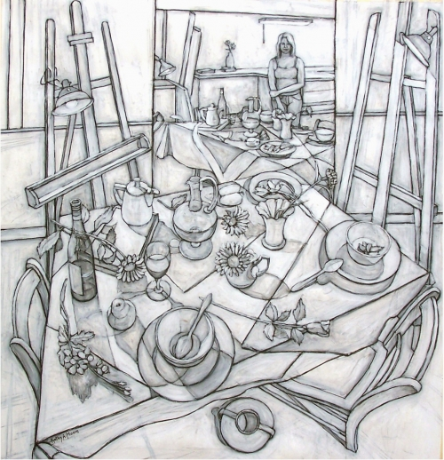
Kathy A. Moore
Observational
Notes:
As in Moore’s “looking Down into Mirrored Self Portrait” where you see the artist reflected, far in the background, behind her still life and its reflection.

Slide 10
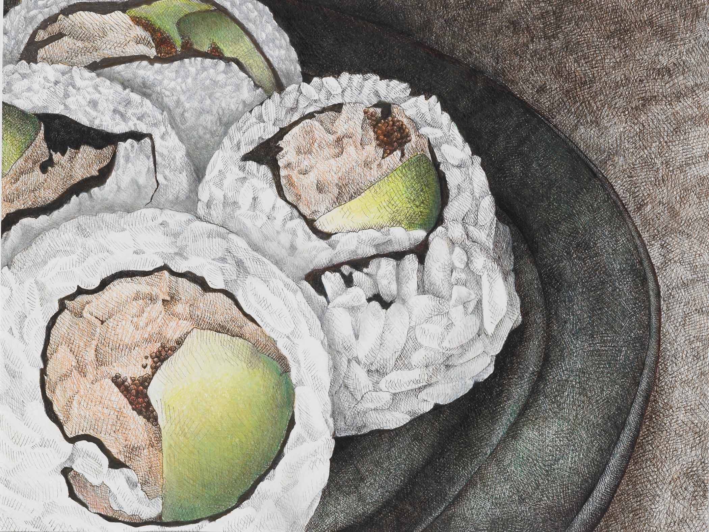
Observational
student work
Notes:
An example of Student work

Slide 11
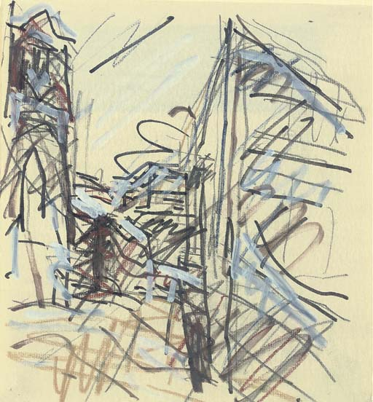
Observational
Frank Auerbach
Notes:
Work from observation is not always work that is tightly rendered or painstakingly worked. Frank Auerback returns repeatedly to the same subjects over decades, constantly looking anew at the same site or individual, striving to capture in quick gestural studies, the indefinable quality of raw sensations, stimulated by the forms and structures he sees.

Slide 12
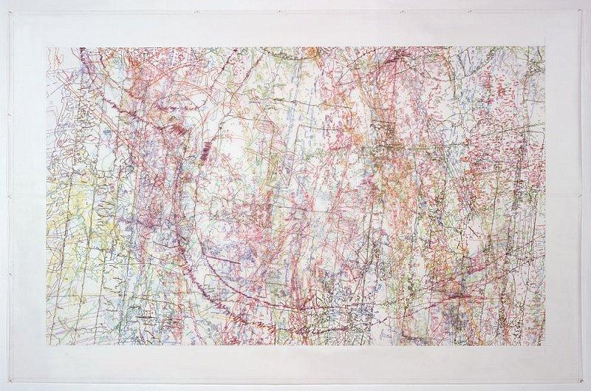
Ingrid Calame
Abstract
Notes:
We will see works of Abstraction. Ingrid Calame focuses her gaze on the left-over and often overlooked – stains on a sidewalk, graffiti on a river bank, tire skid marks on a roadway. After tracing the shapes of these discarded marks, Calame uses this representational, and yet not necessarily recognizable, information to generate abstractions. She refers to this process as a “representation of loss,” resulting in paintings that function in part as landscapes or historical referents to, the forgotten, disregarded or unobserved.

Slide 13
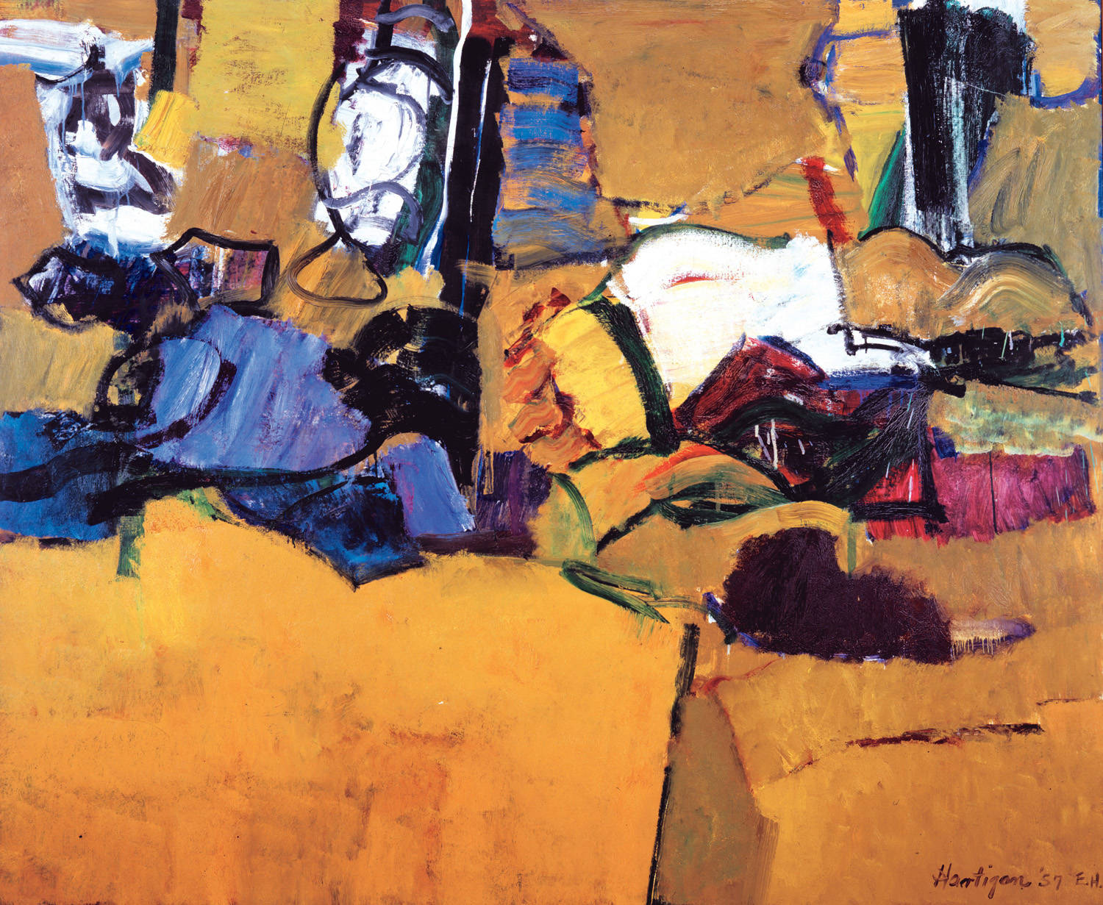
Grace Hartigan
Abstract
Notes:
This painting by Grace Hartigan portrays dynamic, motion-filled colors that could be interpreted as a landscape, a still life, figures, almost anything! She once said … “perhaps the subject of my art is like the definition of humor — emotional pain remembered in tranquillity.”

Slide 14
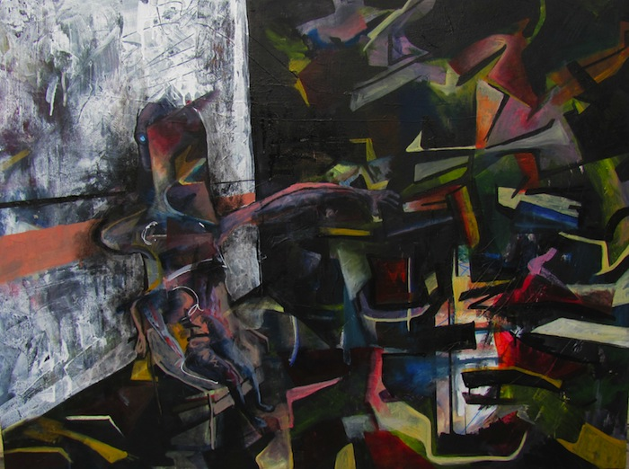
Abstract
student work
Notes:
We will see examples of students using abstraction.

Slide 15
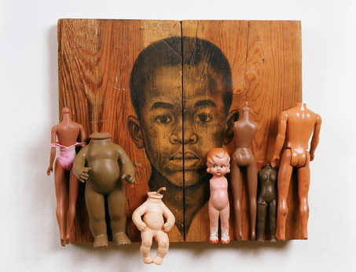
Inventive
Whitfield Lovell
Notes:
There will be inventive uses of materials within the Drawing portfolio. Whitfield Lovell uses vintage portrait photographs of African Americans from the early 1900’s as reference material for his drawings on reclaimed wood, incorporating found objects to tell stories that are as mysterious and open ended as the people whose portraits he draws.

Slide 16
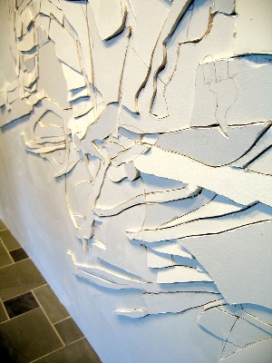
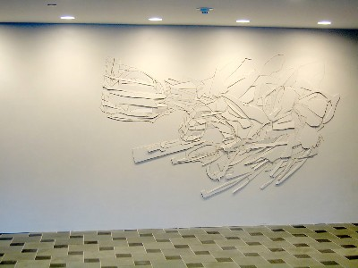
Chris Nau, Inhabitat XVI, graphite and cuts on drywall 96" x 192" x 2"
Inventive
Notes:
Chris Nau makes work in sculpture, three-dimensional drawing, and painting that explores transformation as the foundation for all structures. “Inhabitat is an invented word that describes the middle place between inhabitant (figure/subject/object) and habitat (ground/environment/space).
This middle is a place of both separation and combination. It is the product of opposites colliding to form a third possibility. This work came from the question: How can destructive actions construct an emergent form?”

Slide 17
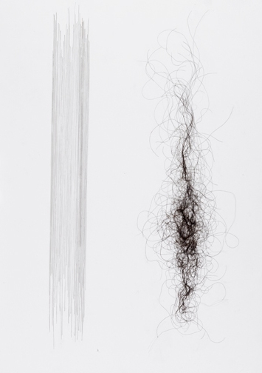
Inventive
student work -hair on board 18x24”
Notes:
In this work the student uses hair as their drawing material. Juxtaposing the rigidly organized parallel lines on the left, with the organic curvilinear tangle on the right.

Slide 18
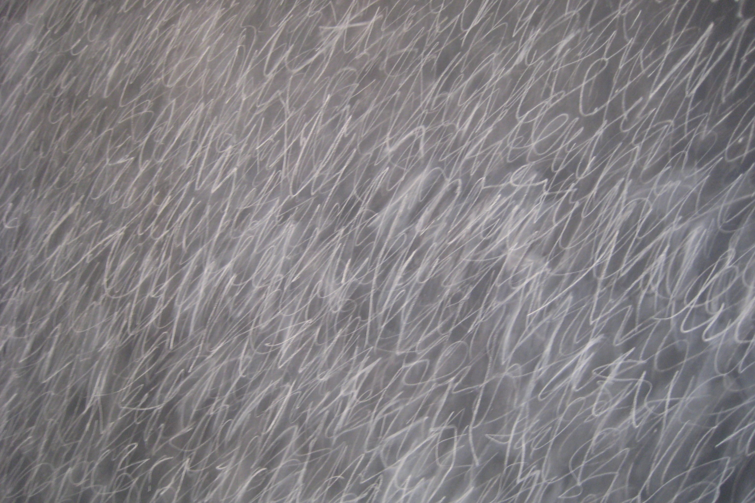
The range of marks used to make drawings, the arrangement of the marks and the materials used to make the marks are endless.
Cy Twombly

Slide 19
Drawing issues include, but are not limited to the following:

Slide 20
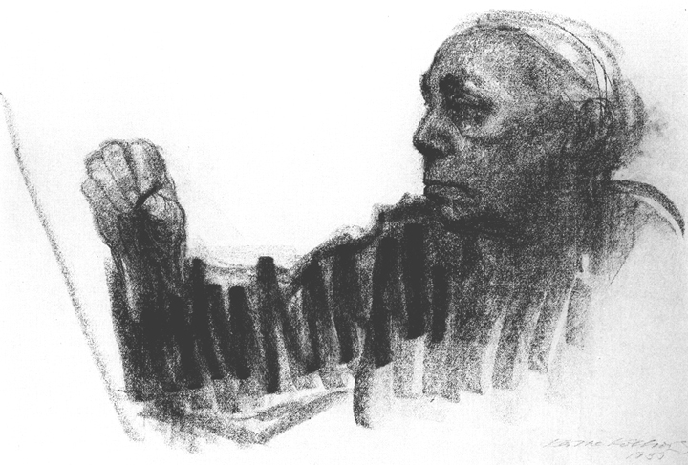
Line quality
Käthe Kollwitz
Notes:
Kollwotz uses a dynamic, rapid, zig-zag line moving from the hand to the face adding activity to an otherwise static self portrait.

Slide 21
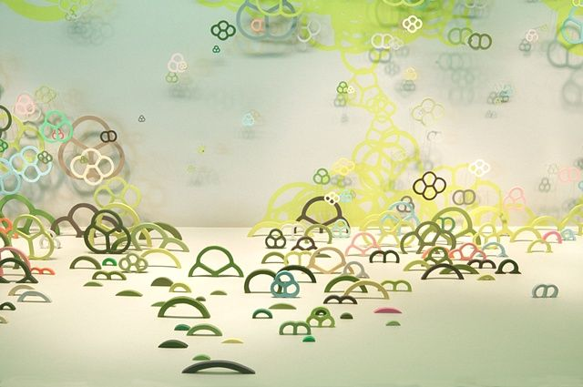
Line quality
Nami Yamamoto
Notes:
Nami Yamamoto, creates large scale installations, using curved shapes and line, that play with light and shadows within space creating layered “drawn” forms. We may see work that challenges our notion of what drawing is, and we will need to look through the drawing lense as we evaluate the work.

Slide 22
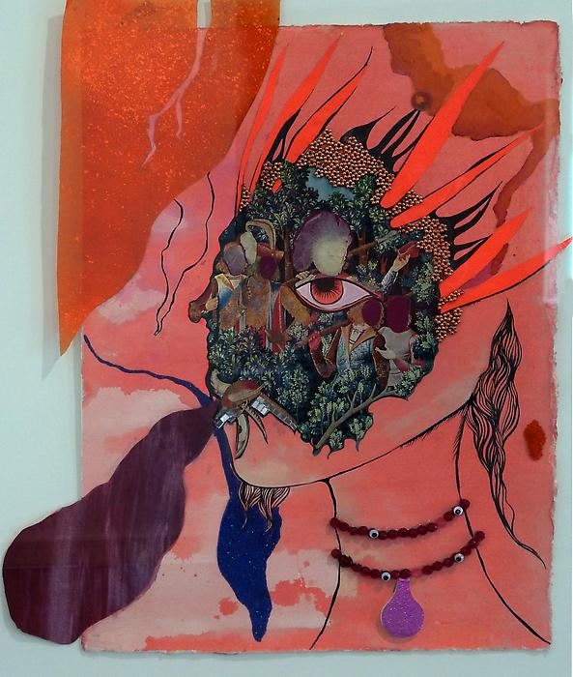
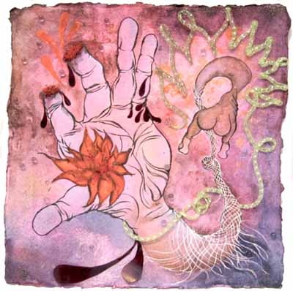
Chitra Ganesh
Line quality
Forest, mixed media on handmade paper
Notes:
By layering disparate materials and visual languages, Ganesh asks her viewers to “seek and consider new narratives of sexuality and power.” These small works on hand made papers are delicately created with imagery that can be bloody and disturbing and at the same time beautiful and seductive.

Slide 23
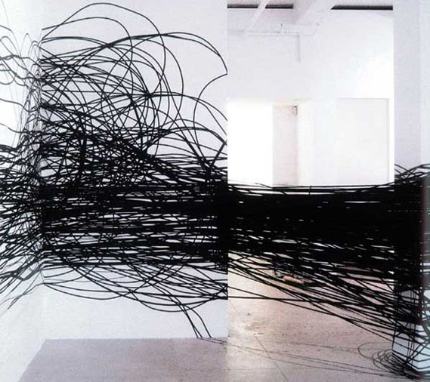
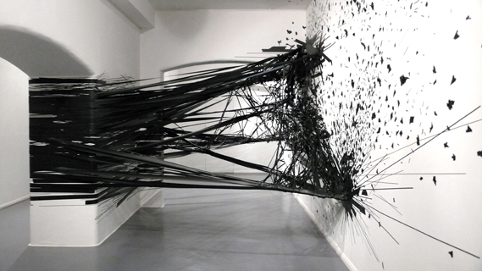
Monika Grzymala
Line quality
Notes:
Monika Grzymala, creates wildly explosive 2-D drawings that refuse to stick to a single surface (or dimension).
“Grzymala applies adhesive tape directly to gallery walls to create three-dimensional drawings that can both wrap around corners and project outwards. She describes her art as being more akin to drawing than installation, viewing the works as complex drawings that leave the walls to take over the surrounding space.”

Slide 24
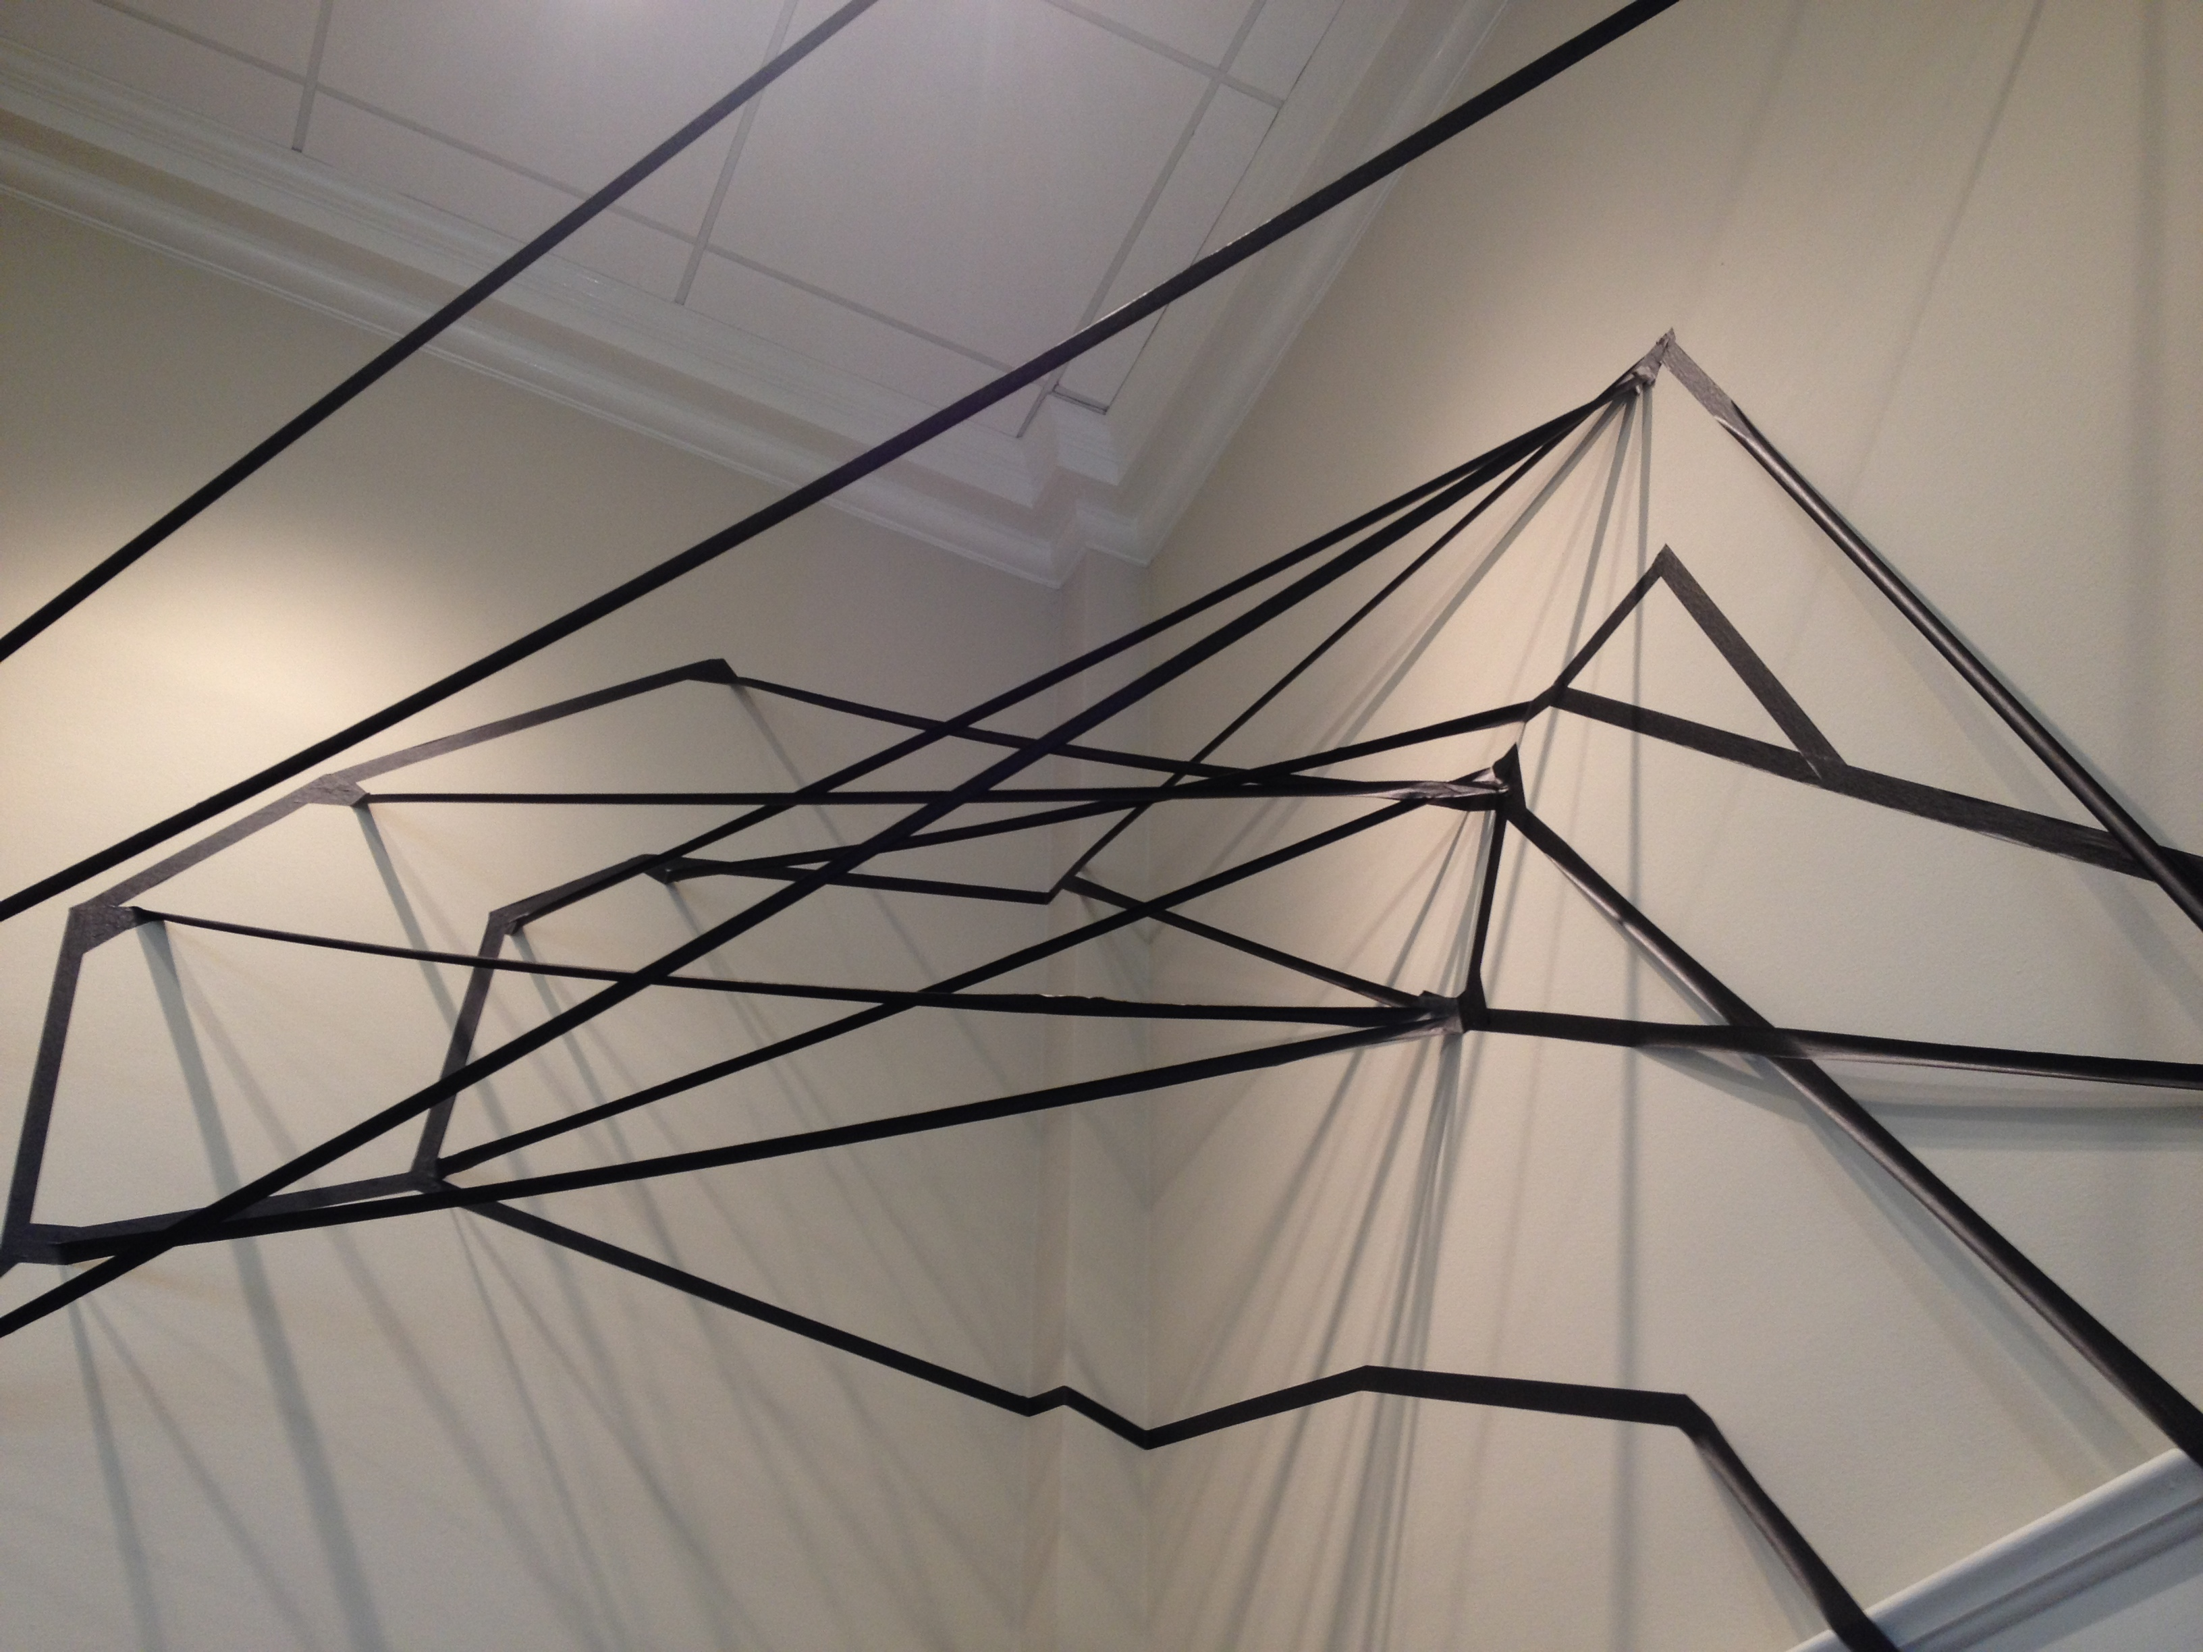
Line quality
Student work
Notes:
This student installation is directly inspired by the work of Gryzmala.

Slide 25
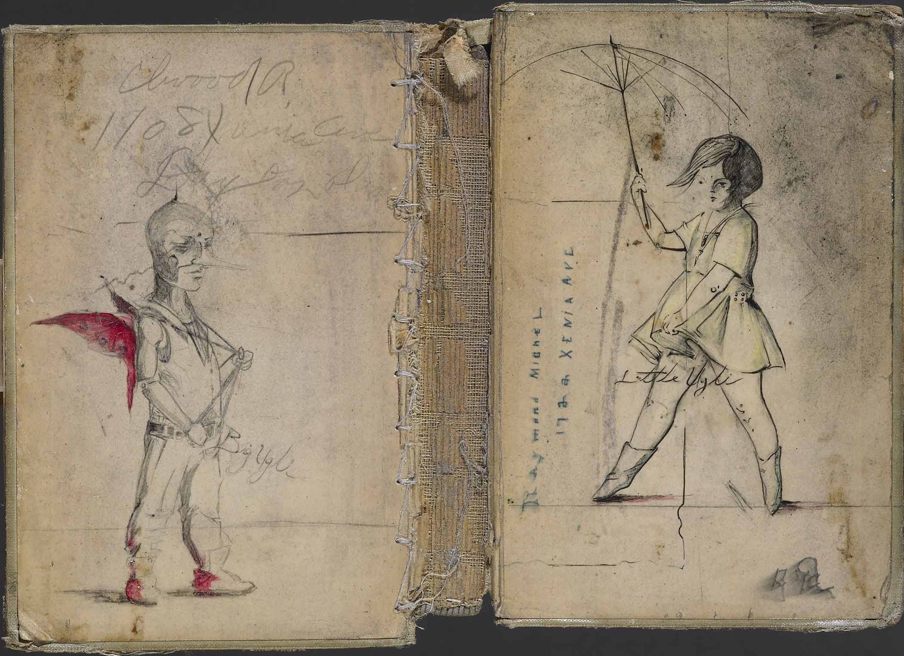
Consider scale
AP student work
Notes:
The images we will see on our computer screen during the reading are depicting artwork that may vary greatly in scale. It may be helpful to look at sizes! You may not have the benefit of something that helps determine scale such as the binding of a book spine.

Slide 26
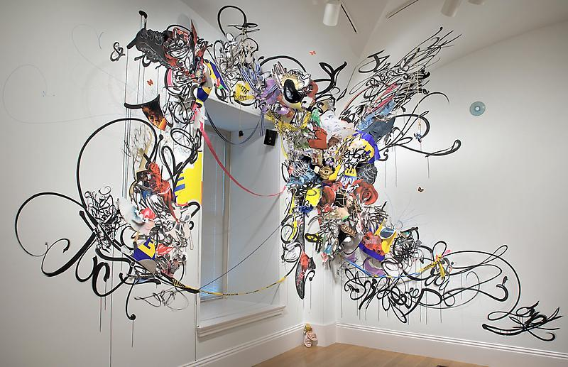
Shinique Smith – Installation
Line quality
Notes:
Or the corner of a wall or window frame.

Slide 27
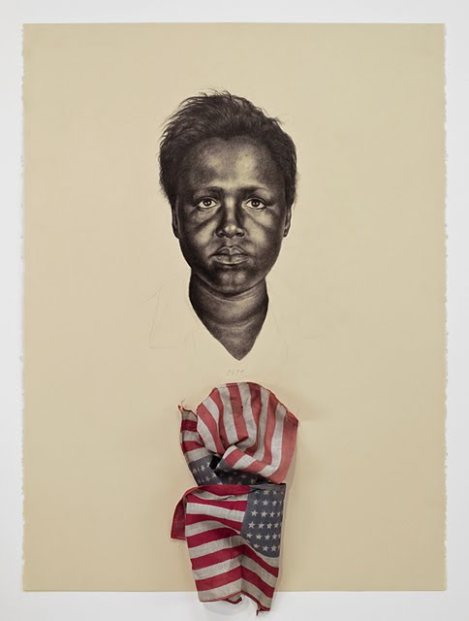
Light and shade
Whitfield Lovell
Notes:
Look for the use of light and shade in a variety of media.

Slide 28
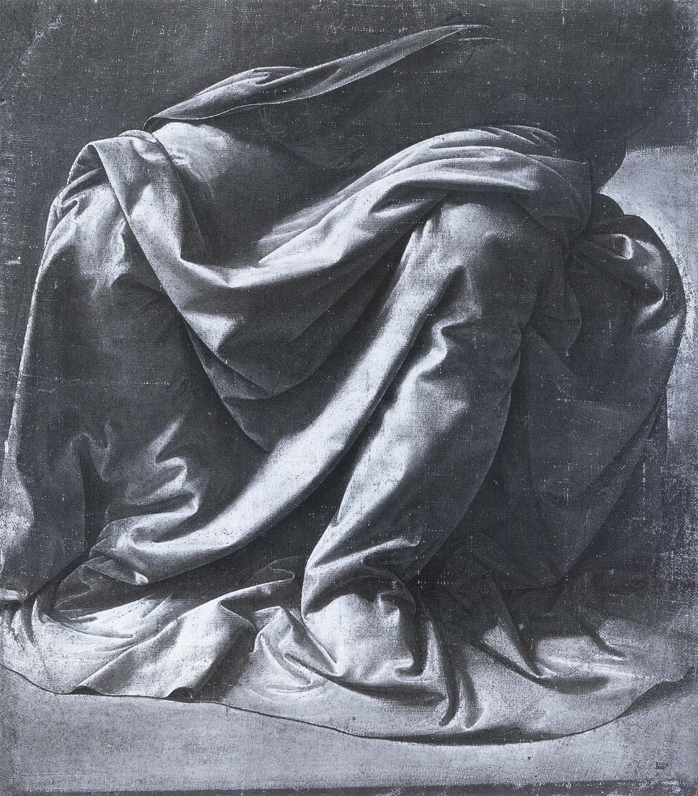
Light and shade
Leonardo DaVinci – Drapery Study
Notes:
AS with this drapery study by DaVinci

Slide 29
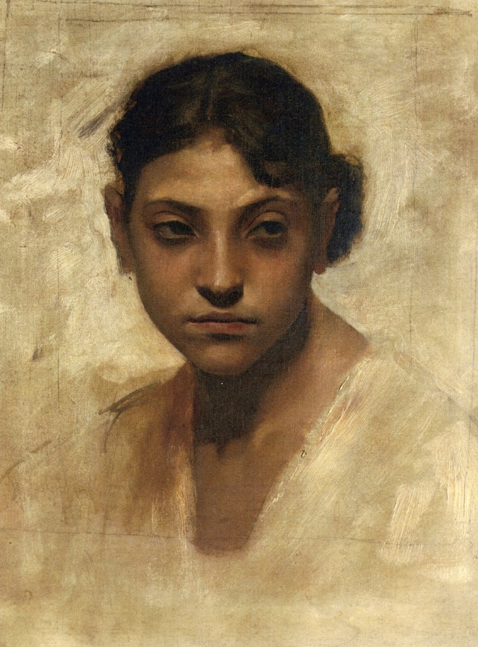
Light and shade
John Singer Sargent
Notes:
Or this portrait by Sargent

Slide 30
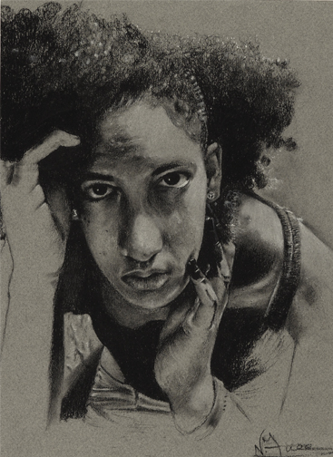
Light and shade
AP student work-charcoal & white pastel on buff paper
Notes:
Look for nuanced subtlety as in this student work.

Slide 31
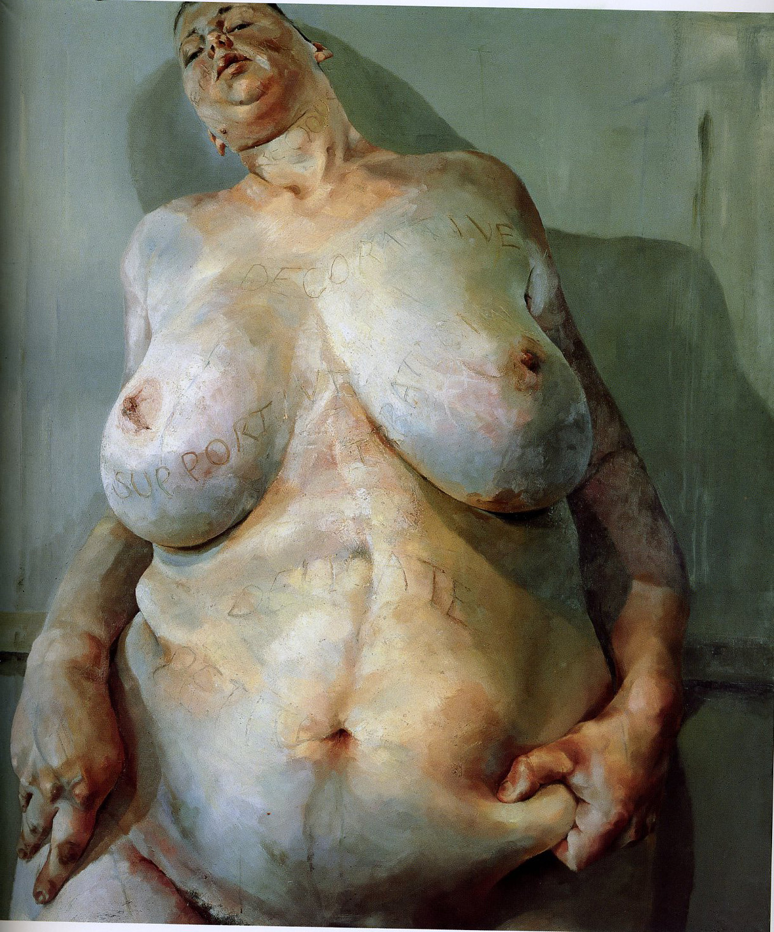
Rendering of form
Jenny Saville-”Branded” oil
Notes:
Consider rendering of Form. Saville paints flesh with color, that is at once sickly and bruised, while also lush and seductive, as she models the form in her larger than life nudes.

Slide 32
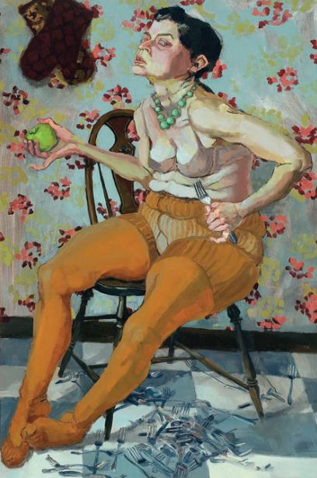
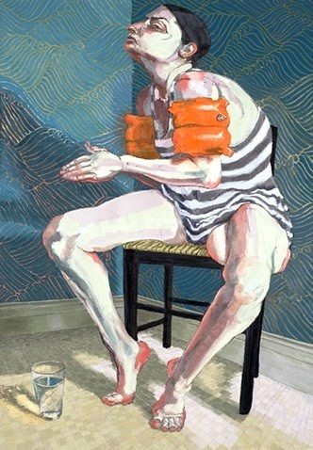
Dara Engler
Rendering of form
Notes:
Dara Engler says she paints “secluded, vacant, zombie-like figures; who have relaxed in their habits until they have lost time…and become sluggish, jaundiced, and so lacking muscle tone that they hang over their chairs and defy anatomy.”
Engler writes that “The most an artist can do is paint the things they know and hope other people see things from a new angle. What I know is that if it were not for the act of painting, I would be lost to the worlds I paint.””

Slide 33
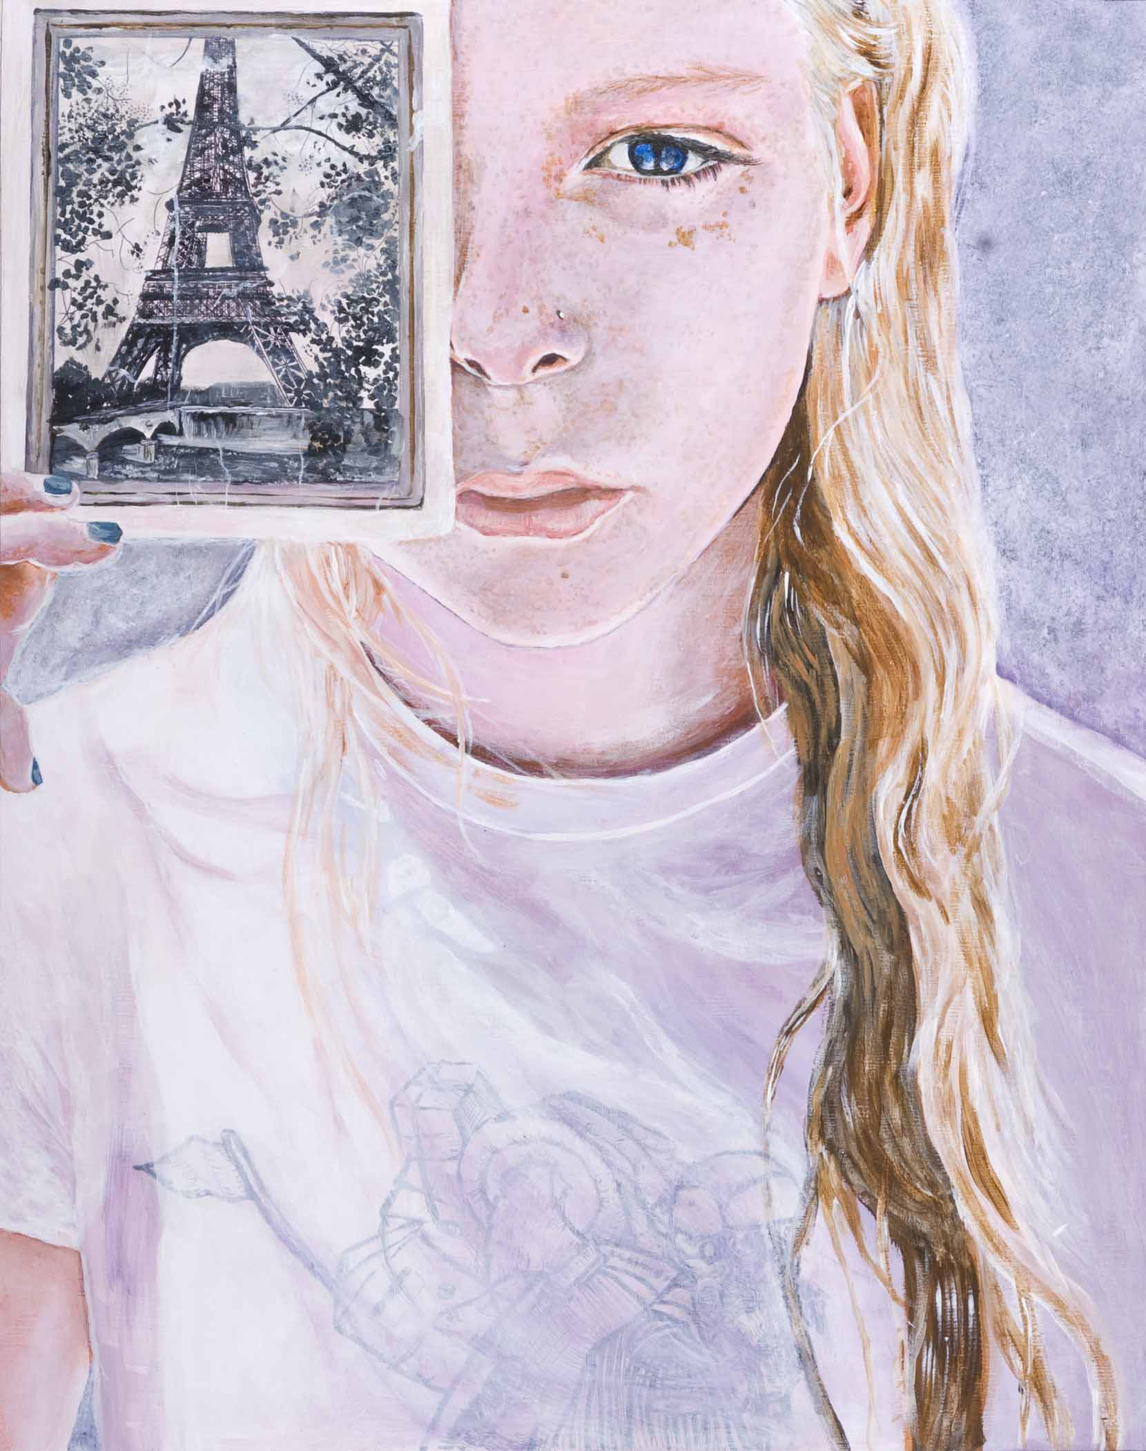
Rendering of form
student work
Notes:
This piece shows an engagement with compositional space that highlights the student vision and emotional message.

Slide 34
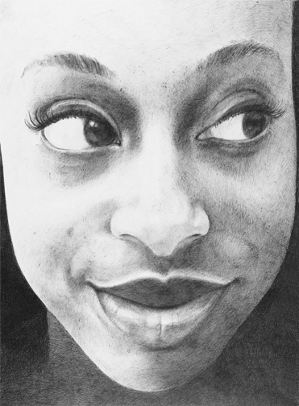
student work - pen
Rendering of form
Notes:
This work uses readily accessible materials to create a larger than life-sized drawing of an expressive face. Remember that materials will vary greatly within the drawing portfolio and ball-point pen, while humble, can create beautiful drawings.

Slide 35
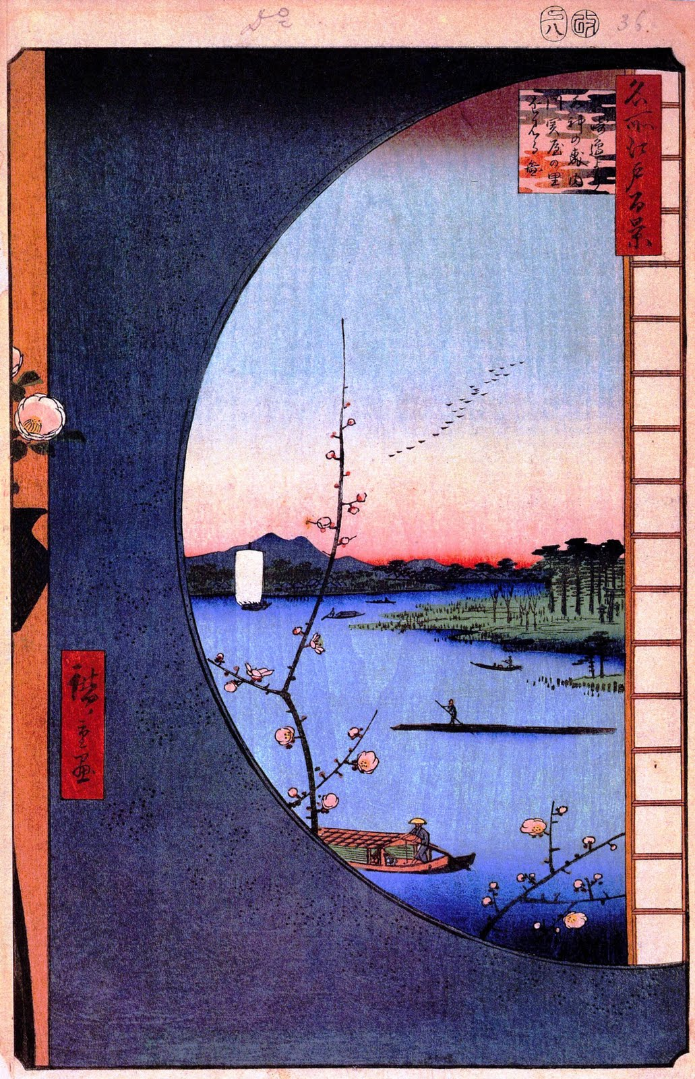
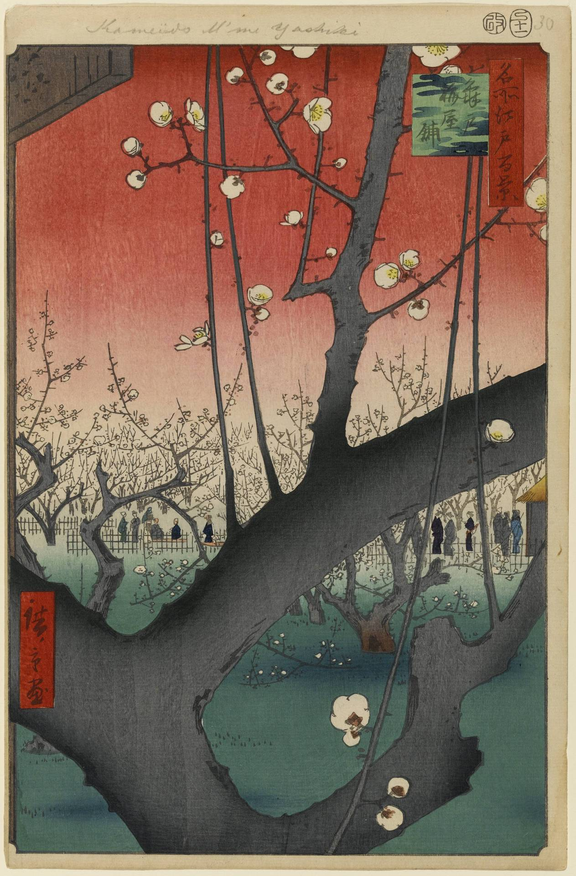
Composition
Hiroshige
Notes:
Consider the compositional structures of the works you will see. Japanese woodblock prints by Hiroshige provided an artistic alternative—in the use of color, perspective, and spatial structure.

Slide 36
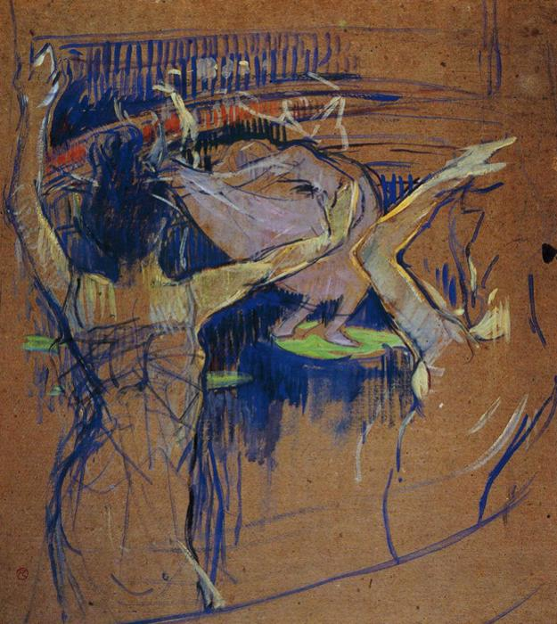
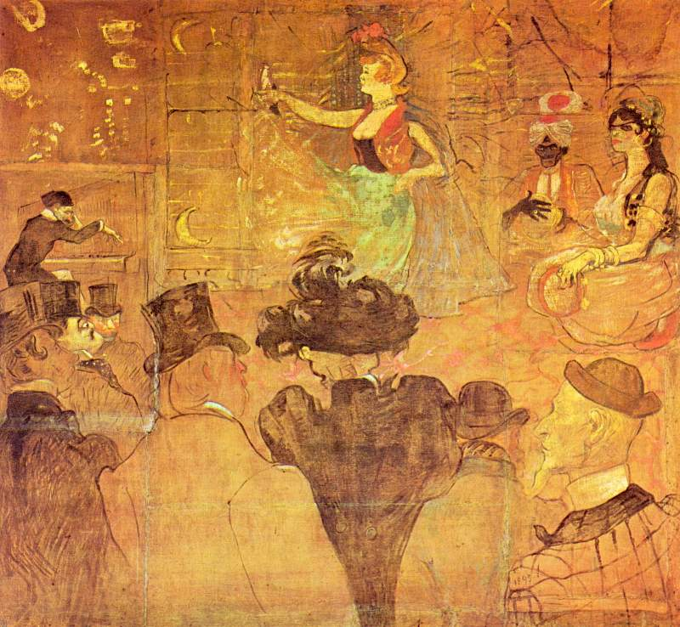
Composition
Toulouse Lautrec
Notes:
Lautrec uses the negative space and raw gestural marks as a visual balance to the active focal points of more rendered passages.

Slide 37
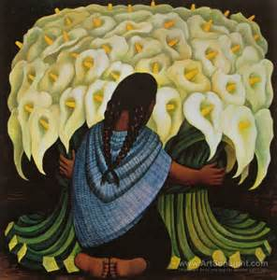
Composition
Diego Rivera
Notes:
There is nothing wrong with the center. Rivera uses symmetry to great a balanced and unified composition.

Slide 38
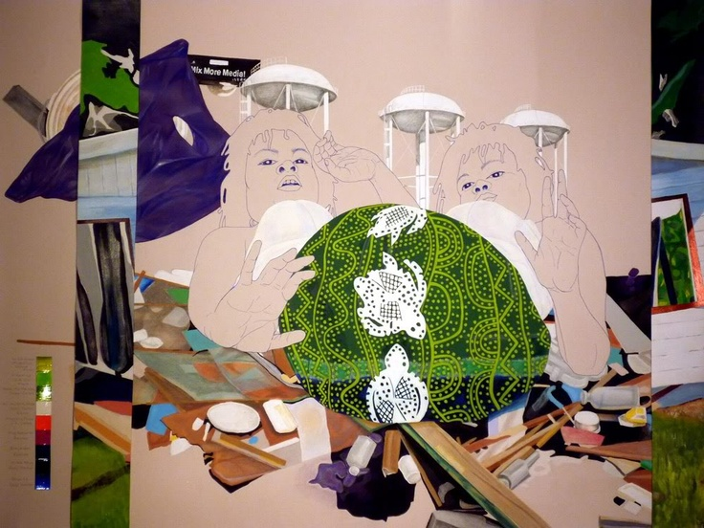
Composition
Nicole Awai
Notes:
Nichole Awai, again brakes the symmetry of her composition by juxtaposing strips of deep space framing the double sided figure within.

Slide 39
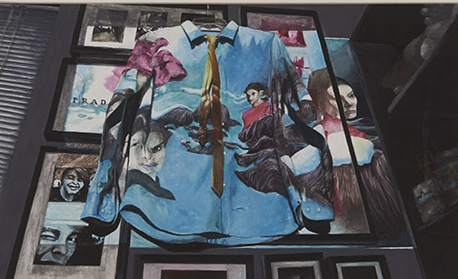
Composition
student work
Notes:
Linear perspective and shallow space are apparent in this work in which the student depicts projected imagery on the hanging shirt and tie suspended in front of family photos.

Slide 40
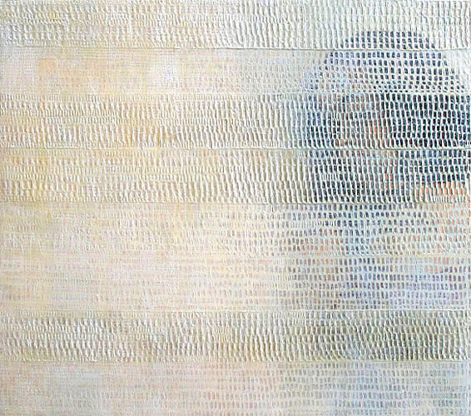
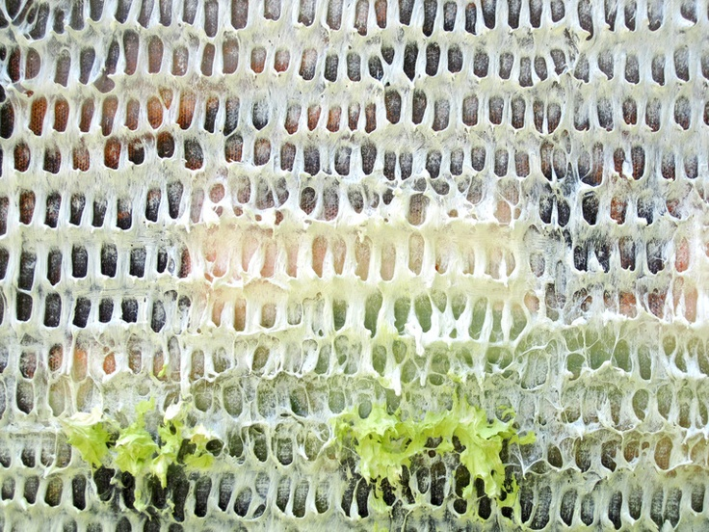
Surface manipulation
Sanjay Vora
Notes:
Pay attention to surface manipulation. Sanjay Vora creates detailed paintings that he then covers with patterned texture, obscuring the image beneath. His rich surfaces push the eye back and forth between seeing the image and seeing only the abstracted shapes in textured relief.
There are many ways to show texture in a piece. Not only will you see actual texture but implied texture is often prominent. Process informs artistic choice.

Slide 41
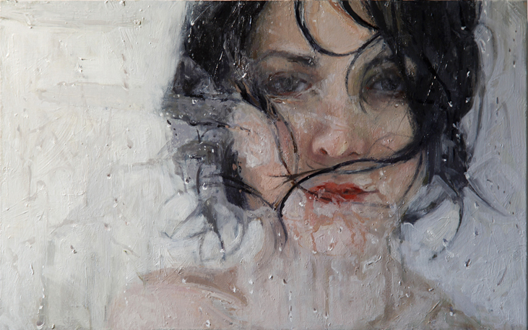
Surface manipulation
Alyssa Monks
Notes:
Alyssa Monks use of thick textural paint application reads as form from a far but upon closer inspection of the surface you see the paint is thick and chunky in some places and smooth and fluid in others. The effect is a painting of a figure that is as much about the paint as it is about the illusion of flesh pressed against wet steamed glass.

Slide 42
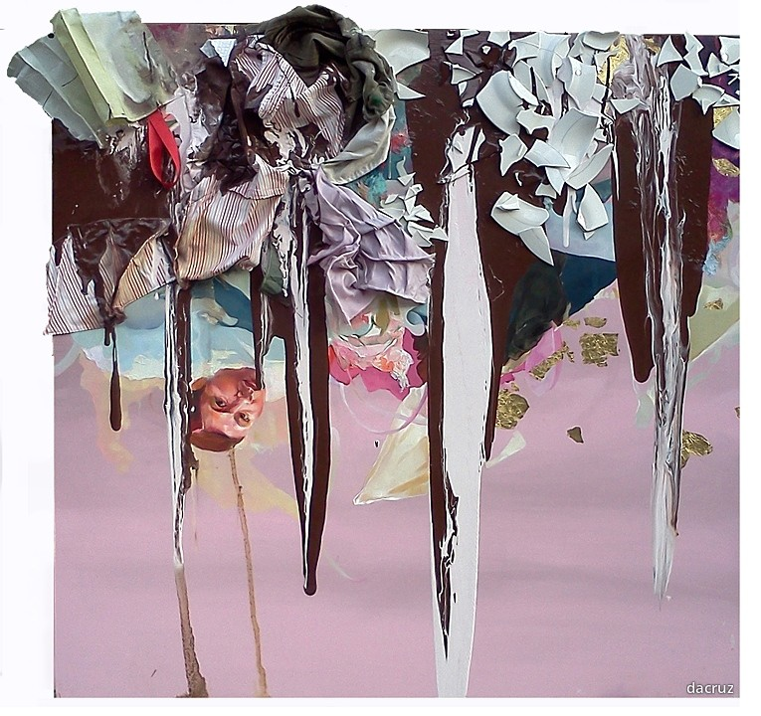
Surface manipulation
David Antonio Cruz, everythingandthepastrychef, 2012.
Notes:
David Antonio Cruz paints the figure and then applies fabric and broken ceramics, to build texture that reaches off the canvas while obscuring the figure beneath.
“ A versatile artist, Cruz uses a variety of media, including painting, sculpture, drawing, and video. In the work here, Cruz challenges the limits of painting by incorporating various objects that have meaning to him. His work not only tests the boundaries of artistic media but also attempts to document the experience of diaspora. “

Slide 43
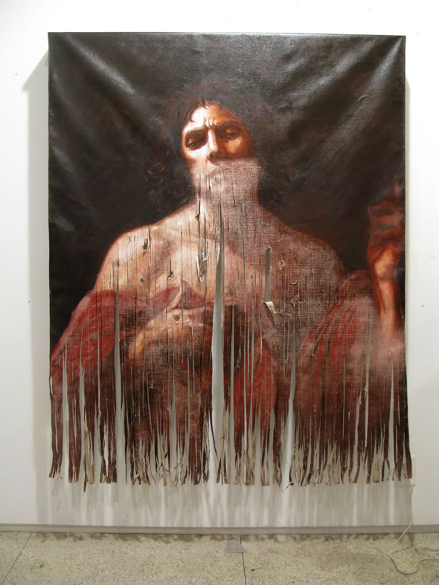
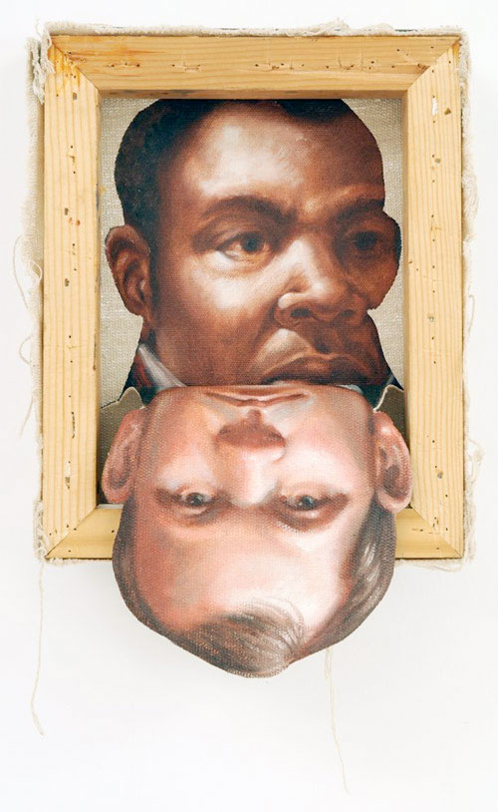
Surface manipulation
Titus Kaphar
Notes:
Titus Kaphar’s “artworks interact with the history of art by appropriating its styles and mediums. Kaphar cuts, bends, sculpts and mixes the work of Classic and Renaissance painters, creating new narratives that highlight the history of slavery and colonialism.

Slide 44
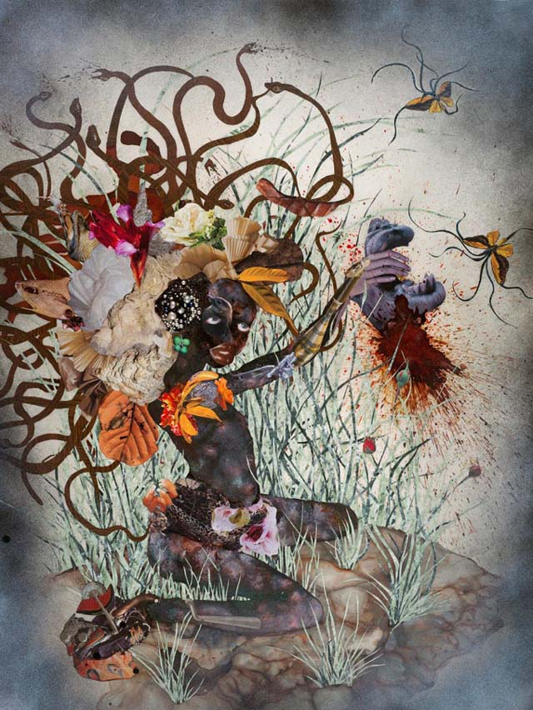
Wangechi Mutu
Surface manipulation
Notes:
Wangechi Mutu uses collage, ink, watercolor, salt and alcohol, manipulating the surface to achieve a variety of textures. She transforms magazine images of of overtly sexualized women, into powerful female figure,s that dominate their surroundings.

Slide 45
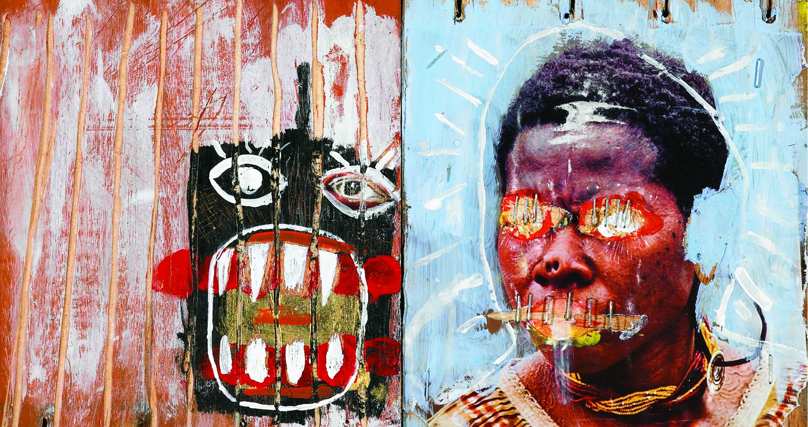
Surface manipulation
AP student work
Notes:
This student work on wood uses cuts into the surface, staples, and applied paint to mark the surface and play between the stylized form, manipulated photo, and the negative space.

Slide 46
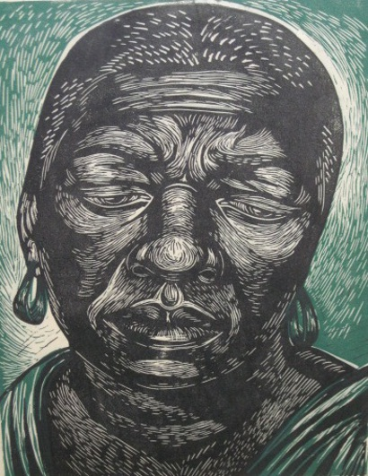
Surface manipulation
Charles White
Notes:
Within printmaking Charles White creates cuts in the plate surface to highlight the texture of skin and hair, following the contours of the form.

Slide 47
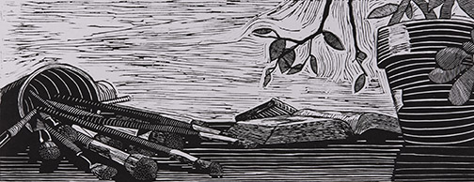
Surface manipulation
AP student work

Slide 48

Illusion of depth
Raphael, “The School of Athens”
Notes:
Look for the illusion of deep space through linear perspective as we see here in Raphael’s “The School of Athens”

Slide 49

Illusion of depth
Camille Pissaro, “Boulevard Montmartre”
Notes:
As well as through color and atmospheric perspective as we see in “Boulevard Monmarte” by Pissaro

Slide 50

Illusion of depth
Val Britton
Collapsible City 2012, 6' h x 7' w, graphite, ink, tempera, and collage on paper
Notes:
Val Britton’s immersive, collaged works on paper draw on the language of maps.
These mixed media abstractions map not only physical locations but also psychological and emotional spaces.
Using paper shapes as collage material, and cutting into the ground paper of a work, he brings the drawings into a sculptural space that hovers between two- and three-dimensions

Slide 51


Odeith Graffiti Artist
Illusion of Depth
Notes:
Odeith, a Brazilian street artist, incorporates the walls and floors of architectural spaces in his graffiti art to create 3-Dimensional illusions that pop out at the viewer.

Slide 52

Illusion of Depth
student work

Slide 53


Mark making
Fahamu Pecou
Notes:
In “Vantage Point” and “Sup With That?”, Fahamu Pecou, through active mark making and mixed media, explores the confines of the picture plane. He uses the fashion-trend of saggin' as an allegory to comment on contradictions of mobility, access and agency for young Black men.

Slide 54

Mark making
student work-
Notes:
Subtle, sensitive rendering of form mixed with seductive line quality is evident in this student work.

Slide 55

Alberto Giacometti
Mark making
Notes:
Alberto Giacometti’s marks depict a great sense of space.

Slide 56

Mark making
AP student work

Slide 57


Raymond Saa
Untitled, charcoal on sewn paper, 2010, 46 " x 35 "
Untitled, ink on sewn paper, 2010, 29" x 31”
Notes:
Raymond Saa ‘s sculptural paper works involve the deconstruction of drawings and their reformation into layered sewn pieces. Larger sculptural works follow the same instincts and often include drawing. Recent pieces involve layering of painted wooden panels into wall ‘shingles’.

Slide 58

Moe Yoshida
Mark making
L.R. I
pencil, acrylic, pastel, paper on board 51x25cm
2010
20" x 10"
Notes:
For Yoshida, drawing is the most direct and effective way to define elusive images. They stem from the awareness of a physical state and from emotional memories. He draws fragments of the human form, arms, legs, etc. He then uses modeling paste as an eraser and through this process of erasing redrawing and erasing again he discovers a hidden narrative through the emergence of memory.

Slide 59


Stephen Emmelmann,
Digitally processed photograph, and oil pastel on paper and canvas.
Notes:
Recognize that drawing can be addressed through a wide range of media that include, but are not limited to, traditional drawing media, painting, printmaking, digital drawing, and combinations of media;

Slide 60
Any work submitted in the drawing portfolio that incorporates digital or photographic processes must address
DRAWING ISSUES!
Notes:
Work that incorporates digital or photographic process must also address the drawing issues we discussed, as well as mark making. Using computer programs merely to manipulate photographs through filters, adjustments, or special effects is not appropriate for the drawing portfolio.
Computers and drawing tablets are increasingly being used to create images. Please remember to look for the drawing issues when evaluating the drawing portfolio.

Slide 61

Digital Drawing
Andy Lee
Notes:
Andy Lee, lives and works in Hawaii. He combines the techniques of Chinese brush painting with digital drawing media. When evaluating student works that are digitally created look for mark making.

Slide 62


Digital Drawing
Andy Lee
Notes:
He is inspired by graphic novels and characters from comics and anime using digital drawing tools as well as traditional brush and ink to create a hybrid imagery that is fantastic and dynamic. We will see a lot of student work that is inspired by similar popular media, and we need to look at these works and score them objectively.

Slide 63

ANIME
Notes:
There is no preferred or unacceptable style or content. You may see many examples of anime (and maybe some zombies) in the next few days. Please rely on your internalization of the rubric to help you make informed evaluations.

Slide 64

Digital Drawing
AP student work
Notes:
This digital drawing incorporates found imagery but then transforms it in the service of the students personal vision. We can evaluate the students use of color, and painterly marks, within the compositional space. Keep in mind that the rubric contains score points from 6, excellent, through 1, poor. And that each score point is characterized by a variety of descriptors. These descriptors represent a range of accomplishment and are provided as examples. Not all the descriptors on the scale will apply to any one particular portfolio

Slide 65

AP student work
Notes:
This student is inspired by graffiti and street art and has created an original style and a compelling use of space, composition, and color. There is a broad range of possibilities for work at a given score point and we must evaluate the work as a whole.

Slide 66

AP student work
Notes:
We will see lots of examples of cartooning, Look for evidence of confidence and student vision in the work presented.

Slide 67

AP student work
Notes:
Experimentation and risk taking as in this students use of space, where the placement of the various figurative elements create a sense of motion and activity within the picture plane around the “main character” in the lower right hand side.

Slide 68

AP student work
Notes:
Technical competence is evident in this work where the student skillfully manipulates the material to create work that is both evocative and risk taking as it flows from rendered form to the atmospheric depiction of an industrial landscape that clogs the figures lungs. Look for the range of marks used to mark drawings, the arrangement of the marks, and the materials used to make the marks.
Please keep in mind that we will be looking at student work and that there is a wide range of ability even with in each scoring descriptor. Use your best judgment and use your RUBRICS!

