Slide 1
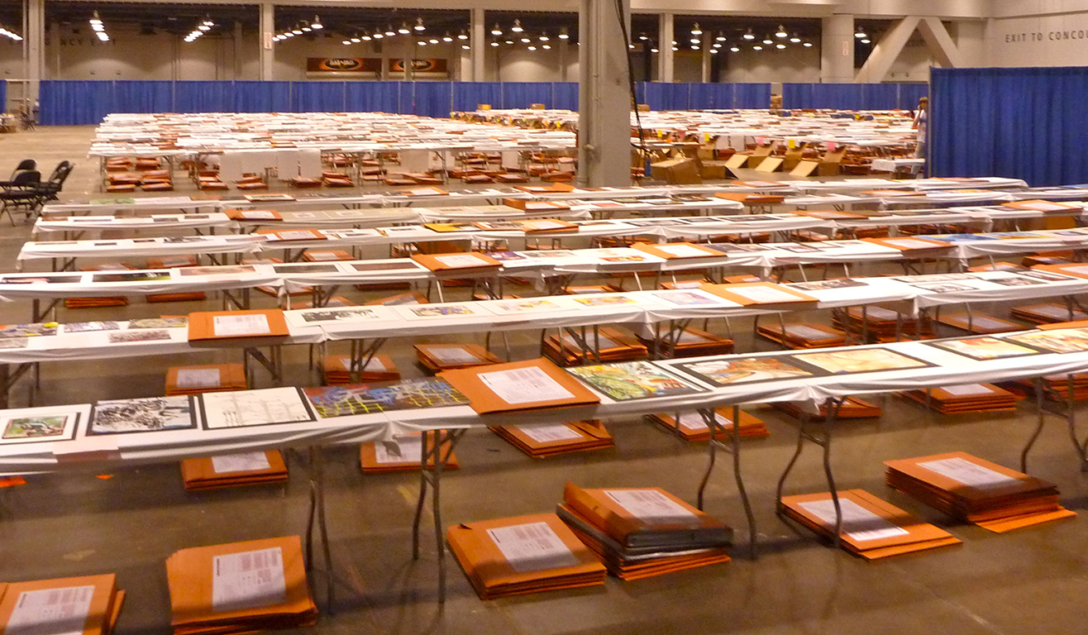
AP Studio Art 2-D Portfolio
2015
by Jeffrey Baykal-Rollins
Notes:
Welcome to the Advanced Placement Studio Art 2-Design Portfolio! In this exam, you may open a portfolio…

Slide 2
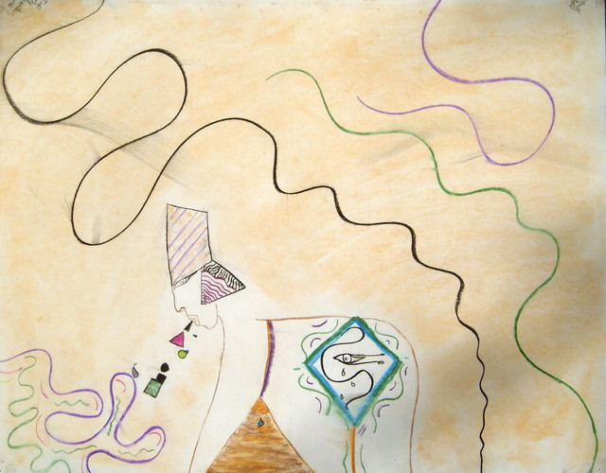
“Retch Like an Egyptian”
Museum of Bad Art (MOBA)
Notes:
And you may find yourself looking at… another part of the world. And you may find yourself…

Slide 3
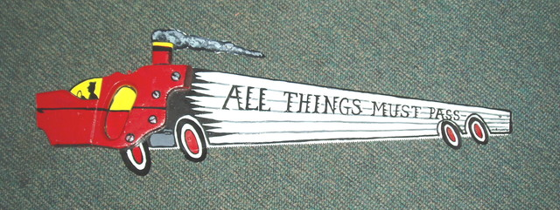
“All Things Must Pass”
Museum of Bad Art (MOBA)
Notes:
staring at the wheels of a large automobile. And you may ask yourself…

Slide 4
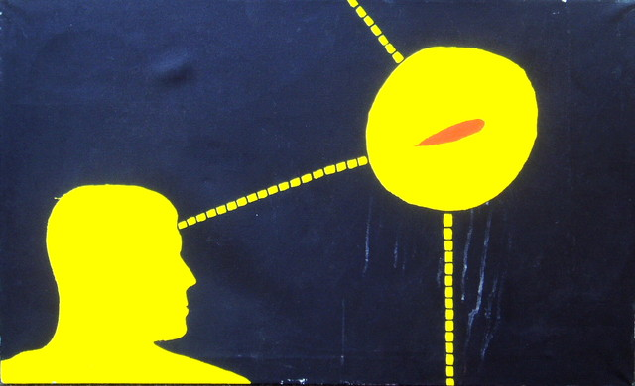
“Germ of an Idea”, Museum of Bad Art (MOBA)
Notes:
well… how did they get there? And you may tell yourself…

Slide 5
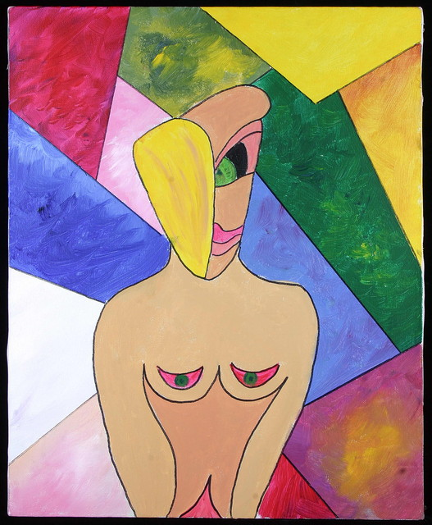
“The Better to See You, My Dear”, Museum of Bad Art (MOBA)
Notes:
this is not a beautiful wife… And you may say to yourself…

Slide 6
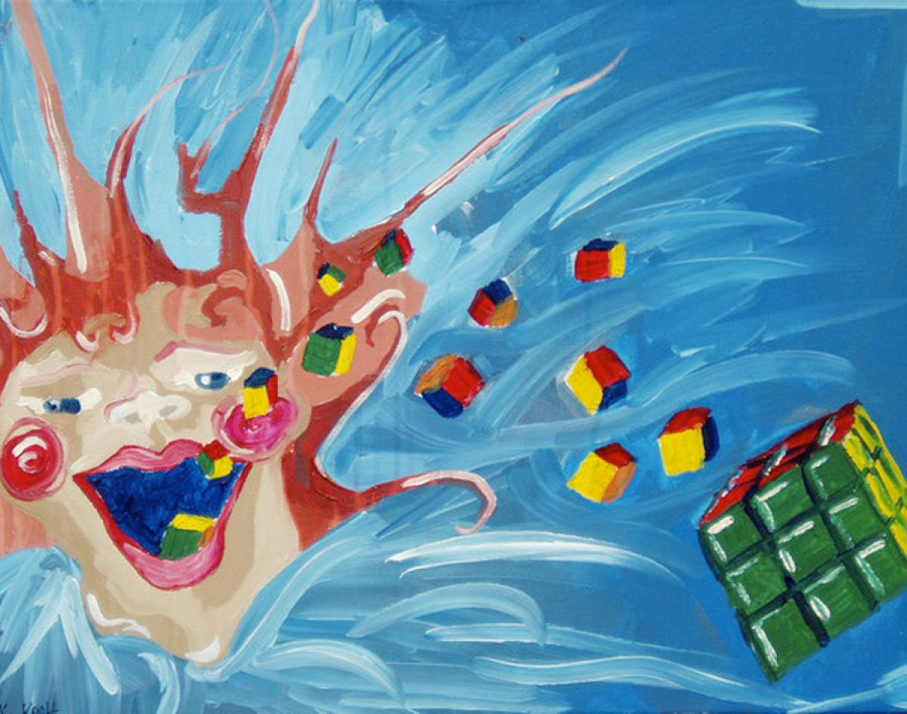
“Spewing Rubik’s Cubes”, Museum of Bad Art (MOBA)
Notes:
my God… what have they done? And you may ask yourself…

Slide 7
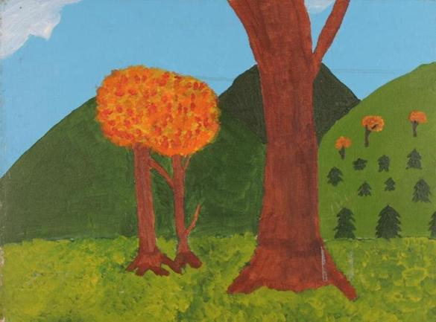
“Two Trees in Love”, Museum of Bad Art (MOBA)
Notes:
how do I work this? And you may see some beautiful pics…

Slide 8
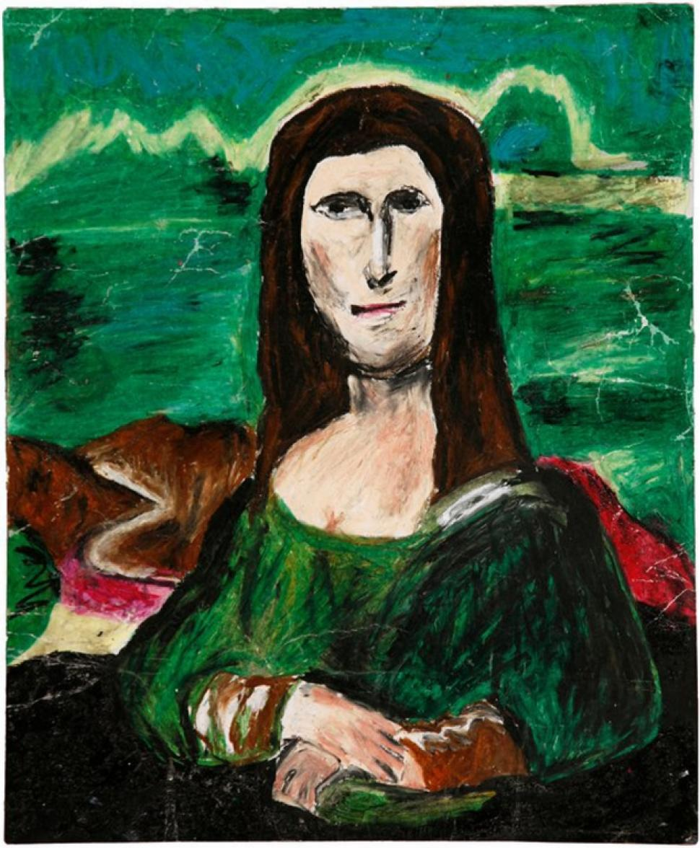
“Mana Lisa”, Museum of Bad Art (MOBA)
Notes:
and you may want to give them a six… And you may ask yourself…

Slide 9
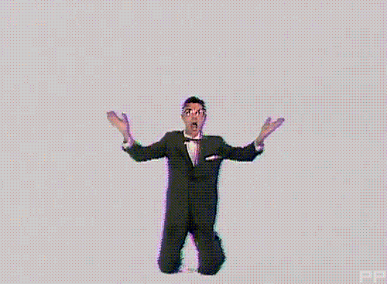
Notes:
am I right… am I wrong? But as the days go by…

Slide 10
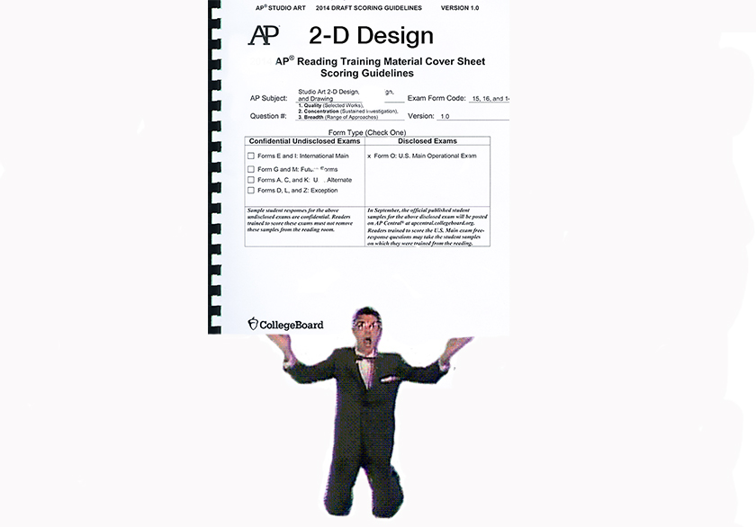
Notes:
Let the rubric hold us down. All of our lifetime…

Slide 11
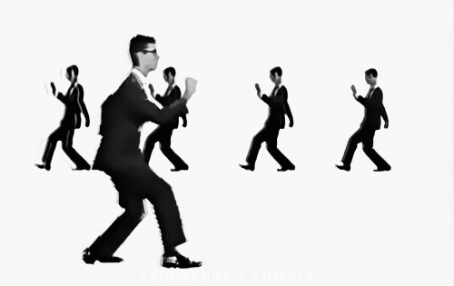
Notes:
Let it be our solid ground. And if you find yourself…

Slide 12
Notes:
stuck on spewing cubes of rubik’s, just come back to yourself…

Slide 13
Notes:
just come back to your rubrics!

Slide 14
PRINCIPLES OF DESIGN
unity/variety
balance/emphasis/contrast
rhythm
repetition
proportion/scale
figure/ground relationships
Notes:
And in this portfolio you may find a student demonstrating their understanding of 2-D design through any two-dimensional medium or process, including, but not limited to, graphic design, digital imaging, photography, collage, fabric design, weaving, fashion design, illustration, painting, drawing and printmaking. This portfolio addresses two-dimensional design issues. The principles of design (unity/variety, balance, emphasis, contrast, rhythm, repetition, proportion/scale, and figure/ground relationships)…

Slide 15
ELEMENTS OF DESIGN
line
shape
color
value
texture
illusion of space
Notes:
can be articulated through the visual elements of (line, shape, color, value, texture, and space).

Slide 16
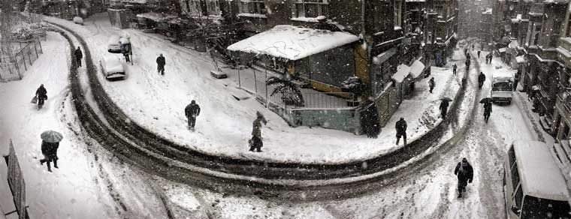
Nuri Bilge Ceylan, film still
Notes:
For example, in this image from Turkey, Nuri Bilge Ceylan uses the element of line to actively engage the visual space, leading the viewer’s eye through tire tracks around the composition from the background, to the foreground, and back again. It doesn’t matter that line is an aspect we normally associate with the Drawing Portfolio, and it doesn’t matter that what we are in fact looking at here is a work of cinema. What matters, is that we look at this image through the lens of two-dimensional design to evaluate the artist’s purposeful decision making, and how they’ve used the elements and principles of art in an integrative way.

Slide 17
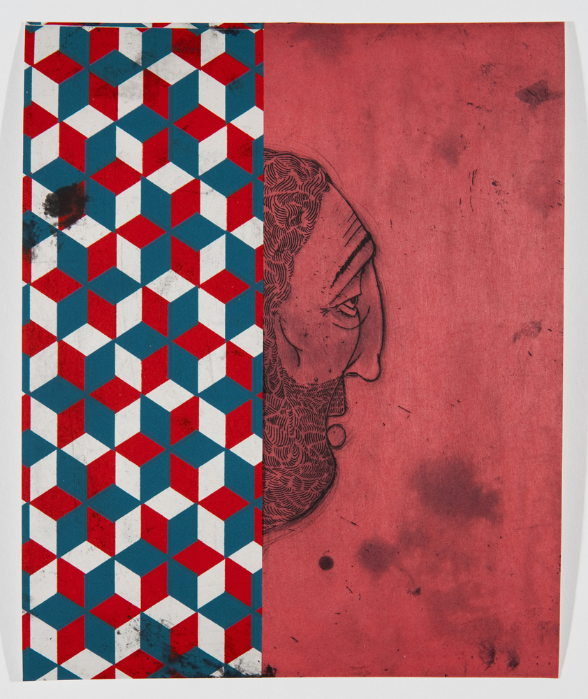
Barry McGee, mixed media on found board
Notes:
We may see mixed media works that challenge us to look through the 2-D design lens, such as that of graffiti artist Barry McGee, who works with repurposed material, combining his own hand-drawn elements with found imagery, producing complex figure/ground relationships through pattern and repetition…

Slide 18
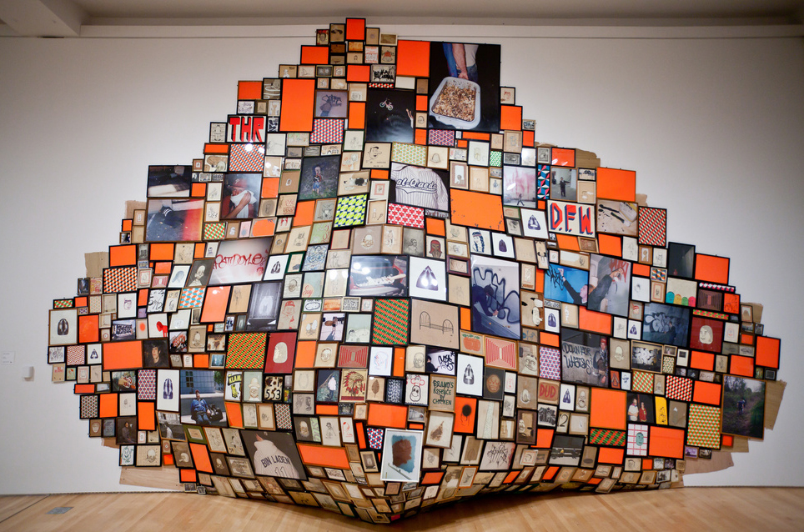
Barry McGee, mixed media installation
Notes:
that extend off the wall into three-dimensional space, but nevertheless can be appreciated for their clear articulation of 2-D design principles.

Slide 19
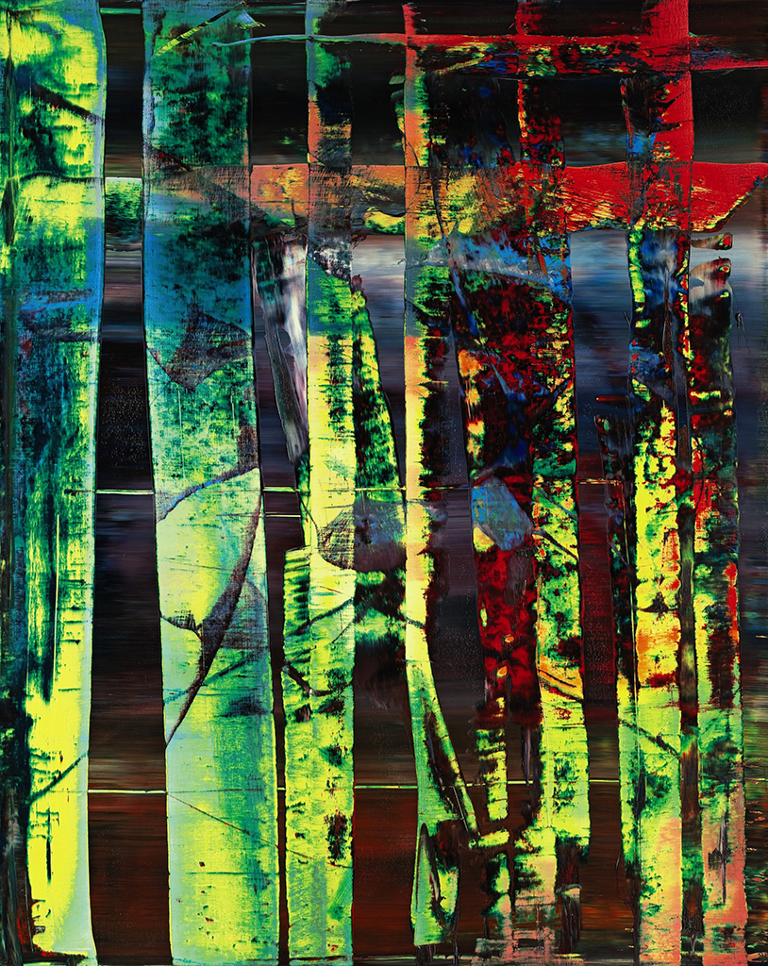
Gerhard Richter, oil on canvas
Notes:
We may see works of abstraction, such as this squeegee painting by Gerhard Richter that explores line, shape, color, value, texture, and space through bold figure/ground relationships.

Slide 20
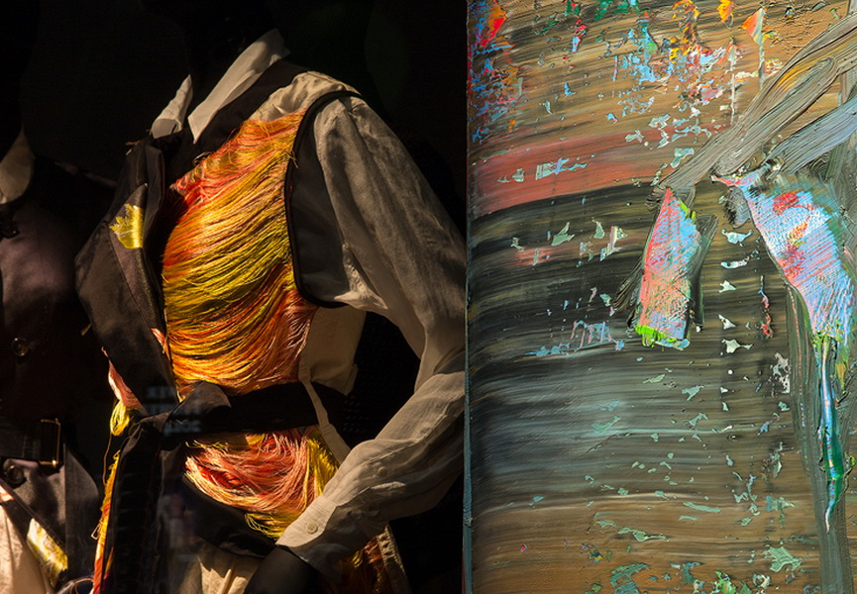
Dries Van Noten, fashion design
Notes:
Looking through the 2-D lens we may even see works of fashion that challenge us to look past their form to the surface the designer has constructed, such as this garment by Dries Van Noten, based on a specific Gerhard Richter painting.

Slide 21
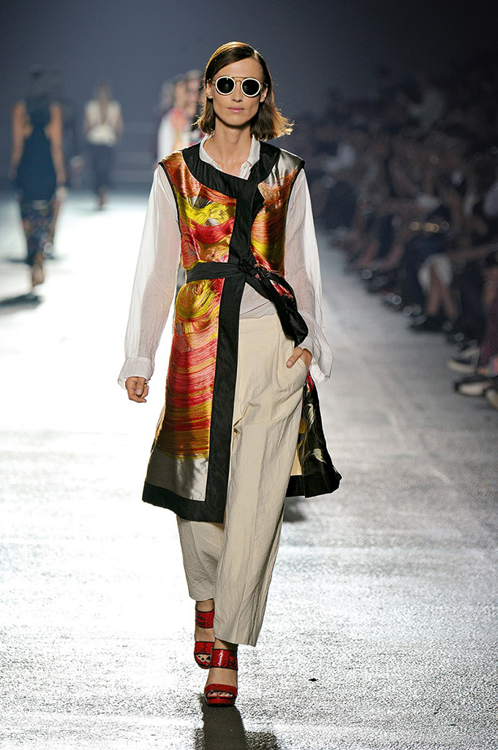
Dries Van Noten, fashion design
Notes:
How do we do this? The same way we evaluate the Richter painting – by considering how effectively all the elements of the two dimensional surface have been designed in an integral way.

Slide 22
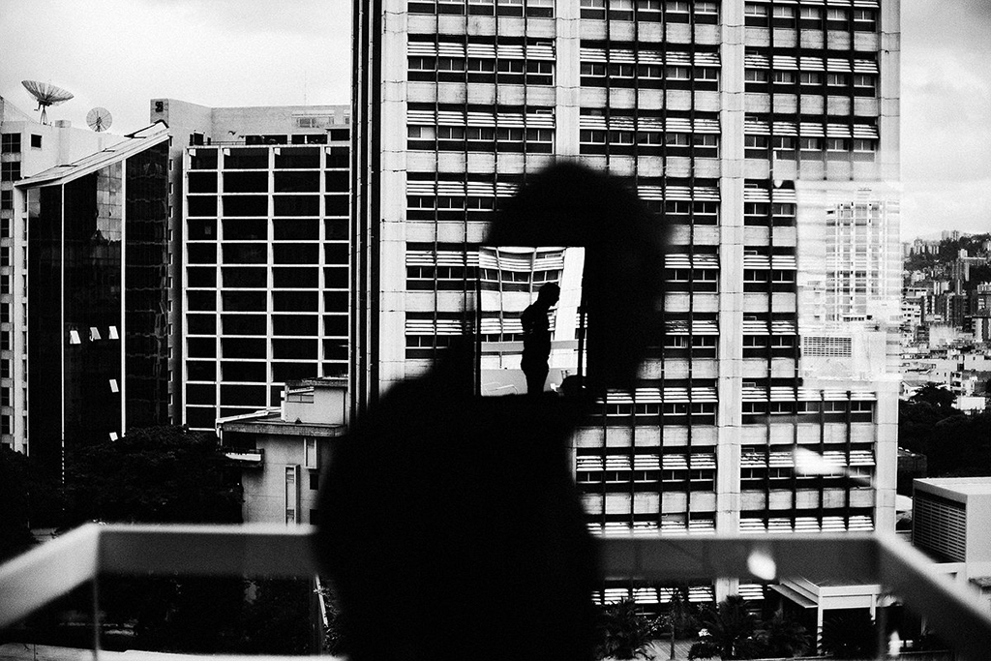
Christopher Anderson, digital photograph
Notes:
We will see photography, maybe even documentary, such as this image by Christopher Anderson, which utilizes a range of elements and principles of design to create visual layers, deepening the layers of meaning in the process.

Slide 23
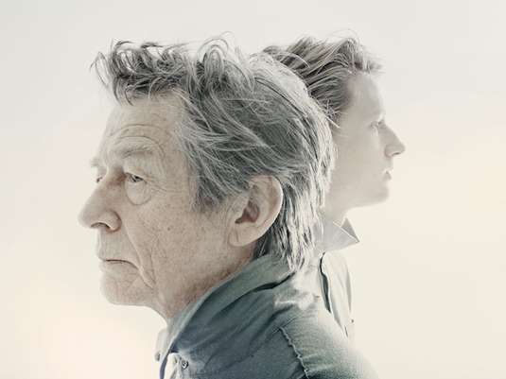
Christopher Anderson, digital photograph
Notes:
In fact, Christopher Anderson is so skilled at narrating his stories through the language of 2-D design that in this photograph he manages to utilize desaturated color to tell one story of faded memory on the older man’s face while the same color indicates a bright future –an entirely different story on the face of the younger man. This is a very good reminder that a strong use of color does not necessarily mean using large amounts of color!

Slide 24
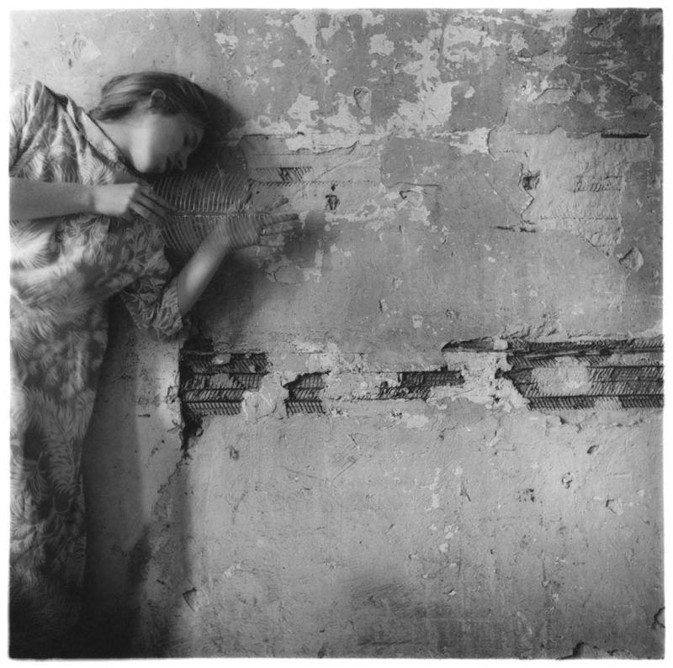
Francesca Woodman, photograph
Notes:
Francesca Woodman, who shot almost exclusively self-portraits, intuitively explored varieties of the elements and principles of design while she explored her own self-image. Finding a wall that offered rich possibilities in line, shape, texture, and pattern, she returned to photograph herself with a fish spine that would visually connect her body to that surface, while she also clothed herself in a dress that repeated those same patterns and texture even further.

Slide 25
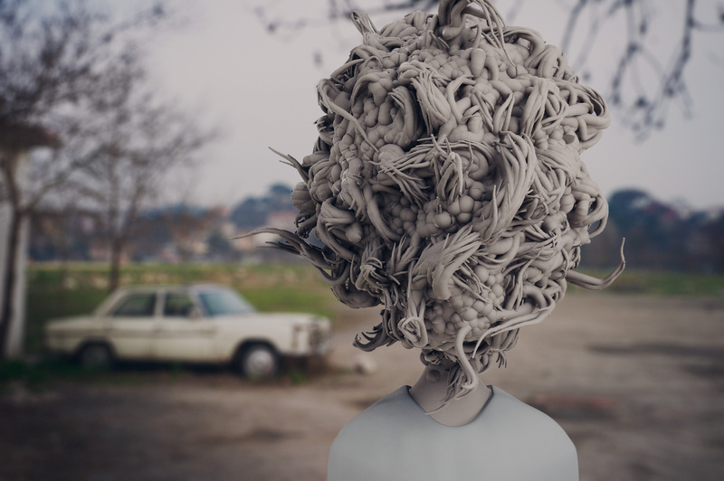
Can Pekdemir, digital photograph
Notes:
We may see photographs, especially digital images, where we are not really sure what we are looking at, or how the image was made. Conceptual artist Can Pekdemir deforms the body through a series of mathematical algorithms in digital 3D design. Yet the final form of these disquietingly constructed realities are always two-dimensional digital prints. As a body of work, this is something we could just as easily come across in the 3-D Design portfolio, but here we are asked to evaluate it as a 2-D digital image.

Slide 26
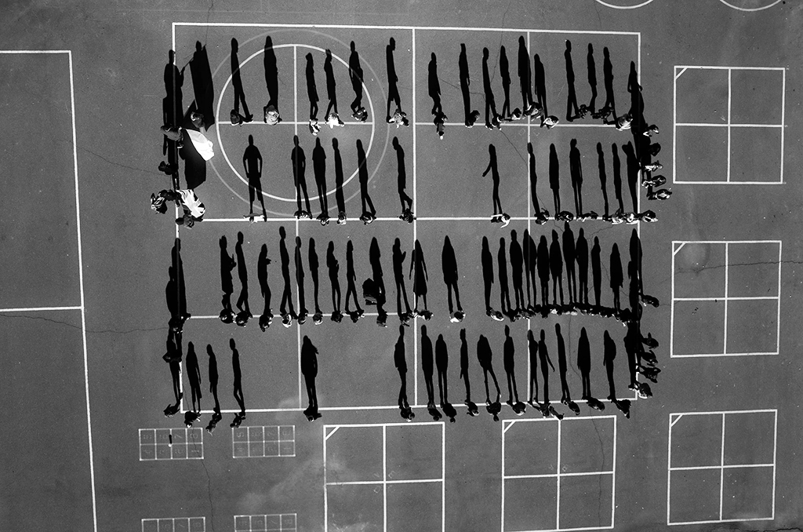
Tomas van Houtryve, drone photograph
Notes:
Technology is changing design, especially digital imaging at a dizzying speed. This year for example, maybe for the first time in this exam, we may see drone photography, yet another digital tool available to our students today. Regardless of the tool, what we need to be asking ourselves is: how is the student using that tool? Tomas van Houtryve travels across America and employs a drone to photograph the very sorts of gatherings that have become habitual targets for foreign air strikes – weddings, funerals, groups of people praying or exercising. These are carefully constructed compositions the photographer observes and positions through a monitor on the ground, exploiting the elements and principles of design to question the very nature of surveillance, personal privacy, and war.

Slide 27
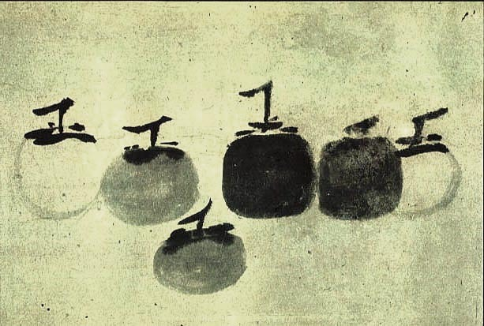
Mu Qi, ink on paper
Notes:
We may be challenged, with a work like this 13th Century ink painting by Mu Qi, to look beyond the deceptively simple to appreciate the subtlety and sophistication of such a confident gesture, achieving unity and variety with economy of means. Although gesture is something we tend to associate often with the Drawing Portfolio, every single image we will see in 2-D Design is just as much the result of a gesture made with some kind of tool, whether that be a bamboo brush, or by drone.

Slide 28
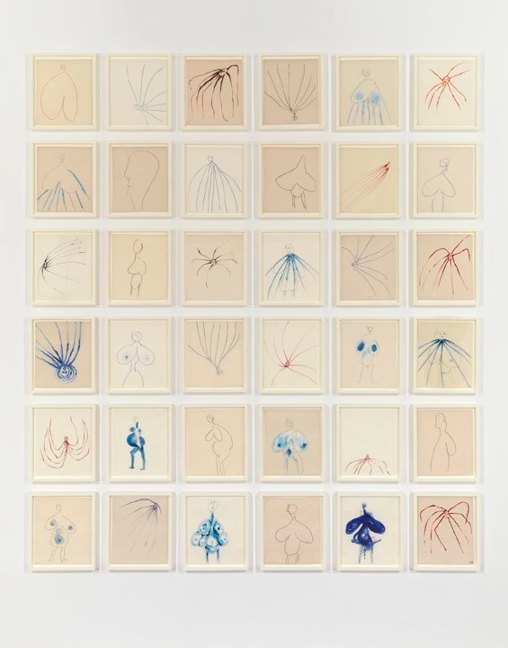
Louise Bourgeois, Digital prints and screenprints with dye additions
Notes:
And maybe that gesture is in the form of the concentration itself: a truly sustained investigation in variations on a theme. This series of drawings by Louise Bourgeois is extensive but never repetitive, through its playful connections between human, insect, fertility, the cosmos, the Greek Artemis, and the Black Madonna – all of this – executed with so very few lines! This is a superb example of how important the distinction can be between what is naively childish and what is insightfully childlike.

Slide 29
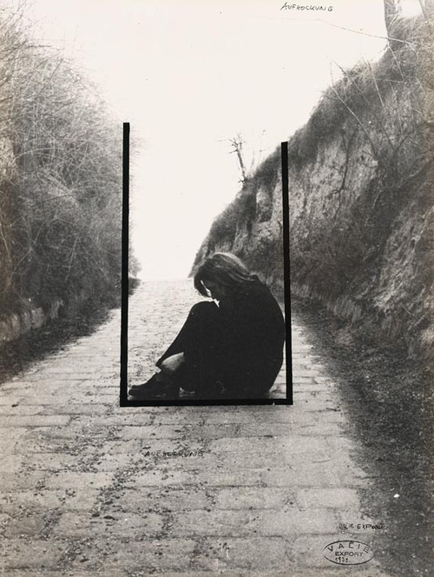
Valie Export, performance/photograph
Notes:
We may see gestures that extend into the realm of performance art, like that of Valie Export, where, through the 2-D design lens we can observe inventive juxtapositions of figure and ground using interactions between line and shape. The photograph in this case is more than merely a document of a performance - the performance was carefully composed for the camera’s lens, from within the frame-within-frame.

Slide 30
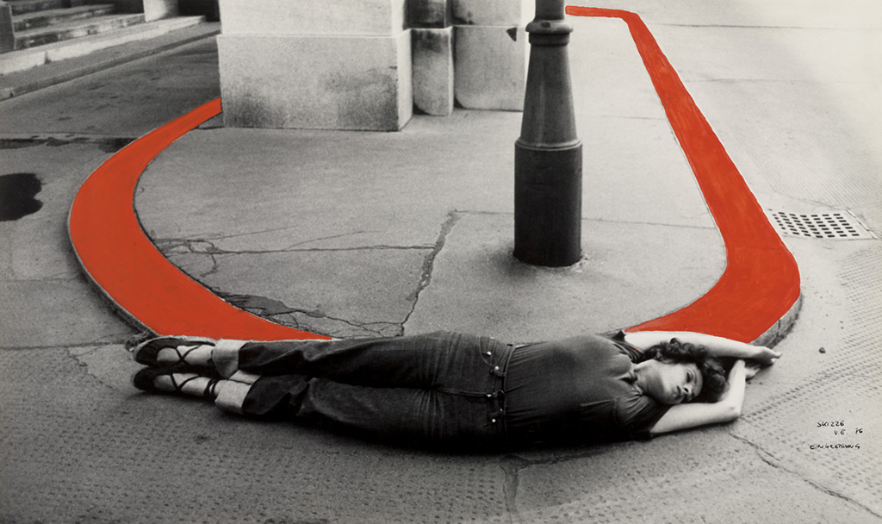
Valie Export, performance/hand-colored photograph
Notes:
In other works Vaile Export extends that bodily gesture back into the final image by hand-painting it.

Slide 31
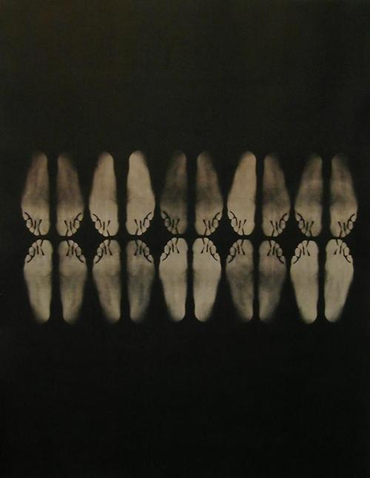
Rashid Johnson, photo-emulsion print
Notes:
In some of the work we will see, gestures can take on conceptual meanings, through the conscious arrangement of elements that resonate with various associations. Rashid Johnson’s Manumission Papers, are geometrically arranged abstractions of feet, named for the papers that freed slaves, a study in racial identity investigated through repetition, pattern, and rhythm.

Slide 32
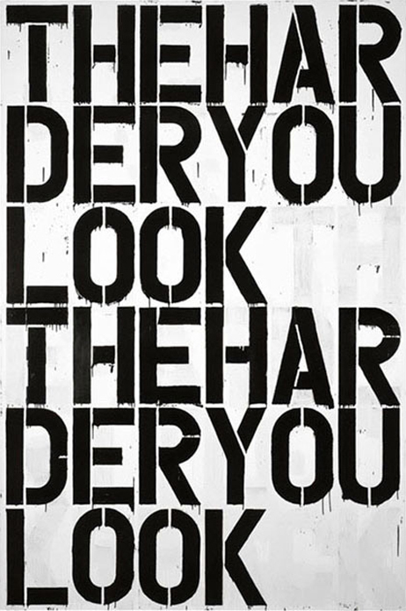
Christopher Wool, enamel paint on aluminum
Notes:
We may see works of typography, works that literally have something to say, in the way that they say it, like this painting by Christopher Wool.

Slide 33
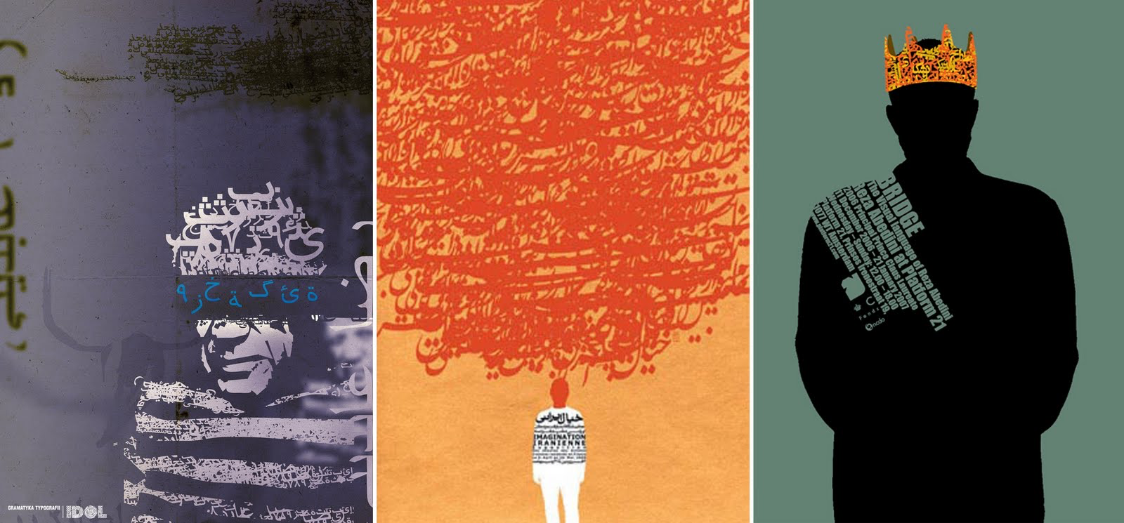
Reza Abedini, graphic design
Notes:
We may see typography in languages we don’t understand, yet skillfully designed, nevertheless communicating much indeed, such as these by Iranian designer Reza Abedini.

Slide 34
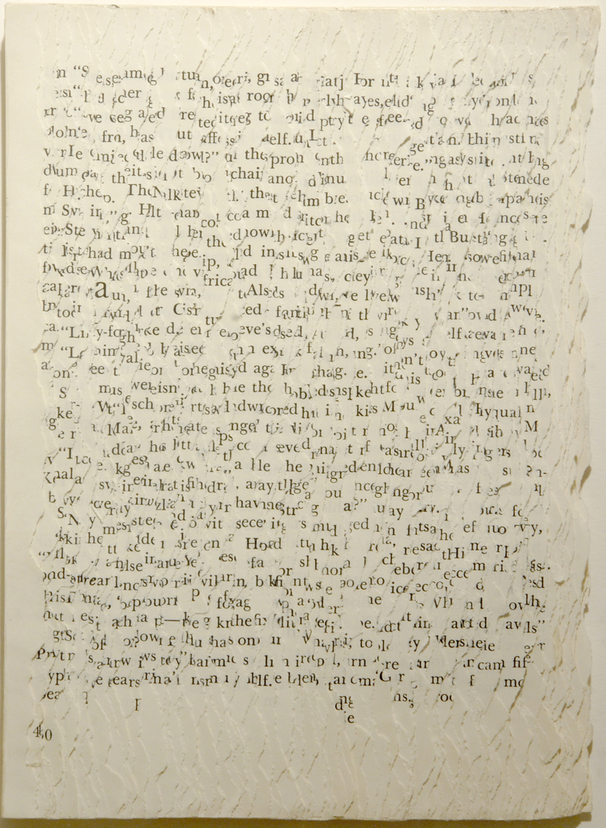
Buzz Spector, altered book
Notes:
And we may also see works of typography that are exploring the very challenges of communication, the difficulty of reading, such as this altered book by Buzz Spector.

Slide 35
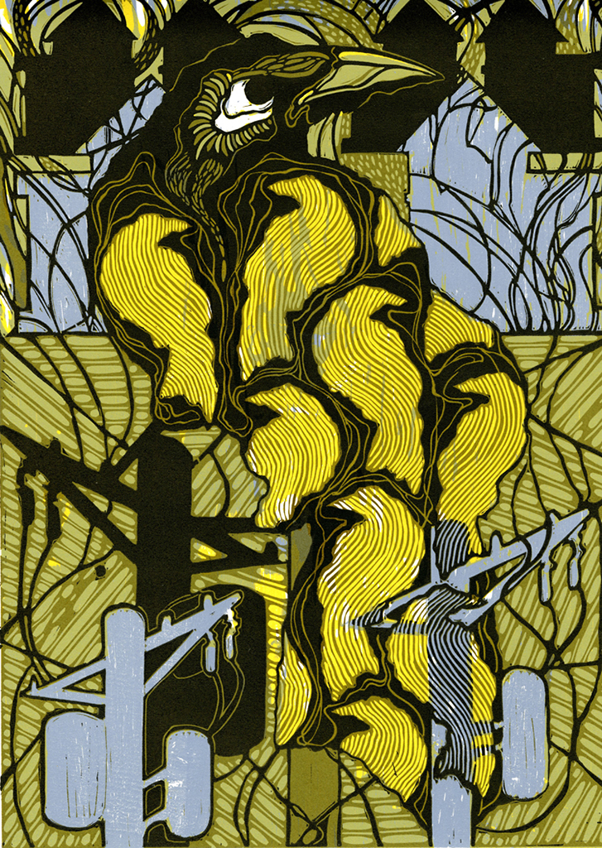
Dale Clifford, linocut and woodcut print
Notes:
We will see printmaking, using one of many different techniques available to our students today, or even a combination of techniques such as this linocut and woodcut by Dale Clifford.

Slide 36
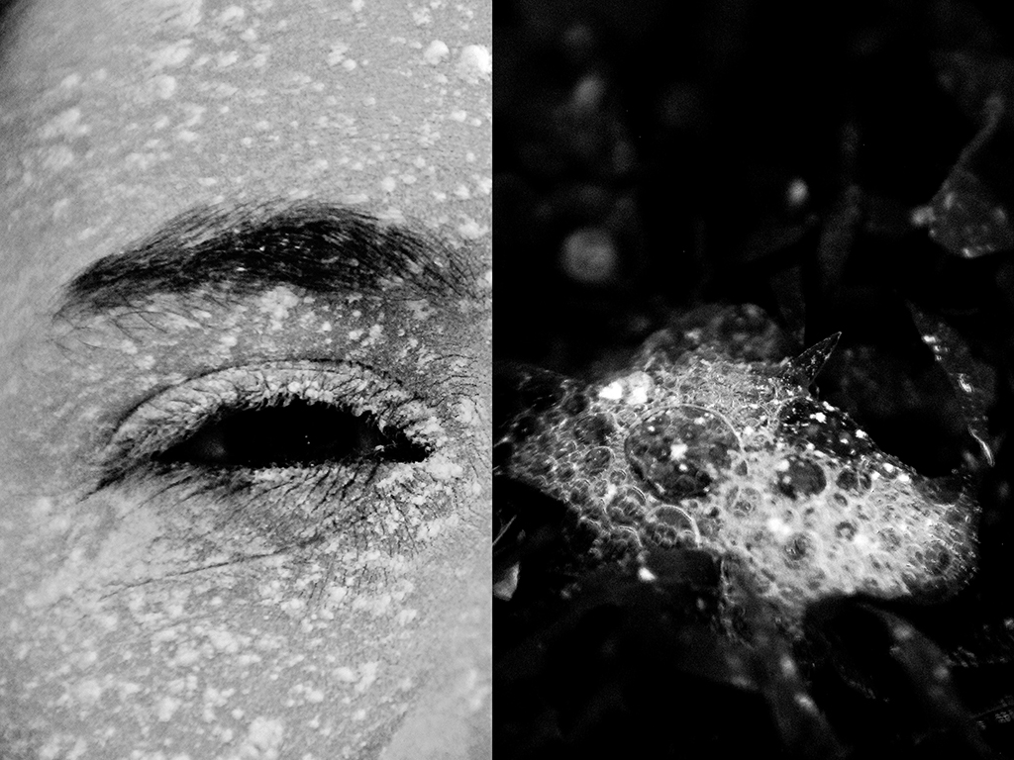
Student Work, digital photograph, Robert College, Istanbul
Notes:
But ultimately, in these portfolios we will not be seeing the work of professional artists and designers as these. We will be seeing the work of students. The portfolios we see may demonstrate breadth through experimentation and a range of conceptual approaches, in a single medium, or in a variety of media. Through multiples…

Slide 37
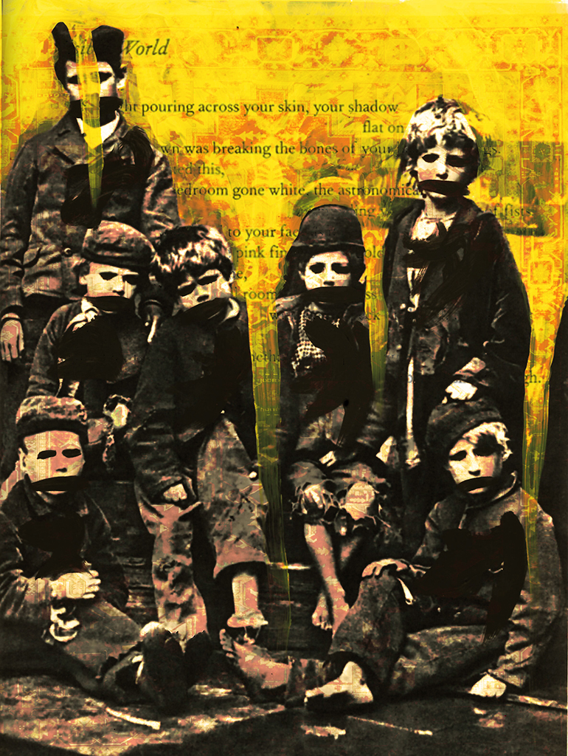
Student Work, acrylic on digital photograph, Robert College, Istanbul
Notes:
Through mixed media.

Slide 38
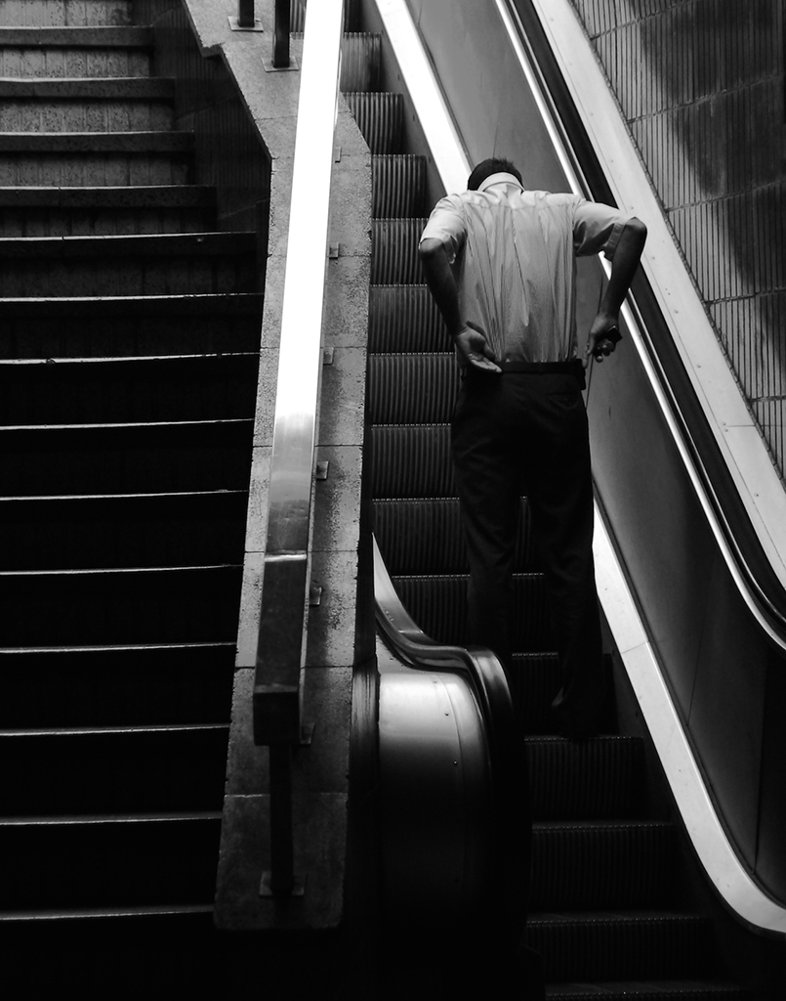
Student Work, digital photograph, Robert College, Istanbul
Notes:
Through conventional digital photographs that keenly utilize the elements and principles of design, such as line and shape.

Slide 39
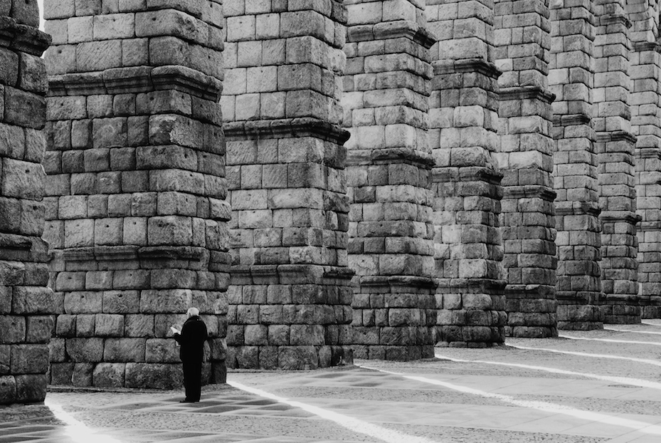
Student Work, digital photograph, Robert College, Istanbul
Notes:
Or through proportion, scale, and visual weight.

Slide 40
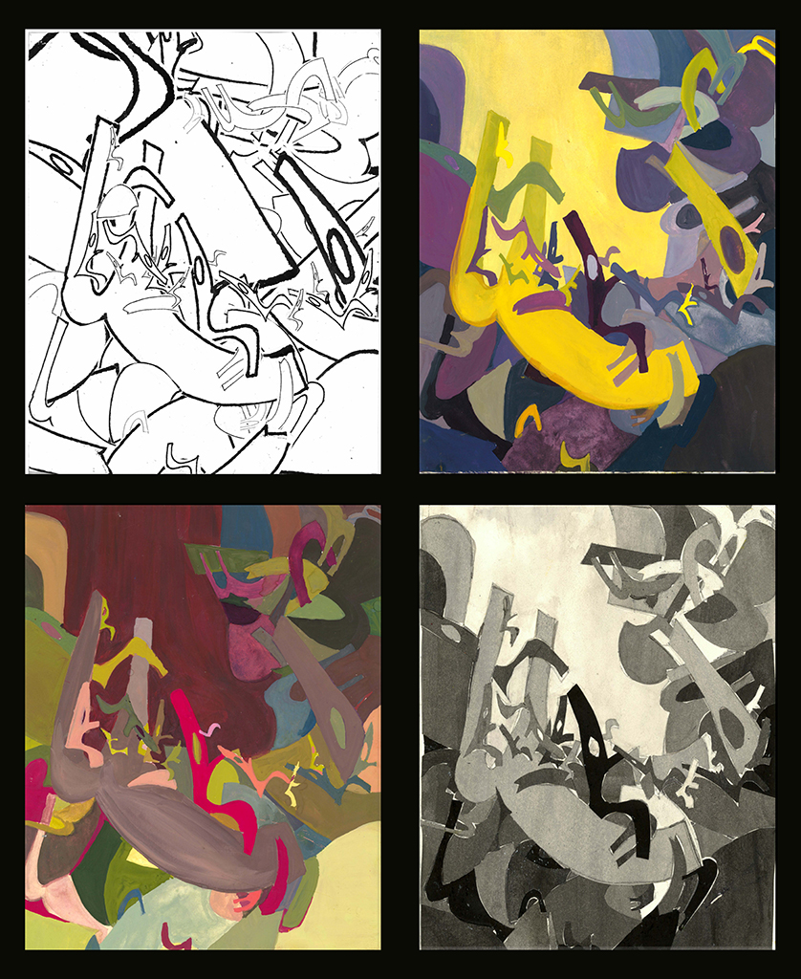
Student Work, ink and acrylic on board, Robert College, Istanbul
Notes:
We may see classroom exercises, particularly in the Breadth section, where the student manages to move beyond the assignment to express their own unique voice.

Slide 41
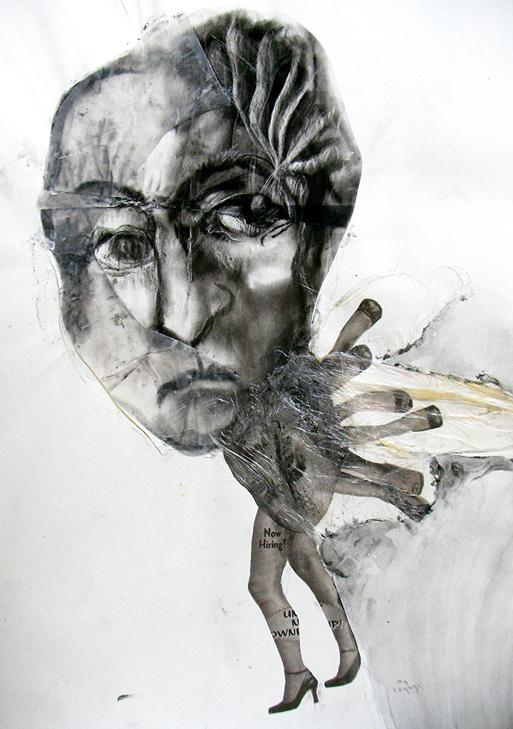
Student Work, charcoal, ink, collage and plastic wrap, Robert College, Istanbul
Notes:
We may see purposeful distortions of form.

Slide 42
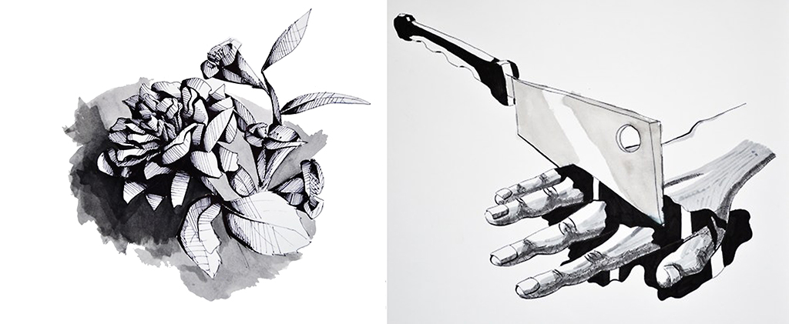
Student Work, ink on paper, Robert College, Istanbul
Notes:
We may see illustration, such as this student…

Slide 43
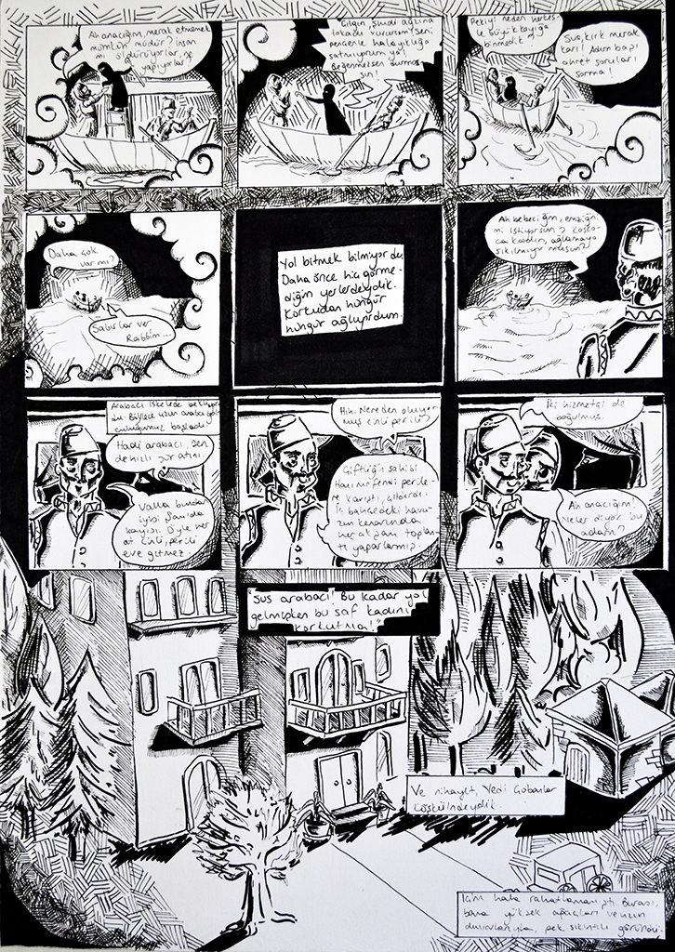
Student Work, ink on paper, Robert College, Istanbul
Notes:
whose concentration consisted of twelve of the pages of a graphic novel she wrote and conceived.

Slide 44
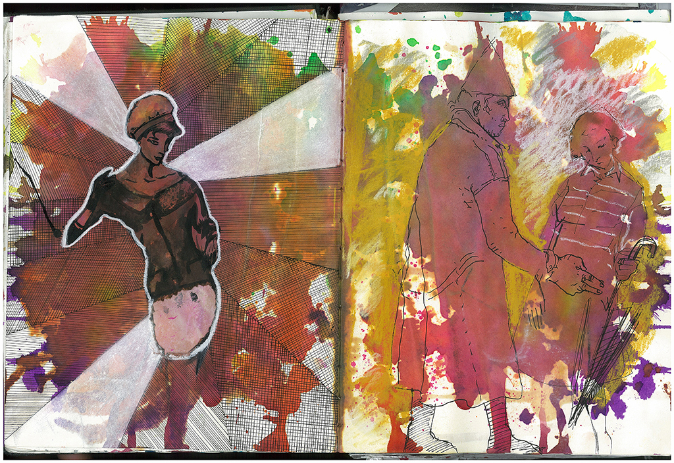
Student Work, sketchbook, Robert College, Istanbul
Notes:
We may see work in sketchbooks, where on one page this student experimented with illustration…

Slide 45
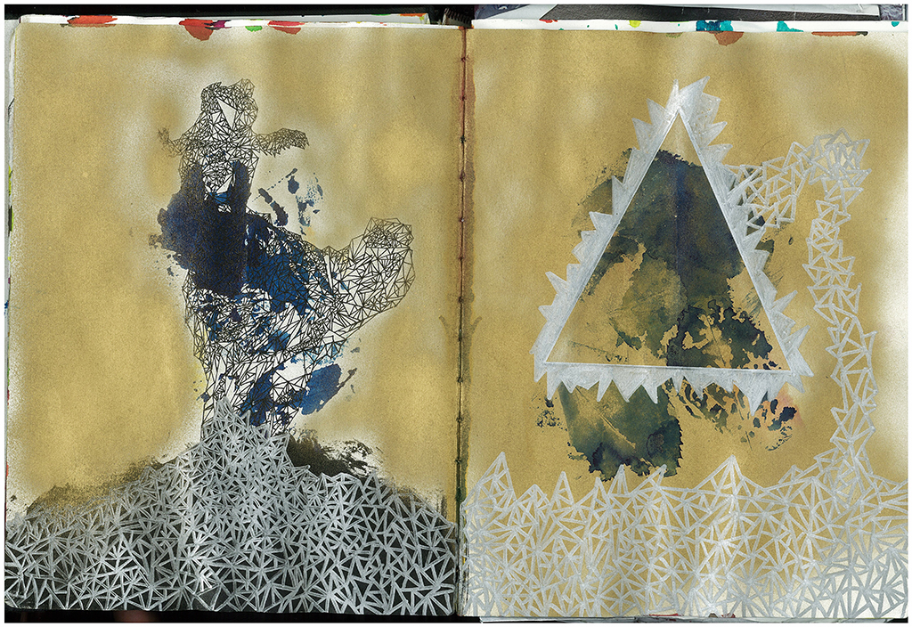
Student Work, sketchbook, Robert College, Istanbul
Notes:
and on another page experimented with abstraction.

Slide 46
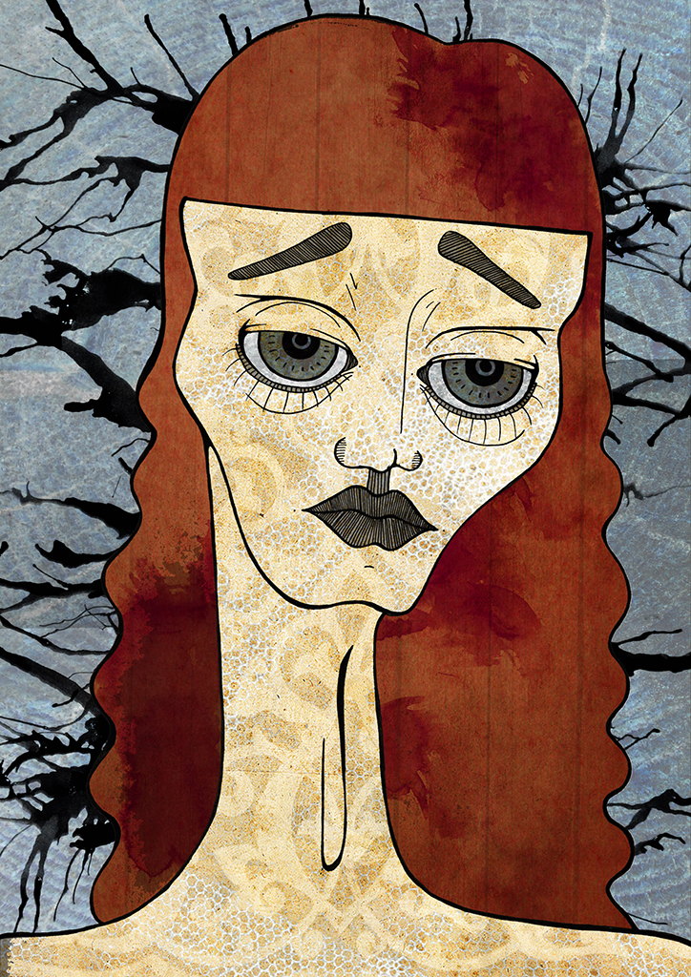
Student Work, ink on paper, Robert College, Istanbul
Notes:
This student also included works of illustration in his portfolio, but this – very multi-dimensional student felt compelled to show breadth through his many interests and passions…

Slide 47

Student Work, digital photograph, Robert College, Istanbul
Notes:
through documentary photographs…

Slide 48
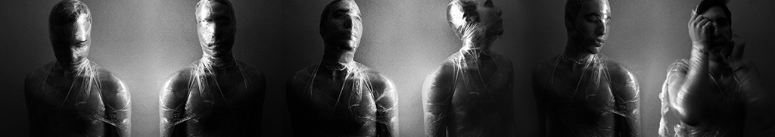
Student Work, performance/digital photograph, Robert College, Istanbul
Notes:
and even through performative self-portraits.

Slide 49
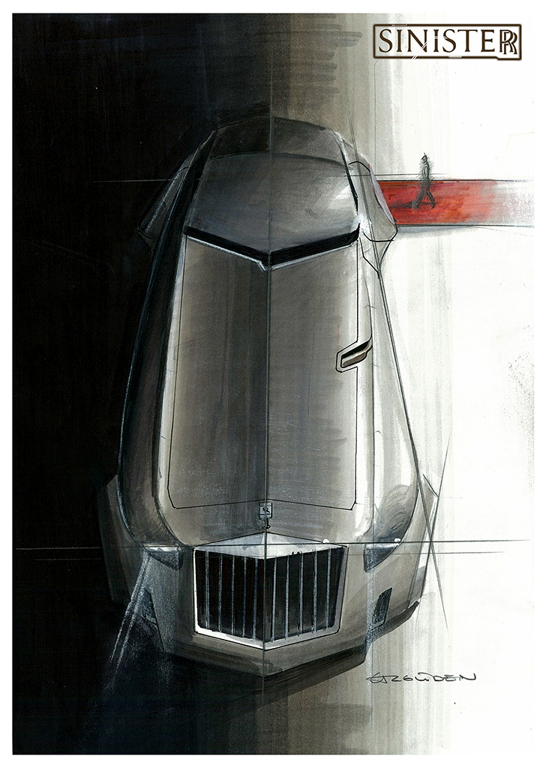
Student Work, pencil and ink on paper, Robert College, Istanbul
Notes:
In the 2-D design portfolio we will see examples of product design, maybe even auto design, such as the work of this student, whose concentration consisted of designing a luxury car for evil. In addition to a series of well-rendered drawings depicting different aspects of his vehicle…

Slide 50
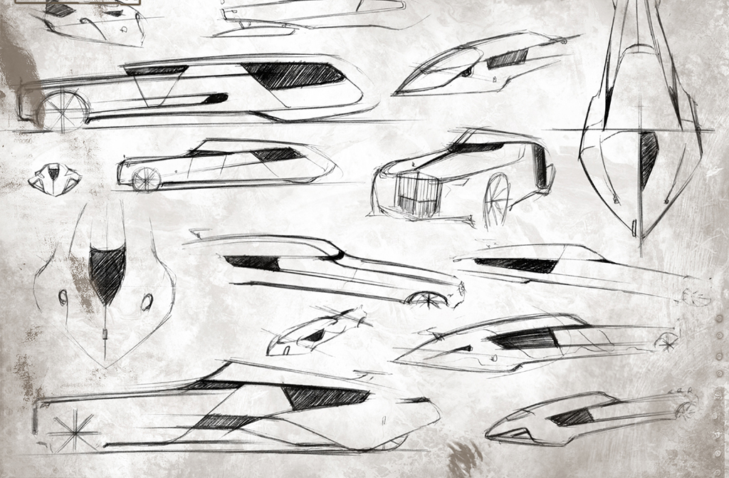
Student Work, ball point pen on paper, Robert College, Istanbul
Notes:
he included preliminary sketches working out his idea over an extensive period of time. In fact, in the AP portfolio, students are now actively encouraged to show images that document their process of thinking and creating. This can give the exam Readers important insight into the working process of certain bodies of work that we otherwise may not be able to appreciate by simply looking at twenty-four finished pieces. For example, in the case of this student, this sketchbook page was one of more than three thousand he produced each year.

Slide 51
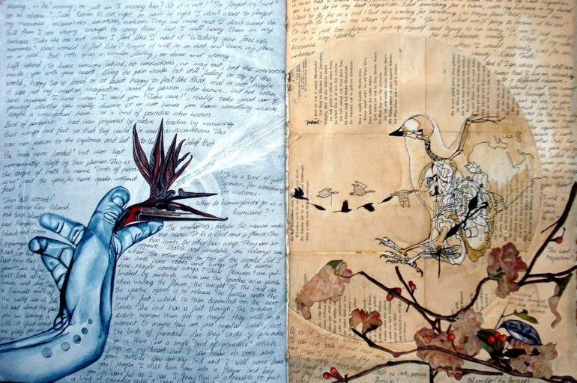
Student Work, sketchbook, Robert College, Istanbul
Notes:
Each student, in their own way, reveals their own unique process. Sketchbook pages or process documentation may contain valuable scribbles of fragments of thought, or they may contain multilayered pages that feel like finished works, in and of themselves. This student labored intensively over everything she did…

Slide 52
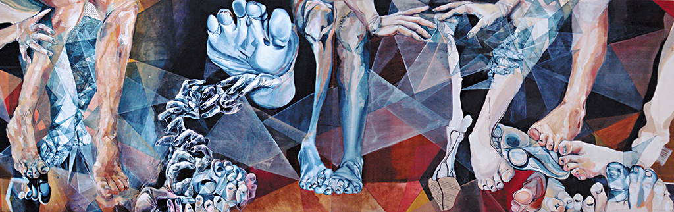
Student Work, oil and acrylic on wood, Robert College, Istanbul
Notes:
and even though her concentration topic was simply “hands and feet”, her elaborate investigation of this topic was anything but simple, consisting of sketchbook pages, photo realist drawings, collages, and even a ten-foot long painting like this!

Slide 53
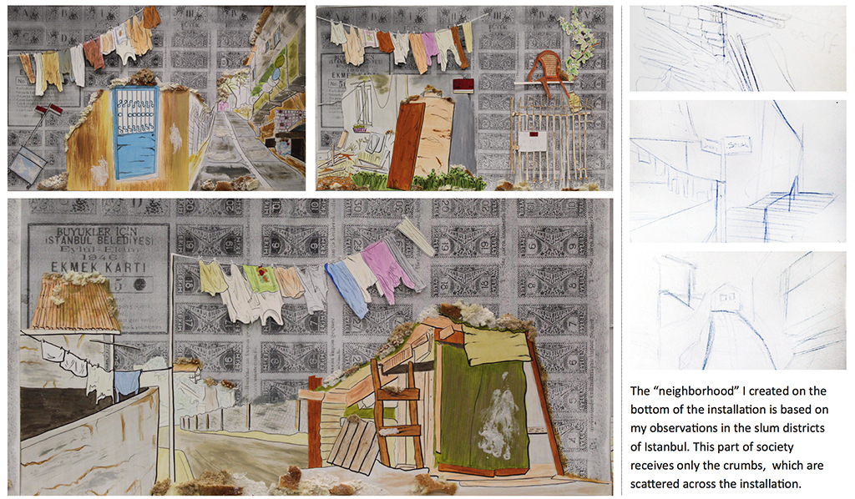
Student Work, ink, acrylic and bread crumbs on vintage ration cards
Robert College, Istanbul
Notes:
Last year this student decided to tackle the very ambitious topic of "Bread and Social Justice" for her AP concentration. She used old Turkish ration cards from World War II and drew and painted images of poverty across their surface, even gluing in bread crumbs. She spent months researching in poor neighborhoods, shooting photographs, and conducting interviews in local bakeries. At the end of the year, she scored well on her AP portfolio, but her devotion to this project had only just begun. She went on to develop a bread distribution program through a number of bakeries where customers could buy extra loves that would be delivered to people in need, designing the logo and entire campaign which continues to spread even today. So the concentration evolved this young woman from student to designer, and from designer to visual citizen.

Slide 54
Notes:
How did they get there?… you may ask yourself. And you may say to yourself… my god… what they have done!

