Slide 1
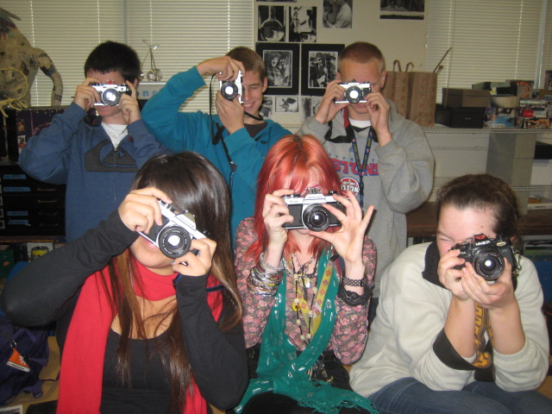
PHOTOGRAPHY
Johanna Herrera
jherrera@srcs.org

Slide 2
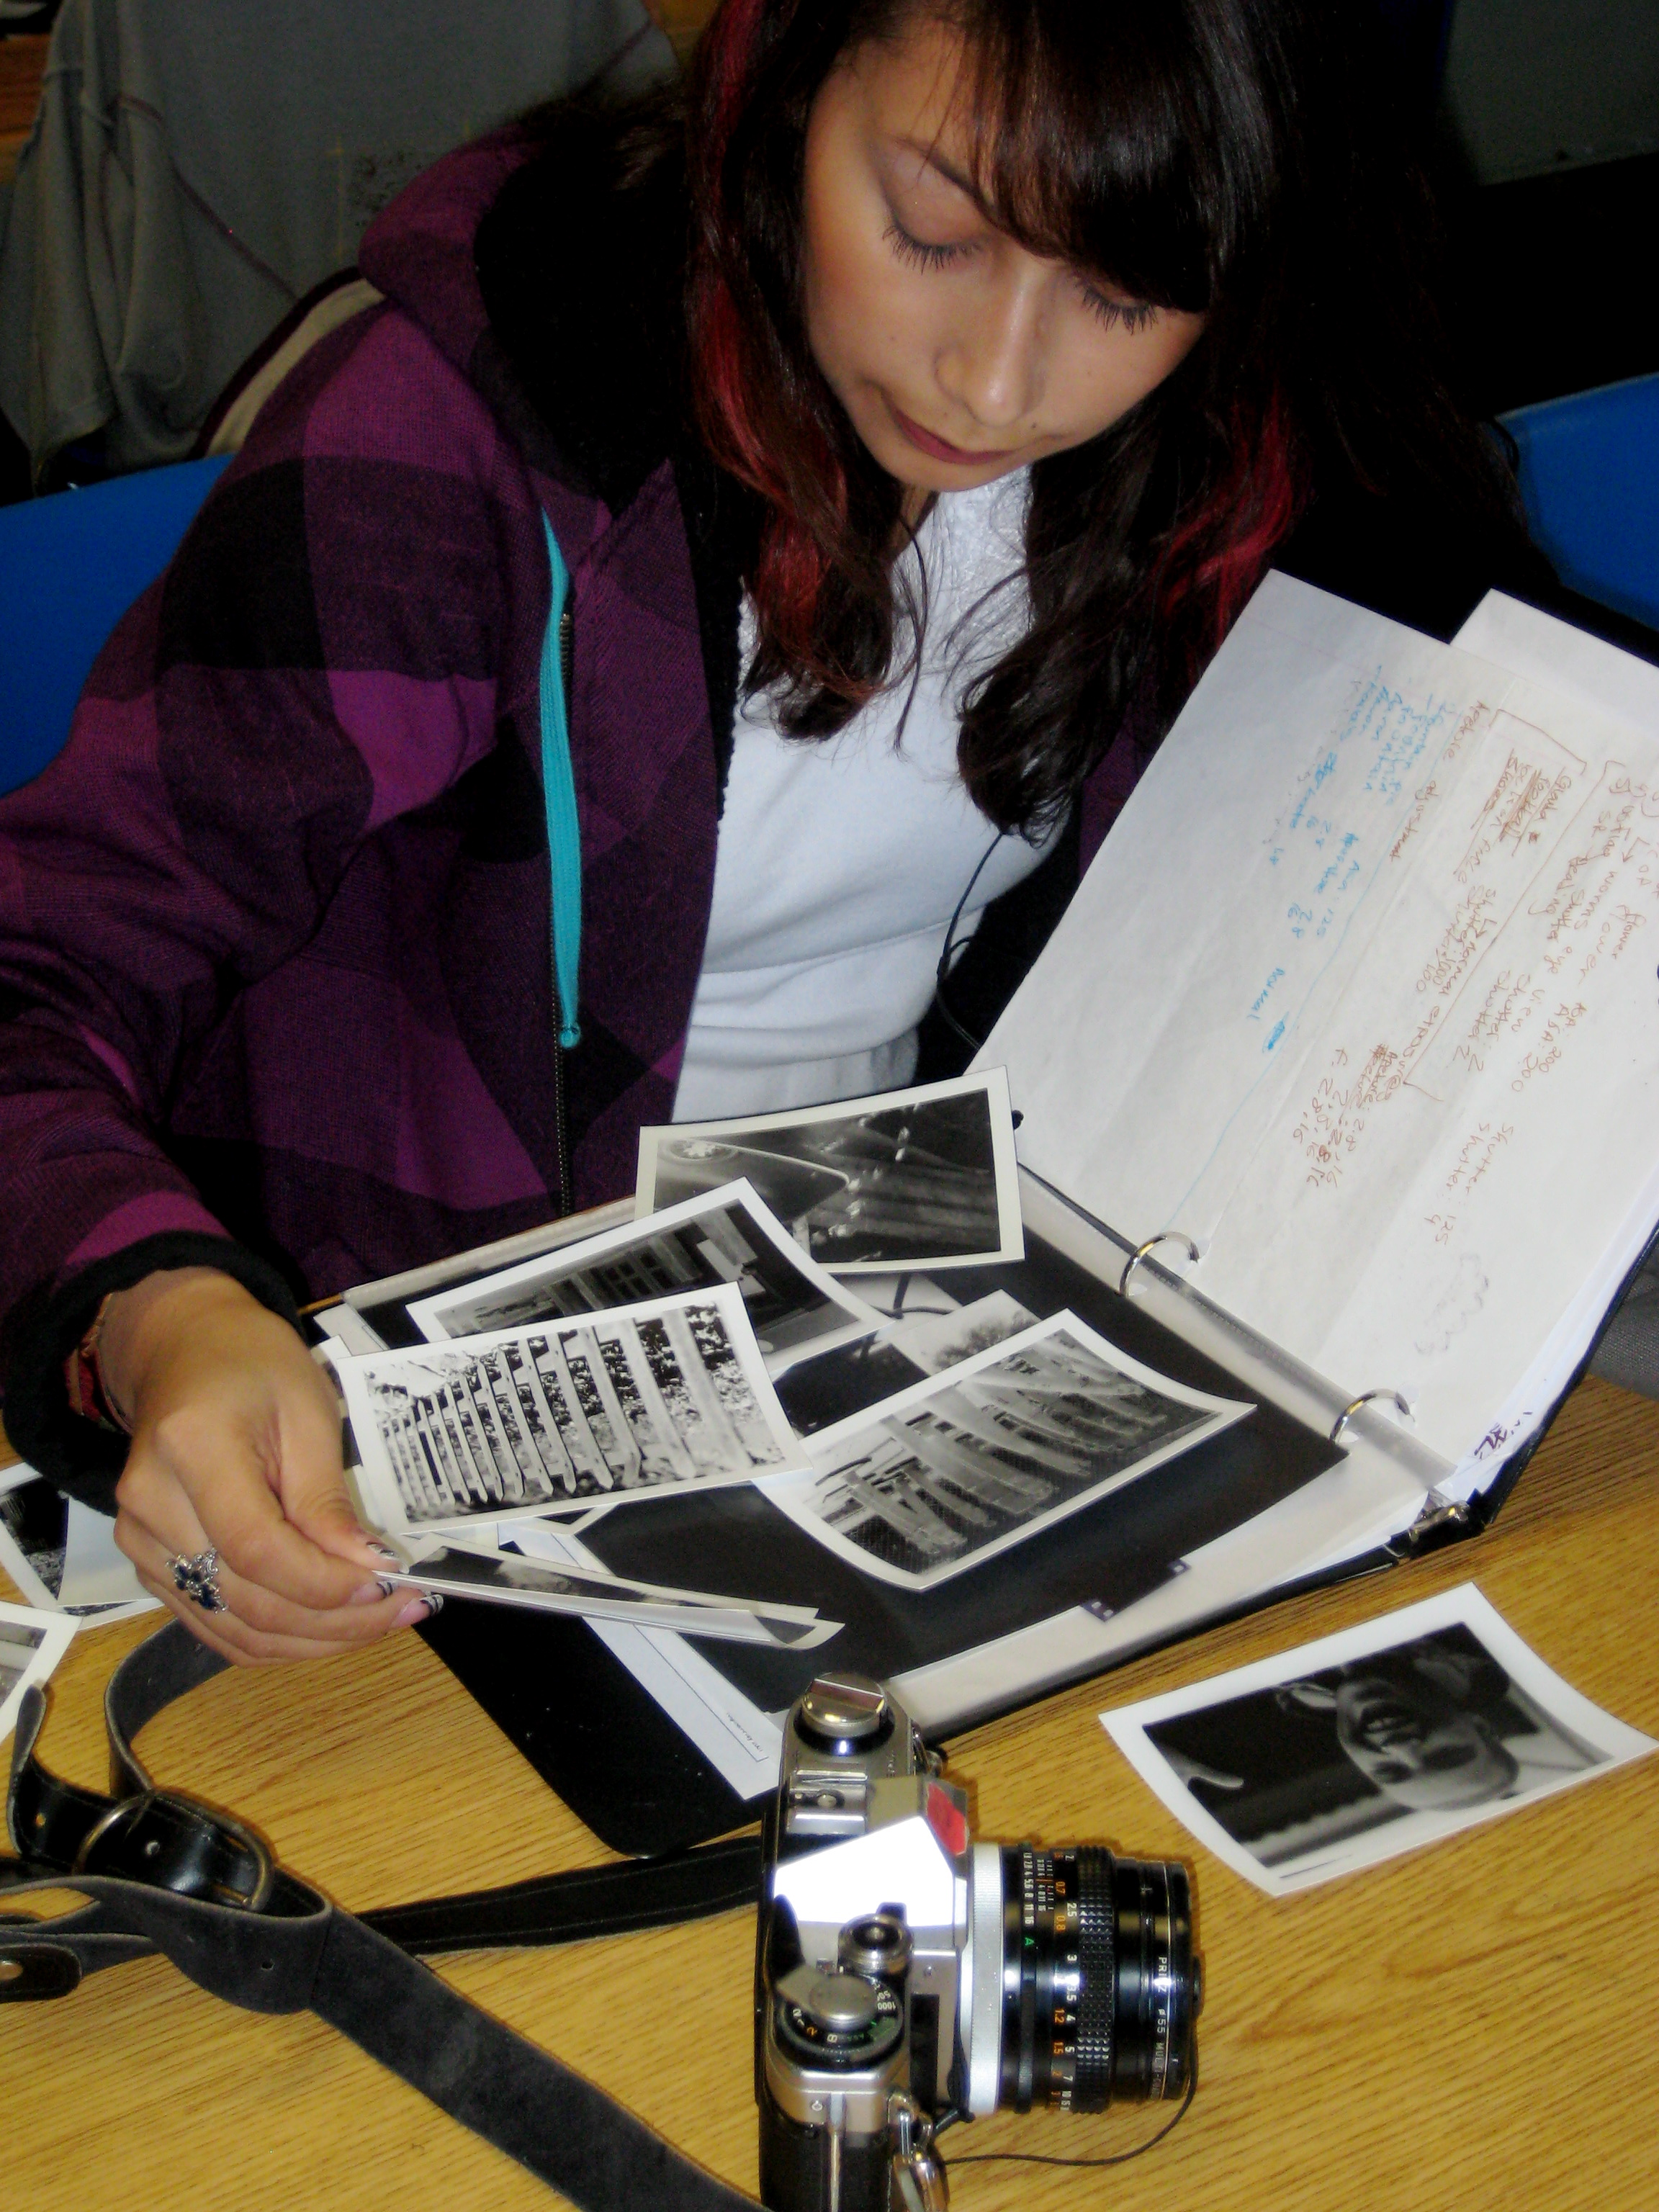
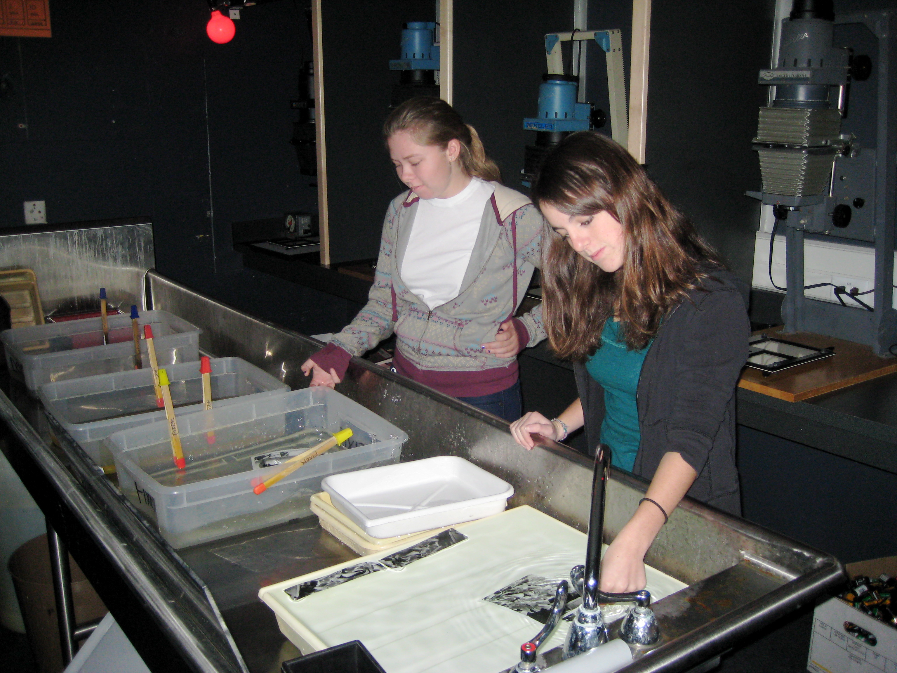
COURSE DESCRIPTION:
Photography 3-6 is a course in black and white film photography which concentrates on :
technical skills
creativity
composition
alternative processes
study of historical and
contemporary photographers

Slide 3
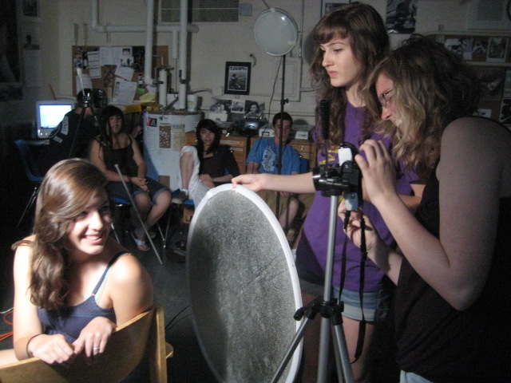
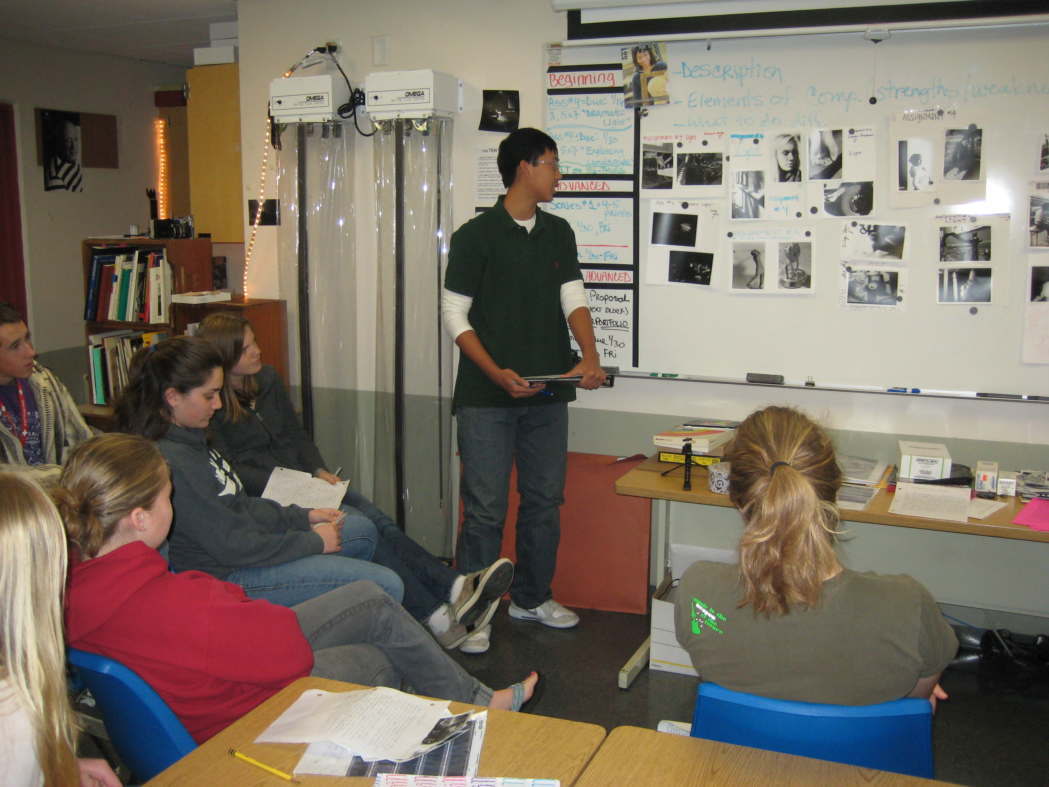
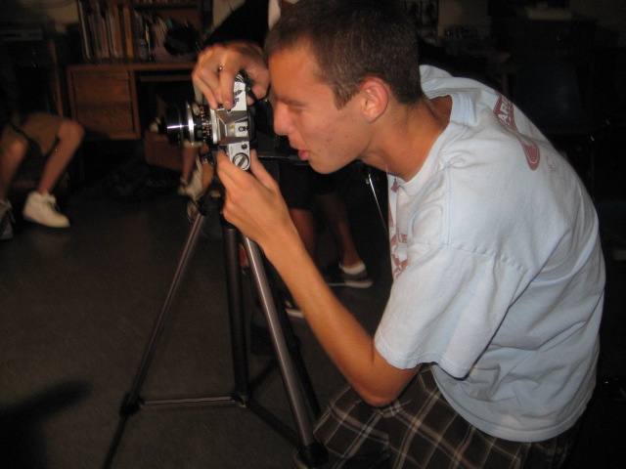
Expectations:
This course requires and includes:
Classroom lectures and demos
2-3 hours weekly spent processing film and working in the darkroom
Shooting assignments for homework outside of class
Students are expected to use classroom time wisely and turn in assignment on time.

Slide 4
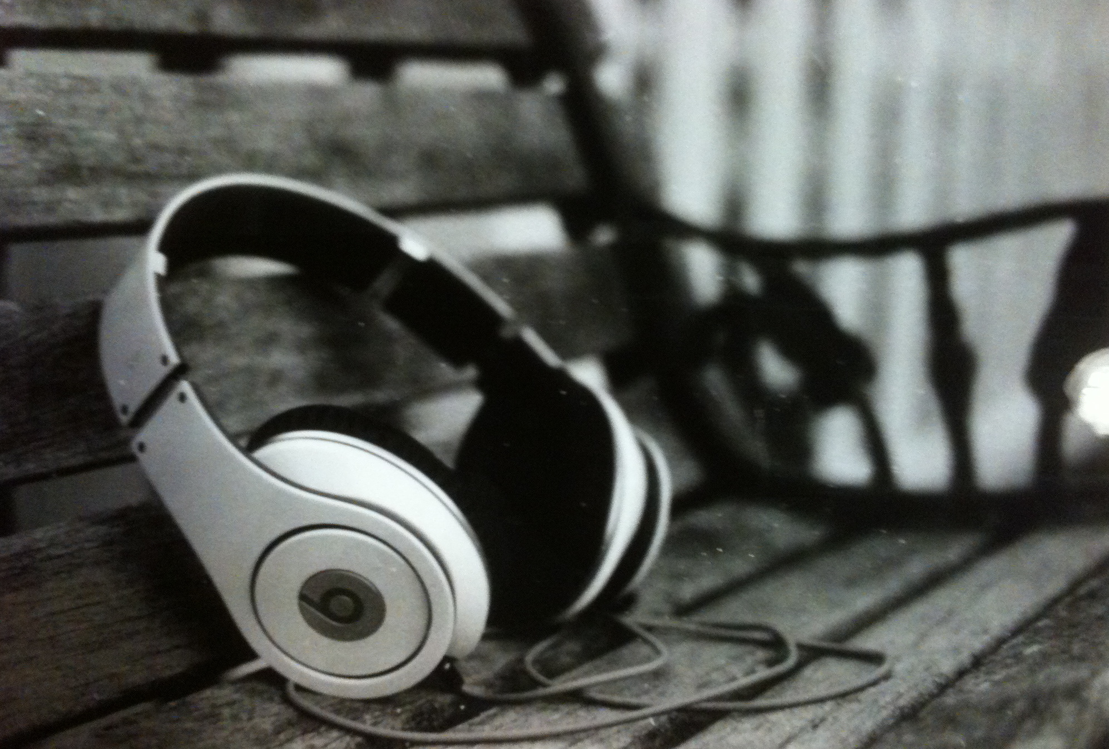
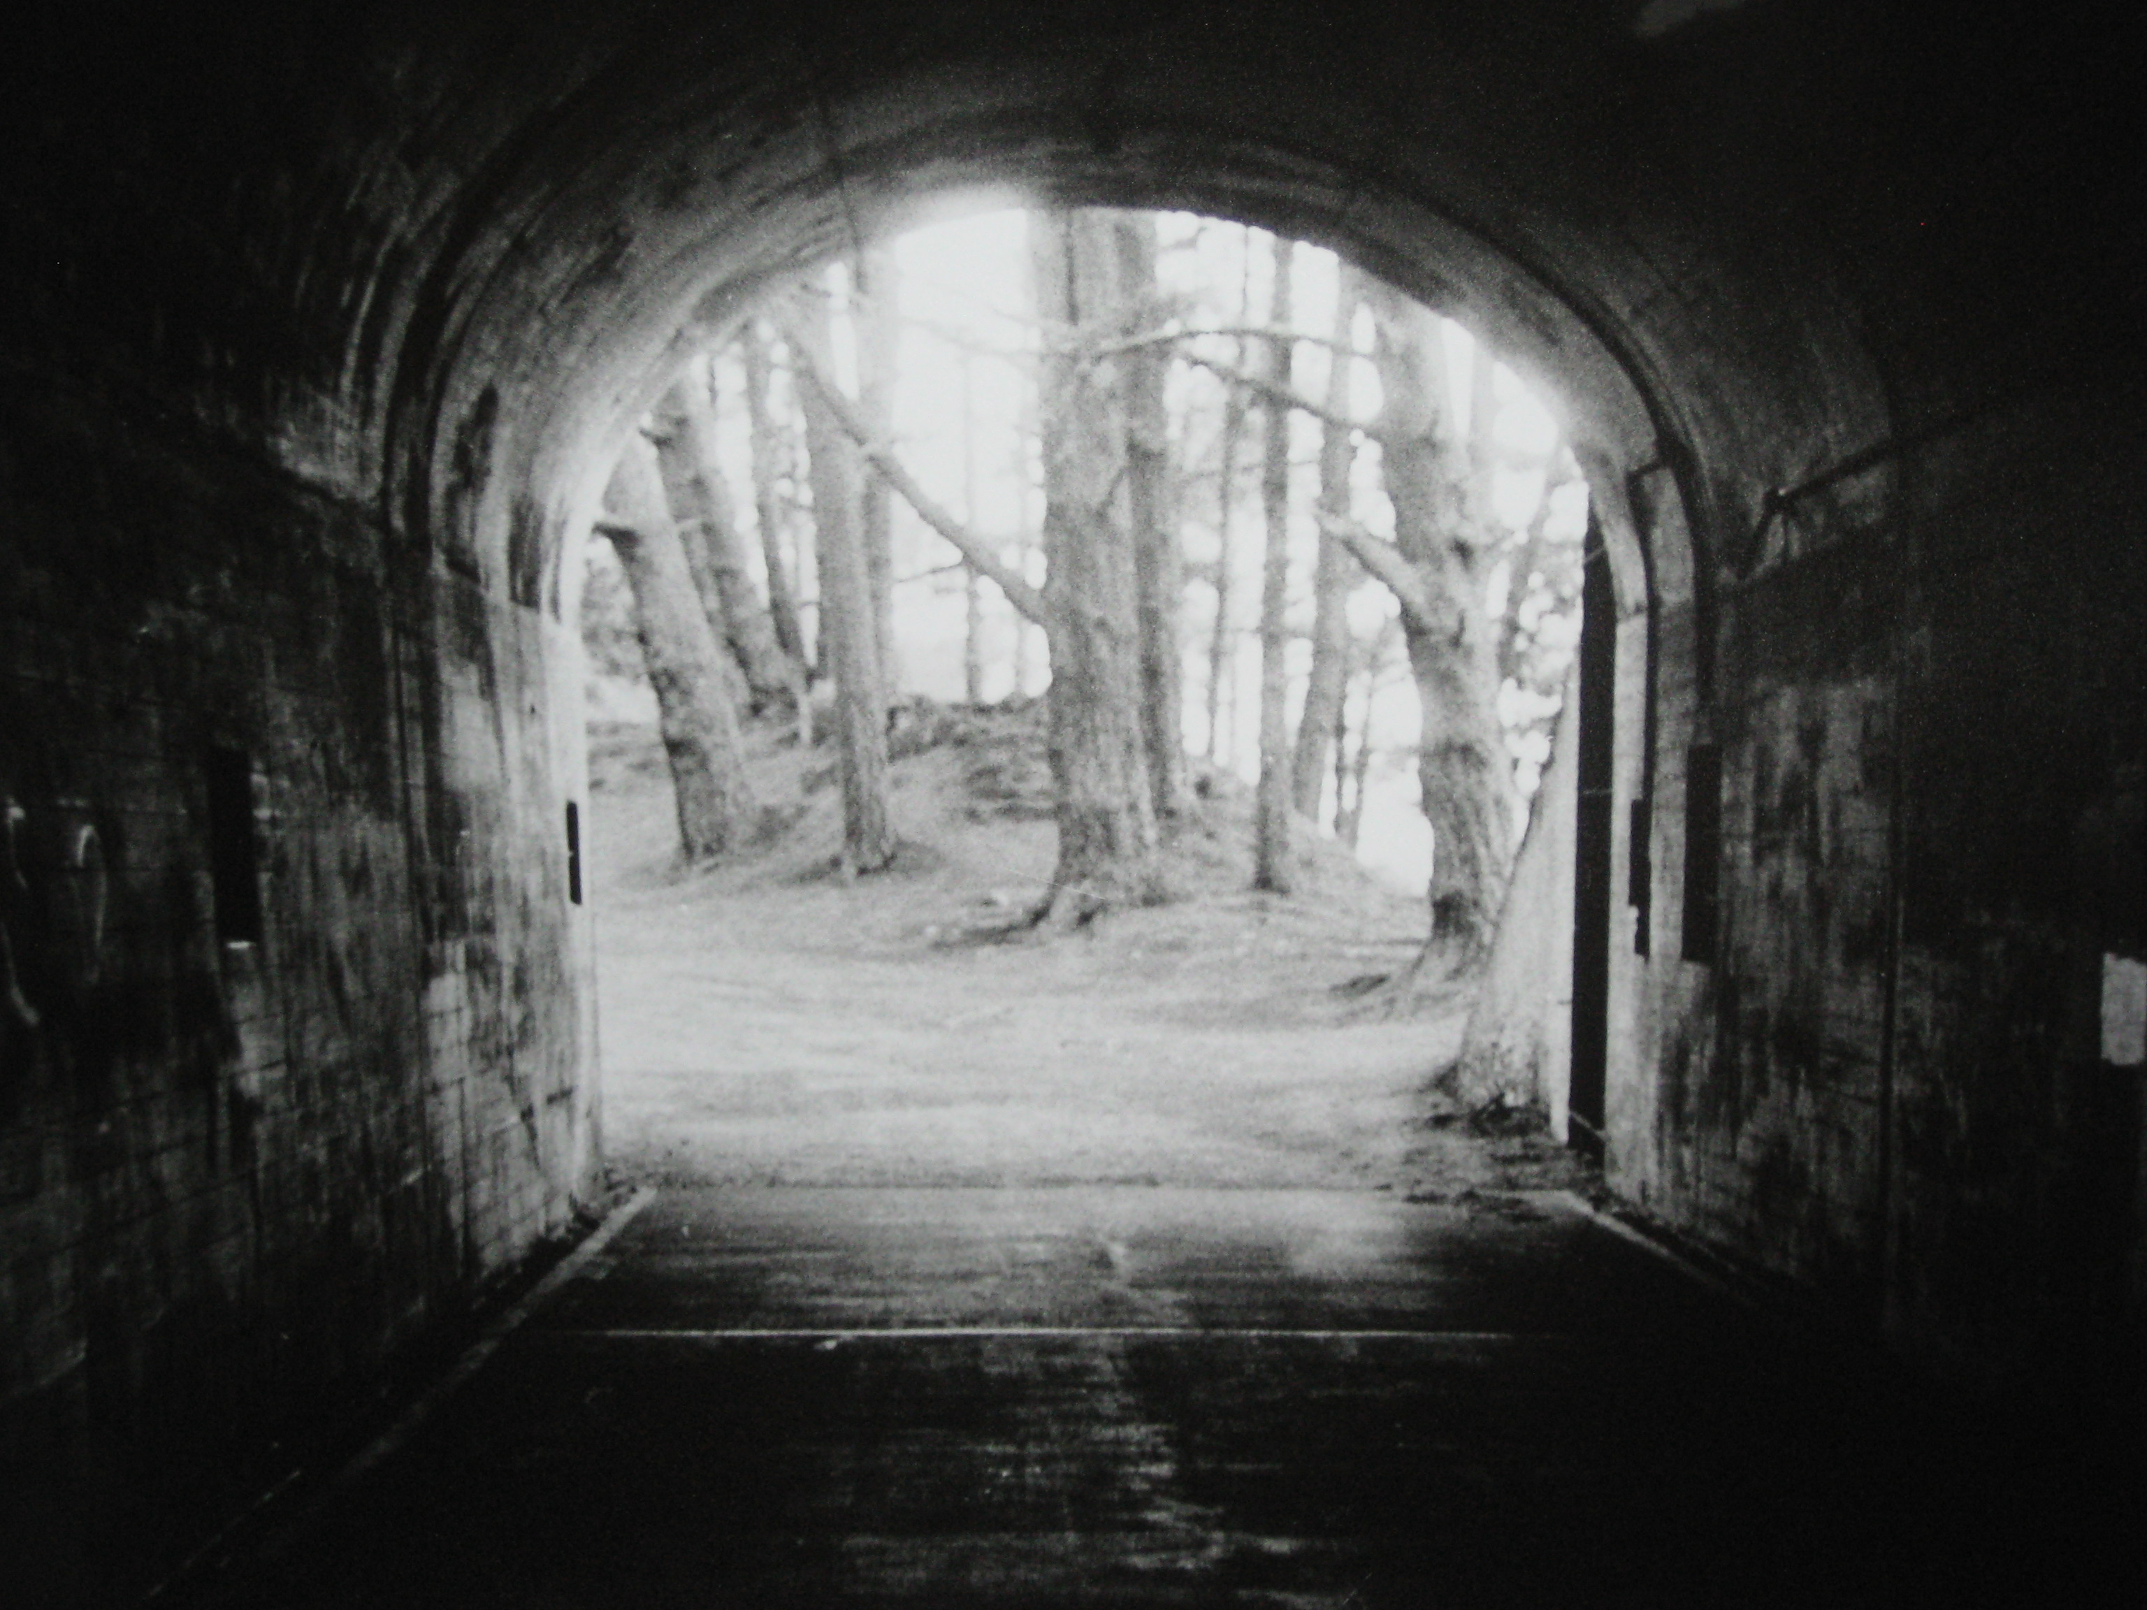
grading policy:
Quarter grades =
60% Portfolio
- photo assignments,
enlarged and mounted
20% BINDER
- notes, negatives and
reflections
20% participation
- attendance, productivity
and clean-up
Semester grades =
40% per quarter +
20% for the final

Slide 5
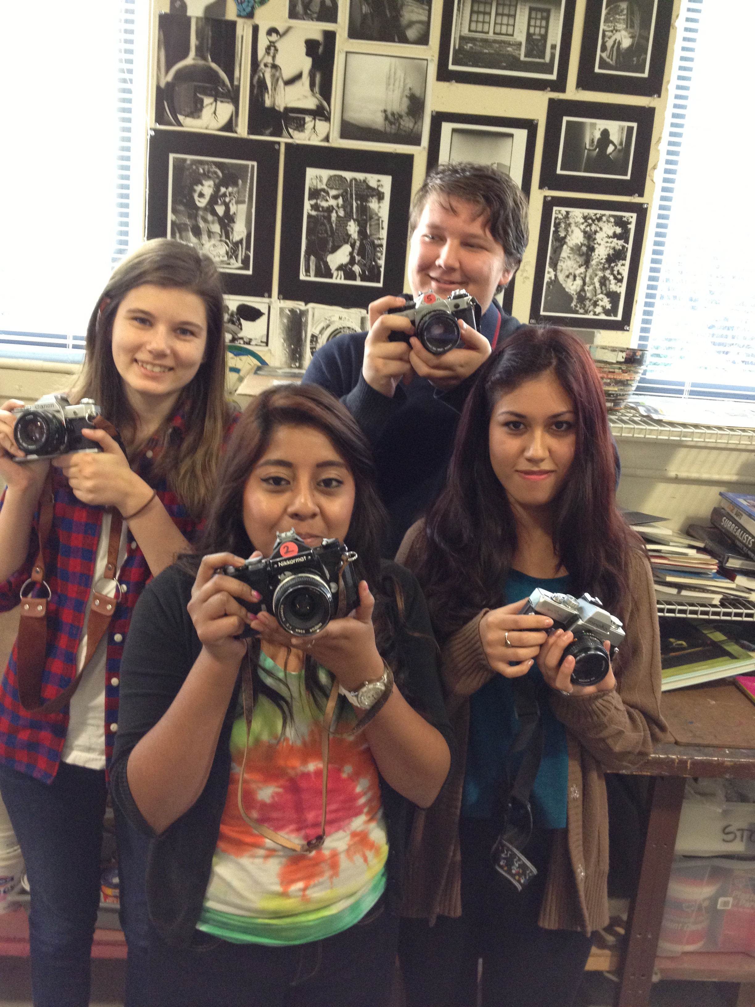
Criteria for grading photography:
How is the work presented?
Was the effort level up to potential?
Was the work clean and neat?
Was the work refined as much
as possible?
Did the student follow the directions and criteria of the assignment?
How is the work representing
individual’s creativity- such as
original ideas, images and styles?

Slide 6
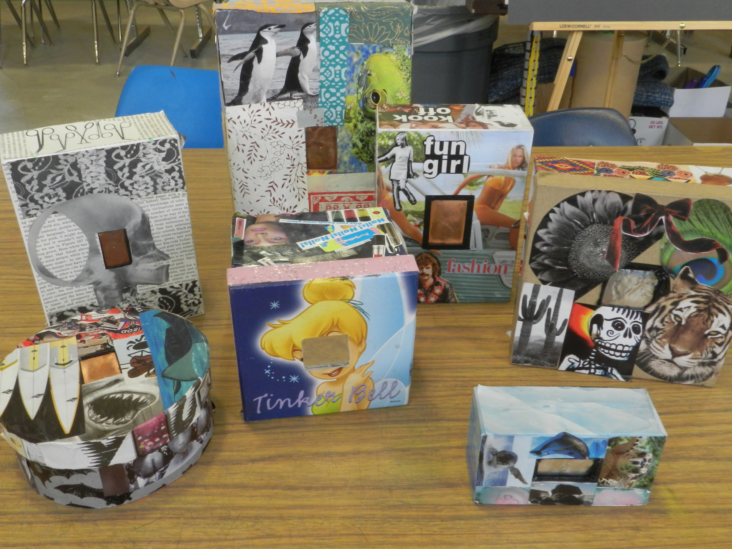
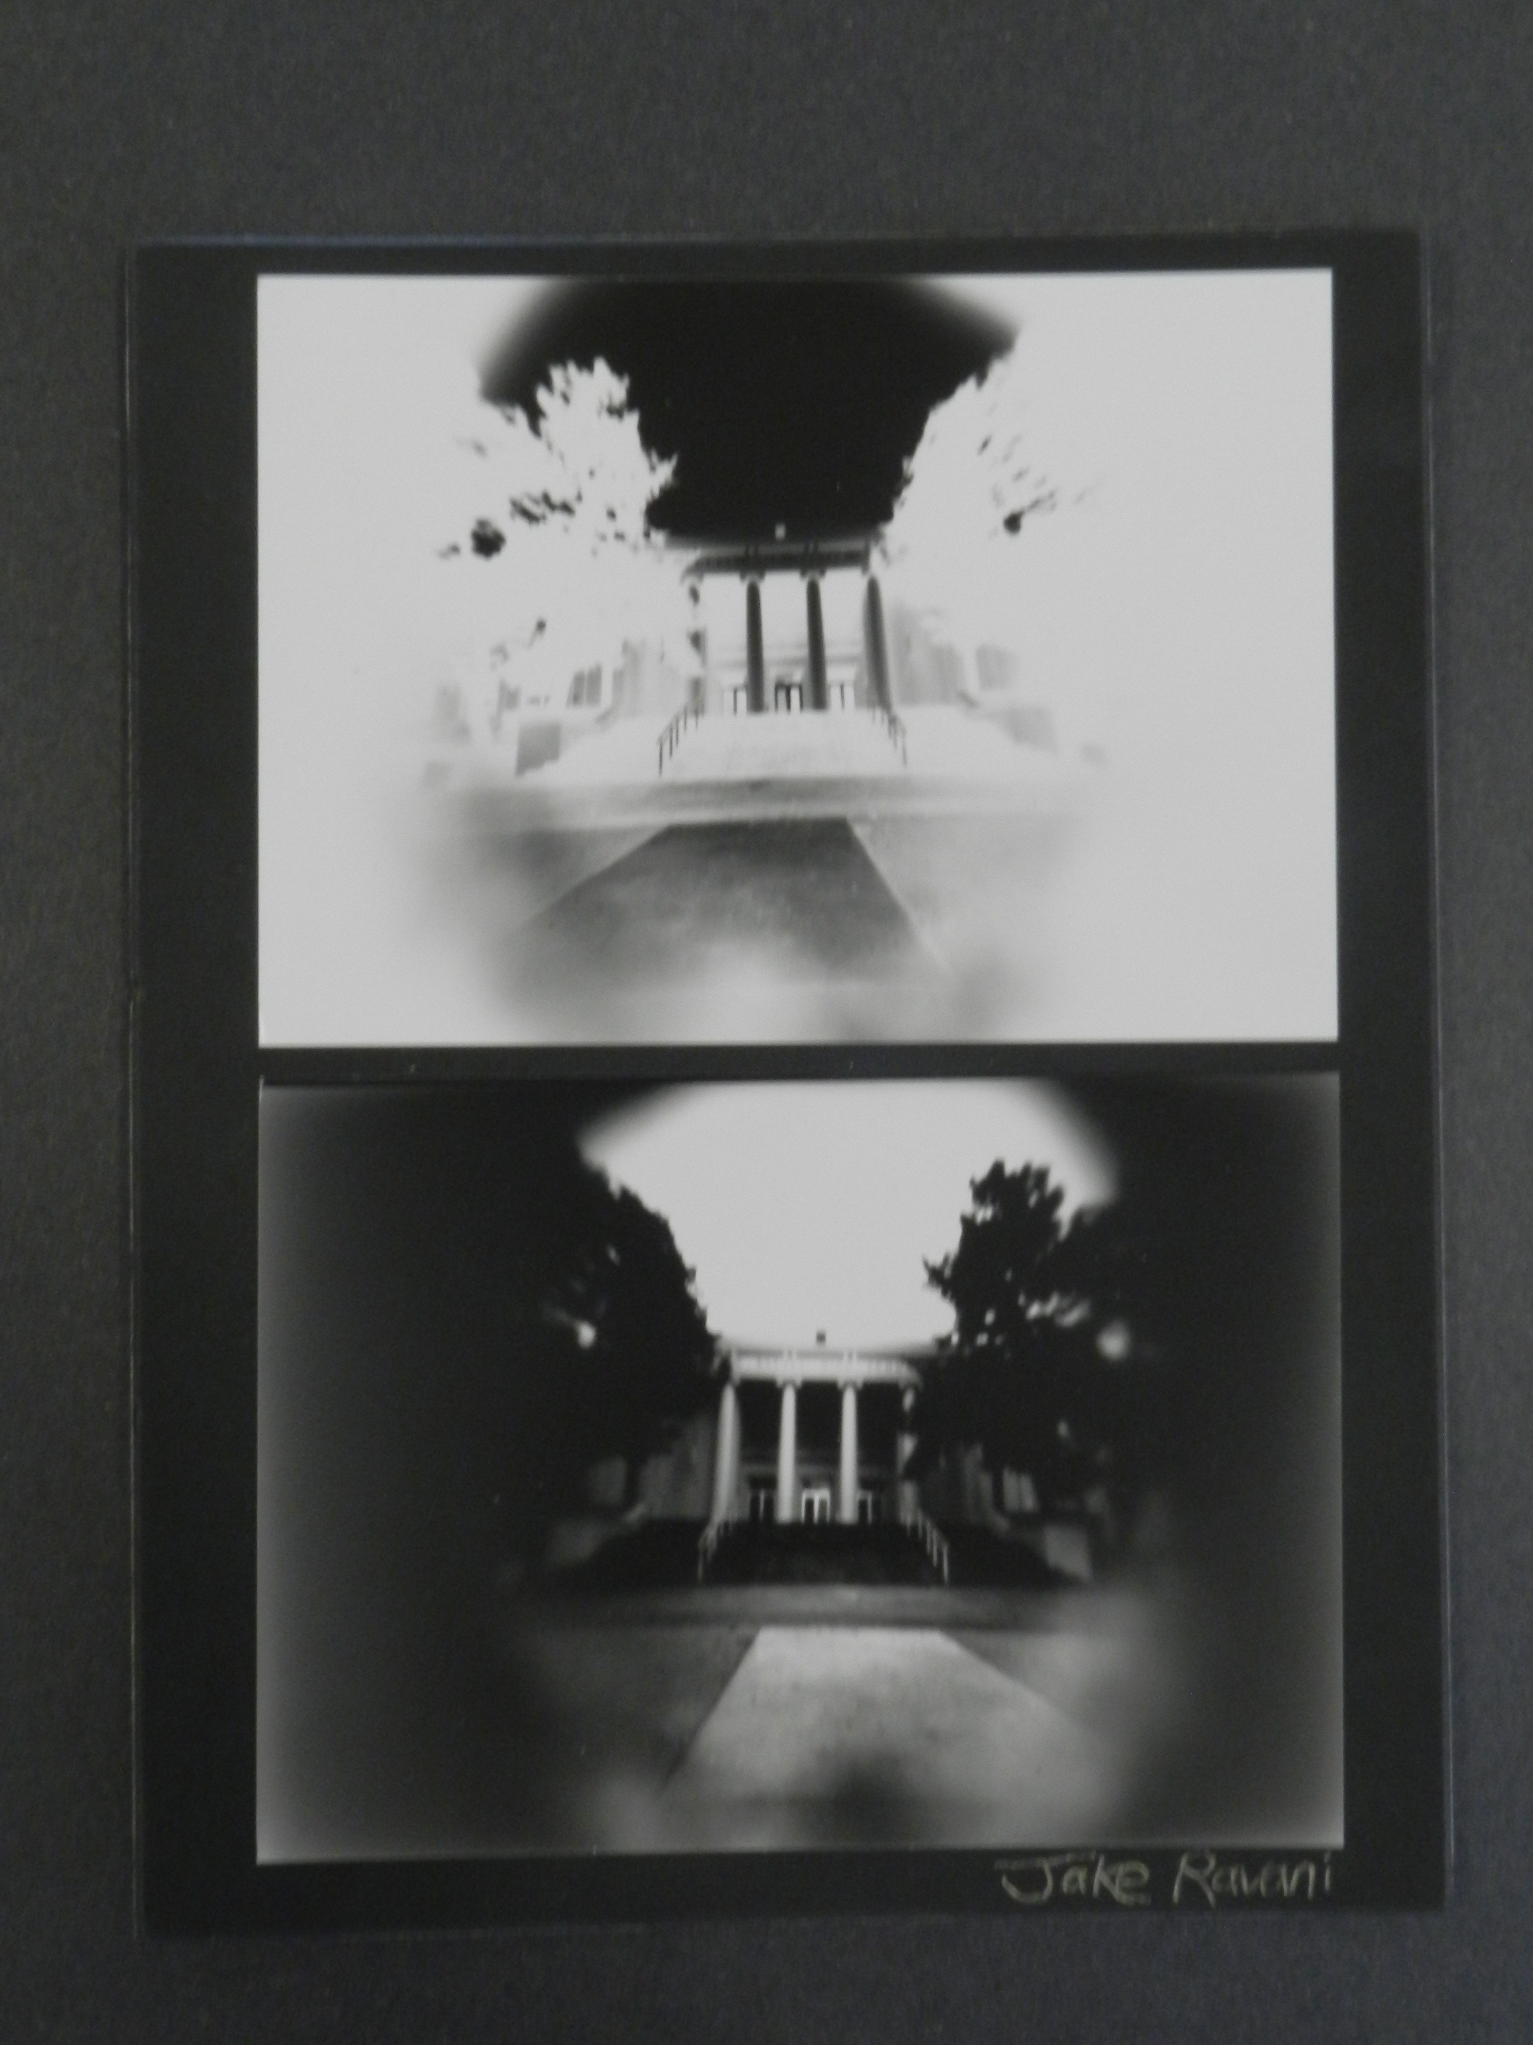
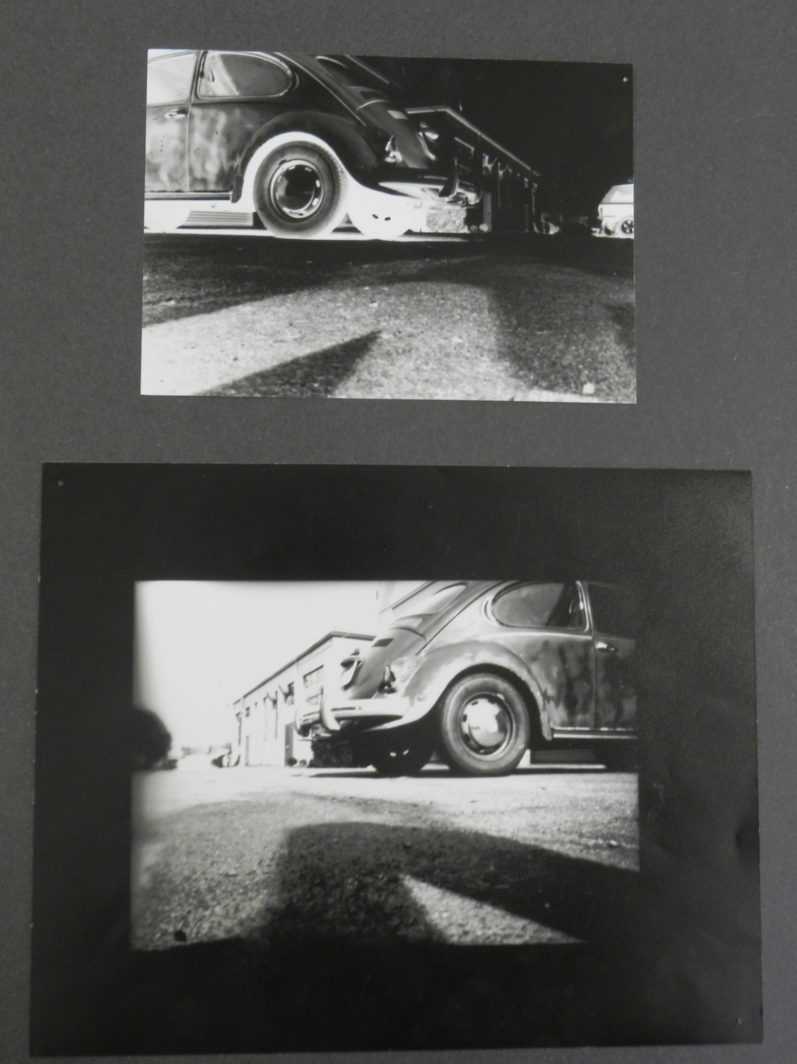
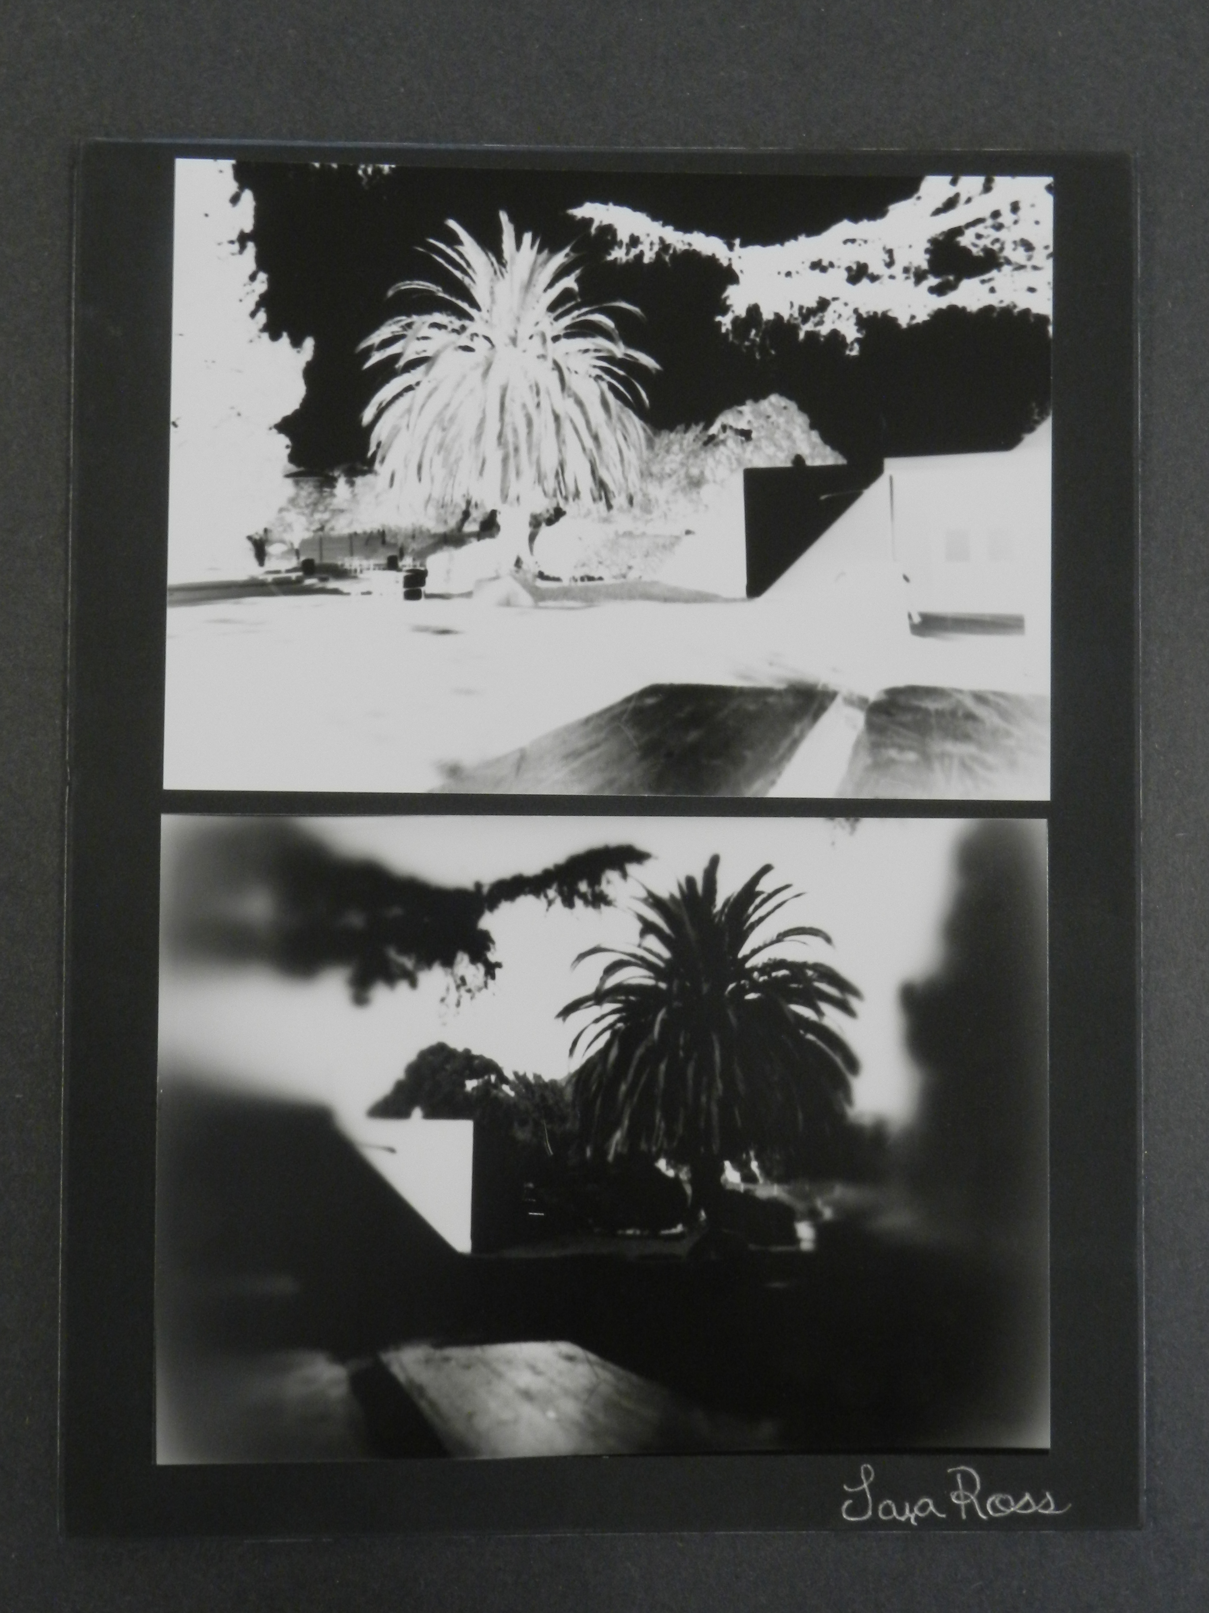
In The Beginning… Pinhole Cameras

Slide 7
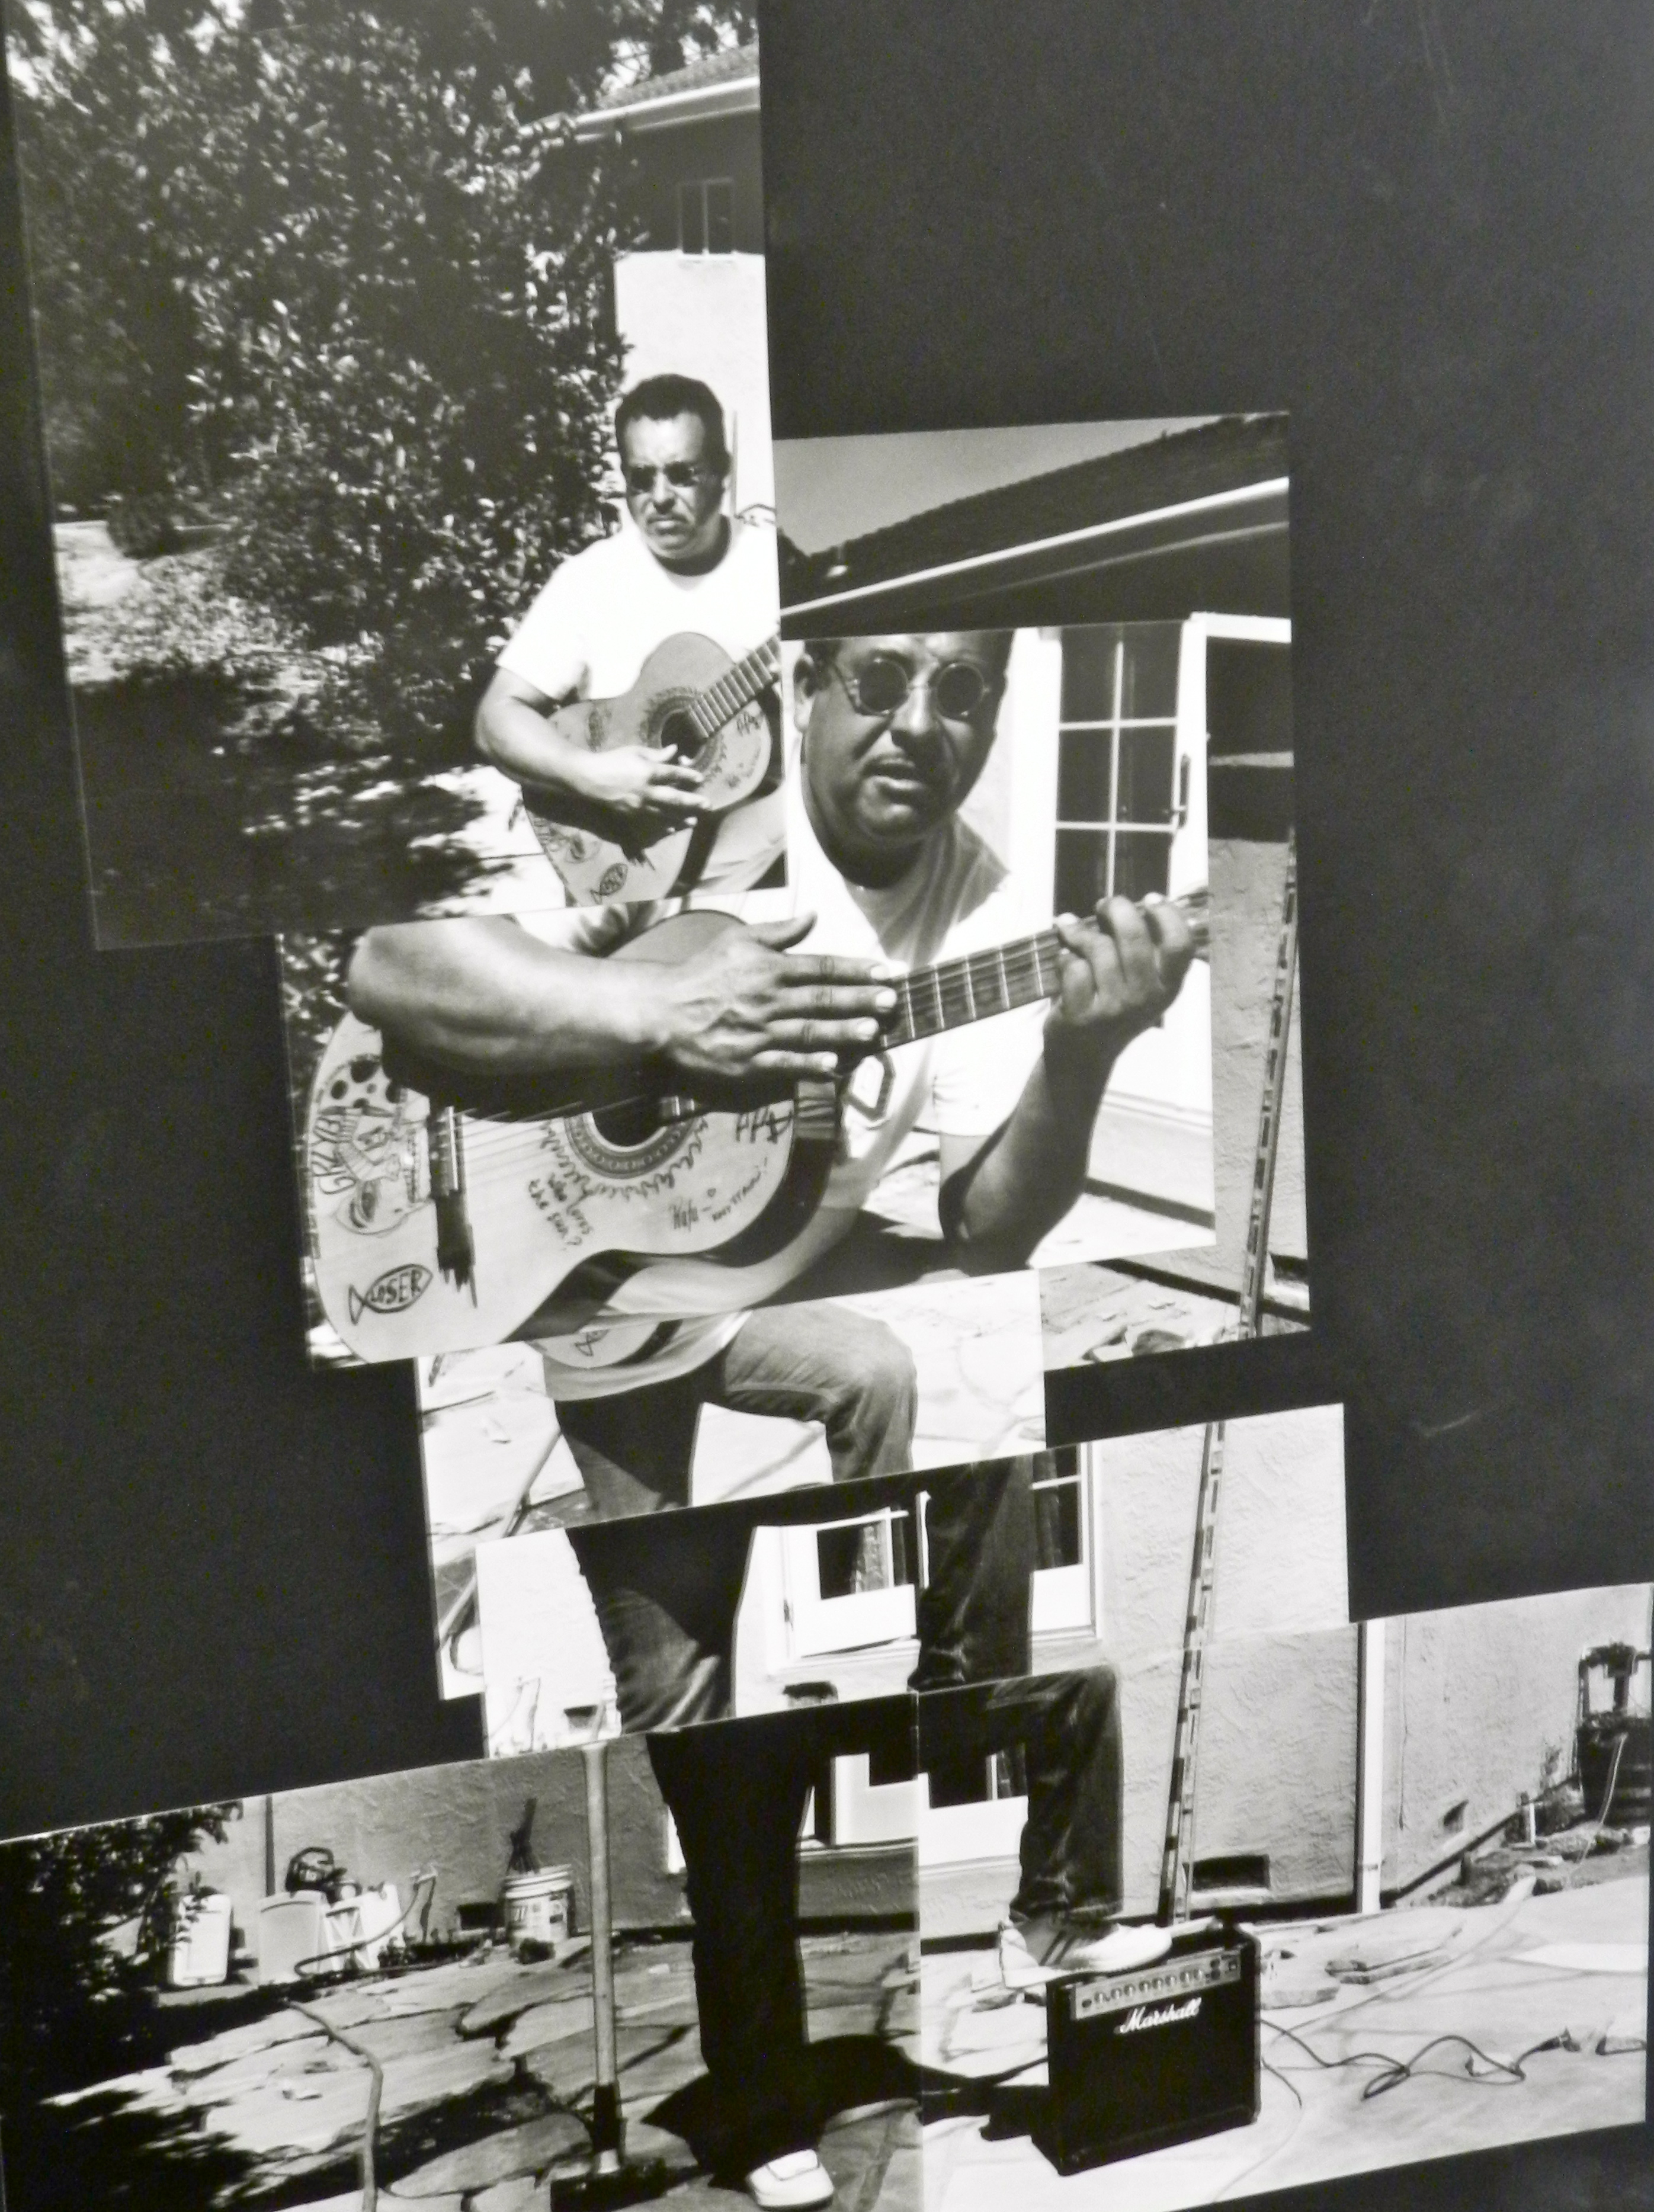
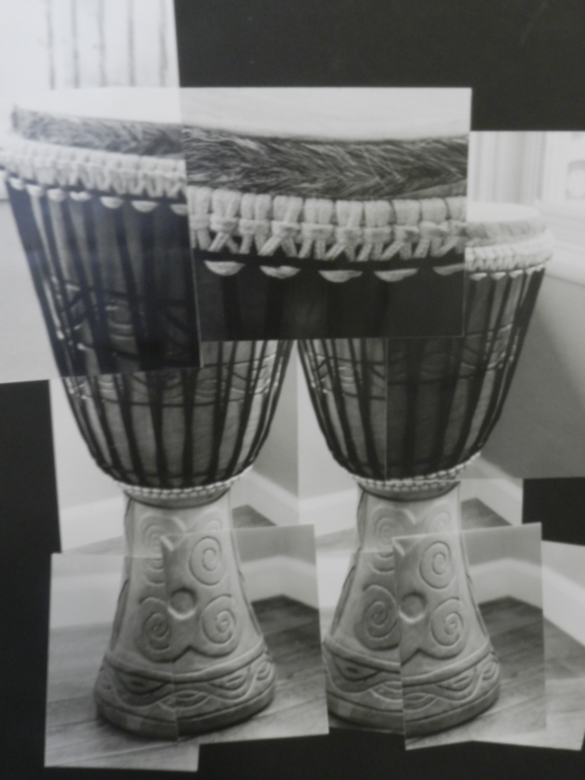
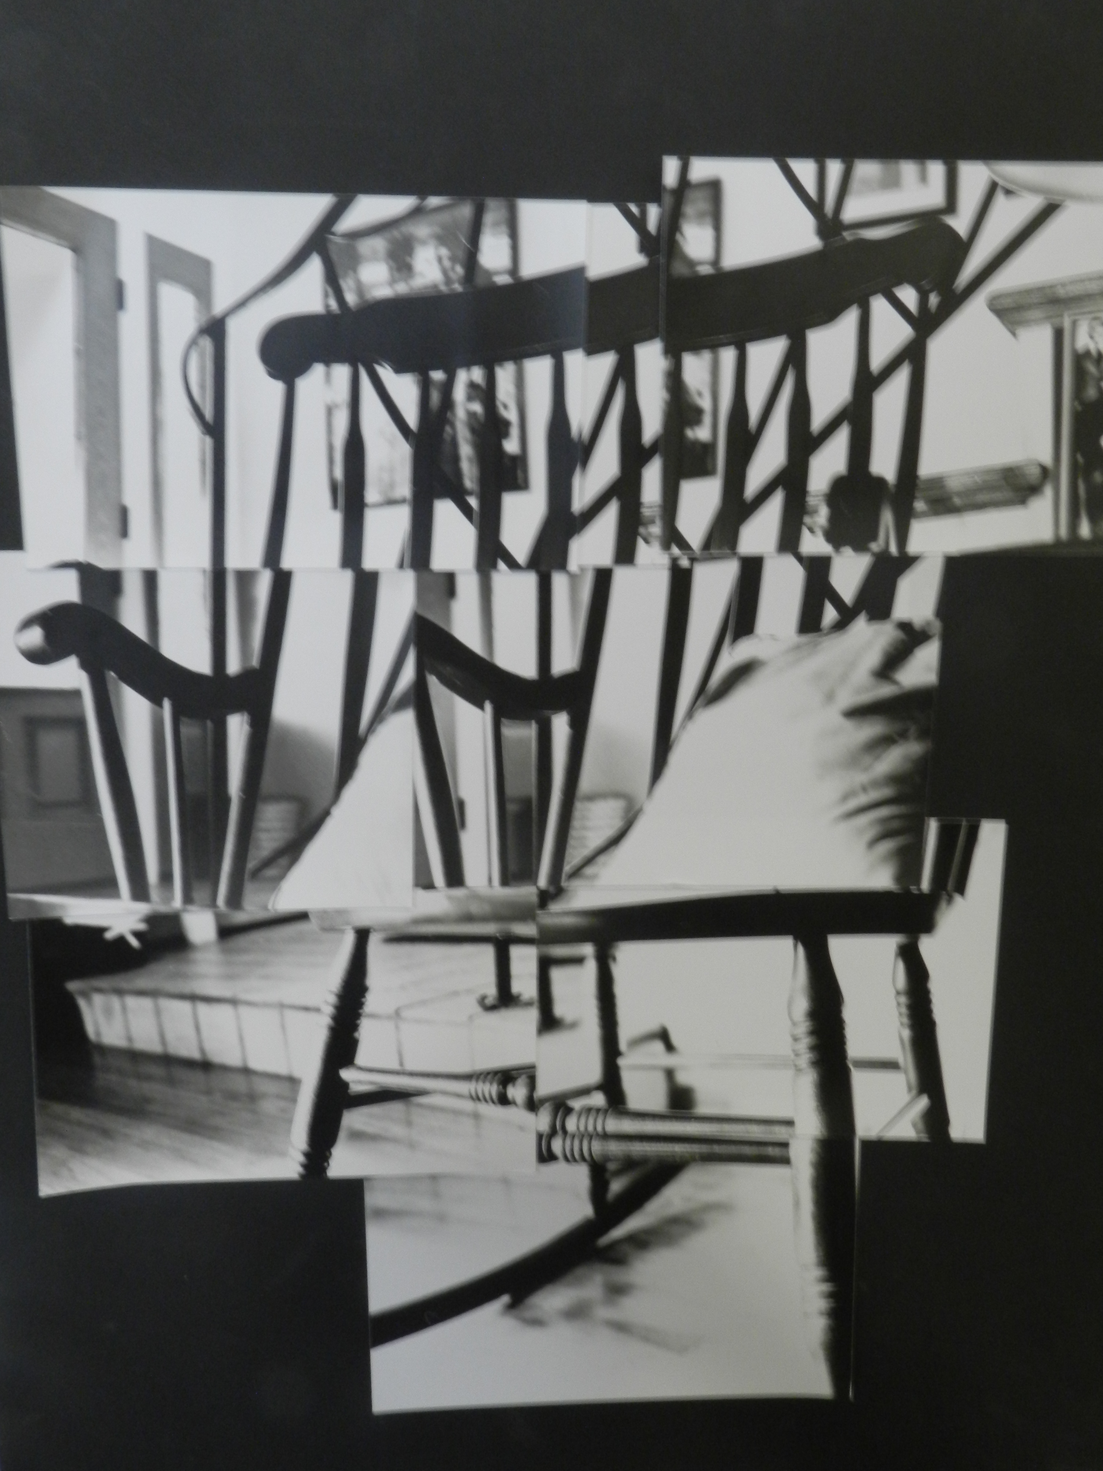
…and Photo Montage for the advanced

Slide 8
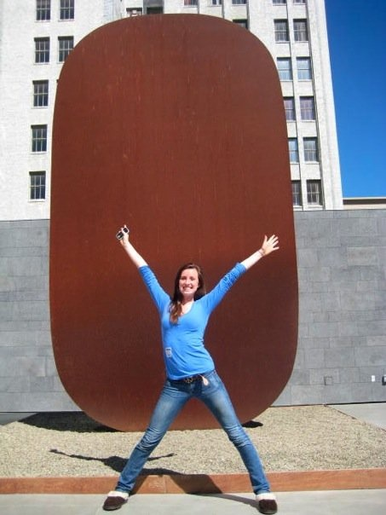
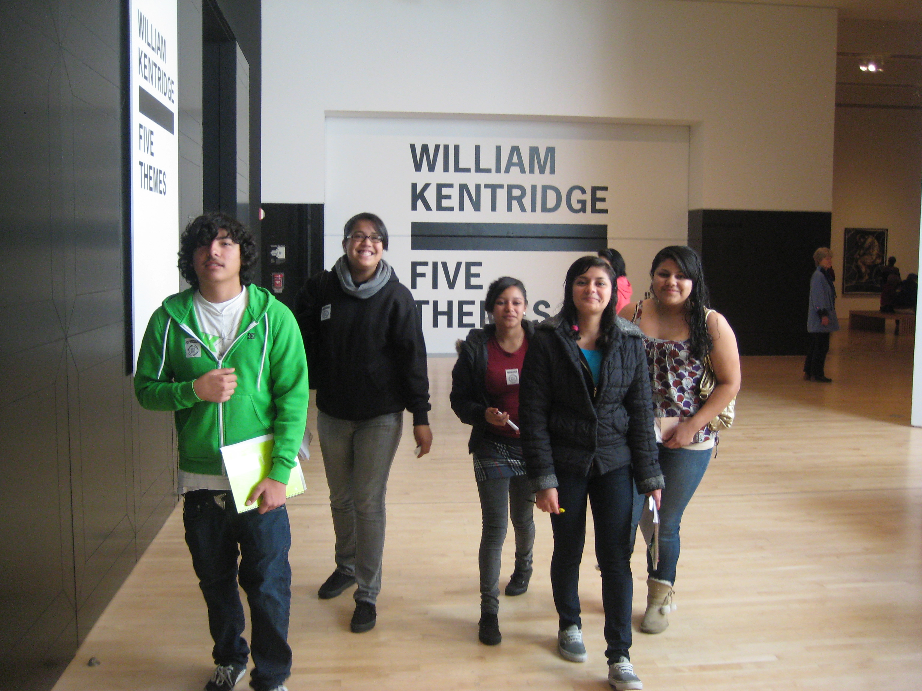
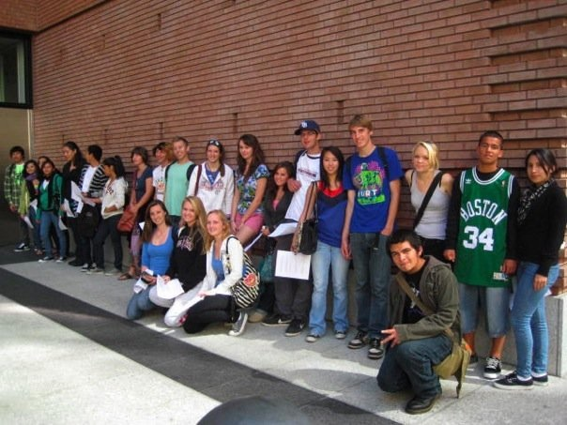
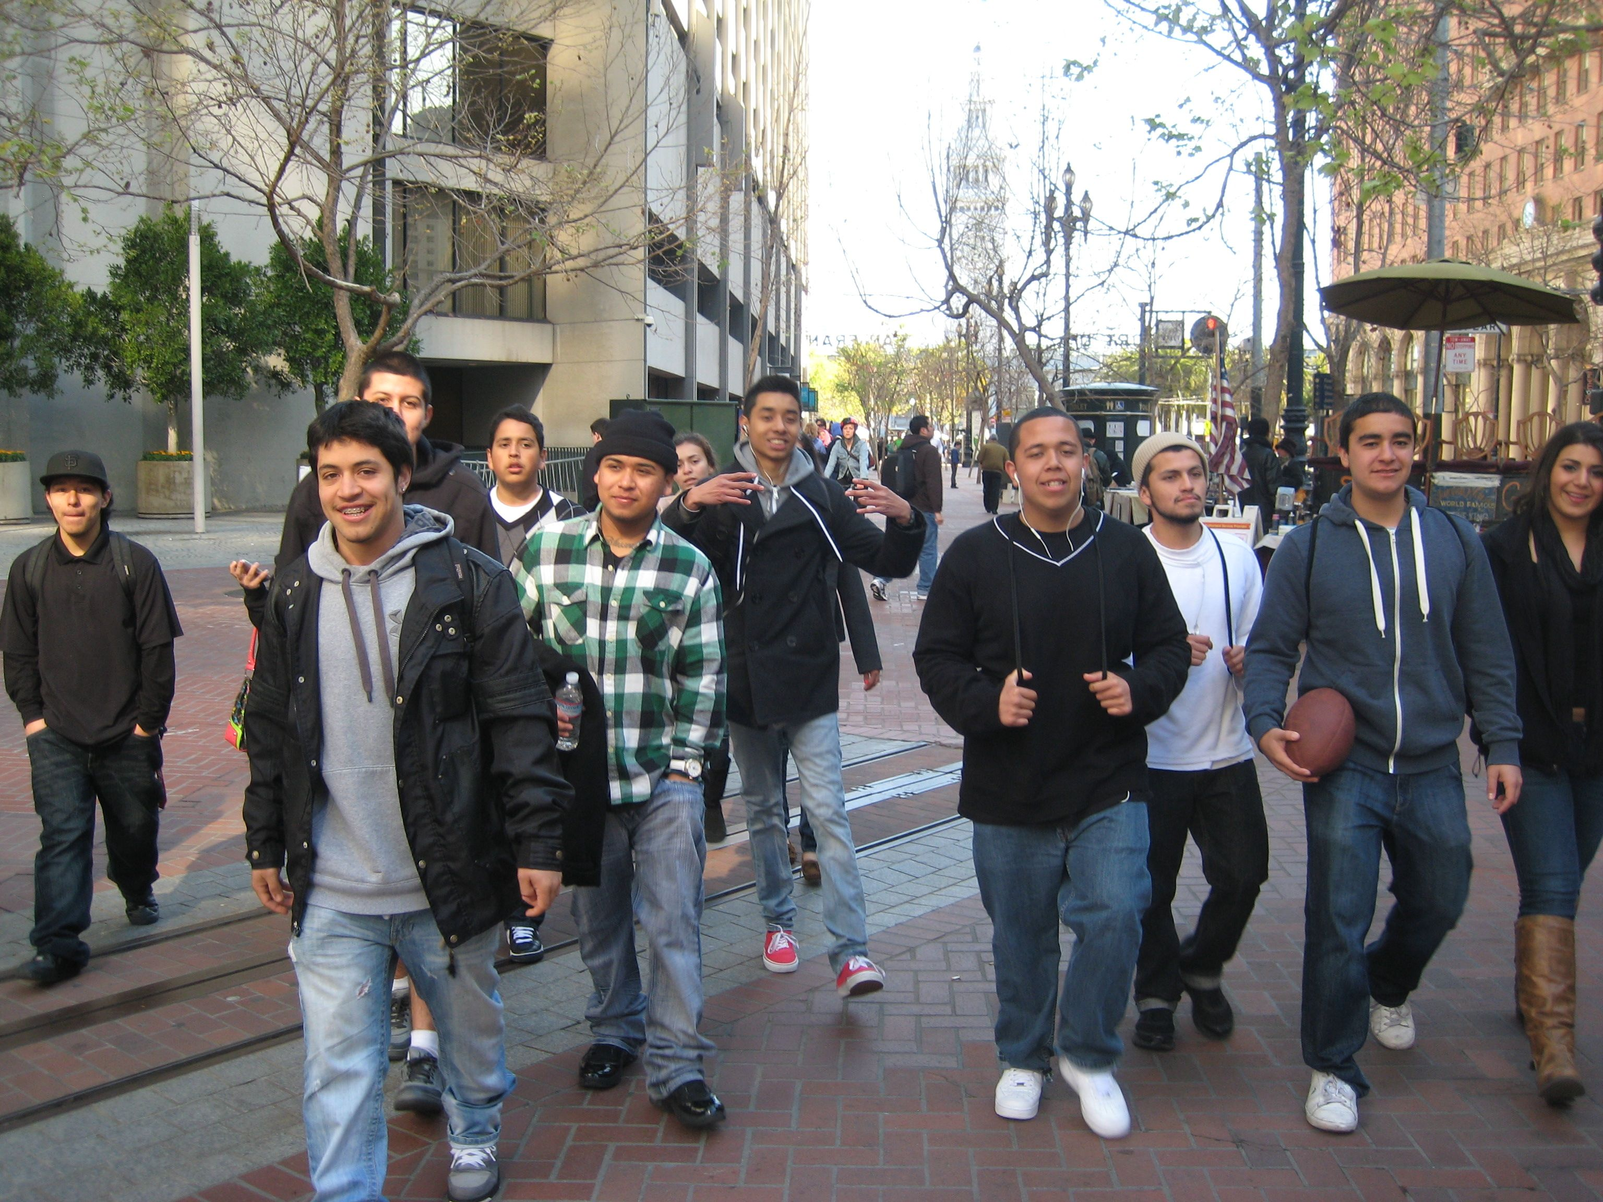
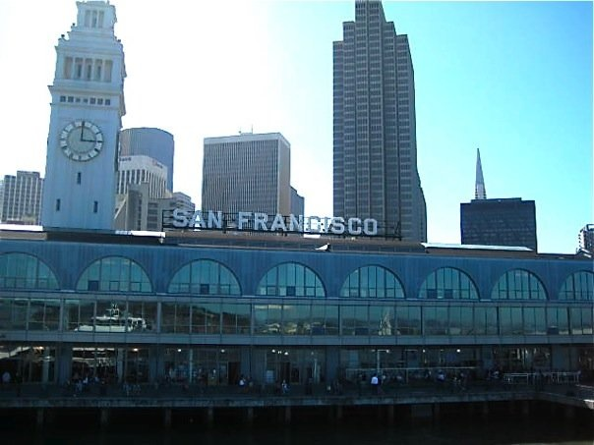
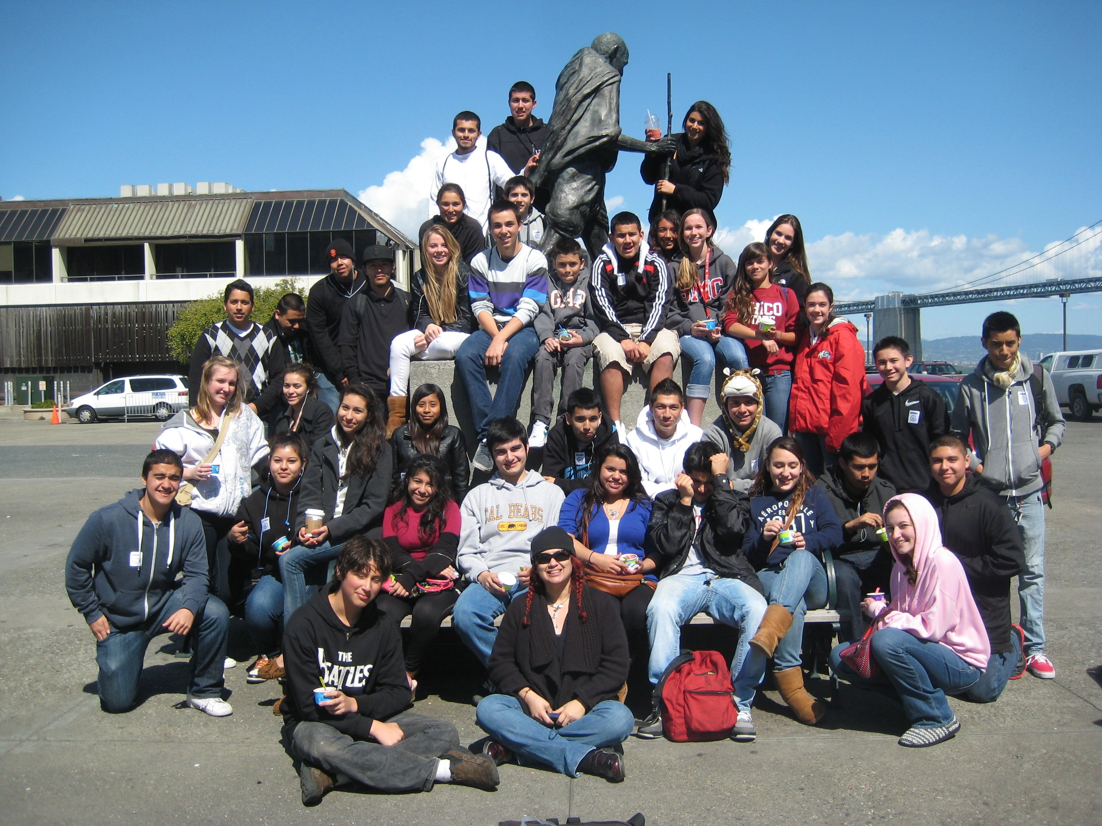
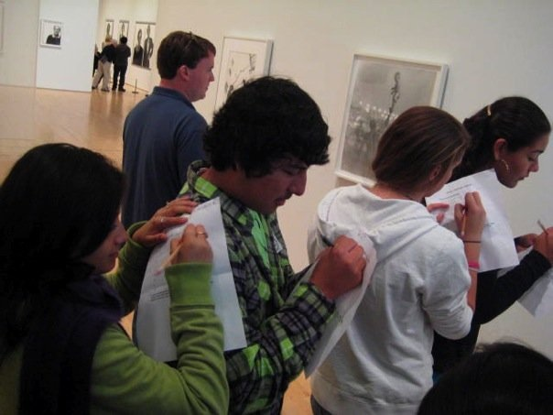
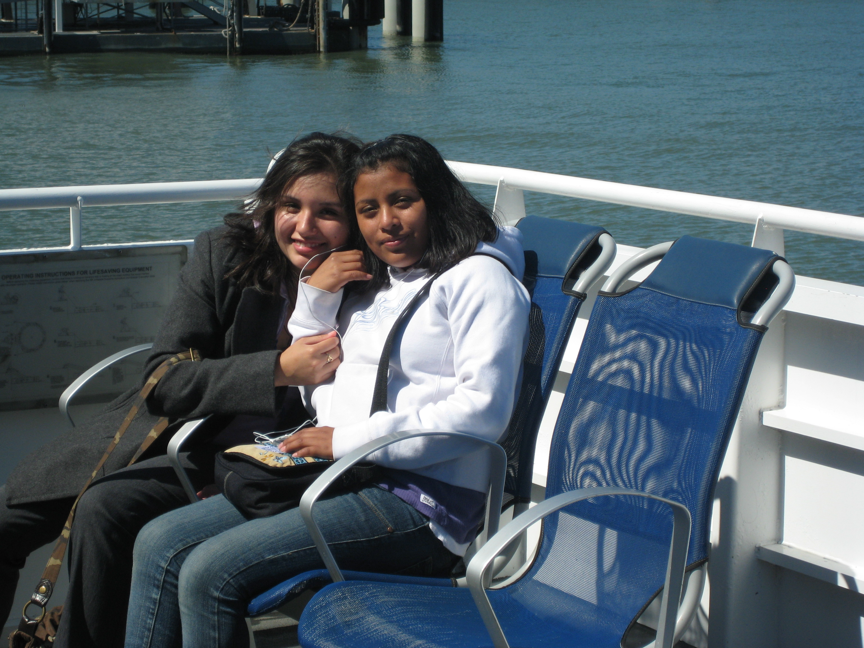
SF MOMA

Slide 9
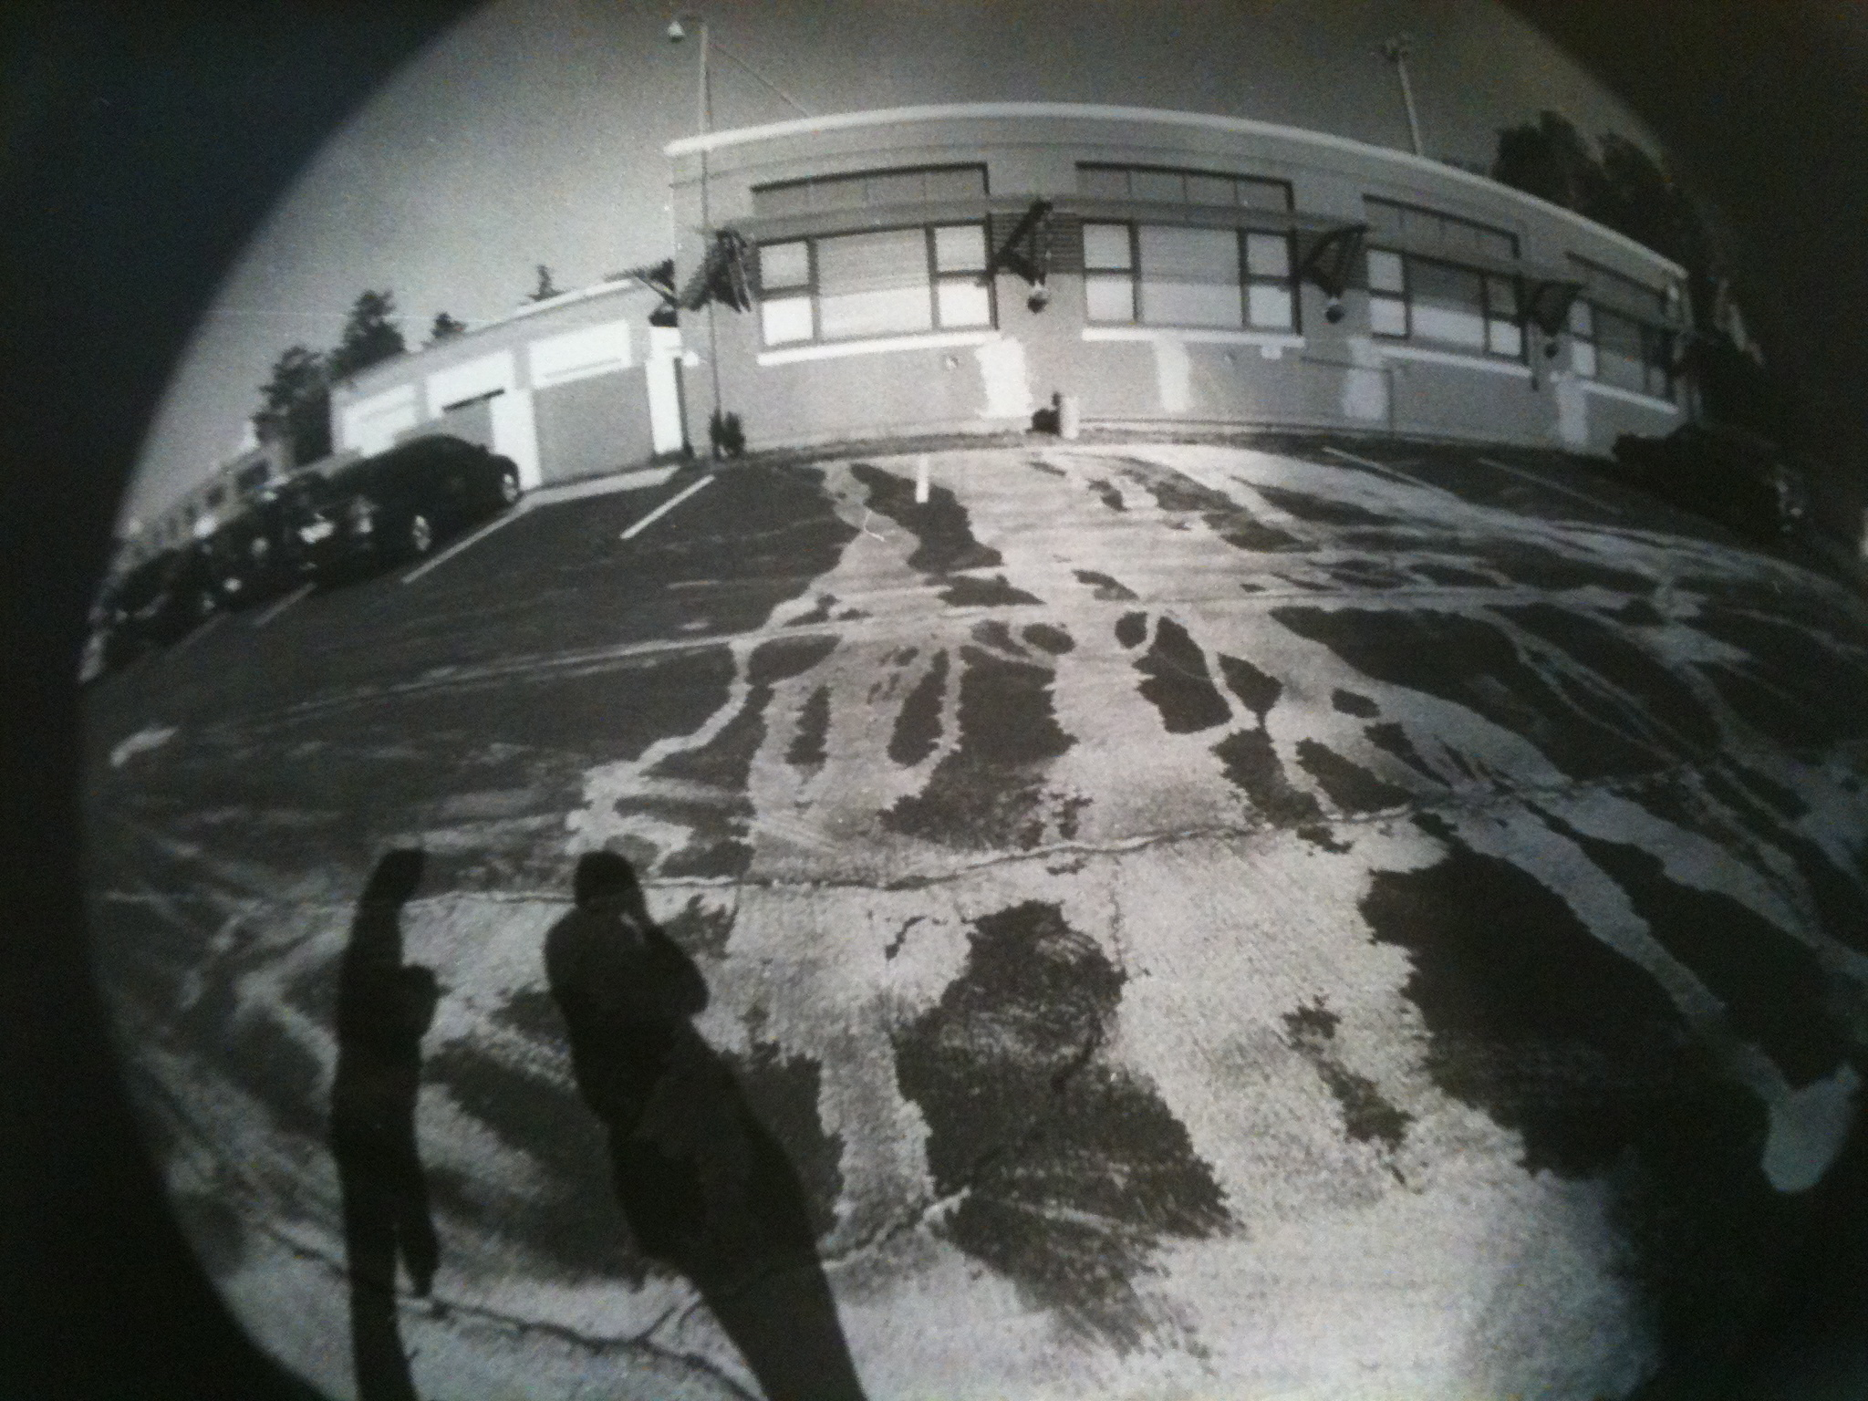
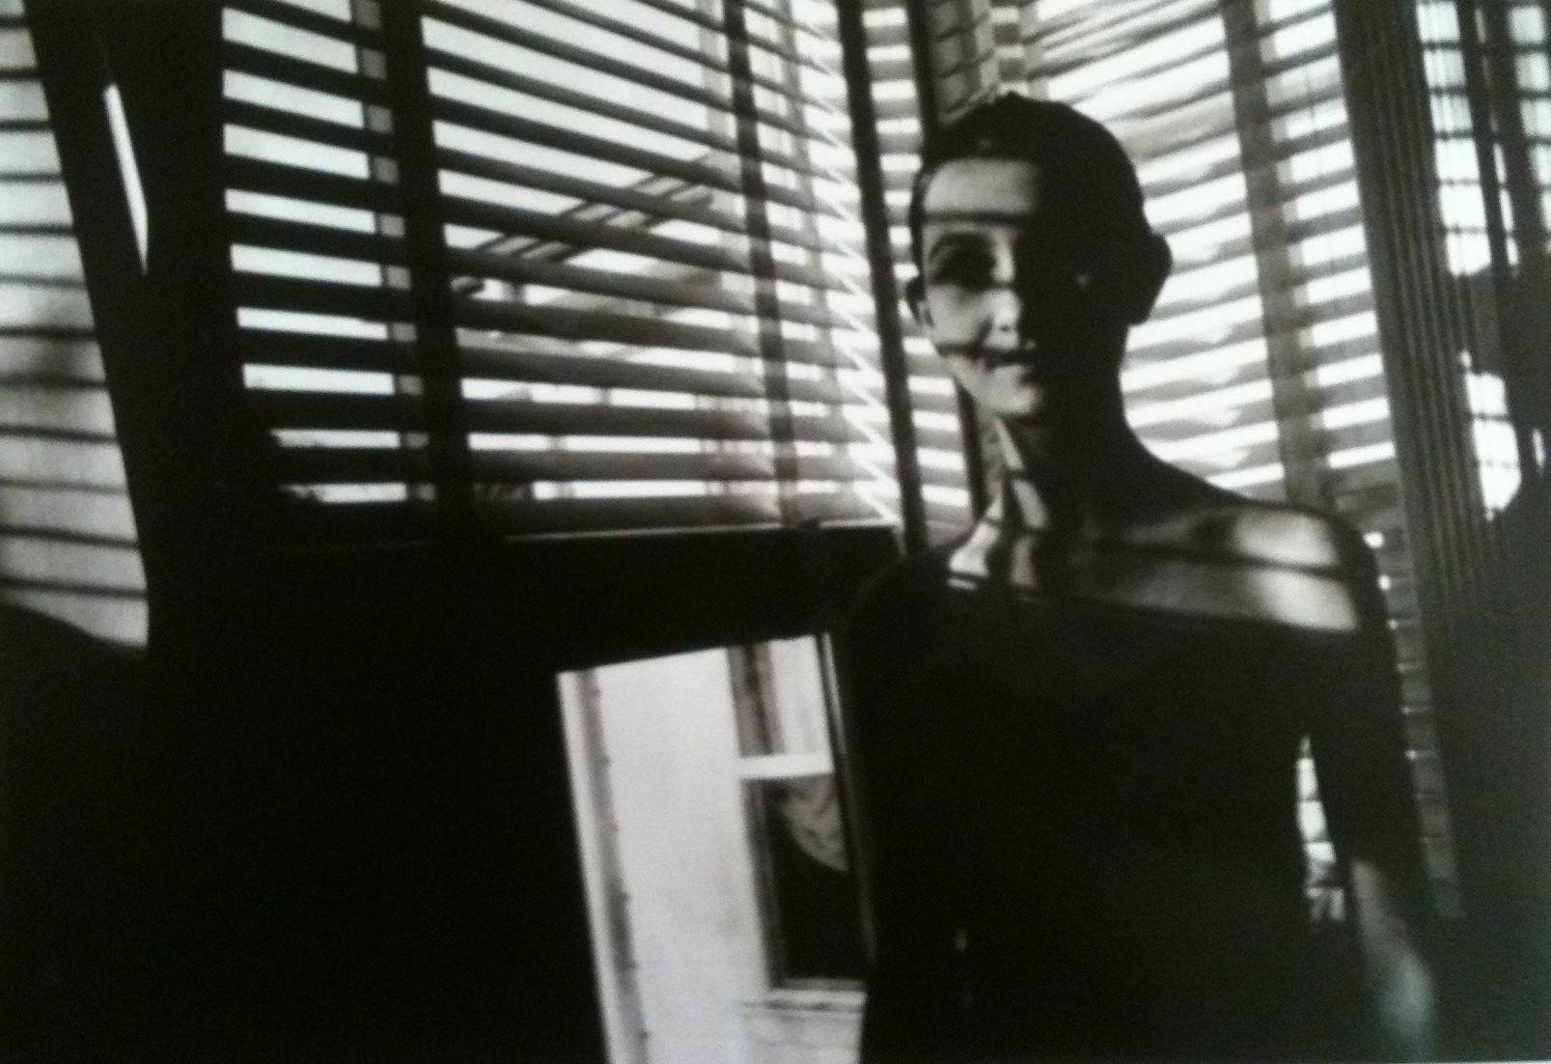
THANK YOU !!!!!!!!!!
“ I enjoy taking Photography
because I can express
the unsaid through film”
Carly Jackson-Clark
Class of 2013
“I enjoy taking Photography
because now I have an eye
for the beauty in life that I
didn’t have before.”
Emily Kuchurian
Class of 2012
Express Yourself Through
SR PHOTOGRAPHY

