Slide 1
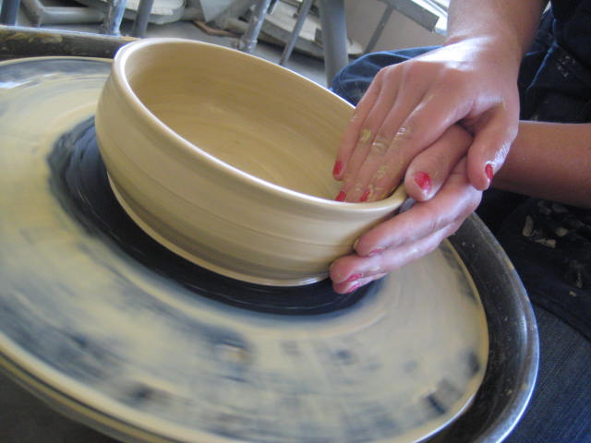
CERAMICS
Johanna Herrera
jherrera@srcs.org

Slide 2
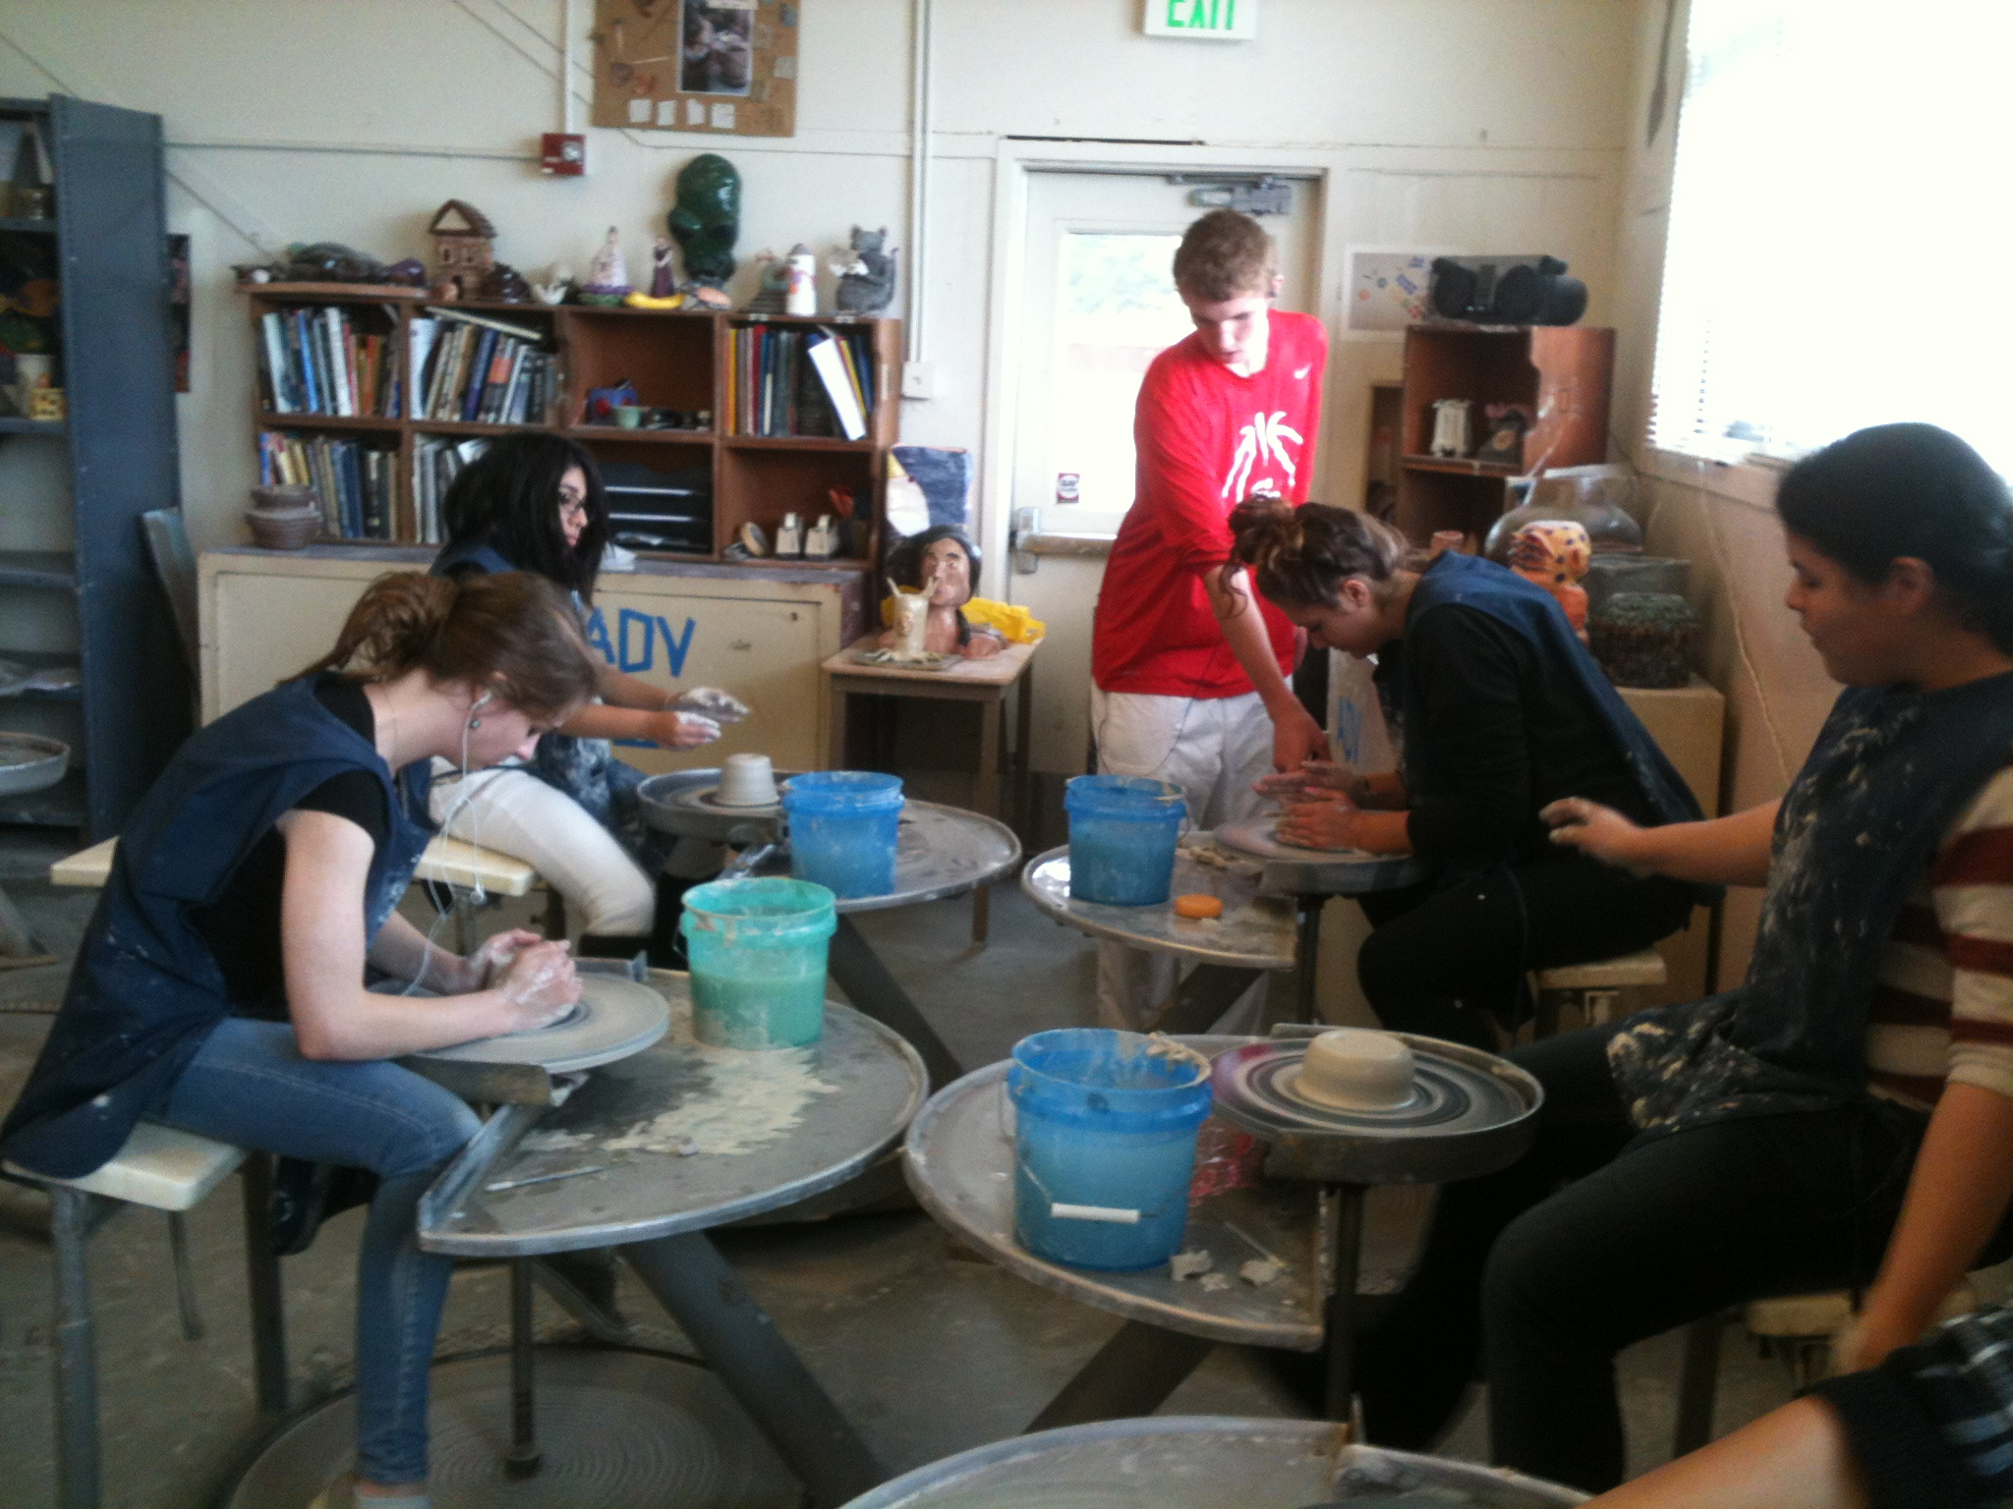
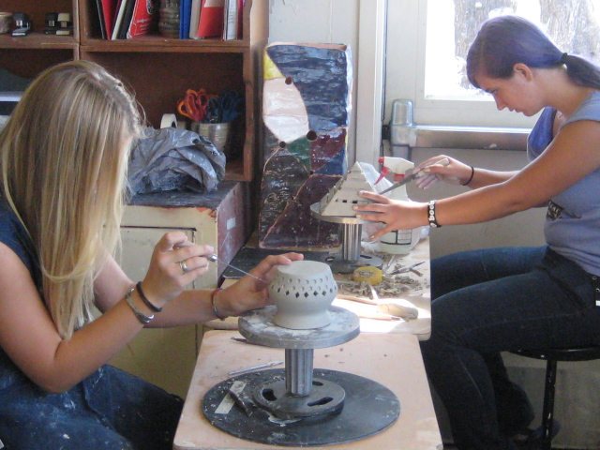
COURSE DESCRIPTION:
Ceramics 1-2 is an introductory level course designed to offer the student an opportunity to explore ceramic media and processes.
Ceramics 3-4 is a more in depth look at ceramics with added freedom for individual inspiration as well as the study of advanced techniques.

Slide 3
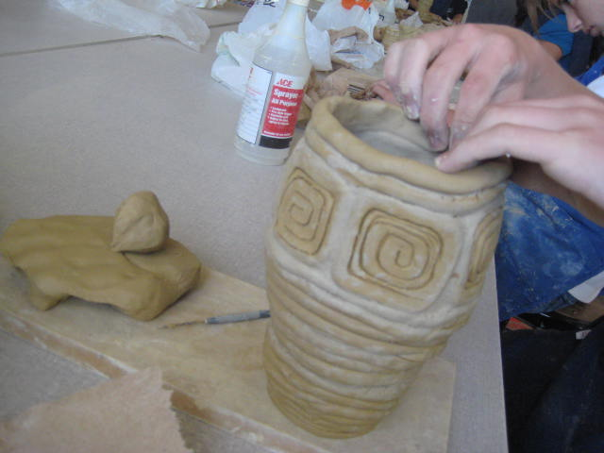
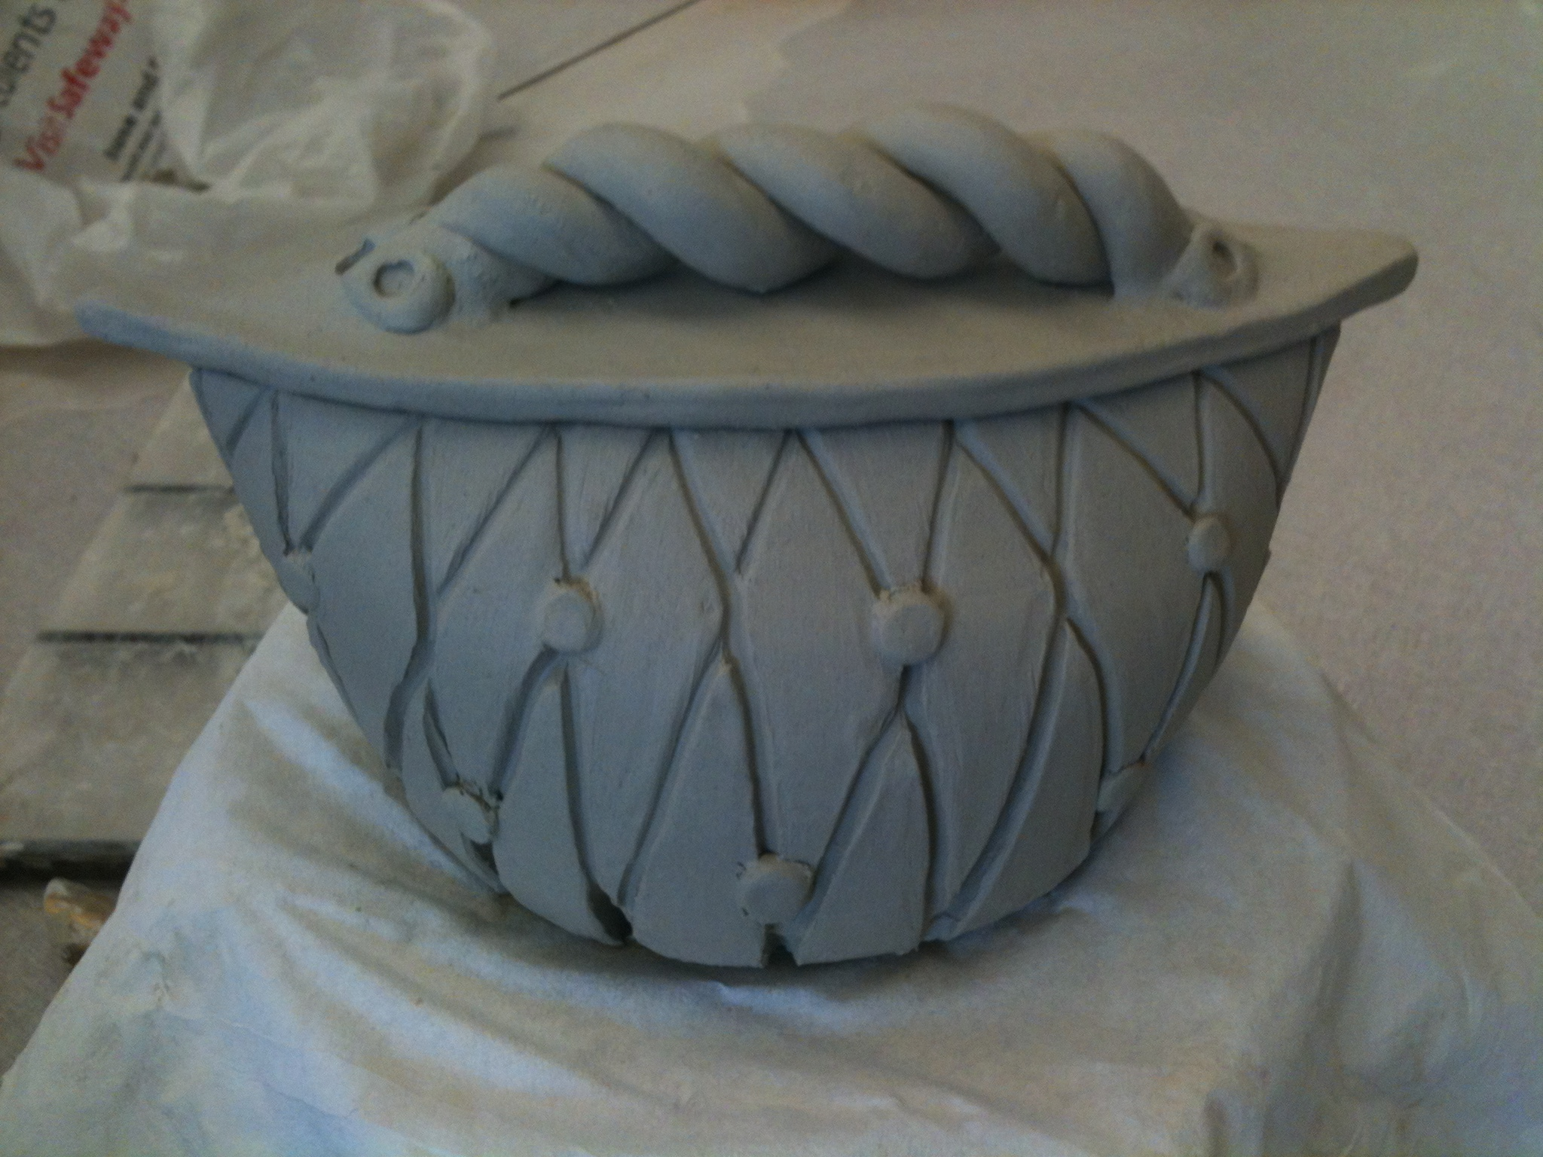
Techniques To Be Covered
Hand Construction
Wheel Throwing
Surface Decoration Techniques
The Firing Process
Also
Reflect and write about the process
Explore cultural and historical connections
Students involve themselves in the critique of their work as well as the work of their fellow classmates

Slide 4
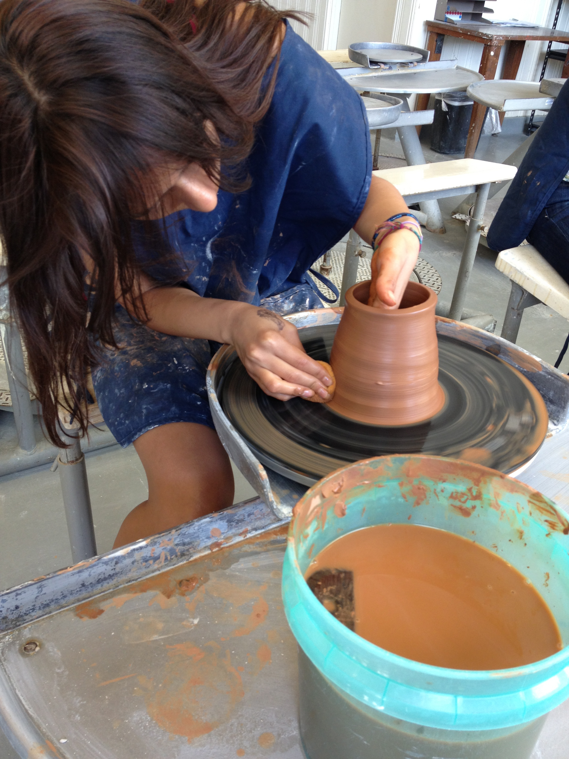
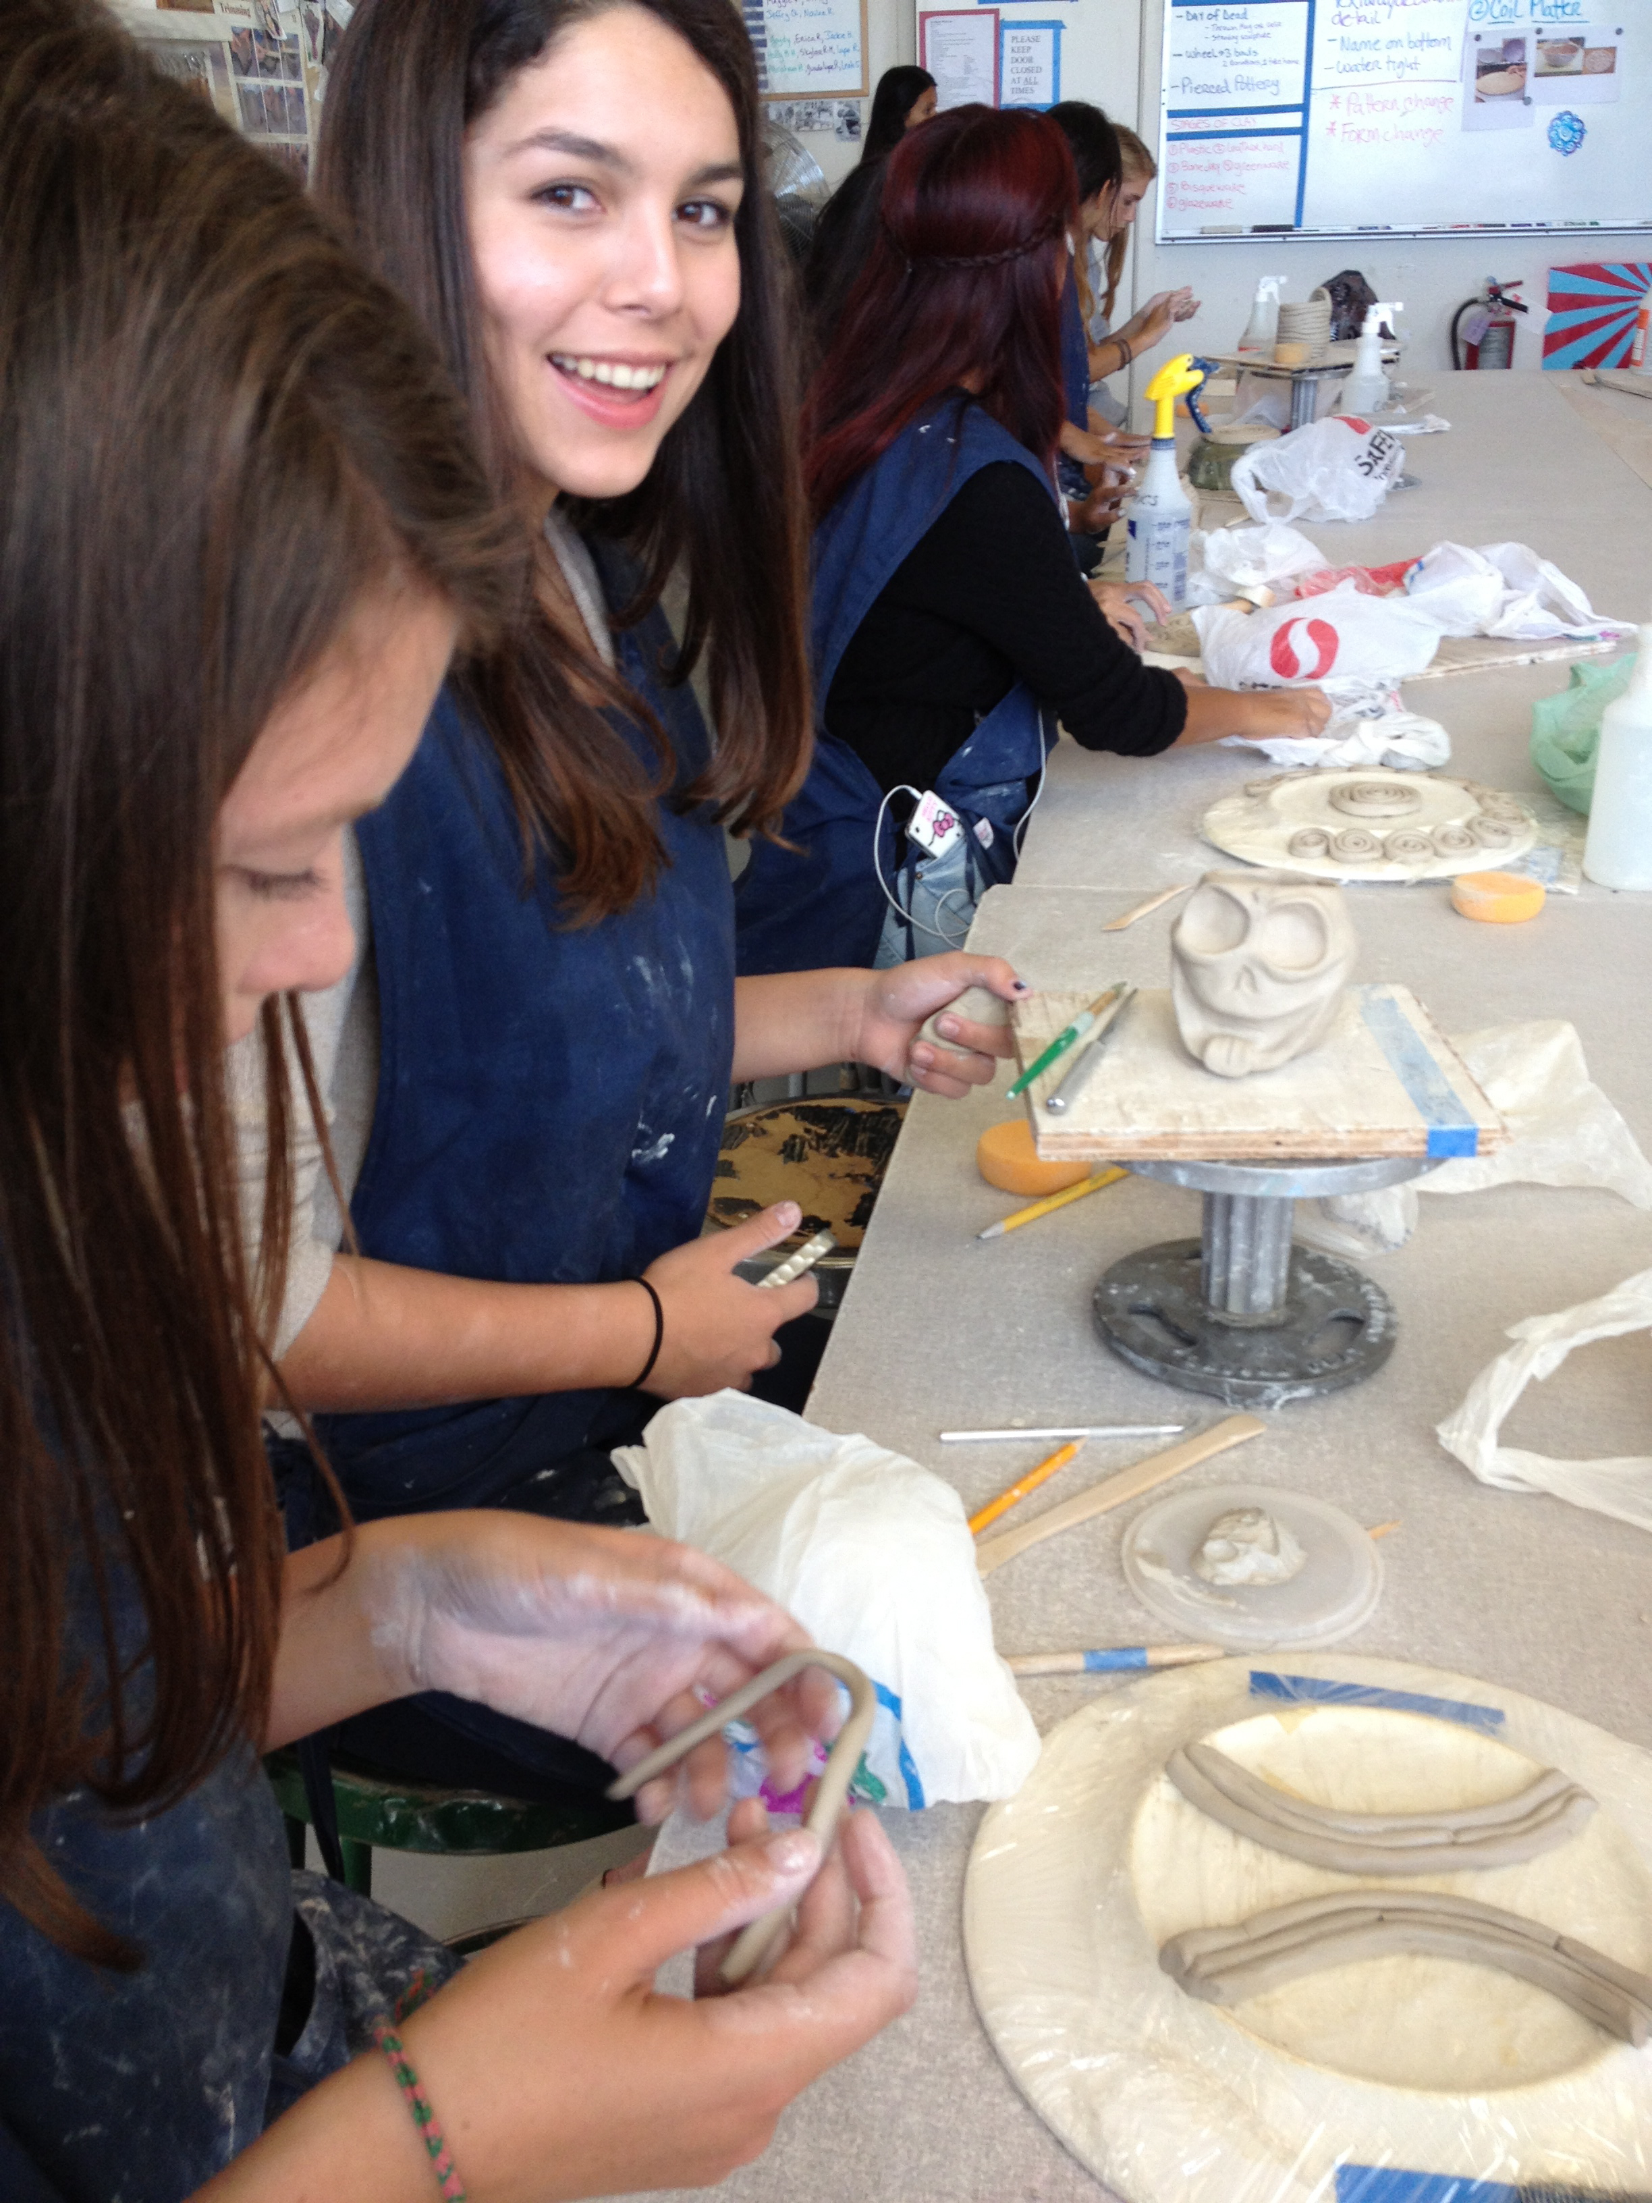
Expectations:
It is important that students are in class daily because of the nature of creating studio artwork.
Missed work must be made up on student’s free time.
Students are expected to use classroom time wisely and turn in assignment on time.

Slide 5
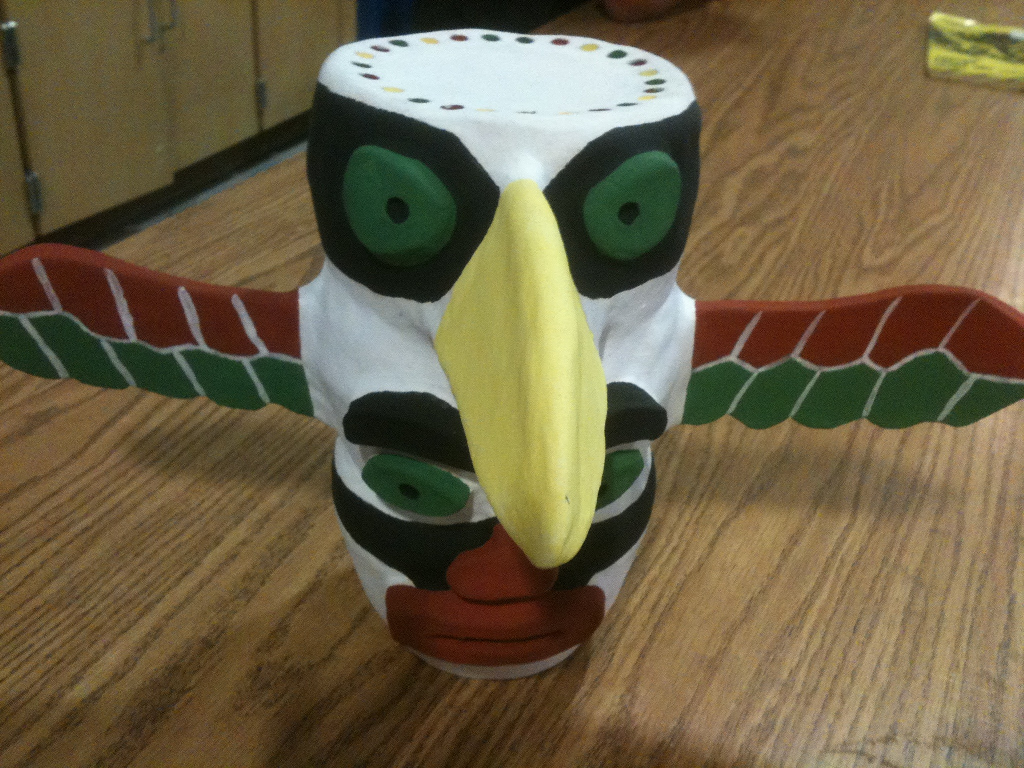
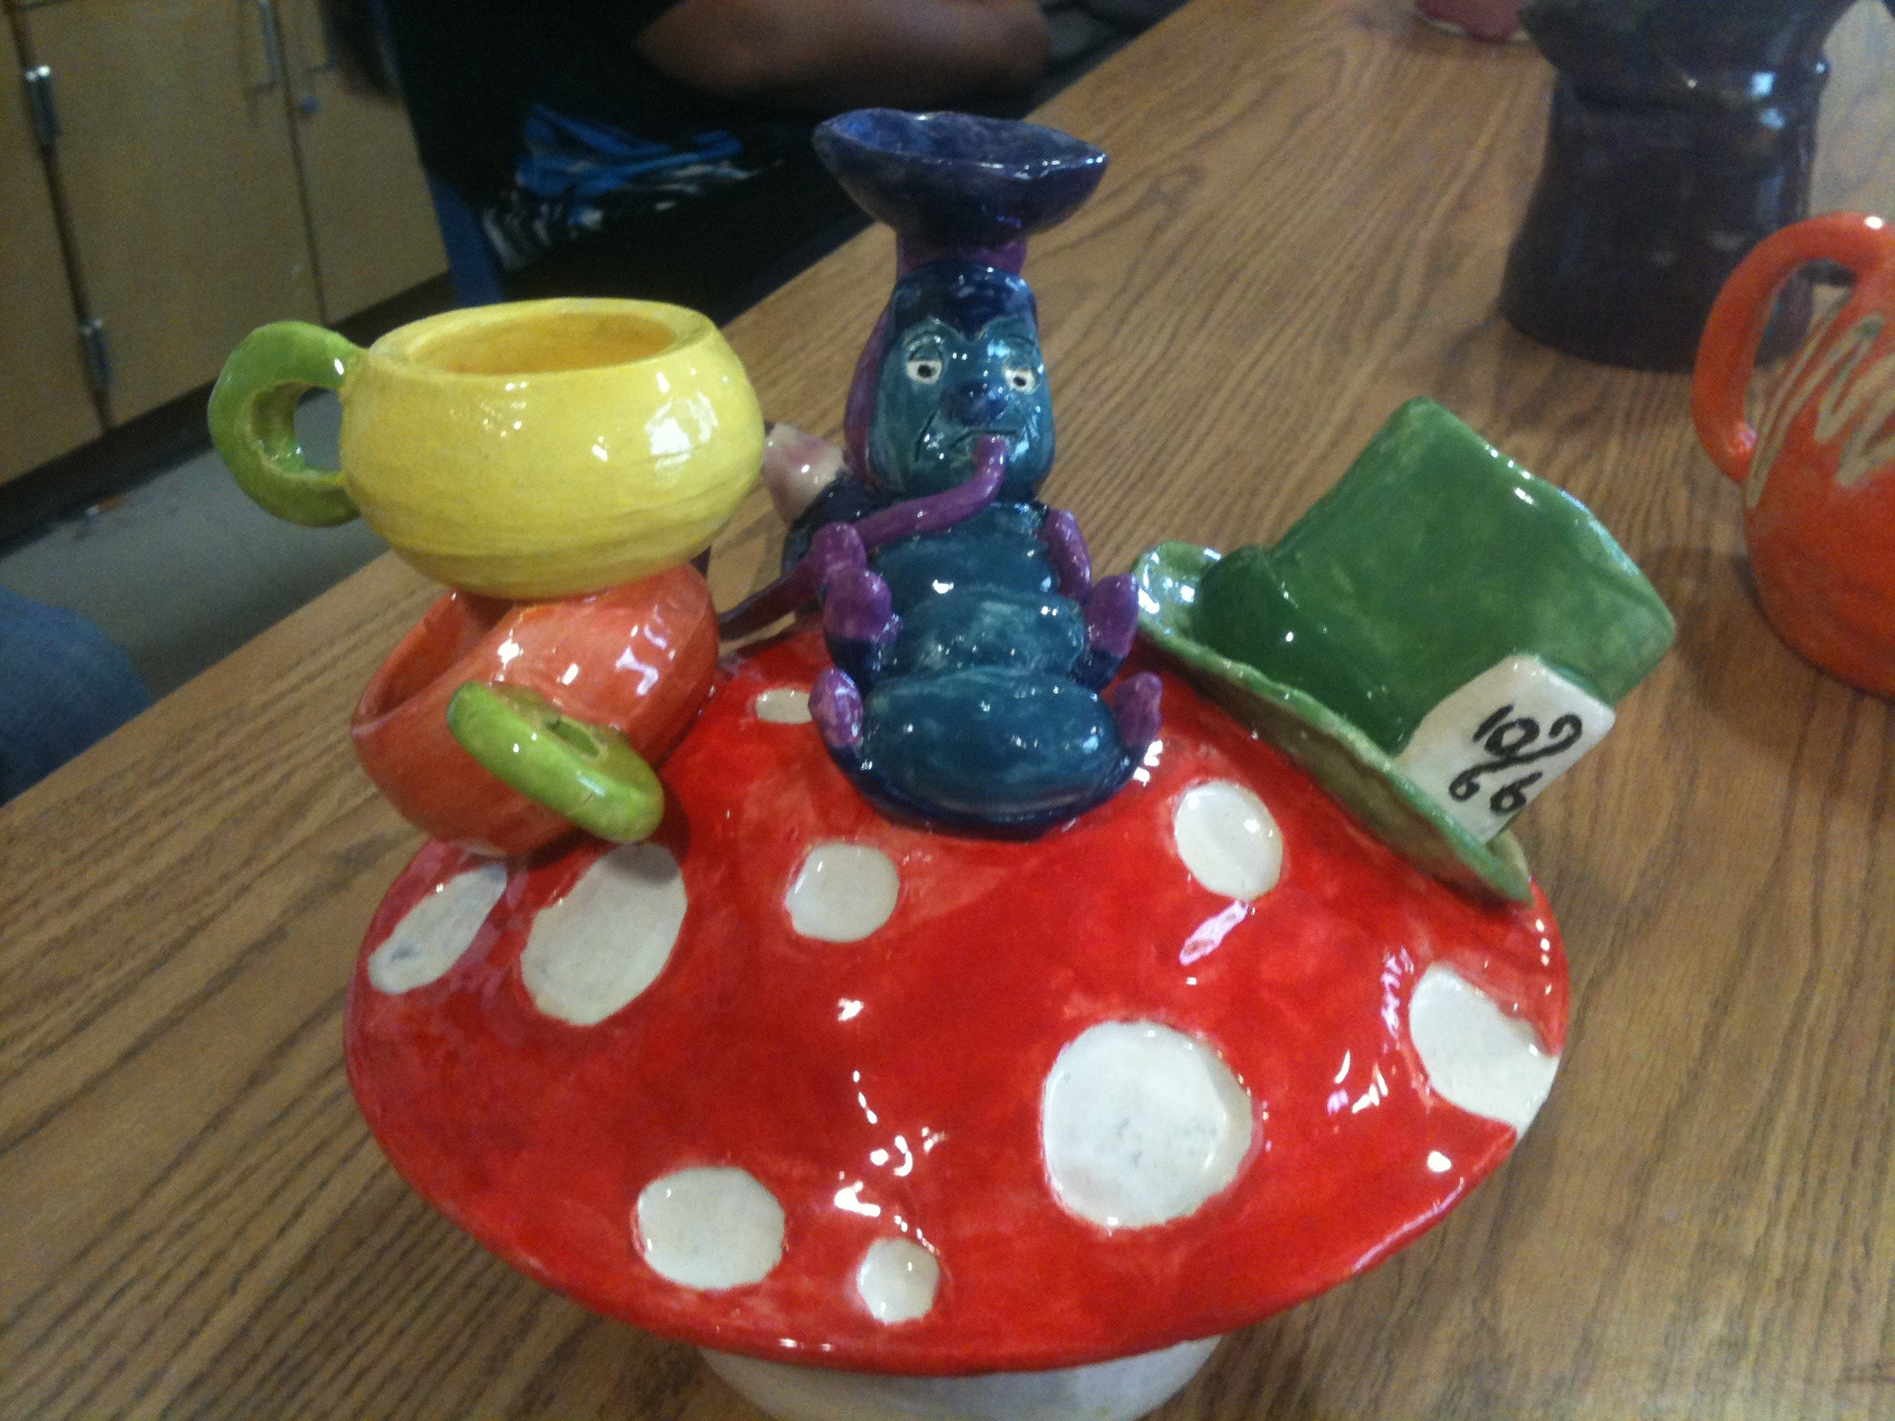
grading policy:
Quarter grades =
60% Portfolio
- in class work
10% BINDER
- notes, sketches and reflections
10% participation
- attendance, productivity and
clean-up
Semester grades =
40% per quarter +
20% for the final

Slide 6
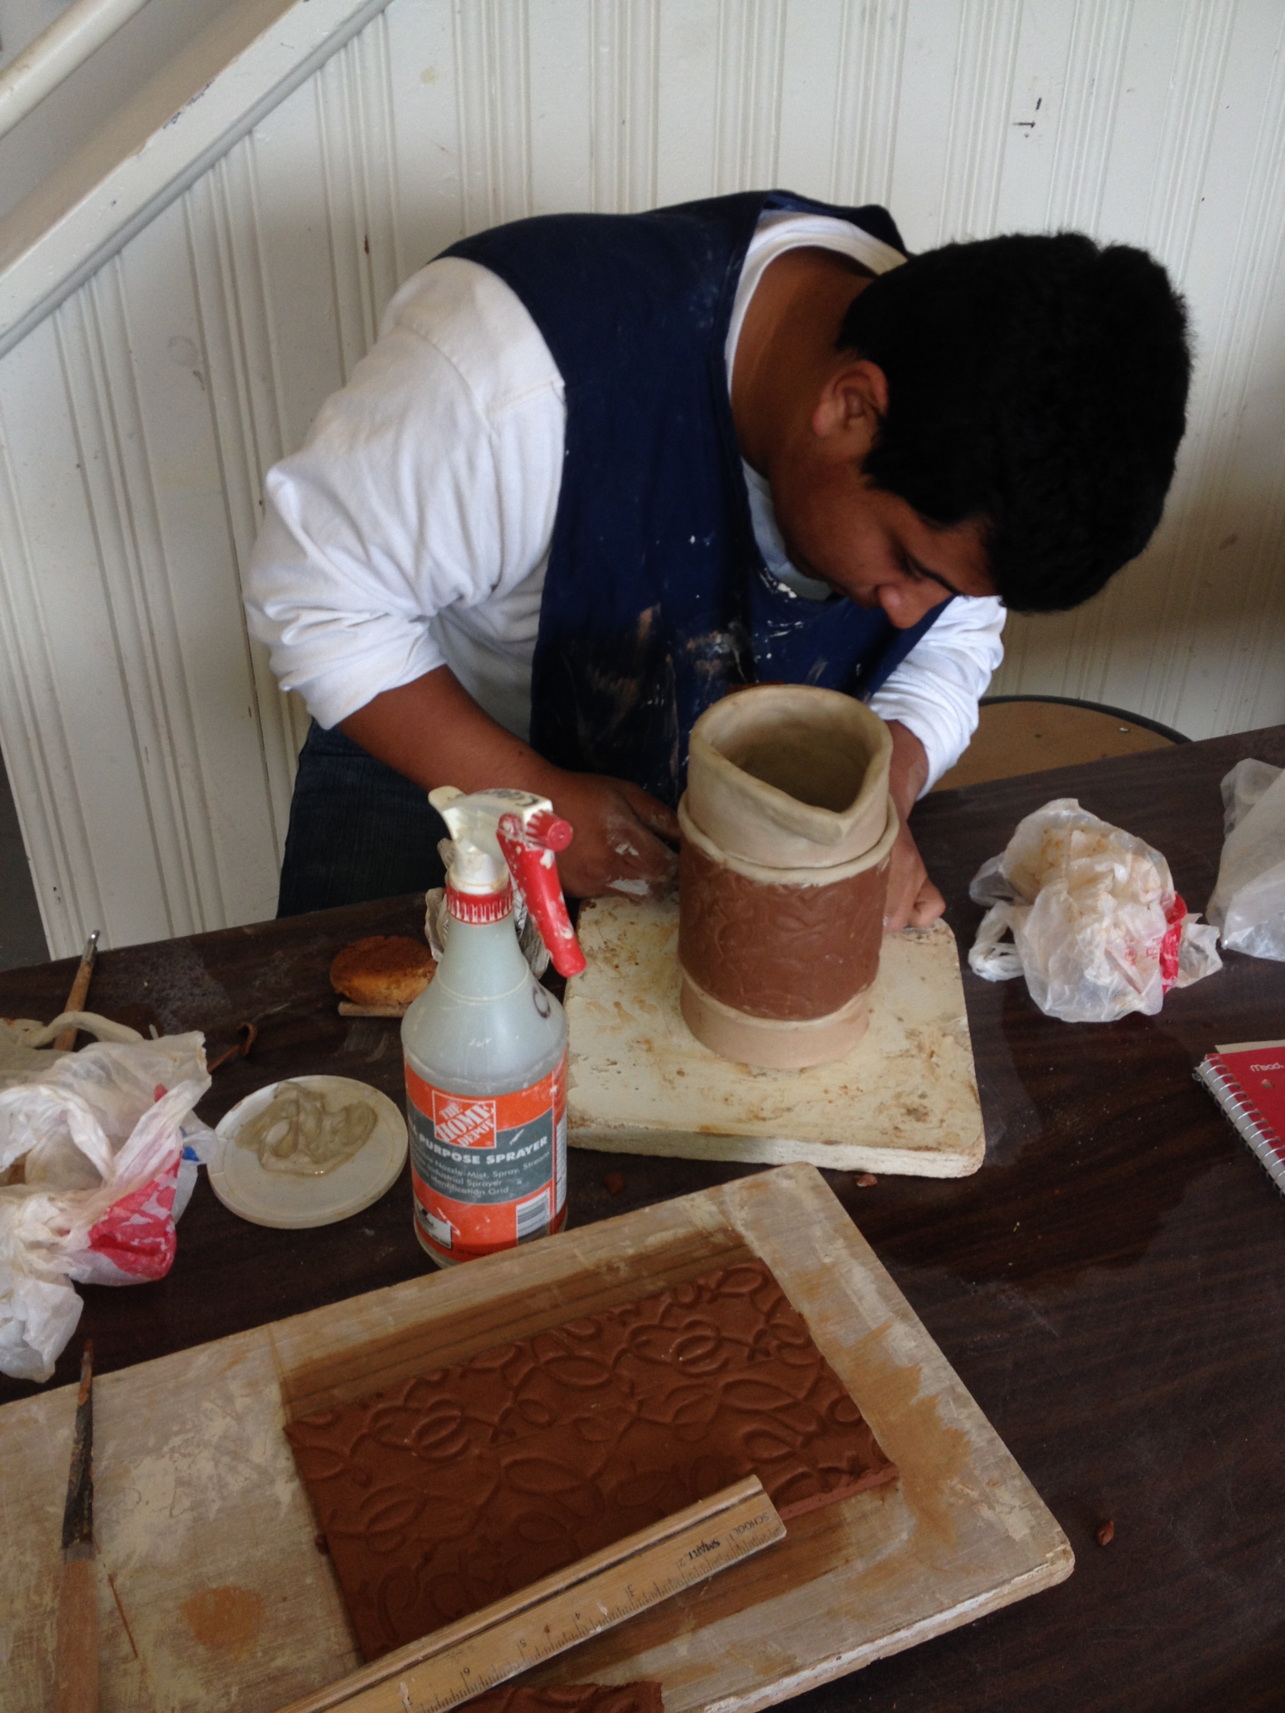
Criteria for grading artwork:
How is the work presented?
Was the effort level up to potential?
Was the work clean and neat?
Was the work refined as much as possible?
Did the student follow the directions and criteria of the assignment?
How is the work representing individual’s creativity- such as original ideas,
images and styles?

Slide 7
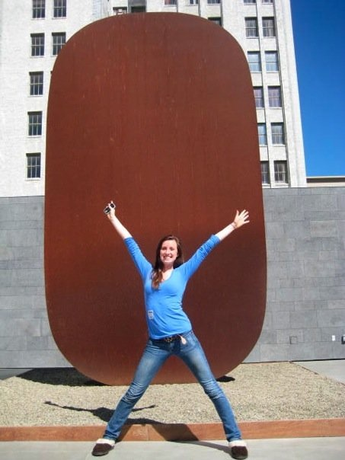
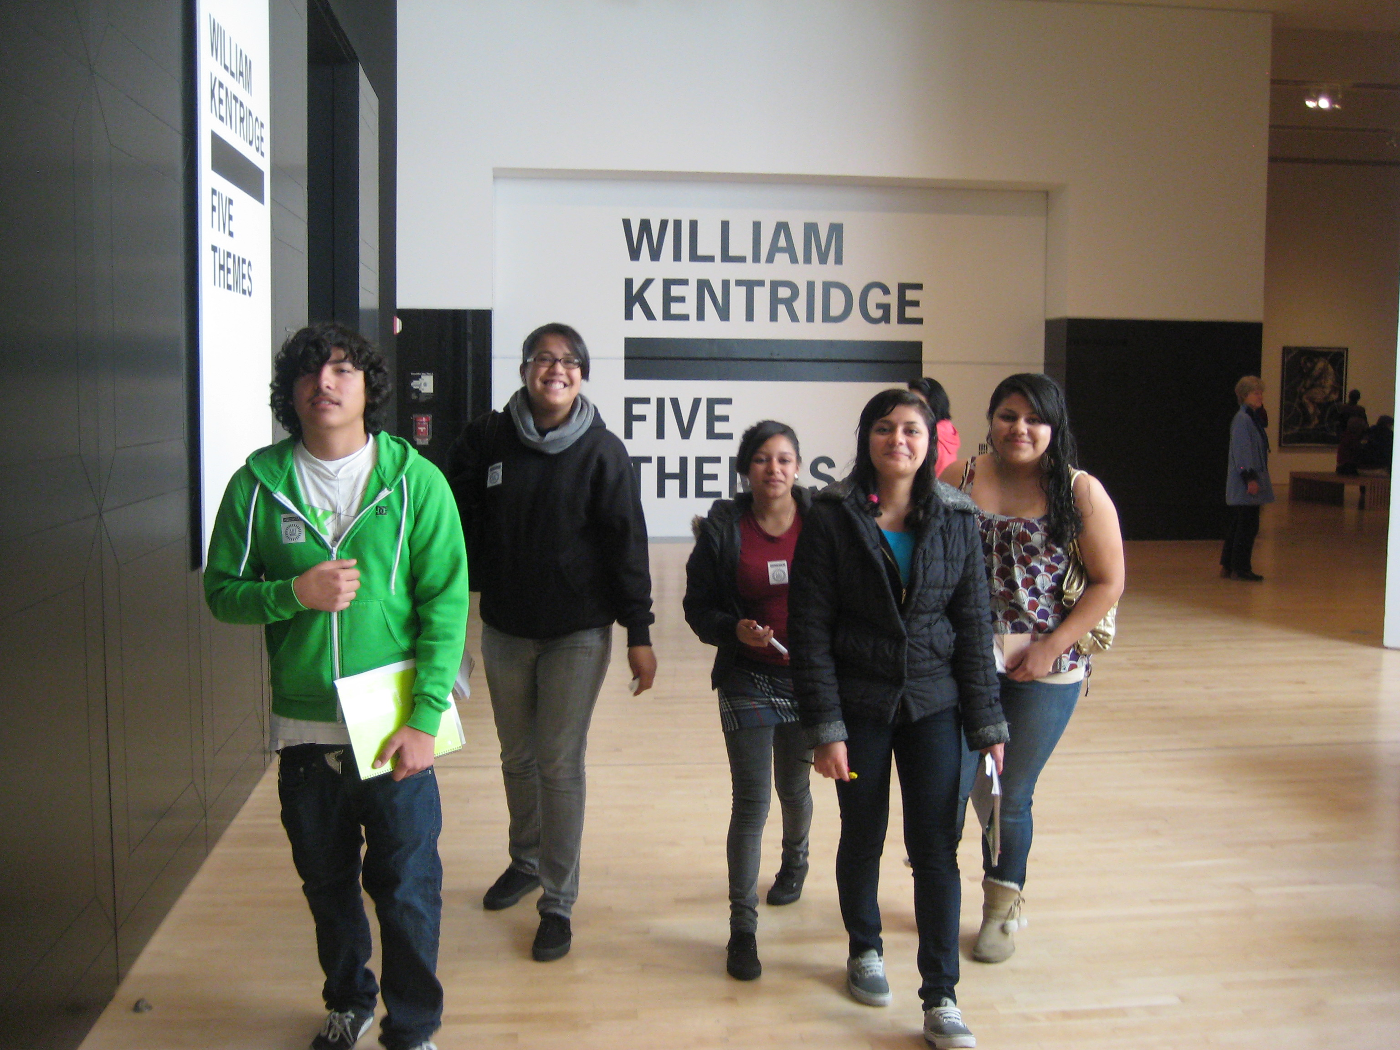
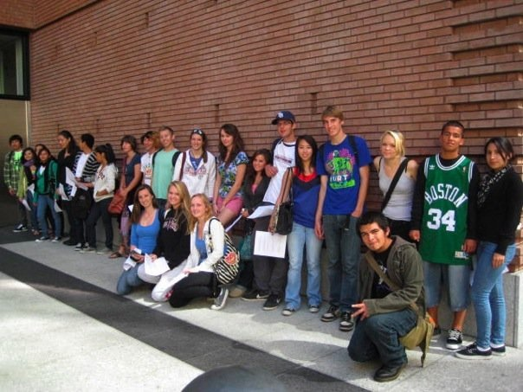
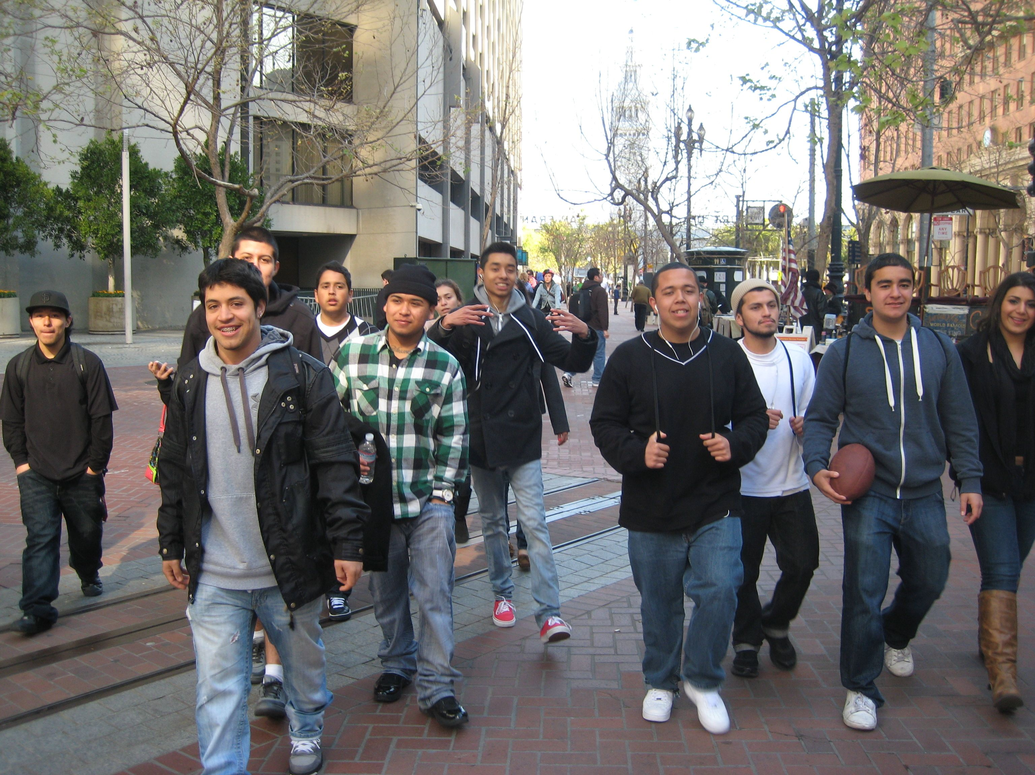
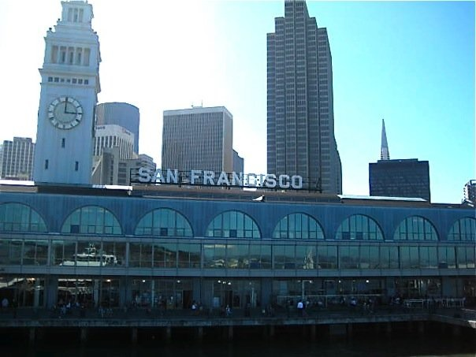
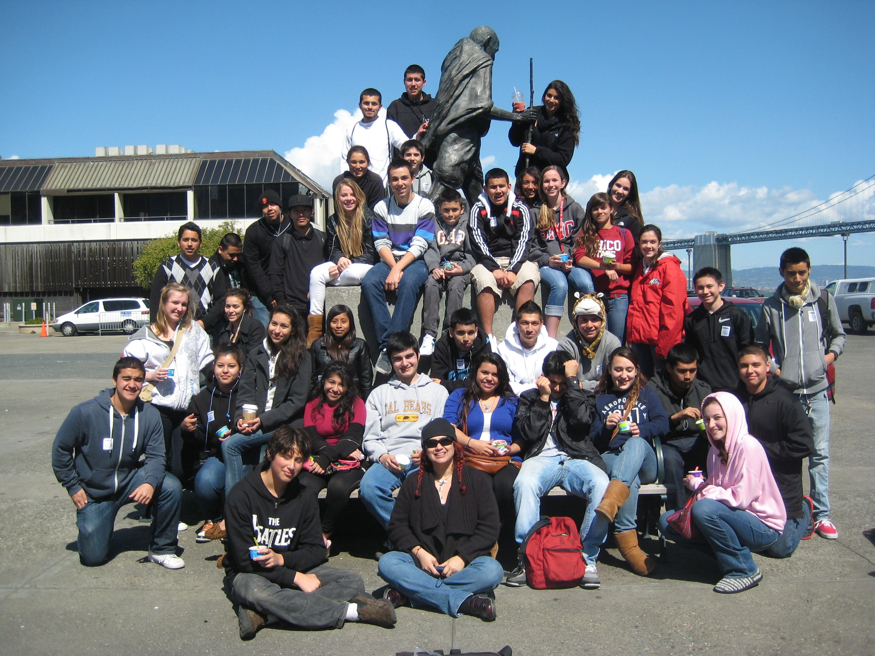
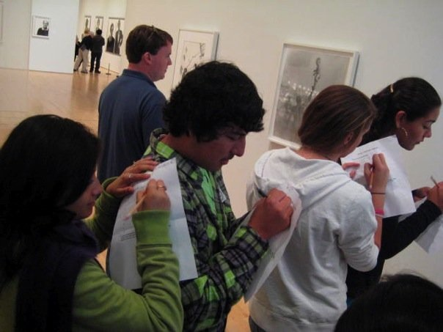

SF MOMA

Slide 8
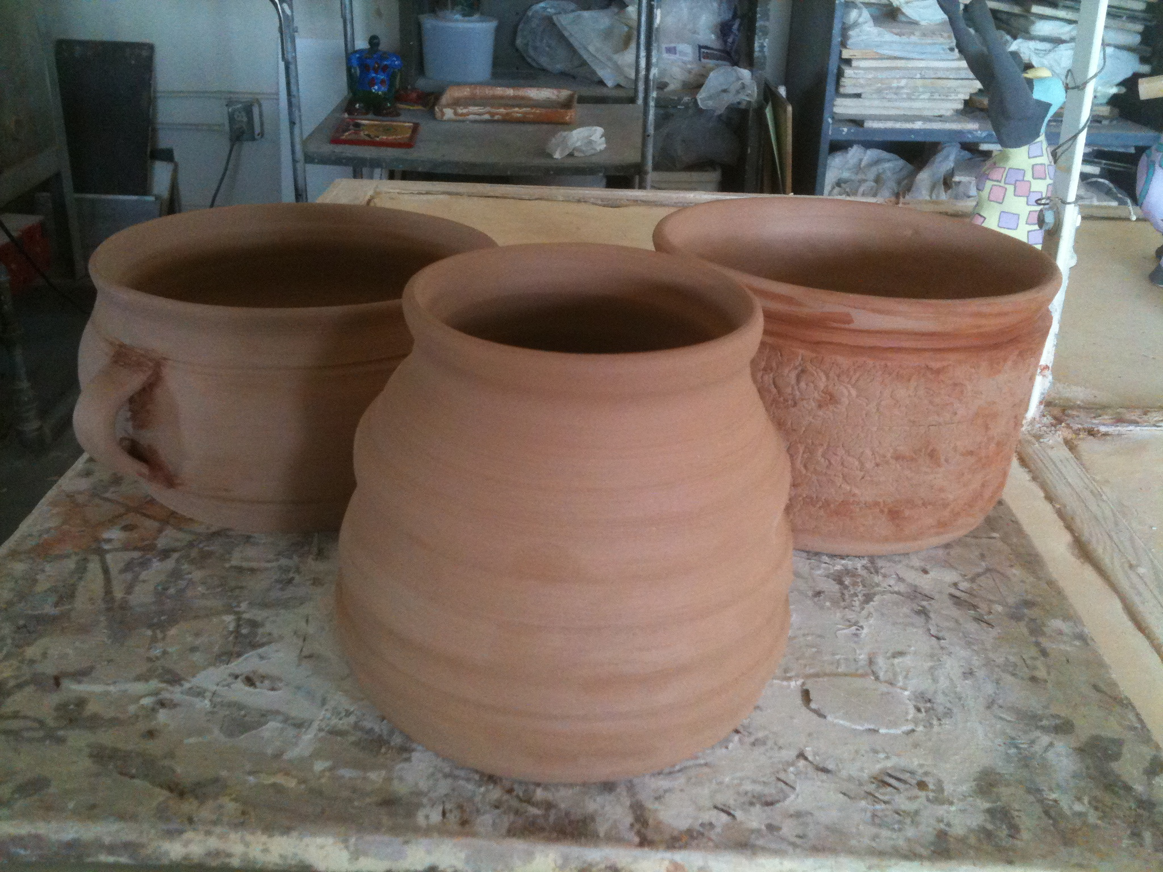
THANK YOU !!!!!!!!!!

