Slide 1
Victorian Era Literature

Slide 2
The Victorian Era
This period refers to the reign of Queen Victoria of England, from 1837 to 1901
It was a long period of peace, prosperity, and national self-confidence in Britain.
The thinking was proper and very stuffy.
Image was everything.

Slide 3
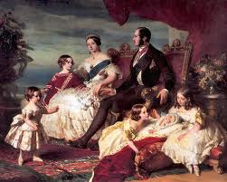

Slide 4
Restraint
It was a period of social and sexual restraint.
The overriding atmosphere emphasized the importance of being proper.
It was a very different time than the way we live today.

Slide 5
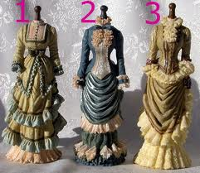

Slide 6
Poverty
While it was a period of relative political calm, there was a lot of poverty in England.
The poor lived side by side with the wealthy who showed little concern for the plight of those who struggled.
If you were poor, you were out of luck.

Slide 7
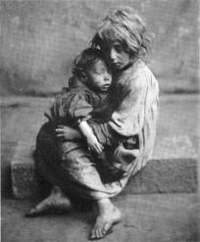

Slide 8
Style
Victorian novels tend to be idealized portraits of difficult lives in which hard work, perseverance, love and luck win out in the end.
Good deeds were rewarded and wrongdoers were suitably punished.
Dickens is one of the most notable of the Victorian Era authors

Slide 9
Gothic Literature
Gothic fiction is sometimes referred to as Gothic horror.
It is a genre of literature that combines elements of both horror and romance.
Novels such as Frankenstein, Dracula, A Christmas Carol, and Oliver Twist are four well known works of Gothic literature.

Slide 10
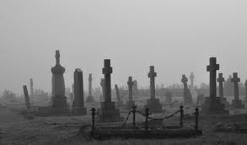

Slide 11
Victorian + Gothic
So in a piece of Gothic literature look for:
Love and romance
Ghosts and danger
Haunted houses and mystery
Storms, cold foggy settings, spooky weird characters.

