Slide 1
The New Deal
1933-1941

Slide 2
“Nothing to Fear but Fear Itself”
In his first inaugural address, FDR declared that the nation “had nothing to fear, but fear itself”
Believing that the “Great Depression” was both economic and mental, FDR:
  Wanted to address both under consumption and the lack of security (mental and physical)
In his First Hundred Days in office, FDR convinced Congress to pass 15 major bills that:
  Helped the needy, created jobs, regulated the economy
  Abandoned laissez-faire and called for deficit spending
    Spending more than the government has (increase debt)

Slide 3
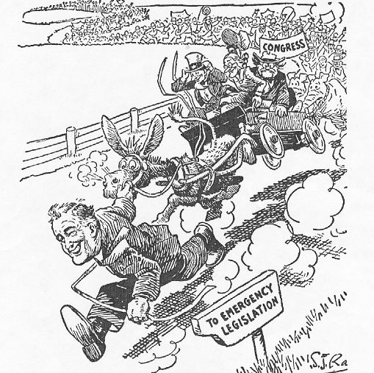

Slide 4
The Three Rs
FDR’s domestic agenda (plan for the US) was called the New Deal
In an effort to correct the causes of the Great Depression, the New Deal focused on the Three Rs:
  Reform (a change in policies)
  Relief (immediate aid to the needy)
  Recovery (immediate long term aid to the economy)
Three Rs helped redefine the relationship between the federal government and citizens

Slide 5
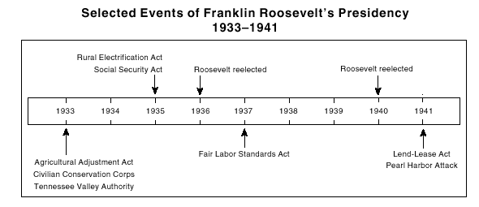

Slide 6


Slide 7
Reform
FDR wanted to restore public confidence in banks and the stock market and prevent another depression. FDR called for and Congress created:
Financial Reform:
  A bank holiday (closed banks for four days) and only allowed good banks to reopen.
  The Federal Deposit Insurance Corporation (FDIC) to insure bank deposits (1933)
  The Securities and Exchange Commission (SEC) to regulate the stock market (1934)
Labor Reform:
  Wagner Act and Fair Labor Standards Act created rights for labor unions, minimum wage, and restricted child labor under age 16

Slide 8
Relief
To help the 15 million Americans who were unemployed when he took office, FDR and Congress created a number of agencies that created jobs and security:
  The Works Progress Administration (WPA)
    Over 8 million workers built playgrounds, schools, libraries, etc.
    Supported the arts (writers, painters, sculptors) SR Pasteur statue
  The Civilian Conservation Corps (CCC)
    Over 2.5 million men worked maintaining forests, parks, etc.
  The Social Security Act (SSA) created three types of insurance to protect the nations most vulnerable citizens:
    Old-age pensions and survivors’ benefits (elderly)
    Unemployment insurance (people without jobs)
    Aid for dependent children, blind, disabled (handicapped)
For the first time, the federal government created a safety net that provided citizens with basic necessities

Slide 9
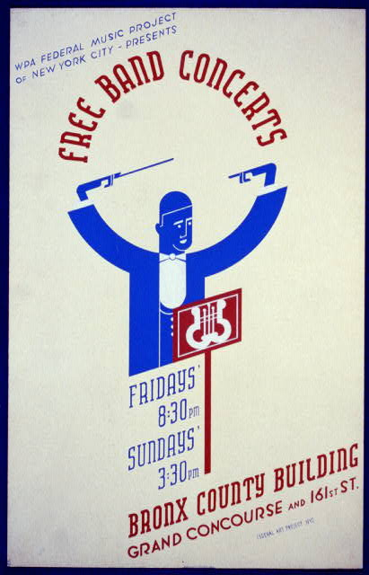
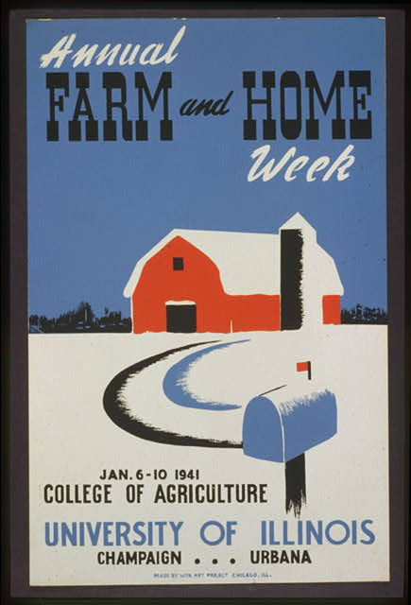

Slide 10
Recovery
In an effort to turn around the economy, the New Deal created a number of agencies to create long term stability
  The National Recovery Act (NRA)
    Tried to regulate prices, wages, and production levels
    Was ruled unconstitutional by the Supreme Court in 1935
  The Agricultural Adjustment Administration (AAA)
    raised farm prices through subsidies (gave money to farmers to keep prices low)
    paid farmers not to grow/grow less (hoped to raise prices)
  The Tennessee Valley Authority (TVA)
    provided jobs, hydroelectric power (electricity), and flood control to farmers in the Tennessee Valley

Slide 11
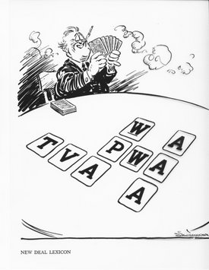

Slide 12


Slide 13
Court-Packing Scheme
Frustrated that the Supreme Court ruled a number New Deal changes unconstitutional, FDR attempted to “pack” the court with supporters:
  Claimed that the justices were old and overworked
  Wanted to add six new justices (that he chose)
Critics claimed that FDR was taking too much power and violated the Separation of Powers
  Even though he was able to appoint a number of justices (retired/died), FDR lost some support
  Republicans and southern Democrats united against New Deal legislation (now hard to get laws passed)

Slide 14
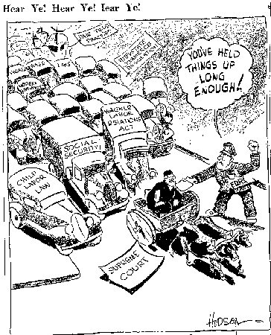

Slide 15
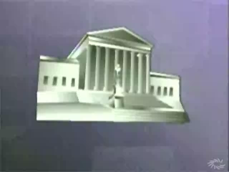
Court Packing Plan

Slide 16
FDR Changes the Presidency
FDR redefined the image of the President. He:
  Was the only President to serve more than two terms in office (was elected 4 times: died in office in 1945)
    Showed that most Americans approved of the New Deal
  Was the nation’s only handicapped President
  Was the first to have a woman in his Cabinet (Frances Perkins: Secretary of Labor)
  Appointed over 100 African Americans to policymaking positions
His wife Eleanor was very active through out his presidency:
  She was an experienced reformer and activists
  Some of her actions and stances embarrassed FDR

Slide 17
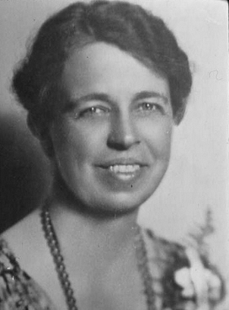
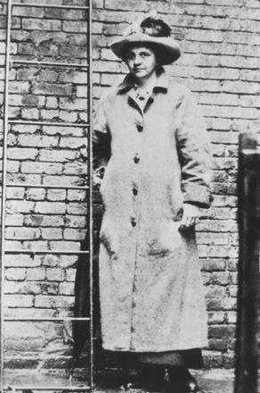
Eleanor and Francis Perkins

Slide 18
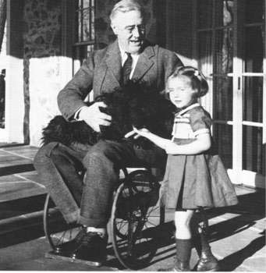
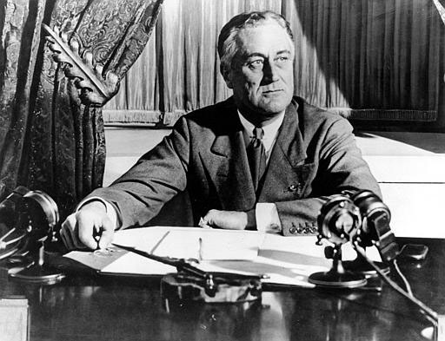
FDR

Slide 19
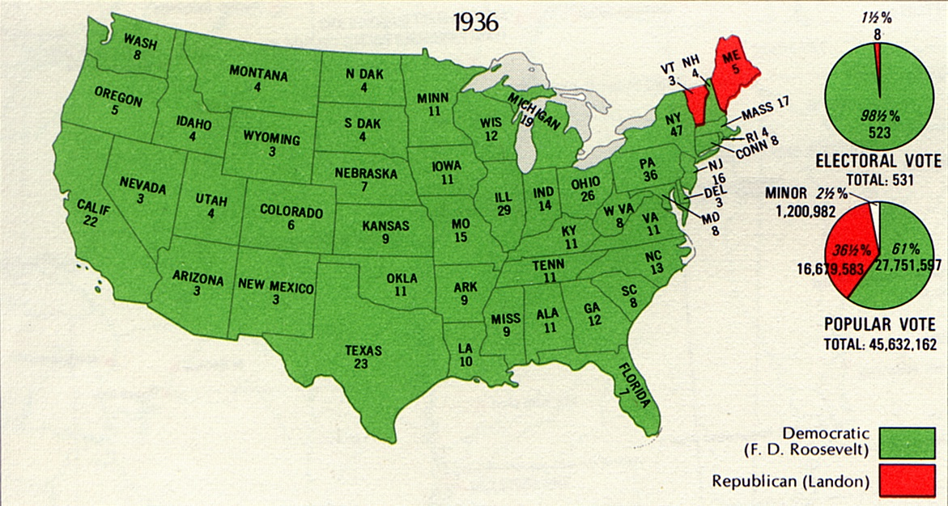
Election Results

Slide 20
Limitations and Critics
Even though the New Deal dramatically changed the role of government, it failed to help a large percentage of the population:
  Many federal relief programs reinforced segregation
    Social Security intentionally excluded farmers and domestic workers (failed to cover two thirds of African Americans)
As the Depression continued, a number of demagogues challenged the New Deal:
    A demagogue is a political leader who gains support by appealing to the public’s desires and prejudices
  People like Father Coughlin and Huey Long argued that the New Deal did not do enough to help

Slide 21
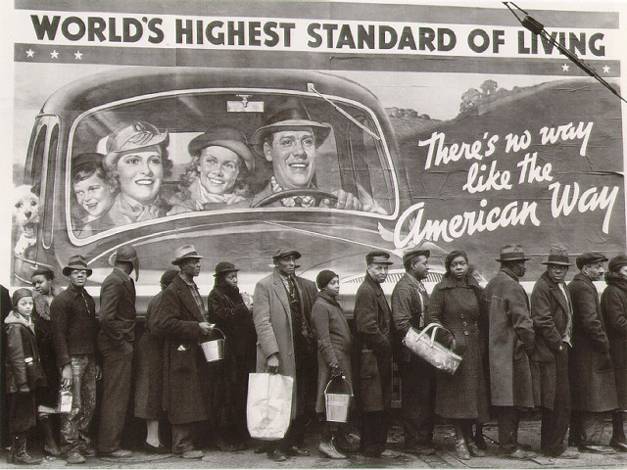

Slide 22
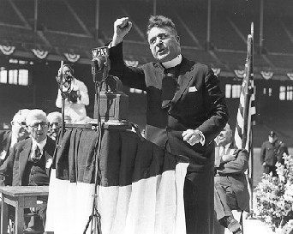
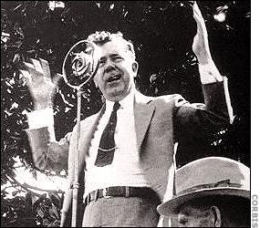
Coughlin and Long

Slide 23
The New Deal’s Effects on Society
The Great Depression and New Deal dramatically altered the lives of Americans and was often reflected in art and literature:
  Hurston’s Their Eyes Were Watching God (1937), and Steinbeck’s The Grapes of Wrath (1939)
  Dorthea Lange took some of the most enduring and iconic images of the Depression and New Deal
In 1935, union representatives from the AFL created the Committee for Industrial Organization (CIO)
  A large number of sit-down strikes, workers stop working but refused to leave the building, took place through out the decade

Slide 24
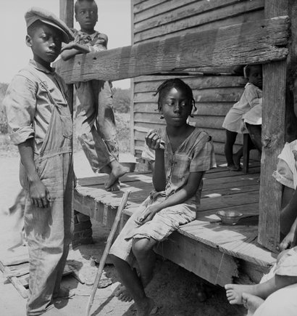
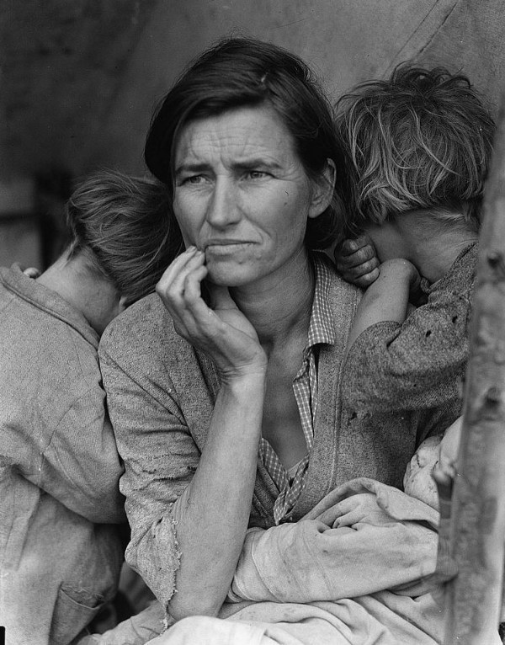

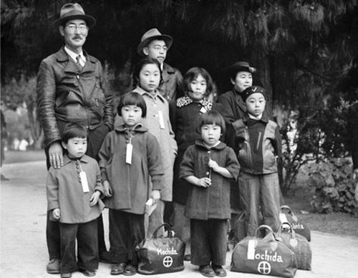
Dorthea
Lange

Slide 25



Slide 26
Legacy of the New Deal
The New Deal had a profound effect on America
  It reshaped the size and power of the federal government
  Workers demanded changes in the workplace (sparked by governmental oversight)
    Union membership continued to rise into the 1970s
New Deal changes are still all around us
  Bridges, dams, tunnels, public buildings, and hospitals built with money from the New Deal still exist to this day
  Federal agencies such as the Tennessee Valley Authority, FDIC, and SEC continue
  The Social Security system is a part of the lives of all Americans
The New Deal’s system of deficit spending is still very controversial

Slide 27
