Slide 1
The Great Depression and New Deal
(1929–1940)

Slide 2
Causes of Great Depression
Even though the economy in 1920s seemed strong, the prosperity hid a number of growing problems.
There were three main causes of the Great Depression:
  Government policies (laissez faire)
  The development of an unstable economy
  Over-speculation (risky investments)
The 1929 stock market crash exposed the causes and the Great Depression started!

Slide 3
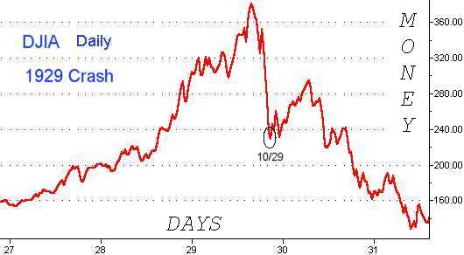
“Black Tuesday” and the Great Crash
Even though it did not cause the Great Depression, the stock market crash, Great Crash, that began on 10/29/1929, Black Tuesday, did trigger it!

Slide 4
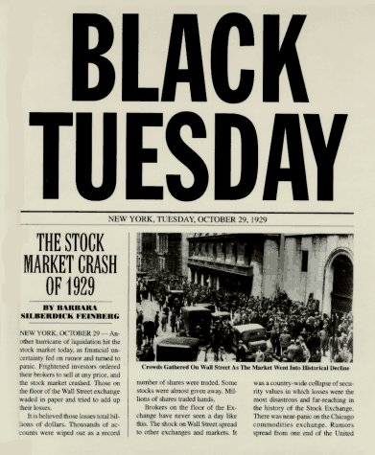
Black Tuesday: October 29, 1929

Slide 5

Effects of the “Great Crash”
Great Crash
Investors
World Payments
Businesses and Workers
Investors lose millions.
Banks
Overall U.S. production plummets.
Businesses and workers cannot repay bank loans.
Consumer spending drops.
Allies cannot pay debts to United States.
U.S. investors have little or no money to invest.
Businesses lose profits.
Businesses cut investment and production Some fail.
Savings accounts are wiped out.
Banks run out of money and fail.
Workers are laid off.
Europeans cannot afford American goods.
U.S. investments in Germany decline.
Bank runs occur.
German war payments to Allies fall off.

Slide 6
Government Policies
In the 1920s, the government supported big business and followed laissez faire economics
  believed that the economy would continue to grow if the government stayed out
As a result, the government did not regulate (control) banks, the stock market, or businesses
  Often led to corruption and fraud
  Some Progressive era protections were ended
  Workers were not protected and wages did not rise
The government lowered taxes for the rich and protected US businesses with tariffs

Slide 7
Unstable Economy
Even though the economy was booming in the 1920s, the nation’s wealth was unevenly distributed:
  Low taxes and no government regulation created a society with few extremely rich and many poor
    Over 60% of American families made less than $2,000 per year
At the same time, US factories and farmers produced more goods than they could sell, overproduction
  This caused the value of goods to decrease
  Eventually, thousands of farms and businesses went bankrupt (could not pay their bills)

Slide 8
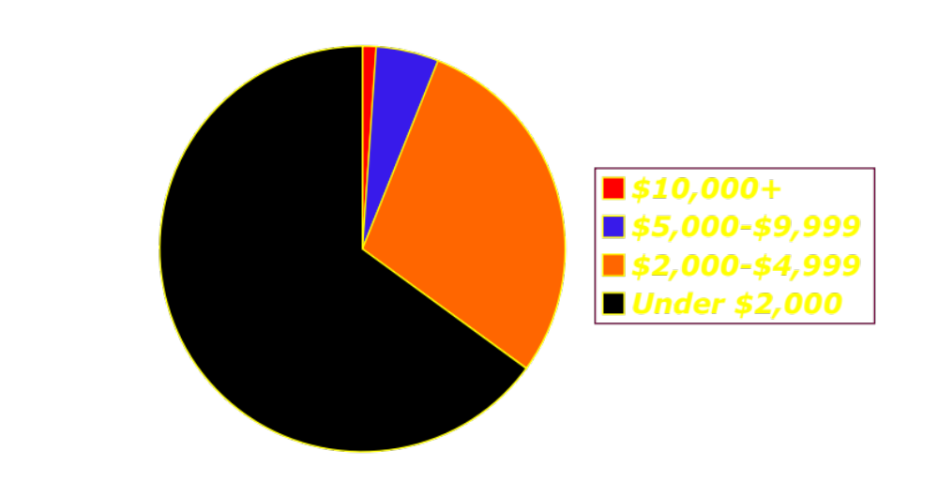
Income Distribution, 1929
1%
40% of U.S. families lived on less than $1,500 per year – in poverty!
5%
29%
65%
Source: Historical Statistics of the United States, Colonial Times to 1970
Notes:
8
Source: Historical Statistics of the United States, Colonial Times to 1970

Slide 9
Problems of the 1920s
Factories and Farms OVERPRODUCING!
Banks have NO $, people lost their savings and jobs, and their was no one to HELP!
Factories Fire Workers (Have No $)
Farm Prices fall (Have no $)
Banks close because they have no money: Loans have not been paid back, can’t give people their savings
Farmers & Factory Workers can’t pay back loans to Banks: DEFAULT!!

Slide 10
Over-speculation
Banks loaned money to people, businesses, and countries that could not pay it back
  Banks invested other’s money in the stock market
  People began buying more than they could afford on credit (80% of Americans had NO savings)
People made risky investments (speculation) and bought stocks on the margin (with borrowed money)
  A person could pay $10 down on a $100 stock and the rest when the stock’s value rose
  When the stock market crashed, people could not pay back the loans
When people failed to pay back the loans, the banks closed. All the money people had in banks vanished!

Slide 11
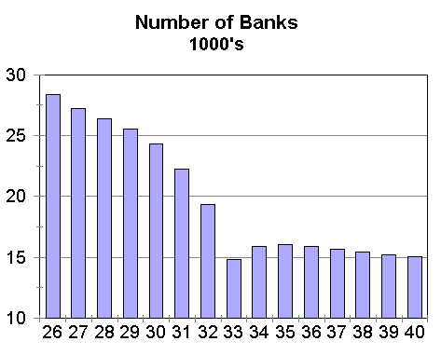
Bank Failures
Banks have no money to give people
Banks Close
People Default on Loans
+
=
People Loose savings

Slide 12
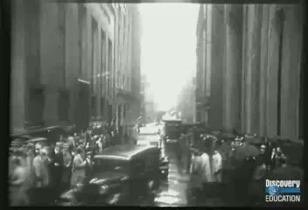
Bank Closures

Slide 13
President Hoover's Belief
Hoover’s Attitude:
“I do not believe that the power and duty of the general government ought to be extended to the relief of individual suffering…though people support the government, the government should not support the people.”
--Herbert Hoover, 1930

Slide 14
Hoover’s Response
Hoover believed the economy would fix itself:
  Continued laissez faire economics
  Did not support federal public assistance because he believed it would destroy people’s “self-respect”
When the economy got worse, Hoover supported:
  Hawley-Smoot Tariff (raised taxes on foreign goods) to protect US business
    Other countries raised their tariffs and trade decreased
  Tax cuts for the rich and cheap loans for big business
Many believed that Hoover only helped the rich and began blaming him for the nation’s problems
  Homeless encampments were built across the nation and mockingly named “Hovervilles”

Slide 15
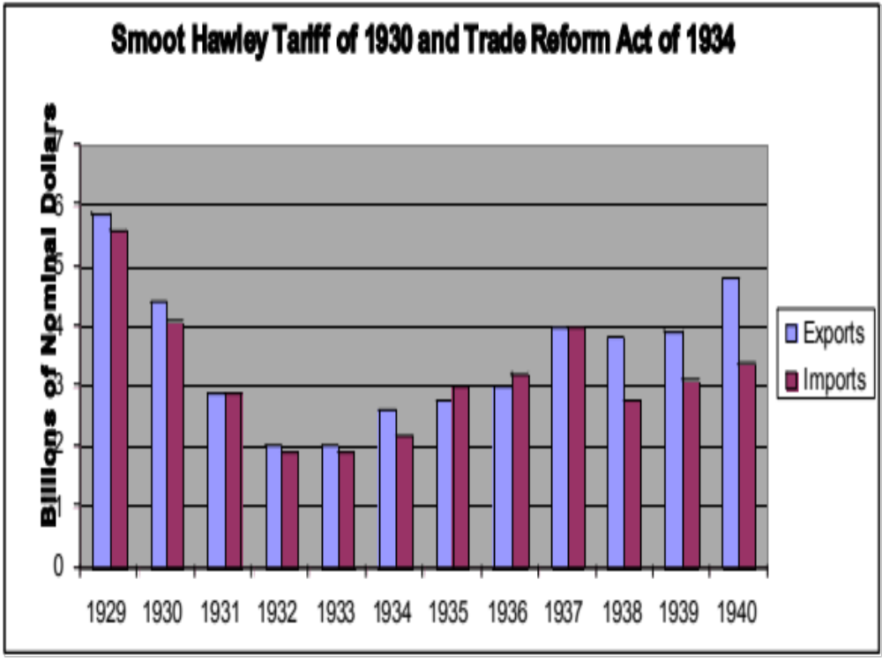
Hawley Smoot Tariff Graph

Slide 16
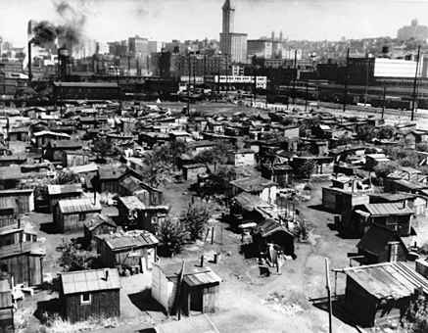
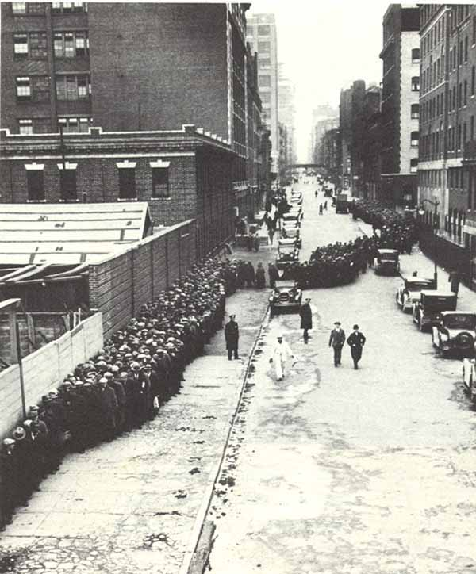
Hooverville and Soup Kitchens
Christmas Day Bread lines: New York City, 1931

Slide 17
The Dust Bowl
Even as the economy soared, American farmers struggled through out the 1920s. Beginning in 1930, a series of manmade and natural disasters rocked American farmers on the Great Plains:
  In an effort to make a profit, farmers planted too much, too frequently and drained the soil of nutrients
  From 1930-1936, severe drought turned the natural soil to dust and wind storms blew the soil away
As a result, the whole area became known as the Dust Bowl.
  About 60% of the families in the Dust Bowl region lost their farms, became homeless, and migrated (lots west)

Slide 18
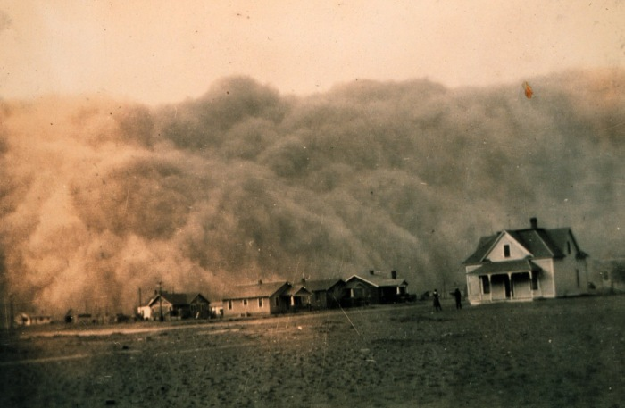
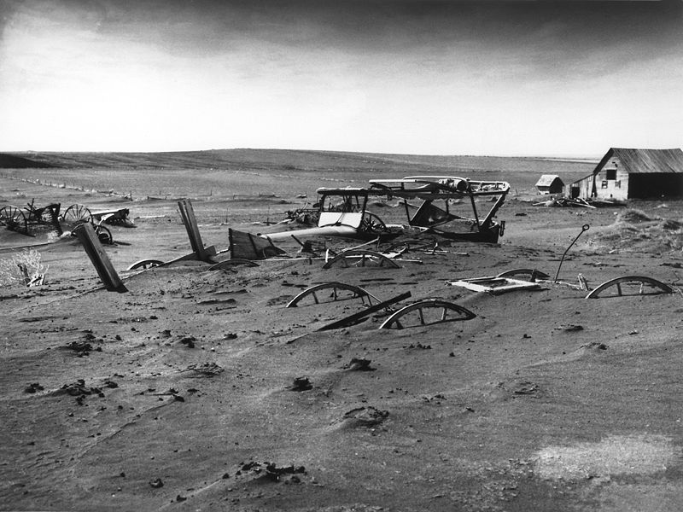
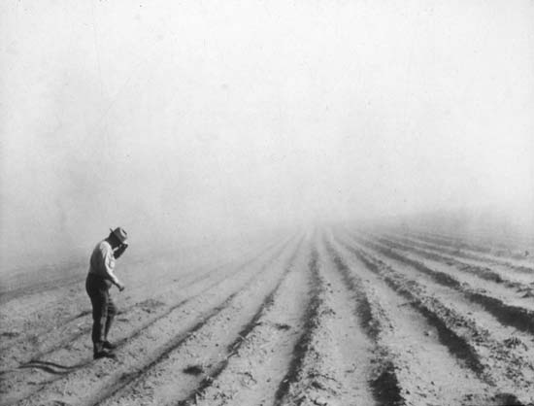
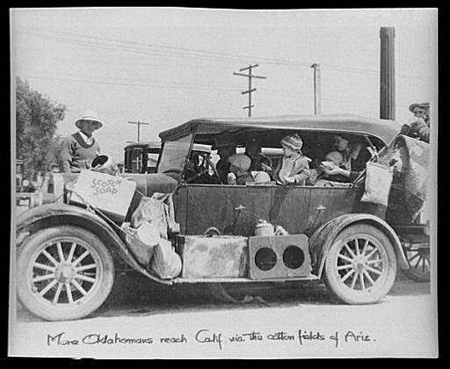
Dust Bowl Images

Slide 19
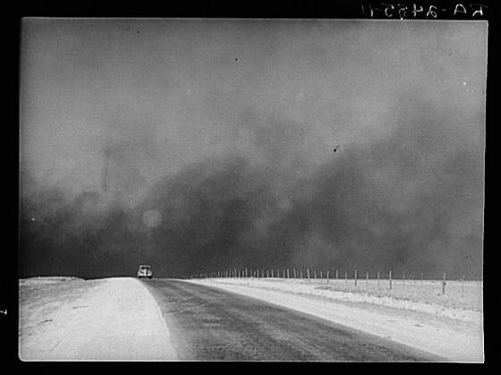

Slide 20
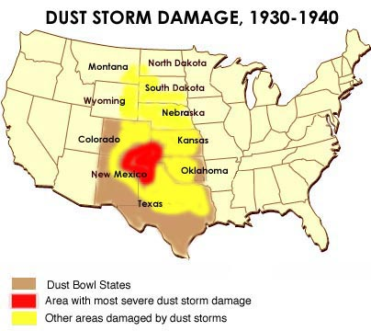
The Dust Bowl Map

Slide 21

The Depression

Slide 22
Hoover and Roosevelt
As Hoover became increasingly unpopular, the governor of NY, Franklin Roosevelt, gained attention for his creative policies:
  Believed government had a responsibility to help people in need
    Created agency to help the large number of unemployed
  Called for more controls on big business
In 1931, Hoover lost even more support when he used the military to deal with the Bonus Army (unemployed WWI vets)

Slide 23
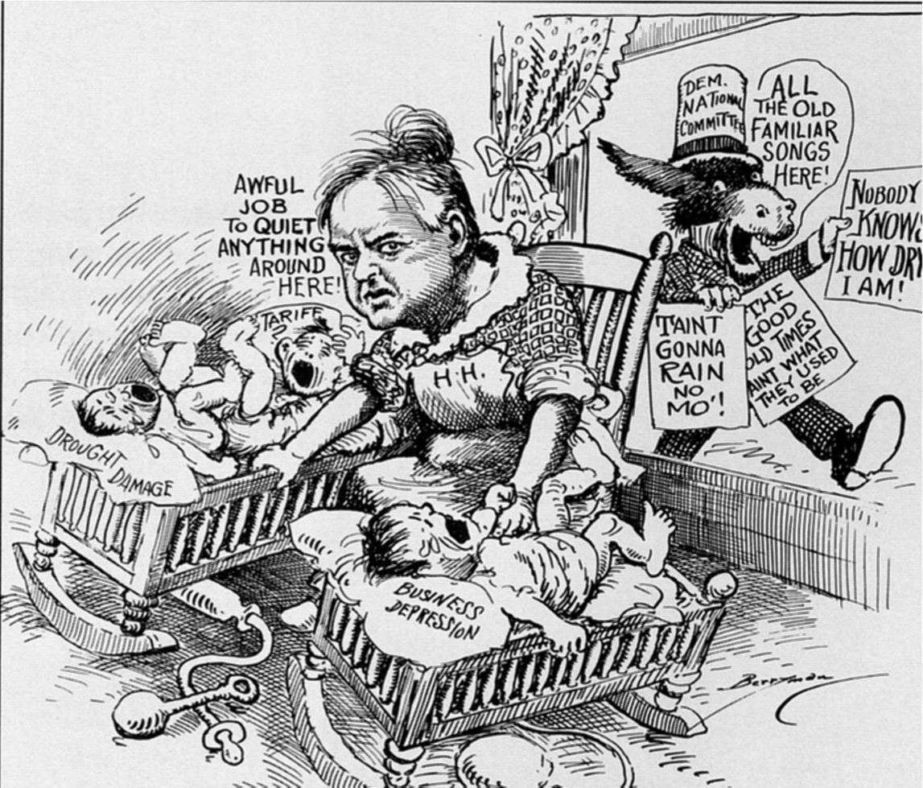
Hoover and Roosevelt

Slide 24
FDR and the Election of 1932
Increasing poverty created problems:
  Men unable to support their families became depressed
    Suicide rates increased through out the 1930s
    Working women were accused of taking jobs away from men
  Competition for jobs increased discrimination
    Attacks on minorities increased throughout the 1930s
As the Depression deepened, Americans demanded change. As a result, Franklin D. Roosevelt easily defeated Hoover in 1932
  Roosevelt (FDR) won support by promising the American public a “New Deal”
  American viewed FDR as a symbol of the nation because they believed he “beat” polio

Slide 25
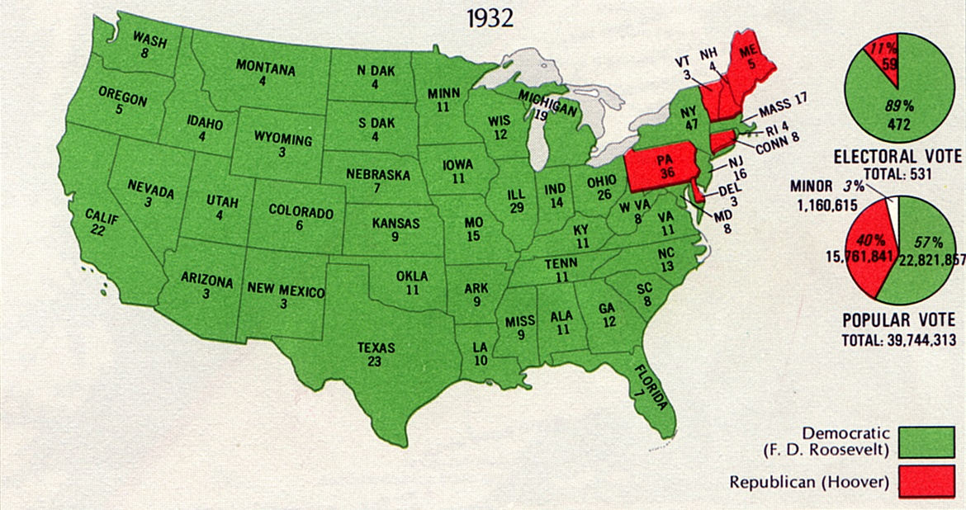
1932 Election Map

Slide 26
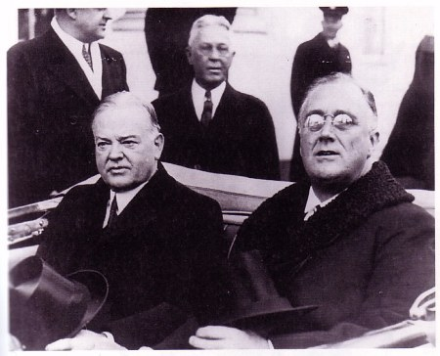
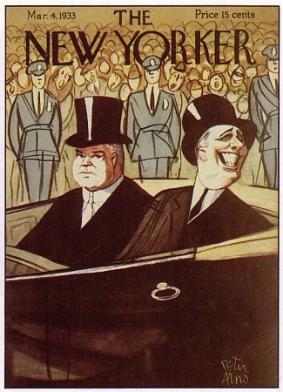
Hoover and Roosevelt

