Slide 1

The Postwar Years at Home
(1945–1960s)

Slide 2
Post War Changes
Just like the 1920s, America in the 1950s experienced dramatic postwar changes:
  Social: conformity and challenge
  Political: Cold War and 2nd Red Scare
  Economic: postwar boom and new technology
The emergence of the US as a super power and their involvement in the Cold War shaped life inside the country

Slide 3
American Society in the 1950s
After WWII, Truman supported a number programs that he called his Fair Deal:
  Extension of FDR’s New Deal, included support for returning soldiers, “GI Bill of Rights”
    Loans for homes and college (growth of suburbs)
    4 million buy homes and 8 million go to college
  Ended segregation in the military
Labor also experienced important changes:
  more “white collar” jobs (office jobs) increased
    White middle class Americans felt pressure to “conform” or dress, think, and act alike (men worked, women stayed home)
  “blue collar” jobs (factory) improved
    AFL and CIO merged to form the powerful AFL-CIO.

Slide 4
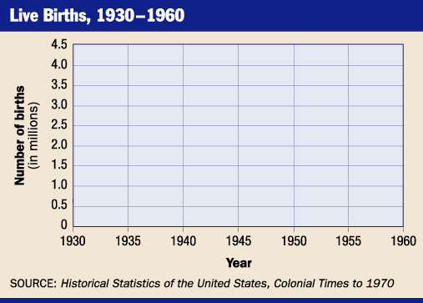
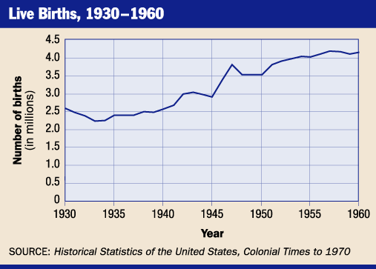
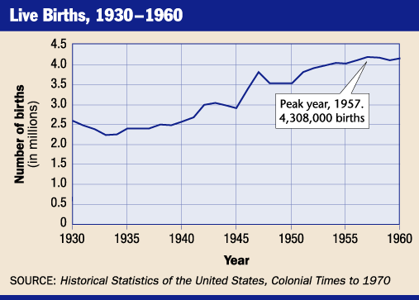
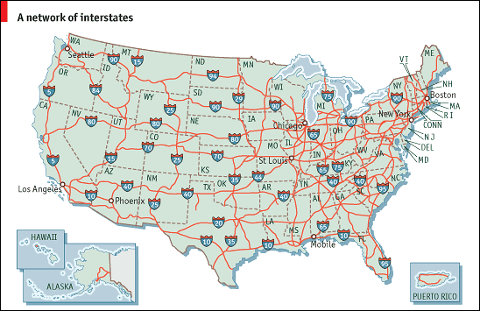
Baby Boom and Highways
The postwar years saw a dramatic rise in the birthrate or baby boom (continued until 1964)
  In 1956, the Federal-Aid Highway Act gave billions to build an interstate highway system

Slide 5
Conformity and Rebellion
The postwar years experienced both a rise in conservatism and rebellion:
  Fearing communism and nuclear war, many Americans turned to religion
  References to God were added to the Pledge of Allegiance and put on money
Like Jazz in the 1920s, the emergence of Rock n’ Roll challenged social norms
  Like Jazz, many adults claimed it promoted immorality and the mixing of races

Slide 6

Elvis Presley

Slide 7
Political Changes
Like the post WWI period, the US experienced an intense fear of communism following WWII. This 2nd Red Scare led to:
  Congress created committees to look into accusations of communism in the US
    HUAC in the House and McCarthy in the Senate
  Following the 1957 launch of Sputnik I, the US entered into the Space Race (created NASA)
    In 1958, the National Defense Education Act and focused on improving math and science in schools (reason you take so many:-)

Slide 8
Cold War Hysteria
Fear of Communism led to fear and suspicion inside the US
  The House Un-American Activities Committee (HUAC) accused citizens of having “Communist leanings”
    A group of actors and screen writers known as the Hollywood Ten, refused to answer HUAC’s questions and were sent to jail
    In response, movie studios blacklisted, anyone accused of “communist leanings”
    A blacklist is a list of people shared by employers of who should not be hired

Slide 9

The 2nd Red Scare & HUAC

Slide 10
The Cold War at Home
Like in the 1920s, fears of communism led to immigration restrictions:
  fears of disloyal immigrants from Communist countries, the 1952 McCarran-Walter Act (reestablished quota system from 1924)
  The famous cases of Alger Hiss and of Julius and Ethel Rosenberg reinforced fears of Soviet spies inside the US
    Like Sacco and Vanzetti, these trials were controversial, but evidence suggests that they were guilty of spying for the Soviets

Slide 11
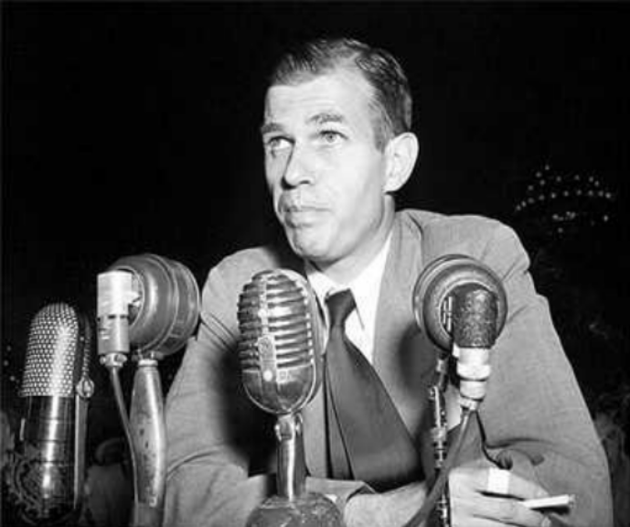
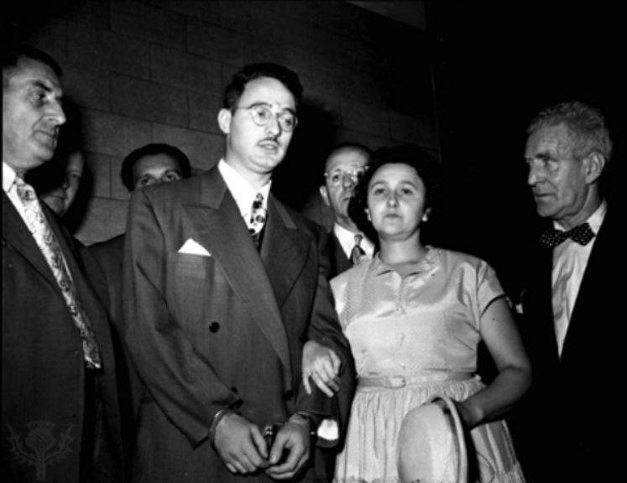
Hiss and the Rosenbergs

Slide 12
Spy Cases

Slide 13
The McCarthy Era
The most famous example of Cold War fear was McCarthyism
  Up for reelection, Senator Joseph McCarthy claimed that he had a list of over 200 Communists in the US government
  Although McCarthy had no evidence, few people spoke out fearing they would be accused of being communist spies
In 1954, McCarthy claimed that communists had taken over the army
  In a series of hearings aired on TV, McCarthy was discredited and lost all his power

Slide 14
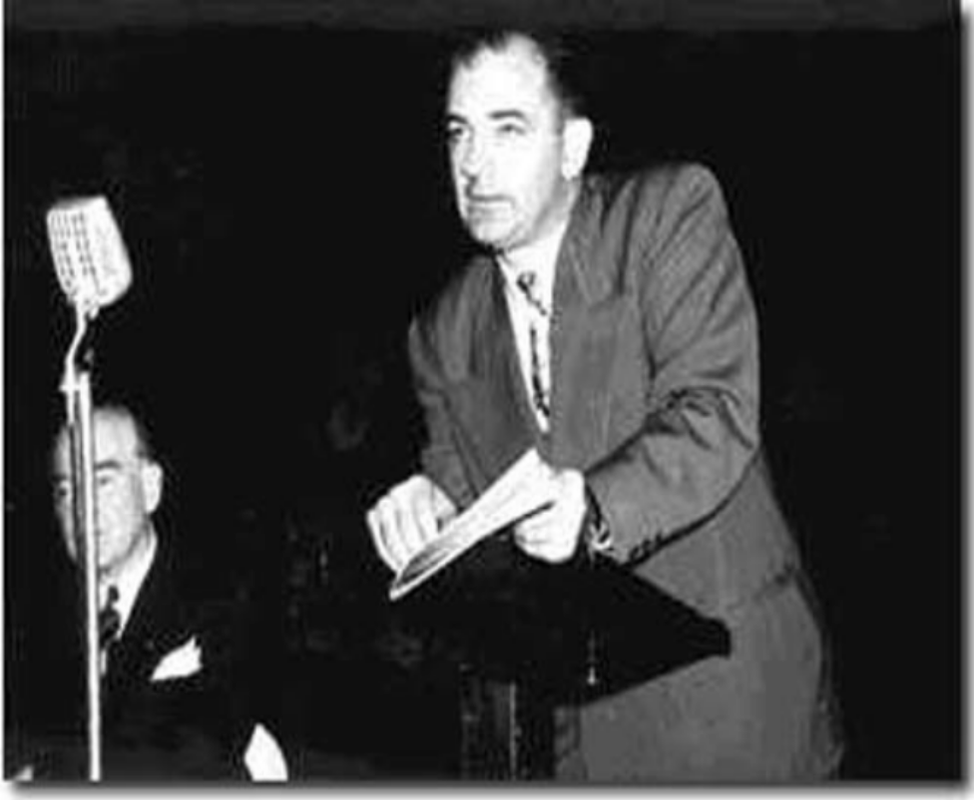
Joseph McCarthy (MR. Winton?)

Slide 15
McCarthyism

Slide 16
Economic Changes
With Europe and Asia destroyed, the US dominated the postwar world economy
Like the 1920s, economic growth in the 1950s changed the nation
  Economic and population growth
    Rise of suburbs and highways
  New technology spurred growth and changed the way people lived

Slide 17
Technology and Change
After WWII, US businesses switched back to making consumer products
Like the 1920s, technology in the 1950s changed Americans lives
  Nuclear energy met the increased demand for power
  Like radios in the 1920s, T.V. changed the way people experienced life
The further people moved away from their jobs (to suburbs), the need for cars and roads increased (Federal Highway Act)

Slide 18
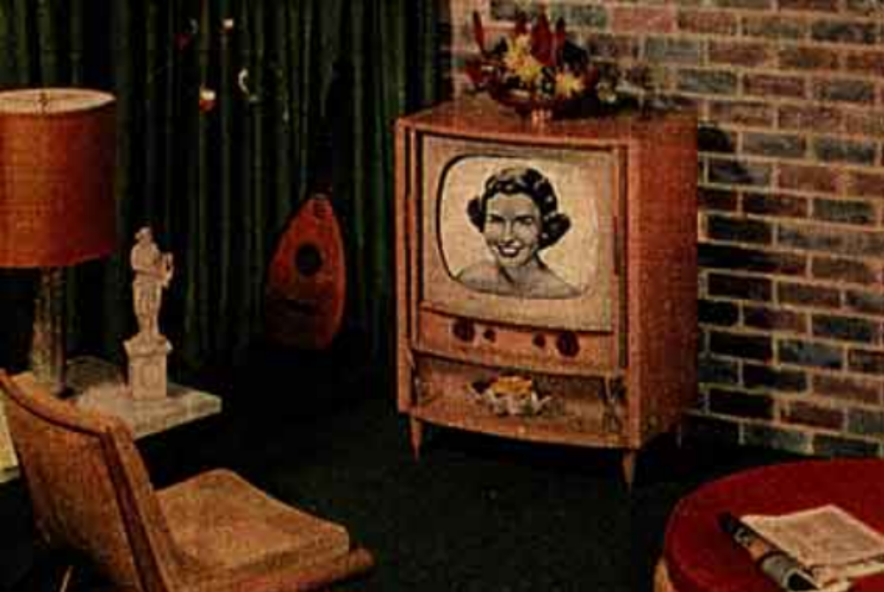
1950s T.V.

