Slide 1







Building Project Updates
Presentation to the Special Administrative Board
Yvonne Green
July 28, 2015

Slide 2
Overview
Update on major building projects:
  L’Ouverture (AESM Middle relocation)
  Wyman (CSMB relocation)
  Pruitt (KIPP new building)
  Madison (new Therapeutic School)

Slide 3
L’Ouverture
Project has been substantially completed as of July 1, 2015
Working on punch-list items
In process of coordinating furniture move into classrooms week of July 20th
Currently working on repairing water main and preparing for resurfacing playground/ parking lot
L’Ouverture is scheduled to be turned over to SLPS on or before July 31st
Closed Chouteau and Spring leased building on schedule (June 25, 2015) - awaiting deposit

Slide 4
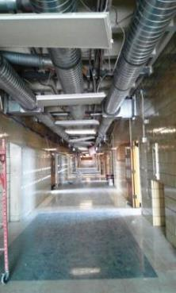
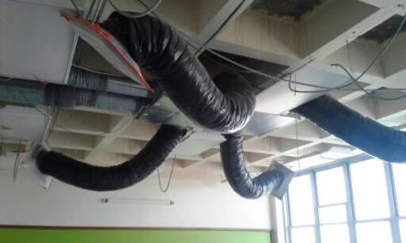
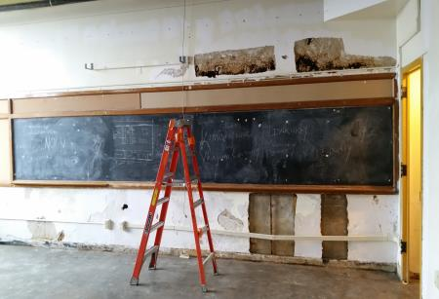
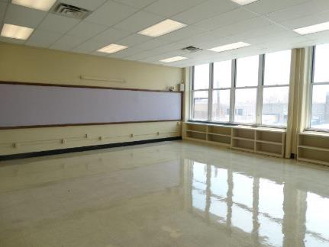
L’Ouverture

Slide 5
Wyman
Modular classrooms are arriving and being installed
Hallway floor refinishing work is 70% complete
Student lockers on back order but should be received and installed by late August
Construction of the ADA hallway and ramp have begun
Wyman is scheduled to be turned over to SLPS on or before July 31st

Slide 6
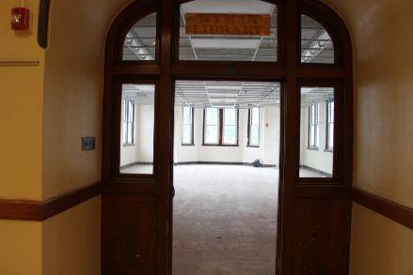
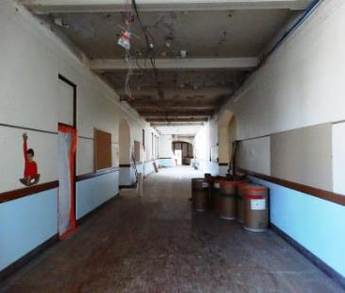
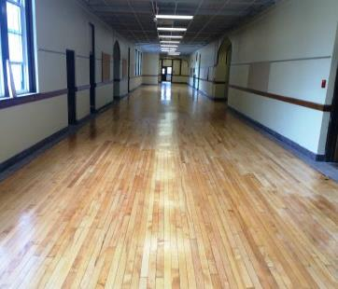
Wyman

Slide 7
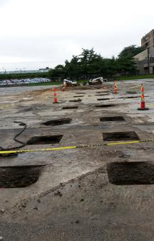
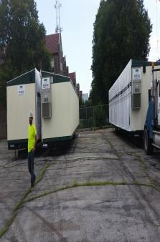
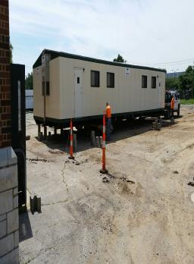
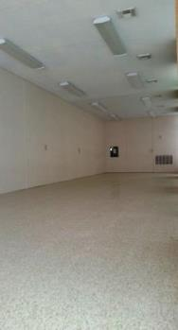
Wyman Modular Science Labs

Slide 8
Pruitt
Building is substantially complete
Working on punch list items and heating unit repairs
KIPP has moved into the building and have been issued 3 sets of keys
Payments have been made promptly when billed

Slide 9
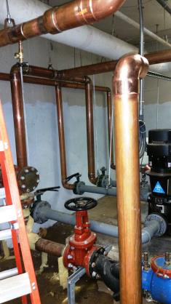
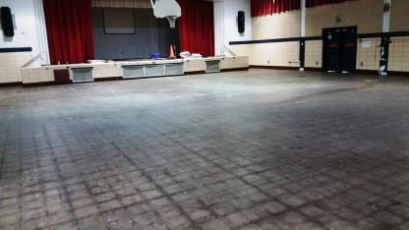
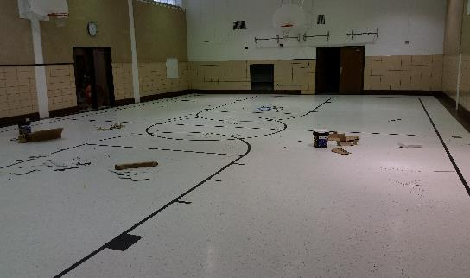
Pruitt

Slide 10
Madison
Moved Special Education functions from McKinley
Moving the Epworth program from Fanning the week of July 27th
Hazmat remediation for lower grades will be completed by July 31st

Slide 11
Questions?

