Slide 1



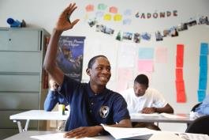



General Operating Budget
3rd Quarter 2014-15 Financial Update
Presentation to the Special Administrative Board
Angie Banks/ Mary Houlihan
May 21, 2015

Slide 2
Budget Objectives
Improve academic outcomes
  Implement SLPS Initiatives
  Re-align resources to support principals, teachers and students
  Target resources to schools based on academic need
Establish Full Accreditation
Balance expenditures and revenues
Reinforce a culture of high expectations and accountability
St. Louis Public Schools

Slide 3
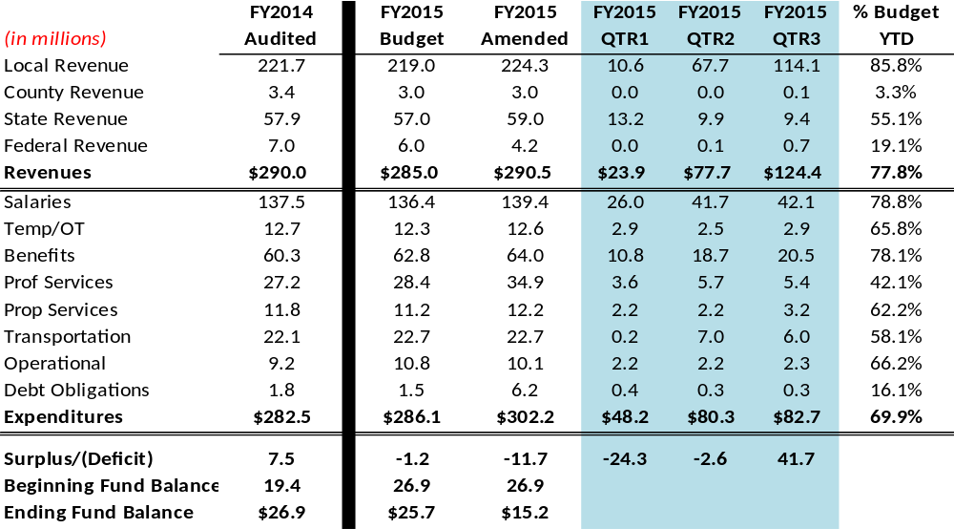
FY2014-15 GOB Quarter#3

Slide 4
FY2014-15 GOB Year-End Projection
FY2015 QTR2 QTR3
Amended Projection Projection
Revenues $290.5M $280.0M $290.5M
Expenditures $302.2M $291.6M $302.2M
Surplus/(Deficit) ($11.7M) ($11.6M) ($11.7M)
Ending Fund $15.2M $15.3M $15.2M
Balance
St. Louis Public Schools

Slide 5
FY2014-15 Considerations
Tax Anticipation Borrowing
Legal Actions
Property Taxes
Additional Formula Funding
Staffing/Vacancies
  Salaries
  Benefits
  Budget Reviews
Risks
Opportunities
St. Louis Public Schools

Slide 6
Questions?
St. Louis Public Schools

