Slide 1







Building Revitalization Collaborative (BRC) Update
Presentation to the Special Administrative Board
Walker Gaffney
Director, Real Estate
August 11, 2015

Slide 2
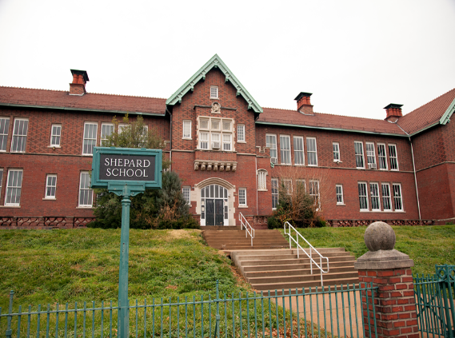
Background
The SAB approved the formation of the Building Revitalization Collaborative (BRC) in February 2015
The role of the BRC is to develop community-driven revitalization strategies for the District’s closed schools
  To promote financial strength for the District
  To promote well-being of the community and neighborhoods
Notes:
Please note:
The bullet points should be brief and include highlights.
There has been a tendency in the past for too much text that is then read word-for-word during the presentation.
The minimum font size for bullets should be Arial 20 or the maximum font size for bullets should Arial 24

Slide 3
Building Revitalization Collaborative (BRC)
A public-facing platform engaging Community Stakeholders and Technical Advisory Committee (TAC)
35 Closed schools
Public
Technical Advisory Committee (TAC)
Community Stakeholders
Architects, Builders, Developers, Preservation, Finance, etc.
35 Building Plans
Notes:
Please note:
The bullet points should be brief and include highlights.
There has been a tendency in the past for too much text that is then read word-for-word during the presentation.
The minimum font size for bullets should be Arial 20 or the maximum font size for bullets should Arial 24

Slide 4
Community Participation and Awareness
Total TAC Members – 46
Total Buildings Toured – 28
Total Tour Attendance – 1,341
Total Comments on the Website – 52
Total Community Forum Attendance – 18
Several Post Dispatch articles
4 local TV segments
KWMU interview that was picked up by national NPR
Notes:
Please note:
The bullet points should be brief and include highlights.
There has been a tendency in the past for too much text that is then read word-for-word during the presentation.
The minimum font size for bullets should be Arial 20 or the maximum font size for bullets should Arial 24

Slide 5
Increased Real Estate Activity
Number of building tours by potential buyers
  May – Aug 2014 – 33
  May – Aug 2015 – 42
Higher quality contracts – not contingent on tax credits
Notes:
Please note:
The bullet points should be brief and include highlights.
There has been a tendency in the past for too much text that is then read word-for-word during the presentation.
The minimum font size for bullets should be Arial 20 or the maximum font size for bullets should Arial 24

Slide 6
Closed School Status
Total Buildings Sold – 2
  Windsor (4/15) , Lafayette (7/15)
Total Buildings Reopened 2015/16 – 3
  Pruitt (KIPP), Wyman (CSMB), L’Ouverture (AESM)
Total Buildings Currently Under Contract – 8
  Scullin, Shepard, Euclid, Gratiot, Old Central, Sherman, Turner Branch, Cook
Total Buildings Listed – 17
Total Buildings Being Held – 5
Notes:
Please note:
The bullet points should be brief and include highlights.
There has been a tendency in the past for too much text that is then read word-for-word during the presentation.
The minimum font size for bullets should be Arial 20 or the maximum font size for bullets should Arial 24

Slide 7
Next Steps
Phase I Site Tours March – May 2015 CONCLUDED | Phase II Community Forums June – August 2015 CONCLUDED
Phase III Action Plan Development August - September 2015 | Phase IV Action Plan Implementation October 2015 and onward
Notes:
Please note:
The bullet points should be brief and include highlights.
There has been a tendency in the past for too much text that is then read word-for-word during the presentation.
The minimum font size for bullets should be Arial 20 or the maximum font size for bullets should Arial 24

Slide 8
Questions?

