Slide 1

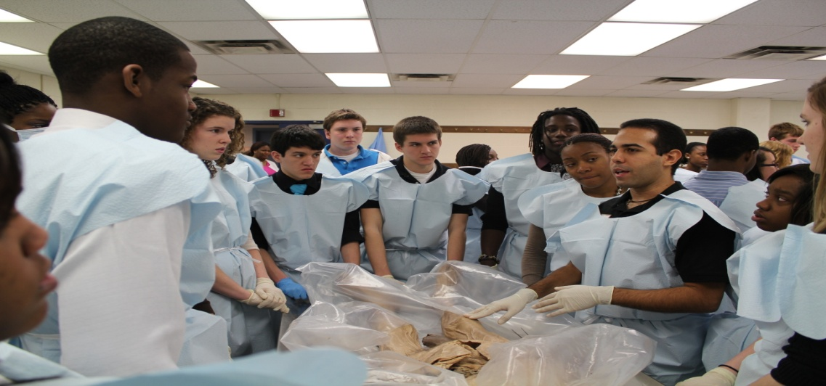
Superintendent’s Update
Revised FY 2014 and Beyond
March 20, 2013

Slide 2
Review
CHALLENGES
SOLUTIONS
  Reduced Federal Funding
    SIG; Sequestration; New Title Guidelines
  Retirement Contributions
    20 million to 27 million increase
  Employee Benefits
    Increase by 2 million
  Transportation Cost
  Alternative Education
  Staffing ratio
    At the desired ratio
  Building Capacity
    21 schools under 60% utilization
  Fund Balance
    New Policy to increase surplus
Reduction in Force
  Central Office/SW/Nurses
School Closure/Consolidation
  Sherman; L’Ouverture; Cleveland
Early Retirement Incentive Program
New Proposed Class Size
  Midpoint as opposed to desired
Other Non-Workforce Efficiencies
  Reduction in contracted amounts

Slide 3
Cleveland Facts
2011 (257)
2012 (260)
Graduation 3rd
ACT 4th
Attendance 5th
Science 3rd
Comm. Arts 5th
Math 6th
Staff/Student Ratio 14-1
Dropouts 5th
College Placement 8th
Graduation 6th
ACT 3rd
Attendance 3rd
Science 3rd
Comm. Arts 6th
Math 5th
Staff/Student Ratio 14-1
Dropouts 8th
College Placement 9th

Slide 4
Cleveland JROTC
Initial Recommendation
Final Recommendation
Close school
Accept 68 students (266)
Cleveland staff assumed an increase in academic performance would increase enrollment
Keep school open
Accept 111 (330)
Create middle school partnerships with Busch, Yeatman, Carondelet Leadership Academy, St Louis Charter
Re-examine applications to become more holistic
Align standards to NJROTC versus current alignment to US Naval Academy (USNA) standards

Slide 5
Proposed Reductions
Initial Recommendation
Final Recommendation
Central Office 12
Nurses, SW and Counselors 20
Share HS Non-Core 20
Class sizes to midpoint 82
Staff Reductions (134 positions)
Central Office 12
Share HS Non-Core 20
Class sizes to midpoint 82
Staff Reductions (114 positions)

Slide 6
Proposed Addition/Increases
  Initial Recommendation
Final Recommendation
Shift from 3 tiers to 2 tiers by adding an additional 94 buses at a cost of 5.7 million
Parent/Staff Survey Spring 2012, largely not in favor of changing bell times (move times 20 min later):
  1st Tier 67% “No”
  2nd Tier 47% “No”
  3rd Tier 66% “No”
Open the Medical High School in Soldan, McKinley or Central
Remove the recommendation to shift from 3 tiers to 2 tiers by adding an additional 94 buses at a cost of 5.7 million
  428 parents responded - 58% disagree with the change
  1433 staff responded - 68% disagree with the change
  The total results indicated 743 ( 33%) agreed and 1,535 (67%) disagreed
Locate the Medical High School to Des Pres

Slide 7
Net Budget Impact
PROPOSED IMPACT
REVISED IMPACT
Staffing Reductions 9.4M
Early Retirement 1.2
Non-Workforce Efficiencies 2.2
Closings/Consolidations 1.8
Bell Times Shift (5.7)
Medical High School (0.5)
Total Net Savings 8.4M
Staff Reductions 7.2 M
Early Retirement 0.9
Non Work-Force 2.2
Closing/Consolidation 1.3
Bell Times Shift -
Medical High School (0.5)
Total Net Savings 11.1M

Slide 8
General Operating Budget
FY2013 FY2014 FY2014 Projected Preliminary Adjusted (2/27/12) (3/20/13)
Starting Fund Balance* $ 3.2M $ 0.8M $ 0.8M
Revenue* $285.2M $282.8M $282.8M
Payroll Expenditures $212.4M $211.2M $202.0M
Non-Payroll Expenditures $ 75.3M $ 76.5M $ 74.6M Expenditure Projection $287.7M $287.7M $276.6M
Annual Surplus/(Deficit) ($2.5M) ($ 4.9M) $ 6.2M
Fund Balance 4.3M
Ending Fund Balance* $0.8M ($8.4M) $ 7.0M
*Excludes Deseg (restricted) funds

