Slide 1







Proposed 2016 District Budget
Presentation to the Special Administrative Board
Angie Banks, CFO
June 25, 2015

Slide 2
Budget Objectives
Establish Full Accreditation
Align resources to support the District’s Transformation Plan Objectives
  Operate a system of excellent school options for all students
  Cultivate and sustain transformational teachers & leaders
  All students read their way to college & career success
  Partnerships support the whole child
Build financial stability with 10% fund balance target
Reinforce a culture of high expectations and accountability

Slide 3
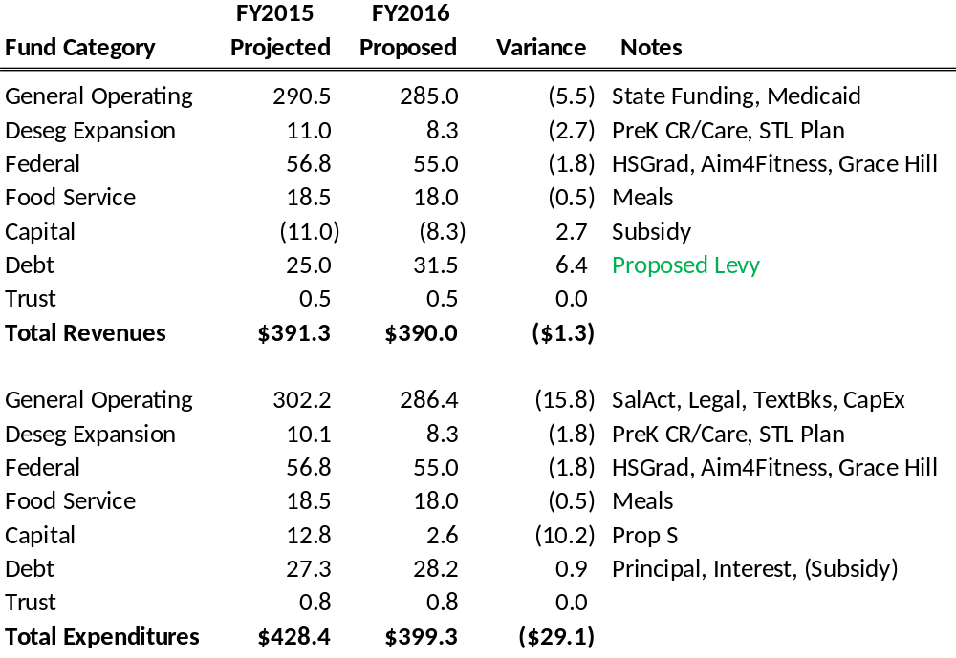
Proposed FY2016 District Budget ($M)

Slide 4
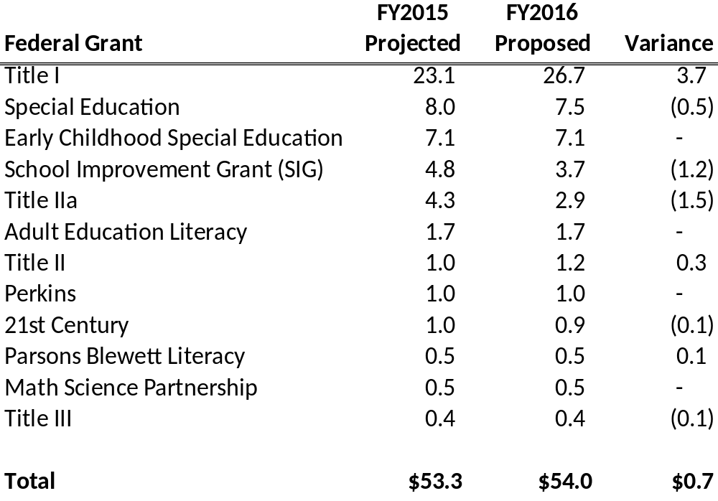
FY2016 Largest Federal Grants ($M)
Carry-over funds not included in FY2016

Slide 5
General Operating Budget
FY2015 FY2016
Amended Proposed Variance
Revenues $290.5M $285.0M ($5.5M)
Expenditures $302.2M $286.4M ($15.8M)
Surplus/(Deficit) ($11.7M) ($ 1.4M)
Ending Fund Balance $15.2M $13.8M
DESE Fund Balance % 7.0% 6.6%

Slide 6
Questions?

