Slide 1







General Operating Budget
FY2014-15 Financial Update
Presentation to the Special Administrative Board
Angie Banks
CFO and Treasurer
August 27, 2015

Slide 2
FY2014-15 Budget Objectives
Improve academic outcomes
  Implement SLPS Initiatives
  Re-align resources to support principals, teachers and students
  Target resources to schools based on academic need
Establish Full Accreditation
Balance expenditures and revenues
Reinforce a culture of high expectations and accountability
St. Louis Public Schools

Slide 3
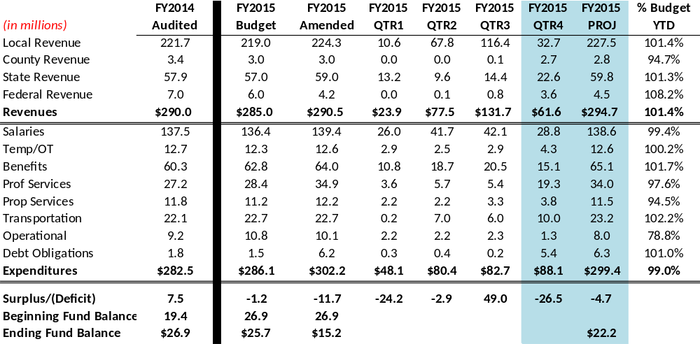
FY2014-15 GOB Quarter#4

Slide 4
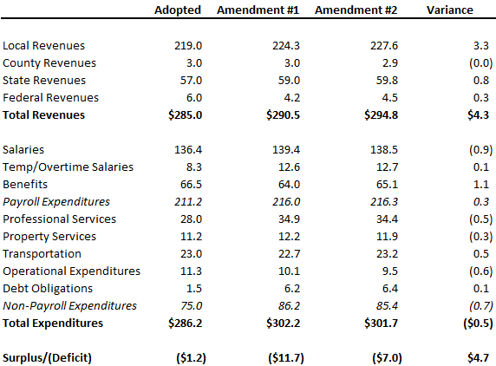
FY2015 GOB Amendment#2
Notes:
Where are we now? Not quite done with FY2015 but close. As you know a budget amendment is required to align expenditures by fund and to ensure expenditures do not exceed budget. The GOB budget is made up of 4 funds; general fund, teachers fund, student health fund, and building capital fund. You have the detail by fund before you. Overall you can see that amend2 includes higher revenues and slightly lower expenditures for a reduced deficit projection of almost $5M. We are requesting approval of amendment #2 tonight.

Slide 5
General Operating Budget
FY2015 FY2015 FY2015 FY2016
Adopted Amend#2 Projected Adopted
Revenues $285.0M $294.8M $294.7M $285.0M
Expenditures $286.2M $301.7M $299.4M $286.4M
Surplus/(Deficit) ($1.2M) ($7.0M) ($4.7M) ($1.4M)
Ending Fund $25.7M $20.0M $22.2M $20.8M
Balance
St. Louis Public Schools

Slide 6
Tax Anticipation Notes
What?
  Provides cash for operating expenditures
  Bridge gap until property tax revenues received
Why Now?
  Capital desegregation funds borrowed in prior years
  Used to fund District Programs past 5 years
    St. Louis Plan
    Early Childhood
    Technology
    Leadership Development
How Much?
  FY2015: $25,000,000
  FY2016: $40,000,000 Requested
St. Louis Public Schools

Slide 7
Board Resolution Approval Request
FY2015 Budget Amendment #2
Questions?
St. Louis Public Schools

