Slide 1
Food Services
Mary Houlihan
Deputy Superintendent of Operations
Althea Albert-Santiago
Director, Nutrition and Food Services

Slide 2
Agenda
Background
Performance
RFP/Bid evaluation
Recommendation

Slide 3
Background
2008-09
  Chartwells awarded contract
2009-10
  Implemented Universal Breakfast
  Improved cafeteria environments
  Created client/community newsletter
  Improved F&R application collection
2010-11
  Implemented changes to menu to meet USDA guidelines
  Renovated 2 elementary kitchens
  Improved nutrition education and use of local produce
2011-12
  Renovated 4 additional elementary kitchens
  Introduced on-line F&R application
2012-13
  Continued to improve menus to meet USDA guidelines
  District received “A” on School Lunch Report Card
  Transitioned 19 elementary kitchens to speed scratch

Slide 4
Food Services Performance
2008/09 – 2012/13
 | 2008-09 Actual | 2009-10 Actual | 2010-11 Actual | 2011-12 Actual | 2012-13 Budget
Enrollment | 27,300 | 26,500 | 25,260 | 24,327 | 27,179
ADA | 90.3% | 91.4% | 92.3% | 93.0% | 93.0%
Breakfast Participation | 49% | 52% | 54% | 56% | 56%
Lunch Participation | 73% | 75% | 77% | 78% | 78%
% F&R applications | 84% | 96% | 98% | 98% | 99%
% F&R population | 75% | 86% | 87% | 88% | 89%
# Meals (millions) | 5.7 | 5.8 | 5.5 | 5.5 | 6.3
FMSC Revenue | $12.3 | $13.8 | $12.7 | $13.6 | $15.9
FMSC Expenses | $13.0 | $13.3 | $13.0 | $13.3 | $15.7
Net Surplus/Deficit | (0.7) | .5 | (.3) | .3 | .2

Slide 5
RFP/Bid Evaluation
Business put out for RFP
Two companies submitted bids:
  Chartwells
    Incumbent with 5 years of solid performance
    Part of Compass Group, global leader in contract catering and food services
    Over 30 years experience with sales of $11.9 billion in US
    Serves 550 districts in the US
  Southwest Food Services
    Privately held company founded in 2004
    Specializes in K-12 Food Service only
    Leadership team has extensive experience with other FMSC’s
    Organic growth with sales at $102 million
    Currently serves 46 districts in AZ, TX, CA, OK, AR, MO, WA
    Sourcing business from self-operated, Aramark, Sodexho and Chartwells

Slide 6
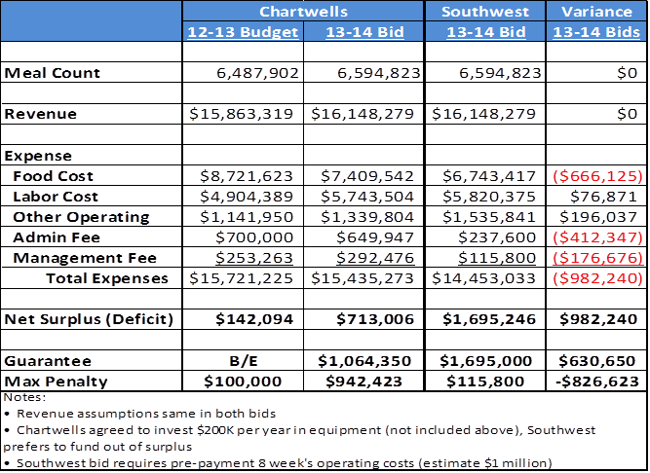
Financial Comparison

Slide 7
Recommendation
Award the business to Southwest Food Service
  Demonstrated passion for K-12 food service
  Innovative approach to providing fresh, nutritional food
  Lean organization with strong service culture
  Lower costs, including management and administrative fees
  Proven success with transitioning food service operations
    Positive references from all 6 districts contacted
    Visited Pleasant Hill outside Kansas City
District | City | State | Previous Self Operation or FSMC | Enrollment | Free & Reduced Percentage
Leander ISD | Leander | TX | Sodexo | 32,152 | 22%
Grand Prairie ISD | Grand Prairie | TX | Self-Operated | 26,541 | 72%
Dysart Unified School District | Surprise | AZ | Sodexo | 26,175 | 53%
Sunnyside Unified School District | Tucson | AZ | Chartwells | 18,600 | 85%
Uvalde CISD | Uvalde | TX | Aramark and Chartwells | 5,054 | 79%
Pleasant Hill | Pleasant Hill | MO | Chartwells | 2,192 | 22%

Slide 8
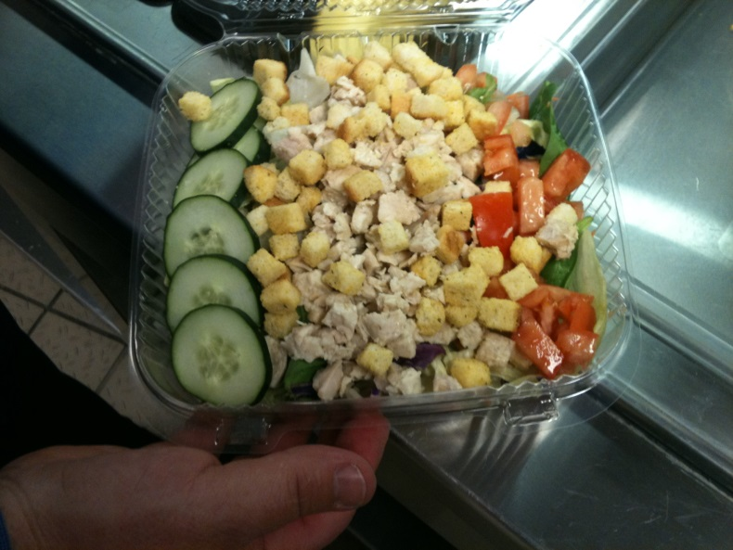
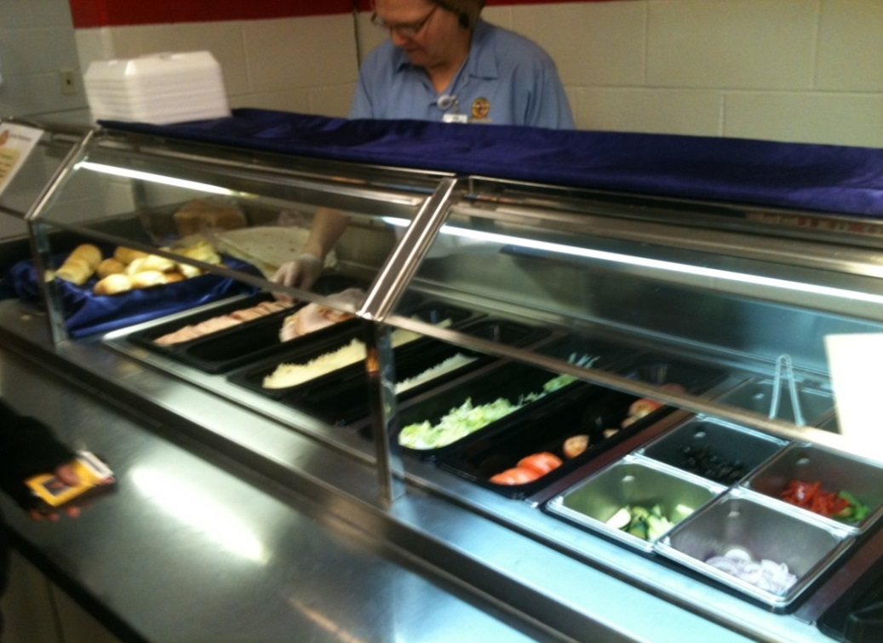
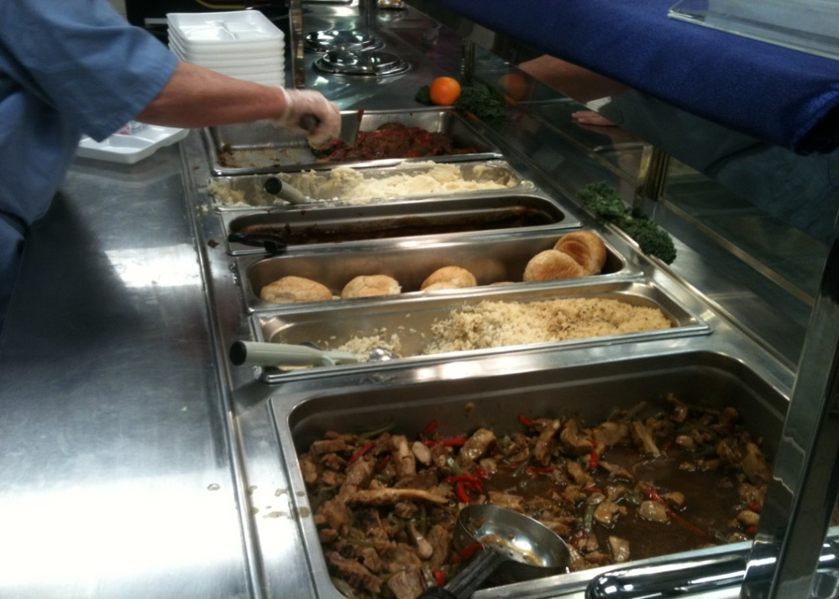
Southwest Food Service at
Pleasant Hills School District
Pre-made Salads
Custom Sandwich Line
Hot Line

Slide 9
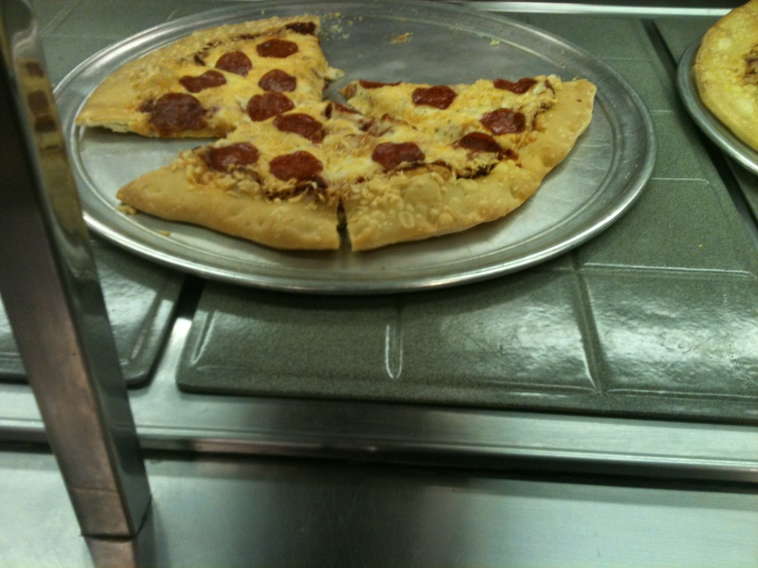
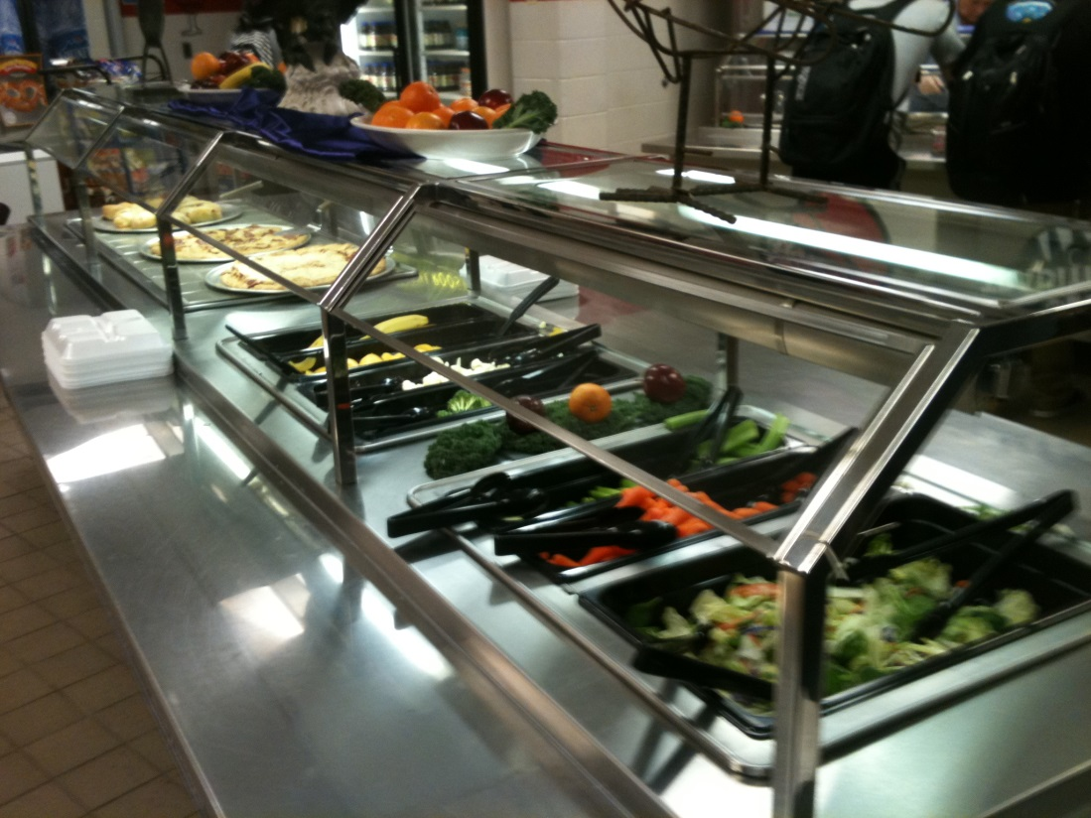
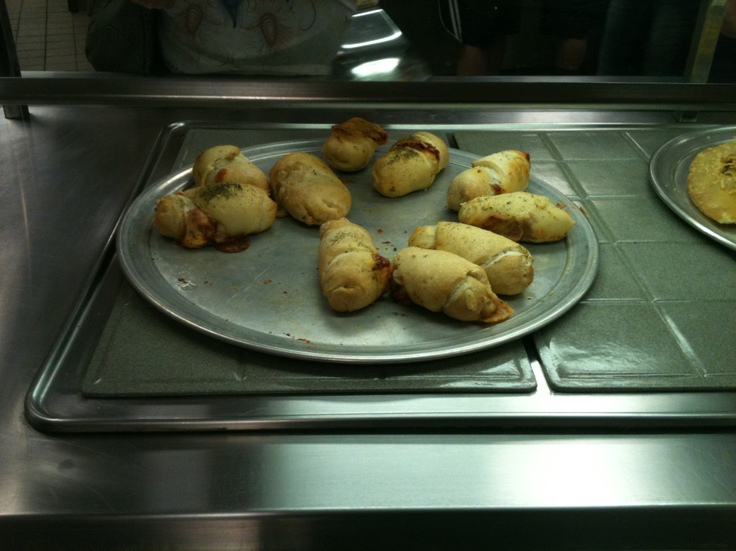
Southwest Food Service at
Pleasant Hills School District
Self-Serve Salad and Pizza Bar

Slide 10
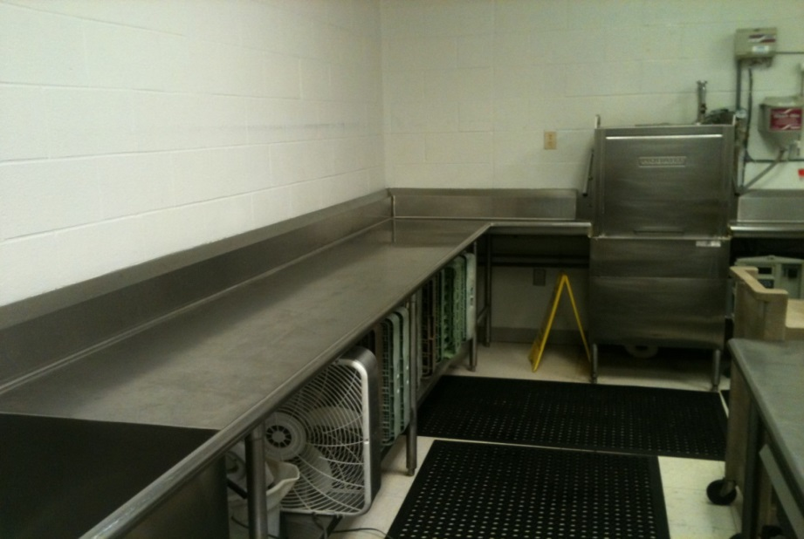
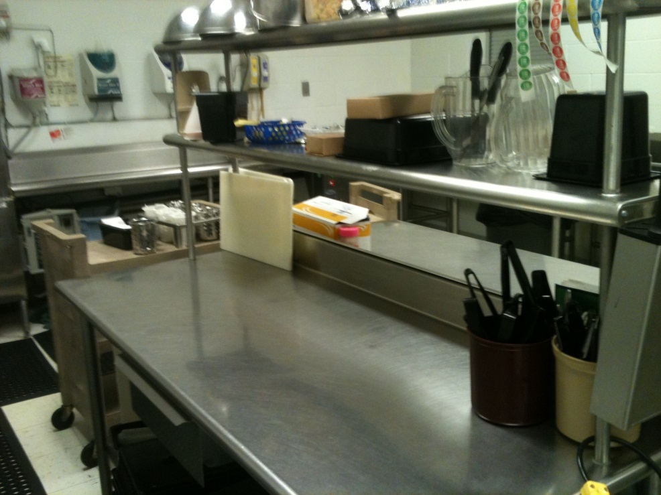
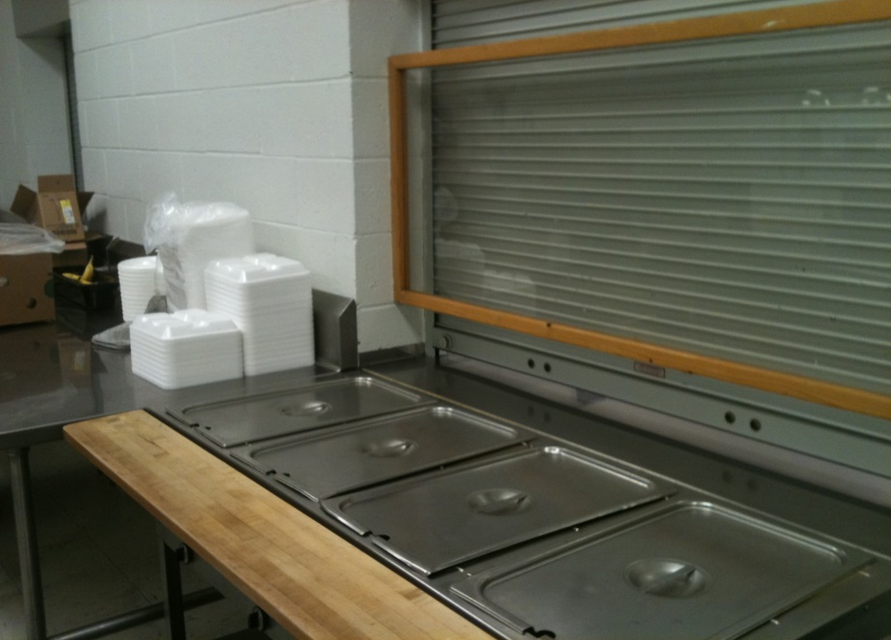
Southwest Food Service at
Pleasant Hills School District
Clean Kitchen After Lunch

Slide 11
Questions?

