Slide 1

SLPS
FY 2013 – Q3 Update
General Operating Budget (GOB)
Leon Fisher, Chief Financial Officer

Slide 2
FY 2013 GOB Budget Modifications
June 2012 - Adopted Budget: $264.8M
  (Revenues = Expenditures)
July 2012 - Budget Amendment
  $7.1M for revenues and expenditures associated with1,700 additional students (Formerly Imagine Academy)
November 2012 - Budget Amendment
  $12.4M for revenues and expenditures associated with 800+ additional students, tax levy (recoupment), misc. adjustments
  Amended GOB Revenues = $284.3 Million
  Amended GOB Expenditures = $288.1 Million
  Planned Utilization of Unrestricted Fund Balance = $3.8 Million

Slide 3
FY 2013 Year-End Projection Q2 vs Q3
Q2 Projection Q3 Projection
Revenues 285.2M 286.8M
Expenditures 287.7M 286.6M
Annual Surplus/(Deficit) ($ 2.5M) $ 0.2M

Slide 4
FY 2013 Year-End Projection Q2 vs Q3 cont.
Revenues $ 1.6M
Higher tax revenue collection rate offset by lower transportation revenue
Expenditures ($ 1.1M)
  New staff salary savings & vacancies

Slide 5
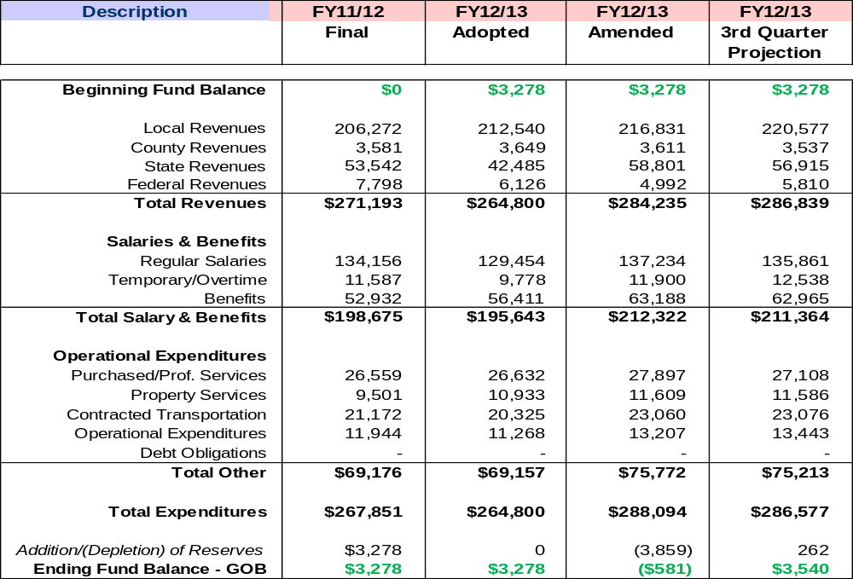
FY 2012-13 GOB Year-End Projection (end of Q3)

Slide 6
FY 2012-13 Additional Considerations
Tax Revenues
  Protested taxes
Retirement Payouts (vacation, sick, and personal days)
State Formula Funds
Staff Vacancies
Savings Due to Improved Contract Monitoring
Risks
Opportunities

