Slide 1



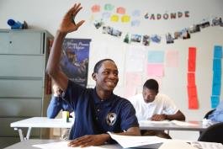



Enrollment & Advertising Update
Presentation to the Special Administrative Board
Stacy Clay and Rachel Seward
July 28, 2015

Slide 2
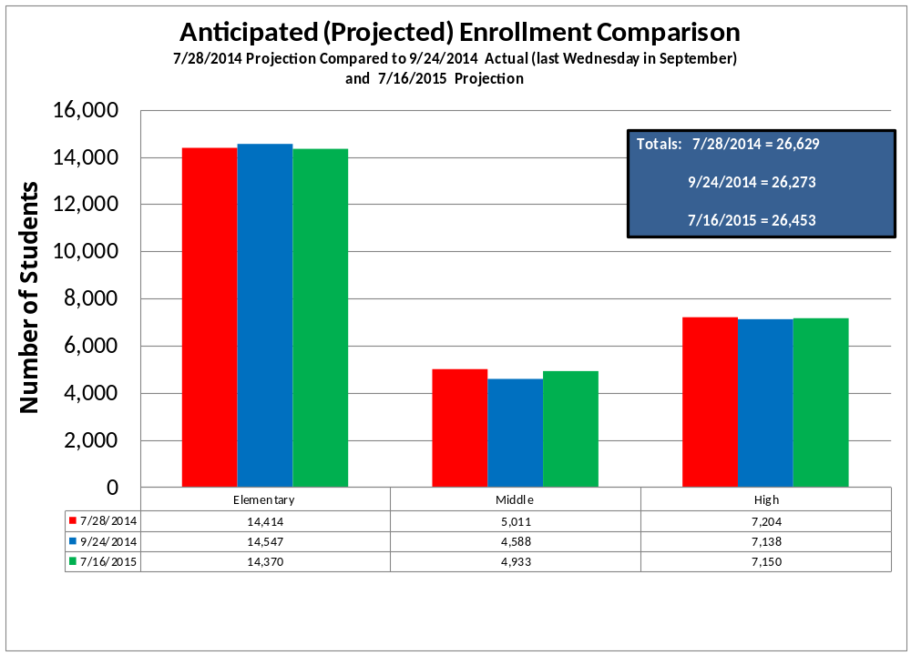

Slide 3
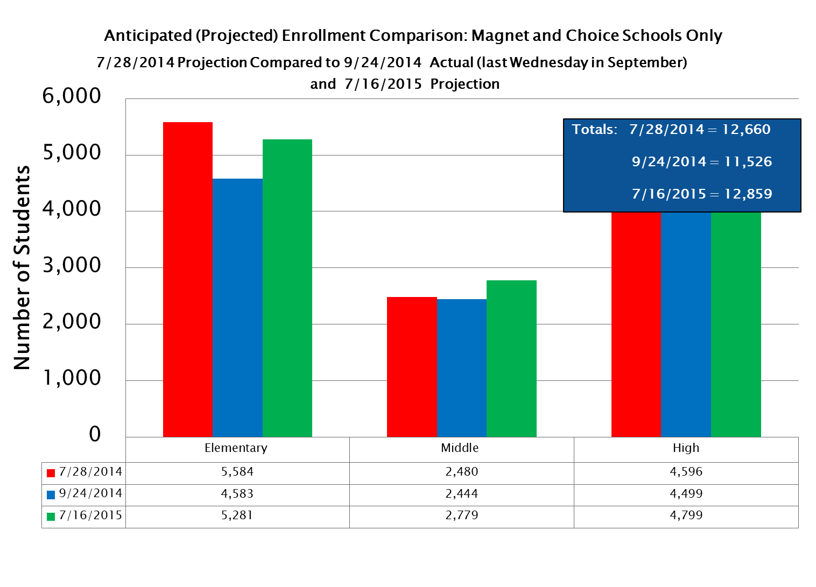

Slide 4
Recruitment Advertising
Radio
Print
Cable
Movie Theaters
Outdoor
Door Hangers
Social Media

Slide 5


Print & Radio
 | St. Louis American | Radio (5 stations)
Frequency | Bi-Weekly Front Page Strip Ad (August – December) | 88 Spots Bi-Weekly (July-December)
Message | Early Childhood Enrollment Choice Schools w/Openings Credit Recovery/Fresh Start | Early Childhood Choice Schools School Starts August 17 Credit Recovery Image-Building
Text
Text
Text

Slide 6

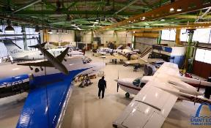
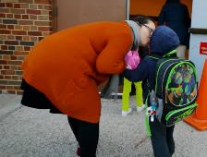
Cable TV & Theaters
 | Cable Channels (303 spots/week) (August-December) 19 targeted channels | Movie Theaters (July-July) West Olive 16 Esquire (thru Nov.) Galleria 6
Content | Short Films with school start date as end graphic Spirit Innovation | Short Films with school start date as end graphic Spirit Innovation Parents (:90)
SPIRIT
INNOVATION
PARENTS
Notes:
Chase is 2x as much as theaters – kids don’t go to Chase.
Esquire is from last year.

Slide 7



Outdoor
Posters (street billboards) August 2015 (4 week campaign) 20 posters, 4 billboards | Door Hangers (Canvassing)
Early Childhood Choice Schools w/ Openings | Early Childhood w/ Openings Choice Schools w/ Openings Fully Accredited Neighborhood Schools
Notes:
13 schools for ECE openings (25 or more)

Slide 8

Social Media
39%
July 2015
59%
July 2014
2000%
100%

Slide 9
Questions?

