Slide 1







2016 Benefits Renewal
Presentation to the Special Administrative Board
Edmond T. Heatley, Ed.D., Chief Human Resources Officer & USI Midwest
August 11, 2015

Slide 2
2016 Benefits Renewal Update
  Medical and Pharmacy: Did not have rate guarantees for the January 1, 2016 Renewal
  Dental: Rate guarantee cap of 8% for January 1, 2016 renewal.
  Vision, Basic Life/AD&D, Voluntary Life, Short Term Disability and Long Term Disability: In the 3rd year of a 3 year rate guarantee that was effective January 1, 2014.
Update on the District’s Wellness Program
Next Steps

Slide 3
Renewal Recommendations of Joint Benefits Committee (JBC)
The Committee is comprised of representatives from Local 420 Active and Retiree groups; Local 148; Local 44; the PSRSSTL Retirement office, Finance and Human Resources. The Committee met on July 15, 2015.
Recommendations
Medical - There is a 4% decrease in the rates for 2016. There is a rate cap of 12.9% for the January 1, 2017 renewal. The Affordable Care Act fees are included. (Coventry Health Care)
Pharmacy - There is an estimated increase of 22.9% due to an escalation in Specialty Utilization and Costs and overall rise in prescription utilization (Express Scripts).
Dental – There is an increase is 3.5% (Delta Dental of Missouri)
  This rate was negotiated down from the initial 8% renewal cap, saving the District approximately $72,000.
  For the January 1, 2017, the rate cap will be based on the claims loss ratio.

Slide 4
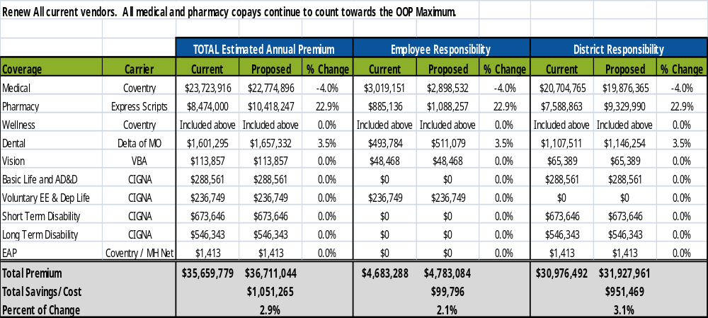
District Responsibility Renewal Scenario

Slide 5
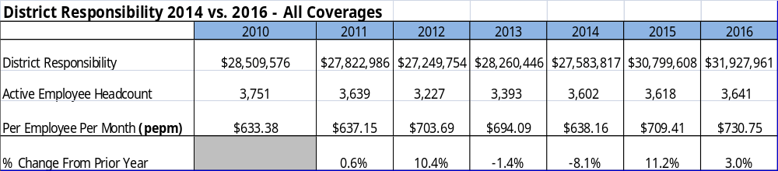
District Responsibility Per Employee Per Month 2010 to 2016

Slide 6
SLPS Wellness Program Update
SLPS Wellness Program with Coventry Health Care
  Health Risk Assessments will be held in August 2015.
  Walking Program: Plan to launch in late October 2015 with a hiking theme.
  The District is participating in the American Diabetes Association – Step Out Walk on October 10, 2015.
  2015 Applications have been submitted as a healthy workplace to:
    American Heart Association for the Fit Friendly Award
    Business Health Coalition for the Business Health Culture Award
    The District was awarded Gold and Platinum American Heart Association Fit Friendly Awards

Slide 7
Next Steps
SAB Consideration of Recommendations
Respectfully request approval of the 2016 Benefit Plans at this meeting so that the employee communication and enrollment process can begin

Slide 8
Questions?

