Slide 1







SLPS 2015 Proposed Tax Levy
Presentation to the Special Administrative Board
Angie Banks, CFO/Treasurer
September 24, 2015

Slide 2
2015 Tax Levy
Special Administrative Board of the Transitional School District of the City of St. Louis, as a political subdivision, is authorized to levy an ad valorem tax (tax based on the value of real estate and personal property – assessed valuations)
Tax levies are approved on an annual basis generally to provide funding for the general operations and debt service of the school district
Proposed tax rates must be submitted to the City of St. Louis Tax Assessor and the State Auditor ‘s Office by October 1st (certification)
Notes:
The SAB approves a tax levy each year to generate the local revenue for district which must be certified by October 1st

Slide 3
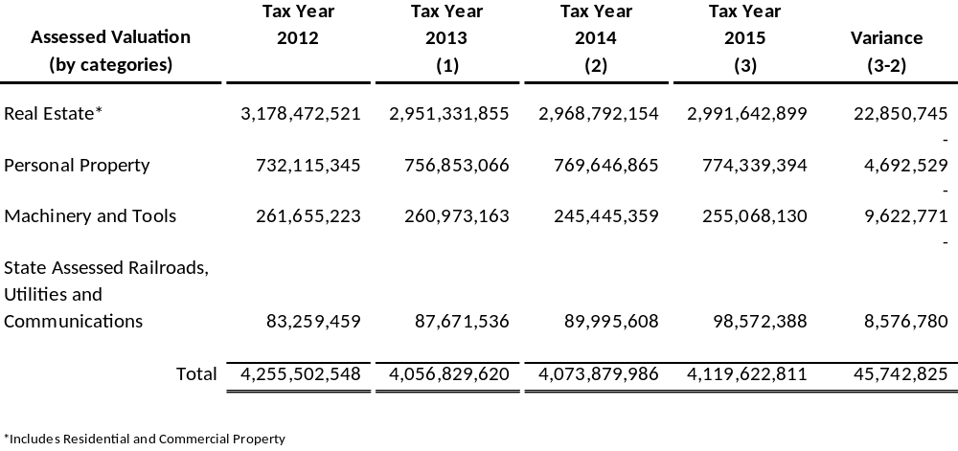
Assessed Valuations
Notes:
The assessed valuations are in four major categories (omit the largest by far being real estate including both residential and commercial). The first three categories are locally assessed and the 4th, railroads and utilities are state assessed. The Avs have increased for the 2nd consecutive year after several years of decline. 2015 Avs have increased to $4.12B, more than $45M from 2014.

Slide 4
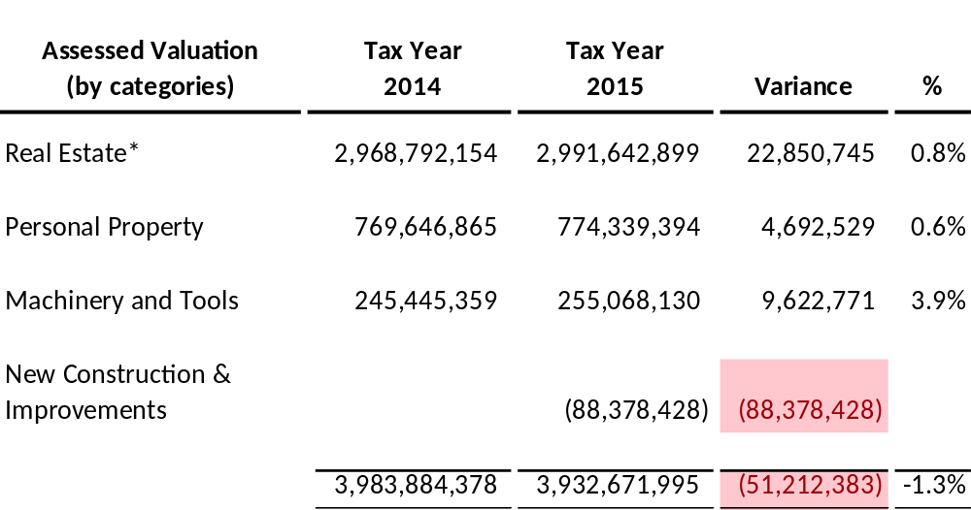
Operating Tax Rate Calculation
Notes:
However, the operating tax rate is calculated only on the local valuations and excludes the new construction and improvement, 88m. So the tax rate is based on a 1.3% decline from 2014.

Slide 5
Tax Levy History
Notes:
Here is a 6 year history of our operating and debt service tax rates. The operating rate increased from 2009 thru 2011, when Avs were declining. 2012 was the recoupment year when we captured lost revenue due to AV reductions from protested tax cases And we have been at the voter approved operating ceiling since 2013. Our debt service levy has been at .6211 for many years (since 2005). These funds are used to pay down the principal and interest on our outstanding bonds.
Once at the ceiling, if Avs decline we can’t increase the levy to maintain the level of revenue except we are entitled to revenue associated with new construction and improvements. That is what happened this year.
(as Avs declined SLPS was entitled to increase the levy to maintain a certain level of revenue – catchup the revenue from through recoupment).

Slide 6
2015 Proposed Tax Levy & Comparison
2014 tax rate
2015 Proposed tax rate
$0.0000 Teachers
$3.7500 Incidental
$0.0000 Capital $3.7500 Operating $0.6211 Debt
$4.3711 Total rate
$0.0000 Teachers
$3.7500 Incidental
$0.0000 Capital $3.7500 Operating $0.8057 Debt
$4.5557 Total rate
Proposed Operating $0.0000
Proposed Debt $0.1846
Proposed Change $0.1846
Notes:
For 2015 we propose the following: the same rate of 3.75 for the operating rate and an increase of 18.46 cents for the debt rate. This would take the debt rate from .6211 to 80.57 cents. This increase will generate additional revenue and to stop the deficit spending and restore the fund balance. The total proposed 2015 tax rate is $4.5557 per $100 of assessed valuation.

Slide 7
2015 Proposed Operating Tax Levy Impact
Operating $3.75 rate cap impact
  Maximum Rate Permitted = $3.7907
  Difference = $0.0407 per $100 AV
  Cap Impact = $1.68m
  Tax Year 2015 – $215,935,050 in Tax Increment Financing (TIF) assessments
  $6.7m increase from 2014
  TIF Impact = $8.1m
Notes:
What is the impact? Since we are at the voter approved operating levy ceiling (teachers, incidental, capital), we will not receive $1.68m revenue based on ~ 4 cents ($4.119B Avs). In addition, the TIF impact to the district is 8.1m (assuming 3.75 rate).

Slide 8
2015 Proposed Debt Tax Levy Impact
Assessed valuation = $4,119,622,811
Debt $0.6211 rate impact
  Revenue* = $25.6m
  Principal & Interest = $27.4m
  Fund balance decline = $1.8m
Debt $0.8057 rate impact
  Revenue* = $33.2m
  Principal & Interest = $27.4m
  Fund Balance increase = $5.8m
* Includes current & delinquent tax revenue
Notes:
The debt levy impact of the 62.11 cents results in a debt service fund balance decline of 1.8m since our principal and interest payments are more than the revenue generated. The proposed higher rate of 80.57 cents increases the fund balance since the revenue generated is more than the principal and interest payments.

Slide 9
2015 Proposed Tax Levy Revenue
The proposed operating rate of $3.7500 will generate approximately $139.0m
The proposed debt service rate of $0.8057 will generate approximately $30.0m
90% collection assumption
Notes:
In summary, assuming a 90% collection rate, the proposed operating rate will generate 139m and the proposed debt rate will generate 30m
In summary, the operating levy will generate ~ 1.5m more than last year (new construction) and the debt levy will generate ~ 7m more than last year (new construction + rate increase).
At 100% $154.5m operating and $33.2m debt
$23m @ 90% /$25.6m @ 100% (based on .6211)

Slide 10
2015 Tax Levy Approval
Special Administrative Board:
Approval of Resolution to Set Tax Rate
Operating Rate @ $3.7500 (no change)
Debt Service Rate @ $0.8057 ($0.1846 increase)
Total Rate @ $4.5557 (4.2% increase)
Notes:
We request the board approve the proposed rates as presented: 3.75 operating, .8057 debt service for a total rate of 4.5557 (if no after discussion)
We request the board approve the proposed rate of 3.75 operating and .6211 debt service for a total rate of 4.3711
$100k homeowner impact = $35/year (100,000*.19/100*.1846 or $190*.1846)
Residential real estate assessed at 19% of market value
Commercial real estate assessed at 32% of market value
Personal property assessed at 33% of market value
Rick needs to sign documents for tax levy and irs bond audit

Slide 11
Questions?

