Slide 1




Creating Great Options
FY 2012 SLPS Budget
Revised for Approval May 26, 2011

Slide 2

Proposed FY 2012 GOB (Millions)
 | FY 2011 Approved | FY 2011 Projected | FY 2012 Proposed (4/27/11) | FY 2012 Proposed (5/26/11)
Revenue | $278.7 | $283.5 | $272.8 | $276.5
Expenditures | $275.7 | $283.5 | $269.8 | $273.5
Surplus/(Deficit) | $ 3.0 | $ 0.0 | $ 3.0 | $ 3.0
Note: Additional $3.7 million in revenue for FY 2012 due to revised revenue estimates based on most recent local manufacturing tax and property tax receipts

Slide 3
Timeline
Presentation to SAB April 27
Public comments via Internet April 28 – May 16
Public forum May 9
Budget revisions May 17 – May 25
SAB vote May 26

Slide 4
GOB Highlights
Early childhood classroom and PIIP expansion $6.1M
Multiple Pathways $658,000
Gender Schools $75,000
African-Centered Curriculum $75,000
Humboldt Academy of Higher Learning $184,000
Beaumont Technical High School $500,000
Charter School Sponsorship N/C
8th Grade School Choice N/C
Performance Based Schools N/C

Slide 5
GOB Highlights
Additional $3.7 million in revenue dedicated to:
  Decrease the number of proposed position reductions
  Fund additional transportation costs
    After school programs and field trips
    Beaumont Technical High School
    Multiple Pathways
If additional funds are available, priority expenditures will be:
  Teaching and library positions
  Custodial and maintenance positions
  Transportation

Slide 6
GOB Highlights
Proposed GOB Position Reductions
 | Proposed 4/27/11 | Proposed 5/26/11 | Variance
Teachers | 108 | 96 | -12
Librarians | 20 | 16 | - 4
Other School Staff | 13 | 12 | - 1
Safety Officers | 20 | 7 | -13
Custodians | 34 | 21 | -13
Trades Central Office | 8 10 | 3 9 | - 5 - 1
TOTAL | 213 | 164 | -49

Slide 7
Federal Title Staffing Impact
Staffing impact remains at 74 position reductions
Teaching Learning Facilitators -15
Parent Support Community -39
Class-size Reduction Teachers - 3
Other Instructional -17

Slide 8
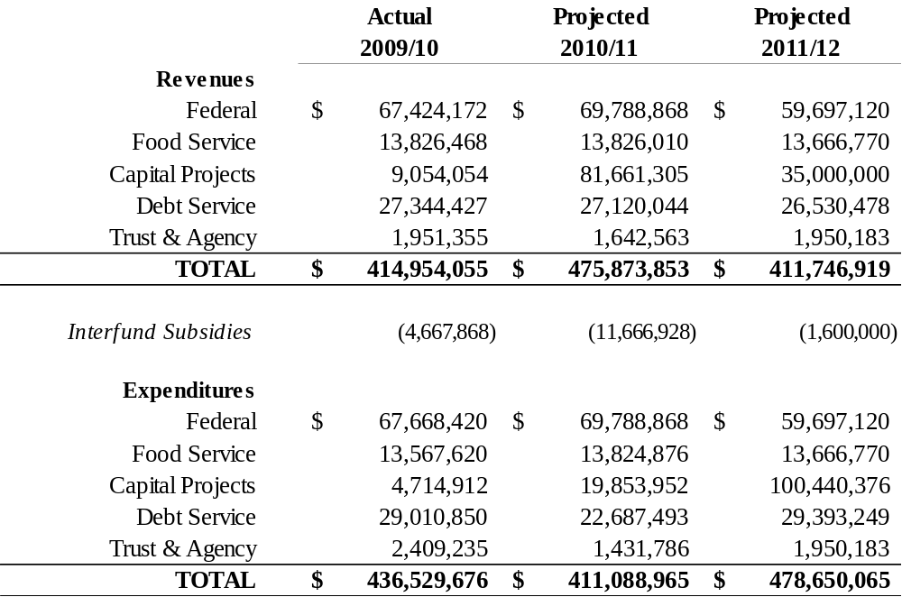
2009-2012 Non GOB

Slide 9
Overall Budget Concerns
Litigation
Health care costs
State revenue
Rising pension costs
Workers compensation and unemployment costs

