Slide 1
Assessing My Career Clusters

Slide 2
What is a “Career Cluster?”
A career cluster is a tool for organizing occupational information.
Each cluster of occupations shares a common function, such as the Health Services cluster – these occupations involve caring for the health of others.

Slide 3
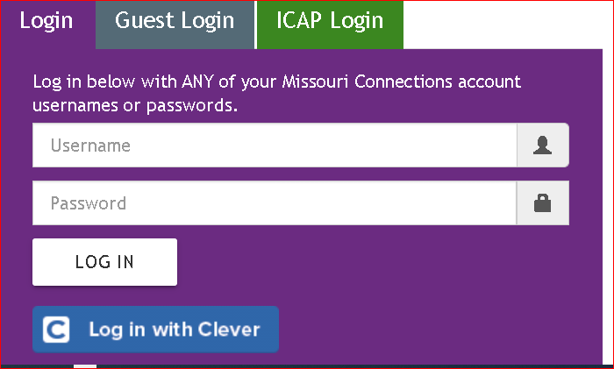
How to Login to MO Connections
Step 1: Go to https://portal.missouriconnections.org/
Step 2: Click on ICAP Login

Slide 4
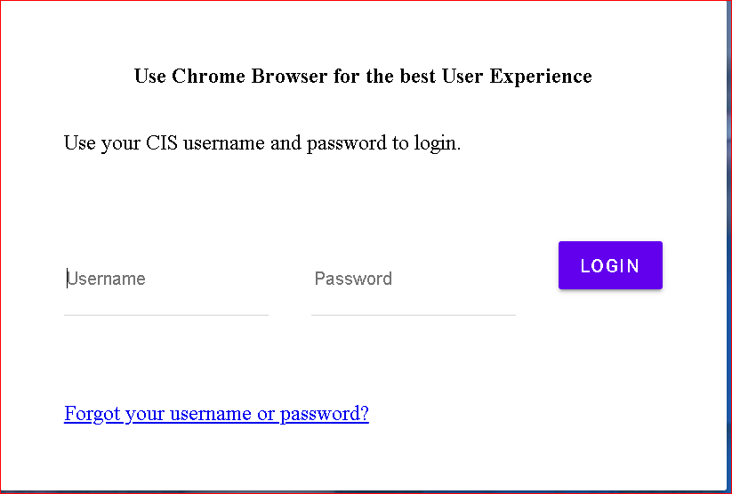
How to Login to MO Connections
Step 3: Scroll down and enter your username and password

Slide 5
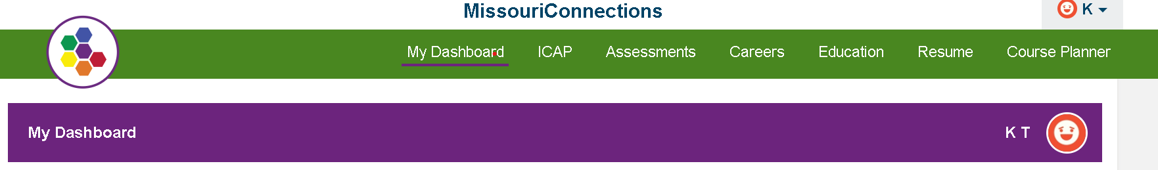
How to Login to Complete the Career Cluster Inventory
Step 4: Click on Assessments

Slide 6
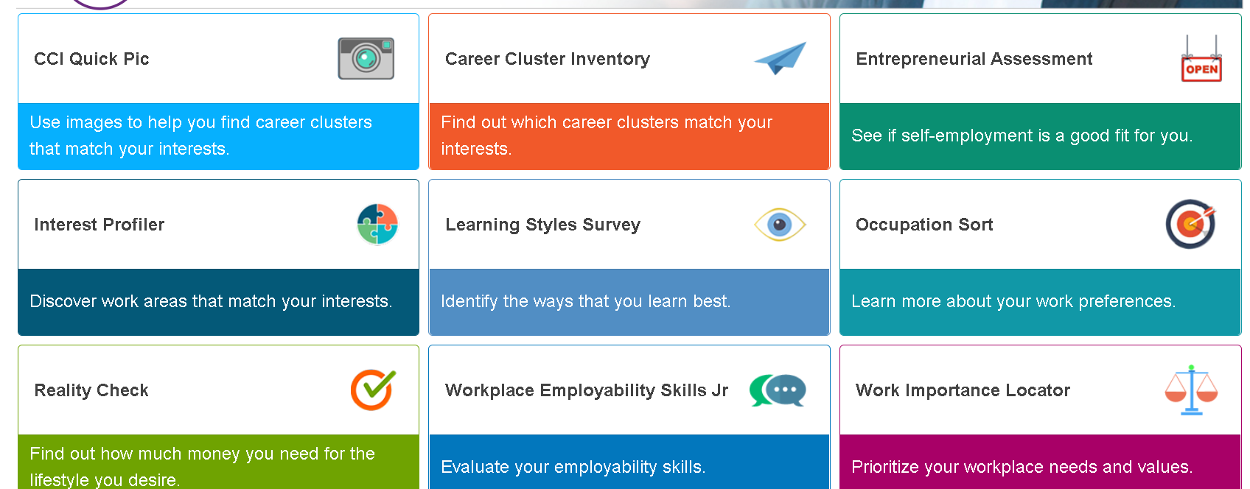
How to Login to Complete the Career Cluster Inventory
Step 5: Click on Career Cluster Inventory

Slide 7
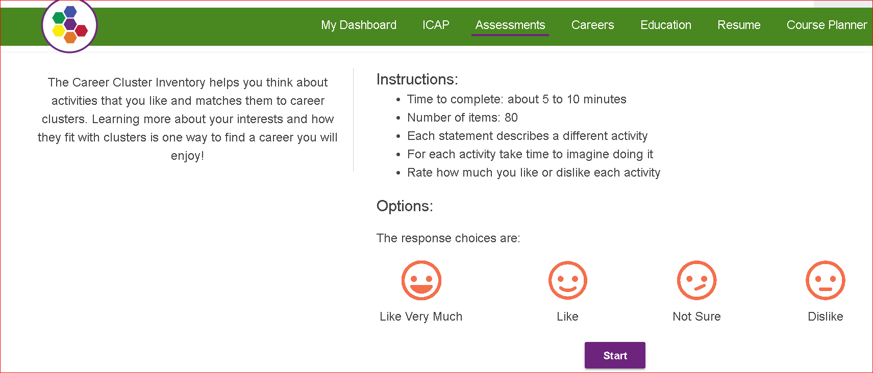
How to Login to Complete the Career Cluster Inventory

Slide 8
Career Cluster Inventory
Contains 80 items to rate on how much you enjoy these.
If you have done the activity, ask yourself, “Did I like doing that?” then rate how much you liked doing it.
If you’ve never done the activity, imagine doing it, and rate how much you think you would like it.
The choices are:
        -- Like Very Much
        -- Like
        -- Not Sure
        -- Dislike
Results will be saved automatically when you reach the Scores page. If you need to log off before rating all the activities, you need to click Save to save what you have completed.
When you save your results, you will be asked to add reflections.

Slide 9
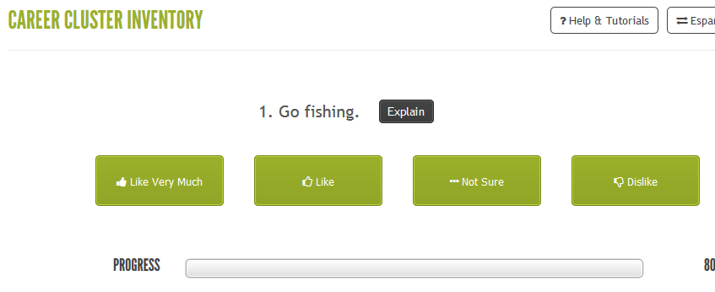
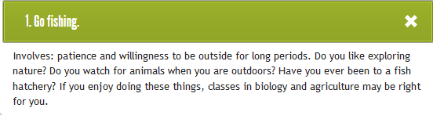
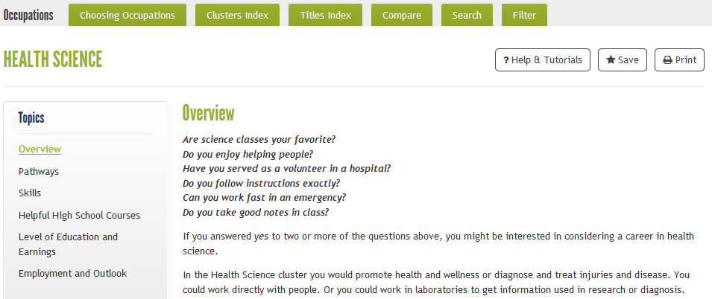

Slide 10
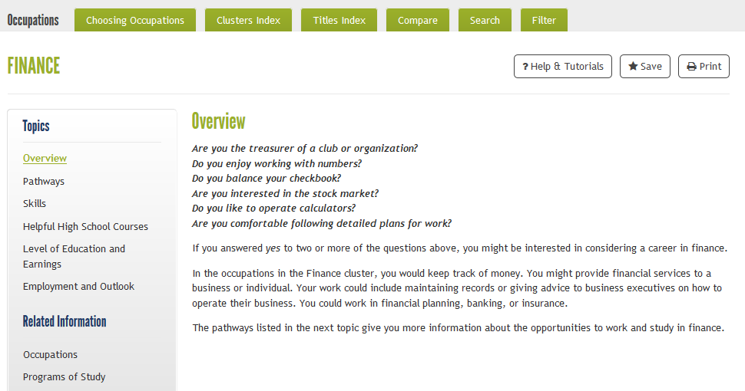
Cluster Topics

Slide 11
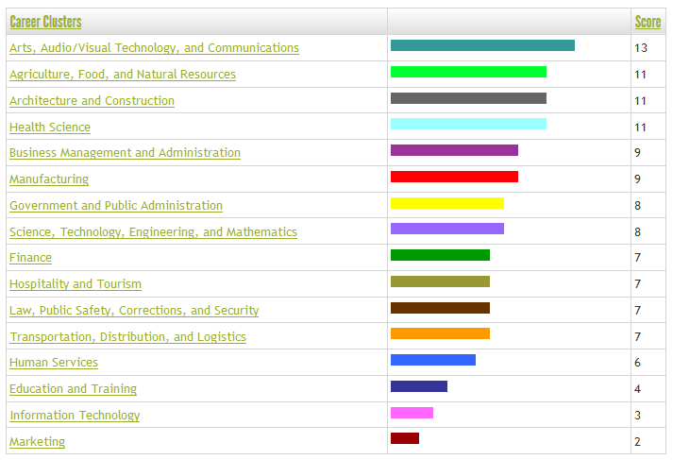
The Career Cluster Inventory graphs your scores for the 16 Clusters
Notes:
Once you get the results, click on the top 3 Career Clusters and find the jobs that have the top salaries, top employment opportunities and helpful high school courses to prepare for those careers.

Slide 12
The Career Cluster Inventory Activity
Once you get the results, click on the top 3 Career Clusters and find the jobs that have:
    -- The top employment opportunities
        -- The jobs that have the top salaries
        -- Top employment opportunities
        -- High School courses to prepare for those careers.

Slide 13
Discussion Prompts:
My three highest clusters are …
What occupations interest you now?
What did you learn about yourself from the assessment you just completed (Career Cluster Inventory)?

