Slide 1
Proposed Operating Budget
FY 2023

Slide 2
Overview
Fiscal Year ‘23 is the first year of the State Budget Biennium and revenue numbers are reflective of the current funding level provided by the DOE. The FY ‘23 State Budget was presented with a 5% increase in compensation for teachers and staff listed in the SOQs. We are able to support this increase for all faculty and staff.
We are proposing a modest budget increase to address the needs of the school and to continue to fund capital projects.

Slide 3
Revenue

Slide 4
Revenue Overview
Fiscal Year | Amount
FY ‘22 | $9,275,112
FY ’23 | $9,610,679
Total Increase:
$335,537 (3.6%)

Slide 5
Revenue Detail
Description | Amount
Local Contribution: 760 students x $8,866 (3.0 % per student increase) | $6,738,160
Building Rental | $7,000
Salary Supplement Incentive | $12,500
Dual Enrollment | $50,000
Technology Initiative | $26,000
Building Reserve and Carryover State Contribution | $200,000 $2,577,019
Total FY ‘23:
$9,610,679

Slide 6
Expenses

Slide 7
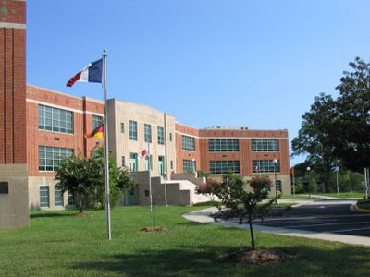
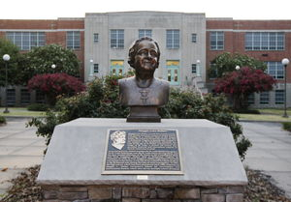
Expenses Overview
FY ‘23:
$9,610,679

Slide 8
Major Expense Detail-Additions
Description | Amount
Administration Fees (Altria and Convenience Fee for Online Payments) | $10,000
Salary/Benefits | $366,708 (Provides 5% raises)
Instructional / Office Supplies | $2,600
Building Reserve | $71,265
Service Contracts | $13,680
Health Insurance | $54,872
Total Additions: $473,693*
*And incremental increases for inflation in certain areas

Slide 9
Major Expense Detail-Reductions
Description | Amount
Textbooks | $14,349
Repairs and Maintenance | $133,878
Purchased Educational Services | $46,000
Utilities | $3,860
VRS Employer | $24,042
Office Equipment | $11,539
Total Reductions: $234,574*
* Most reductions were due to re-classifying some of the accounts as well as reducing the need to pay for non-MLWGS instructors.

Slide 10
Conclusion

Slide 11
Thoughts Going Forward
Funding outlook for FY’24
There are two budget amendments to the state FY’23 that would base direct aid to governors' schools on the SOQs. This could yield as much as $500,000 in additional revenue.

Slide 12
Next Steps
March 18 - Budget Public Hearing
https://goo.gl/forms/5nvco8hUrp6kEEAt1
April 15 - Request for Budget Approval

