Slide 1
The Legacy of Faith:
The Journey
By Brian Spielbauer

Slide 2
Tales of Lemuria
The Demon’s Chamber - 2017
The Three Charms - 2018
The Child King - 2019
The Legacy of Faith
The Journey - 2021
New Beginnings - 2022
Generations – 2023
The Battle - 2023

Slide 3
About me…
Grew up on a farm just outside Osterdock, IA
Graduated from Guttenberg High School in 1991
Graduated from William Penn University in 1996
Graduated from Bemidji State University in 2002

Slide 4
About me, continued…
  Junior High Science Teacher
    1996-2000
  College Basketball Coach
    2000-2012
  College Director of Athletics
    2012-2019
  Agent and Business Development Director
    2019-present

Slide 5
Family
Wife, Jennifer (Daughter of Martha Hoch)
  Daughter: Sydney, 18
  Daughter: Allie, 15
  We live if Fayette MO

Slide 6
The Beginning…
I started writing The Demon’s Chamber around 2009
Did not find a publisher until 2016!
  Meeting Rodney Earle
The Demon’s Chamber came out on September 1st, 2017

Slide 7
The Tales of Lemuria
Fantasy books about dwarf brothers who have to lead their people after their father is murdered.
Overcome many obstacles, including one angry demon, to the end of their journey.
Trilogy, similar to Lord of the Rings.

Slide 8
Writing Historical Fiction
What is it?
Taking a historical event and making up a fictional story within the greater context of what was going on at the time.
What is the difference between writing historical fiction and fantasy?
In historical fiction there is a lot of details you must look up and get right. There is a framework of events to work within.
In fantasy, you get to/have to make up everything!
Both can be daunting tasks!

Slide 9
My Writing Process
I write every day
One word at a time, one sentence at time, one paragraph at a time.
Even when it was bad, especially when it was bad, I write.

Slide 10
Trust the Process
Don’t worry about writing it perfect the first time
Accept the fact that it is going to have between 5-10 rewrites
The man rode to town.
  How can we make this more interesting?

Slide 11
‘You can’t edit the unwritten sentence’
The good thing: There is no time limit
The bad thing: There is no time limit!

Slide 12
My Writing Process, Step 2:
After writing the entire story, then start over
One sentence at a time, write it more colorful
  Describe the feel, the smell, the fear, the nervousness
  Make the reader feel/sense what is happening

Slide 13
Perseverance
Overcoming obstacles and hardships to achieve a goal.
I had many!
  Lots of ‘No’s’
  My computer crashed and lost half of it!

Slide 14
Must be Tough!
So many people will tell you it can’t happen
  That you can’t do it
  That your crazy for trying
Never let the odds keep you from doing what in your heart you know you were meant to do!

Slide 15
What’s your Dream?
What do you think about before you go to sleep, and then again right when you wake up?
What’s that thing that keeps popping into your head, that you can’t learn enough about?

Slide 16
State it! Own it! Plan it!
It took me 9 years of working and planning to earn the great day when my book was released.
You need to start working your plan to earn your great day!

Slide 17
Believe in good things!
Many times I wanted to start writing, but didn’t
Too many ‘what if’s’ stopped me
Even if its only me and God

Slide 18
Positive Self Talk
When someone says something bad to us, we usually repeat it to ourselves at least 10 times
My life became FAR more fun when I stopped talking myself out of things, and started talking myself into things!

Slide 19
What should I write about?
Write about what you know, or what’s interesting to you
We like to assume we are the only ones like us. It is not true!
We are all different, but our fears and anxieties are very similar!
Write about what you like, and chances are there are a lot of people out there who will be I interested.

Slide 20
How should I write it?
Again, write it in a way that is interesting to you!
Don’t worry what it looks like or what it sounds like
Just get something out of your head and on paper
  Then start piecing it together!
  Even if its just for you!

Slide 21
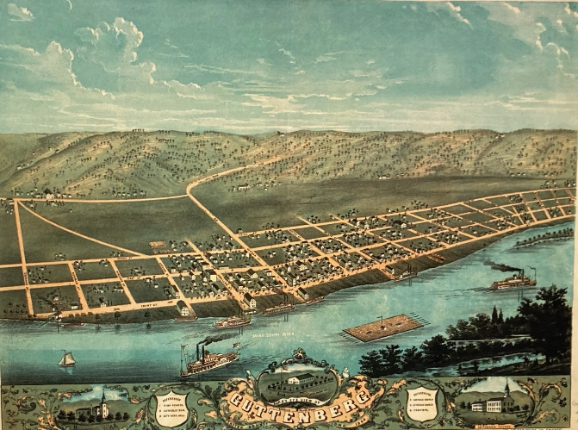
The Legacy of Faith
By Brian Spielbauer

Slide 22
Special Thanks!
Walter W. Jacobs, The First 100 Years, a History of Guttenberg, Iowa
Betty Weingartner, The Tschohl Family History
Hilda Spielbauer Brooks, Living Arrows
Mary Nigg Bartholet, Guttenberg Memories
Souvenir of the Diamond Jubilee of St. Mary’s Parish, Guttenberg, Iowa
Special thanks also to my Aunt Hilda Spielbauer Brooks and Uncle Arnie Spielbauer, who terrific family history documentation greatly aided my endeavor.

Slide 23
Family Tree
Spielbauer / Johll / Rohner Family Tree
Johann Baptist Tschohl
 | John Baptiste Johll
 | Sara Fortner
 |  | Julianna Johll (17)
 | Mathias Rohner (45)
Felix Anton Rohner | Isabella Brown ('56'-86') |  | Francis Rohner | Frank Spielbauer | Brian Spielbauer
Lucia Kaiser * |  |  | George Spielbauer | Jackie Wessels | Jennifer Bryant
 |  | Mary Brimeyer
 |  | Joseph Spielbauer
 | Mary Pankraz
 | George Spielbauer

Slide 24
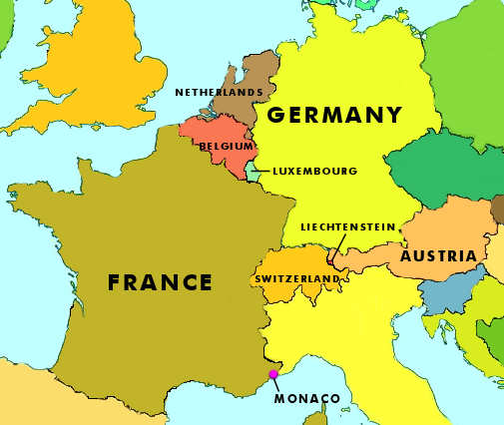
Liechtenstein and Central Europe
Lichtenstein
Le Havre, France
Balzers, Voralberg, Austria
Bavaria

Slide 25
The Journey of Tschohl’s
Johann Baptiste Tschohl
  3 oldest daughters came over in 1845
  1 came alone in 1850
2nd wife died, and he and his 4 sons came over in 1855
Find the Serampore boat list
Arrived in Guttenberg, May 15th, 1855

Slide 26
Mathias Rohner
Arrived by April 1st, 1866
  Son of a Austrian army captain. His mother was a cousin to the eventual Arch Duke Franz Ferdinand of Austria. Who is that?
  Wanted to avoid getting conscripted/drafted into the Austrian Army
  Swam Lake Constance in the middle of the night to avoid the army.
Came to Guttenberg
Met his future wife, Isabella Brown as they both worked for G.F. Wiest
In the limestone building across from The Landing, still standing!
Married Isabella in 1873

Slide 27
George Spielbauer & Mary Pankraz
George came to America in the mid 1860s
Lived with/married Mary Pankraz
Child was Joseph Spielbauer
  Was he a Spielbauer?
Mary supposedly worked in an Austrian Palace
No marriage certificate has, to date, been found that (I am aware of)
  The did have another child in 1885, Clara Spielbauer

Slide 28
Joseph Spielbauer and the Castle Dilemna…
First, I tried for Kaiser Wilhelm, the King of Prussia.
Then I looked farther south, to the Country of Bavaria.
  King Ludwig
  Prince Otto

Slide 29
Due out on March 15th, 2022

Slide 30
The Legacy of Faith:
New Beginnings
Due out March 15th, 2022
Covers:
  Mathias Rohner and his marriage to his first wife
  The ongoings of the Tschohl Family in northeast Iowa and southwest Wisconsin.
    Little Johnnie Tschohl goes to the Civil War
  The continual development of George and Mary Pankraz, and Mary’s son Joseph.
  We get to know more of the people and happenings in Guttenberg, Iowa.

Slide 31
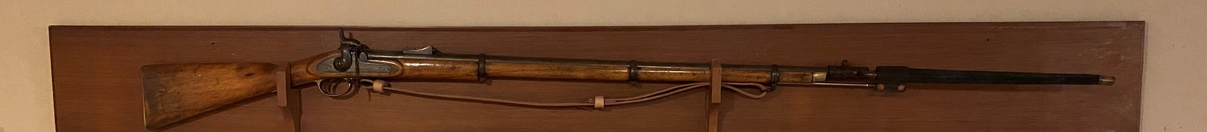
Story of Arnie Spielbauer and how I came into possession of my Great-Great Grandfather’s Civil War Rifle
… and how he came to have and Enfield instead of a Springfield…
- Robert Lee Burris, from Unionville MO!

Slide 32
Thank you!
For your time and interest!
Please consider leaving a review on Goodreads for The Legacy of Faith
  And tell your friends and family!

