Slide 1

TOPICS FOR PRINCIPALS
AND
BOOKKEEPERS

Slide 2
PUBLIC FUNDS
  Generated school wide
  Funds raised through state, local, or federal taxation
  Restricted use of funds
  Used for all students
  Controlled by the principal

Slide 3
NON-PUBLIC FUNDS
  Funds raised for a particular group
  Organization or parent group determines how funds are to be expended.
  Controlled by sponsor/organization
  Self-imposed fees, not state-required

Slide 4
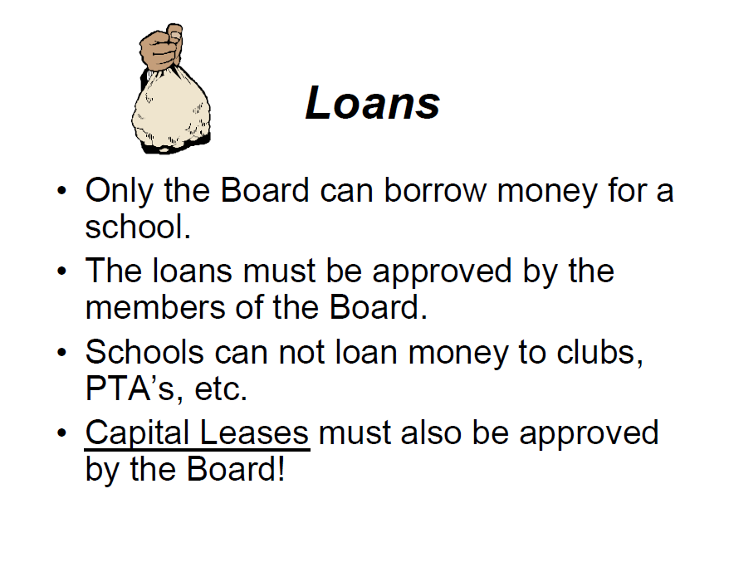

Slide 5
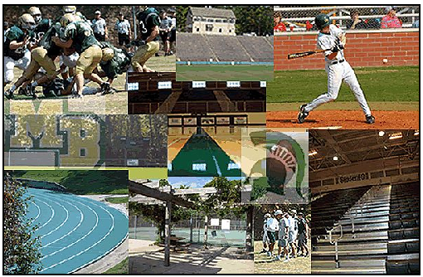
Any contract or lease must be reviewed by the CSFO and signed by the Superintendent.
Athletic camps should be approved by the Athletic Director and filed with the CSFO.

Slide 6
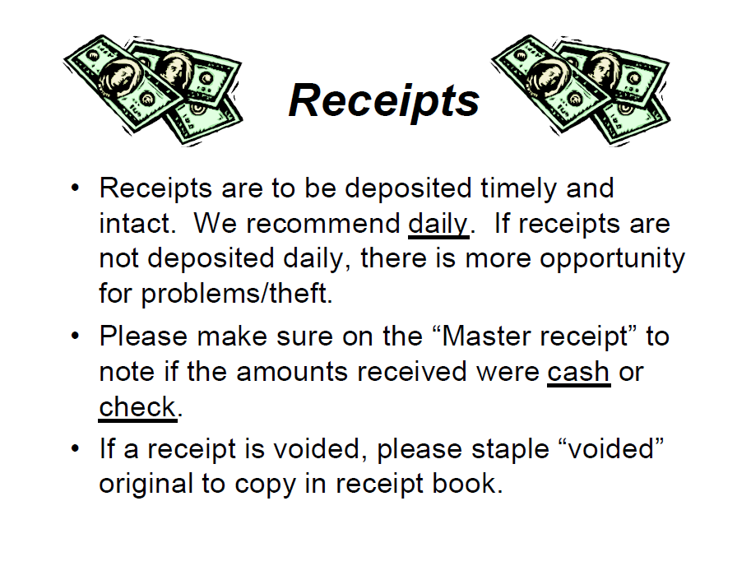
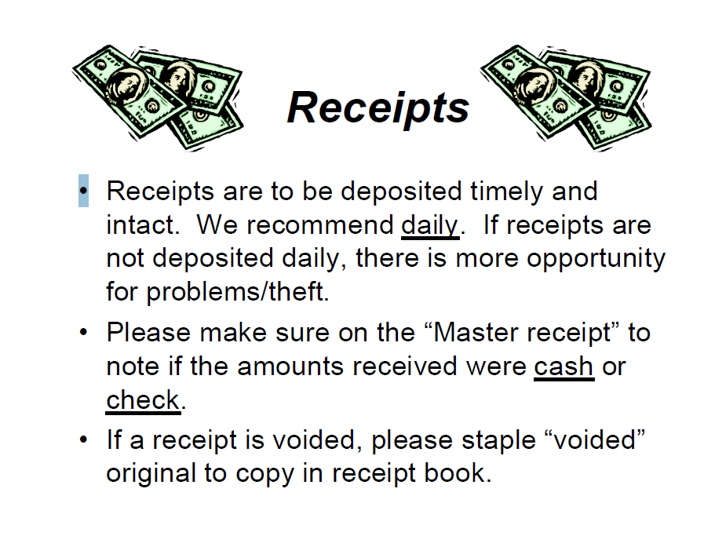

Slide 7
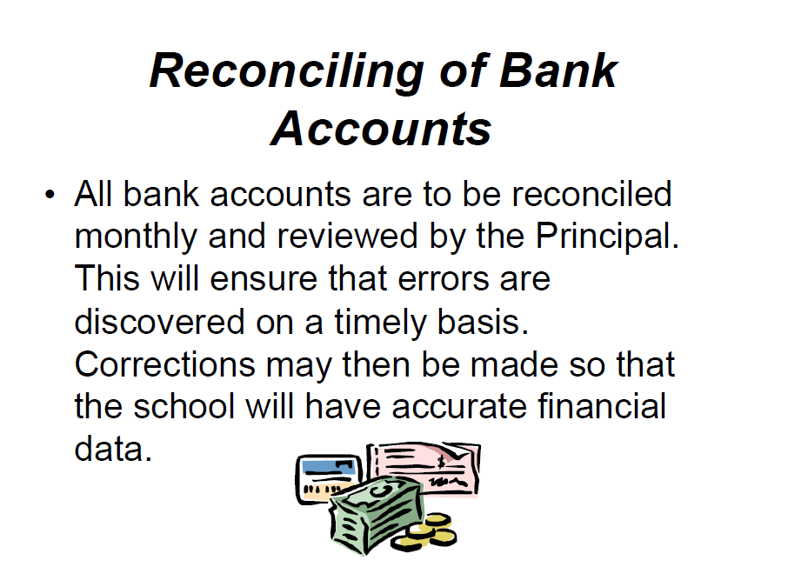

Slide 8
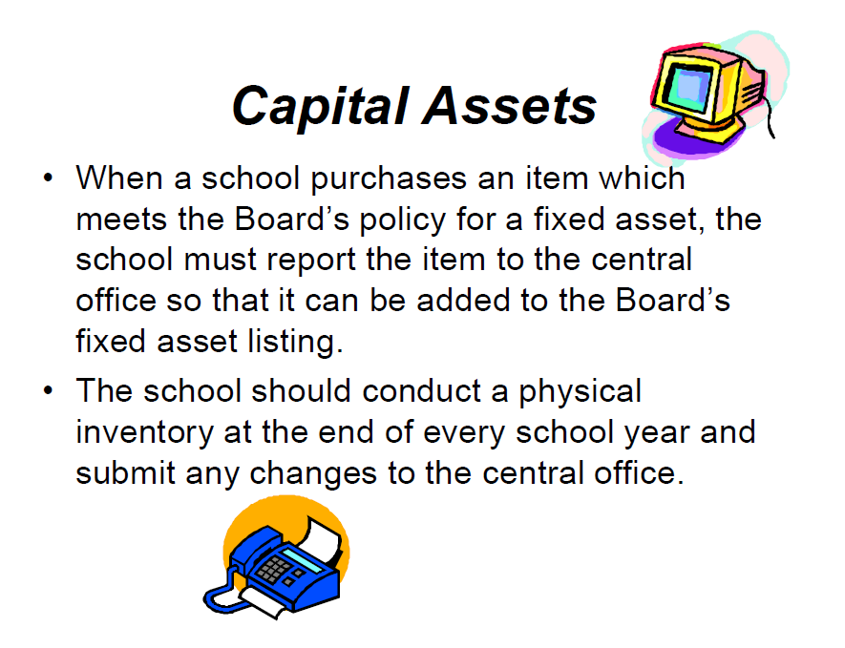

Slide 9
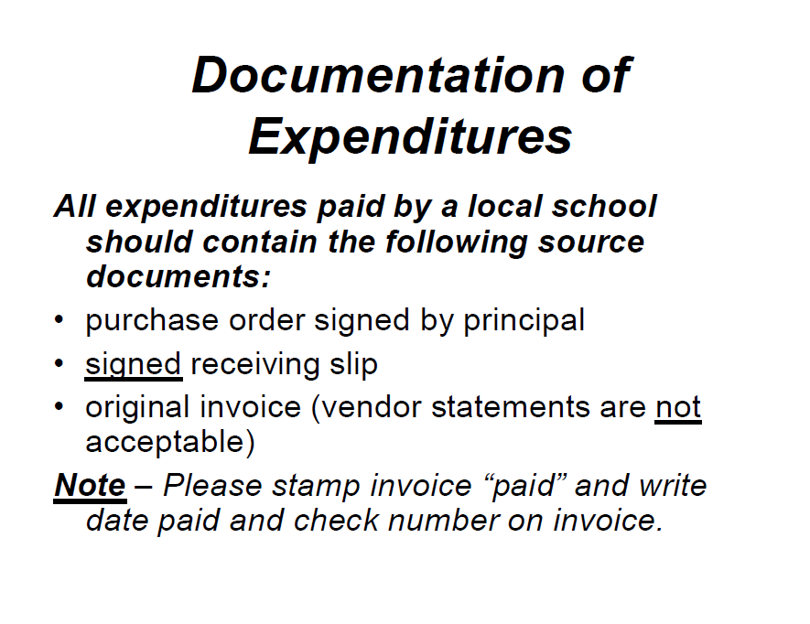

Slide 10
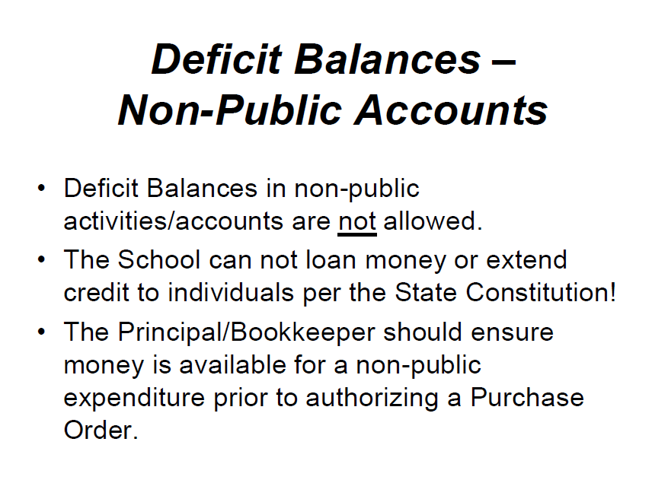

Slide 11
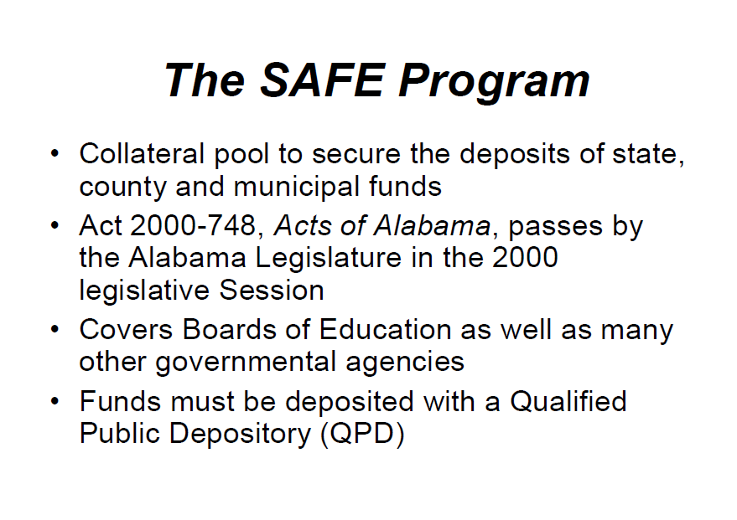

Slide 12
QUALIFIED PUBLIC DEPOSITORY
(QPD)
A QPD is any financial institution (banks and
savings associations) organized under the laws of
the State or United States to conduct business of
making loans and taking deposits in this state) that
has deposit insurance under the Federal Deposit
Insurance Act, 12 U.S.C., Section 1811 et. Seq.,
that meets all of the requirements of the Act and
that has been Designated by Board of Directors of
the SAFE Program as a Qualified Public
Depository.

Slide 13
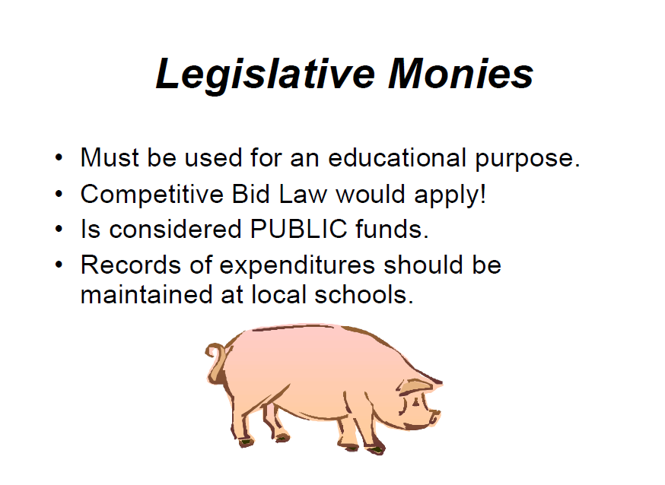

Slide 14
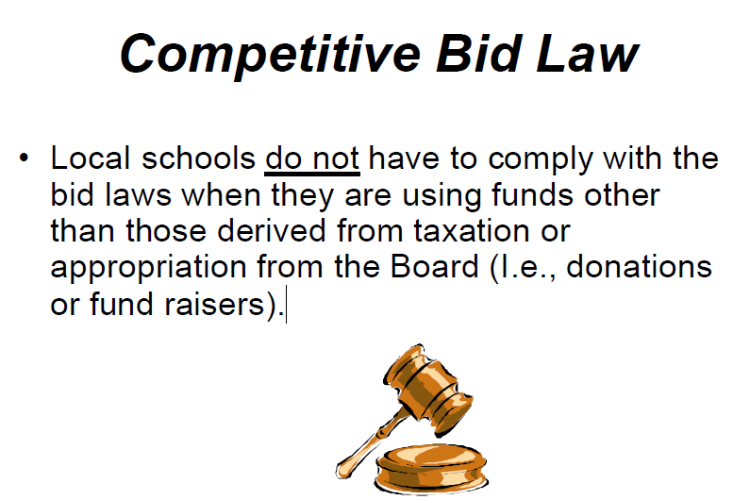
New threshold for amount - $15,000.00

Slide 15
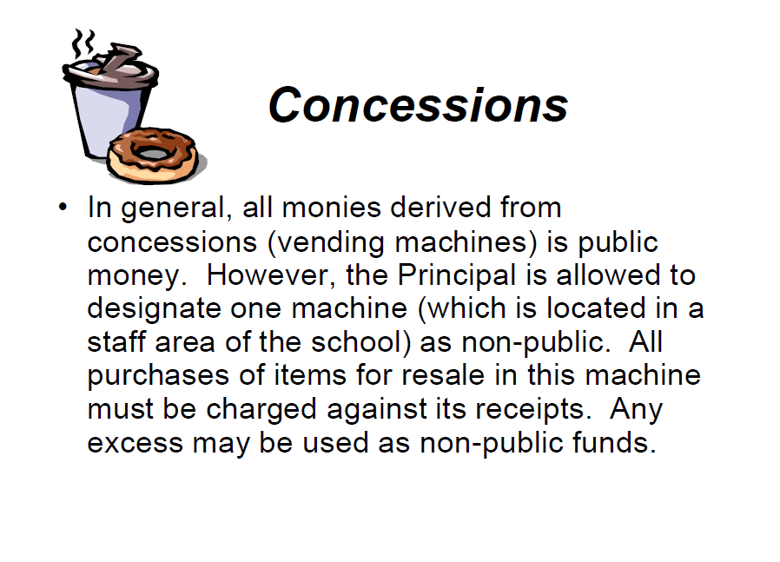

Slide 16

Concessions
The principal or bookkeeper should periodically review the concession profits or losses to determine if any problems exist.

Slide 17
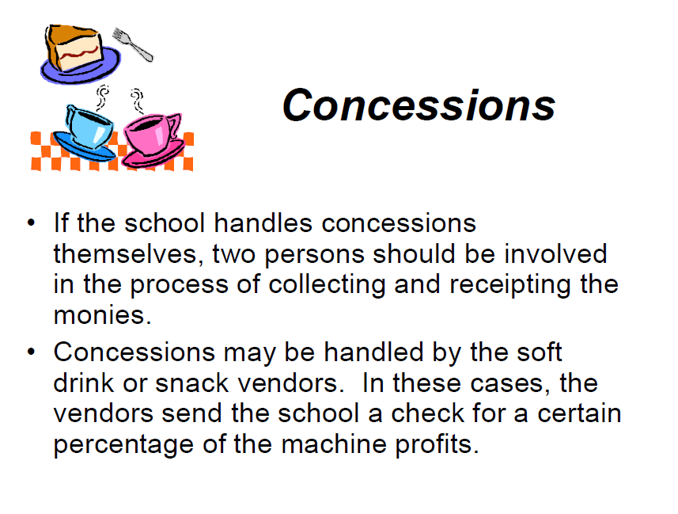

Slide 18
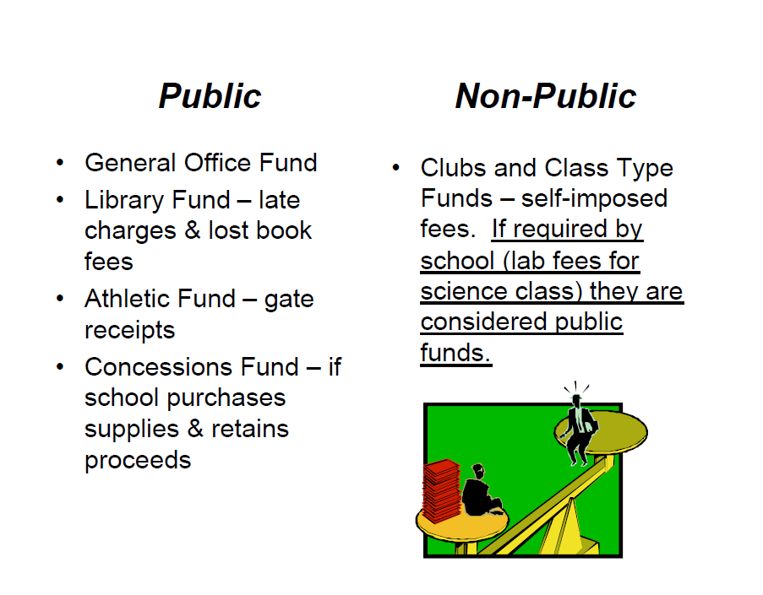

Slide 19
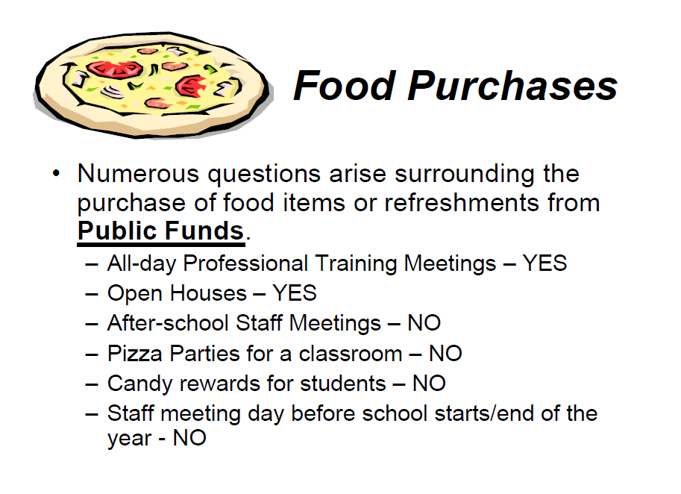

Slide 20
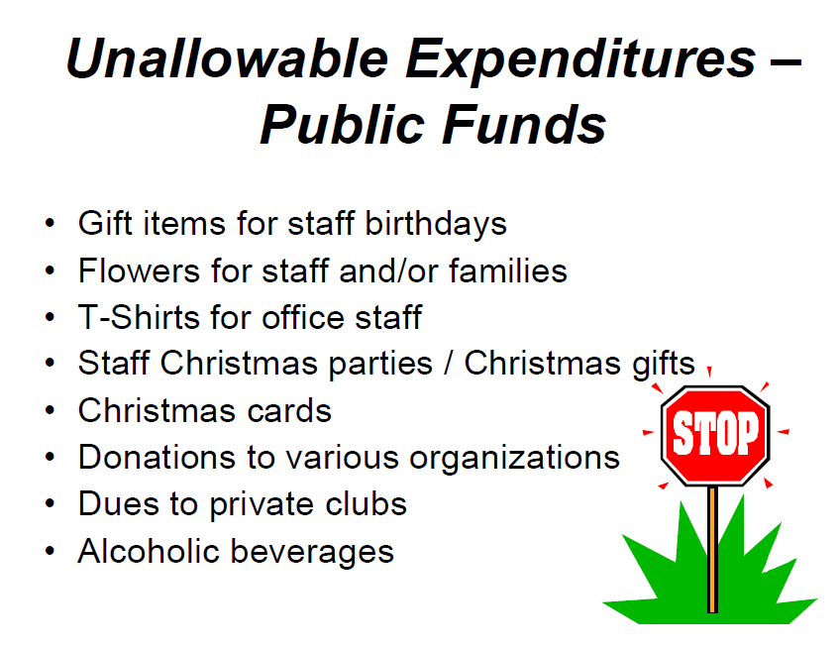

Slide 21
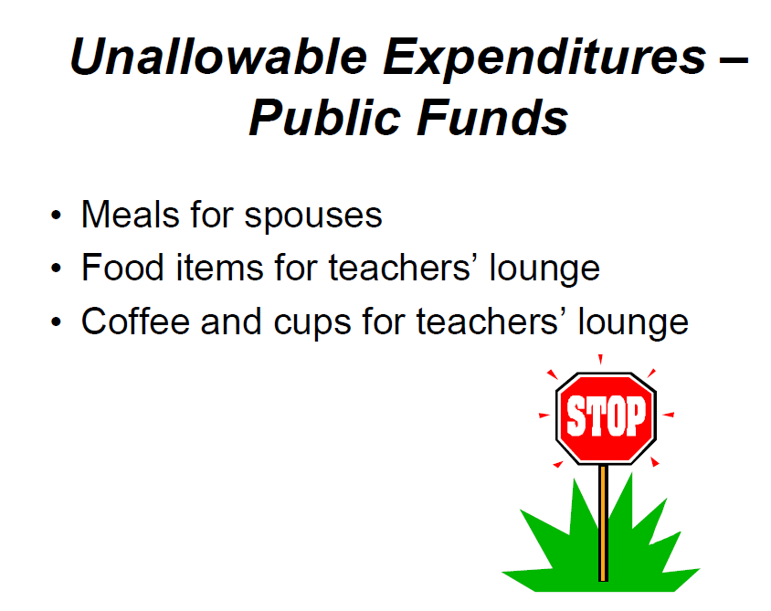

Slide 22
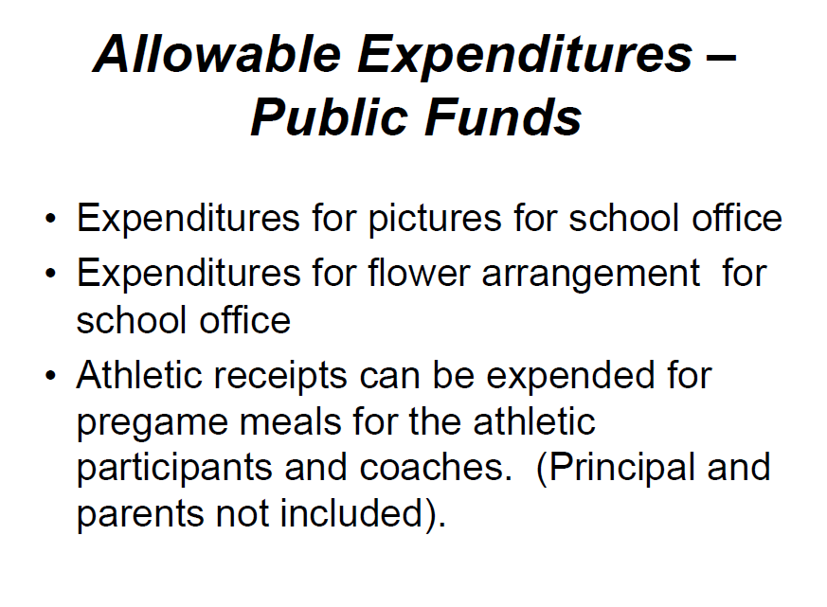

Slide 23

Allowable Expenditures –
Public Funds
• Plaques and other awards for Significant
Academic Achievement or Significant
Contribution to the School

Slide 24
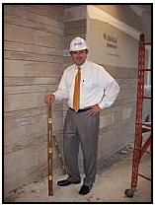
The Principal is ultimately responsible for school finances. If illegal expenditures are made the chargeback is to the Principal.

Slide 25
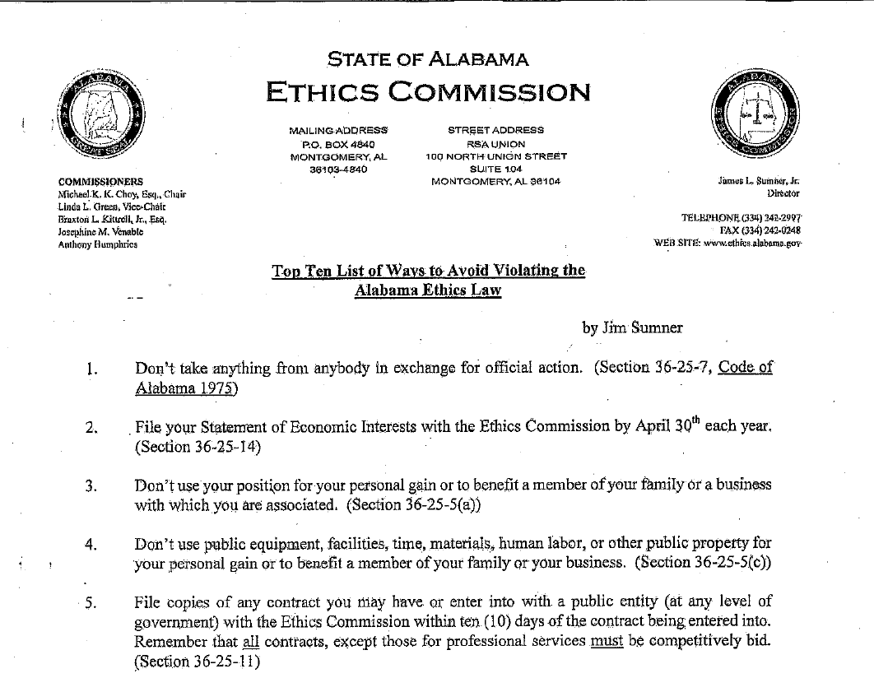

Slide 26
