Slide 1
El día de los muertos
The Day of the Dead
¿Cierto o falso?
True or False?

Slide 2
¿Cierto o Falso?
The Day of the Dead is a holiday celebrated only in Mexico.

Slide 3
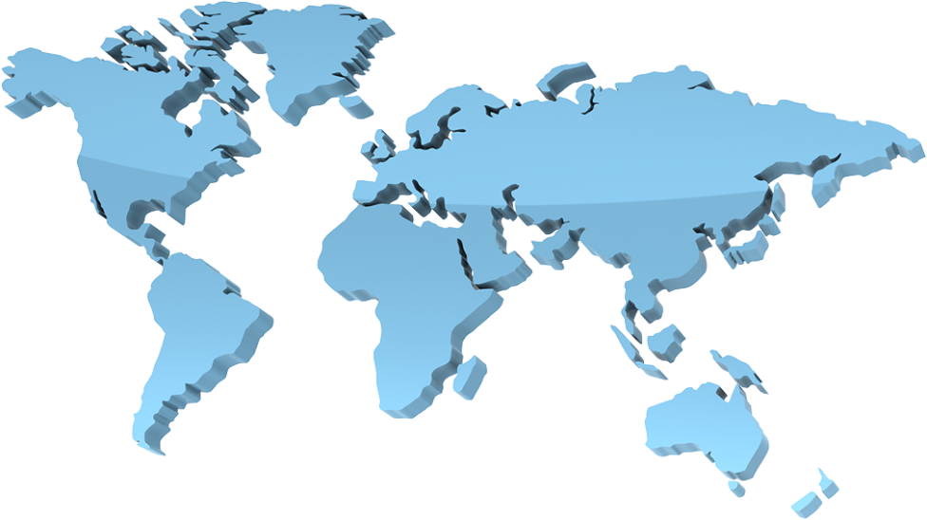
¡Falso!
The Day of the Dead is celebrated in many countries all over the world, from North America and South America, to Europe and Asia. Some people in the United States even celebrate this holiday.

Slide 4
¿Cierto o Falso?
The Day of the Dead is a happy and joyous holiday. It is a time to remember and honor loved ones and friends who have passed away.

Slide 5

¡Cierto!
The Day of the dead is a happy, not sad, holiday. People enjoy telling stories about their loved ones as a way to remember them. It is a celebration of the life that was lived.

Slide 6
¿Cierto o Falso?
El día de los muertos is a scary and spooky day. It is supposed to frighten people.

Slide 7
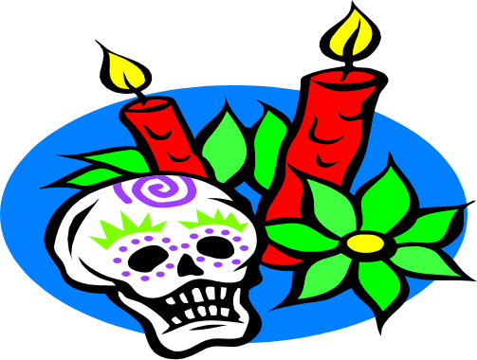
¡Falso!
El día de los muertos is not spooky or scary. The skeletons and skulls represent the cycle of life and death. The skeletons are made to look like they are dancing, playing music, or having fun.

Slide 8
¿Cierto o Falso?
The main focus of the holiday is storytelling.

Slide 9
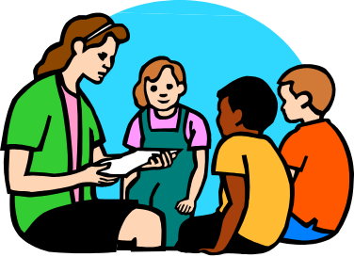
¡Cierto!
People love to tell stories about family members who have passed away. Children can learn about their family history, and it is a way to keep the memories of their loved ones alive.

Slide 10
¿Cierto o Falso?
Families do not like to visit cemeteries on the Day of the Dead. It is too sad.

Slide 11
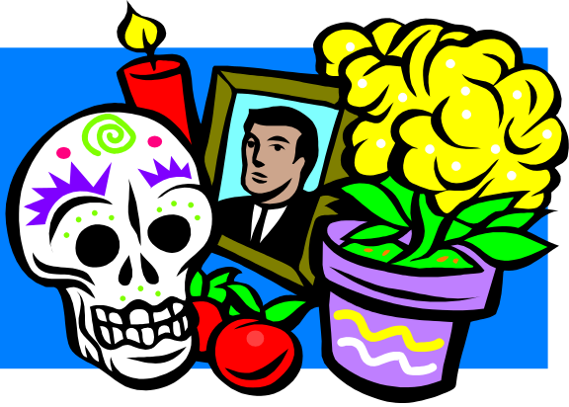
¡Falso!
People enjoy going to cemeteries to clean the graves of their loved ones as a sign of respect. They also like to bring flowers and pictures, light candles, and eat delicious foods.

Slide 12
¿Cierto o Falso?
There are special foods eaten during el día de los muertos festivities.

Slide 13
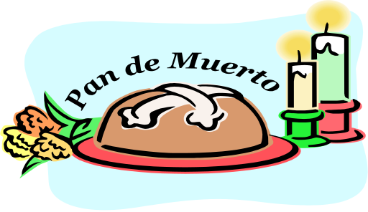
¡Cierto!
Food is a big part of celebrating this holiday! Family members make their loved ones’ favorite foods. Children buy sugar skulls with colorful decorations. Pan de muerto (bread of the dead) is decorated with icing to look like skeletons or skulls. In Guatemala, people enjoy eating fiembre, a type of salad with lots of different ingredients.

Slide 14
¡El fin!
How many did you get right?

