Slide 1
Back to School Night
2022-2023

Slide 2

Abby Bontrager
Katie Harrison
Leah Saab
Rachel Fitzpatrick
Rachel Sparks

Slide 3

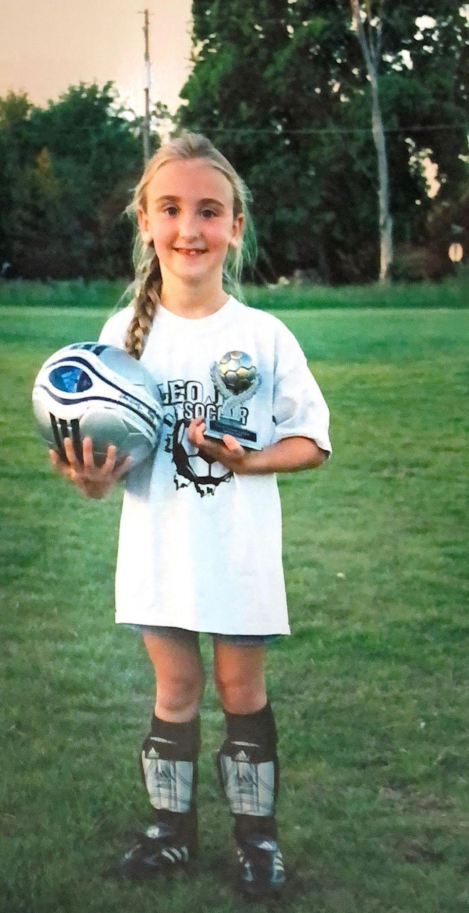
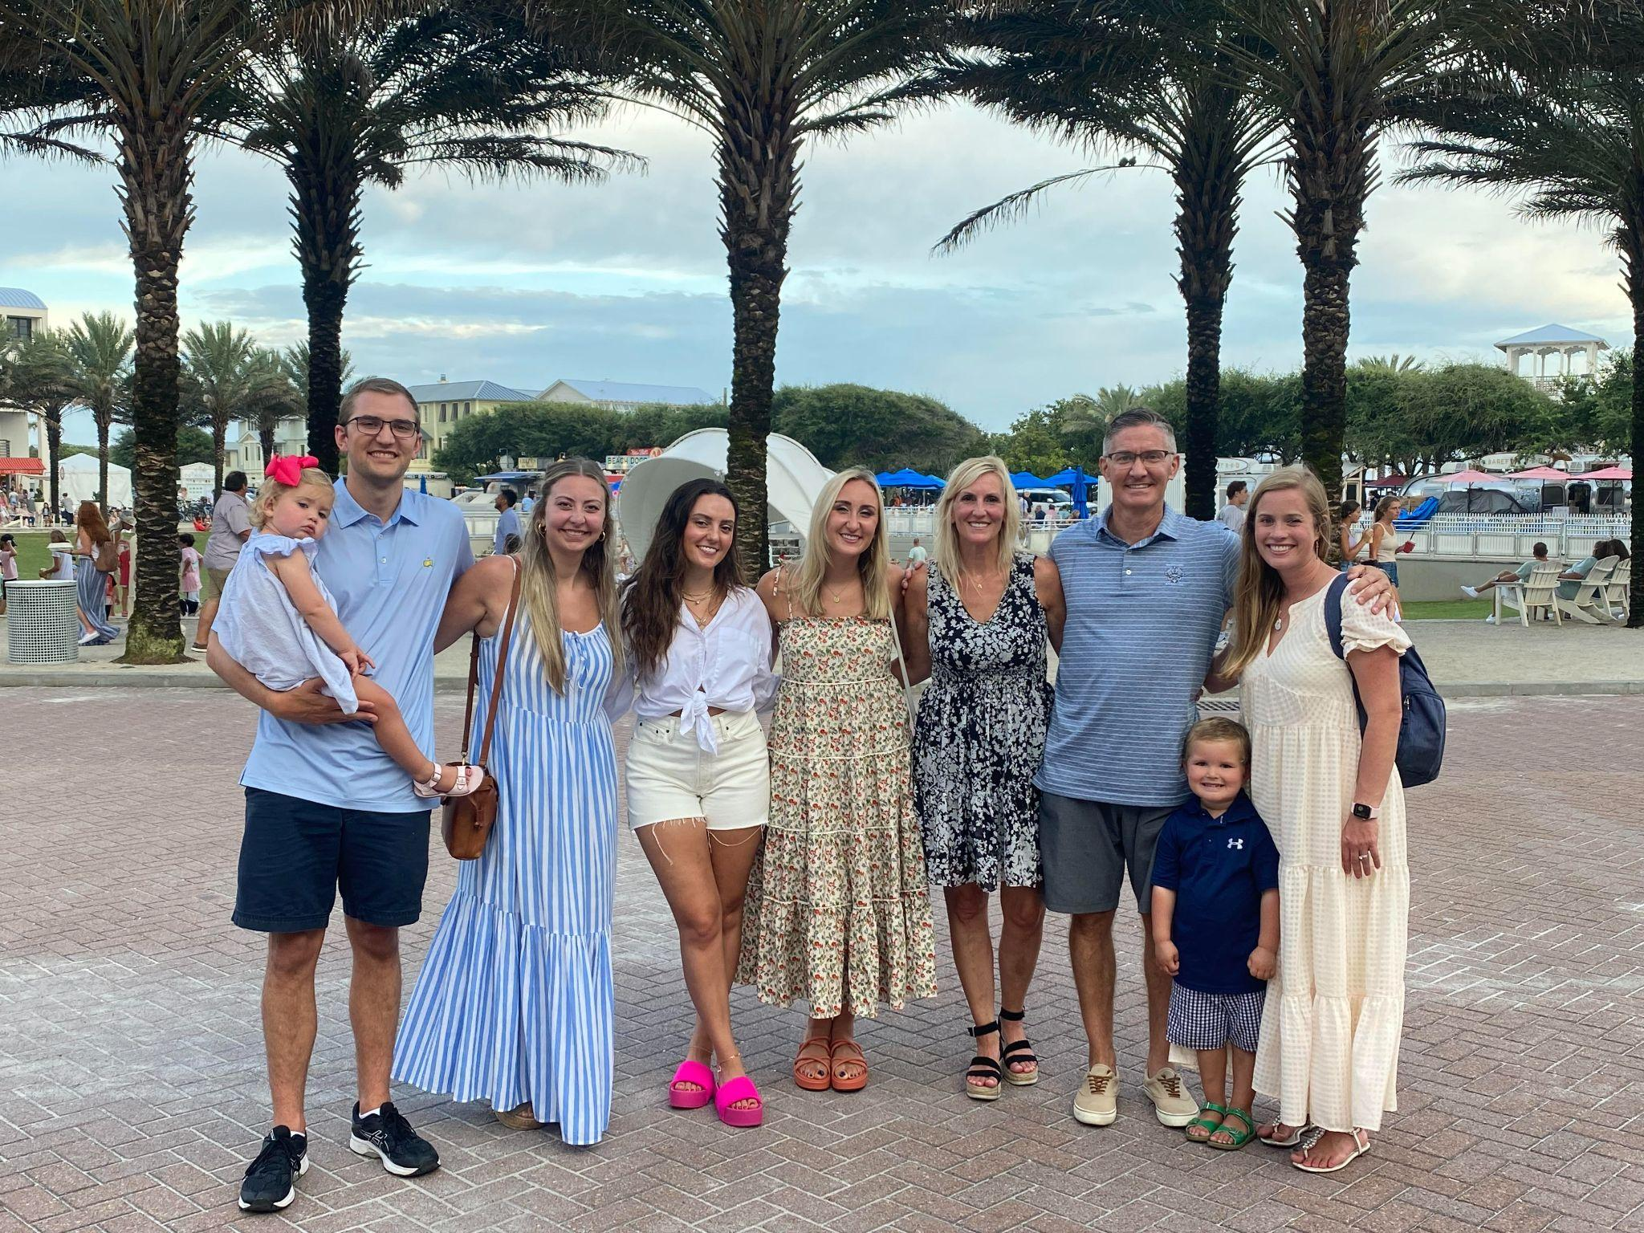
Abby Bontrager
Katie Harrison
Leah Saab
Rachel Fitzpatrick
Rachel Sparks

Slide 4

The Chief Way
Caring
Hardworking
Inspiring
Eager
Fearless

Slide 5
Daily Schedule
8:00-8:30 Chief Chat
8:30-9:00 Phonics
9:00-10:00 Reader’s Workshop
10:00-10:35 Writer’s Workshop
10:40-11:10 Lunch
11:15-11:35 Recess
11:35-12:00 Rest/Intervention
12:00-12:40 Math Workshop
12:45-1:20 Specials
1:20-1:55 PE
2:00-2:30 Snack/Centers/Mad Science Friday
2:30-2:45 Dismissal

Slide 6
Absences
  Excused absences include illness of the student, death in the immediate family, and religious holidays
  Parents must fill out the online absence form found on the CBS website. This form is filled out for illness or for pre-planned vacations. Below is the link to the form:
  https://www.mtnbrook.k12.al.us/Page/11412 OR send an email to cbesabsences@mtnbrook.k12.al.us
  If an excuse is not sent in online, the absence will be considered unexcused.
  When a student’s unexcused absences reach seven (7) days in any academic year, the principal may refer the issue to the district attendance officer, who shall consider filing a complaint/petition with the Family Court.

Slide 7
Star Chief
Mystery Reader

Slide 8

Birthdays
  The student’s birthday may be celebrated on the birthday or a day close to it.
  Summer birthdays can be celebrated on the student’s half birthday or in May.
  Birthday party invitations may be given out in school only if the entire class is included (unless it is just all boys or all girls).

Slide 9
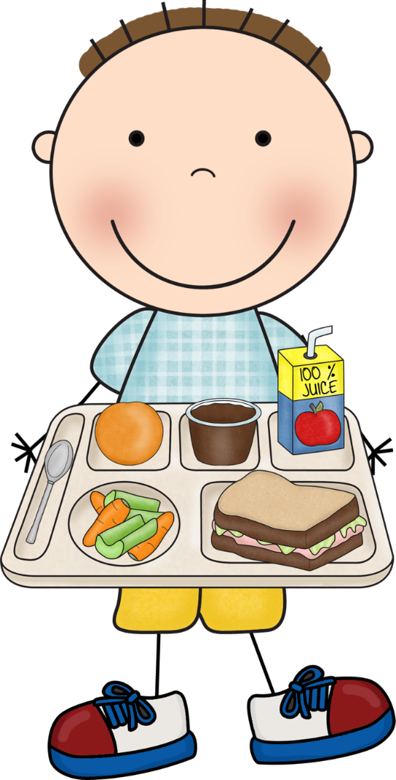
Lunch
  Menus are on the CBES website.
  Lunches cost $4.00.
  Students are allowed to get a milk or a water
from the lunchroom if they pay for it.
  The new system is called Titan. You should have received an email about how to load money into your child’s account.

Slide 10
Health & Safety
  All medication must be turned into the school nurse.
  No medication is given by the classroom teacher.
  If a child visits the health room, a health form notice will be in Powerschool.
  Sick children should be kept at home. They must be fever free without medicine for 24 hours before returning back to school.

Slide 11
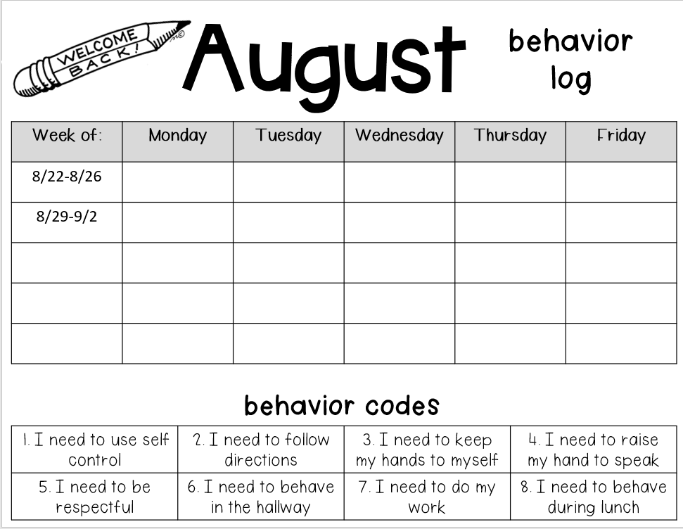
Behavior Log

Slide 12

Dismissal
  If your child needs help buckling their seat belt, please pull into a parking spot (not along the curb) to take time to do this.
  Please put the yellow card with your child’s name on it in your front window.
  If your child is a walker, please make sure they are aware of their rainy day plan. Rainy day will be announced by 2:30, and all students will go through normal carpool if this happens!
  Please don’t use your phone and make sure to keep moving to ensure dismissal is quick and effective.

Slide 13
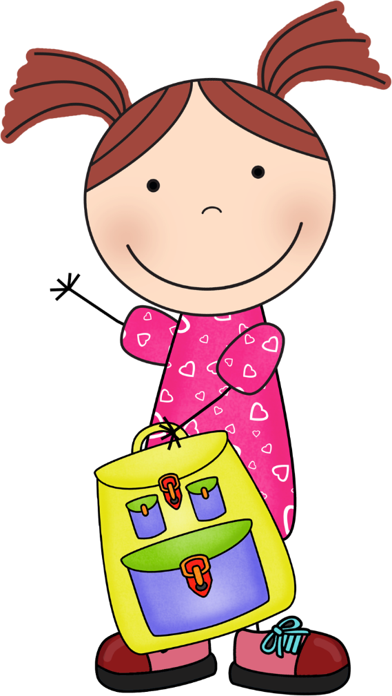
Your Child Will Need…
bloomers/shorts underneath dresses and skirts.
tennis shoes for P.E.
an extra change of clothes in backpack
snack and water bottle
all personal items should be labeled.

Slide 14



Snack
  Each child should bring a healthy(ish) snack from home each day.
  Please make sure your child knows which items are snack, and which items are lunch.
  Please make sure your child can open their own snack.

Slide 15
Specials
Physical Education
Spanish
Art
Music
Library
S.T.E.M.
FOAC/Guidance

Slide 16
Volunteer Opportunities & PTO Initiatives
We will be having special activities or snacks once a month throughout the year. Please volunteer for these days on the PTO website.
https://www.chiefpto.com/
We will also have opportunities for you to volunteer to come in and host Mad Science Fridays!

Slide 17
Communication
E-mail is the most efficient way to get in touch with your child’s teacher during the day. If you send an email about carpool after 2 p.m., please call the front office to make sure your child’s teacher gets the message.
We will be using the Seesaw app to communicate occasionally. Please make sure you connect to your child’s account.
Please know we are engaged in instruction from 8:00-2:40 and may not be able to check or return emails.
Please check your child’s take home folder nightly and send back cleaned out each day.
We meet for parent-teacher conferences two times a year. Fall conferences in October and spring conferences are in March.

Slide 18
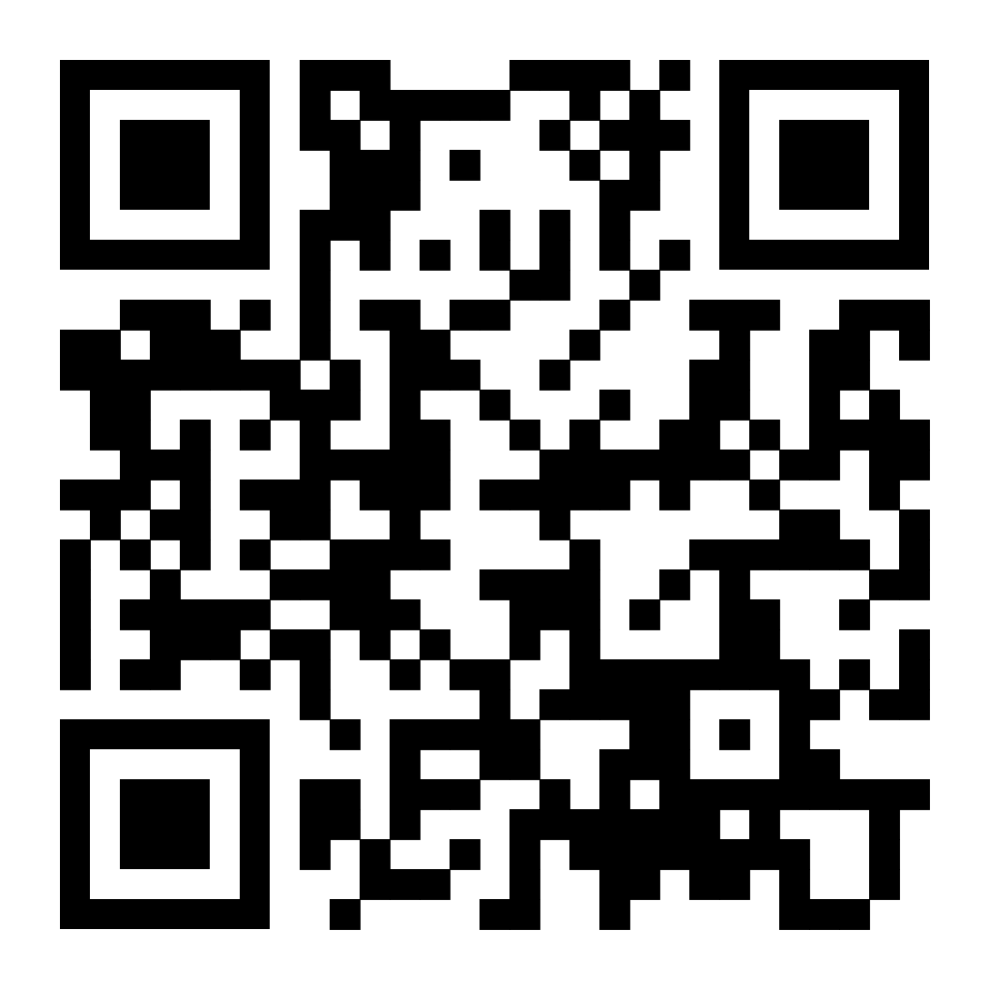
Seesaw
If you have not yet connected to your child’s Seesaw account, Please use this QR code to connect!

Slide 19

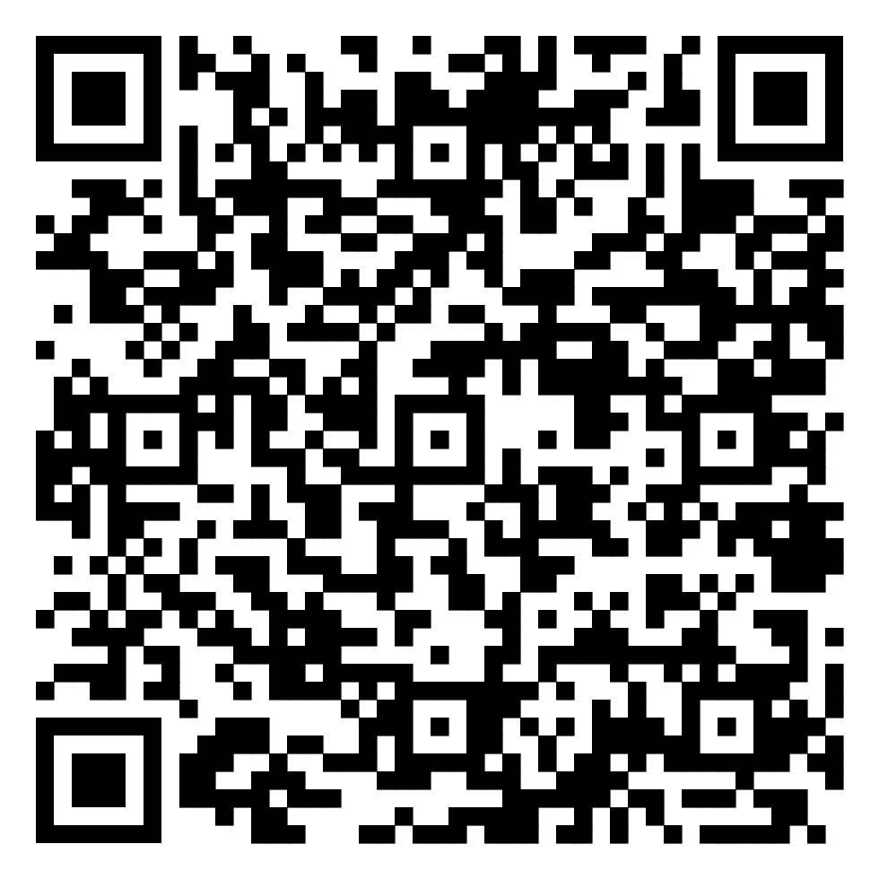

Slide 20
Thank you so much for coming!

