Slide 1

Back to School Night
Miss McLean’s Marvels / 2nd Grade
Notes:
Welcome!
Again I am Miss McLean. This is my 2nd year teaching at Cherokee Bend. I absolutely love it. I was a student teacher here in Kindergarten 2 years ago and graduated from UAB. I live in Trussville. I love reading, running, Jazzercise, my nephew, McRay, my church, going to the lake or the beach, spending time with friends, etc.

Slide 2

Welcome Room Mothers!
Brooke Cannon & Sydney Bragiel

Slide 3
Schedule
7:30 – 8:15 Morning Routines
8:15 – 9:50 Reader’s Workshop
9:50 – 10:25 Specials
Mon. (Art), Tues. (Music), Wed. (Spanish), Thurs. (Library), Fri. (FOAC)
10:30 – 11:00 P.E.
11:00 – 11:30 Snack + Grammar/Word Study
11:30 – 12:25 Writer’s Workshop
12:25 – 12:50 Lunch
12:55 – 1:15 Recess
1:20 – 2:10 Math Workshop
2:10 – 2:30 Science/SS
2:30 – 2:40 Afternoon Routines
Notes:
Morning - routines (jobs, work on unfinished work, fun, drawers, etc.), meeting (greet, message, share, activity - community building) + reading + GOAL Time (time for working at own pace - extensions, review, small groups, reteaching, etc.)
Specials, PE
Mid Day- SNACK, Grammar, Phonics/ Word Study, Writing
Lunch, Recess
Afternoon - Math & Science/SS (STEM on Fridays)

Slide 4
Curriculum
Reading, Writing, Phonics
Math
Science (STEMScopes)
Social Studies
Notes:
Workshop model - lesson, independent work/small group, share
Reading - standards based, Lucy, Hoyt, Fountas & Pinnell, other resources, etc.
Writing - Lucy Calkins
Phonics - District progression, some Lucy Calkins
Grammar: SchoolWide
Math - Envision (NEW this year) - + Investigations as needed
Science - STEMscopes by Accelerate Learning (living things, landforms, matter, maps, water, quick/slow changes to land, etc.)
Social Studies - traditional, whole group Studies Weekly, Famous Americans
STEM - creative hands-on problem-solving integration + STEM during indoor recess / Fridays / challenges, team-building, critical thinking that involves science, technology, engineering, math / coding, digital literacy working on chromebooks *building, creativity, team building, problem solving, critical thinking, etc.
still have Schoology
Assessments done right now
Progress Monitoring based on those results
2nd Grade benchmark
Beginning of the Year
progress Monitoring based on those results
2nd Grade Benchmark
Exs: J - August - September
K - October - December
L- January - March
M- April - May
2nd can go up to P but would then go deeper within texts for what is appropriate for the age

Slide 5
Standards, Grading, & Assessments
Standards Based Report Card (+, -)
Report Cards per 9 weeks
October Conferences
March Conferences (optional)
ex: aimsWeb PLUS, AMC, Fountas & Pinnell, WTW
Notes:
Our instruction is driven by standards & data
See GOALS handout
Formative, Summative per unit/skill ex: sticky note
AMC, aimsWeb PLUS (math and reading), F & Ps, teacher observations
Goal Sheet (+, -)
October - mandatory
March - optional
Goals handout

Slide 6
Expectations (3 Rs)
Responsible: Am I being safe?
Ready: Am I doing my best?
Respectful: Am I valuing others & myself?
Notes:
3 Rs: responsible, ready, respectful
•Responsible – seated with mask on & distanced
•Ready – listening “When it’s not your turn to talk, it’s your turn to listen.”
•Respectful – hands & feet to self
•My job & Your job - to keep you safe & you keep it that way
Conscious Discipline
reminder, logical, appropriate consequence, parent contact, office referral (7+ incidences in a month)
Friendly reminder: No thank you, Solve it
Consequence: appropriate, helpful ex: playing with pencil sharpener → hold for little while to not be tempted to play with it when get back - discuss how long
Expectation Reflection - together
Parent Contact / Office Referral (7+ out of 20)
Focus on what to do, not what to not do
Choice, relationship, rapport, Conscious Discipline, Love & Logic, Words of Life
I think + rapport helps a lot & lessens the likelihood of continuing down the behavioral chain so to speak. So I am big on focusing what to do & try to give a lot of choice throughout the day. Along with relationship-building activities (ex: Words of Life, Growth Mindset)

Slide 7
Communication
Email: mcleant@mtnbrook.k12.al.us
Weekly Email: A Note from Miss McLean
Wednesday Folders
Room Moms
Notes:
Friday- A Note from Miss McLean + updates (important dates, reminders, academics - learning + where going), etc.
SMORE - link in Friday email updates on academics

Slide 8
Safety (drills reviewed)
Home (Read, Read, Read! & Math Facts)
Scholastic
Our Class Code: WTBBR
Birthdays: wrapped treat
Field Trips: TBD
Notes:
Masks - snack, lunch inside the classroom / right now, outside sit 6 feet away from me
in regard to physical distancing Any time during eating ^ mask while moving like to throw away or fill up water bottle
we have reviewed other safety plans like fire drill, lockdown, & weather drill as class as well
only one reviewed so far is fire - will do lockdown & weather soon
No HW assigned except READ, READ, READ - asking questions & discussing the book with them - overall goal: instill LOVE of reading *growth mindset *also math all around (like bug math) - can do in car, cooking, playing, etc. (Math handout)

Slide 9
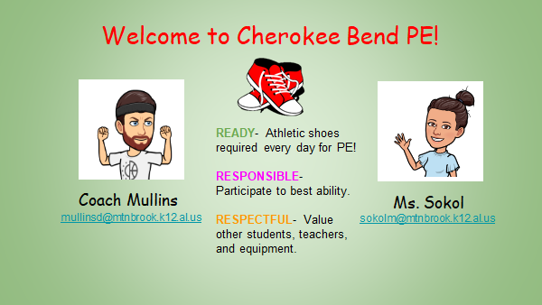

Slide 10
Handouts:
Math & ELA Goals
Math Tips
Growth Mindset
optional: note & “parent kid quiz”

Slide 11

Thank You!!!
I am SO excited about our year. We are off to a great start😊 Please contact me directly with any questions.
Notes:
Q- contact directly
I am learning everyday, just like the students.
I love teaching & am grateful for the privilege to teach your children. I am excited about our year!
If no other questions/comments, have a great night!

