Slide 1

Standardized Testing Report
2013-2014
Notes:
Annual report to the Board on standardized tests for the 20010-11 school year.
Will review scores on state-mandated tests AND Those our students take as part of the college application process.
I will also have information abut some changes to the state-mandated tests that are coming this year.

Slide 2
Measures of
Student Preparedness
PSAT (10-11)→SAT (11-12)
PLAN (10)→ACT (11-12)
AP (11-12)
EXPLORE (8)
Science Assessment (7)
ACT Aspire (7-8)
Science Assessment (5)
ACT Aspire (3-6)
Standardized Tests

Slide 3
ACT Aspire
State-mandated, criterion-referenced and normed-referenced test – Grades 3-8
Student progress in reading and math measured over multiple years
Scaled score indicates “Ready,” “Close,” or “Needs Support”
Notes:
The next test is the Alabama Reading and Math Test or ARMT
Criterion-referenced test, where students are measured against a pre-set standard, not against a national group of their peers.
Designed to match the state curriculum and the score is derived from all items on the ARMT and some items from the Stanford.
It is given in the spring along with the Stanford, and is used for Accountability. This year will be the last year our students will take the ARMT as it is currently written. Next year, a revised test will be given, called ARMT Plus. It will include the portions of the Stanford that were previously used for Accountability, and it will align with the most current reading and math state standards. It will also include the science assessment next year.

Slide 4
Measures of
Student Preparedness
PSAT (10-11)→SAT (11-12)
PLAN (10)→ACT (11-12)
AP (11-12)
EXPLORE (8)
Science Assessment (7)
ARMT + (7-8)
Science Assessment (5)
ARMT + (3-6)
Science Assessment
7
Standardized Tests
Science Assessment
5

Slide 5
Alabama Science Assessment
Grades 5 and 7
State-mandated, criterion-referenced achievement test
Designed to match state curriculum
Will be replaced by ACT Aspire this school year
Notes:
The next test I will review is a fairly new test. Last spring was only the second time the Alabama Science Assessment has been given.
It is a criterion-referenced test that was designed to match our state curriculum, and scores are measured against a pre-set standard.
At this time, it is only used for accountability for the rate of participation.
Next year, AL Science Assessment will be absorbed into the ARMT Plus, so this year will be the last year students will take this as a separate test.

Slide 6
Alabama Science Assessment
Grades 5 and 7
Percent of students meeting or exceeding standard
5th Grade 98%
7th Grade 97%
Notes:
On the Alabama Science Assessment,
100% of our 5th graders met or exceeded the standard, and
98% of our 7th graders met or exceeded the standard, which means that percentage scored at levels 3 or 4.

Slide 7
Measures of
Student Preparedness
AP (11-12)
PSAT (10-11)→SAT (11-12)
PLAN (10)→ACT (11-12)
EXPLORE (8)
Science Assessment (7)
(7-8)
Science Assessment (5)
ACT Aspire (3-6)
EXPLORE
Standardized Tests

Slide 8
EXPLORE
  Norm-referenced test given in the fall of 8th grade
  Includes English, reading, math, and science
  First part of a longitudinal assessment plan: Followed by PLAN in 10th grade, ACT in 11th grade, and WorkKeys in 12th grade
  Will be replaced next school year by ACT Aspire
Notes:
A test has been added this year, called EXPLORE.
Norm-referenced, so it assesses our students on a national sampling of curriculum that includes Eng, Reading, Math, and Science. It will be given in the 8th grade, in 2 weeks at our junior high.
We will receive test results within 4 weeks so teachers and students can use the results for enrichment or intervention during the same school year.
It is part of a new longitudinal assessment program from the state, that prepares students for taking the ACT in the 11th grade. Essentially, it is the Pre- Pre – ACT, and includes a Career Interest Inventory so students can plan their high school coursework in such a way to continue in their strengths and strengthen their more challenging areas.

Slide 9
EXPLORE - 2013
Average Test Scores
(maximum score of 25)
 | Mountain Brook | National
English | 17.9 | 14.7
Reading | 17.6 | 14.6
Math | 18.8 | 15.5
Science | 19.0 | 16.6
COMPOSITE | 18.5 | 15.5

Slide 10
Measures of
Student Preparedness
PSAT (10-11)→SAT (11-12)
PLAN (10)→ACT (11-12)
AP (11-12)
EXPLORE (8)
Science Assessment (7)
ARMT + (7-8)
Science Assessment (5)
ACT Aspire (3-6)
PLAN→ACT
EXPLORE
Standardized Tests

Slide 11
PLAN – 2013
Average Test Scores
(maximum score of 31)
 | Mountain Brook | National
English | 21.8 | 16.2
Reading | 21.3 | 16.7
Math | 23.1 | 17.6
Science | 22.3 | 17.8
COMPOSITE | 22.2 | 17.2

Slide 12
American College Testing (ACT) 2014
(Average Score on a Scale of 1-36)
12th grade 11th grade | State Average 20.6 18.0 | National Average 21.0 ___ | MBHS Average 27.0 25.9
Notes:
This shows the scores from last year’s seniors as compared to the state and national averages. 97% of students took the ACT last year. (287 students)
(According to ACT.org, all colleges and universities in the US now accept the ACT.)

Slide 13
Measures of
Student Preparedness
AP (11-12)
PSAT (10-11)→SAT (11-12)
PLAN (10)→ACT (11-12)
EXPLORE (8)
Science Assessment (7)
ACT Aspire (7-8)
Science Assessment (5)
ACT Aspire (3-6)
PSAT→SAT
Standardized Tests

Slide 14
PSAT
2013
(Average Score on Scale of 20-80)
 | National Average | MBHS Average
Critical Reading | 46.6 | 52.2
Math | 47.8 | 55.7
Writing | 45.3 | 52.1
Notes:
These scores represent last year’s 11th graders from the October administration of the test.
Our average scores continue to be well above the national average.

Slide 15
SAT - 2014
(Average Score on a Scale of 200-800)
 | National Average | MBHS Average
Critical Reading | 497 | 626
Math Writing Total | 513 487 1497 | 635 611 1872
+375
Notes:
These are the scores from last year’s seniors as compared to the national average. Our students scored well above the national average in each area.

Slide 16
Measures of
Student Preparedness
AP (11-12)
PSAT (10-11)→SAT (11-12)
PLAN (10)→ACT (11-12) Graduation Exam (11-12)
EXPLORE (8)
Science Assessment (7)
ACT Aspire (7-8)
Science Assessment (5)
ACT Aspire (3-6)
AP Exams
Standardized Tests

Slide 17
Advanced Placement Courses
Courses offered at high school level that can be taken for college credit
Test given at the end of the course to determine if college credit is earned
Exams taken in 25 AP courses at MBHS
Notes:
And the last test we will review today are those our students take at the end of Advanced Placement courses.
Students can receive college credit for these courses if they score a 3, 4, or 5 on the AP tests. Last May, exams were taken in 24 AP courses at MBHS.
If asked: 17 were courses we teach, 7 were independent study courses.

Slide 18
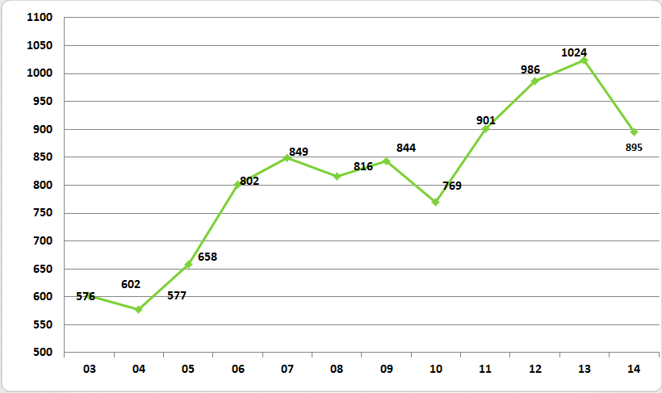
Advanced Placement Courses
# of AP tests taken by MB students
Notes:
This graph shows the number of AP exams our students have taken since 1992, or the last 18 years.
(IF asked:
No specific reason, but fewer students taking each test added up to the decrease that you see. About 70)
Some colleges will not award credit for taking both AP English Language and AP English Literature – one or the other – or for AP Environmental Science.

Slide 19
Advanced Placement Courses
Number of MB Students exams with each score
 |  | 2007 |  | 2014
5 |  | 196 |  | 235
4 |  | 247 |  | 283
3 |  | 244 |  | 247
2 |  | 119 |  | 107
1 |  | 43 |  | 23
Total |  | 849 |  | 895
Total 3,4, 5 |  | 687 80% |  | 765 85.5%
Notes:
One of the things that MBHS can be proud of is that over the past 10 years, the # of students taking AP courses has increased, and yet the scores have remained very high.
The tests are taken in May at the conclusion of the course; they are scored on a scale of 1 -5, with scores of 3, 4, or 5 earning college credit.
This chart shows the number of students with each score for the past 7 years.
313 AP students last year took at least one AP exam (11th and 12th graders)

Slide 20
Advanced Placement Exams
2014
 | National | Mountain Brook
Total % 3 or higher | 41.1% | 85.4%
Notes:
This chart compares our students’ scores to the national scores.
Almost 3 million AP tests were given last year across the country.
Nationally, 35% of students scored a 4 or 5, while 63% of Mountain Brook students scored a 4 or 5.
89% of our students scored 3 or higher and earned college credit as compared to 59% nationally.

Slide 21
Alabama College- and Career- Ready
Assessment System
GRADE | 2011-2012 | 2012-2013 | 2013-2014 | 2014-2015 | 2015-2016
K-8th | Formative/Interim/ Benchmark Assessments | Formative/Interim/ Benchmark Assessments | Formative/Interim/ Benchmark Assessments | Formative/Interim/ Benchmark Assessments | Formative/Interim/ Benchmark Assessments
3rd-8th | ARMT+ | ARMT+ | Aspire | Aspire | Aspire
8th | EXPLORE | EXPLORE | EXPLORE | EXPLORE
9th |  | Quality Core Assessment | Quality Core Assessment | Quality Core Assessment | Quality Core Assessment
10th |  | PLAN | PLAN | PLAN | Aspire
 |  | Quality Core Assessment | Quality Core Assessment | Quality Core Assessment | Quality Core Assessment
11th | AHSGE | AHSGE | ACT Plus Writing | ACT Plus Writing | ACT Plus Writing
12th | AHSGE | AHSGE |  | WorkKeys | WorkKeys

