Slide 1


Working in the Cloud
Information when and where you need it
Notes:
Desktops to mobile phones.

Slide 2


Why the Cloud?
Anytime-Anywhere Education
The Networking of Education
Anytime-anywhere learning, work, and communication
Notes:
Access to information for teacher and student. Both teaching and learning happens anytime-anywhere.

Slide 3

Why the Cloud?
Anytime-Anywhere Education
The Networking of Education
Monitoring your students (e.g., using Socrative)
Notes:
Monitor students as they take formative assessments online or how far they get on an assignment (whether or not the teacher is with them).

Slide 4
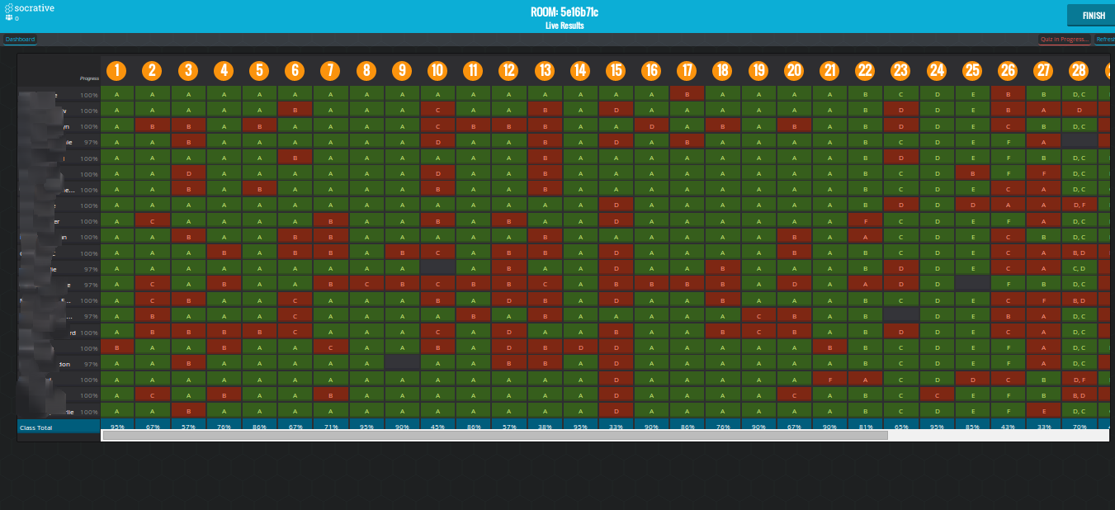
Socrative: Live View and Data Rich
Notes:
Example of live data and formative assessment assisting in directing instruction.

Slide 5


Why the Cloud?
Anytime-Anywhere Education
The Networking of Education
Feedback for students (e.g., grading and time recovery)
Notes:
It is becoming quicker and easier to use cloud-based instruction to grade and provide feedback.

Slide 6
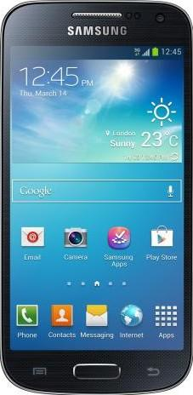
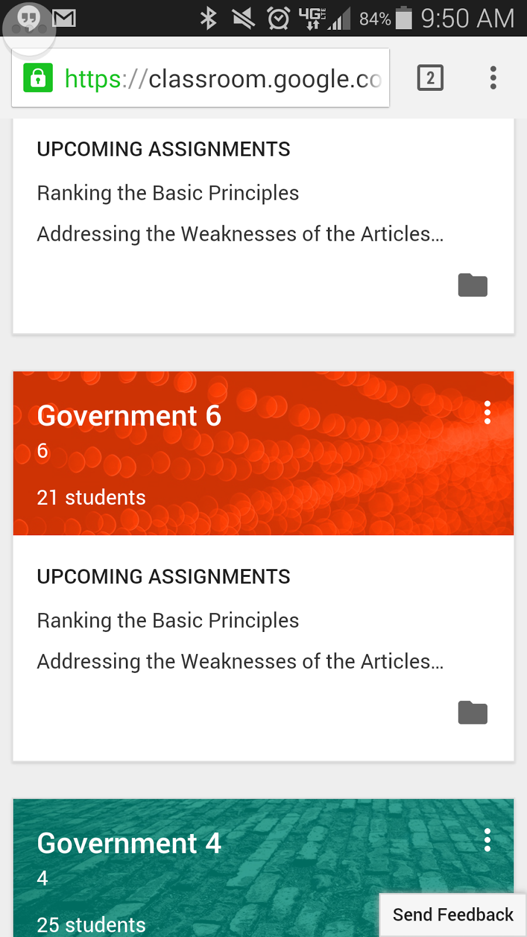
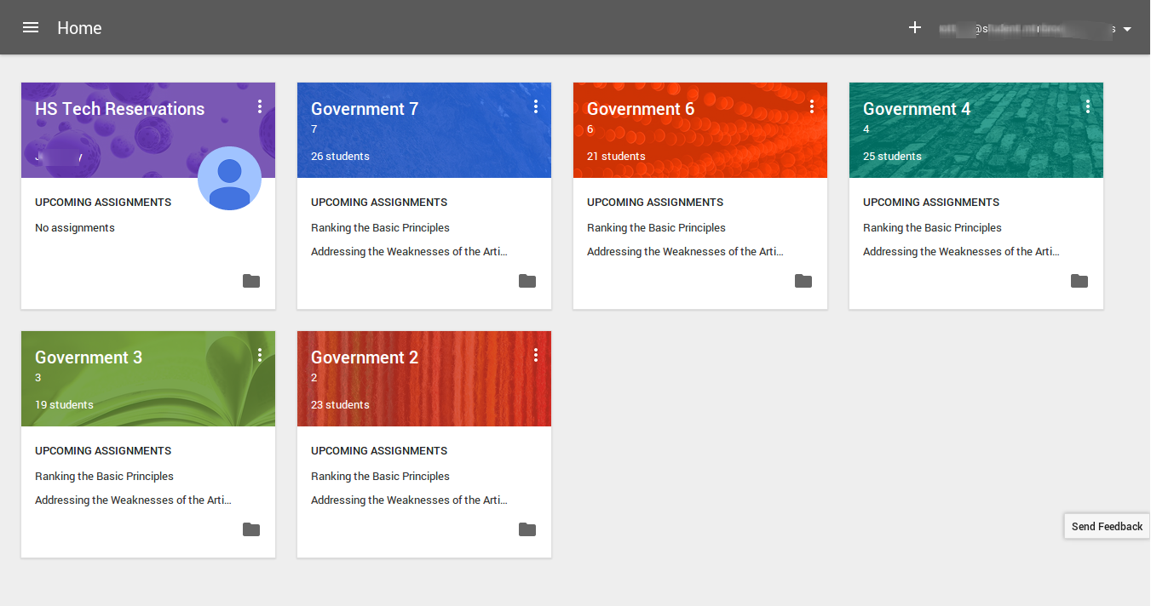
Google as a Learning Management System
Google Classroom
SMARTPHONE
Notes:
The new Google Classroom makes educational networking easier and more accessible.

Slide 7


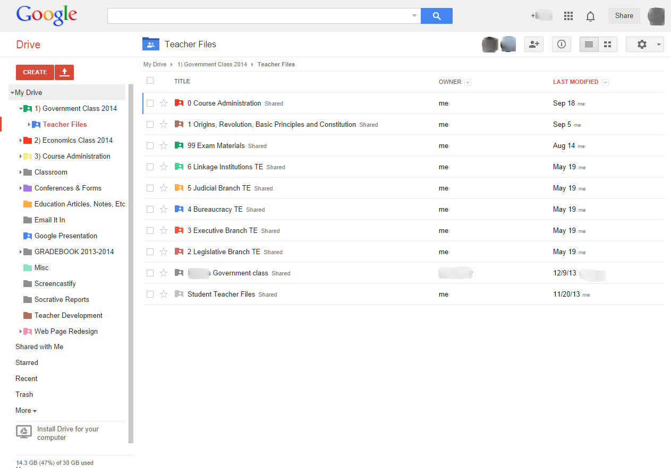
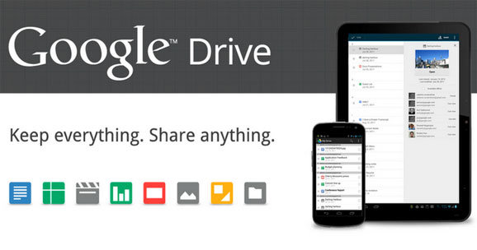
Mobile Storage System
Google Drive
Notes:
Google Drive provides a place a to store your material instead of a physical device. Cooperates nicely with Googe Classroom.

Slide 8




Office Suite
Google Email
Google Docs
Google Sheets
Google Slides
Notes:
Just as productive as the Microsoft and Apple suites, Google offers a mobile package that works on its own or with Google Classroom.

Slide 9
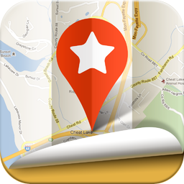



Google Extras
Google My Maps (Engine)
Google+
Google Sites
Google Calendar

Slide 10
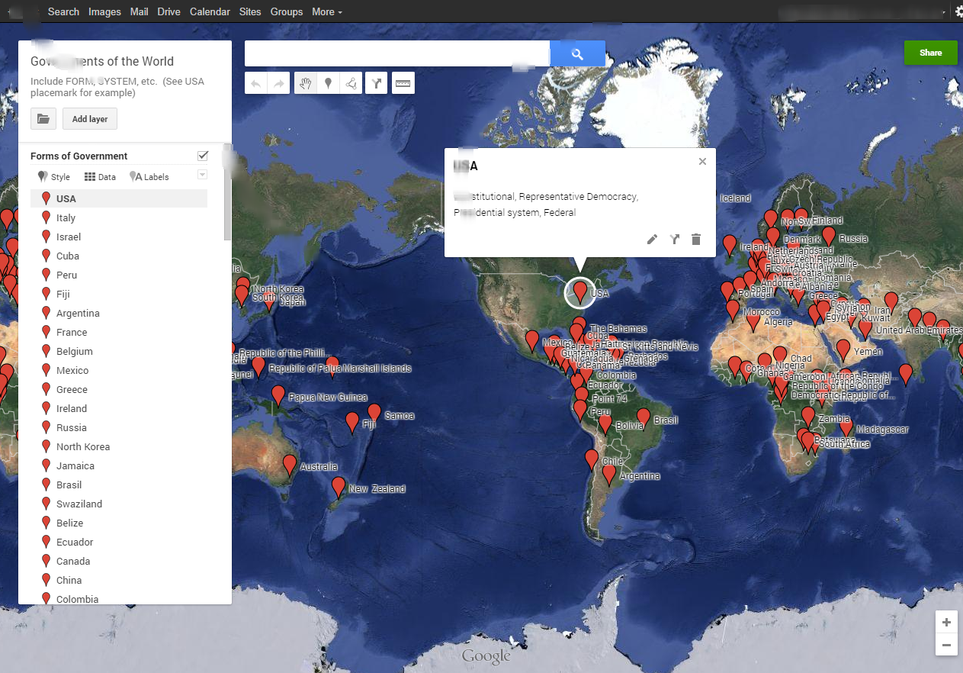
Google My Maps (Engine)
Edit Layers and Add Info for Data Rich Potential
anytime, anywhere, anyone

Slide 11
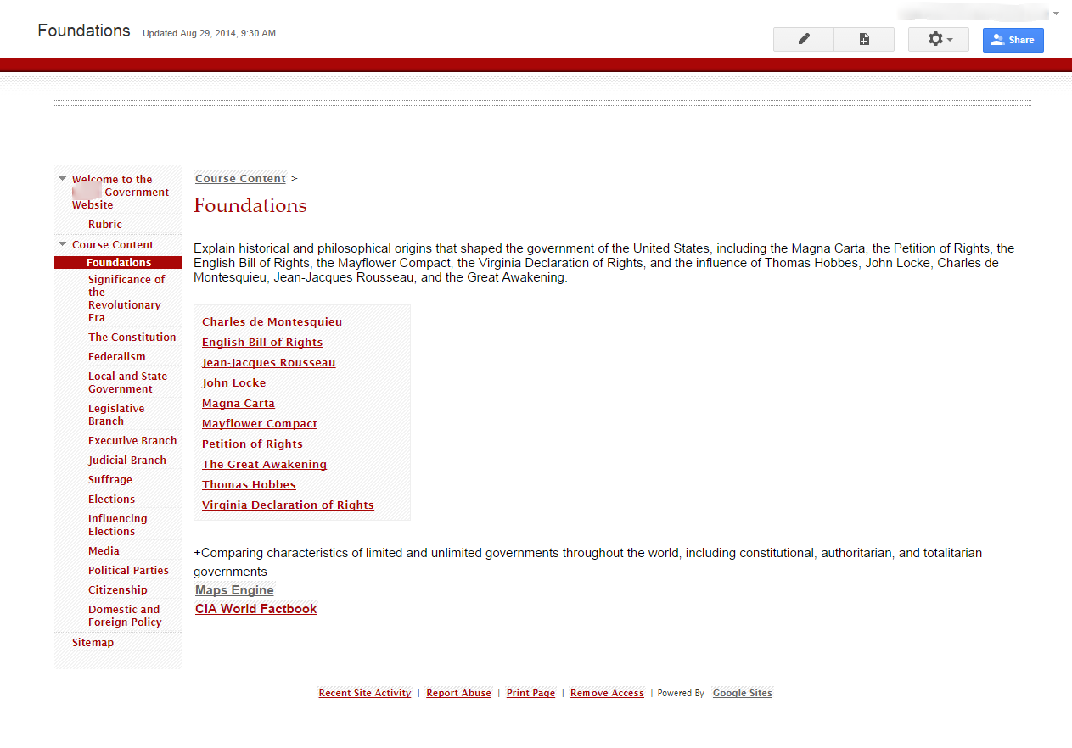
Google Sites
A Place to Contribute, Store, and Share Information
anytime, anywhere, anyone

Slide 12

WORKING IN THE CLOUD
The Power of choice……
AND/OR
Available Now
Available to MBHS Staff and Students by January

Slide 13
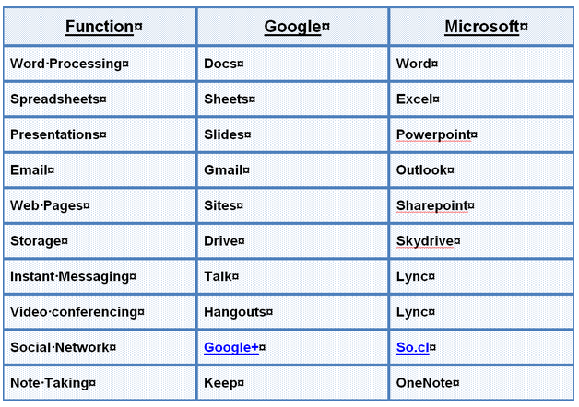
http://www.techrepublic.com/blog/google-in-the-enterprise/10-comparisons-between-google-apps-and-office-365/

Slide 14
STORAGE CAPACITY…..
50GB of space in Outlook &
25GB in Skydrive
30GB of space which is currently spread among Gmail, Drive, and Picasa.

Slide 15
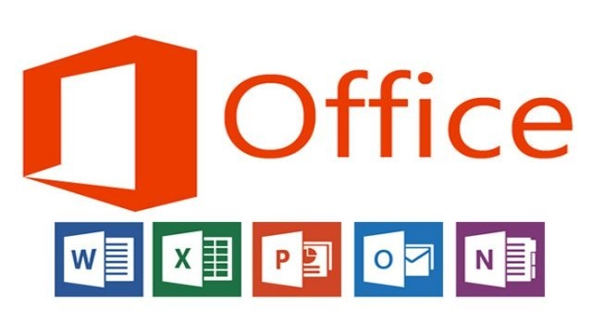

Slide 16
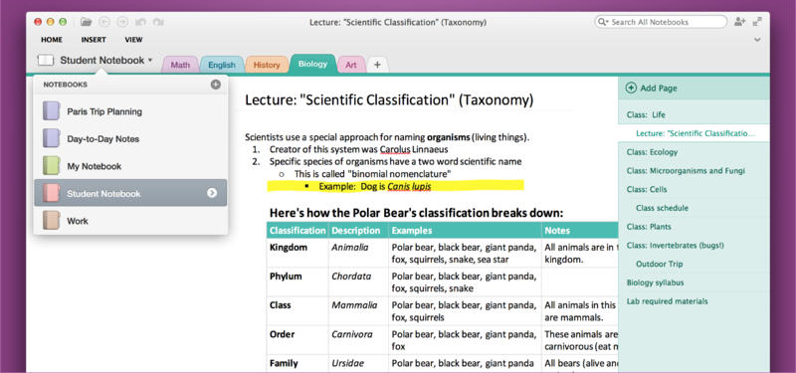
MicroSoft OneNote – Everything in One Location

Slide 17
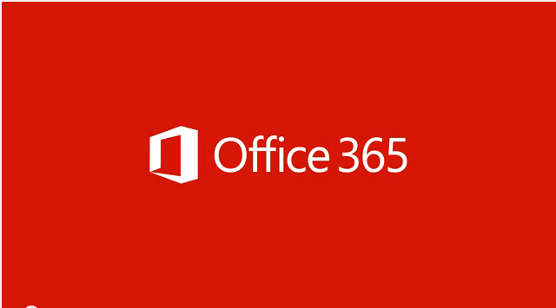
Quick overview of Office 365
http://www.youtube.com/watch?v=SF1S8hivw_8

Slide 18
THANKS FOR VIEWING…..

