Slide 1

Tech Tools for Educators
Presentation available on MBHS Professional Development Website

Slide 2
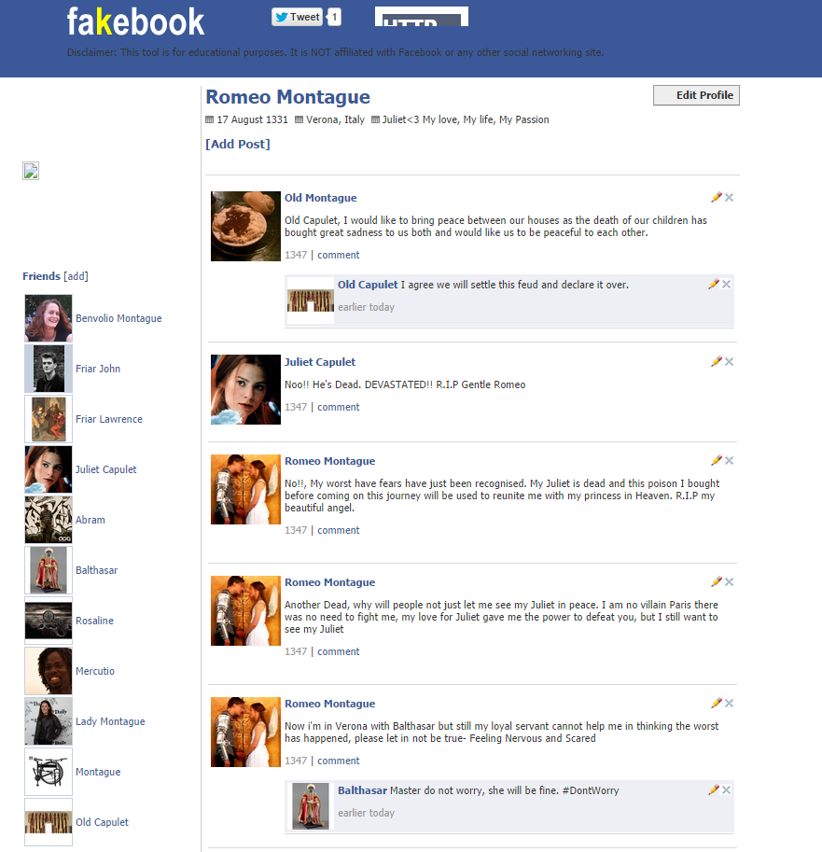
Fakebook: http://www.classtools.net/FB/home-page
Classroom Use:
show how two
characters might
interact in a story,
or in history
role playing
digital citizenship

Slide 3
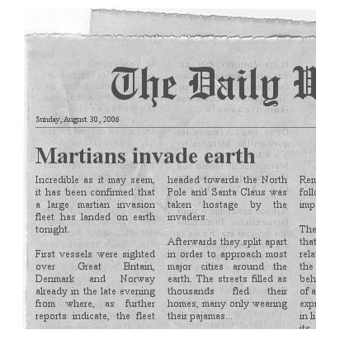
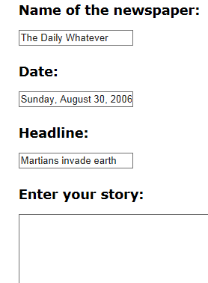
Newspaper Clipping Generator http://www.fodey.com/generators/newspaper/snippet.asp
Make a newspaper clipping you can put on a blog or website.

Slide 4
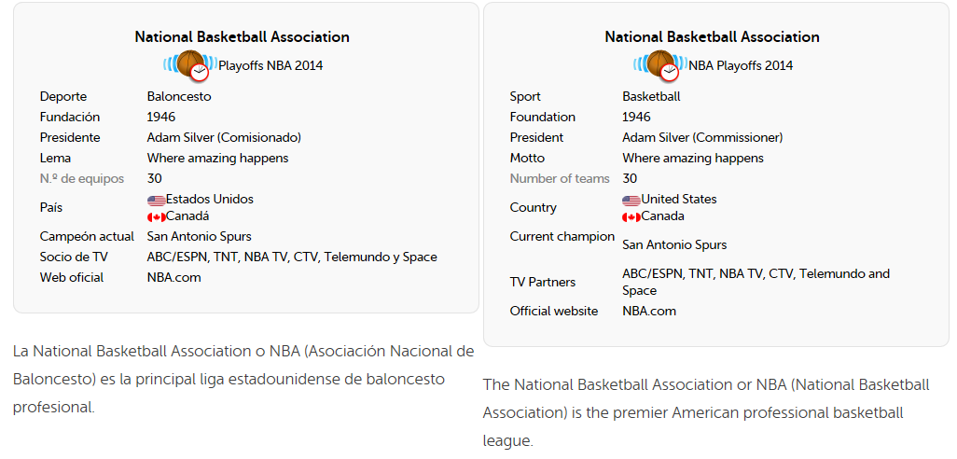
Duolingo http://www.duolingo.com/
Free Language Education for the world.

Slide 5
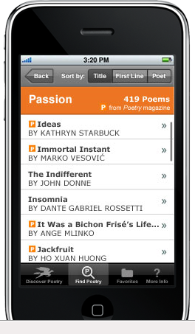
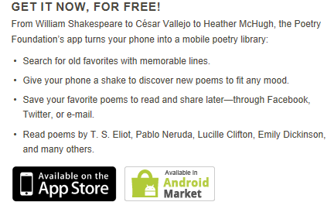
POETRY mobile app from Poetry Foundation for iPhone, iPad and Android

Slide 6

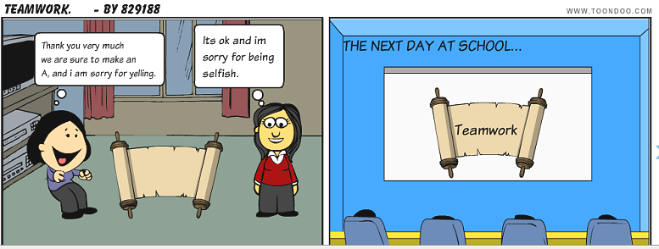
ToonDoo http://www.toondoo.com
Create comics
Classroom Use:
Visual learning tool
Great for “non-artists”

Slide 7
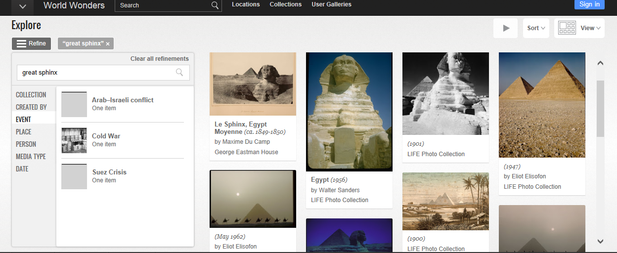
Google World Wonders http://www.google.com/intl/en/culturalinstitute/worldwonders/
Bring to life the wonders of the modern and ancient world.
Classroom Use:
Virtual field trips
Explore historic sites

Slide 8
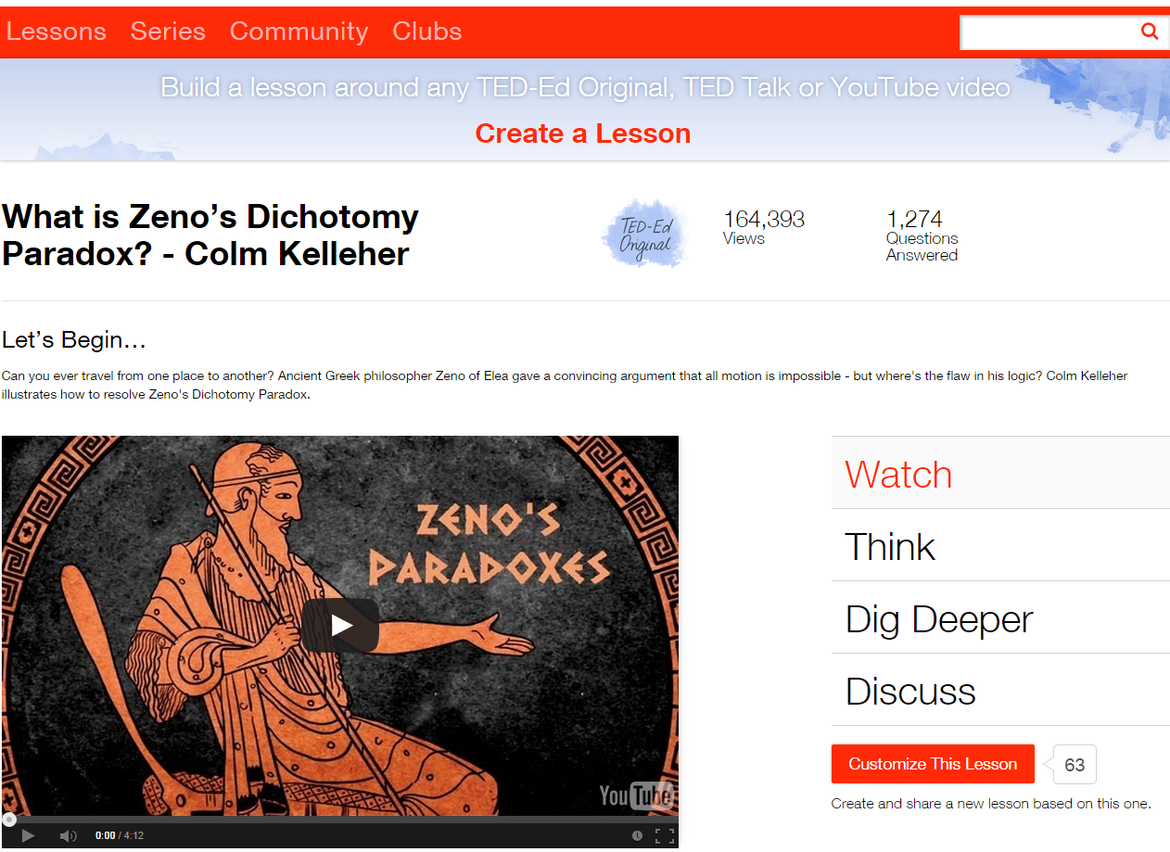
TedEd http://ed.ted.com/
Create customized lessons using any educational video.
Create your own
Search the site and use an existing lesson
Customize an existing lesson.

Slide 9

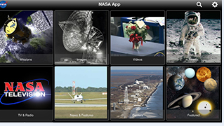
NASA mobile app for Smartphones and tablets
Features:
Current NASA mission info
Over 13,000 images
Current visible passes for the International Space Station (ISS) and notifications
Launch information & countdown clocks
ISS and Earth orbiting satellite trackers
Latest NASA tweets from around the agency
Third Rock internet streaming radio

Slide 10
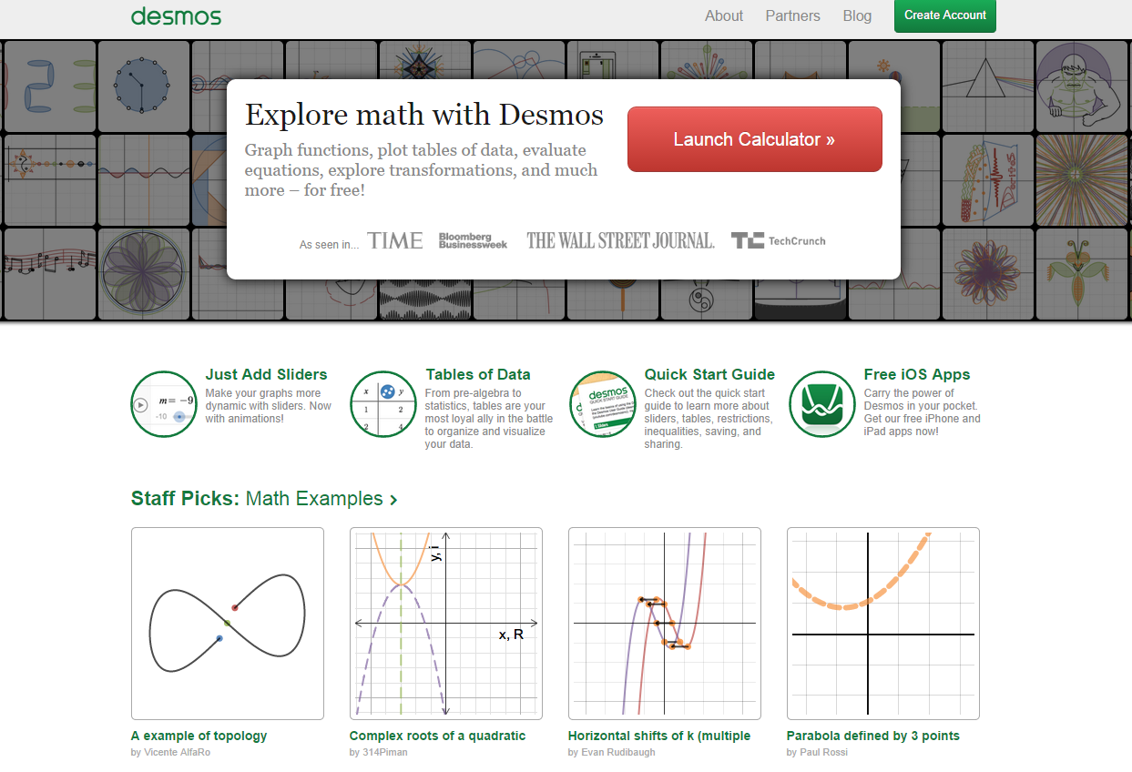
Desmos Graphing Calculator https://www.desmos.com/
Free web-based graphing calculator.

Slide 11


Earth Album http://www.earthalbum.com
Features:
stunning photos from Google maps and Flickr
images change every few weeks
click anywhere on map to get photos

Slide 12
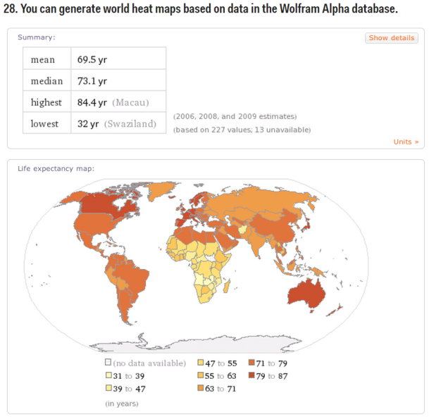
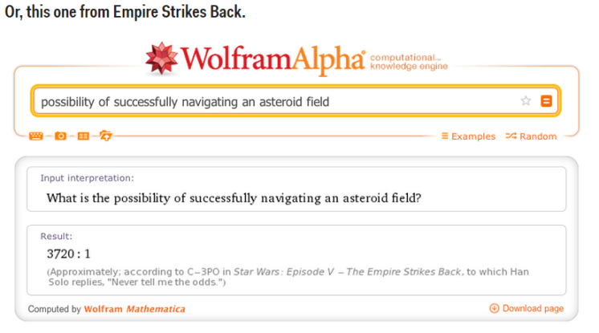
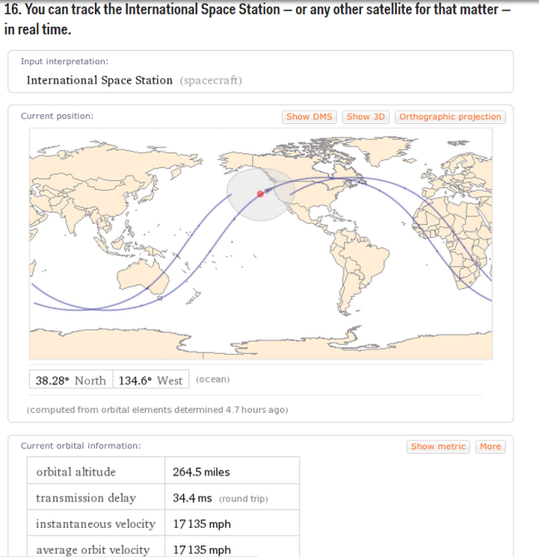
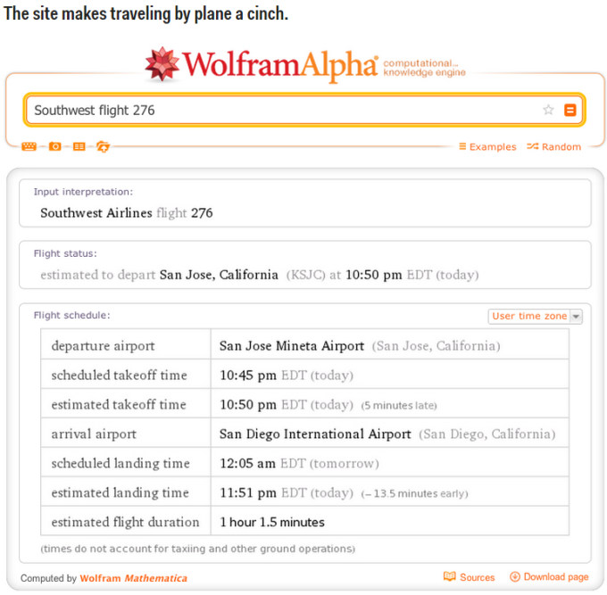
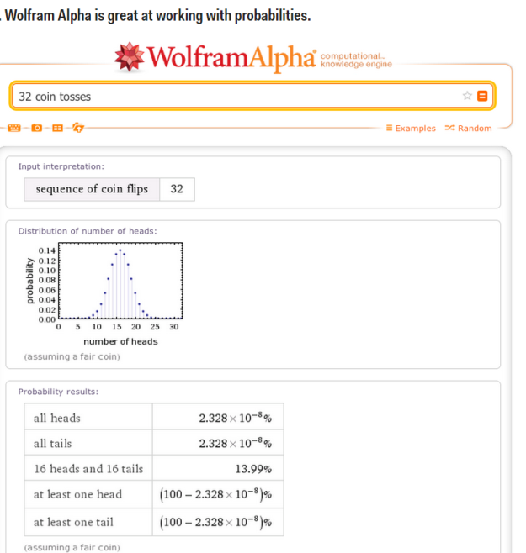
Wolfram Alpha http://www.wolframalpha.com/
It's not a search engine, it's not an encyclopedia, and it's not a calculator, but it's a little bit of all of that.
http://www.businessinsider.com/awesome-things-you-can-do-with-wolfram-alpha-2013-7?op=1

Slide 13
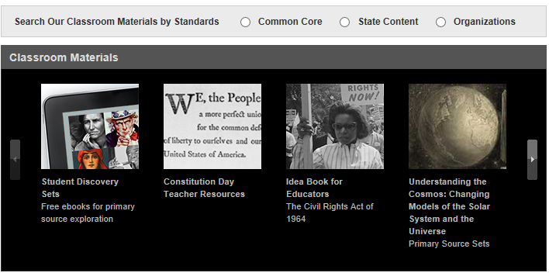
Library of Congress for Teachers http://www.loc.gov/teachers/
The Library of Congress offers classroom materials and professional development to help teachers effectively use primary sources from the Library's vast digital collections in their teaching.

Slide 14

ThingLink https://www.thinglink.com/
ThingLink is a web tool that lets you create interactive images.
Interactive images can contain
links.
videos.
presentations.

Slide 15
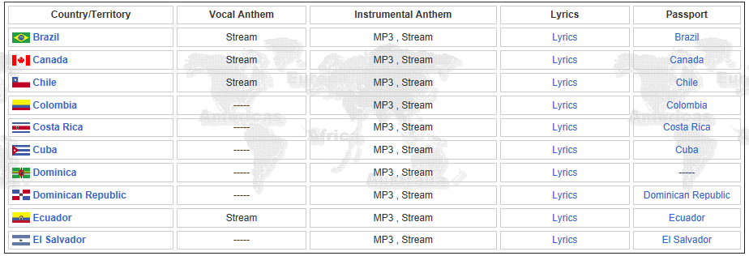
National Anthems http://www.national-anthems.net/
National anthems and other info about the countries of the world.
The sentiments of national anthems vary, from prayers for the monarch to allusions to nationally important battles or uprisings.

Slide 16
User Friendly Tools and Apps
Printfriendly.com --- takes out ads from internet articles
Sweetsearch.com --- vetted as quality research
OneNote and Evernote --- organizational note-taking apps that allow you to have a digital notebook.
Science360 --- app for iPad; images and videos from National Science Foundation or scientists from various colleges and universitites.
ScreenChomp --- iPad app to write and record voice – good for working out problems
Braingle --- www.braingle.com --- Brain Teasers, Riddles, Trivia, Brain Exercises, Games, Forums and more...
Presentation tools – Printerfocus for Windows or Mousepose for Macs --- mouse spotlight, magnifier, highlight mouse pointer, on-screen annotation pen, and more

