Slide 1

INTERNATIONAL SOCIETY FOR
TECHNOLOGY EDUCATION
5 member team from Mountain Brook High School
40+ members from Mountain Brook Schools

Slide 2
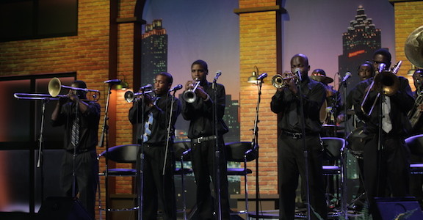
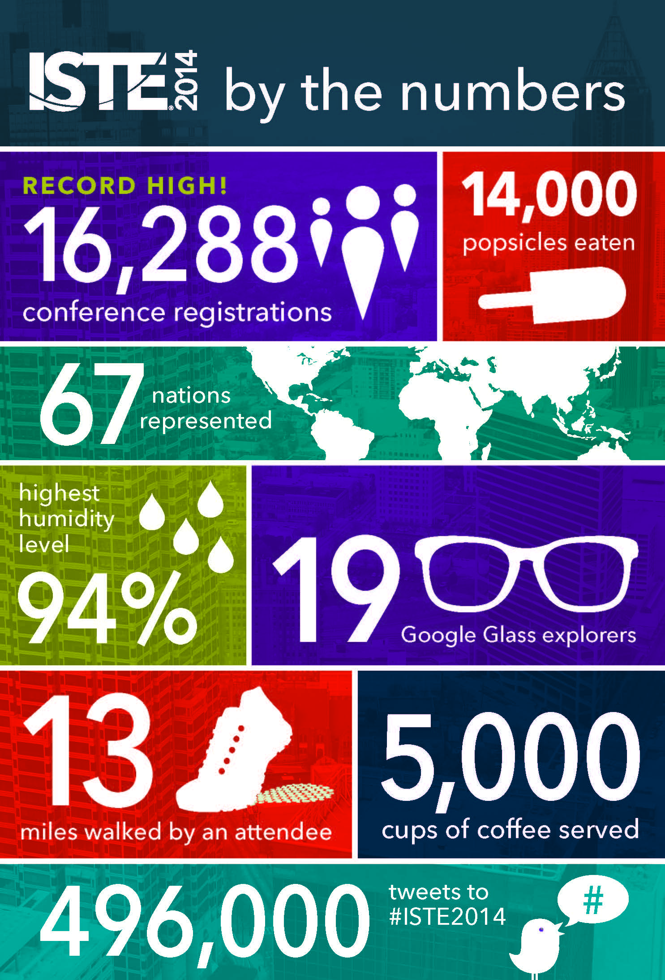

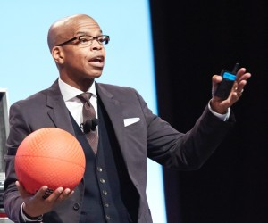
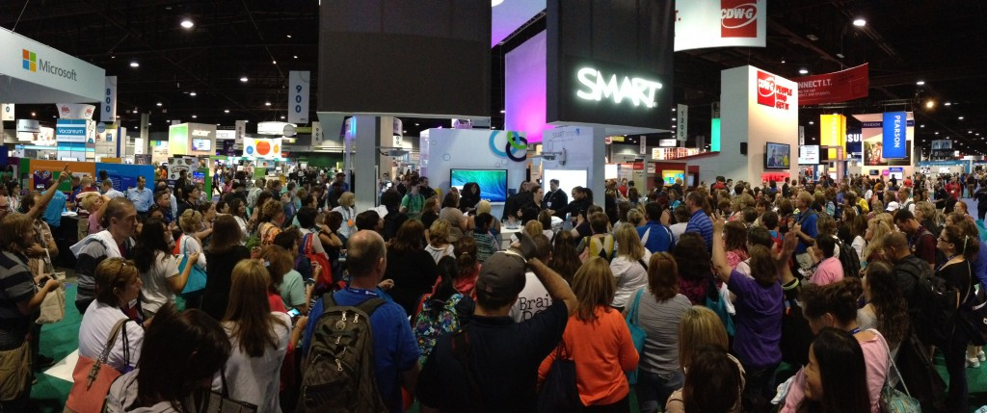
Set a Record for Attendance
67 Nations Represented
Unbelievable Training Vendor Floor
Amazing Sessions to Attend

Slide 3
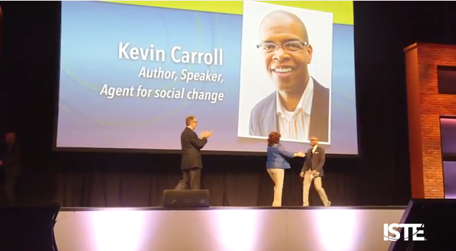
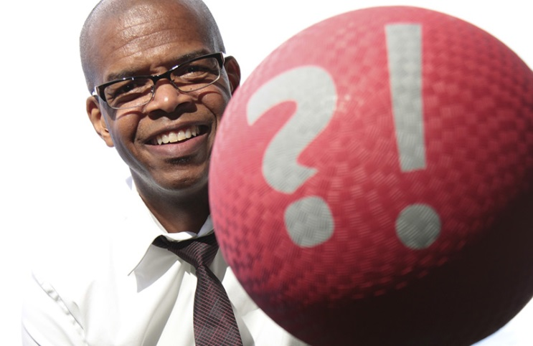
Kevin Carroll
The Red Rubber Ball Theory
Inspirational Speakers………The Power of Play
http://v4.kevincarrollkatalyst.com/about

